Slide 1
Processes
Chapter 4

Slide 2
Processes
Multiprogramming operating systems are built around the concept of process (also called task).
A process is the active execution of one (or more) programs.

Slide 3
Processes
A given program, or part of program, can be traversed by several processes, simultaneously or sequentially.
Two users could run the same email program at the same time
  two processes
    same code
    different data
  could share the same copy of the code
    but individual context.

Slide 4
OS Support for Processes
OS must interleave the execution of several processes to maximize CPU usage while providing reasonable response time
OS must allocate resources to processes
  and avoid deadlock and starvation
OS must support inter-process communication and user creation of processes

Slide 5
Dispatcher (short-term scheduler)
An OS program that switches the CPU from one process to another
It prevents a single process from monopolizing CPU time
It decides who goes next according to a scheduling algorithm (chap 6)
The CPU executes instructions in the dispatcher while switching from process A to process B

Slide 6
Communications Models
Message Passing
Shared Memory
process A
M
process A
shared memory
process B
M
process B
kernel
M
kernel

Slide 7
When does a process get created?
Submission of a batch job
User logs on
Created by OS to provide a service to a user (ex: printing a file)
Spawned by an existing process
  user programs can create one or more processes during execution
  The new process is called the “child” and the process that spawned it is called the “parent”

Slide 8
When does a process get terminated?
Batch job issues Halt instruction
User logs off
Process executes a service request to terminate
Error or fault conditions

Slide 9
Reasons for Process Termination
Normal completion
Time limit exceeded
Memory unavailable
Memory bounds violation
Protection error
  example: write to read-only file
Arithmetic error
Timeout
  process waited longer than a specified maximum for an event

Slide 10
Reasons for Process Termination
I/O failure
Invalid instruction
  happens when try to execute data
Privileged instruction
Operating system intervention
  such as when deadlock occurs
Parent request to terminate child
Parent terminates so child processes terminate automatically
Etc.

Slide 11
Simple State Model
Suppose we have a list of active processes and a dispatcher that regularly pauses (interrupts) the active process and selects the next process from a list to get a “turn” (this is “round robin” scheduling)
We can view this with a simple two-state process model

Slide 12
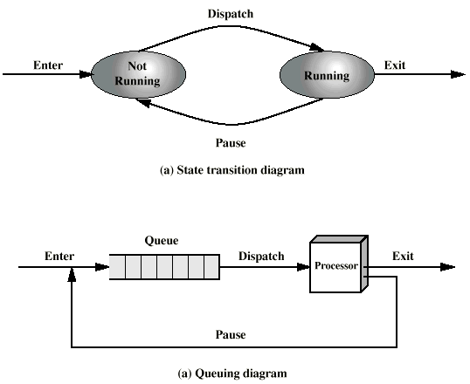
Simple Two-State Process Model

Slide 13
Limitations to Two-State Model
Two states is enough to handle processes that are always ready to execute
In reality, processes are often “blocked” waiting for the completion of some I/O or other operation
The dispatcher can only restart processes that are really “ready” to run again
We need a more realistic process model
For simplicity, assume there is only one processor, so only one process can be running at a time.
  (With “symmetric multiprocessing”, one process can be running on each CPU)

Slide 14
Process States
Let us start with these states:
  The Running state
    The process that is executing on the CPU is in the Running state
  The Blocked state
    A process that is waiting for something (e.g. I/O) to complete is in the Blocked state
  The Ready state
    A process that is ready to be executed, but not currently assigned to a CPU, is in the Ready state

Slide 15
Other Useful States
The New state
  OS has performed the necessary actions to create the process
    has created a process identifier
    has created tables needed to manage the process
  but has not yet committed to execute the process (not yet “admitted”)
    because resources are limited

Slide 16
Other Useful States
The Exit state
  Termination moves the process to this state
  It is no longer eligible for execution
  Tables and other info are temporarily preserved for auxiliary program
    Ex: accounting program that accumulates resource usage for billing users
The process (and its tables) are deleted when the data is no longer needed

Slide 17
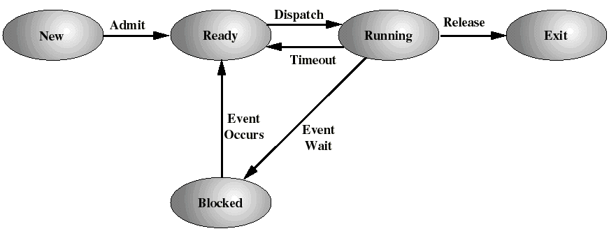
A Five-state Process Model

Slide 18
Process Transitions
Ready --> Running
  The dispatcher selects a new process to run (scheduling problem: Chapter 6).
Running --> Ready
  the running process has used its maximum “time slice” (most OS’s do this)
  the running process is preempted by a higher priority process which is in the ready state
    ..if the OS supports process priorities

Slide 19
Process Transitions
Running --> Blocked
  When a process requests something for which it must wait
    a service of the OS that requires a wait
    initiates I/O and must wait for the result
    an access to a resource not yet available
    waiting for a process to provide input (IPC)
Blocked --> Ready
  When the event for which it was waiting occurs

Slide 20
A Five-state Process Model
One more case:
  Ready --> Exit: For example, parent terminates a child process
  Child removed directly from Ready queue

Slide 21
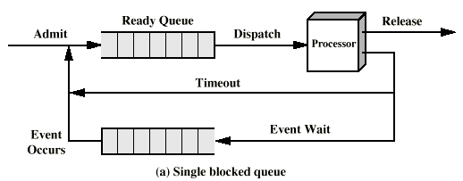
Single Blocked Queue
When a particular event occurs, the scheduler must scan the entire blocked queue looking for processes waiting for that particular event

Slide 22
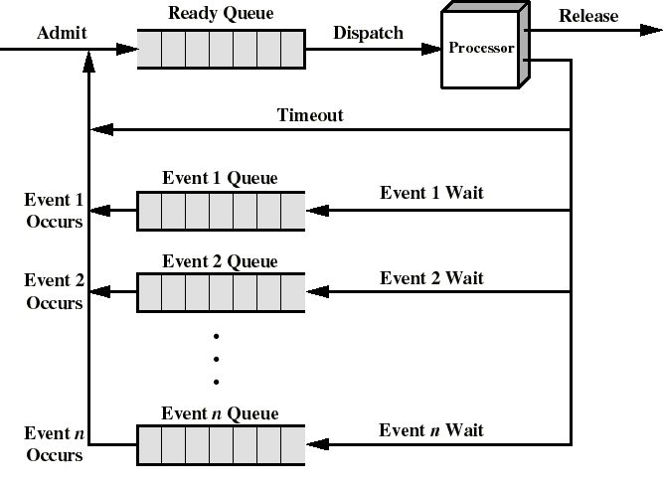
A Better Queuing Discipline
One queue for each event
When event n occurs, all processes in queue “n” are moved to the ready queue

Slide 23
The Need for Swapping
We have assumed that all processes have space allocated in main memory
Even with virtual memory, too many processes in main memory deteriorates system performance
Sometimes there will be no processes in the Ready state, because they are all blocked
So the OS could suspend one of these blocked processes: swap it out to auxiliary memory (disk).
And the OS can admit, or activate either a new process, or one that was swapped out earlier
So we will add a Suspend state, for those processes swapped out of memory

Slide 24
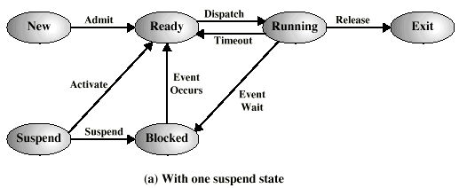
Add Suspend State

Slide 25
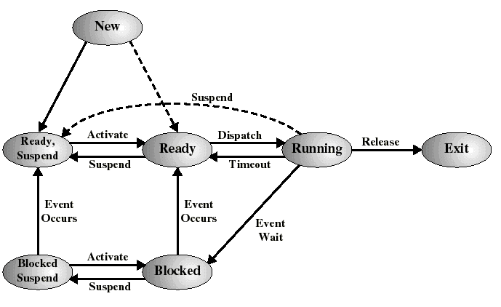
A Seven-State Process Model
But it is better to add two states to keep track of those that are still blocked, and those which are no longer blocked because their event has occurred..

Slide 26
Some New state Transitions
Blocked --> Blocked Suspend
  When all processes are blocked, the OS may remove a blocked process to bring an unblocked process into memory
    The “swap out” frees up memory to allow this to happen
Blocked Suspend --> Ready Suspend
  When the event for which process has been waiting occurs
Ready Suspend --> Ready
  When there are no ready processes in main memory
  Normally, this transition is paired with Blocked --> Blocked suspend for another process (a “swap”)

Slide 27
More New state Transitions
Ready--> Ready Suspend
  When there are no blocked processes and must free up memory for performance reasons
New--> Ready Suspend
  Probably the preferred way to introduce new processes

Slide 28
Constituents of a Process
A “process image” can be thought of as:
  Program code (“text segment”)
    may be shared with other processes
  Stack(s)
  Data Section
The Operating Systems keeps track of each process using a Process Control Block

Slide 29

Process Control Block

Slide 30
Some Other Process Control Information (in PCB)
Interprocess Communication
  may hold flags and signals for IPC
Process Privileges
  access to certain memory locations...
Memory management
  pointers to segment/page tables assigned to this process
Resource ownership and utilization
  resources in use: open files, I/O devices...
  history of usage (of CPU time, I/O...)

Slide 31
Creation of a Process
Assign a unique process identifier (pid)
Allocate space for the process image
  code, data, stacks
Initialize process control block
  usually default values (State = New, no I/O devices or files...)
Set up appropriate linkages
  Add new PCB to linked list used for the scheduling queue (probably the “NEW” queue)

Slide 32

Queues as linked lists of PCBs
Silberschatz, Galvin, and Gagne©1999

Slide 33
Two Types of Context Switch
Simple Mode Switch to process an interrupt without switching processes: user process is suspended but will be resumed immediately:
  only save what is necessary to resume execution of the same process (e.g. program counter, couple of registers)
Full Process Switch: process is suspended and another process will get the CPU:
  save entire context into PCB, load new context from other PCB, update process state.
  A “heavier duty” operation

Slide 34

CPU Switch From Process to Process
Silberschatz, Galvin, and Gagne©1999

Slide 35
Steps for Full Process Switch
Save context of CPU including program counter and other registers
Update the PCB of the running process with its new state and other info
Move PCB to appropriate queue
  Ready, Blocked, etc.
Select another process for execution
Update PCB of the selected process
  Running
Restore CPU context from PCB of the selected process

