Slide 1
File Management (Chapter 12)
Files
  Field: Basic element of data.
  Record: A collection of related fields that can be treated as a unit.
  File: A collection of similar record.
  Database: A collection of related data. The essential aspects of a database are the explicit relationships that exist among elements of data.
Typical operations
  Retrieve_All
  Retrieve_One
  Retrieve_Next
  Retrieve_Previous
  Retrieve_Few
  Delete_One
  Update_One

Slide 2
File Management Systems
Objectives
  To meet the data-management needs and requirements of the user, which include storage of data and the ability to perform the operations listed.
  To guarantee that the data in the file are valid.
  To optimize performance, in terms of throughput and response time.
  To provide I/O support for a variety of types of storage devices.
  To minimize or eliminate the potential of lost or destroyed data.
  To provide a standardized set of I/O interface routines.
  To provide I/O support for multiple users in the case of multiple-user systems.
Requirements
  Each user can create, delete and change files.
  Each user may have controlled access to other user’s files.
  Each user may control what types of access are allowed to the user’s file.
  Each user can restructure the user’s files.
  Each user can move data between files.
  Each user can backup or recover the files in case of damage
  Each user should be able to access the user’s files by a symbolic name.

Slide 3
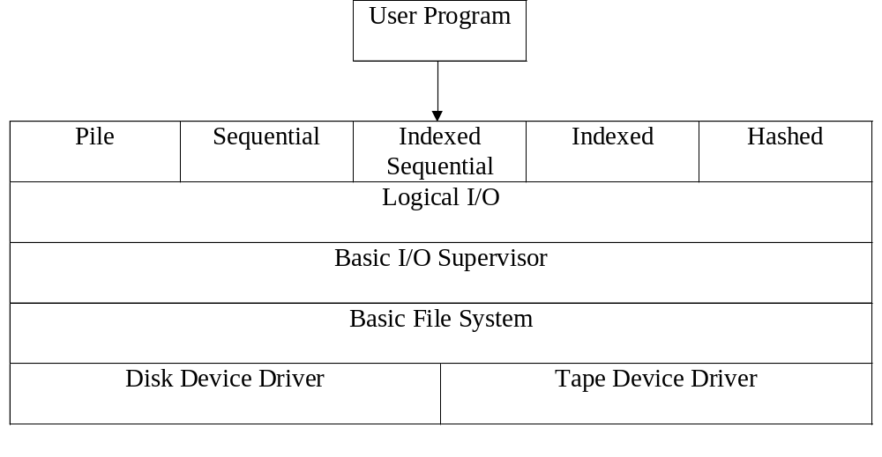
File System Architecture

Slide 4
File Organization & Access
Important Criteria
  Rapid access for effective information retrieval.
  Ease of update to aid in having up-to-date information.
  Economy of storage to reduce storage costs.
  Simple maintenance to reduce cost and potential for error.
  Reliability to assure confidence in the data.
Organizations
  The pile
  The sequential file
  The indexed-sequential file
  The indexed file
  The direct, or hashed, file

Slide 5
File Directories and File Sharing
File Directories
  Contents: information about files -- attributes, location, ownership
  Structure: name, address, size, and organization.
    Search
    Create file
    Delete file
    List directory
  Naming: user need to refer to a file by a symbolic name (unique naming)
    Pathname and working directory
File Sharing
  Access rights (Specific user, user group, all)
    None, Knowledge, Execution, Reading, Appending, Updating, Changing Protection, Deletion.
  Simultaneous access

