Slide 1
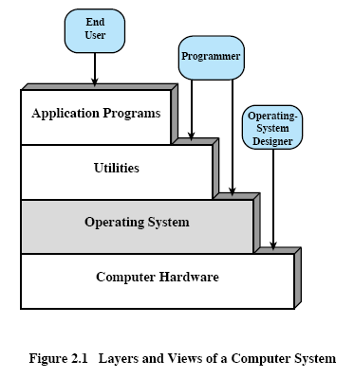
Operating System (O.S.) Objectives & Functions
An operating system is a program that controls the execution of application programs and acts as an interface between the user of a computer and the computer hardware.
Three Objectives can be observed:
  Convenience
  Efficiency
  Ability to evolve
O.S. as a User / Computer Interface (Figure 2.1)
Programmer

Slide 2
Services provided by the O.S.
Program Creation --- editors, debuggers, ... etc.. These are in the forms of utility programs that are not actually part of the O.S. but are accessible through the O.S.
Program Execution --- to execute a program, instructions and data must be loaded into the main memory, I/O devices and files must be initialized.
Access to I/O devices --- as if simple read and write to the programmers
Controlled Access to Files --- not only the control of I/O devices, but file format on the storage medium.
System Access --- shared and public resources, protection of resources and data, resolve conflicts in the contention for resources.
Error Detection and Response
  Internal/external hardware errors (memory error, device failures and mal-functions)
  Software errors (arithmetic overflows, attempt to access forbidden memory locations, inability of the O.S. to grant the request of an application)
  Ending a program, retrying , and reporting errors.
Accounting --- collect usage statistics for various resources, billing, and monitoring performance.

Slide 3
The Evolution of O.S.
Serial Processing
  1940 - mid 1950 (no O.S.)
  display lights, toggle switches, input devices (card readers), & printers
  program in machine code
  error indicated by the lights
  debug by examining registers and main memory
  normal completion => output on the printer
  problems:
    Scheduling - sign-up sheet (by half an hour block)
    Setup time - loading compiler, mounting and dismounting tapes, setting up card decks.
  evolution of libraries of common functions, linkers, loaders, debuggers, and I/O driver routines.

Slide 4
The Evolution of O.S. (continue)
Simple Batch Systems
  1st batch system by General Motor (GM) in the mid 50’s on an IBM 701
  to reduce the time wasted by scheduling and setup time
  the use of monitor
  Monitor loads programs one after another in a batch.
    Users have no direct access to computers.
  main memory divided into two parts (Figure 2.3)
    resident monitor
    user program area
  Machine time alternates between execution of user
  programs and execution of the monitor.
  Overhead: memory and machine time for monitor
Interrupt
Processing
Device
Drivers
Job
Sequencing
Control Language
Interpreter
User Program
Area
Monitor
Boundary

Slide 5
The Evolution of O.S. (continue.)
The monitor / batch O.S. is simply a computer program.
It relies on the ability of the processor to fetch instructions from various
portions of main memory to alternately seize and relinquish control
Hardware Features
  Memory Protection: User programs must not alter the monitor area
    User mode, kernel mode
  Timer: Prevent a single job from monopolizing the system
  Privileged Instructions: E.g., every I/O must be through the monitor
  Interrupts: Flexibility in relinquishing control to and regaining control from the user programs
Job control language (JCL)
  a special type of language used to provide instructions to the monitor to setup jobs; predecessor of OS commands
MS-DOS
  no memory protection
  no privileged I/O instructions

Slide 6
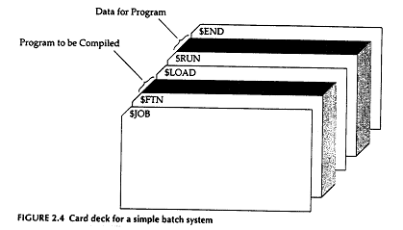
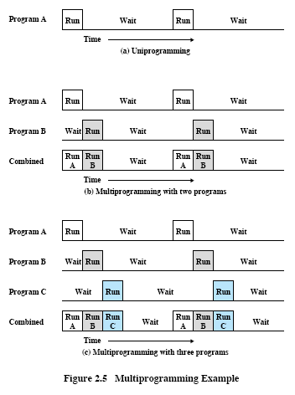
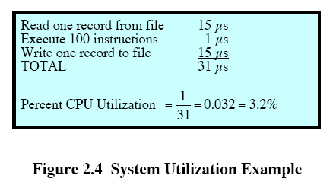

Slide 7
The Evolution of O.S. (continue..)
Multi-programmed Batch Systems
  Multi-programming = Multi-tasking
  Figure 2.4 & 2.5
  Table 2.1 & 2.2
  Figure 2.6a & 2.6b
  Hardware Requirements
    I/O Interrupts and DMA (Dynamic Memory Access):
    With interrupt driven I/O or DMA, the processor can issue an I/O command for one job and proceed with the execution of another job while the I/O is carried out by the device controller.
    When I/O operation is completed, the processor is interrupted and control is passed to an interrupt handling program in the O.S.
  Software Requirements
    Memory management
    Job scheduling algorithm

Slide 8
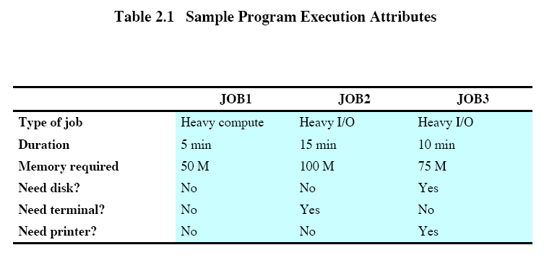
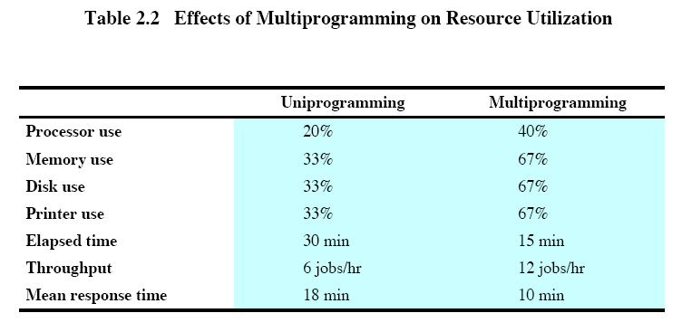

Slide 9
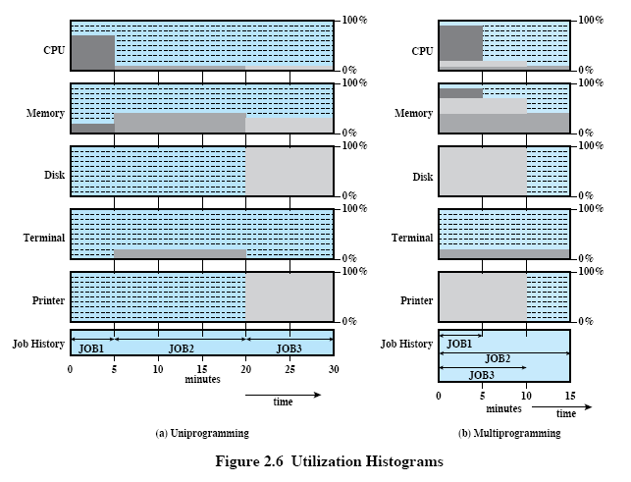

Slide 10
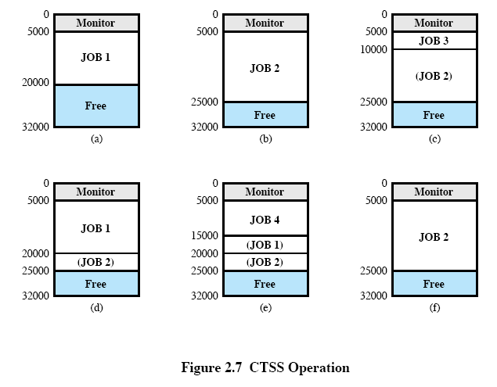

Slide 11
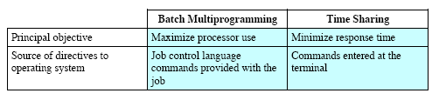
The Evolution of O.S. (continue...)
Time Sharing Systems
  the keyword is interactive
  the O.S. interleaving the execution of each program in a short burst, or quantum of computation.
  Batch Multiprogramming Vs. Time Sharing

Slide 12
The Evolution of O.S. (continue....)
Compatible Time-Sharing System (CTSS) at MIT (in 60’s)
  32 K main memory; 5 K monitor; time quantum = 0.2 sec, max 32 users
  Example
    JOB1: 15K
    JOB2: 20K
    JOB3: 5K
    JOB4: 10K
    refer to Figure 2.7
  Simple => minimize the size of the monitor.
  A job was always loaded into the same location => no need for relocation at load time.
  Minimized disk activity.
  Problems Raised:
    Multiple jobs in memory => memory protection
    Multiple users in the system => file protection
    Contention for resources -- printers, mass storage media, and shared data (concurrency)

Slide 13
Major Achievements I --- Processes
Processes Definitions
A program in execution
The “animated spirit” of a program
That entity that can be assigned to and executed on a processor
Three Major Lines of Development
Multiprogramming Batch System (max. efficiency)
Time Sharing System (responsiveness, multi-user support, program development, compilation and debugging, job execution)
Real-time Transaction Processing System (1 or few applications, sharing resources, responsiveness)
Main tool for all these three developments
Interrupts
Problems
Improper synchronization
Failed mutual exclusion
Non-determinate program operations
Deadlocks
Implementation --- Figure 2.8

Slide 14
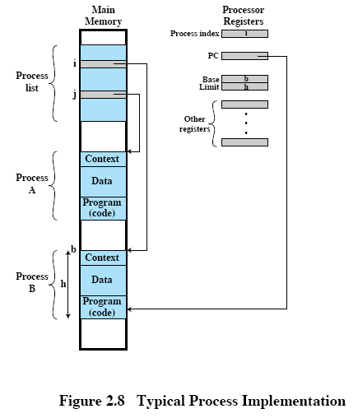

Slide 15
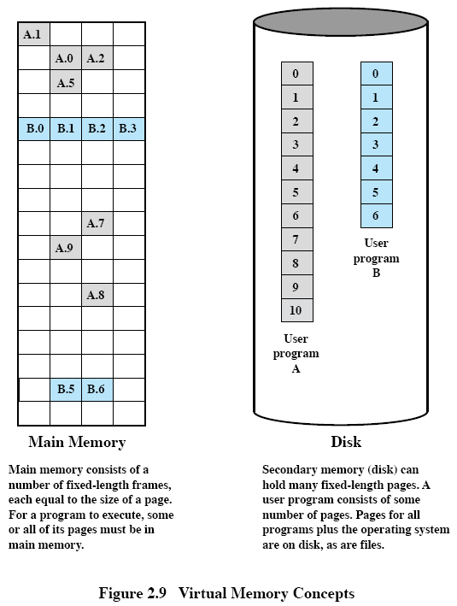

Slide 16
Major Achievements II --- Memory Management
Objectives
Users: modular programming and flexible use of data
System Manager: efficient and orderly control of storage allocation
Problems
Process Isolation (independence, prevent interference)
Automatic Allocation & Management (dynamic allocation, transparent, efficiency)
Support of Modular Programming (create, destroy, & alter the size of modules dynamically)
Protection and Access Control (sharing of memory needs protection & control)
Long-term Storage
Implementation --- Virtual Memory (Figure 2.9 & 2.10)

Slide 17
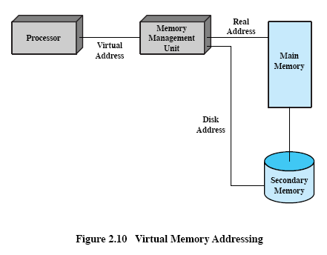

Slide 18
Major Achievements III --- Information Protection & Security
Problems
Obtain economic & market information (from government, and between competitive organizations)
Information about individuals
Intentional fraud through illegal access
Invasion of individual rights (by intelligence community, government intrusion)
Protection Policies (with increasing difficulties)
No sharing
Sharing originals of programs or data files
Confined, or memoryless, sub-systems
Controlled information dissemination (security levels)
Implementation
Access control
Information flow control
Certification

Slide 19
Major Achievements IV --- Scheduling & Resource Management
Objectives
Fairness
Differential responsiveness
Efficiency
Operating Systems Design Hierarchy (Table 2.4)
Section 2.4s --- 2.7 are very good sections for reading, especially Section 2.5
Major Achievements V --- System Structure
Characteristics of Modern Operating Systems

Slide 20
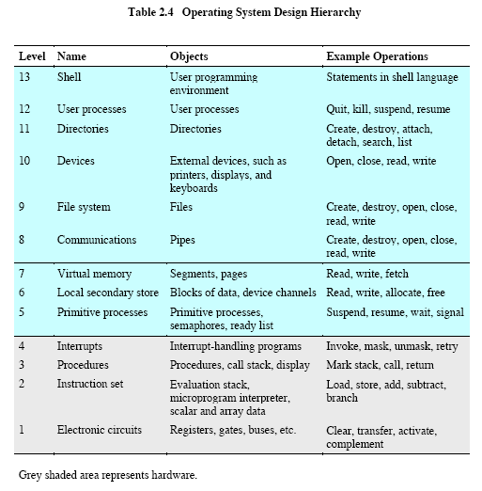
Notes:
CTSS: 32K, IBM OS/360: 1M instructions; Multis: 20M; Windows NT: 16M lines; Windows 2000: 32M lines
Anomaly: (6) everything must undergo local secondary store – what about instructions in RAM?
(4) Why do interrupts sit on top of procedures?
(8) An extremely simple program has no data communication.

Slide 21
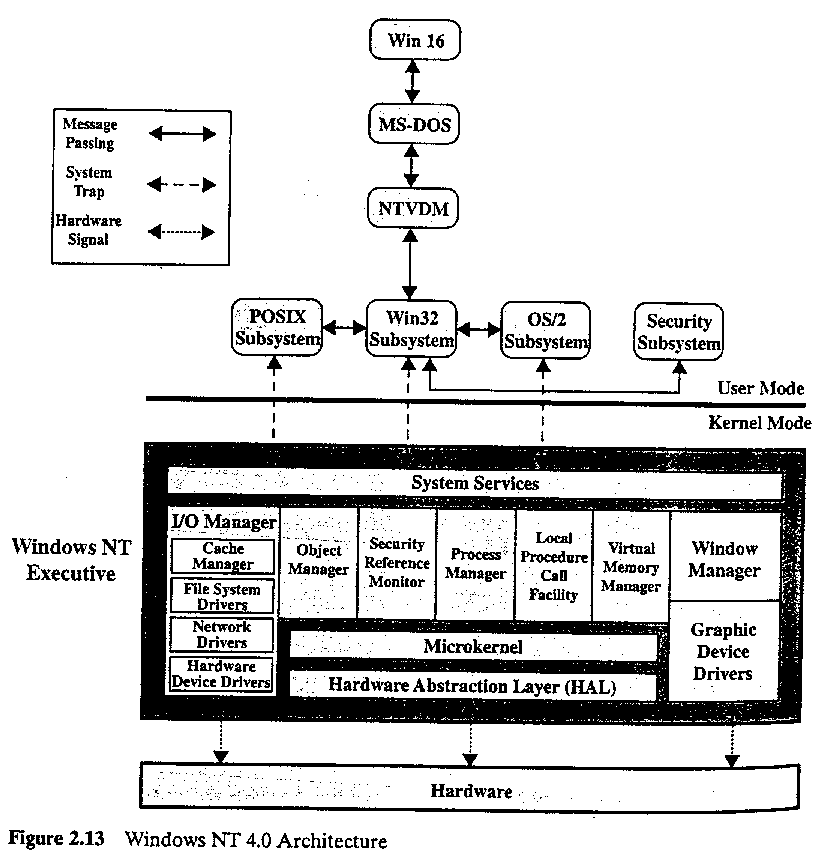
Notes:
Multitasking; 32-bit;
Object manager: processes, threads, synchronization objects for Windows Executive (kernel level)

Slide 22
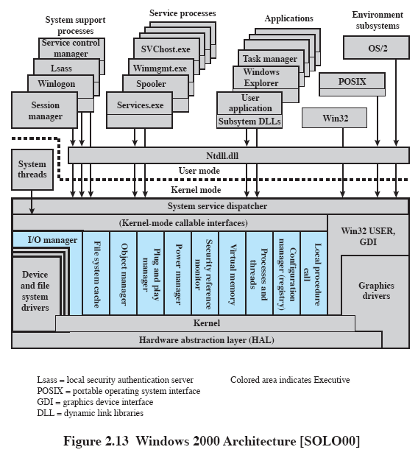
Notes:
GUI in kernel mode for speed; client/server computing
Services and functions for distributed processing
Service processes: event logger, accounting , etc.

Slide 23
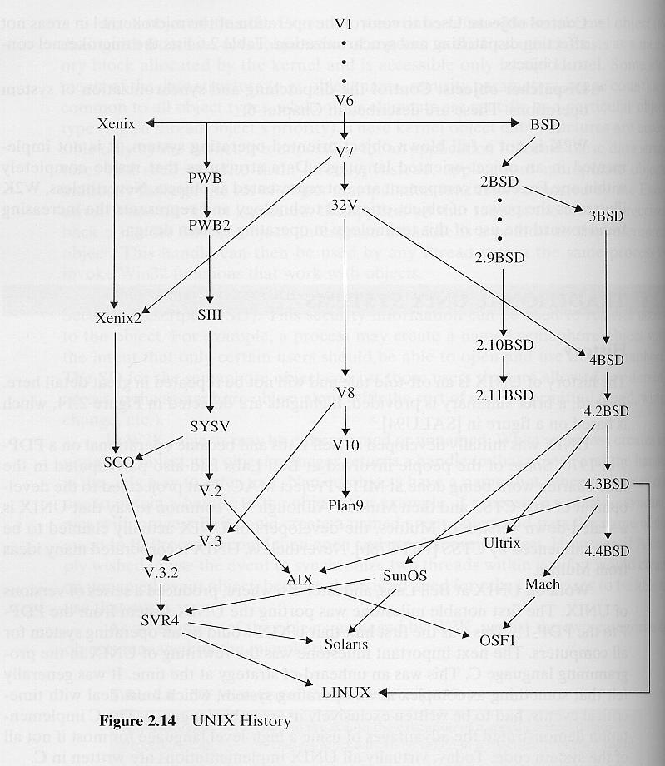

Slide 24
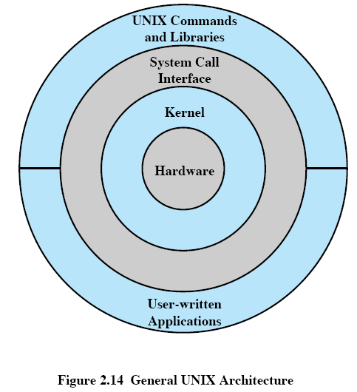

Slide 25
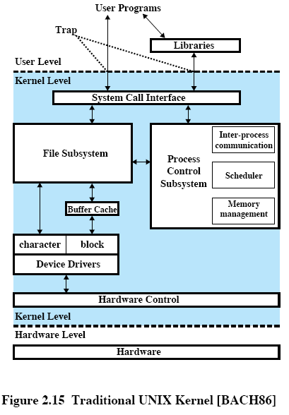
Notes:
Single processor, single type of file system, single file format

Slide 26
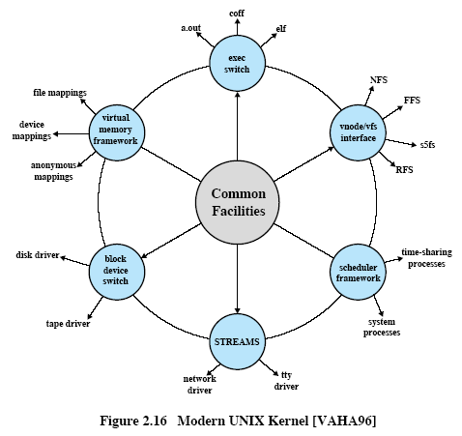

Slide 27
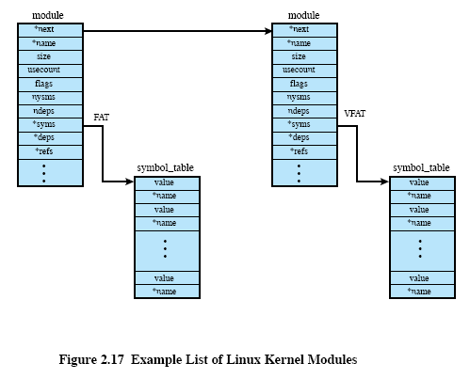

Slide 28
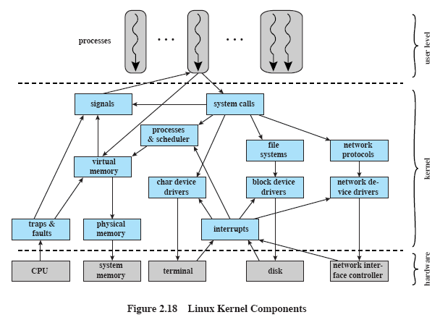
Notes:
Key for success: open source code, free to everybody, high quality, stability, highly modular, easily configured for various applications; 20+% penetration in corporate world

