Slide 1
Process Description and Control (Chapter 3)
Recall definition of a process
  a program in execution
  the “animated spirit” of a program
  an instance of a program running on a computer
  The entity that can be assigned to and executed on a processor.
  A unit of activity characterized by the execution of a sequence of instructions, a current state, and an associated set of system resources.

Slide 2
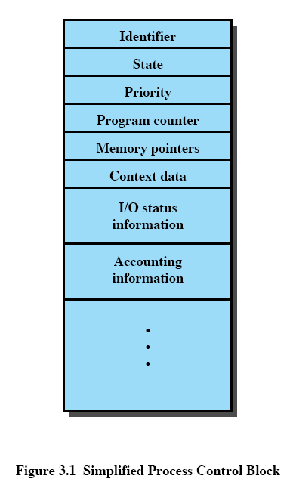
State: running, blocked, etc.
Context data: data in CPU registers
  Not data file or data array
Memory pointers: location of program code, data allocated (e.g., an array), memory blocks shared with other processes, etc.
I/O status information: outstanding I/O requests, I/O devices assigned to this process, a list of files in use by this process, etc.
Accounting information: CPU time used, clock time used, etc.

Slide 3
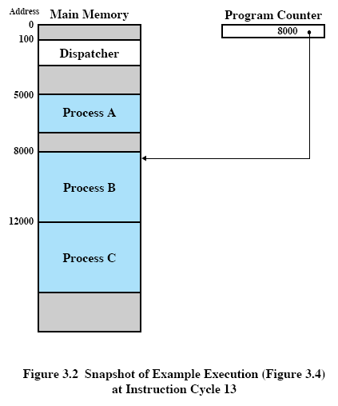
Three major requirements that an OS must meet with reference to processes
The OS must interleave the execution of a number of processes to maximize processor use while providing reasonable response time.
The OS must allocate resources to processes in conformance with a specific policy while at the same time avoid deadlock/starvation.
The OS may be required to support interprocess communication and user creation of processes, both of which may aid in the structuring of applications.

Slide 4
Components of a process
A process usually consists of
  an executable program
  the associated data needed by the program (variables, work space, buffers, etc.)
  the execution context of the program, e.g.,
    contents of registers, including program counter
    priority
    Is the processed being blocked for I/O?

Slide 5
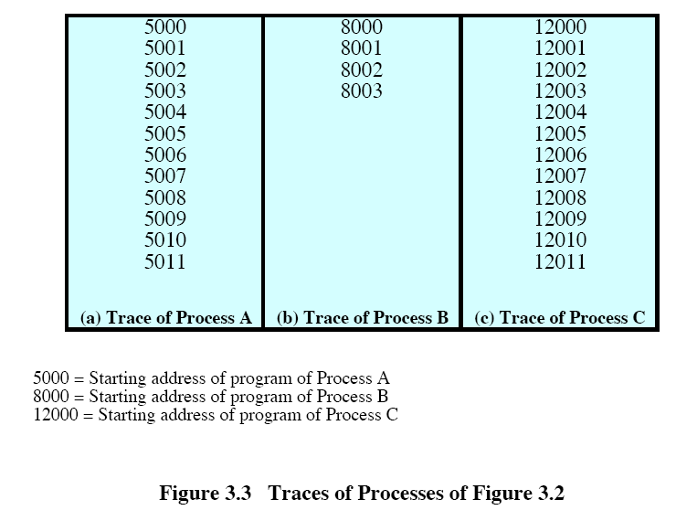

Slide 6
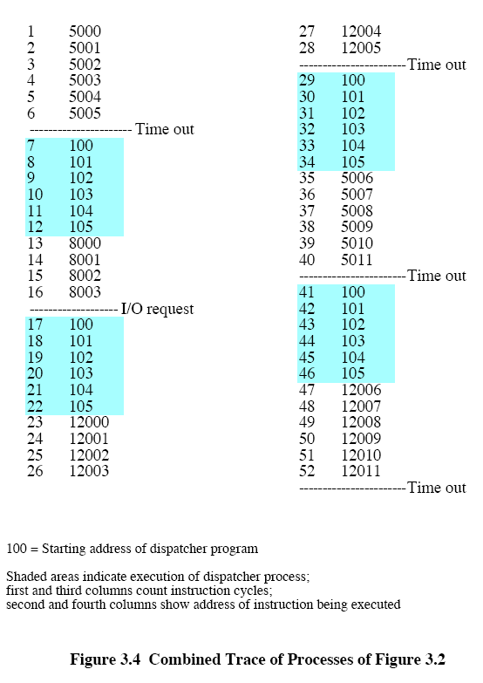

Slide 7
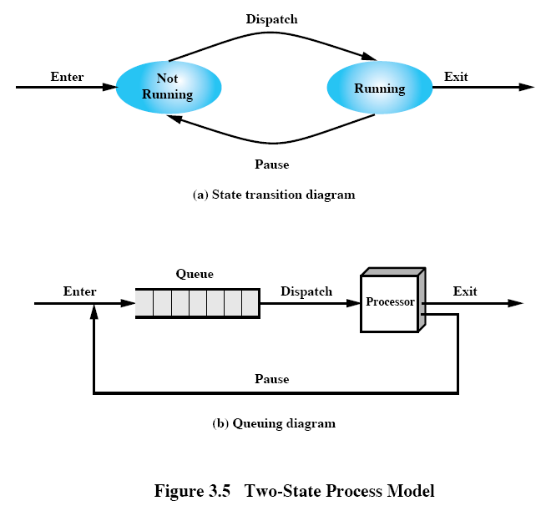

Slide 8
Process Creation and Termination
The behavior of a process can be characterized by listing the sequence of instructions that execute for that process. This listing is called the trace of a process.
Events leading to the creation of a process
  batch job submission
  interactive log on
  OS creating a process to service a user request, e.g., printing, telnet
  spawned by existing processes, e.g.,
    A server program listens to requests for connection from clients and spawns a new process to handle the data, print, or communication requests.
    A user program may spawn a separate process to process data that the program generates.
    The process that creates the new process is called the parent process. The created process is called the child process.
    e.g., UNIX fork()

Slide 9
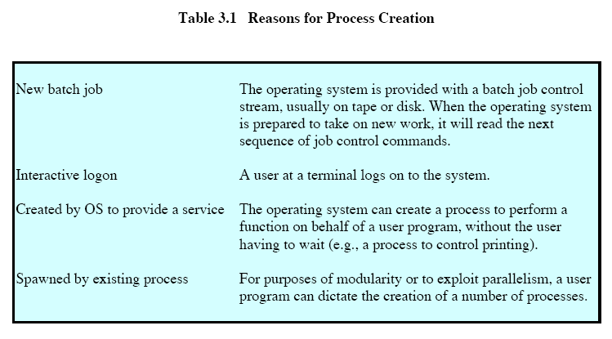

Slide 10
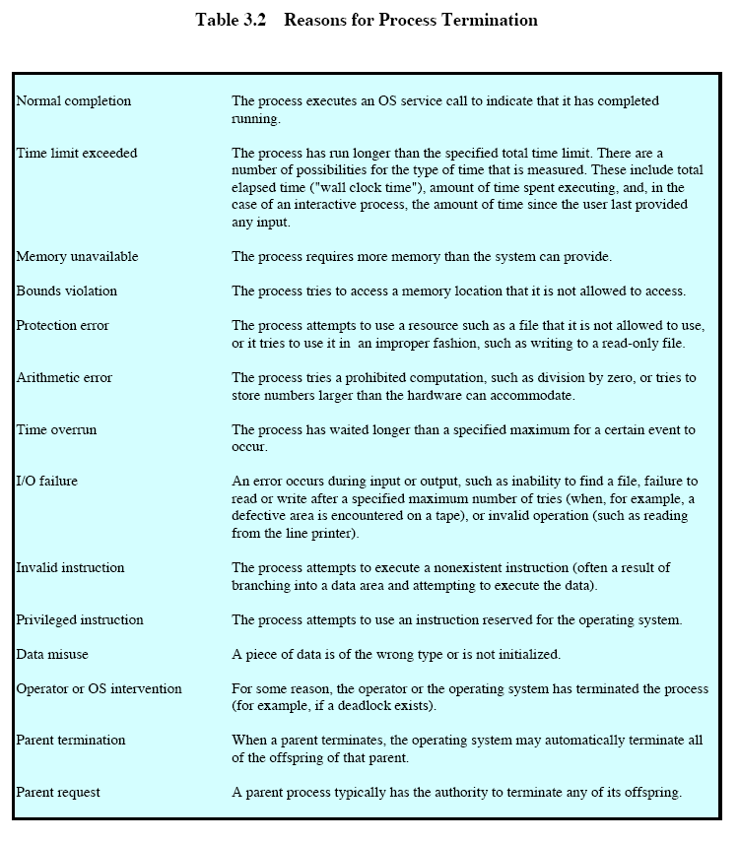

Slide 11
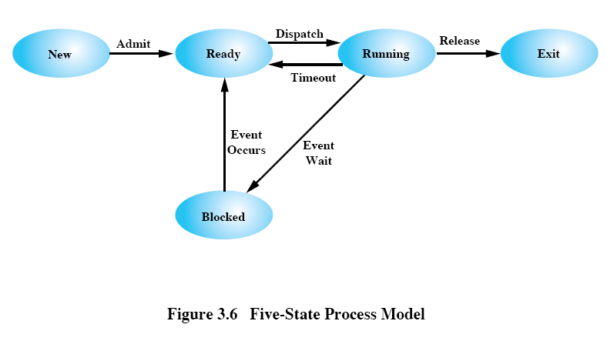

Slide 12
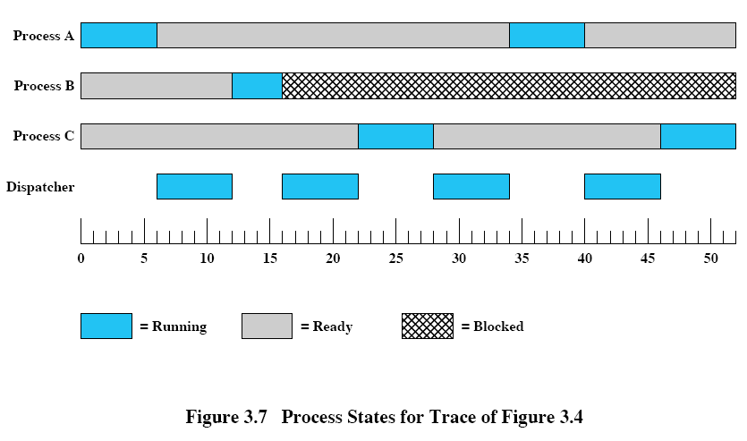

Slide 13
Process States
new state
  new login, new batch job
  The OS assigns a process ID, updates the process table, etc.
  The process waits to go to the ready state.
    There may be a limit on the maximum number of processes allowed to get ready.
ready state
  waiting for CPU, but otherwise ready
  Each process must be represented in some way so that the OS can keep track of it, including current state and location in memory.
  The OS maintains a ready list/queue of ready processes to be dispatched for running.
  If the dispatching of processes is dictated by a priority scheme, then it is convenient to have a number of ready queues, one for each priority level.

Slide 14
Process States (cont.)
running state
  has CPU
blocked state
  waiting for something to happen, such as I/O completion
exit state
  termination of process
  Before the OS deletes the information, memory, etc. of the process, other programs may need to do accounting, record resource utilization, billing, etc.

Slide 15
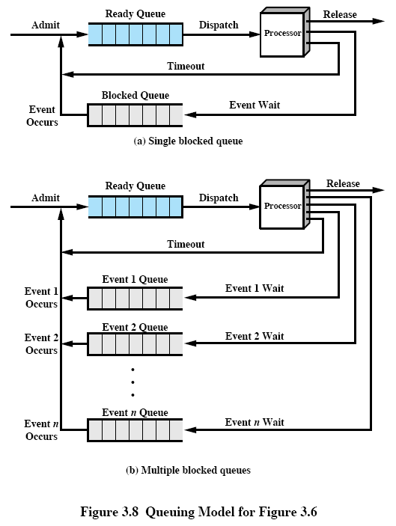

Slide 16
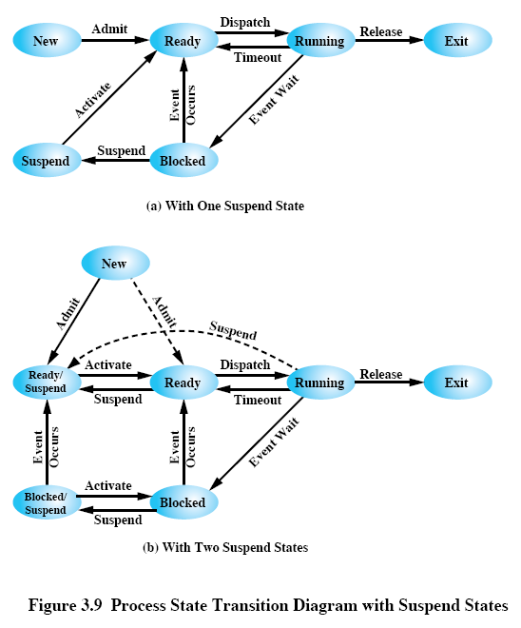

Slide 17
Process Suspension
A process that is suspended is being swapped to hard disk and is not immediately available for execution.
The OS then brings in another process from the suspended queue, or it honors a new-process request.
blocked, suspend state
  The process has been swapped out (of main memory), and it is still blocked, waiting for an event to occur.
ready, suspend state
  The process was suspended, but the event it had been waiting for has occurred.
  It is available for execution as soon as it is loaded into main memory.
The information of suspended processes must still be kept in the OS process list.

Slide 18
Process Suspension (continue)
Reasons for process suspension
  Swapping: The OS needs to release sufficient main memory to bring in a process that is ready to execute.
  Other OS reason: The OS may suspend a background or utility process or a process that is suspected of causing a problem.
  Interactive user request: A user may wish to suspend execution of a program for purposes of debugging or in connection with the use of resources.
  Timing: A process may be executed periodically and may be suspended while waiting for the next time interval.
  Parent process request: A parent process may wish to suspend execution of a descendant to examine or modify the suspended process or to coordinate the activity of various descendants.

Slide 19
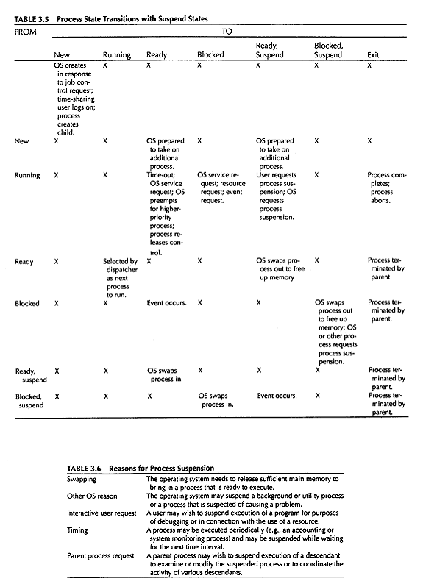

Slide 20
Transitions worth considering
New state -> Ready, suspend state
  Due to insufficient main memory, the newly allocated address space may have to reside in secondary storage.
Blocked, suspend state -> blocked state
  This circumstance seems reasonable in the following scenario:
  A process has just terminated and freed up some memory. There is a process in the blocked, suspend queue that has a higher priority than any of the process in the ready, suspend queue. The OS has reason to believe that the blocking event for that higher priority process will occur soon, e.g., disk backup job starting at 2am.
Running state -> ready, suspend state
  This happens when a running process gives way to a high priority process in the blocked, suspend queue that has just become unblocked.

Slide 21
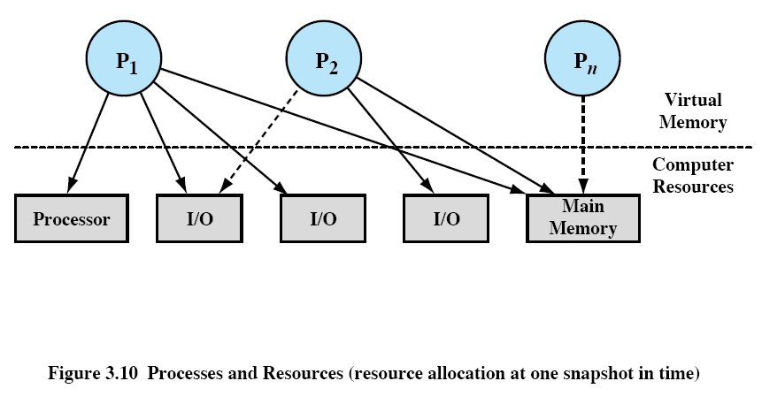

Slide 22
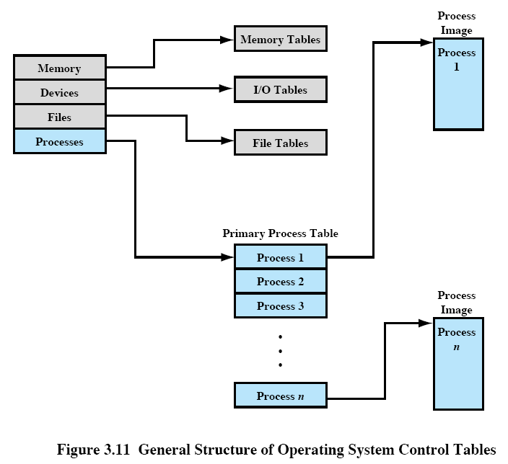

Slide 23
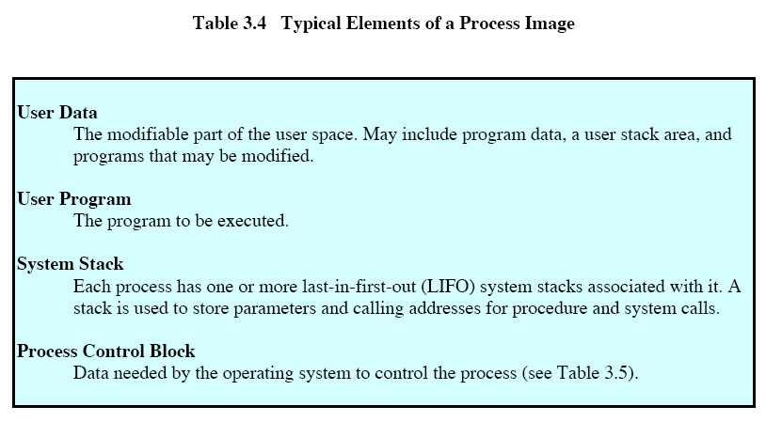

Slide 24
OS Control Structures
The OS manages the use of system resources
  processor(s), I/O devices, main memory
Operating system control structures
  Tables of information are maintained about the current status of each process and resource.
  Memory tables
    the allocation of main memory to processes
    the allocation of secondary memory to processes
    protection attributes of segments of main or virtual memory
      Which processes may access certain shared memory regions?
    virtual memory management
  I/O tables
    Which I/O device is available or assigned to a particular process?
    status of each I/O operation
    location in main memory for I/O transfer (The location may be used for source or destination.)

Slide 25
OS Control Structures (cont.)
  File tables
    information about the existence of files; file system hierarchy
    location of files in secondary memory
    current status
      opened/ closed?
      read/write pointer
    attributes (read/write/execute bits, etc.)
  Process tables
  The above tables must be linked or cross-referenced in some fashion.
    A process structure points to memory, I/O, and file tables.
    Entries in memory tables point to processes due to memory reallocation.
  The system administrator may configure the initial parameters in these tables.

Slide 26
Process Control Structures
Process control structure is needed to keep track of
  process location
  the attributes of the process (Table 3.5)
process image
  User program: a program or set of programs to be executed.
  User data: data location for local and global variables, and user defined constants.
  System stack: a stack to keep track of procedure calls & parameters passing between procedures.
  Process control block: Info. needed by the OS to control the process.
    always kept in main memory

Slide 27
Process Control Block (PCB)
contains the attributes of each process
alias: task control block, process descriptor, and task descriptor
Process identifiers
  usually numeric.
  identify a process table entry, either by direct indexing or by mapping.
  used by other tables to cross reference process tables
  indicate communication partner, parent processes, descendant processes, etc.
Processor state information
  register contents
  program status word (PSW), e.g., EFLAGS in Pentium
Process control information

Slide 28
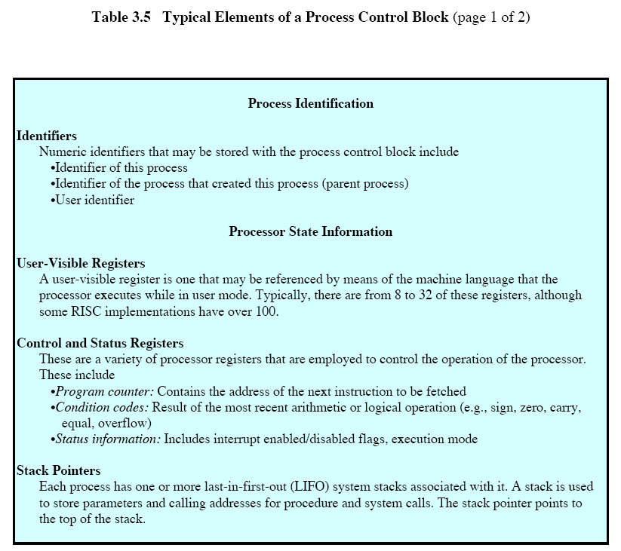

Slide 29
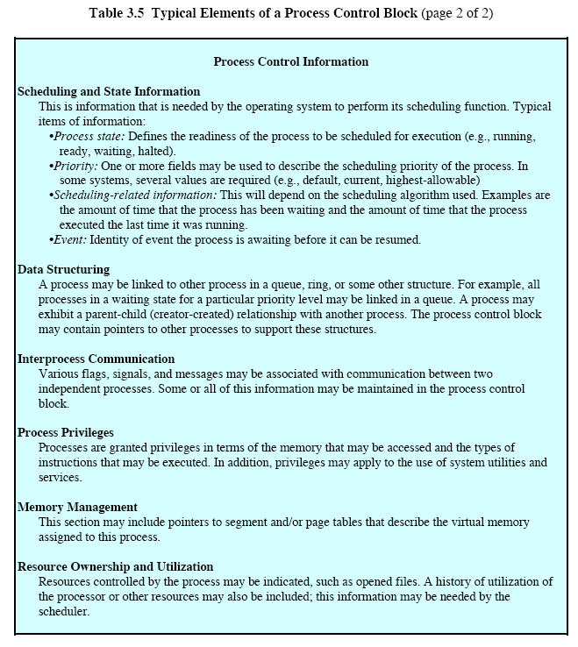

Slide 30
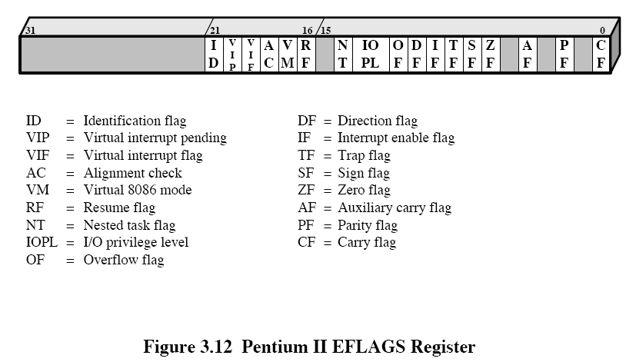

Slide 31
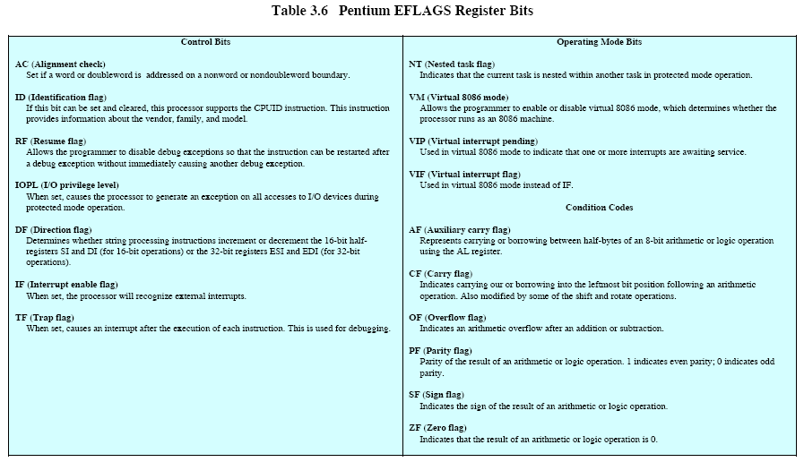

Slide 32
Process Control Block (cont.)
PCB’s are kept in linked lists for the operation of the OS.
  ready queue, blocked queues
  parent-child lists
  sibling lists
role of PCB
  one of the most important data structures in an OS
  PCB’s are read/modified by almost all modules in the OS.
    scheduling, resource allocation, interrupt processing, performance monitoring and analysis
  A bug in a single routine, e.g., an interrupt handler, may damage PCB’s, and the consequence could be tremendous.
  A design change of the PCB data structure affects every module in the OS.
  A remedy is to require all routines in the OS to go through a handler routine for reading and writing of PCB’s.
    A better solution is to use object-oriented designs.

Slide 33
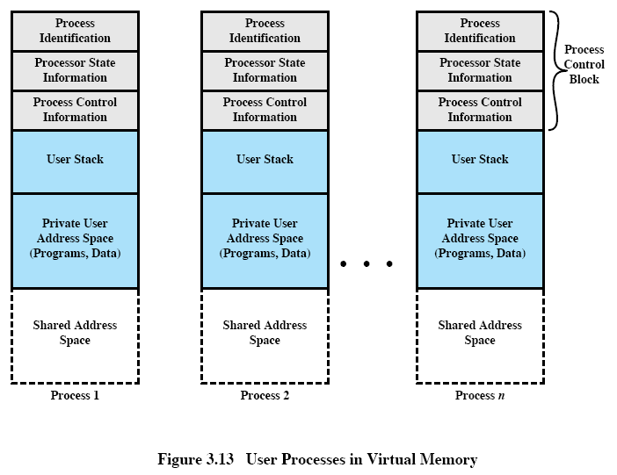

Slide 34
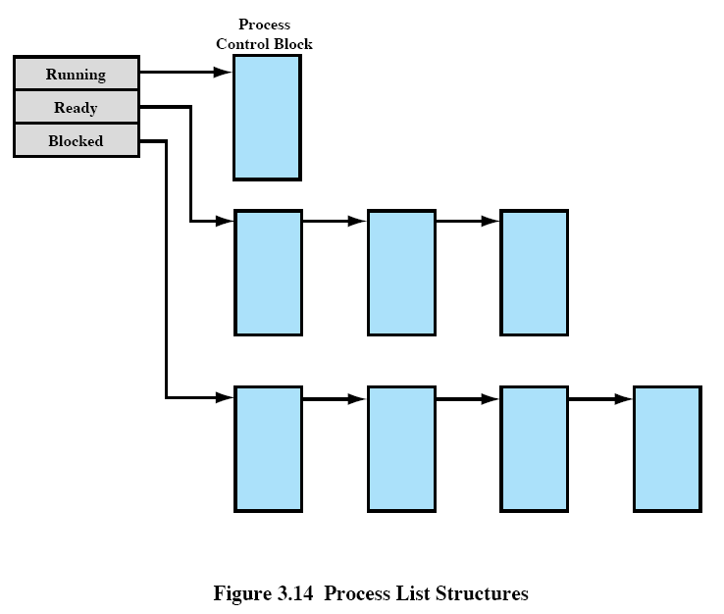

Slide 35
Process control
Modes of execution of a processor
  usually indicated by a bit in the PSW
  system/control/kernel mode
    privileged
    reading/altering control registers, such as PSW
    primitive I/O instructions
    memory management instruments (not regular MOV)
    accessing reserved memory regions
  user mode
    User programs typically execute in this mode.

Slide 36
Process control (cont.)
  The mode changes from user to system when the user program executes a system call.
    assembly language level: change mode hardware instruction
    When a user places a system call, the compiled assembly code starts with this change mode instruction.
    The processor hardware, while executing this instruction, checks the current execution mode.
    If the mode is user, the processor goes to the OS (probably via an interrupt), which returns an error unless the mode change is to be allowed.

Slide 37
Creation of process
Assign a unique process ID.
Create a new entry in the primary process table corresponding to this process ID.
Allocate space for the process.
  program size + user data space + user stack space
  User space usually has default values depending on the application, but can be requested to be changed by the user.
    Parent processes know these values for child processes.
  Linkages may be setup for shared address space.
  Allocate space for PCB.

Slide 38
Creation of process (cont.)
Initialize PCB.
  process ID entry, parent ID entry
  processor state information (usually initialized with 0’s, except for program counter and system stack pointers)
    normally no I/O devices attached
  process state -- ready or ready, suspend
  priority -- unless specified, initialized to lowest value
Set other linkages
  ready or ready, suspend queue
Set other data structures
  billing, resource usage, performance evaluation, etc.

Slide 39
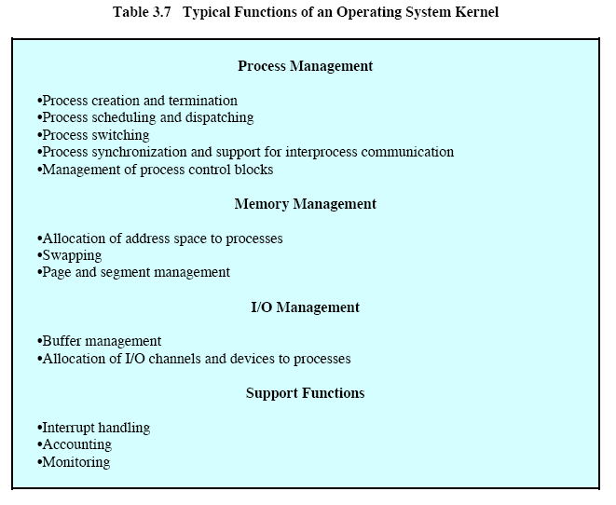

Slide 40
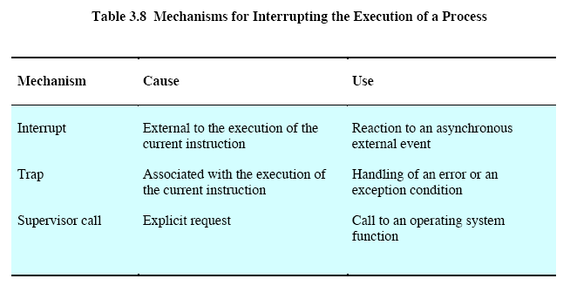

Slide 41
Process switching
A process switch may occur any time that the OS has gained control from the currently running process.
  interrupts (asynchronous)
    caused by external events independent of the running process, e.g.
    I/O devices, clock time-out, memory page fault (only the needed page is not in main memory, not illegal access)
    The execution is first transferred to an interrupt handler, and then to the OS.
    Except for an external termination by the parent, the process is still “alive”.
  traps (synchronous)
    error or exception condition, e.g.,
    arithmetic overflow, illegal access/segmentation fault, etc.
    The OS determines whether the error is fatal. The OS tries to recover from nonfatal exceptions and resume the currently running process.

Slide 42
Process switching (cont.)
  Supervisor call (SVC)(synchronous)
    The user program performs system calls.
      The user process may go from a running state to a blocked state.
Mode/Context switching
  During an interrupt, the processor saves the information that may be altered by the interrupt handler. This includes
    the processor state information in the PCB.
    Usually this is done by hardware.
  It may happen the interrupt is not serious enough to cause a process switch, e.g., the interrupt handler may
    reset some flags,
    do an acknowledgment to an I/O device, and check for error conditions. Normally there is no error.

Slide 43
Process switching (cont.)
Mode/Context switching (cont.)
  In this case the interrupt handler passes control back to the original process.
    The state of the process has not been changed.
  Thus context switching involves saving much less information than process switching.
A full process switch involves
  saving processor state information, as in context switching,
  updating the PCB:
    change the state entry from running state -> ready; blocked; ready, suspend; etc.
    accounting information, such as execution time, etc.
  moving the PCB to the appropriate queue,
  selecting another process for execution,
  updating the PCB of the process selected,
  updating memory management data structures,

Slide 44
Process switching (cont.)
full process switch (cont.)
    restoring the context of the processor to accommodate the selected process.
      This involves changing all registers, whose new values must be fetched from memory.

Slide 45
Execution of the OS
The OS is an ordinary computer software executed by the processor.
The OS frequently relinquishes control and must depend on the processor to regain control.
Question: how is the OS related to processes being executed?
Nonprocess kernel
  used in older OS designs and mainframes
  The OS has its own region of memory and system stack.
  The concept of process applies only to user programs.
  The OS is executed as a separate entity in privileged mode.

Slide 46
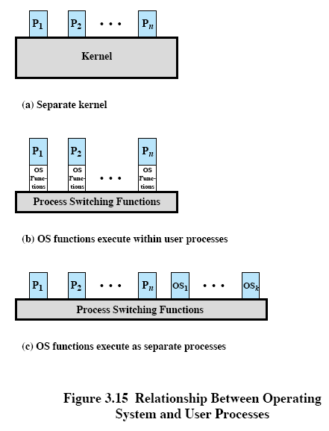
Older OS
E.g., UNIX (early 1970’s)
E.g., Solaris, Windows NT, Windows 2000, Windows XP, Linux

Slide 47
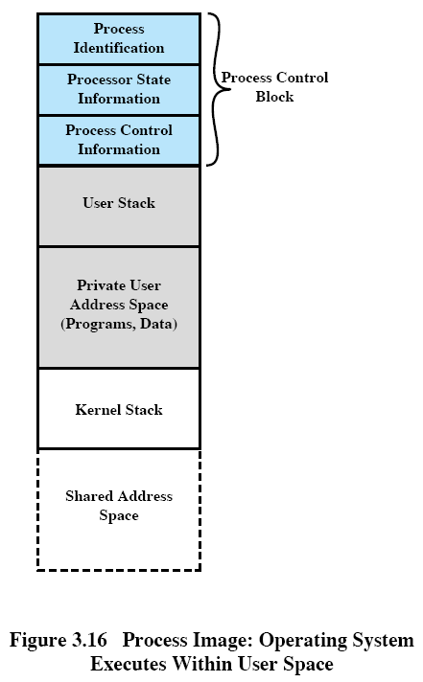

Slide 48
Execution of the OS (cont.)
Execution within user processes
  used in smaller machines, minicomputers
  Execute virtually all OS software in the context of a user process.
  The OS is primarily a collection of routines that the user calls to perform various functions and are executed within the environment of the user’s process.
  Each process image includes program, data, and stack areas for kernel programs.
    Kernel programs and data are shared, but the stack is local.
  All interrupts, traps and supervisor calls cause context switches to the OS. The processor is changed to kernel mode and execution continues within the current user process.
    advantage -- no process switch in some supervisor calls such as changing directories
  Depending on system design, the process-switching routine may or may not execute in the current process.

Slide 49
Execution of the OS (cont.)
Execution within user processes (cont.)
  Because of the switching to kernel mode, the user cannot tamper with the OS routines, even though these routines are executing in the user’s process environment.
Process-based OS
  Implement the OS as a collection of system processes.
  These processes execute in kernel mode.
  Advantages
    modular OS design with minimal, clean interfaces
    Some noncritical OS functions are implemented as separate processes, e.g., performance monitoring utilities.
    performance improvement in multiprocessors

Slide 50
UNIX System V process description
  UNIX employs two running states to indicate kernel or user mode.
  The ready to run state and preempted states are essentially the same state and belong to the same queue of ready processes.
    A process can only be preempted (switched) from kernel mode.
  process control
    Most of the OS executes within the environment of a user process.
    There are important processes, centralized to the functioning of UNIX, that run in kernel mode.
      Swapper process
        predefined as a data structure loaded at boot time
        process number 0 (can be seen by typing the UNIX command ps aux)
        spawns init process
      Init process
        process number 1
        accepts user logon requests.
        spawns processes for each user.

Slide 51
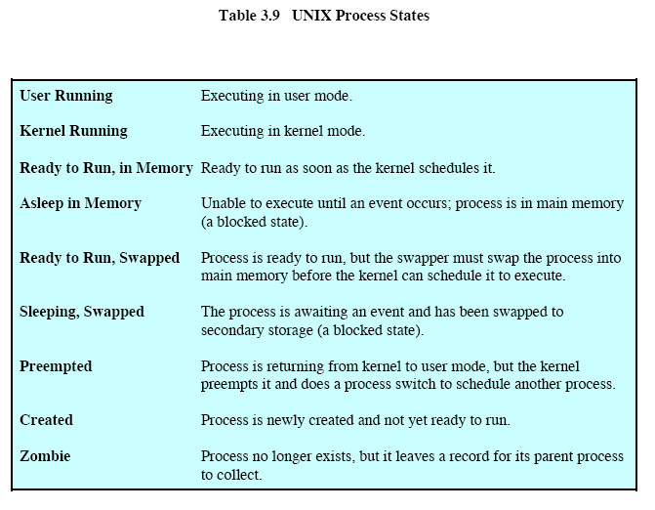

Slide 52
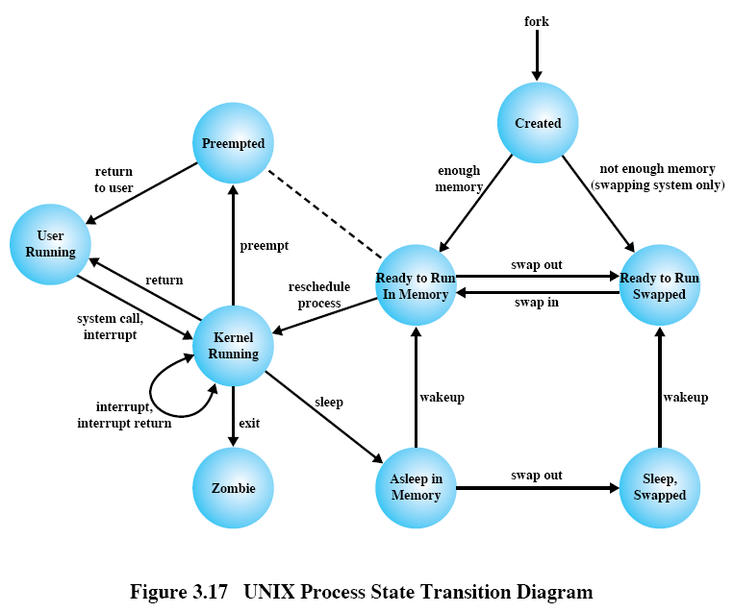

Slide 53
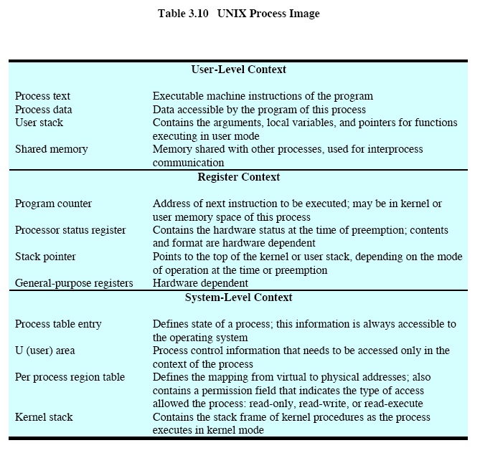

Slide 54
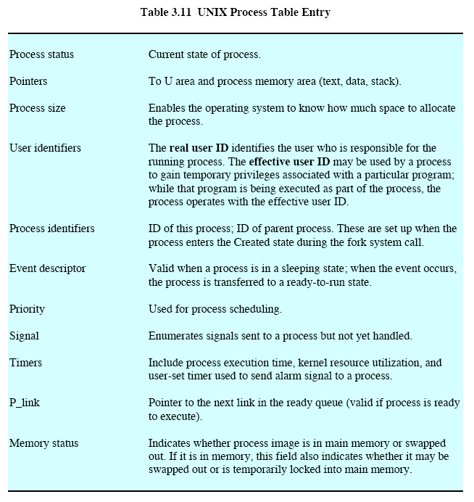

Slide 55
