Slide 1
Threads, SMP, and MicroKernels
Processes and threads
  The two characteristics of a process
    unit of resource ownership
      virtual address space for the process image
      I/O channels, devices, files
    unit of dispatching/scheduling/execution
      This is the execution path through one or more modules.
      It is also the entity that is being scheduled and dispatched by the OS.
      A process may have many dispatching units. A unit of dispatching is commonly called a thread or lightweight process.
  New notion of Process : unit of resource ownership

Slide 2
Threads
  Single process, single thread
    DOS
  Multiple processes, single thread per process
    UNIX
  One process, multiple threads
    Java run-time (actually not an OS)
  Multiple processes, multiple threads per process
    Solaris, Windows 2000/XP, Windows XP, Mach, OS/2, Linux
  Multithreading
    a process
      unit of protection and unit of resource allocation
        virtual address space, process image
        protected access to processors, interprocess communication (IPC), files, I/O resources

Slide 3
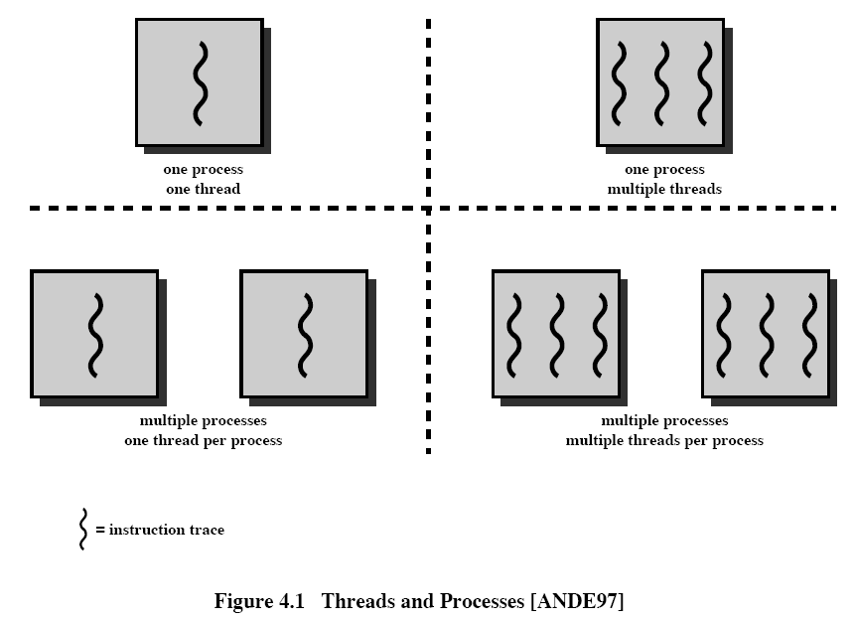

Slide 4
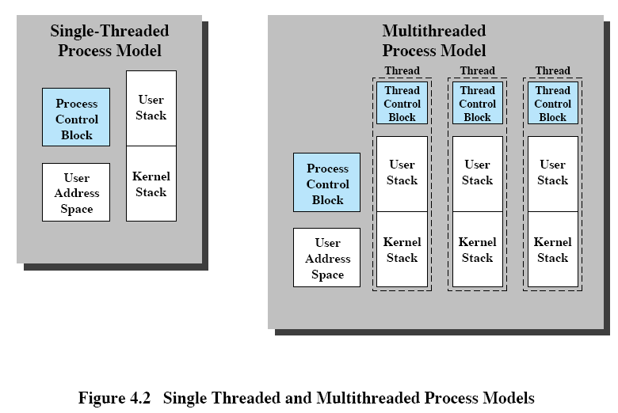

Slide 5
Threads (cont.)
  Multithreading (cont.)
    Each thread has
      a thread execution state (running, ready, etc.)
      a separate control block, with priority, some thread related state information, and saved processor context when not running (with program counter)
      an execution stack
      some per-thread static storage for local variables
      access to the memory and resources of its process, shared with all other threads in the process,
    A single application logically doing several functions, especially in GUI systems.
      Example application -- a file server entertaining requests to create, open, read, and write on files.
        One thread per request
        Two threads cannot write on the same file at the same time.

Slide 6
Benefits of threads
less time to create (10 times) and terminate than doing the same thing to a process
less time to switch between two threads within the same process
parallel processing -- multiple threads executing simultaneously on different processors.
communication between different executing modules within the same process
  In most OS, communication between independent processes requires the intervention of the kernel to provide protection and the mechanism needed for communication.
  Because threads within the same task share memory and files, they can communicate with each other without invoking the kernel.

Slide 7
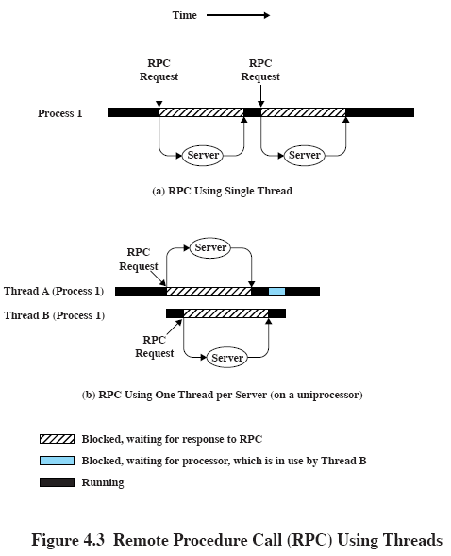

Slide 8
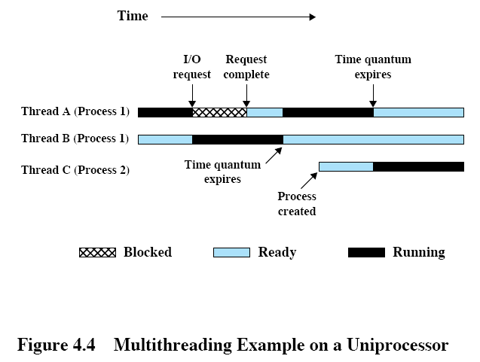

Slide 9
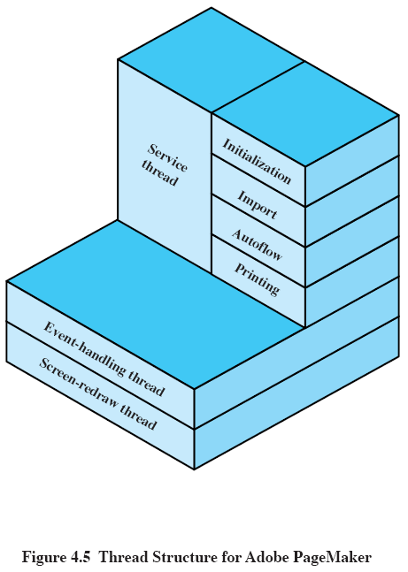

Slide 10
Example applications using threads
Threads in a spreadsheet program
  One thread displays menus and read user input (foreground work).
  Another thread executes user commands and updates the spreadsheet (background work).
Adobe PageMaker
  Writing, design, and production tool for desktop publishing
  service thread
  event-handling thread
  screen-drawing thread
  When the event-handling thread (e.g., doing a large computation, etc.) or the screen-drawing thread is busy, the service thread (e.g., printing, file importing, etc.) restricts user activity by disabling menu items and displaying a “busy” cursor. The user is free to switch to other applications, or even kill the computation through the service thread.

Slide 11
Example applications using threads (cont.)
Adobe PageMaker (cont.)
  Dynamic scrolling
    Redrawing the screen as the user drags the scroll indicator -- is possible. The event-handling thread monitors the scroll bar and redraws the margin ruler (which can be done relatively quickly).
    Meanwhile, the screen-redraw thread constantly tries to redraw the page and catch up. (Each user click on the scroll bar aborts the previous drawing and starts a new one.) In this example, the event-handling thread can be considered as doing foreground work while the screen-redraw thread is considered the background work.

Slide 12
Example applications using threads (cont.)
Asynchronous processing
  Have a backup thread periodically saving the current user data to disk when the main thread is doing some computation.
Speedy execution
  In a multiprocessor system, one thread reads in data while another thread does the computation.

Slide 13
Threads (cont.)
Because all threads in a task share the same address space, all threads must enter a suspend state at the same time.
Thread functionality
  thread states
    running, ready, blocked
    no suspend state
    thread operations
      spawn, block, unblock, finish
  thread synchronization
    The alteration of one resource by a thread affects other threads.
      e.g., opening files
    same techniques as process synchronization

Slide 14
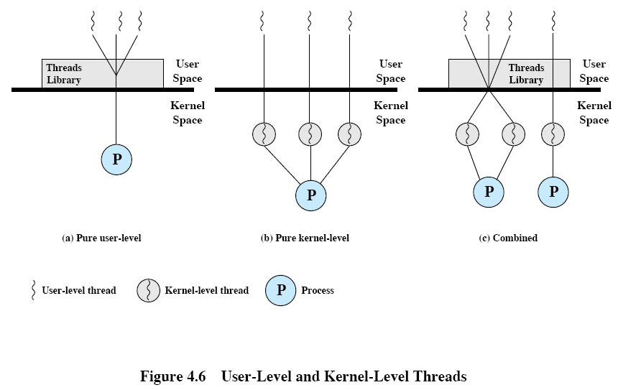

Slide 15
User-level threads (ULT)
thread management done by a threads library at user mode/space
  thread spawning, destruction, scheduling, message passing, switching--saving and restoring thread context
  setting state of each thread
kernel not aware of existence of threads
Examples in Fig. 4.7
  Fig. 4.7b: thread 2 invokes I/O action.
  Fig. 4.7c: process B’s clock quantum expires.
  Fig. 4.7d: thread 2 needs some action performed by thread 1; thread switching occurs and is managed by threads library.

Slide 16
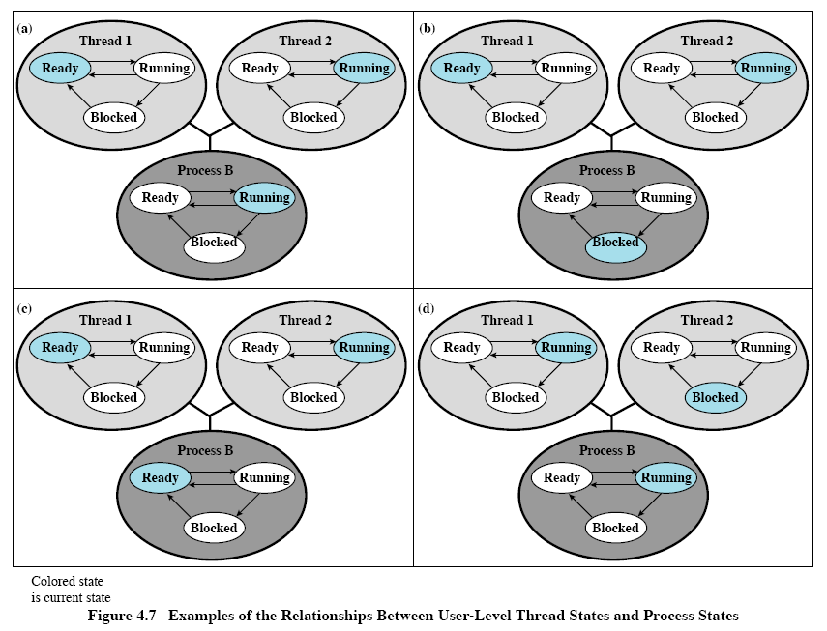

Slide 17
ULT vs KLT
advantages of ULT over KLT
  Thread switching does not require kernel mode privileges, i.e., no mode switches.
  Scheduling can be application specific.
    round-robin for one application, priority-based for another
  ULT runs on any OS, even ones not supporting multithreading.
disadvantages of ULT
  In a typical OS, many system calls are blocking. When a ULT executes a system call (I/O, etc.) , all of the threads within the process are blocked.
  A multithreaded application cannot take advantage of multiprocessing: the kernel assigns only one CPU to the process.

Slide 18
Kernel-level threads (KLT)
also called lightweight processes
thread management done by kernel
Examples: Windows 2000, Linux, OS/2
advantages of KLT
  The kernel can assign multiple CPUs to different threads of the same process, i.e., true multiprocessing.
  If one thread in a process is blocked, the kernel can schedule another thread of the same process.
  Kernel routines themselves can be multithreaded.
disadvantages of KLT
  The transfer of control from one thread to another within the same process requires a mode switch to the kernel. This is very time consuming. See table 4.1.

Slide 19
Combined ULT and KLT
example: Solaris
Thread creation, scheduling, and synchronization are done completely in user space.
The multiple ULTs from a single application are mapped onto some (smaller or equal) number of KLTs.
advantages
  Multiple threads within the same application can run in parallel on multiple CPUs.
  A blocking system call need not block the entire process.

Slide 20
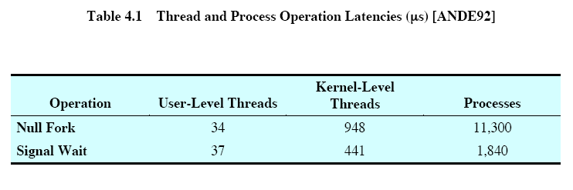
User and Kernel-Level Threads Performance
Performance
  Null fork: the time to create, schedule, execute, and complete a process/thread that invokes the null procedure.
  Signal-Wait: the time for a process/thread to signal a waiting process/thread and then wait on a condition.
  Procedure call: 7 s Kernel Trap:17 s
Thread Operation Latencies (taken on VAX (1992))

Slide 21
User and Kernel-Level Threads Performance
Observations
  While there is a significant speedup by using KLT multithreading compared to single-threaded processes, there is an additional significant speedup by using ULTs.
  However, whether or not the additional speedup is realized depends on the nature of the applications involved.
  If most of the thread switches require kernel mode access, then ULT may not perform much better than KLT.

Slide 22
Symmetric multiprocessing
SISD (Single instruction, single data stream)
SIMD (multiple data stream)
  vector and array processors
MIMD (multiple instruction, multiple data stream)
  general purpose processors, each capable of processing any instruction
  distributed memory (loosely coupled)
  shared memory (tightly coupled)
    master/slave
      The OS kernel always runs on a particular processor (master).
      relatively simple OS (compared to SMP)
      Disadvantages: single point of failure, bottleneck

Slide 23
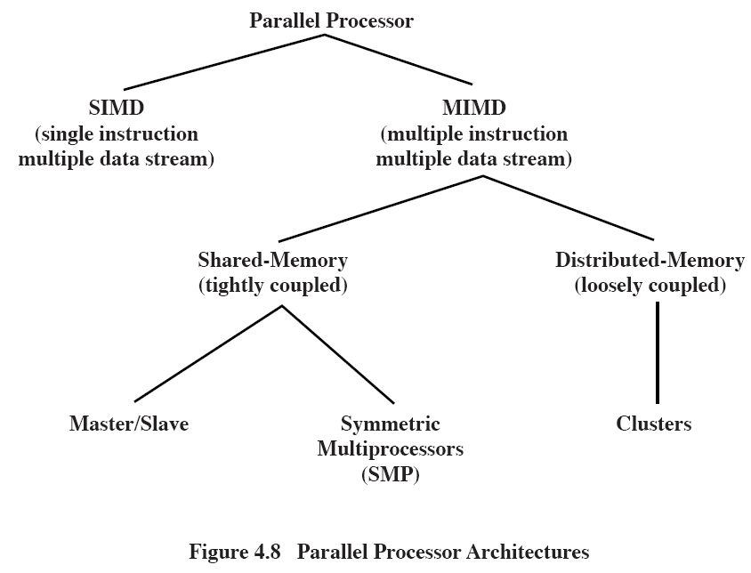

Slide 24
Symmetric multiprocessing (cont.)
  shared memory (tightly coupled) (cont.)
    symmetric (SMP)
      kernel executed as multiple processes or threads
      Each processor may execute these kernel threads; self scheduling.
        Complicated OS : synchronization, conflict resolution, etc.
SMP organization
  shared memory, bus, I/O subsystem
  separate cache : cache coherence problem

Slide 25
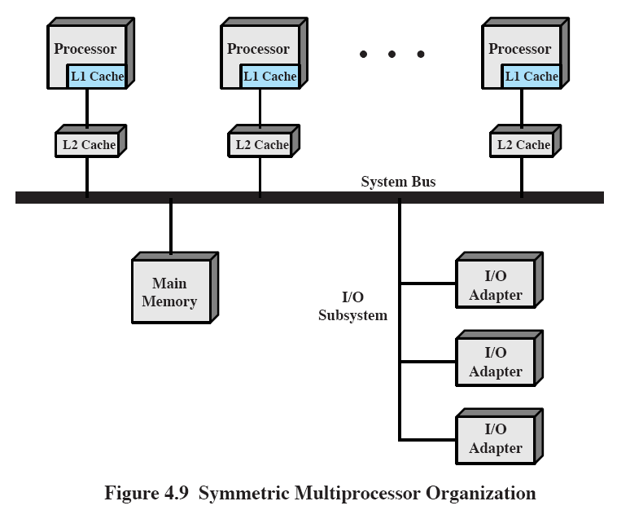

Slide 26
Multiprocessor OS design considerations
simultaneous concurrent processes or threads
  reentrant code for kernel routines
  no deadlock for kernel tables and management structures
scheduling
synchronization
  mutual exclusion, locks, event ordering
memory management
  coordinate paging of processor/cache couple
reliability
  graceful degradation during processor failure

Slide 27
Microkernels
microkernel architecture
  Old OS’s are big
    IBM OS/360: 5000 programmers, 1 million lines, 5 years
    Multics: 20 million lines
    Difficulty of maintenance
  New OS’s: object-oriented architecture
  absolutely essential core OS functions
    kernel (supervisor) mode
  external subsystems
    built on the microkernel
    executed in user mode as server processes (that are part of the OS)
      interaction via message passing through microkernel
    device drivers, file systems, virtual memory manager, windowing system, security services

Slide 28
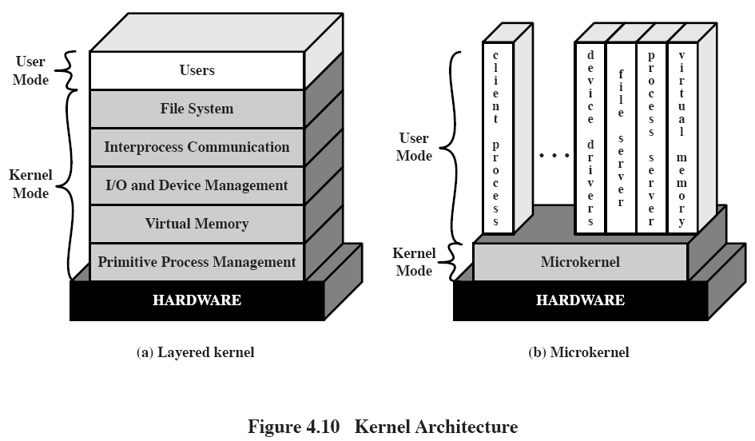

Slide 29
Benefits of a microkernel organization
uniform interface
  no distinction between user-level and kernel-level services: all done by message passing
extensibility
  e.g., addition of new types of disks
flexibility
  easiness of modification to adapt to different environment
  addition/deletion of services for different types of users
portability
  minimal effort to port to different machines
reliability
  microkernel can be rigorously tested because of its small size; small number of API library functions
distributed system support
  A process can send a message (with service provider ID) without knowing on which machine the target service resides.
Object-oriented OS

Slide 30
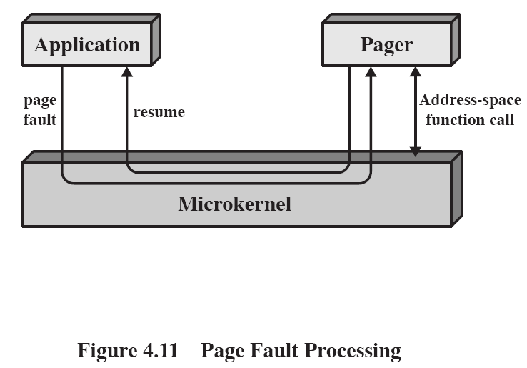

Slide 31
Microkernels (cont.)
Performance of microkernel
  It takes longer to build and send messages than to make supervisor calls.
  more user/kernel mode switch than traditional OS
Microkernel design
  no absolute rules on services included
  hardware dependent functions
  functions needed to support servers and applications running in user mode
  Low-level memory management
    mapping a virtual page to a physical page frame
    outside microkernel
      protection of address space of one process from another at process level
      page replacement algorithm
      application-specific memory sharing policies

Slide 32
Microkernels (cont.)
Microkernel design (cont.)
  Interprocess communication (IPC)
    messages
      header (with sender and receiver ID), data
      between threads: send location of data
      between processes: memory-to-memory copy
    The microkernel maintains ports where queues of messages are associated; ports also indicate which other processes can communicate to them.
    Ports are assigned to processes for IPC.
  I/O and interrupt management
    I/O ports address space
    recognition of interrupts
    only assignment of interrupts to certain interrupt handlers
    The interrupt handlers are external to the microkernel.

Slide 33
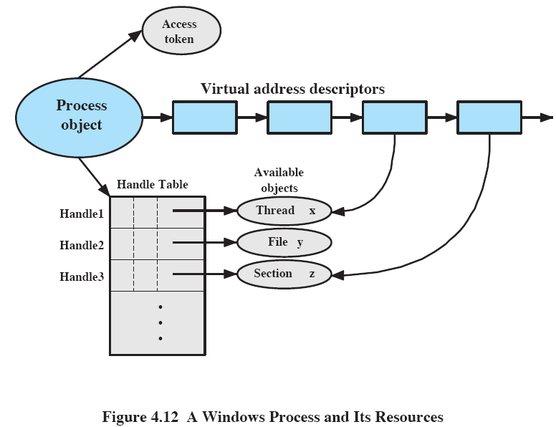

Slide 34
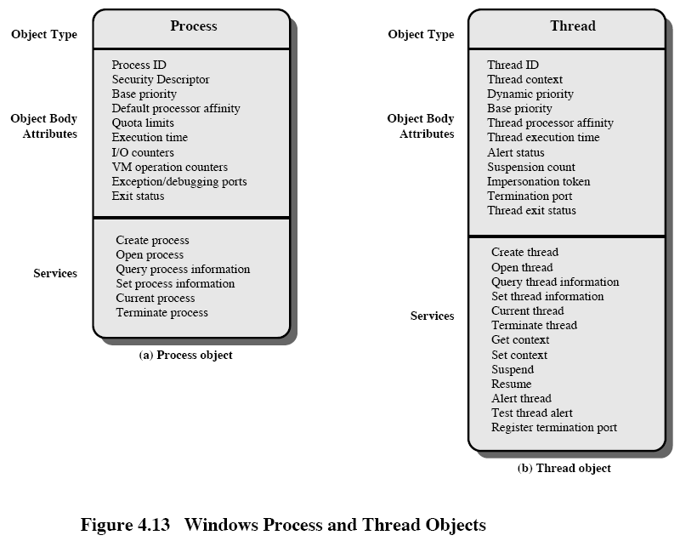

Slide 35
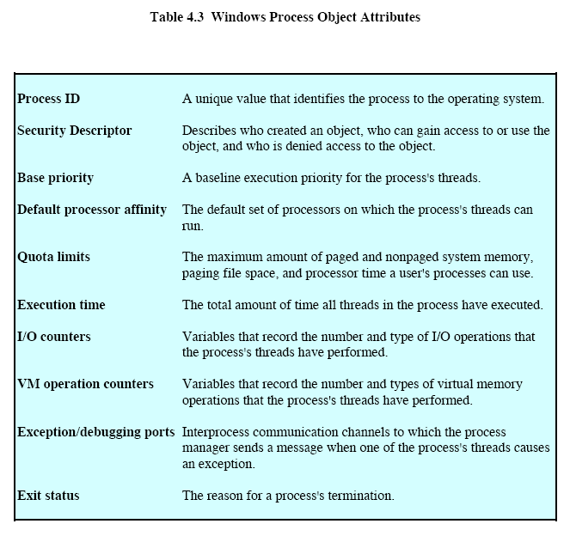

Slide 36
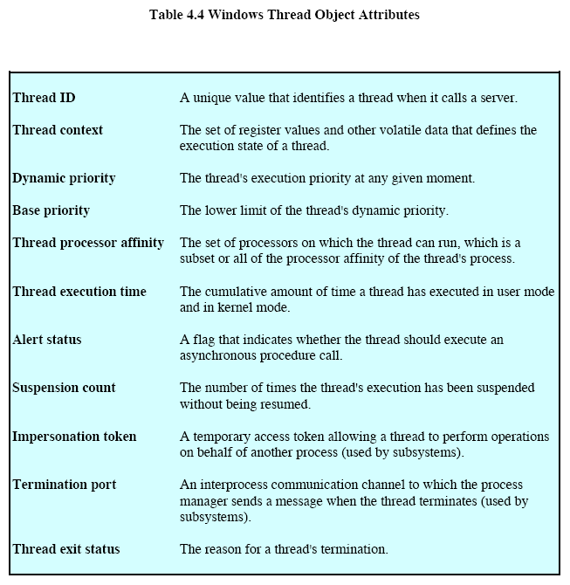

Slide 37
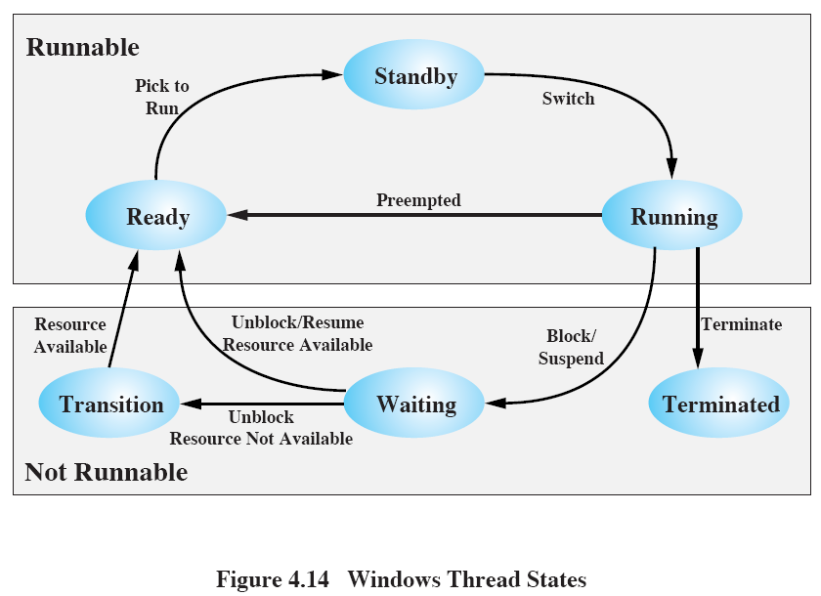

Slide 38
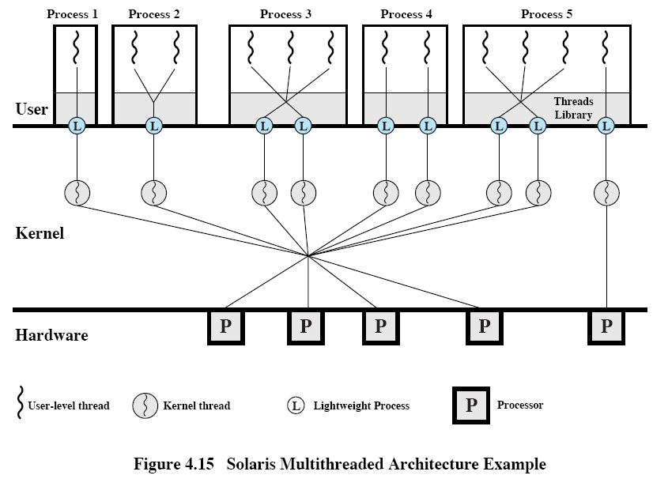

Slide 39
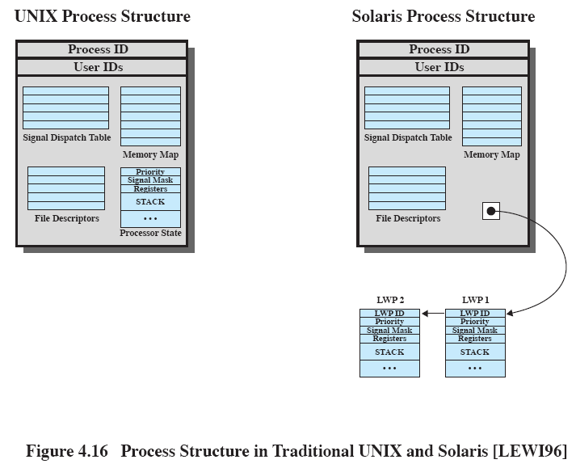

Slide 40
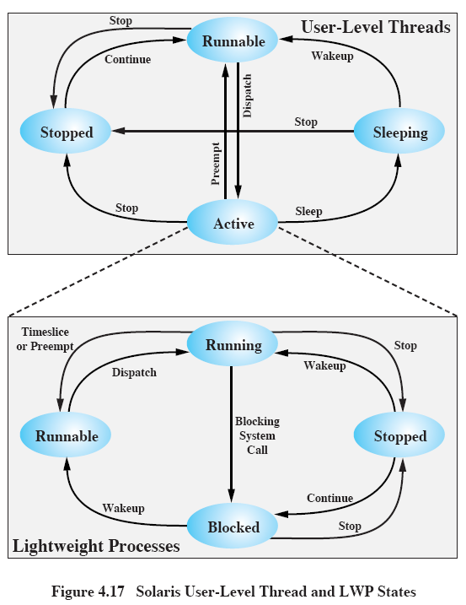

Slide 41
