Slide 1
Concurrency : Mutual Exclusion and Synchronization
Concurrent execution of processes
  Multiprogramming
    1 CPU, many processes
  Multiprocessing
    1 computer with more than 1 CPU, many processes
  Distributed processing
    more than 1 computer
      each may or may not have more than 1 processor
    many processes
Principles of concurrency
  Uniprocessor : interleaving
  Multiprocessor : interlreaving and overlapping
  Difficulties (applies to both uniprocessor and multiprocessor cases)
    relative speed of execution of processes unpredictable
    programming errors typically not reproducible

Slide 2
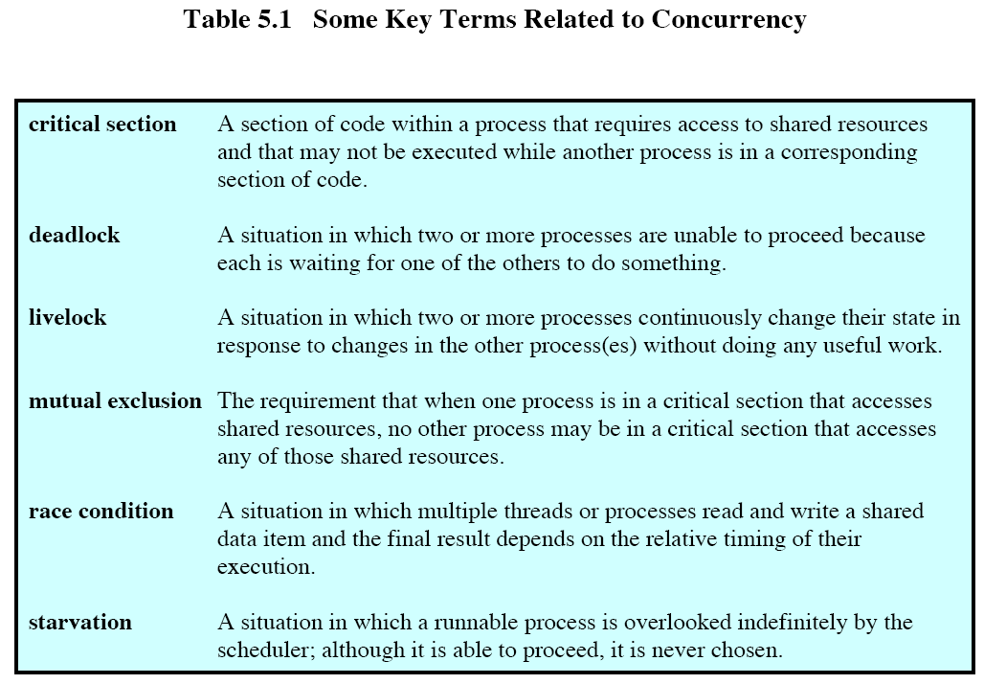

Slide 3
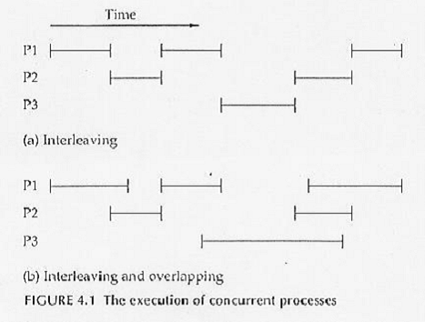
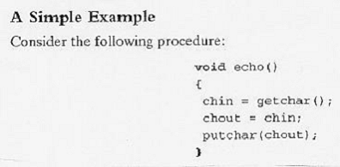
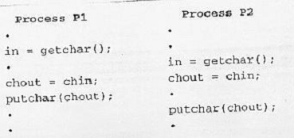

Slide 4
Principles of concurrency
  Difficulties (cont.)
    shared variables
      The order in which the various reads and writes are executed is critical.
      multiprocessor systems
        The order can be at random.
      uniprocessor systems
        The order depends on the timing of the interrupt, which is unpredictable.
      Example : procedure echo
        Uniprocessor case : an interrupt stops instruction execution and the value in a critical shared variable is overwritten.
        Multiprocessor case : Both processes may be executing simultaneously and both are trying to access the same global variable. The value to this variable written by one process is overwritten by the other process.

Slide 5
Principles of concurrency (cont.)
  Difficulties (cont.)
    Race condition
      Multiple processes/threads read and write data items so that the final result depends on the order of execution of instructions.
      Example : initially b = 1, c = 2.
      P3 : b := b + c;
      P4 : c := b + c;
      If P3 executes first, the final values are b = 3 and c = 5.
      If P4 executes first, the final values are b = 4 and c = 3.
  Design and management issues
    It is difficult for the OS to manage the allocation of resources optimally.
      Processor time, memory, files, I/O devices
      If a process is allocated a resource and subsequently suspended before releasing that resource, inefficiency results.
    The OS must keep track of all active processes via PCB.
    The OS must protect the data and physical resources of each process against unintended interference by other processes.
    The relative execution speeds of different processes do not affect the results.

Slide 6
Process interaction
Processes unaware of each other (competition)
  independent processes not working together
  The OS must resolve the competition for resources.
    I/O, memory, printer, tape drive, etc.
  Each process should leave the state of any resource that it uses unaffected.
  issues involved
    Mutual exclusion
      The resource being competed for is called a critical resource.
      The portion of program in each process that uses the critical resource is called the critical section or critical region.
      At any time, only one program is allowed to be in its critical section.
    Deadlock
    Starvation

Slide 7
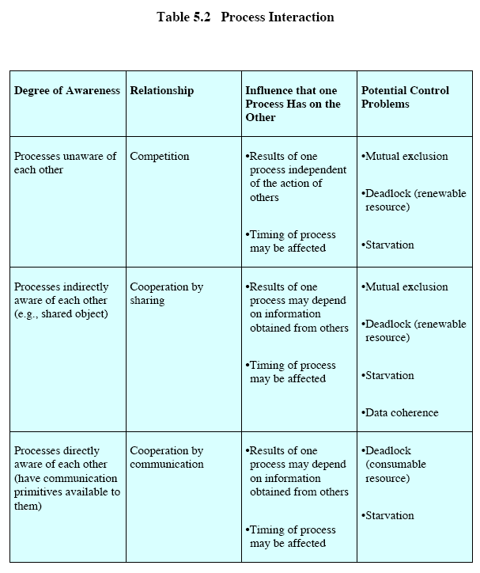

Slide 8
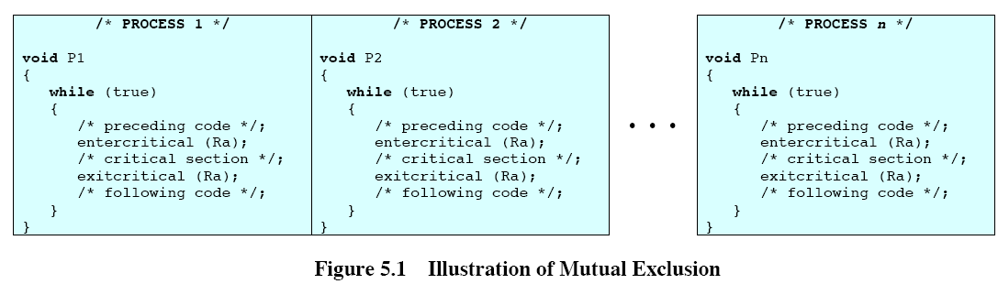

Slide 9
Process interaction (cont.)
Processes indirectly aware of each other (cooperation by sharing)
  shared access to some object
    shared variables, files, or databases
    Processes may use and update the shared data without reference to other process, but know that other processes may have access to the same data.
  Issues involved
    maintenance of data integrity
    Since data are stored in resources (devices, memory), the control problems of mutual exclusion, deadlock, and starvation are still present.
      Mutual exclusion applies only to writing, not reading of data.
    Data coherence
      Example : a = b must be enforced in the following two processes:
      P1 : a := a + 1;
      b := b + 1;
      P2 : b := 2 * b;
      a := 2 * a;

Slide 10
Process interaction (cont.)
Processes indirectly aware of each other (cont.)
    Data coherence
      If the traces of P1 and P2 are as below, a = b is not enforced.
      a := a + 1;
      b := 2 * b;
      b := b + 1;
      a := 2 * a;
      The solution is to put the instructions of each process in a critical section.

Slide 11
Process interaction (cont.)
Processes directly aware of each other (cooperation by communication)
  Interprocess communication exists.
  Sending and receiving of messages are involved.
  Issues involved
    no shared object, hence no mutual exclusion
    The problems of deadlock and starvation are still present.
      Two processes may each be blocked, waiting for a message from the other.
      Three processes are involved in communication, but two of them exchange information repeatedly that the third one waits indefinitely for its turn.

Slide 12
Requirements for mutual exclusion
Only one process at a time is allowed into its critical section among all processes that have critical sections for the same resource.
A process that halts in its noncritical section must do so without interfering with other processes.
No deadlock or starvation can be allowed.
When no process is in a critical section, any process requesting entry to its critical section must be allowed without delay.
No assumptions are made about relative speeds or number of processes.
A process remains inside its critical section for a finite time only.

Slide 13
Software approaches for mutual exclusion
No hardware, OS, or programming language level supported is assumed.
Simultaneous accesses to the same memory location are serialized by some memory arbiter.
  The OS may impose priorities, or the decision is arbitrary.
  Only one access is allowed at a time.
Dekker’s algorithm (1965)
  weakness of version 1
    Processone always enters first.
    The execution of critical sections must alternate between the 2 processes.
      There is no provision for one process to enter its critical section more frequent than the other.
      If one process terminates or goes into an infinite loop, eventually the other one is unable to enter the critical section.
      The lockstep synchronization is enforced by using a single global variable.

Slide 14
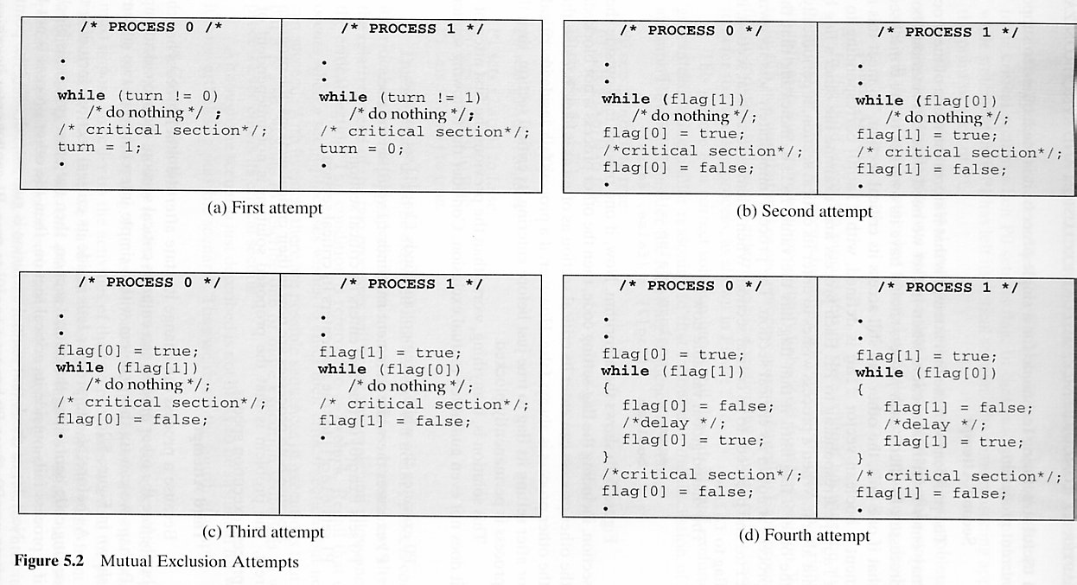

Slide 15
Dekker’s algorithm (cont.)
version 2
  2 global variables
  If any process fails outside the critical section, the other process can enter its critical section as often as it likes.
  If one process fails inside the critical section, the other process is still blocked -- any mutual exclusion algorithm cannot avoid the permanent blocking of other processes if a process fails in its critical section.
weakness of version 2
  no mutual exclusion is guaranteed.
  Scenario:
    Initially both p1inside and p2inside are false.
    Both processone and processtwo attempt to access the critical section simultaneously.
    Processone finds p2inside false before processtwo sets p2inside true.

Slide 16
Dekker’s algorithm (cont.)
weakness of version 2 (cont.)
    Processtwo finds p1inside false before processone sets p1inside true.
    Both processes get in their critical sections simultaneously, i.e., mutual exclusion is not guaranteed.
    Dilemma: p1inside and p2inside are shared variables readable and writable by either process, the 2 variables should themselves be specially handled or put in critical sections.
    Between the time a process determines in the while test that it can go ahead and the time the process sets a flag to say that it is in its critical section, there is enough time for the other process to test its flag and slip into its critical section.
    In other words, the solution is not independent of relative speeds of process execution.

Slide 17
Dekker’s algorithm (cont.)
version 3
  Once a process attempts the while test, it must be assured that the other process cannot proceed past its own while test.
  Each process sets its own flag prior to performing the while test.
  Mutual exclusion is guaranteed.
  If one process fails outside its critical section, the other process is not blocked.
weakness of version 3
  If each process sets its flag before proceeding to the while test, then each process will find the other’s flag set and will loop forever in the while do.
  A process sets its state without knowing the state of the other process.
  two-process deadlock

Slide 18
Dekker’s algorithm (cont.)
version 4
  forces each looping process to set its flag false repeatedly for brief periods.
  allows the other process to proceed past its while loop with its own flag still on.
  guarantees mutual exclusion and deadlock free.
weakness of version 4
  indefinite (not infinite) postponement
  The processes could proceed in tandem.
  Scenario 1:
    Each process sets its flag to true, then makes the while test, then enters the body of the while loop, then sets its flag to false, then sets its flag to true, and then repeats the sequence.
    This version fails due to mutual courtesy.

Slide 19
Dekker’s algorithm (cont.)
weakness of version 4 (cont.)
  Scenario 2:
    Process 1 is so slow compared to process 2 that within the delay period of process 1, process 2 exits its critical section and immediately reenters its critical section again before process 1 sets p1wantstoenter back to true.
    This scenario may cause starvation to the slow process.
  The scenarios have a low probability of occurring, but they are possible.

Slide 20
Dekker’s algorithm (cont.)
version 5 (Dekker’s algorithm)
  Version 4 has too much courtesy built into the algorithm.
  3 shared variables
    Two to indicate the states of the two processes.
    One to indicate the turn of each process.
  If both processes want to enter the critical section at the same time, there is an arbitration flag such that one process sets its wanttoenter flag to false.

Slide 21
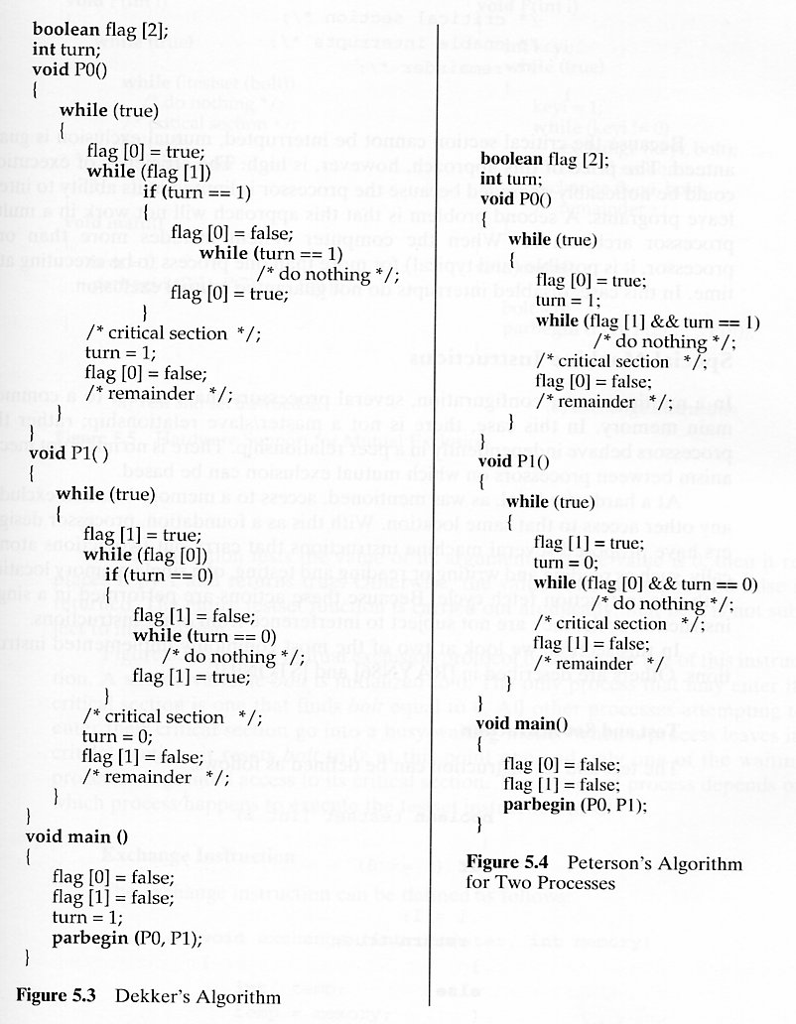

Slide 22
Peterson’s algorithm (1981)
simpler than Dekker’s algorithm
If process 1 has set p1wantstoenter to true, process 2 cannot enter its critical section.
  If process 2 is already in its critical section, then p2wantstoenter is true and process 1 is blocked from entering its critical section.
Mutual blocking is prevented -- if process 1 is blocked in its while loop, then p2wantstoenter is true and favoredprocess = second.
  Now process 2 must be in its critical section because p2wantstoenter is true and the condition for the while loop of process 2 is false.
Process 2 cannot monopolize access to the critical section because it has to set favoredprocess to first before each attempt to enter its critical section.
This algorithm can be generalized to the case of n processes.

Slide 23
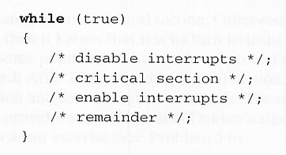
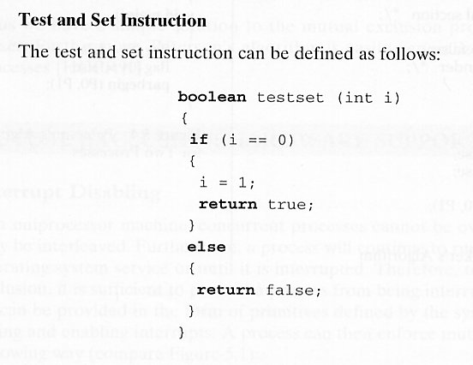
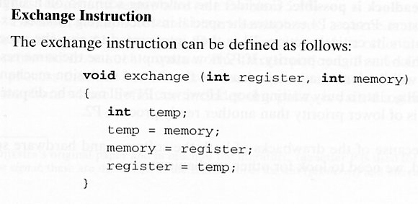
Software Solution
  Dekker’s Algorithm
  Peterson’s Algorithm
Hardware Solution
  Disable Interrupt
  Test & Set
  Exchange Instruction
Disable Interrupt

Slide 24
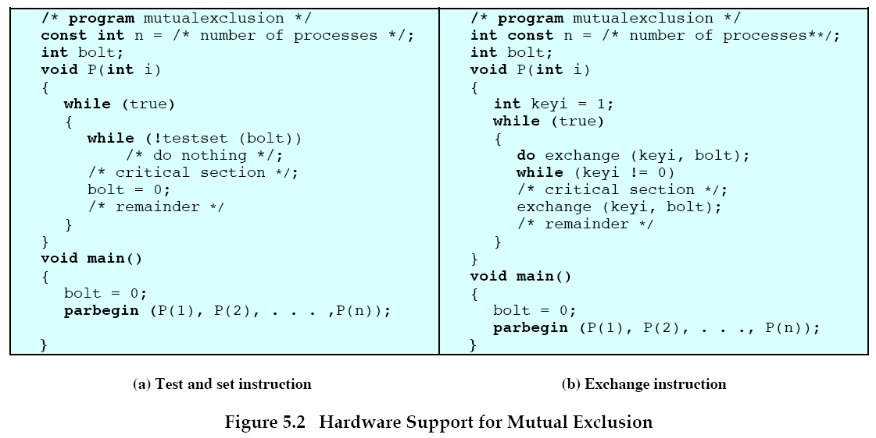

Slide 25
Hardware support for mutual exclusion
Purely software approaches are complicated.
Interrupt disabling
  uniprocessor case only
  Disadvantages
    limits the ability of the processor to interleave programs.
    does not work in a multiprocessor environment.
Machine instructions that carry out two actions atomically
  In all main memory hardware, the access to a memory location excludes any other access to the same location.
  If the read/write and test operations are performed in a single (uninterruptable) instruction cycle, instructions from another process cannot interfere.

Slide 26
Hardware support for mutual exclusion (cont.)
The test and set instruction
  testset( i )
    If i is 0, the function replace i by 1 and returns true.
    If i is 1, do nothing and returns false.
The exchange instruction
  This instruction exchanges the contents of a register with that of a memory location in one instruction cycle.
  In the attached example, only one instance of procedure P() is able to obtain a value of 0 for the local variable key_{i} .
Advantages of machine-instruction approach
  It is applicable to any number of processes and processors, as long as the memory is shared.
  programming simplicity compared to software-only approach
  It supports multiple critical sections, as long as each section is defined by its own variable.

Slide 27
Hardware support for mutual exclusion (cont.)
Disadvantages of machine-instruction approach
  The busy-waiting consumes processor time.
  The selection of a waiting process is arbitrary. Thus starvation is possible.
  Deadlock is possible.
    If a lower priority process enters a critical section and the processor switches to a higher priority process waiting to enter the same critical section, deadlock results.
  still too primitive

Slide 28
Semaphores (Dijkstra 1965)
OS and programming language support for mutual exclusion and synchronization
Basic principle:
  A process can be forced to stop at a specific place until it has received a specific signal.
  Special variables called semaphores are used for awaiting and sending the signals.
Usage of a semaphore s:
  semWait(s) : to wait for the signal related to the semaphore s.
  semSignal(s) : to send a signal related to s.
  Usage : a process executes semWait(s). If the corresponding signal has not yet been transmitted, the process is suspended until the transmission takes place.
  semWait(s) and semSignal(s) are widely used as P(s) and V(s), respectively, for the Dutch names proberen(test) and verhogen(increment).

Slide 29
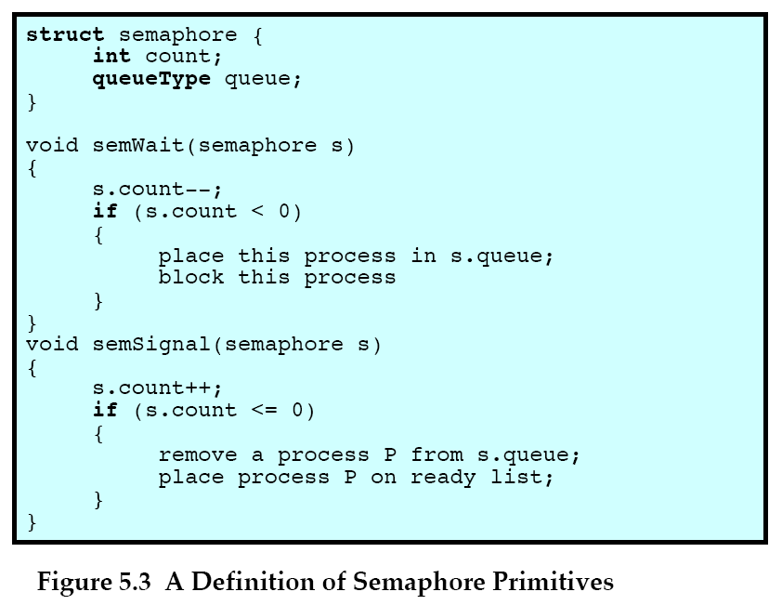

Slide 30
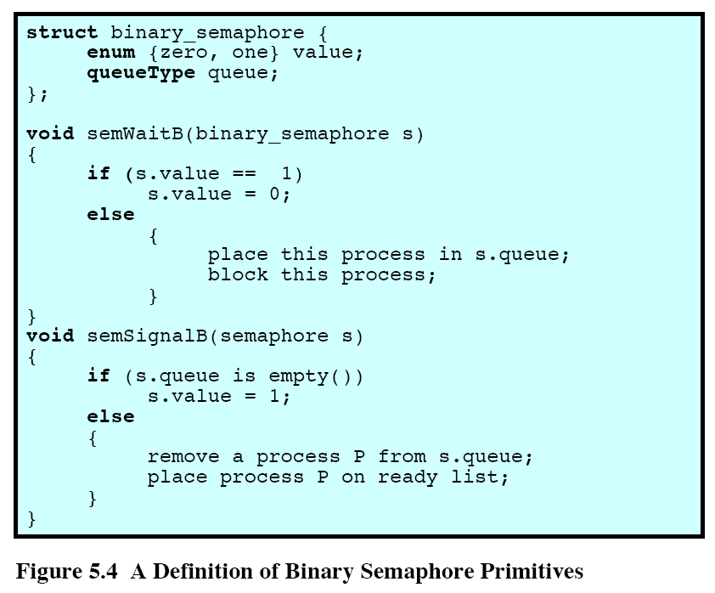

Slide 31
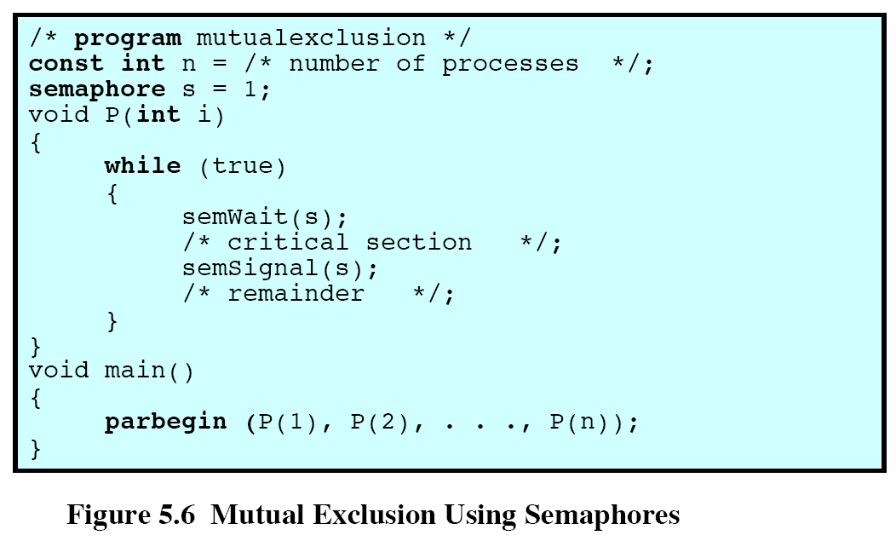

Slide 32
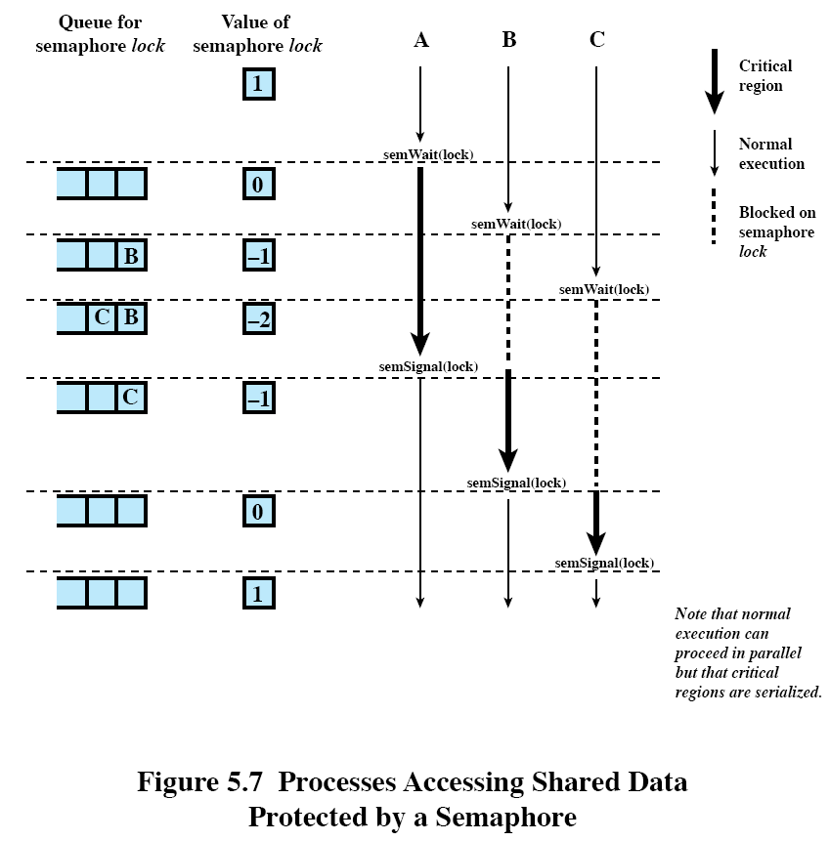

Slide 33
Semaphores (cont.)
Formal definition for operations on a semaphore s:
  A semaphore may be initialized to a nonnegative value.
  The semWait(s) operation decrements the semaphore value. If the value becomes negative, then the process executing the wait is blocked.
  The semSignal(s) operation increments the semaphore value. If the value is not positive, then a process blocked by a wait operation is unblocked.
The semWait(s) and semSignal(s) operations are assumed to be atomic.
Binary semaphores
  assume only values 0 and 1.
  It is possible to implement general semaphores by binary semaphores.
For both general and binary semaphores, a queue is used to hold processes waiting on the semaphore.
  Strong semaphore: FIFO policy in queue
  Weak semaphore: no policy specified in which processes are removed from the queue.
General semaphores are also called counting semaphores.

Slide 34
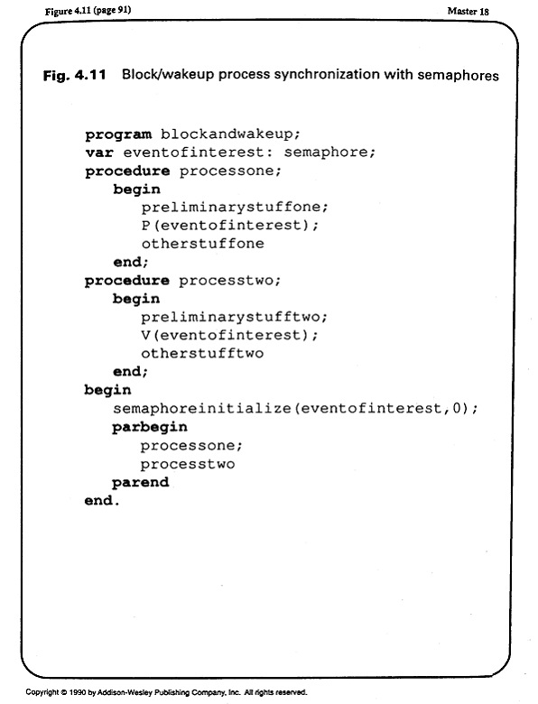

Slide 35
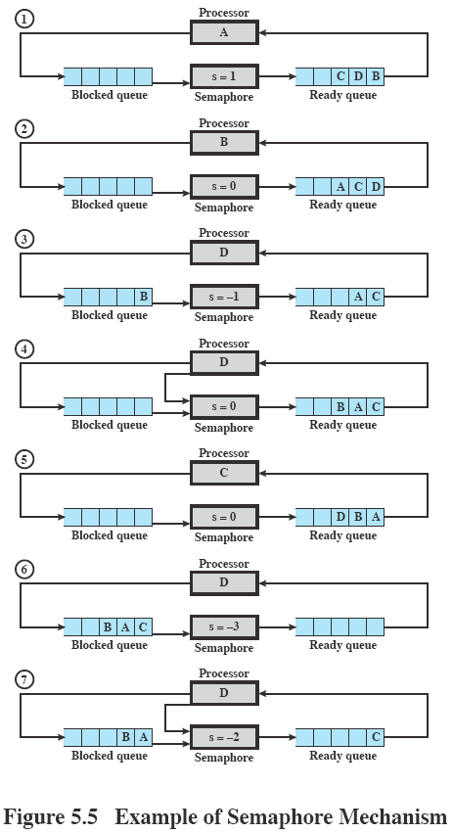
Processes A, B, and C depend on data generated by process D; semaphore s counts the number of data available; initially 1 datum is available (s=1).
A, B, C execute:
semWait(s);
//consumes data
D executes:
//produces data
semSignal(s);

Slide 36
Example applications of semaphores
Block/wakeup protocol
  for I/O blocking and completion, server blocking for client requests, etc.
  The semaphore s is initialized to 0 so that P(s) blocks.
  The execution of V(s) signals that the event has occurred.
  This approach works even if V(s) is executed before P(s).
Mutual exclusion by semaphores
  See Fig 5.6.
    Set the value of the semaphore equal to 1.
    A total of n processes can compete to enter the critical section.
    The first semWait() gets in and decrements the value of the semaphore.
    Further calls to semWait() decrements the semaphore to indicate the number of processes waiting.
    The semaphore is incremented by the departing process. Meanwhile, one of the waiting processes is allowed to enter its critical section.

Slide 37
Example applications of semaphores (cont.)
Mutual exclusion by semaphores (cont.)
  If n processes are allowed into their critical sections at a time, initialize the semaphore to n.
    Interpretation of s.count
      s.count >= 0 ; s.count is the number of processes that can execute semWait(s) without blocking (if no semSignal(s) is executed in the meantime).
      s.count < 0 ; the magnitude of s.count is the number of processes blocked in s.queue.

Slide 38
Example applications of semaphores (cont.)
The producer/consumer problem
  Scenario
    One or more producers are generating some type of data and placing these in a buffer.
    One consumer is taking items out of the buffer one at a time, but the total number of consumers may be bigger than 1.
    Only one agent (producer or consumer) may access the buffer at any one time to prevent overlap.
  One producer, one consumer case using 2 semaphores to block and wakeup
    The buffer is of size 1.
    P() and V() are used to synchronize the two processes with uneven speeds.

Slide 39
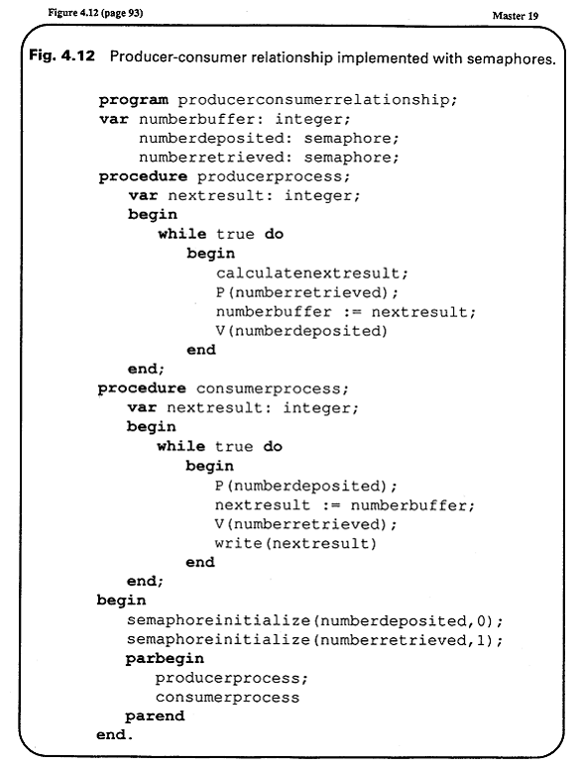
one-producer, one-consumer

Slide 40
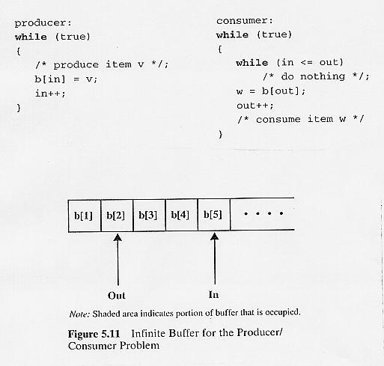

Slide 41
Example applications of semaphores (cont.)
The producer/consumer problem (cont.)
  Infinite buffer case using binary semaphores
    The statement
    if n = 0 then semWaitB( delay )
    in the consumer procedure may not call semWaitB() to match the corresponding semSignalB( delay ) in the producer procedure.
    Moving the condition statement inside the critical section of the consumer causes deadlock.
    Moving the semSignalB(s) after the condition statement makes the critical section too lengthy.
    An auxiliary variable fixes the problem.

Slide 42
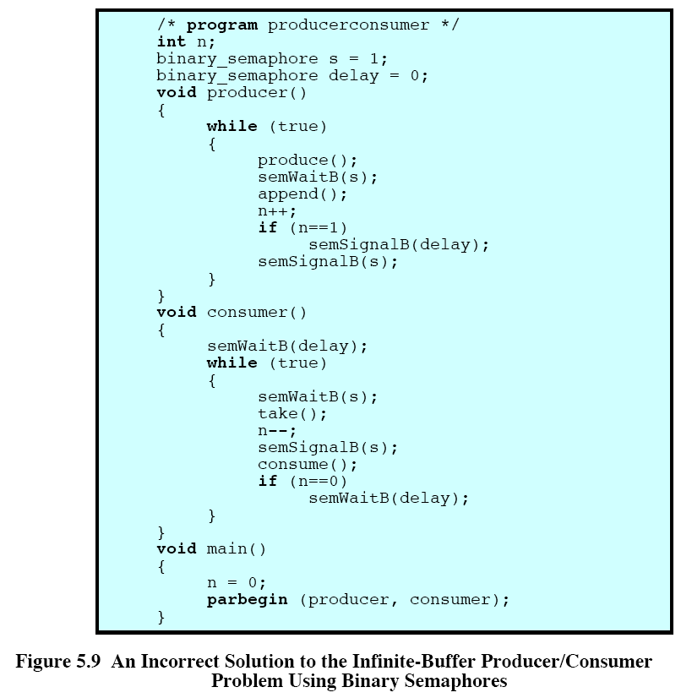

Slide 43
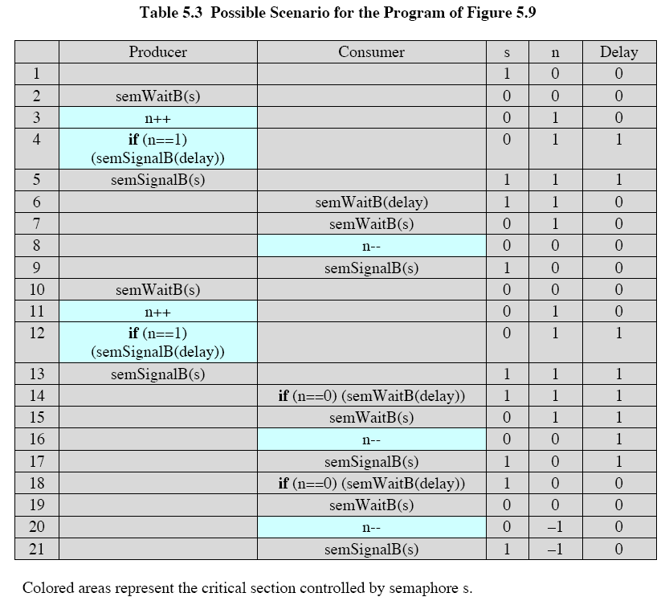

Slide 44
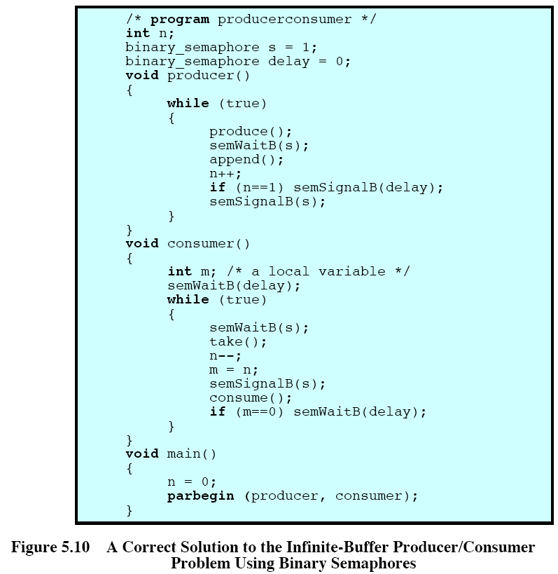

Slide 45
Example applications of semaphores (cont.)
The producer/consumer problem (cont.)
  Infinite buffer case using general semaphores
    The variable n is now a semaphore, with value still equal to the number of items in the buffer.
    Subtlety
      An accidental interchanging of semWait(n) and semWait(s) in the consumer procedure will cause a deadlock.
      This shows the difficulty of concurrent programming.
  Finite buffer case using general semaphores
    The buffer is treated as a circular storage.
    Three semaphores are involved.
      The algorithm is based on the infinite buffer case.
      The semaphore e keeps track of the number of empty slots.

Slide 46
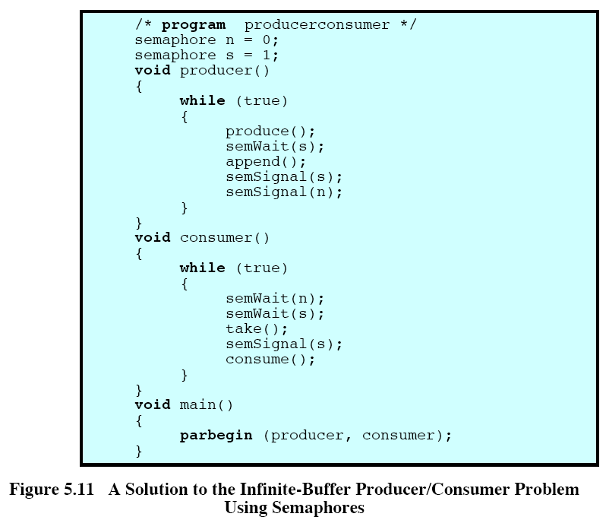

Slide 47
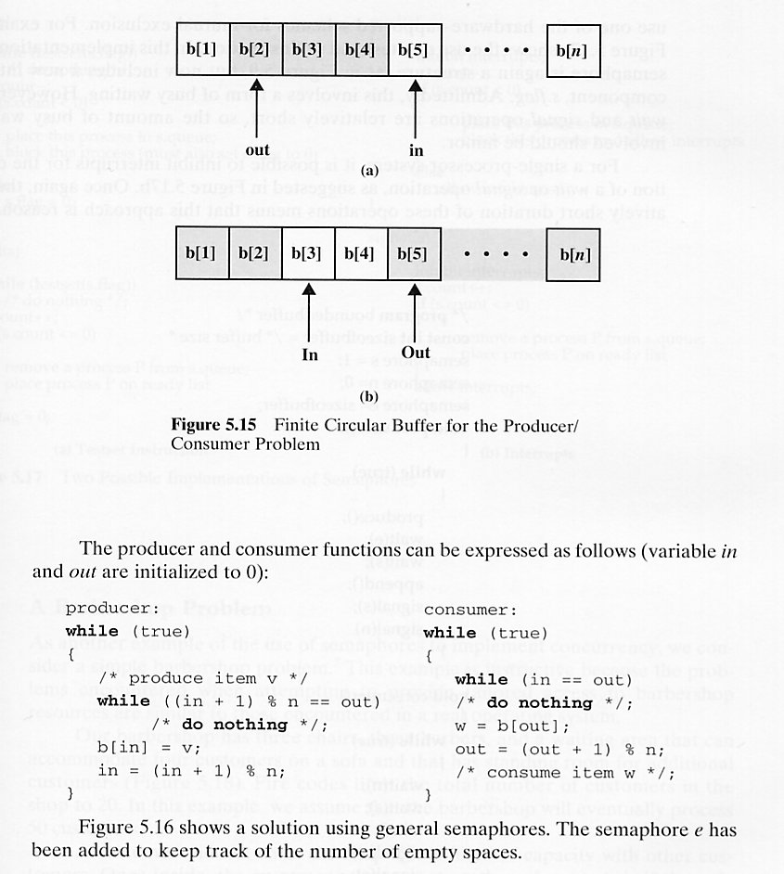

Slide 48
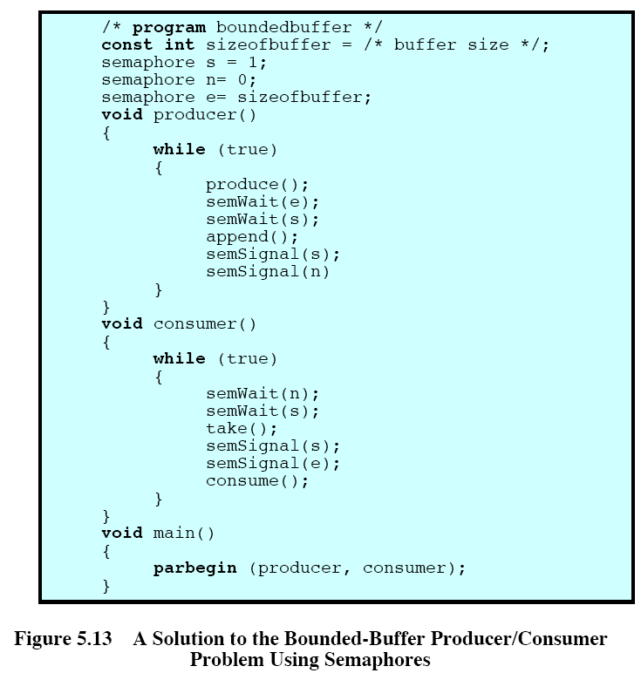

Slide 49
Implementation of semaphores
Any software schemes, such as Dekker’s or Peterson’s algorithm, can be used to implement semaphores. However, the busy-waiting in each of them imposes a large overhead.
  Recall that the Peterson’s algorithm discussed above involves only two processes. Generalizing this algorithm for n processes to implement general semaphores has a large overhead.
Hardware implementation based on
  test and set instruction
    The busy-waiting in the semWait() and semSignal() operations are relatively short.
  disabling interrupts
    There is no wait loop, but this approach works only on a single processor system (1 processor, multiple processes).

Slide 50
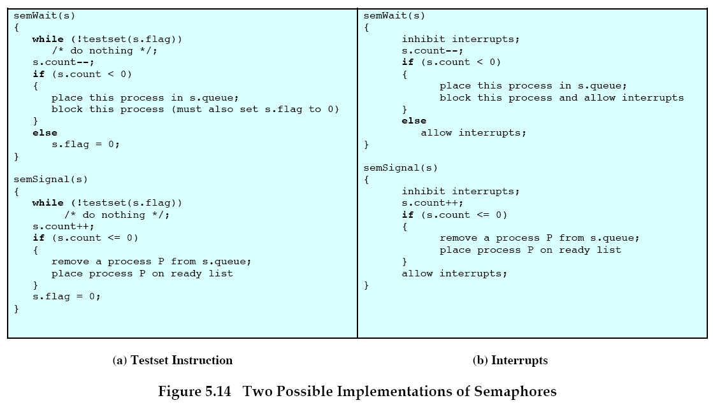

Slide 51
Disadvantages of semaphores
too primitive
difficult to verify program correctness
The semWait() and semSignal() operations may be scattered throughout a program and they destroy the layout of a structured program.
Any misuse will corrupt the operation of the concurrent system.
  For example, consider the implementation of mutual exclusion using semaphores.
    If P is omitted, mutual exclusion is not enforced.
    If V is omitted, tasks waiting for P operations will be deadlocked.
    The user cannot backout and take an alternate course once P begins.
    A task may wait on only one semaphore at a time -- deadlock may occur in resource allocation situations.

Slide 52
Monitors
A monitor is a programming-language construct that provides equivalent functionality as that of semaphores and that is easier to control.
  Java, Concurrent Pascal, Pascal-Plus, Modula-2, Modula-3, etc.
It is an abstract data type for defining shared objects or resources and for scheduling access to these objects in a multiprogramming environment.
Characteristics
  A monitor consists of procedures, the shared objects (resources), and administrative data.
  Procedures are the gateway to the shared resources and are called by the threads needing to access the resources.
  Procedures are also operations that can be performed on the resources.
  Only one thread can be active (i.e., executing a procedure) within the monitor at a time--this is enforced by an implicit thread associated with the monitor.

Slide 53
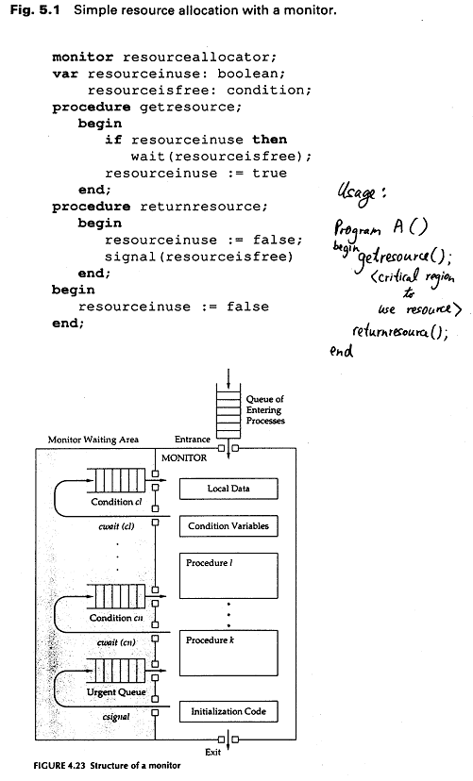

Slide 54
Monitors (cont.)
Characteristics (cont.)
  When a thread is active within the monitor, threads trying to enter the monitor are placed in the monitor’s entry queue (common to the entire monitor).
  By encapsulating the shared resources, a monitor guarantees mutual exclusion.
  Procedures of a monitor can only access data local to the monitor; they cannot access outside variables.
  Variables or data local to a monitor cannot be directly accessed from outside (information hiding).
  Monitor initialization is required.
  A monitor is able to delay and resume the execution of threads calling the monitor’s procedures.

Slide 55
Monitor synchronization
Synchronization is done via cwait() and csignal() within the monitor’s procedures.
  The functions cwait() and csignal() accept a condition variable
    The condition variable is associated with a queue of threads that are currently waiting on that condition.
  Executing a cwait() suspends the caller thread and the caller thread relinquishes the control of the monitor.
  Executing a csignal() causes exactly one thread waiting for that condition to immediately regain the control of the monitor.
    The waiting thread is suspended on a condition queue; the threads in a condition queue have a higher priority for regaining control of the monitor than the threads trying to enter the monitor (entry queue).
      The entry queue consists of threads trying to enter the monitor for the first time.
      The condition queue has higher priority so that waiting threads are not indefinitely postponed by new threads.

Slide 56
Monitor synchronization (cont.)
      When a waiting thread is signaled, it starts execution from the next statement following the cwait() statement.
      Csignal() has no effect if there is no other waiting thread.
  Urgent queue
    If csignal() does not occur at the end of a procedure, the thread issuing the signal is suspended to make the monitor available and placed in an urgent queue until the monitor is free.
    The urgent queue has higher priority than the entry queue, but less than condition queues.
    Some languages dictate that csignal() appears only at the end of procedures so that no urgent queue is necessary.

Slide 57
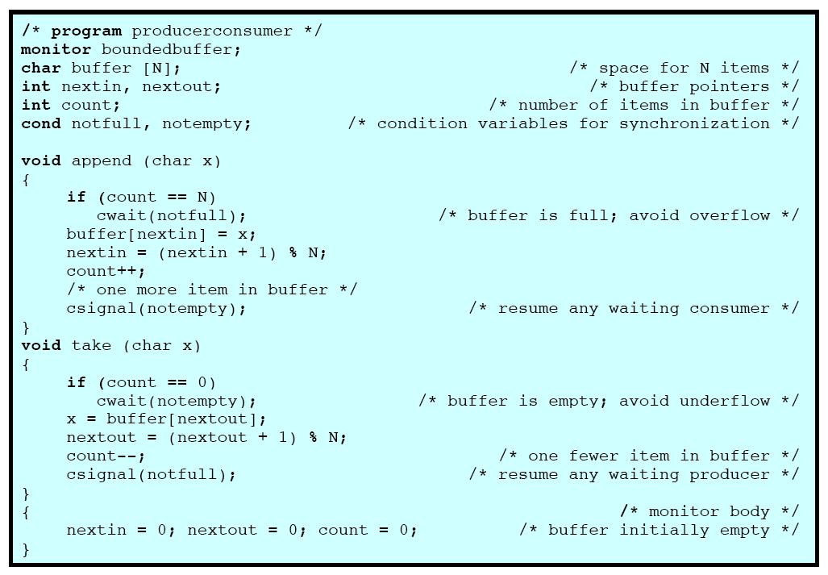

Slide 58
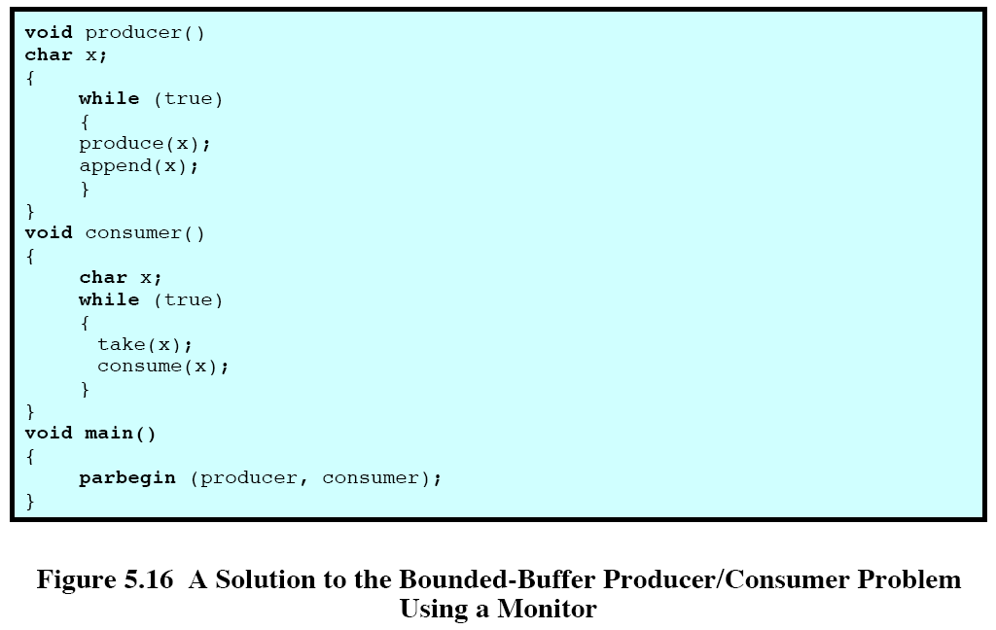

Slide 59
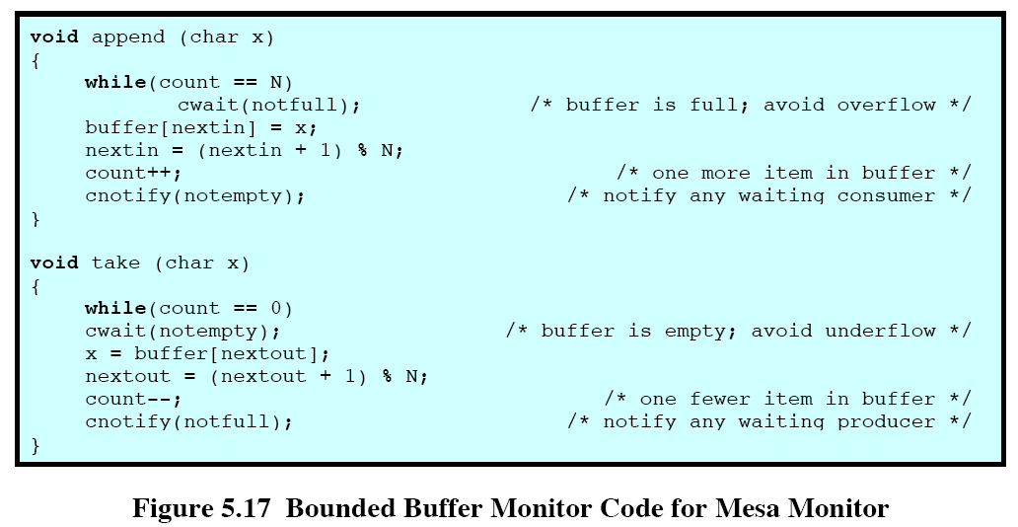

Slide 60
Comparison between semaphores and monitors
Semaphores are a much lower level means of enforcing process synchronization and mutual exclusion.
Monitors use information hiding and data abstraction techniques.
Users do not have direct access to monitor variables, nor do they see the internal monitor procedures.

Slide 61
Drawbacks of monitors
If a monitor encapsulates the resource, concurrent access to the resource is lost.
To allow concurrent access to the resource, the resource must be separated from the monitor.
For proper synchronization, procedures of the monitor must be invoked before and after accessing the shared resource.
This arrangement allows the possibility of threads improperly accessing the resources without first invoking the monitor’s procedures.
Nested monitor calls may cause deadlocks.
  Suppose a thread calls a monitor procedure that in turn calls another lower level monitor procedure.
  If a wait is executed in the lower level monitor, the control of the lower level monitor is relinquished, but not the control of the higher level monitor.
  Since the higher level monitor is still being occupied, no other thread is allowed to enter the higher level monitor and subsequently sends a signal to the lower level monitor.

Slide 62
Message Passing
Two fundamental requirements must be satisfied when processes interact: synchronization and communication.
Message passing is a common approach for distributed systems.
It is normally provided in the form of a pair of primitives:
  send(destination, message)
  receive(source, message)
Major design characteristics of message systems for Inter-processor Communication and Synchronization:
  Synchronization
    Send : blocking vs. non-blocking
    Receive : blocking, non-blocking, test for arrival
  Addressing:
    Direct
      Send
      Receive : explicit vs. implicit
    Indirect
      Static, dynamic, ownership
  Format: message content; Length -- fixed vs. variable
  Queuing Discipline: FIFO, Priority Driven

Slide 63
Readers/writers problem
Problem definition
  There is a data area or file shared by a number of reader and writer processes.
  The processes obey the following rules:
    Any number of readers may simultaneously read the file.
    Only one writer at a time may write to the file.
    If a writer is writing to the file, no reader may read it.
  There are four cases.
    Reader’s priority
      1. After somebody has finished writing, if there are waiting readers and writers, the readers are allowed to proceed.
      2. If somebody is reading, and there is (are) writer(s) waiting, newly arrived readers are allowed to proceed.
      These requirements prevent the indefinite postponement of readers.
      However, writers may starve.

Slide 64
Readers/writers problem (cont.)
    Weak reader’s priority
      Only rule 2 in reader’s priority is enforced.
      lessens the starvation of writers.
    Writer’s priority
      1. After all current readers have finished, or a writer has just finished writing, if there are waiting readers and writers, the writers are allowed to proceed.
      2. If somebody is reading, and there is (are) writer(s) waiting, newly arrived readers must wait.
      These requirements prevent the indefinite postponement of writers.
      However, readers may starve.
    Weak writer’s priority
      Only rule 2 in writer’s priority is enforced.
      lessens the starvation of readers.

Slide 65
Readers/writers problem (cont.)
This problem is different from the producer / consumer problem.
  The producer reads the queue pointer, as well as writes to the next buffer item.
  The producer must determine if the buffer is full.
  The consumer not only reads data, but also adjusts the queue pointer.
A solution to the writer’s priority case using monitors
  See attached figure.
A solution to weak reader’s priority using semaphores.
  See attached figure.
  Two semaphores are used.

Slide 66
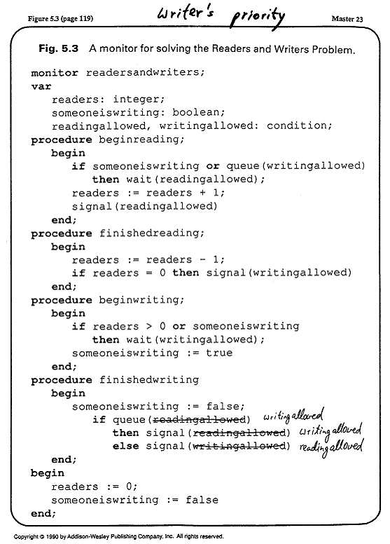

Slide 67
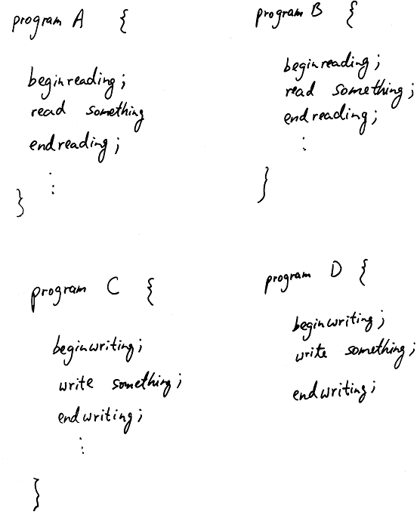

Slide 68
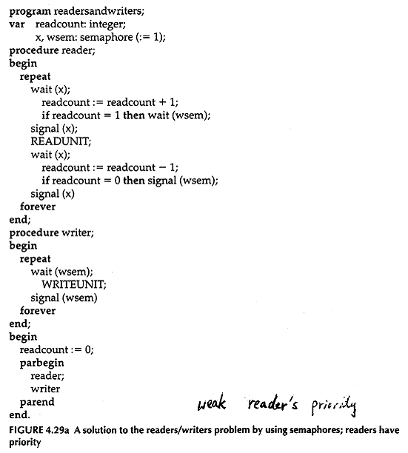

Slide 69
Readers/writers problem (cont.)
A solution to reader’s priority using semaphores.
  See attached figure.
  Three semaphores are needed.
    The semaphore srmutex ensures that there is only 1 writer at a time.
    The semaphore wmutex ensures that either reading or writing can occur at a given time, but not both.
    The semaphore mutex ensures mutual exclusion for the variable nreaders
    If some readers are active, newly arrived reader processes are also allowed to proceed to read, even though some writers are waiting -- weak reader’s priority.
    When a writer has just finished, if there are writers and readers waiting, the readers are allowed to proceed -- implemented by the order of srmutex and wmutex.
      When a writer is writing, srmutex blocks all other writers.
      If the writer finishes, it releases wmutex, which then allows other readers to proceed, before another waiting writer has a chance to check on srmutex -- reader’s priority.

Slide 70
