Slide 1
Concurrency : Deadlock and Starvation
Principles of deadlock
  Deadlock is the permanent blocking of a set of processes that either compete for system resources or communicate with each other.
  Types of resources
    Reusable
      A reusable resource is one that can be safely used by only one process at a time and is not depleted by that use.
      Examples:
        processors, I/O channels, main and secondary memory, devices, files, data bases, semaphores
    Consumable
      A consumable resource is one that can be created and destroyed.
      The number of consumable resources is usually unlimited.
      When a resource is acquired by a process, the resource ceases to exist.
      Examples:
        interrupts, signals, messages, information in I/O buffers

Slide 2
Examples of deadlock
traffic deadlock
resource deadlock (reusable resources)
  circular wait/deadly embrace
    Process A holds resource 1 and is requesting resource 2.
    Process B holds resource 2 and is requesting resource 1.
    Deadlock occurs if each process refuses to free its acquired resources until it has obtained everything it requests for.
deadlock in spooling systems
  A spooling system is used to improve system throughout by disassociating a program from the slow operating speeds of devices such as printers.
  e.g., printer operations
    Printers are slow.
    Output lines from a file are firstly routed to a faster device such as a disk drive, where they are temporarily stored until they may be printed.
  Spool means simultaneous peripheral operations on line.
  Throughput is the number of processes serviced per unit time.

Slide 3
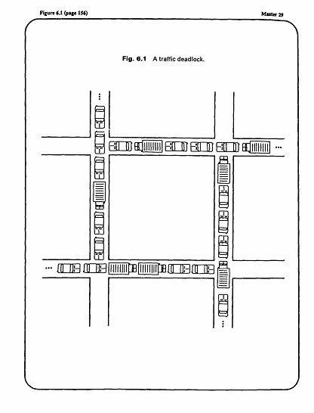
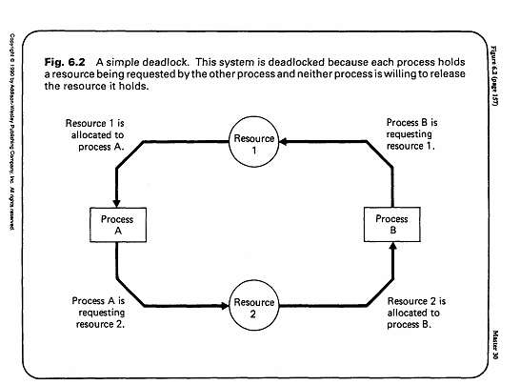

Slide 4
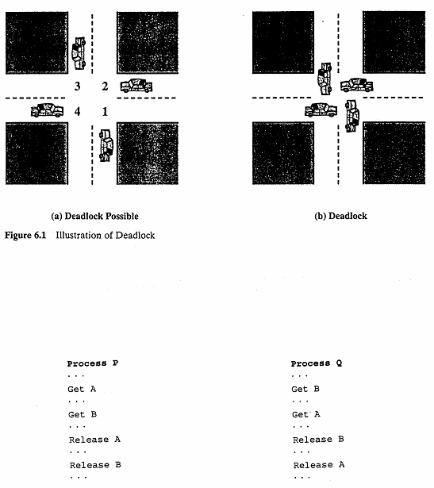

Slide 5
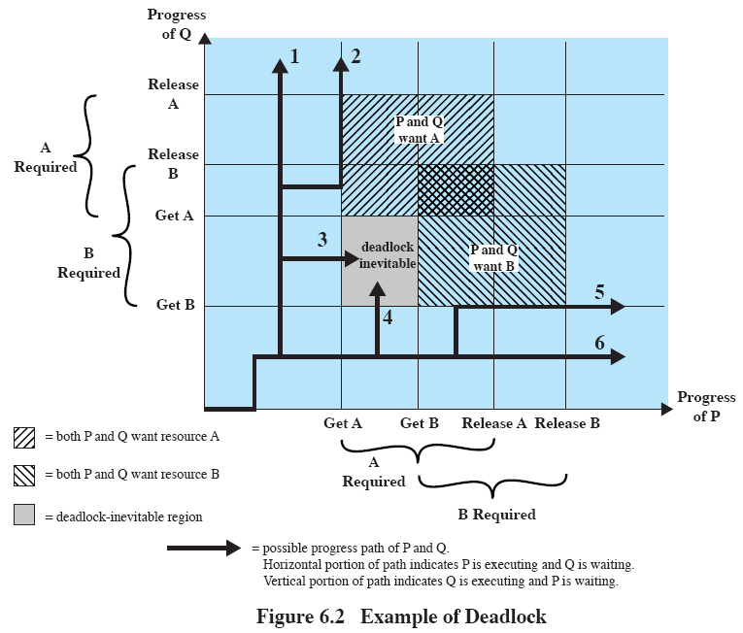

Slide 6
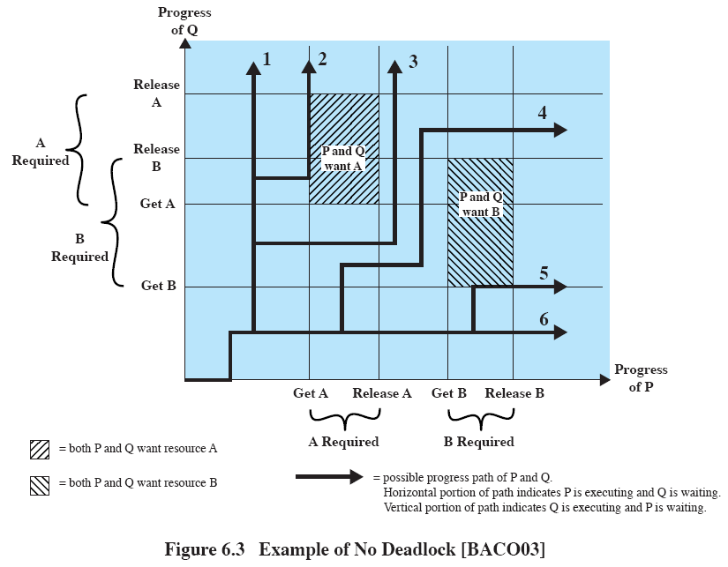

Slide 7
Examples of deadlock (cont.)
deadlock in spooling systems (cont.)
  In some spooling systems, the complete output from a program must be available before actual printing can begin.
  Deadlock occurs if several partially completed jobs generating print lines to spool files fill up the available space.
  If the OS administrator is still in control, he/she can kill some of the deadlocked processes until sufficient spooling space is available for the remaining jobs.
    Otherwise, the system must be restarted, so that all jobs are lost.
  remedy
    Specify more spooling space in the OS, if this number must be preset.
    OS stops admitting more spooling jobs when a saturation threshold of spooling space, say 75%, is reached.
    Modern OS starts printing before the spooling files are completely copied into the disks.
    dynamic allocation of spooling space

Slide 8
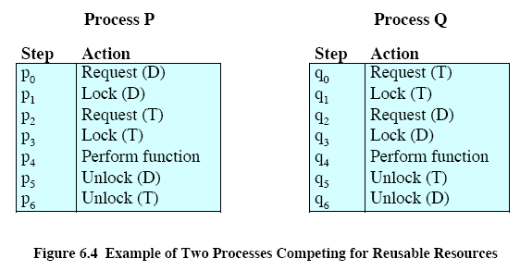
P1
…
Request 80 Kbytes
…
Request 60 Kbytes
P2
…
Request 70 Kbytes
…
Request 80 Kbytes
Another example of deadlock with main memory as reusable resource (assumption: total 200 Kbytes). Deadlock occurs if both processes progress to their second request.

Slide 9
Examples of deadlock (cont.)
message deadlock
  two processes, each waiting to receive a message from the other
    This deadlock is difficult to detect.
P1
…
Receive (P2);
…
Send (P2, M1);
P2
…
Receive (P1);
…
Send (P1, M2);

Slide 10
Examples of deadlock (cont.)
  message deadlock (cont.)
    Suppose a server process and a client process run on two different machines.
      The server first sends an initialization message to the client, and then waits for a request from the client.
      The client first waits for the initialization message, and then makes requests.
      If the two machines are of the same speed, and they are started simultaneously, then the system runs smoothly.
      If, say in a few years, the server is upgraded to a high speed one -- so fast that after the server’s initialization message arrives at the client, the client is still in its bootup stage, then the initialization message will be lost.
      Thus, the client is waiting for the initialization message, whereas the server is waiting for a request message from the client.
      A deadlock now occurs.

Slide 11
Starvation
This is the phenomenon where the scheduling of a process is delayed indefinitely while other processes receive the attention of the OS.
also called indefinite blocking or indefinite postponement
Starvation occurs because of biases in a system’s resource scheduling policies.
  When resources are scheduled on a priority basis, it is possible for a given process to wait indefinitely for a resource as processes with higher priorities continue arriving.
  remedy -- aging
    Allow a process’s priority to increase as it waits for a resource.

Slide 12
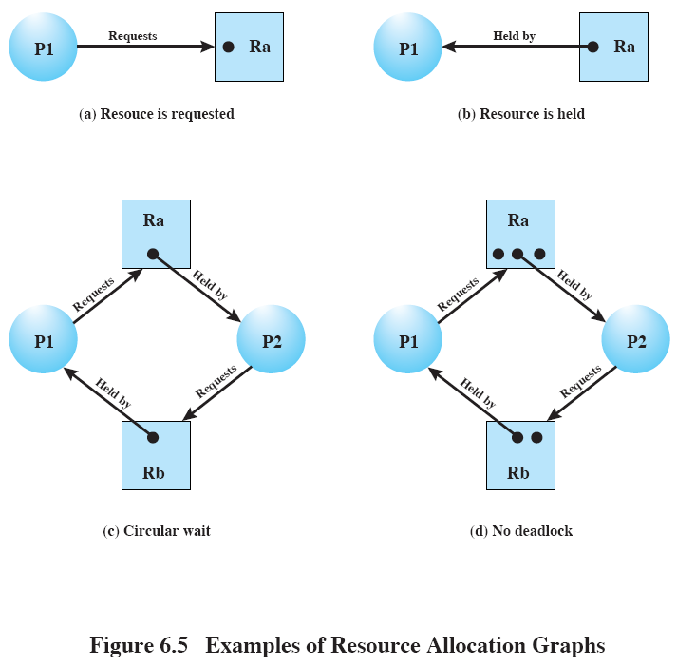

Slide 13
Four Necessary conditions for deadlocks
Mutual exclusion condition
  Processes claim exclusive control of the resources they require.
Hold-and-wait condition
  Processes hold resources already allocated to them while waiting for additional resources.
  The emphasis here is that not all resources requested are allocated at the same time.
No preemption condition
  Resources cannot be removed from the processes holding them until the resources are used to completion.
Circular wait condition
  A circular chain of processes exists in which each process holds one or more resources that are requested by the next process in the chain.

Slide 14
Four Necessary conditions for deadlocks (cont.)
The four conditions are also sufficient for a deadlock to exist.
  Given the first three conditions, a sequence of events may occur that leads to an unresolvable circular wait.
    The circular wait is unresolvable because of the first three conditions.
  The first three conditions are policies, whereas circular wait is a circumstance that might occur depending on the sequencing of requests and releases.

Slide 15
Deadlock prevention
removes any possibility of deadlocks occurring
may result in poor resource utilization
most frequently used approach
Strategies for denying necessary conditions (Havender 1968)
  denying the mutual exclusion condition
    This condition cannot be disallowed.
  denying the hold-and-wait condition
    Each process request all its required resources at once.
    Resources are granted on an all or none basis.
    If the complete set is not available, the process must wait.
    While the process waits, it cannot hold any resources.
    This strategy may cause indefinite postponement since not all the required resources may become available at once.
      The process could also have started with only some of the resources. Thus the scheme causes unnecessary delay.

Slide 16
Deadlock prevention (cont.)
  denying the hold-and-wait condition (cont.)
    It leads to waste of resources.
      The process is granted all its requested resources, but it does not need them all at the same time.
      Remedy -- divide a program into several steps that run relatively independent of one another.
      Each step controls its own resource allocation.
      The remedy gives better resource utilization, but increases design and execution overhead.
    charging problem
      Whether to charge users for allocated but unused resources?
  denying the no-preemption condition
    When a process holding resources is denied a request for additional resources, that process must release its held resources.
    The removed resources must be requested again.

Slide 17
Deadlock prevention (cont.)
  denying the no-preemption condition (cont.)
    When a process releases resources, it may lose all its work to that point.
      Thus this approach applies only to resources whose state can be easily saved and restored later.
    Indefinite postponement is possible since a process might repeatedly request and release the same resources.
      In addition, system performance is degraded in performing the request and release operations.
    Notice that denying the no-preemption condition is different from denying the hold-and-wait condition.
      In the no-preemption condition, a process requesting 10 resources may ask for them one by one; as long as each request is fulfilled, the no-preemption condition is not violated.
      In the no hold-and-wait condition, the same process must request all 10 resources at the same time.

Slide 18
Deadlock prevention (cont.)
  denying the circular wait condition
    Each resource is uniquely numbered.
    All processes must request resources in a linear ascending order.
    difficulties
      Resource numbers are preassigned during installation.
      Addition of resources may cause problems, probably the modification of OS system programs.
      Resource numbering usually reflects the normal ordering in which jobs use the resources. For jobs needing the resources in a different order than the assumed one, resources early in the line have to be requested and held idle for a long time, causing considerable waste.
      Application programs may have to be reorganized to optimize for the linear ordering; this destroys the user transparency of resource management.
  Deadlock prevention strategies are usually too conservative.

Slide 19
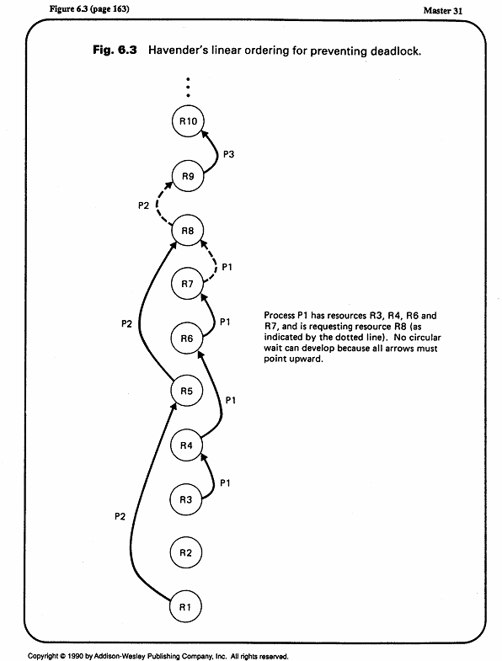

Slide 20
Deadlock detection
Resource requests are granted whenever possible.
Periodically, algorithms are run to detect the circular wait condition.
Resource allocation graph
  is a directed graph.
  Squares represent processes.
  Large circles represent classes of identical devices.
  Small circles within large circles represent the number of identical devices in each class.
  Requests and allocations are indicated by arrows.
Deadlock detection by reducing resource allocation graphs
  If a process’s requests may be granted, the resource allocation graph may be reduced by that process.
    Remove the arrows to and from that process.
  If a graph can be reduced by all its processes, there is no deadlock.

Slide 21
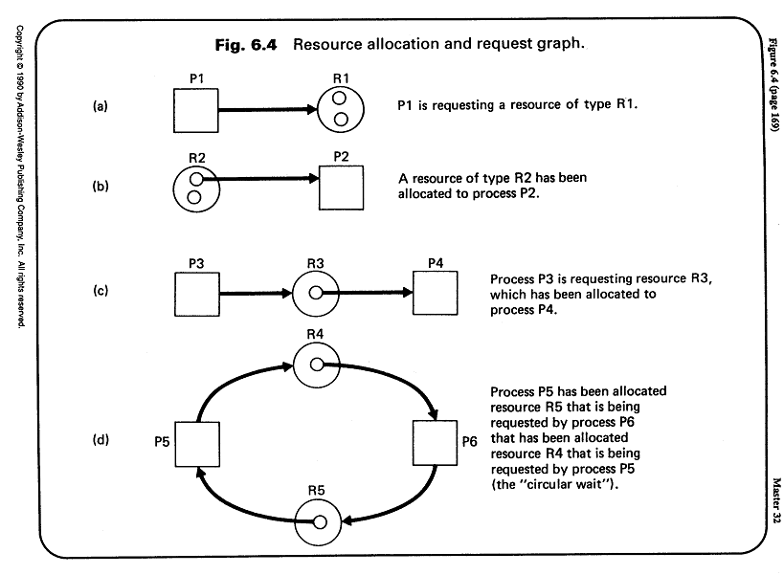

Slide 22
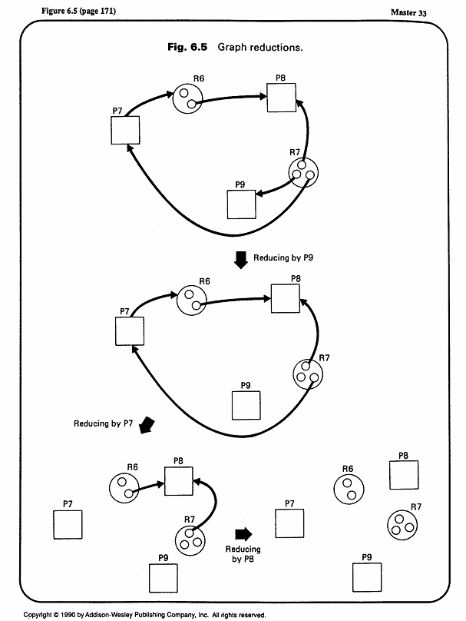

Slide 23
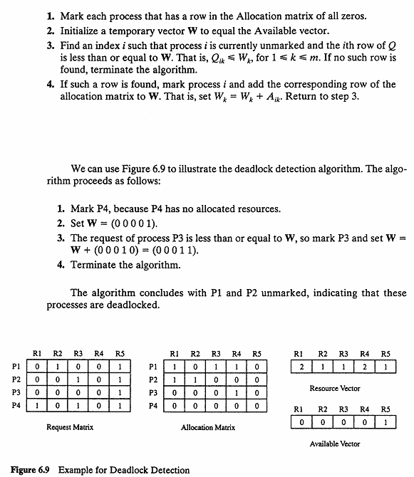

Slide 24
Deadlock detection (cont.)
Deadlock recovery
  Once deadlock has been detected, some strategy is needed for recovery.
  The following are possible approaches, in order of increasing sophistication.
    Abort all deadlocked processes.
    Back up each deadlocked process to some previously defined checkpoint, and restart all processes.
      Rollback mechanisms are needed.
      After restarting, due to the nondeterminancy of concurrent processing, the original deadlock is unlikely to reoccur.
    Successively abort deadlocked processes until deadlock no longer exists.
      The order of abortion should be based on minimum cost.
      After each abortion, reinvoke the detection algorithm again.

Slide 25
Deadlock detection (cont.)
    4. Successively preempt resources until deadlock no longer exists.
      The order of preemption is based on minimum cost.
      A process that loses a resource must be rolled back to a point before its acquisition of that resource.
  For items 3 and 4, the selection criterion could be
    least amount of processor time consumed so far,
    least number of lines of output produced so far,
    most estimated time remaining,
    least total resources allocated so far,
    lowest priority.

Slide 26
Deadlock detection (cont.)
Difficulties in deadlock recovery
  The priority order may be biased, such as the deadline of a small insignificant job.
  Many systems have poor facilities for suspending a process indefinitely, removing it from the system, and resuming it at a later time.
    not even <Ctrl-Z> in UNIX
    Most systems do not have suspension facilities, and the removed processes are ordinary lost.
    Even if suspension is possible, it involves considerable overhead and the attention of highly skilled operators.
    Sometimes there is insufficient skilled manpower -- consider a deadlock involving tens or hundreds of processes.
    Some systems have checkpoint/restart features, with a loss of the work since the last checkpoint; this still cost considerable effort on the application developers.
    Real-time processes can simply not be suspended.
By not limiting resource access, deadlock detection is too liberal in restricting process actions.

Slide 27
Deadlock avoidance
Deadlock avoidance imposes less stringent conditions than in deadlock prevention in order to get better resource utilization.
All mutual exclusion, hold-wand-wait, and no-preemption conditions are allowed.
Judicious choices of allocation are made to assure that deadlock is never reached.
A decision is made dynamically on whether the current resource request could potentially lead to a deadlock.
  Do not start a process if its demands might lead to deadlock.
    See attached equations.
  Do not grant an incremental resource request to a process if this allocation will lead to deadlock.

Slide 28
Deadlock avoidance (cont.)
Dijkstra’s banker’s algorithm (1965)
  The state of the system is the current allocation of resources to processes.
  A safe state is one in which there is at least one order in which all processes can be run to completion within a finite time without resulting in a deadlock. (It is possible to go from a safe state to an unsafe state.)
  The OS is analogous to a banker, and job requests are analogous to the clients.
  The system grants requests that result in safe states only.
  Unsafe states need not be deadlocked ; there is only a potential for deadlock. The banker’s algorithm assures that there is never such a possibility.

Slide 29
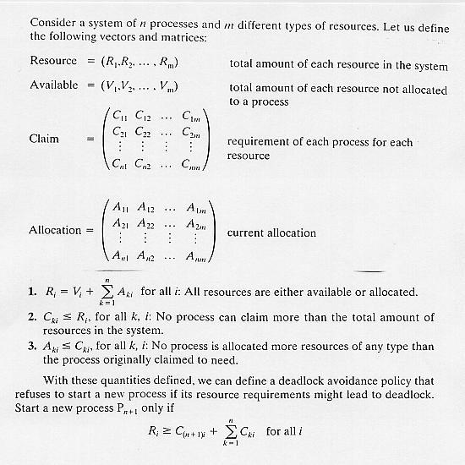

Slide 30
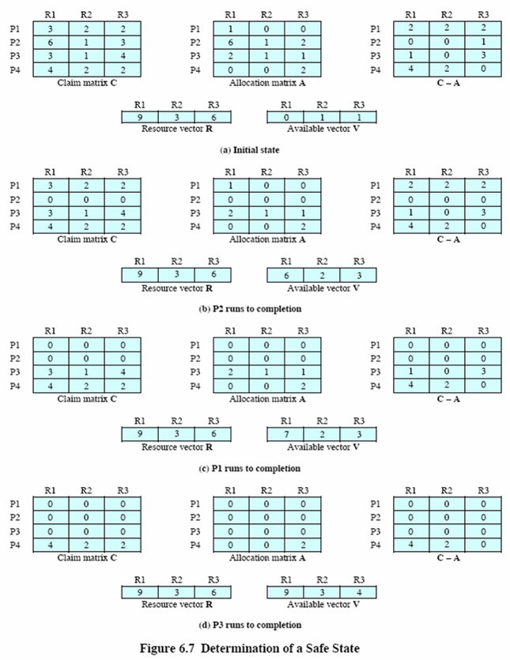

Slide 31
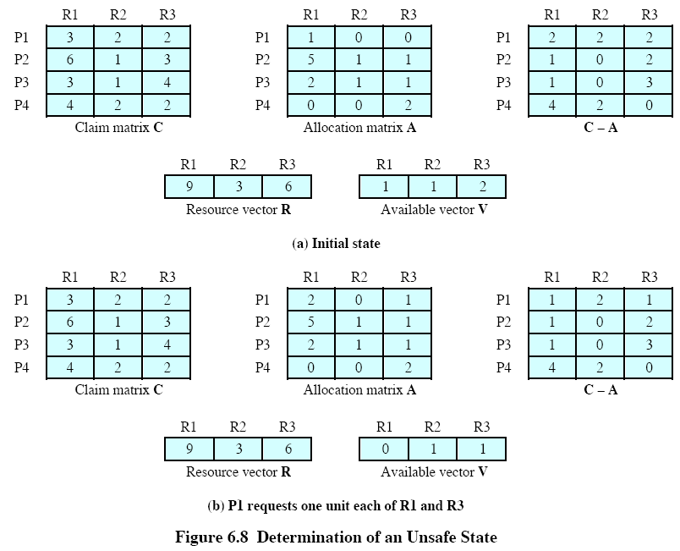

Slide 32
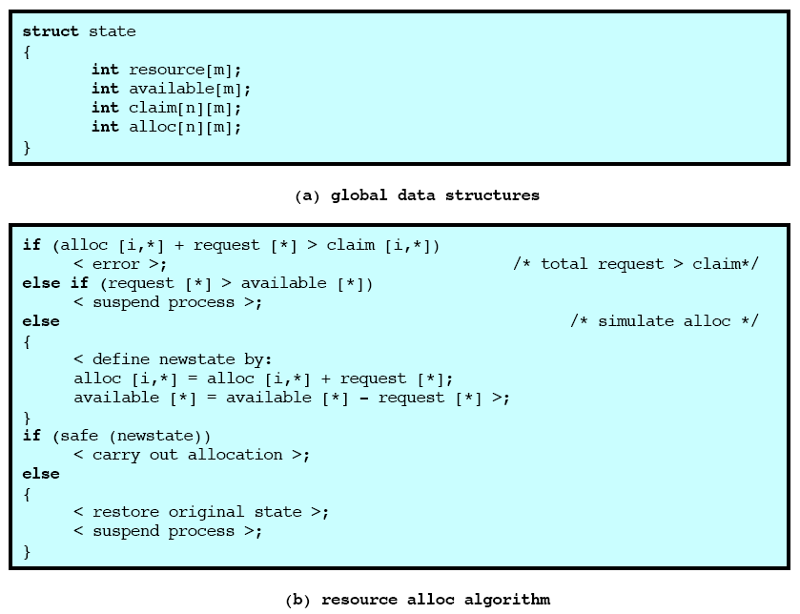

Slide 33
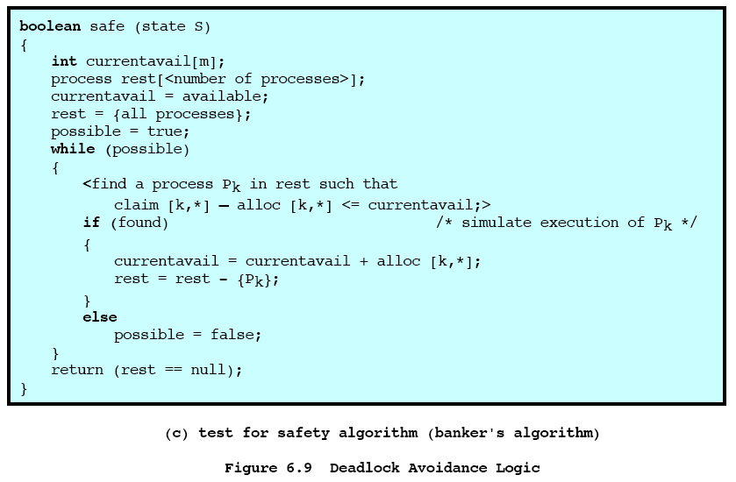

Slide 34
Deadlock avoidance (cont.)
Weakness in the banker’s algorithm
  The total number of resources available is fixed, but resources frequently breakdown or require maintenance service.
  The algorithm requires that the banker grant all requests within a finite time, but “finite time” is insufficient in real-time systems.
  The algorithm requires that satisfied clients repay all loans within a finite time, but this may cause lengthy delay to other clients waiting in line.
  Users must state their maximum resource usage in advance, but many jobs are interactive and dynamic and users cannot anticipate their eventual requirements.
  The processes under consideration must be independent -- they cannot be constrained by any synchronization requirements.

Slide 35
An integrated deadlock strategy
Group resources into a number of different resource classes.
Use the linear ordering strategy defined for the prevention of circular wait to prevent deadlocks between resource classes.
Within a resource class, use an algorithm most appropriate for that class.
Example resource classes (in their order of assignment)
  Swappable space
    memory blocks in secondary storage
    Use deadlock prevention by allocating all required space at one time, i.e., disallowing the hold-and-wait condition.
    Deadlock avoidance is also possible.
  Process resources
    assignable devices such as tape drives, files
    Use deadlock avoidance because the total required resources are often known ahead of time.
    Deadlock prevention is also possible.

Slide 36
An integrated deadlock strategy (cont.)
Example resource classes (cont.)
  Main memory
    in pages or segments
    Use deadlock prevention by preemption because this is easy to do.
  Internal resources
    I/O channels
    Prevention by means of resource ordering can be used.

Slide 37
The dining philosophers problem
Problem definition
  There are a number of philosophers, say five, who think and eat intermittently.
  There are five plates on the table, and five forks set in between the plates.
  Each philosopher is assigned his own plate.
  Each philosopher needs both forks on each side to eat.
  No two philosophers can use the same fork at the same time (mutual exclusion).
  If each philosopher picks up the fork on the left and wait for the fork on the right, deadlock occurs.
  Question: find an algorithm that allows the philosophers to eat, meanwhile avoiding deadlock and starvation.

Slide 38
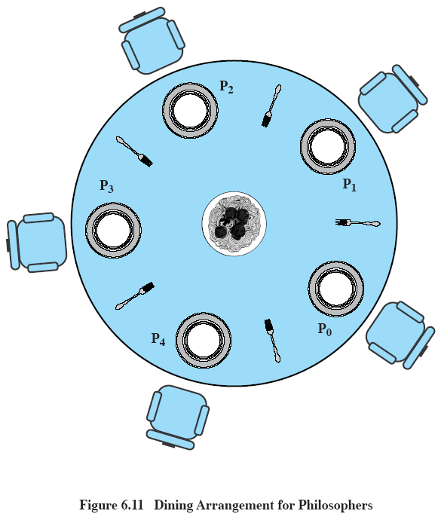

Slide 39
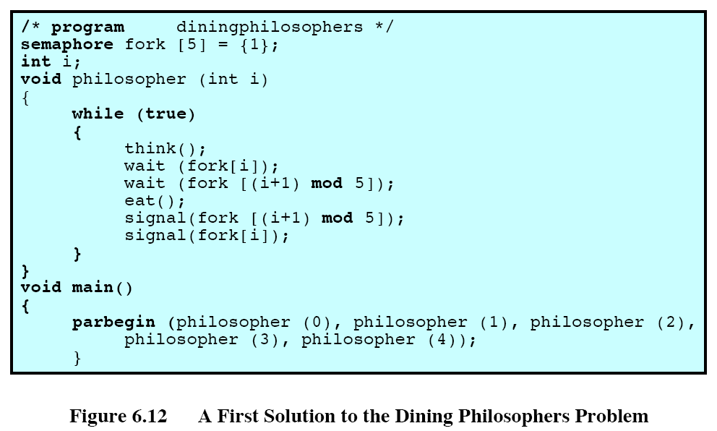

Slide 40
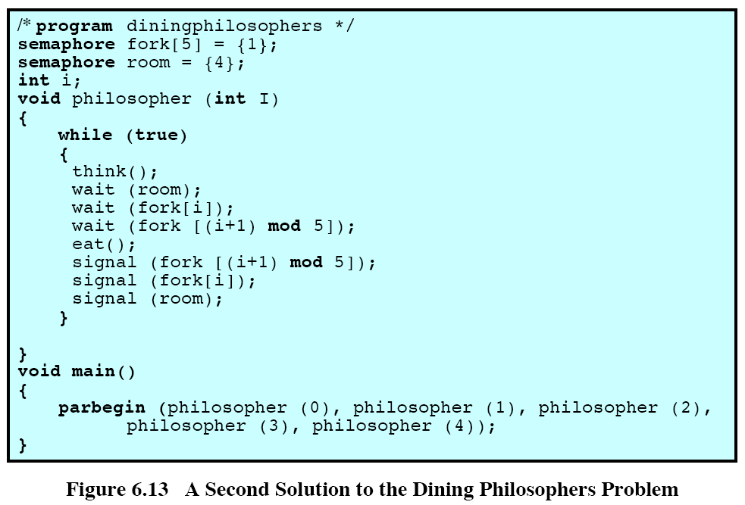

Slide 41
