Slide 1
Memory Management
Memory Management Requirements
  Relocation
    A programmer does not know in advance which other programs will be resident in main memory at the time of execution of a program.
    To maximize processor usage, processes are swapped in and out of main memory so as to provide a large pool of ready processes to execute.
    Processes are also swapped out to make room for other processes that require a large memory space or have higher priorities.
    Once a program is swapped, it needs not be swapped back into the same memory region.
    The processor and OS software must be able to translate memory references in the program code into actual physical memory addresses.
      branch instructions
      data references
      process control block (PCB)
      program entry point
      stack pointers

Slide 2
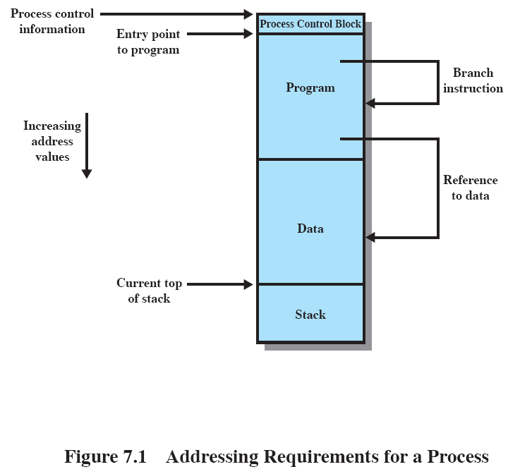

Slide 3
Memory Management (cont.)
Memory Management Requirements (cont.)
  Protection
    A process should be protected against unwanted interference by other processes.
    A user process cannot access any portion of the OS
      except through permitted system calls.
    The processor hardware must have the capability to check illegal memory access at run time.
      The OS cannot anticipate all the memory references a program will make.
      Because the location of a program in main memory is unknown, it is impossible to check absolute addresses at compile time.
      Programming languages allow the dynamic calculation of addresses at run time.
        e.g., array indexes, data structure pointers
      Hardware access check is very fast.

Slide 4
Memory Management (cont.)
Memory Management Requirements (cont.)
  Sharing
    While disallowing illegal interferences by other programs, the OS should allow the sharing of program code by several processes.
      Reentrant code
        The program must not modify itself and each user must have its own data area.
    sharing of data/files/databases by cooperating processes

Slide 5
Memory Management (cont.)
Memory Management Requirements (cont.)
  Logical Organization
    The main and secondary memory are organized linearly.
    Execution and data modules are the natural entities in modern software packages.
      Modules can be written and compiled independently, with all references from one module to another resolved by the system at run time.
      Different degrees of protection (read-only, execute-only) for different modules can be implemented.
      Modules can be shared among processes.
        This corresponds to the user’s way of viewing the problem, and hence to the user’s way of specifying the sharing that is desired.
    Tools : segmentation
  Physical organization
    A programmer should not deal with the organization of the flow of information between main and secondary memory.
    In a multiprogramming environment, the programmer does not know at the time of coding how much space will be available or where that space will be.

Slide 6
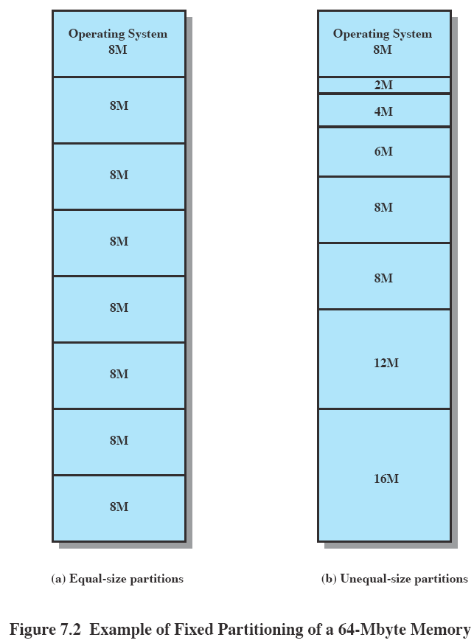

Slide 7
Loading programs into main memory
Fixed partitioning
  The OS occupies a fixed portion of main memory.
  The rest of main memory is subdivided into partitions.
  Partition sizes
    Equal-size partitions
      Any program must be loaded into a partition.
      Programs too big for a partition must use overlays.
      Overlays: When a module is needed that is not present, the user’s program must load that module into the program’s partition, overlaying whatever programs or data are there.
      Any program, no matter how small, occupies a partition. The use of main memory is extremely inefficient.
      The phenomenon of wasted space internal to a partition is called internal fragmentation.
    Unequal-size partitions
      This approach lessens the need for overlays.
      Internal fragments are smaller than those in equal-size partitions.

Slide 8
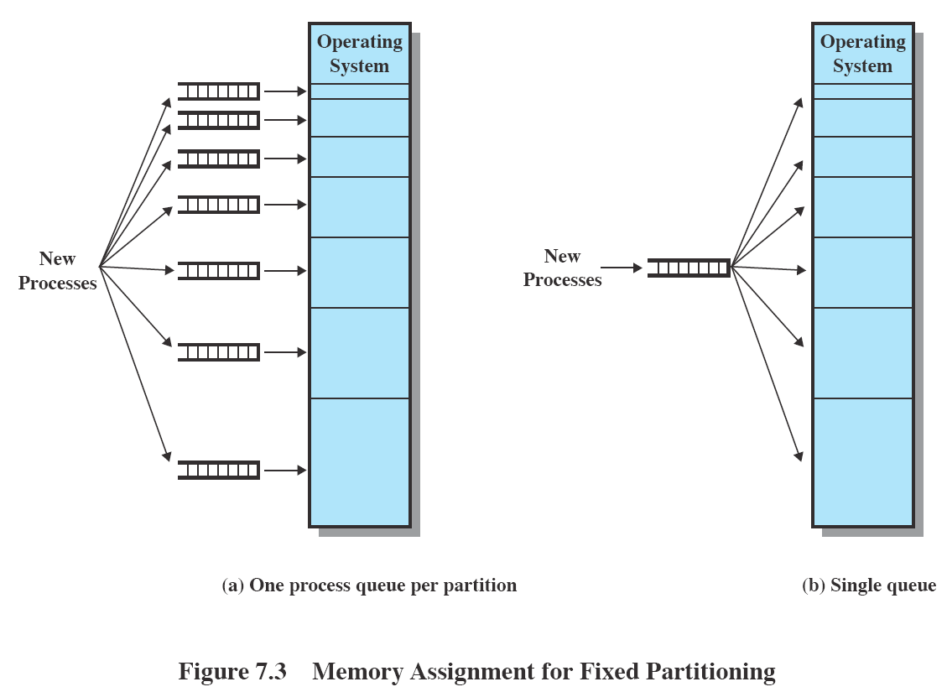

Slide 9
Loading programs into main memory (cont.)
Fixed partitioning (cont.)
  Placement algorithms
    Equal-size partitions
      trivial
      which process to be swapped out -- to be discussed in the next chapter
    Unequal-size partitions
      Best-fit -- assign each process to the smallest partition within which it will fit.
        This assumes that one knows the maximum amount of memory that a process will require.
        A scheduling queue is needed for each partition to hold swapped out and new processes that best fit that partition.
        Advantage : minimizes memory waste within a partition.
        Disadvantage : some queues may be empty, whereas other queues are long.
        A preferable approach is to employ a single queue for all processes.
  Disadvantages of fixed partitioning
    The number of partitions is predefined and limits the total number of active processes in the system.
    Partition sizes are preset and small jobs do not run efficiently.

Slide 10
Loading programs into main memory (cont.)
Dynamic partitioning
  The partitions are of variable length and number.
  When a process is loaded, it is allocated exactly as much memory as it requires.
  When processes finish and new processes are brought in, the main memory becomes more and more fragmented, and memory use declines.
    This phenomenon that the memory external to all partitions becomes increasingly fragmented is called external fragmentation.
    Remedy : compaction
      The OS shifts the processes so that the memory left is contiguous in one large block.
      Compaction requires dynamic relocation capability and is time consuming.

Slide 11
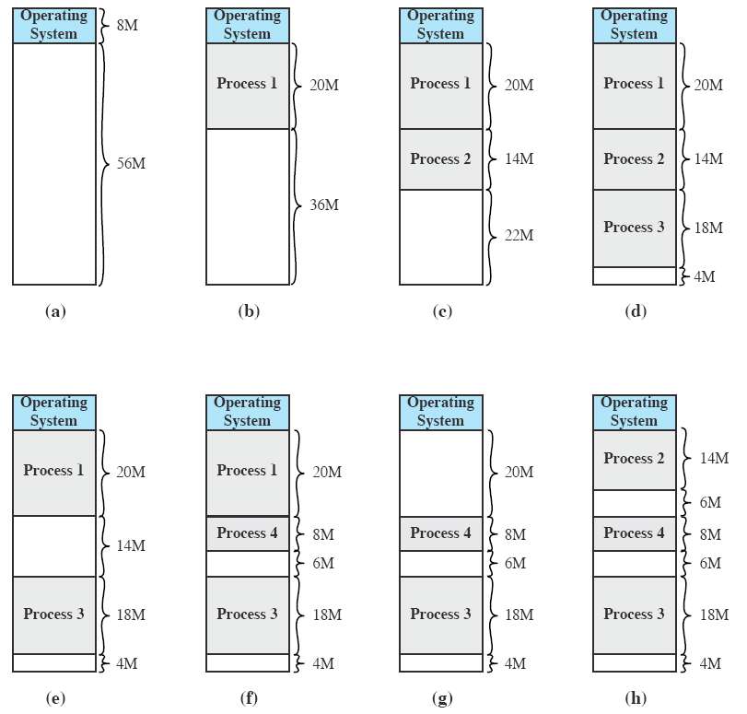

Slide 12
Loading programs into main memory (cont.)
Dynamic partitioning (cont.)
  Placement algorithms
    When a new or ready process is swapped into main memory, and if there is more than one free memory block of sufficient size, the OS must decide which free block to allocate.
      The goal is to defer compaction as much as possible.
    Best-fit strategy
      Choose the free block that is the closest in size to the request.
    First-fit strategy
      Scan memory from the beginning and choose the first available block that is large enough.
      Intention : free blocks at the end of memory may be large enough for large programs.
    Next-fit strategy
      Scan memory from the location of the last placement and choose the next free block that is large enough.
      Intention : this approach statistically lessens the scan time.
    Worst-fit strategy
      Load the process into the largest free memory block.
      Intention : hopefully the remaining space in this block is also large enough for other processes.

Slide 13
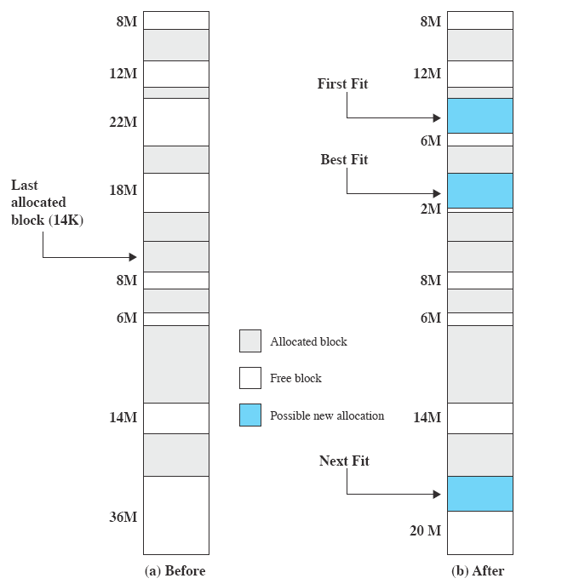


Slide 14
Loading programs into main memory (cont.)
Dynamic partitioning (cont.)
  Discussion of placement algorithms
    Best-fit strategy
      The fragment left behind is as small as possible.
      The main memory is quickly littered by blocks too small for anything.
      Memory compaction must be done more frequently than other algorithms.
    First-fit strategy
      This approach is the simplest, and usually the best and fastest.
      The front-end is littered with small free partitions, but large blocks are available at the end of the memory space.
    Next-fit strategy
      This approach more frequently leads to an allocation from a free block at the end of memory.
      The largest block of free memory, usually at the end of the memory space, is quickly broken up into small fragments.
      Compaction is required more frequently than first-fit.
    Worst-fit strategy
      The effect is similar to that of next-fit.

Slide 15
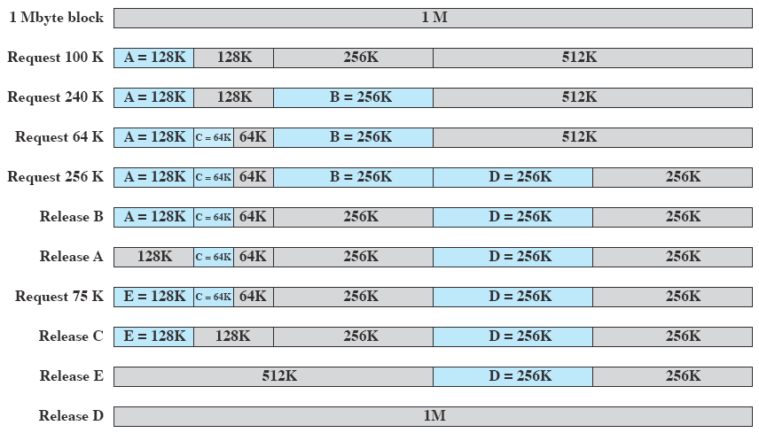
Loading programs into main memory (cont.)
A scheme compromising fixed and dynamic partitioning: the Buddy System
  Memory blocks are of size 2^{r}, e.g., 256K, 512K, etc.
  Best-fit allocation strategy, with merging of freed blocks.

Slide 16
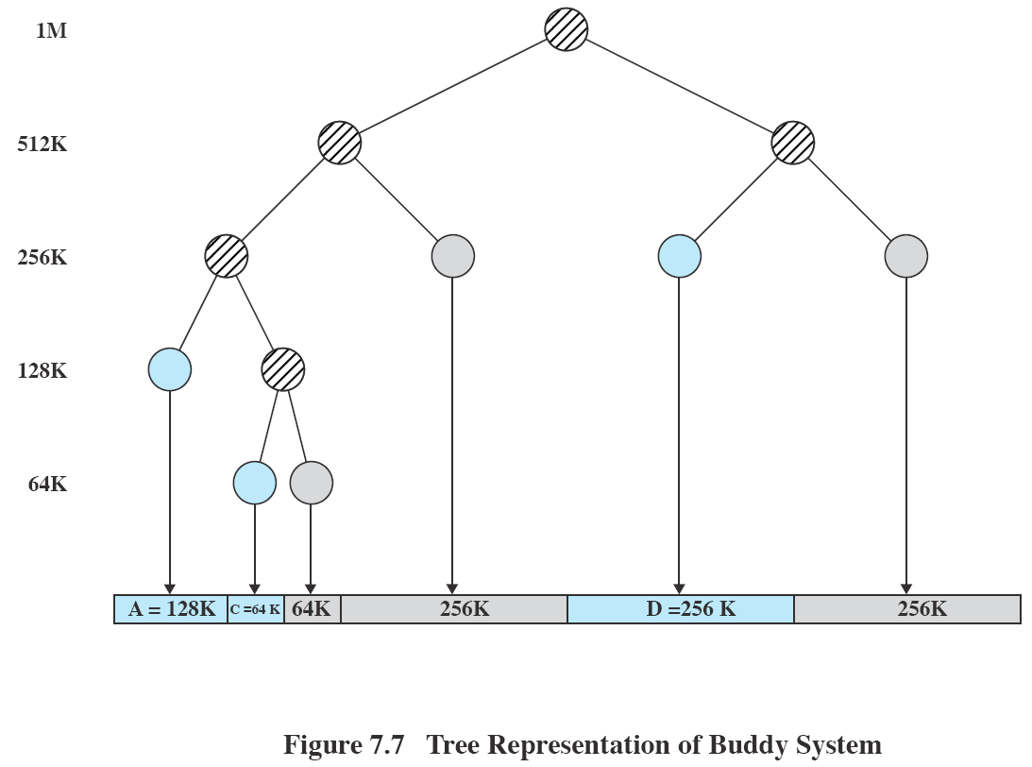

Slide 17
Relocation of processes
In Fig. 7.3a, a process is always assigned to the same partition.
  Even after being swapped out and swapped in.
  Absolute addresses (or physical addresses) can be used.
In Figs. 7.2a and 7.3b, a process may occupy different partitions during its life time.
  Swapped out – then swapped back into a different partition.
  One must use logical addresses.
Process relocation also needed in dynamic partitioning.
  E.g., Figs 7.4c and h, and in memory compaction.
Logical addresses
  Address references that are independent of current assignment of process image/data/code to memory partitions.
  Address translation always needed.
  Relative addresses – a common form of logical addresses
    relative distance from beginning of program or segment
    They appear in
      contents of the instruction register,
      instruction addresses in branch and call instructions, and
      data addresses in load and store instructions
    (base address, relative address) pair to generate physical address
    Bounds register checks if the resulting address goes beyond the process image or segment.
      if yes -- segmentation fault

Slide 18
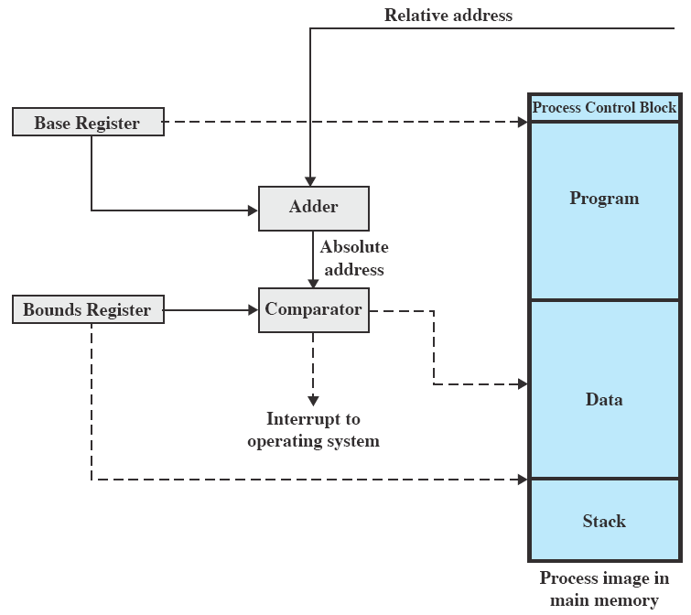

Slide 19
Simple Paging
Each process is divided into small, fixed-size chunks called pages.
The main memory is also partitioned into small chunks of the same size, called frames or page frames.
The chunks of a process are assigned to available page frames in memory.
The wasted space in memory for each process is limited to internal fragmentation of, on the average, half a page size, and there is no external fragmentation.
The page frames belonging to a process need not be contiguous.
  However, due to the principle of locality, a few pages are usually fetched at a time, possible to contiguous memory blocks.
The OS maintains
  a list of free frames in memory,
  a page table for each process that shows the frame location for each page of the process.
    Within a program, each logical address consists of a page number and an offset within the page.
    Using the page table, page number, and offset of a logical address, the processor hardware translates the logical address into physical address (frame number, offset).

Slide 20
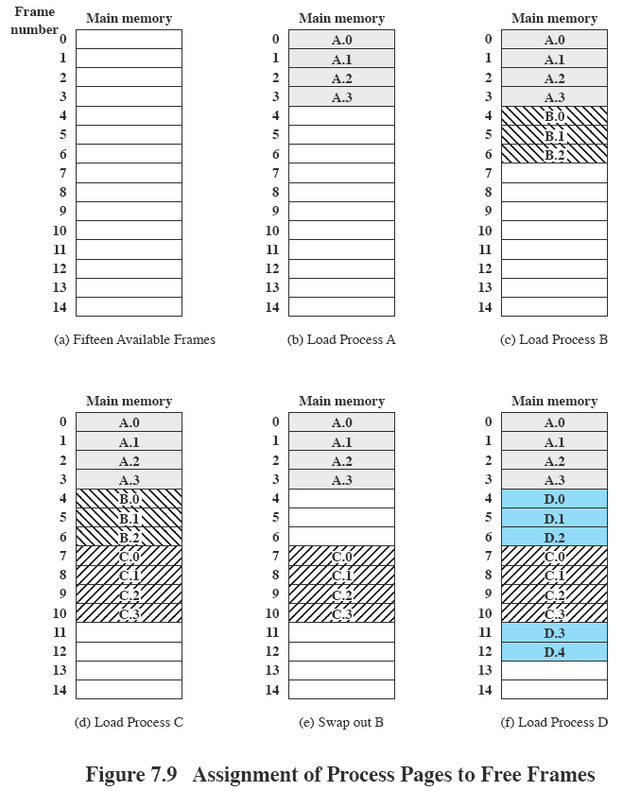

Slide 21
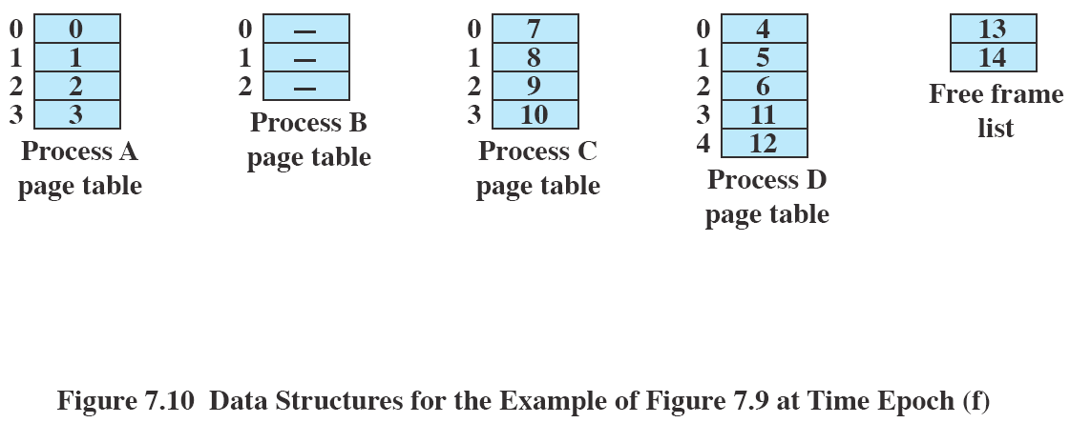

Slide 22
Simple Paging (cont.)
Simple paging is similar to fixed-sized partitioning, except that
  the partition size is small,
  a program may occupy more than one partition,
  the partitions of a process need not be contiguous.
Page sizes are chosen as powers of 2 so that the relative addresses and logical addresses are equal.
  This means that the first few bits of a relative address gives the page number of that address.
  This also makes the hardware translation of logical to physical addresses relatively easy.
    Using the page number of an address, the hardware indexes into the page table to obtain the frame number.
    The offset is appended to the frame number to obtain the physical address (no calculation is needed).
  Consequently, paging is user transparent.

Slide 23
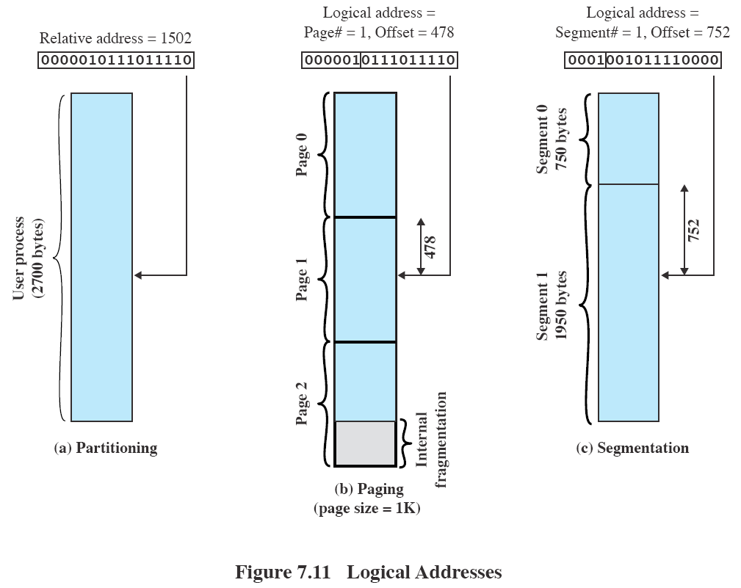

Slide 24
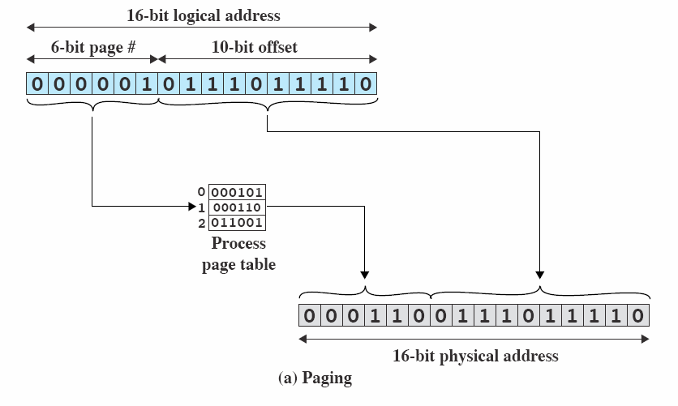

Slide 25
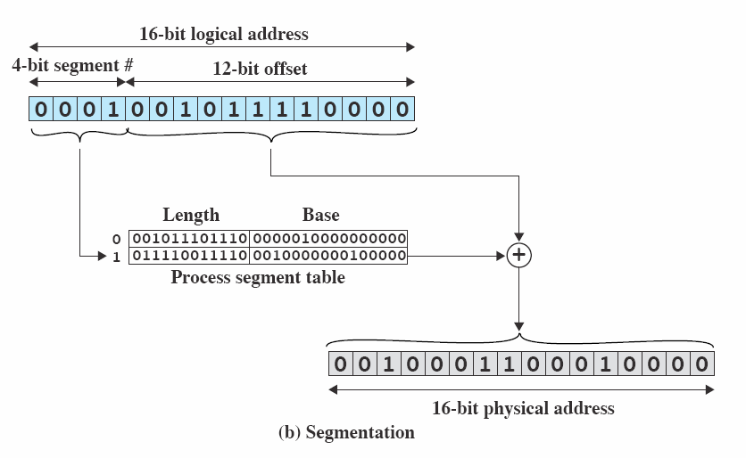

Slide 26
Simple segmentation
The program and its associated data are divided into a number of segments.
The segments need not be of the same length.
A logical address using segmentation consists of a segment number and an offset.
The OS maintains a segment table for each process.
  The segment number of a logical address indexes into the segment table.
  Each segment table entry consists of the length and base address of a segment.
  Physical address = base address + offset.
  Length > offset.
  Error case: offset >= length (segmentation fault)
Segmentation is similar to dynamic partitioning.
  Similarities
    Segmentation eliminates internal fragmentation.
    In the absence of an overlay scheme or virtual memory, all segments must be loaded into main memory.
    Segmentation still suffers from external fragmentation, but to a lesser degree because a program is broken up into small pieces.
  Differences
    Segments of a program may occupy more than one partition.
    These partitions need not be contiguous.

Slide 27
Simple segmentation (cont.)
Segmentation is visible to the programmer.
  The programmer assigns programs and data to different segments.
  Different program modules are put into different segments.
  The programmer must also know the maximum size limitation on segments.
There is no simple relationship between logical addresses and relative addresses, as in paging.

Slide 28
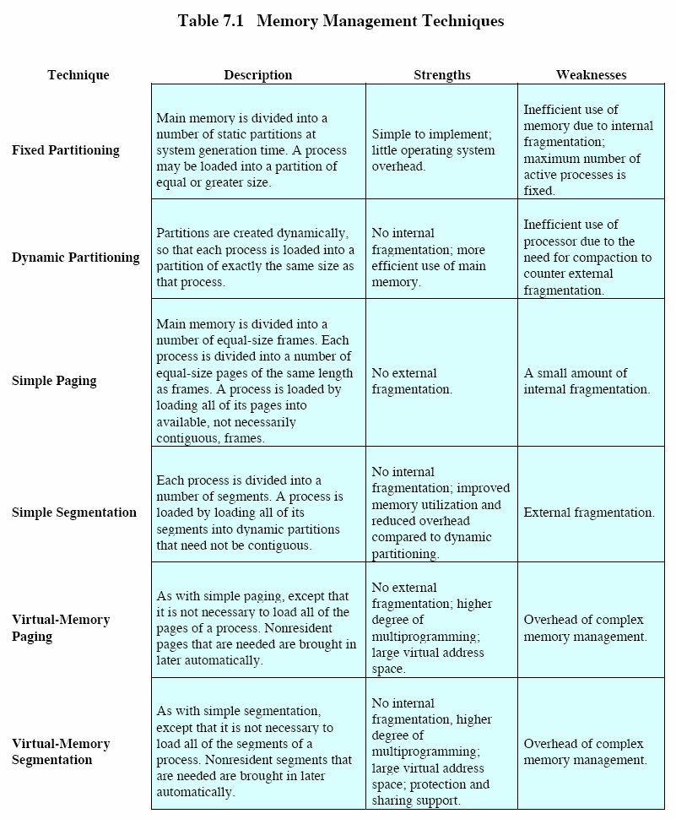

Slide 29
Loading and linking (optional)
An application software consists of object-code modules from different files.
These modules must be combined (linked), together with any library modules, to form a single load module (e.g., a.out in UNIX).
  Linking consists of resolving references to routines and variables external to a module.
  Shared library code must also be properly addressed.
When an executable code (e.g., a.out) is run, the OS creates a process image.
  A process control block is created.
  The load module is loaded into memory by the loader.
    This becomes the user program part of a process image.
    A data area is allocated according to the information specified in the load module (e.g., reserving space for an array.)
  The OS allocates a stack.
Loading
  When a load module is being loaded in memory, branching instructions and data references must be given definite locations.
  Absolute loading
    A given load module is always loaded into the same location in main memory.

Slide 30
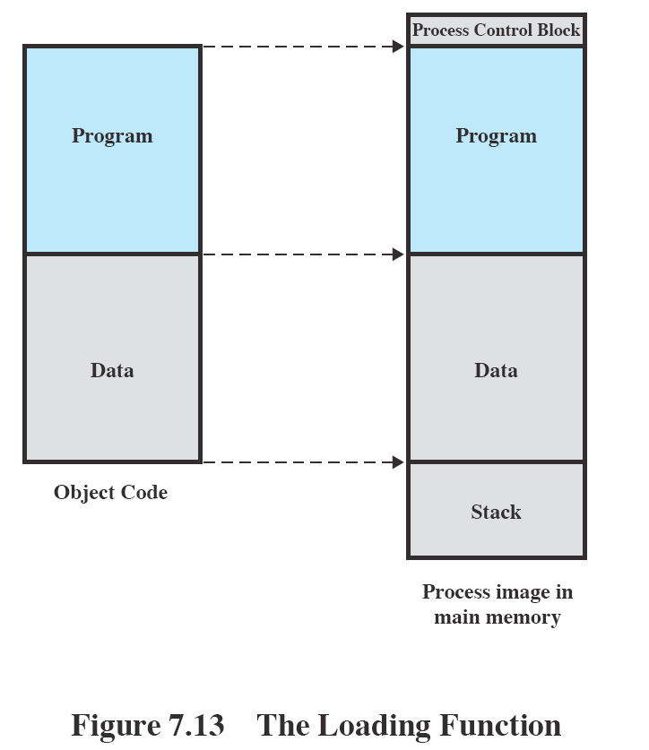

Slide 31
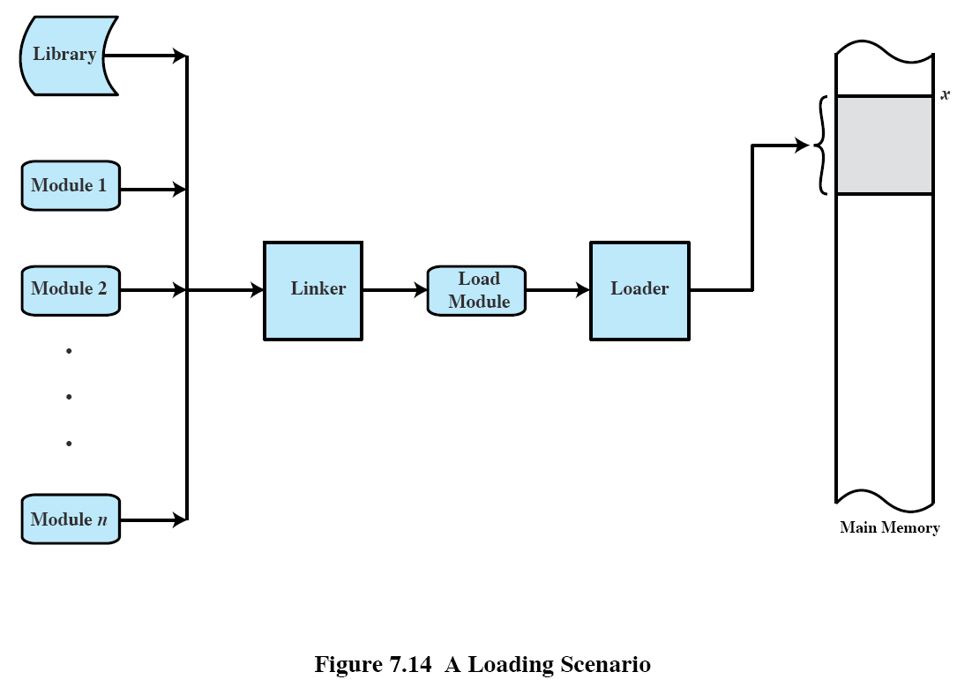

Slide 32
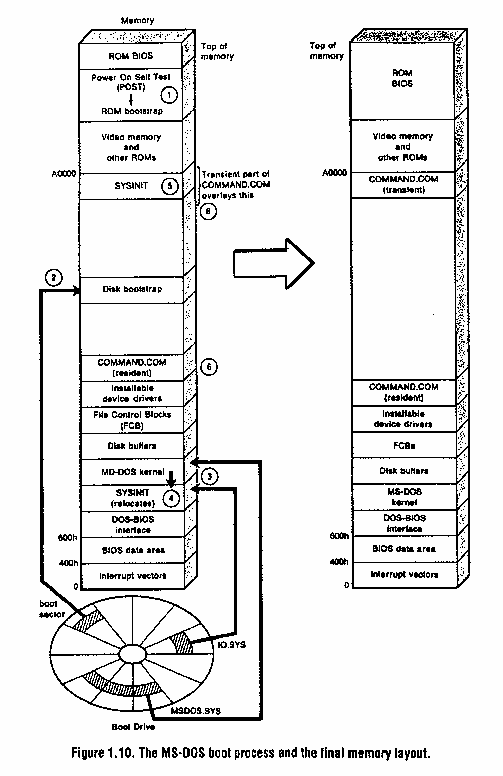

Slide 33
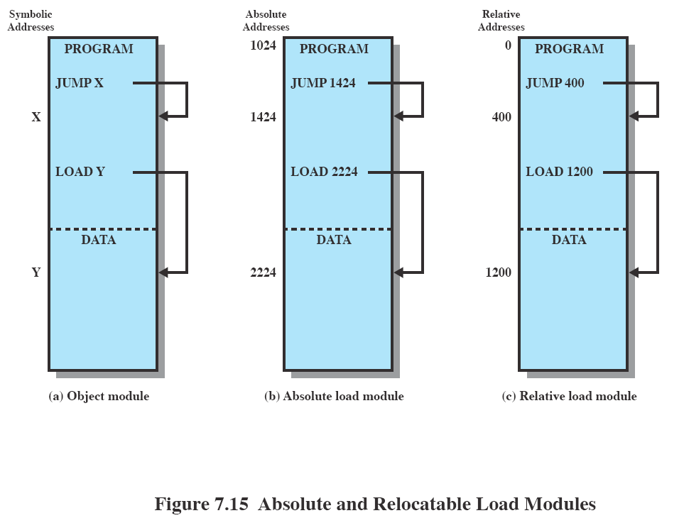

Slide 34
Loading and linking (optional) (cont.)
    All address references in the load module are absolute/physical main memory addresses.
    The assignment of addresses are done by the programmer or by the compiler or assembler.
    Disadvantages
      The programmer needs to know the intended assignment strategy for placing modules into main memory.
      If insertions or deletions are to be made in the module, all addresses have to be altered.
    Absolute loaded programs are seldom written by programmers, except, e.g., in
      the bootstrap routines and boot sector in MS-DOS.
  Relocatable loading
    Load modules can be located anywhere in main memory.
    The assembler or compiler produces addresses relative to some point, e.g., the start of a module.
    At load time, if a module is to be loaded beginning at location x, the loader adds x to all the relative addresses in the module.
      To assist in this task, the load module must include a relocation dictionary that tells the loader where the address references are.

Slide 35
Loading and linking (optional) (cont.)
  Dynamic run-time loading
    Once loaded, a relocatable module still contains absolute addresses in memory and cannot be moved around by the OS.
    In dynamic run-time loading, the load module is loaded into main memory with all memory references in relative form.
    The calculation of an absolute address is deferred until it is actually needed at run time.
    Special processor hardware is usually provided for this purpose.
      A base register stores the base address of the load module.
      A relative address is added to the base address to obtain the absolute address.
      The absolute address is compared with the value stored in the bounds register to capture illegal access.

Slide 36
Loading and linking (optional) (cont.)
Linking
  A linker takes a collection of object modules and produce a single load module.
  In each object module, there may be address references to locations in other modules.
    In an unlinked module, external address references are usually symbolic.
    A linker changes these intermodule symbolic references to ones referencing locations within the overall load module.
  The nature of address linkage depends on the type of load module to be created and on when the linkage occurs.
  Linkage editor
    A linker that produces a relocatable load module is called a linkage editor.
      All object modules are created with references relative to the beginning of the object module.
      The linkage editor puts these object modules together and all address references are made relative to the origin of the load module.

Slide 37
Loading and linking (optional) (cont.)
  Dynamic linker
    The linkage of some external modules is deferred until after the load module has been created.
      The load module contains unresolved external references.
    Load-time dynamic linking
      The load module is first loaded into memory, and any unresolved external reference causes the loader to find and load the target module.
      Advantages
        It is easy to incorporate upgraded versions of the target module -- the entire load module needs not be relinked.
        In PC software, usually the source and object code are not available and relinking of the load module is impossible.
        It is possible for several applications to share the same target module.
        Independent software developers can write their own target modules and extend the capabilities of existing software.

Slide 38
Loading and linking (optional) (cont.)
    Run-time dynamic linking
      The load module is loaded in memory, but external references to target modules are left unresolved.
      The target module is loaded only when a call to it is actually made during execution.
      Advantages
        Memory is not allocated to program units that are not called at runtime.
      Example, in the following code,
      if ( using_double_precision )
      cos( x );
      else
      r_cos_( s_x ); /* single precision version */
      the single precision and double precision version of cos() need not be both loaded.

Slide 39
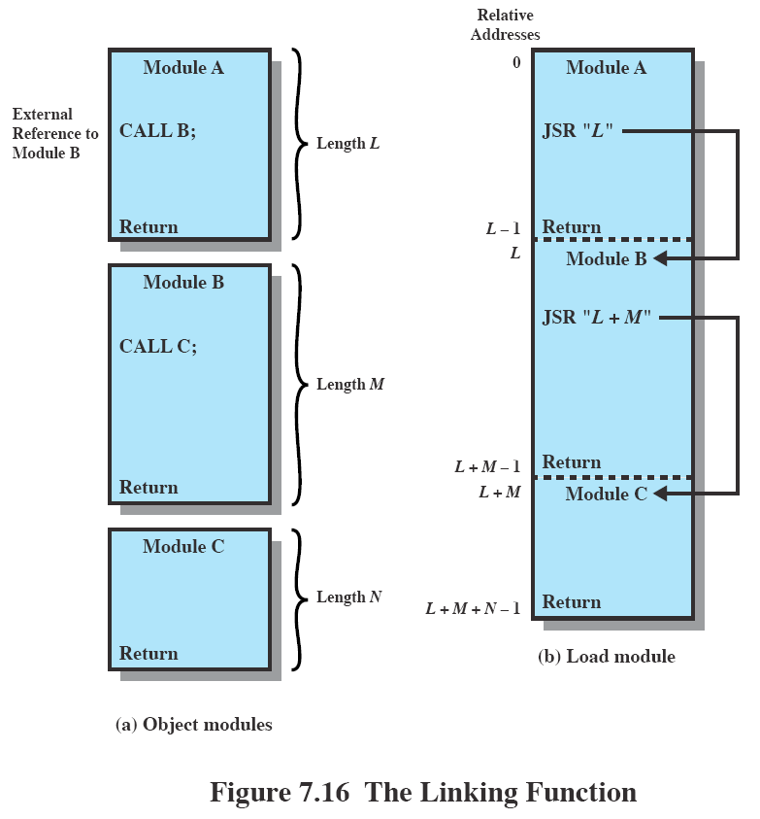

Slide 40
