Slide 1
Virtual Memory
Characteristics of paging and segmentation
  All memory references within a process are logical addresses that are dynamically translated into physical addresses at run time.
  A process may be swapped in and out of main memory such that it occupies different regions of main memory at different times during the course of execution.
  A process may be broken into pieces.
  These pieces need not be contiguously located in main memory during execution.
  It is not necessary that all these pieces be in main memory.
    The program may proceed, at least for one instruction, as long as the current instruction and the data being accessed is in main memory.
    Advantages
      More processes may be maintained in main memory.
        The processor is less likely to be idle, since more processes are likely to be in the ready state.
      It is possible for a process image to be larger than all the main memory.
        A programmer perceives a main memory space as large as the hard disk space.
        This perceived memory space is called virtual memory.
Terminology
  Main memory: real memory
  Hard disk memory: virtual memory

Slide 2
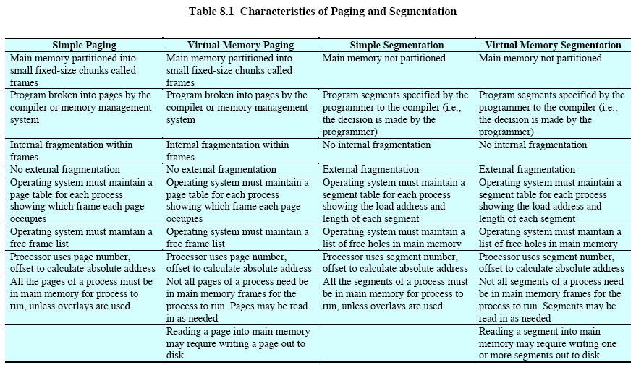

Slide 3
Locality and Virtual Memory
Principle of locality
  Program and data references within a process tend to cluster.
    Over a short period, execution may be confined to a small section of the program. (Fig 8.1)
    Loops, core subroutines, data arrays
  It is wasteful (in processor time and memory space) to load in too many pieces for a process and later the program is swapped out of memory (to free up space for other processes).
Machine support for virtual memory
  Hardware
    There must be base registers, bounds registers, address adders and comparators, etc. to facilitate the efficient translation from logical addresses to physical addresses.
      This translation, plus the actual memory fetch, must be done in 1 clock cycle.
  Software
    A careful choice of the pages to be swapped in and out must be performed to avoid thrashing.
      If main memory is fully occupied, when the processor brings a piece of a program in, it must throw another out.
      If the thrown out piece is about to be used, the processor must bring that piece in again almost immediately.
      Too much of this activity leads to thrashing -- the processor spends most of its time swapping pieces rather than executing user instructions.

Slide 4
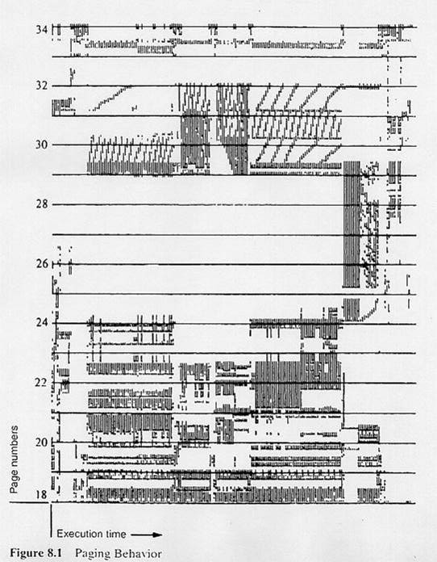

Slide 5
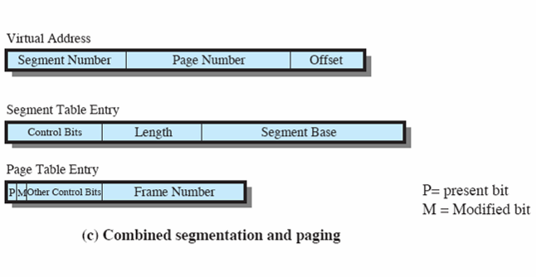
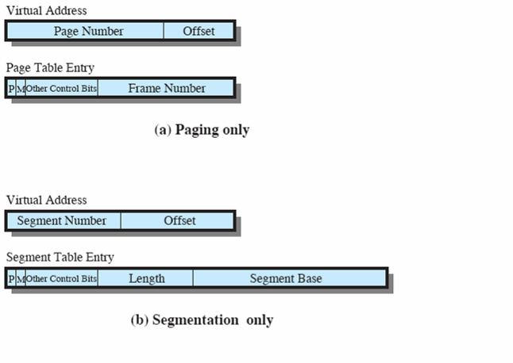

Slide 6
Virtual memory paging
Each virtual address is of the form (page number, offset).
Each page table entry carries a present bit (P) to indicate whether the table is in memory.
  The stored frame number is valid only when the present bit is set.
There is also a modify bit (M) to indicate whether the contents of the page have been altered.
  A modified page has to be written out to disk when the page is replaced.
possibly Protection or sharing bits
Page table (at least one per process)
  A page table base register holds the base address of the page table.
  The virtual page number is used to index into the page table and look up the frame number of the page.
  Page sizes are usually from 512 to 8K bytes.

Slide 7
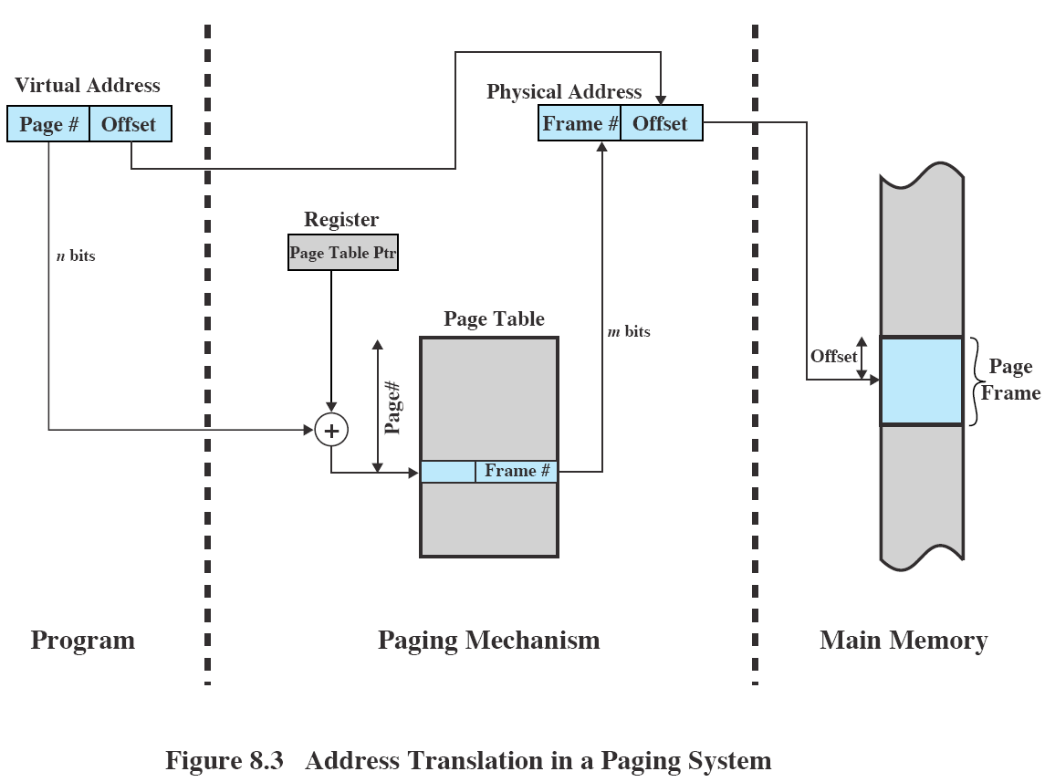
typically n > m

Slide 8
Virtual memory paging (cont.)
Page table (cont.)
  The amount of memory devoted to page tables alone could be very high.
    Page tables themselves are subject to paging.
    Page tables are also stored in virtual memory.
    Some processors use a two-level scheme to organize large page tables.
      The first level is called a root page table or page directory.
      Each entry in the page directory points to a page in the user page table.
    Example
      Given a process whose process image is of size 2³² = 4-Gbytes.
      Suppose1 page = 2¹² = 4Kbytes.
      Number of pages = ( 2³² / 2¹² ) = 2²⁰, i.e., over 1 million pages
      Suppose 1 page table entry (PTE) takes 4 bytes.
      Size of user page table = 4 × 2²⁰ = 2²² bytes = 4 Mbytes
      I.e., user page table occupies (2²² / 2¹² ) = 2¹⁰ pages of memory.
        Each page of 2¹² bytes holds 2¹⁰ = 1024 PTEs.
      Size of root page table = 4 × 2¹⁰ = 4 Kbytes
    The root page always remains in main memory.

Slide 9
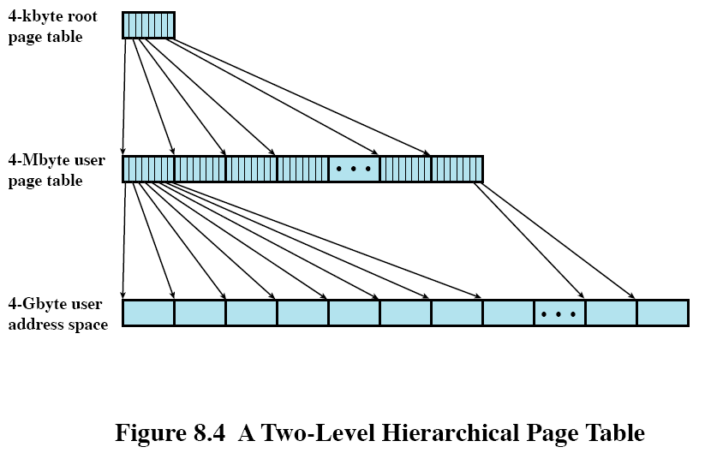

Slide 10
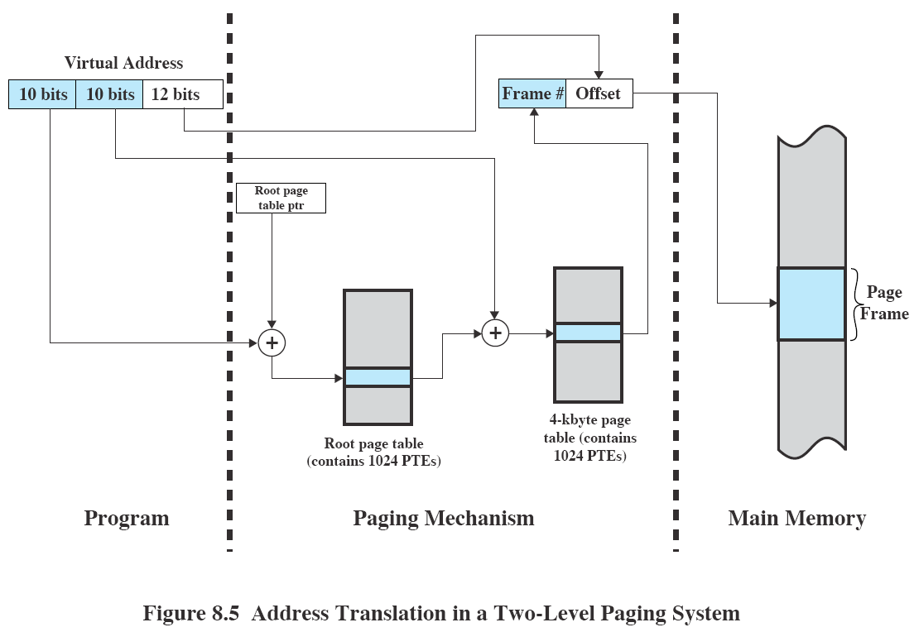

Slide 11
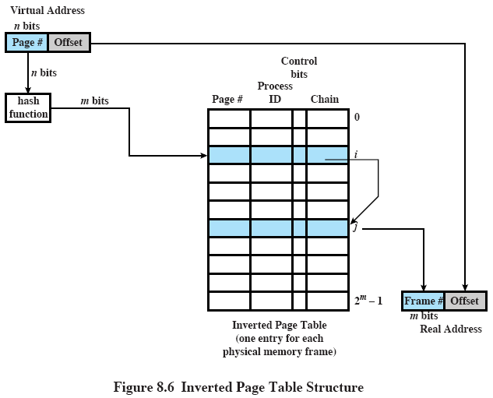
Inverted Page Table (optional)
One global page table with number of PTEs = number of memory frames.
Page number, process ID, control bits, chain pointer

Slide 12
Translation lookaside buffer (TLB)
Normal paging takes two memory accesses per lookup -- one for page table, one for data.
The TLB tries to cut the access time down to 1 cycle.
The TLB is a special cache that holds page table entries.
  The TLB contains the page table entries that have been most recently used.
  Each entry in the TLB includes the page number as well as the complete page table entry.
    The page number alone is insufficient to index into the TLB.
  The TLB is implemented with a special memory called associative memory.
    A lookup into the TLB searches a number of entries simultaneously.
  Given a virtual address, the process first examines the TLB.
    If the desired page table entry is present (a TLB hit), the TLB returns the frame number stored in the matched entry.

Slide 13
Translation lookaside buffer (TLB) (cont.)
    If it is a TLB miss, the page table entry is in main memory and the processor fetches it the usual way.
    The processor updates the TLB to include this new page table entry.
    If the present bit is not set, a page fault interrupt is issued and the desired page must be fetched from disk.
    After the page is loaded from disk, the present bit is set.
  By the principle of locality, most virtual memory references involve page table entries in the TLB, and access time is 1 cycle.
Interaction between virtual memory mechanism and cache system
  See Fig. 8.10.
  The page table entry involved may be in TLB, RAM, or on disk.
  The referenced word may be in cache, RAM, or on disk.
  Most of the time, a fine-tuned system will have both a TLB hit and a cache hit.
    All recently accessed pages are in cache.
    number of rows in TLB × page size < cache size

Slide 14
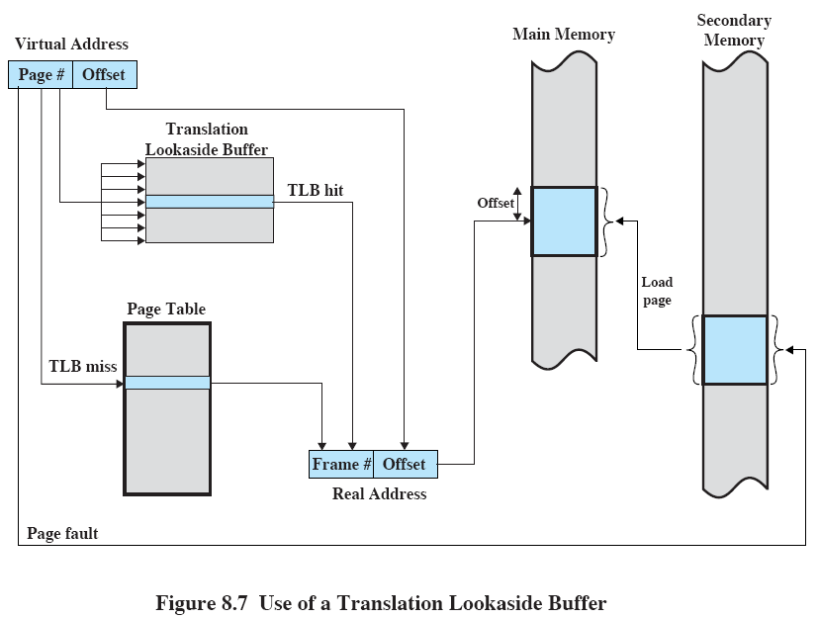

Slide 15
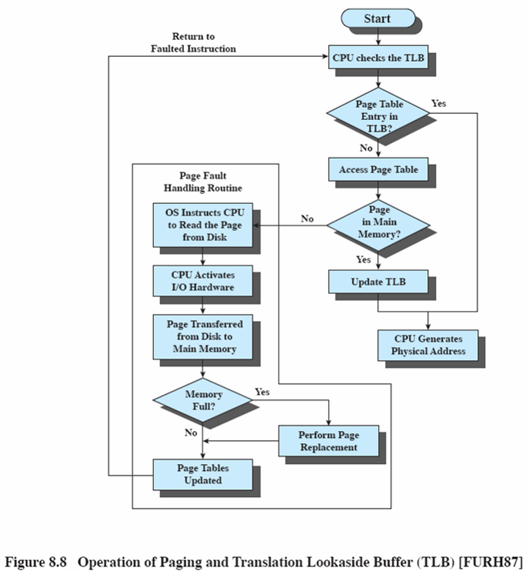

Slide 16
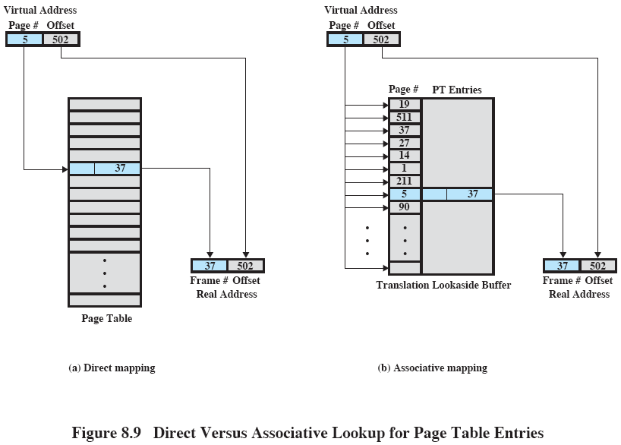

Slide 17
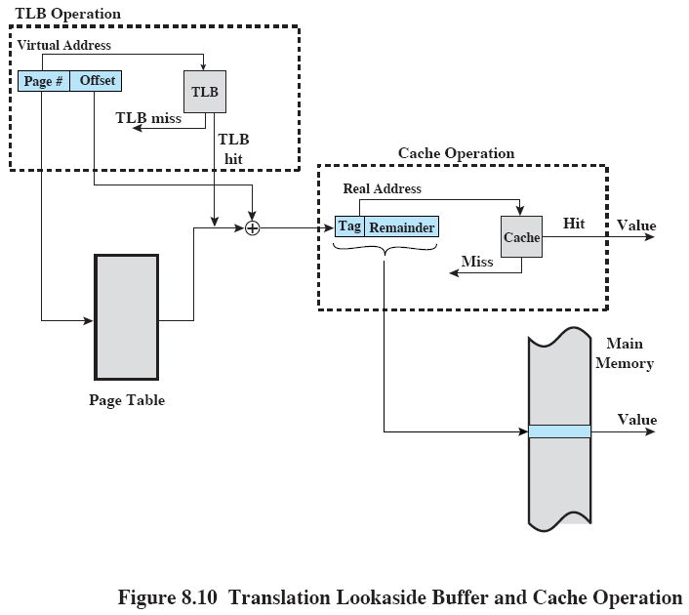
number of rows in TLB × page size < cache size

Slide 18
Page Size
Internal fragmentation
  The smaller the page size, the less the amount of internal fragmentation.
Number of pages
  The smaller the page, the larger the page table per process.
  For large programs in a heavily multiprogrammed environment, this may mean a double page fault per memory reference -- first for the page table entry, and next for the desired page.
Secondary storage characteristics
  Disk and tapes are rotational, and larger page sizes give more efficient block transfers of data.
Page fault rates (Fig 8.11)
  If the page size is very small,
    a relatively large number of pages will be in memory.
    After a time, the pages in memory will all contain portions of the process near recent references.
    Thus the page fault rate should be low.

Slide 19
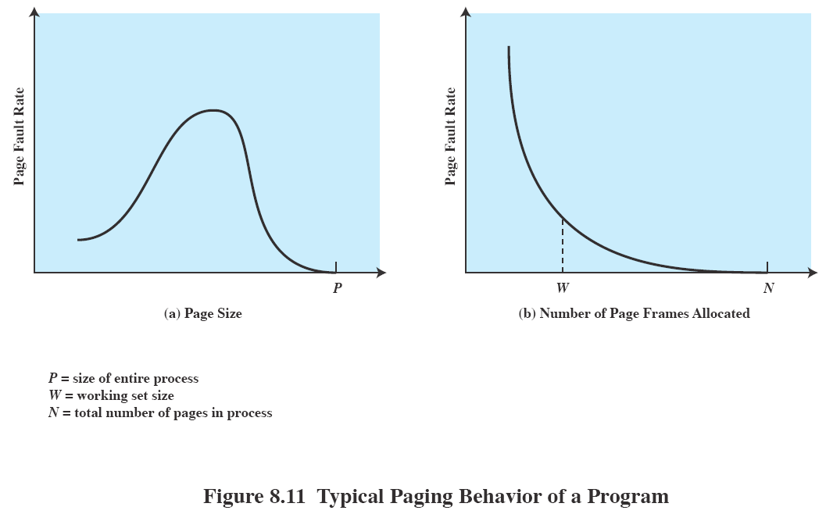
(assuming fixed page size)

Slide 20
Page Size (cont.)
Page fault rates (cont.)
  As the size of the page is increased,
    each page contains more and more irrelevant information.
    The effect of principle of locality is weakened.
  Eventually, increasing the page size lowers the page fault rate again, as the page size approaches the size of the entire process.
    Limiting case -- there is no page fault if the entire process contains a single page.
  The page fault rate is also dependent on the number of frames allocated to a process.
    For a fixed page size, the fault rate drops as the number of pages maintained in memory grows.
Effects of physical memory size
  The TLB sizes of contemporary machines do not grow as fast as main memory sizes.
    The TLB size is related to hardware designs such as the cache size.
    As the program size grows, the TLB hit ratio decreases.
    An alternative is to increase the page size as the main memory grows larger, but this leads to performance degradation.

Slide 21
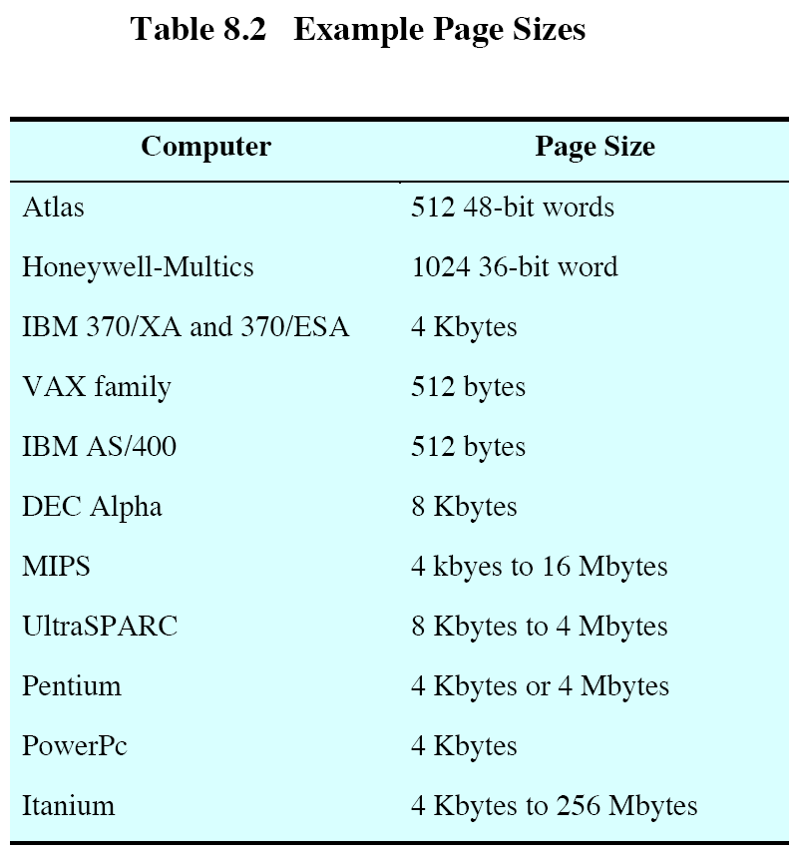

Slide 22
Virtual memory segmentation
Segments may be of dynamic length.
Memory references are of the form (segment number, offset).
  The segment number indexes into the segment table stored in memory.
  A segment table entry stores the physical base address, segment length, present bit, modified bit, protection and sharing bits, etc. of the segment.
  Segment tables are much shorter than comparable page tables.
Advantages of segmentation over non-segmented addressing:
  A process may have several segments -- code, data, stack, etc.
  It simplifies the handling of growing data structures.
    A data structure can have its own segment and the OS expands, shrinks, or moves the segment as needed.
  Program modules can be recompiled separately.
  Code or data sharing among processes is possible.
  Access privileges can be assigned to different segments.

Slide 23
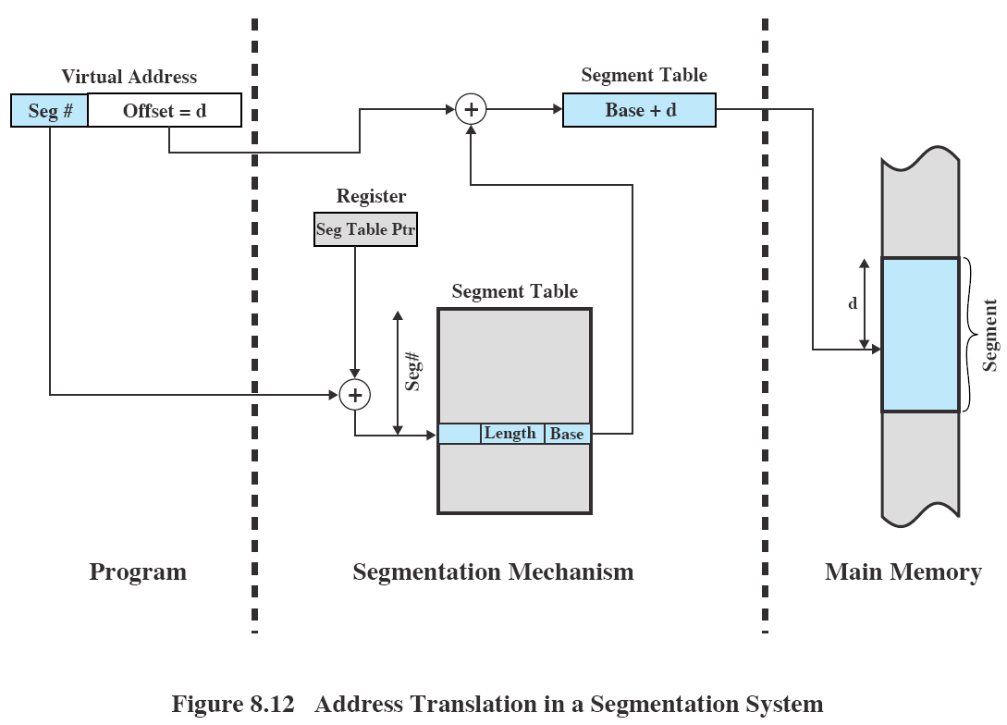

Slide 24
Comparison between paging and segmentation
Paging
  eliminates external fragmentation,
  is user transparent.
  The pieces that are moved around are of fixed length.
    Sophisticated memory management algorithms exploits this behavior. (See below.)
Segmentation
  eliminates internal fragmentation,
  is visible to the user,
  handles growing data structures,
  has modularity,
  supports sharing and protection.

Slide 25
Combined paging and segmentation
A user’s address space is broken up into segments of code, data, etc. by the user.
Each segment is broken up into pages equal in size to the main memory page frame.
  Each segment has its own page table.
  Segments smaller than one page occupies one page.
From the programmer’s point of view, a logical address is still (segment number, offset).
The system views the offset as (page number, page offset).
Virtual memory reference
  When a new process runs, a segment table pointer register is loaded with the starting address of the segment table.
  For each virtual address reference, the processor uses the segment number to index into the process segment table to find the page table for that segment.
  The page number portion is used to index into the page table and look up the corresponding frame number.
  The page offset is then used to index into the particular page.
The present and modified bits are not needed now in the segment table entries, because these are present in the page table entries.

Slide 26
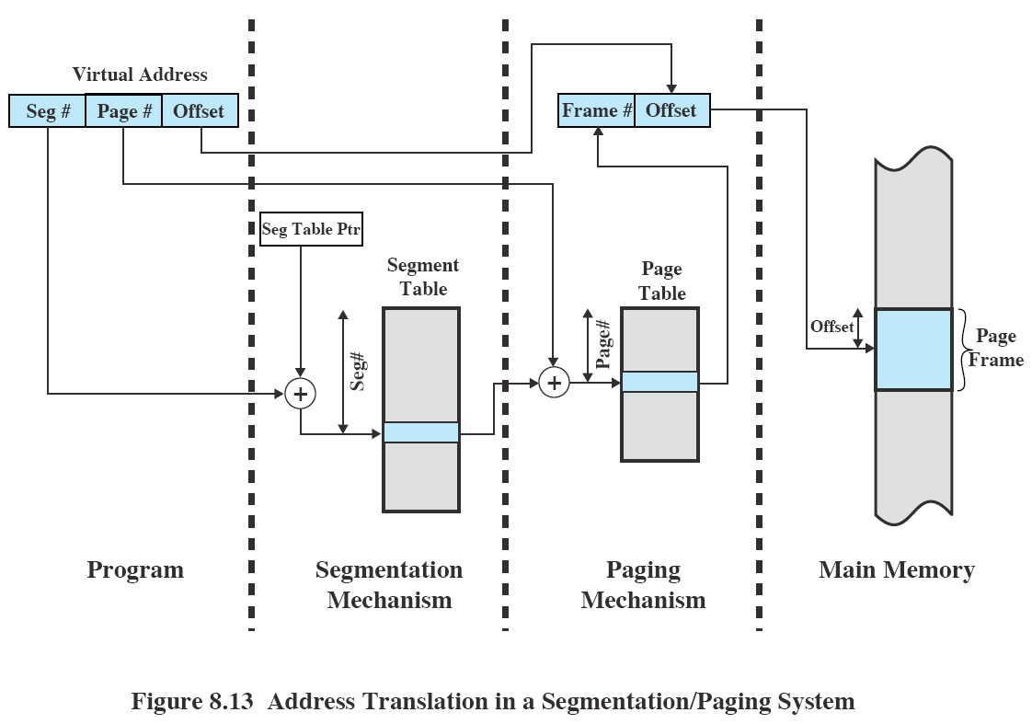

Slide 27
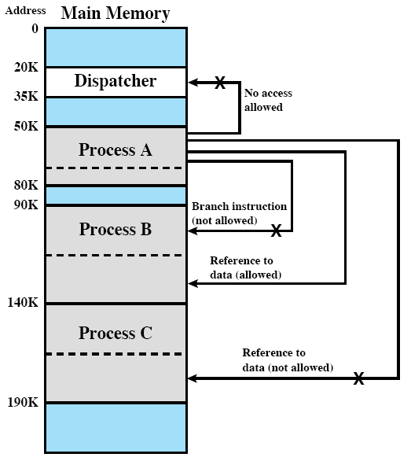
Protection and sharing by segmentation
The length field in segment table entries protects against illegal access outside the current segment.
  Such illegal accesses give segmentation faults.
A segment may be referenced in the segment tables of more than one processes, thus sharing is provided.
These are impossible in paging.
  One cannot specify certain pages of a program to be shared or protected.

Slide 28
Operating System Policies for Virtual Memory
Assumption : virtual memory with hardware support for paging and segmentation
The key is to minimize the rate of page faults.
  The overhead of a page fault is high.
    OS decides on which page to replace.
    I/O of exchanging pages
      Write back old page if it has been modified.
      Read in new page.
    OS schedules another process to run during the I/O.
      This causes a process switch.
There is no single optimal memory management policy.
  The performance depends on
    the main memory size,
    the relative speed of main and secondary memory,
    the size and number of processes competing for resources,
    the execution behavior of individual programs. This depends on
      the nature of the application,
      the programming language and compiler employed,
      the programming style,
      the dynamic behavior of the user.

Slide 29
OS Policies for Virtual Memory (cont.)
Fetch policy
  demand paging
    A page is brought into memory only when a reference is made to a location on the page.
    Common scenario
      When a process is first started, there are a lot of page faults.
      After a time, the useful pages are brought in, and by the principle of locality, the number of page faults drop to a very low level.
  prepaging
    Pages other than the one demanded by a page fault are brought in.
      Rationale -- disks and tapes have seek times and rotational latency to bring the data block in. It is efficient to bring in a few contiguous pages at a time.
    This policy is ineffective if the extra pages are not referenced.
Placement policy
  This concerns with where in the main memory a new page will reside.
  Placement policies such as best-fit, first-fit, etc. used in pure segmentation are irrelevant in a normal paging system -- the pages can be put anywhere.
  For a parallel computer system with asymmetric memory arrangements, where some RAMs are closer to some particular processors, an automatic placement strategy is desirable.
    This placement situation is usually application dependent.

Slide 30
Replacement policy
This deals with the selection of a page in memory to be replaced when a new page is brought in.
The set of pages to be considered for replacement is discussed in resident set management.
Objective
  The page to be removed should be the page least likely to be referenced in the near future.
Frame Locking
  Some frames in memory may be locked and are not eligible for replacement. These include
    most of the OS kernel,
    I/O buffers,
    time-critical areas,
    some frames specified by a user program.
  Locking is done by setting a lock bit associated with each frame.
All policies considered are based on the recent referencing history.
  By the principle of locality, this is likely to influence future referencing patterns.

Slide 31
Replacement policy (cont.)
Optimal policy
  Select for replacement the page for which the time to the next reference is the longest.
  This policy is impossible to achieve, and is the standard against which other policies are compared.
Least recently used (LRU) policy
  Replace the page in memory that has not been referenced for the longest time.
  This policy is near optimal.
  Problem : difficulty of implementation
    One needs to tag each page with the time of its last memory reference (time stamp).
    This has to be done for each memory reference (instruction or data).
First-in, first-out (FIFO) policy
  Replace the page that has been in memory the longest.
  Treat the page frames as a circular buffer, and pages are removed in a round-robin style.
  Flaw : a page heavily in use may have been in memory the longest.
    This page may be repeatedly paged in and out.

Slide 32
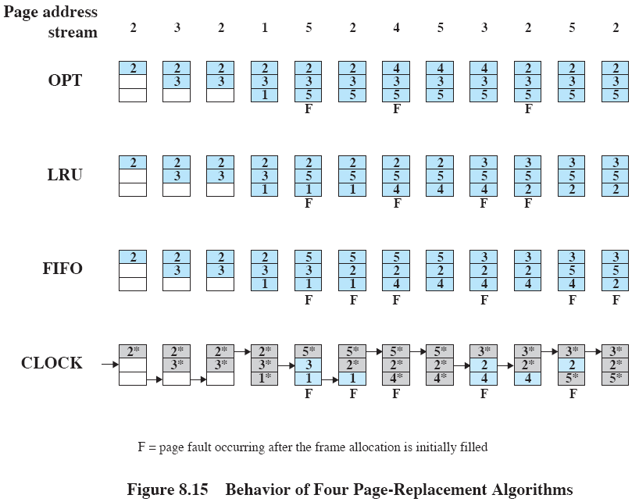
* : use bit in clock algorithm; arrow: current position of pointer

Slide 33
Replacement policy (cont.)
Clock policy
  This policy enhances FIFO by associating a use bit with each frame.
  When a page is first loaded into a frame in memory, the use bit for that frame is set to 1.
    The first loading of the page is not considered as a page fault.
  Each time the frame is subsequently referenced, the use bit is set to 1.
  The set of frames is considered to be a circular buffer with a pointer.
  When a page is replaced, the pointer is set to indicate the next frame in the buffer.
  When it is time to replace a page, the OS scans the buffer, starting from the current pointer location, to find a frame with a use bit set to 0.
    The first frame with use bit equal to 0 is replaced.
  Each time it encounters a frame with a use bit of 1, it resets that bit to 0.
  If all frames have a use bit of 1, the pointer will make a complete cycle and stop at its original position, replacing that particular page.
  If a page is referenced often, its use bit is usually 1 and the page is unlikely to be replaced.
  This policy (or its variations) is employed by many OS’s, such as Multics (predecessor of UNIX).
  This policy enhances FIFO in that any recently used frame is passed over for replacement.

Slide 34
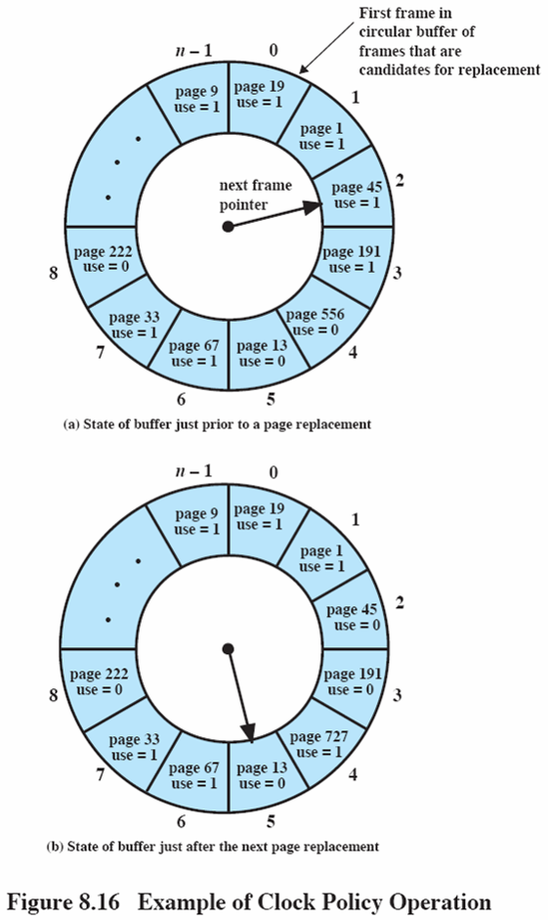

Slide 35
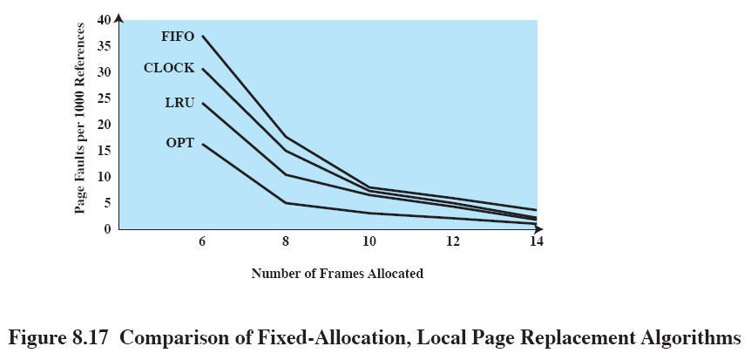

Slide 36
Replacement policy (cont.)
Clock policy enhancement
  Rationale : among page frames not recently accessed, choose the unmodified ones for replacement first over the modified ones.
  Both the use bit and modified bits are used. There are four categories:
    (u = 0 ; m = 0)
    (u = 0 ; m = 1)
    (u = 1 ; m = 0)
    (u = 1 ; m = 1)
  Algorithm:
    1. Beginning at the current pointer location, scan the frame buffer, but do not change the use bits. The first frame encountered with (u = 0 ; m = 0) is selected for replacement.
    2. If step 1 fails, scan again and look for (u = 0 ; m = 1). The first such frame encountered is replaced. During this scan, set the use bit to 0 on each frame bypassed.
    3. If step 2 fails, the pointer should have returned to its original position and all the frames in the set will have a use bit of 0. Repeat step 1. This time, a frame will be found.
  This strategy is used in the Macintosh.

Slide 37
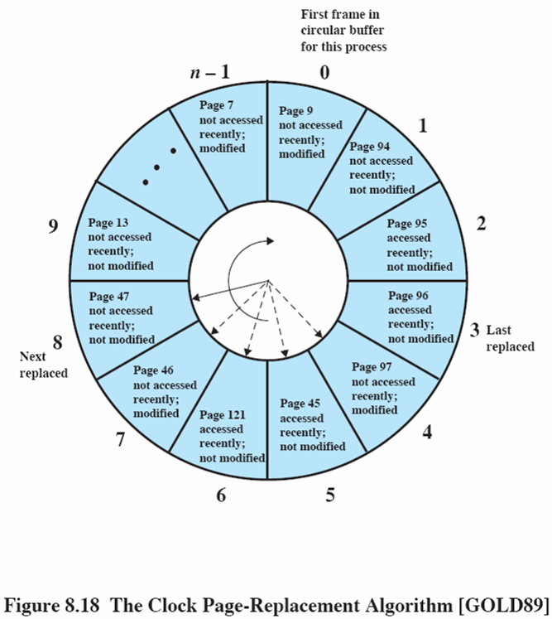

Slide 38
Replacement policy (cont.)
Page Buffering
  is FIFO based with two extra lists kept:
    free page list
    modified page list
  A replaced page is assigned to the tail of the
    free page list if it has not been modified,
    modified page list if it has been modified.
  The replaced page is not physically moved in memory --only its entry in the original page table is deleted.
    If this page is later referenced again, it is moved from either the free page list or the modified page list back to the process.
  Page frames for new pages are obtained from the head of the free list. This is the time when the old page is actually destroyed.
  To reduce I/O operations, modified pages in the modified page list are written to disk in clusters.
  This approach is used in the Mach OS.

Slide 39
Resident set management
The OS must decide on how many pages to allocate to a process (the resident set). Relevant factors are:
  The smaller the number of pages per process is, the more processes can reside in main memory. Hence there may be more ready processes for the OS to dispatch.
  If the number of pages per process is too small, the rate of page fault will be high.
  Beyond a certain size, additional allocation of pages will have little effect due to the principle of locality.
Allocation policies
  Fixed-allocation
    The number of pages for each processes is decided at initial load time.
    This number depends on the type of process (interactive or batch) or on user or system manager guidance.
  Variable-allocation
    The number of page frames for each process varies.
    A process suffering persistent high levels of page faults needs additional page frames (for the principle of locality to function).
    A process having an exceptionally low page fault rate may have its allocation reduced.
    This policy requires the processor to access the behavior of active processors and is dependent on hardware support.

Slide 40
Resident set management (cont.)
Replacement scope
  local replacement policy
    Choose among only the resident pages of the process that generated the page fault.
  global replacement policy
    Consider all pages in main memory to be replacement candidates.
    The overhead of this policy is cheaper.
Fixed allocation, local scope
  If the predetermined allocation is too small, there will be a high page fault rate, causing the entire multiprogramming system to run slowly.
  If allocations are too large, there will be too few programs in main memory and there may be considerable processor idle time.
Variable allocation, global scope
  This policy is the easiest to implement.
  Each process experiencing page faults is allow to grow in size.
  The page selected for replacement is made from among all the frames in memory, using LRU, FIFO, Clock, etc. policies.
  This page can belong to any of the resident processes, and there is no guarantee that this is the optimal process to choose.
  A remedy : use variable allocation, global scope with page buffering.

Slide 41
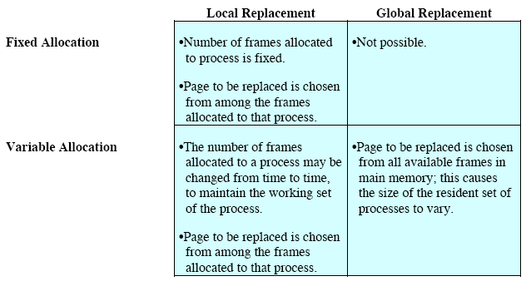
Resident set management (cont.)
Variable allocation, local scope
  Allocate to a new process a number of page frames based on the application type, program request, etc.
  Use either prepaging or demand paging to fill up the allocation.
  When a page fault occurs, select the page to replace from among the resident set of the process that suffers default.
  Reevaluate the allocation to a process from time to time and increase or decrease the number of pages accordingly.

Slide 42
Working set strategy (Denning 68) (optional)
It is a strategy to determine the resident set size and the timing of changes in the variable-allocation, local-scope strategy.
A working set is a collection of pages a process is actively referencing.
For a program to run efficiently, its working set must be maintained in primary storage, otherwise, thrashing occurs.
  Thrashing means excessive paging activities occur as the program repeatedly requests pages from the secondary storage.
Denote the working set of a process during the virtual time interval t - w to t by W(t,w).
  The virtual time is the time during which a process has the CPU.
The variable w is called the working set window size.
The working set size increases as w increases, i.e.,
W(t, w) is a subset of W(t, w+1).
The larger the working set, the more infrequent page faults occur.

Slide 43
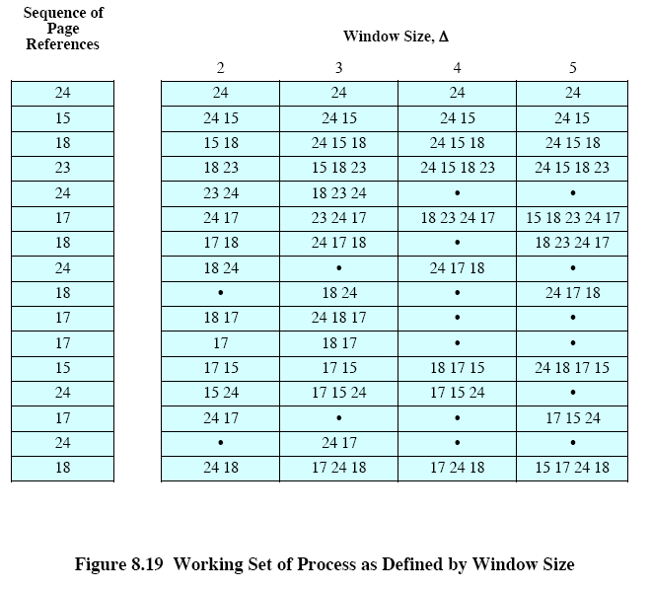

Slide 44
Working set strategy (cont.) (optional)
Working sets change as a process executes.
  When a process first begins executing, it gradually builds up to a working set as it references new pages.
  Eventually, by the principle of locality, the process stabilizes on a certain set of pages.
  A process may enter a difference execution phase and require a completely different working set.
  During the transition, the process is rapidly demand paging.
  Some of the pages from the old locality remain within the window, causing the number of pages in main memory to increase.
  Primary storage usage is reduced as the process stabilizes in the next working set.
  Stabilization is detected by fewer or no page references in some of the pages.
The working set strategy
  Monitor the working set of each process.
  Periodically remove from the resident set of a process those pages that are not in its working set.
  A new process may be admitted only if its resident set includes its working set.
Difficulties
  The optimal value of w is unknown and varies with time.
  A true measurement of the working set is too costly.

Slide 45
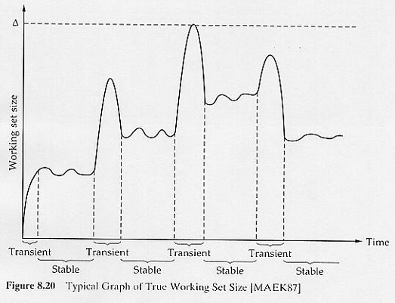

Slide 46
Page fault frequency (PFF) algorithm
It is based on the working set strategy. The principles are:
  Focus on the page fault rate of a process. (The page fault rate is inversely related to the resident set size.)
  If the page fault rate for a process is below some minimum threshold, assign a smaller resident set size to the process (so that hopefully pages that are not in the working set are removed).
  If the page fault rate is above some maximum threshold, increase the resident set size (so that the resident set includes the working set).
Algorithm:
  A use bit is associated with each page in memory. The bit is set to 1 when the page is accessed.
  When a page fault occurs, the OS notes the virtual time T since the last page fault for that process.
    Page fault rate (or page fault frequency) (PFF) = 1/ T
  Define a threshold F.
  If T < F, add a page to the resident set of the process.
  Otherwise, discard all pages with a use bit of 0.
  Meanwhile, reset the use bit on the remaining pages to 0.
Advantage
  PFF adjusts the resident set only after a page fault.
Disadvantage
  No provision is given to the transient periods.
  No page ever drops out of the resident set before F virtual time units have elapsed since it was last referenced.
  During transient periods, the resident set tends to swell.

Slide 47
Cleaning policy
This policy determines when a modified page should be written out to secondary memory.
Demand cleaning
  A page is written out to disk only when it has been selected for replacement.
  Disadvantage
    A page fault results in 2 page I/O’s -- writing out the old page, and reading in the new page.
    This causes substantial delay to the current process.
Precleaning
  Write modified pages to disk before their page frames are needed, so that they can be written in batches.
  These pages still remain in main memory until the page replacement algorithm removes them.
  Disadvantage
    The written pages may be modified again shortly.
A better policy
  Use demand cleaning with page buffering, i.e., decouple cleaning and replacement.
  Replaced pages are put in either a modified or unmodified list.
  The pages on the modified list are periodically written out in batches and moved to the unmodified list.

Slide 48
Load control
Multiprogramming level
  This concerns with determining the number of processes to be allowed to reside in main memory.
    Too few processes may result in every process being blocked.
    Too many processes may result in thrashing.
  The working set or PFF algorithm implicitly incorporates load control.
  Other algorithms are also available, e.g., based on the clock algorithm, on the amount of paging activities as a percentage of the overall processor time, etc.
Process suspension
  Possibilities are
    lowest priority process
    faulting process (process having page fault)
    last process activated
    process with the smallest resident set
    largest process
    process with the largest remaining execution window (time)

Slide 49
