Slide 1
Project 1 Prerequisites
read the project description
check the newsgroup
read the ELF specification
  (pages 1-1..1-4, 2-1..2-3, 2-7..2-8)

Slide 2
Project 1 Roadmap
Check
is exeFileData valid ?
read the elfHeader correctly ?
  magic numbers
found the two programHeaders ?
  check against objdump -x, elfdump
Fill out
numSegments
entryAddr
segmentList[]
Problems ?
try objdump –x , elfdump on geekos/src/user/a.exe
try lprogdebug=1 in geekos/src/geekos/lprog.c
post your headache on the newsgroup !

Slide 3
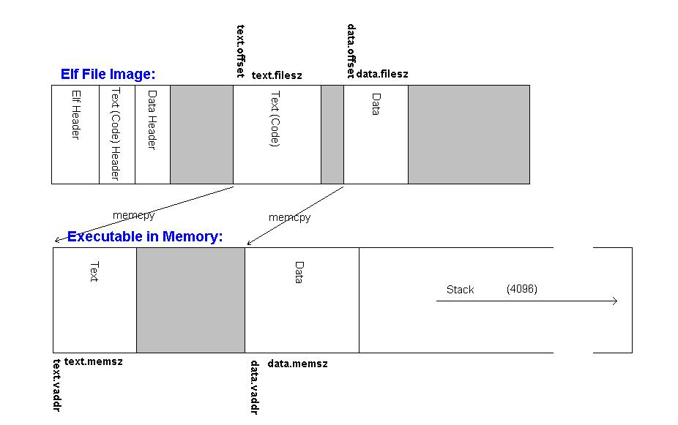
ELF File Image vs Executable Image

