Slide 1
Project 4 Roadmap

Slide 2
x86 Paging Overview
ftp://download.intel.com/design/Pentium4/manuals/25366814.pdf
figures on pages 3-2, 3-21

Slide 3
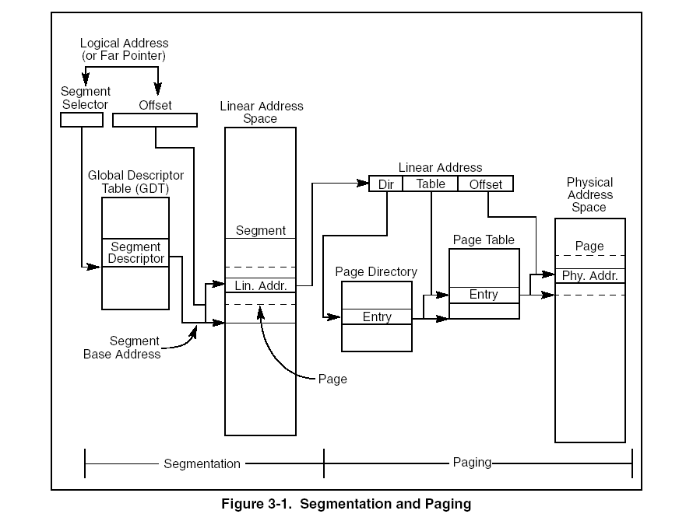

Slide 4
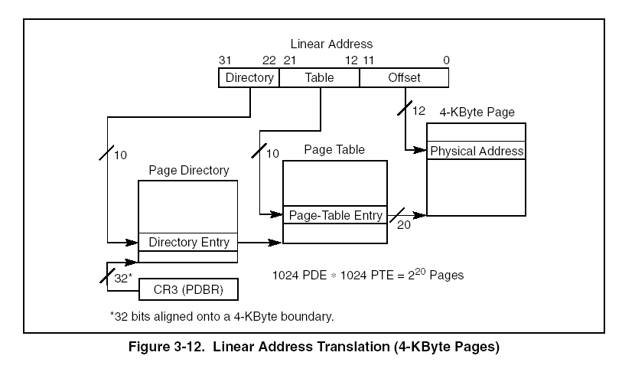

Slide 5
Mapping kernel memory (theory)
Premise: for the kernel, linear to physical mapping is one-to-one
GeekOS has 8MB of physical memory
  how many page directories will be needed ?
  how many page tables will be needed ?
Kernel is mapped from 0-2GB, user from 2GB-4GB
  how does the paging infrastructure look like ?

Slide 6
Mapping kernel memory (practice)
Crucial ! cannot get credit for any part of the project if this doesn’t work
basic idea: for the kernel, linear to physical mapping is one-to-one
effectively
  for all linear pages: map linear pages i to physical page i)
early deadline for this, see webpage

Slide 7
Mapping kernel memory : steps
Remember: for the kernel, linear to physical mapping is one-to-one
determine the amount of physical memory (bootInfo->memSizeKB)
allocate page directory
write functions for allocating page directory entries/page table entries
  handy PAGE_DIRECTORY_INDEX/PAGE_TABLE_INDEX are defined for you
for (i=0; i< allPhysical Pages;i++) do
  register page (i.e. linear page i maps to physical page i)
  use Get_Page(addr) from mem.h to get the struct Page associated with a physical page
  flags to (VM_WRITE | VM_READ | VM_USER) for pde_t/pte_t
turn on paging (Enable_Paging)
register page fault handler (Install_Interrupt_Handler)
test here!
works ? if yes, remove VM_USER from flags and go on

Slide 8
Modify your spawn code
don’t leave space for stack
allocate page directory; save it in a field in userContext
copy kernel’s page directory entries
allocate pages for data/text; copy from image
allocate two more for stack/args
memory space
  start address is 0x80000000
  stack at the end (what is “the end” then ?)

Slide 9
Page fault handler
register handler w/interrupt 14 in paging.c
implementation
  only a user program may fault
  case 1 – “page in” request
  case 2 – stack growth request
test: use rec.c to trigger a fault (memory pressure)

Slide 10
Swapping (I)
Alloc_Pageable_Page() vs Alloc_Page()
  flags
  possibly swap out
  use Alloc_Page() for directories/page tables
  use Alloc_Pageable_Page() for everything else

Slide 11
Swapping (II)
LRU in theory:see textbook 10.4.4
Ours - “pseudo” LRU
  add hook in Page_Fault_Handler()
  walk thru all physical pages
  if page subject to paging and accesed==1 then increment clock, set accesed=0
  (see struct Page, struct pte_t)
  HW sets the accesed to 1 automatically upon read/write in that page; but you have to set it to 0 manually when you update the clocks
  Find_Page_To_Page_Out finds page with lowest clock

Slide 12
Swapping (III)
Page out
  when ?
  which page ? (Find_Page_To_Page_Out, see previous slide!)
  where ? (Find_Space_On_Paging_File())
  how ? (you’ll do Write_To_Paging_File (void *paddr, ulong_t virtual, int pageFileIndex))
Page in
  when ?
  how ? (you’ll do Read_From_Paging_File(void *paddr, ulong_t virtual, int pageFileIndex))
Housekeeping
  pageTable->kernelInfo = KINFO_PAGE_ON_DISK/0
  pageTable->pageBaseAddr = <block on disk>
  disk page management – have to do it yourself

