Slide 1
Project 3 Roadmap
Message Passing

Slide 2
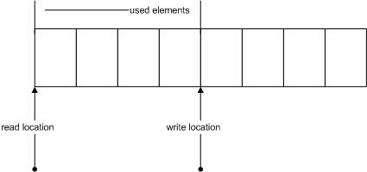
Fast communication mechanism
Usually implemented as a Circular Buffer
Think of an UNIX pipe

Slide 3
Message_Queue_Create()
int Message_Queue_Create(const char *name, ulong_t queue_size)
similar to Create_Semaphore()
each queue has name, id and a bounded size
shared among threads
add a message queue list to User_Context

Slide 4
Message_Queue_Destroy()
int Message_Queue_Destroy(int mqid)
similar to Destroy_Semaphore()
keep a ref count, free only when ref count reaches 0

Slide 5
Message_Queue_Send()
int Message_Queue_Send(int mqid, void * buffer, ulong_t message_size)
check buffer and message size
similar to Write()
blocks is queue full

Slide 6
Message_Queue_Receive()
int Message_Queue_Receive(int mqid, void * buffer, ulong_t message_size)
check buffer and message size
similar to Read()
blocks is queue empty

