Slide 1
Project 1 Roadmap
read the project description ?
read the newsgroup ?
read the ELF specification ?
  (1-1..1-4, 2-1..2-3, 2-7..2-8)
read the elfHeader correctly ?
  ident, type=ET_EXEC, machine=EM_386
found the two programHeaders ?
  check against objdump -x, elfdump
figure out the total size
  > sum of codesize+datasize !
  leave spack for stack, round to 4096
allocate
copy the two segments; don’t forget to add base addr to source and destination
entryPoint = entry from elfHeader; leave untouched
free original buffer, done !

Slide 2
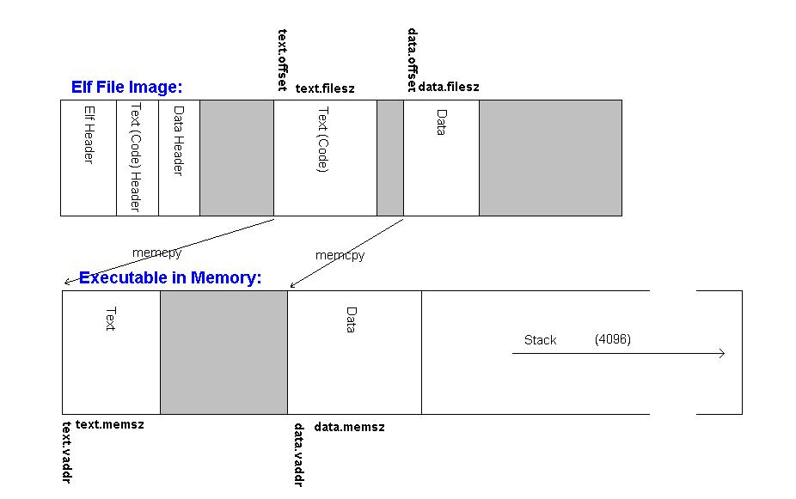
Everything is in this picture !

Slide 3
You will need to parse the ELF headers
malloc a piece of memory big enough for the executable image (including the stack)
copy the text and data sections from the ELF file image to the correct places within this memory
fill in the Loadable_Program structure that will provide information to our functions (and later to your functions) that will run the code
You should also free the buffer that was read in by ReadFileAndAllocate()

