Slide 1
Project 3 Roadmap
Multilevel Feedback Scheduling
Semaphores
Passing Parameters to New Processes

Slide 2
Multilevel Feedback Scheduling
Get_Time() - trivial
Multilevel Feedback Scheduling
  add current queue/blocked state for each Thread
  create 4 queues; a thread is intially in q0 (except IDLE thread)
  end of quanta ?
    if blocked promote
    if has run demote
  make sure your Set_Scheduling_Policy() works before stuff gets complicated
  becomes blocked in Wait()

Slide 3
Semaphores
drilling, drilling
rough guideline
  add two files sem.h/sem.c
  create a semaphore structure
  each has a thread queue, count, name, etc
  P/V semantics
    P decrease, block if needed
    V increase, never blocks

Slide 4
Passing Parameters to New Processes(I)
start with & processing in shell
pass the string via Spawn_Program syscall
  (drop the & of course)
kernel takes exec name, creates UserThread
whole command line gets into user memory space
time for Entry() to do lots of stuff
  recover cmd line
  split into argv
  call Main(argc, argv)
User
Kernel
User

Slide 5
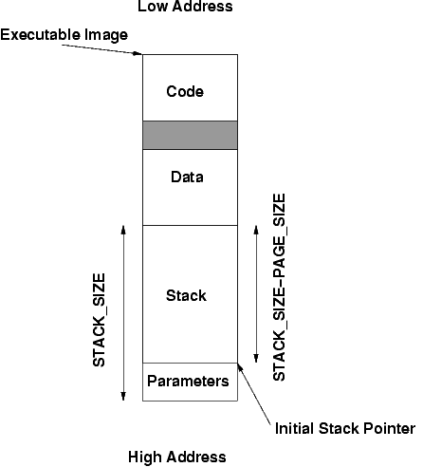
Passing Parameters to New Processes(II)

Slide 6
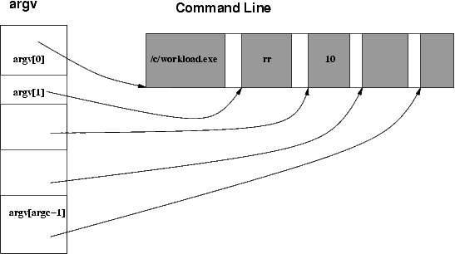
Passing Parameters to New Processes(III)

