Slide 1
Project 4 Roadmap
http://www.intel.com/design/pentium4/manuals/24547212.pdf pages 3-2, 3-21

Slide 2
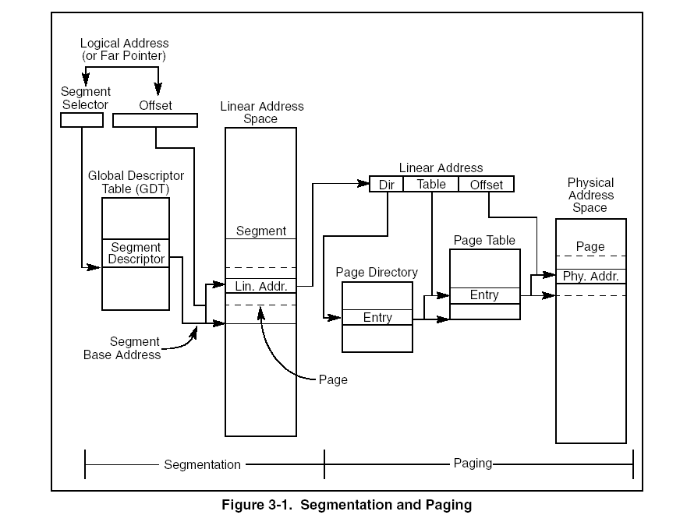

Slide 3
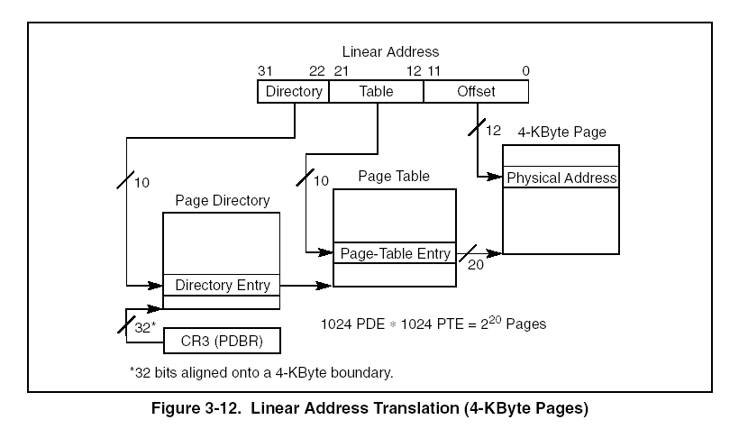

Slide 4
Mapping kernel memory (theory)
Premise: for the kernel, linear to physical mapping is one-to-one
Say we have 8MB of physical memory.
Answer (on paper) to these questions:
  how many page directories will be needed ?
  how many page tables will be needed ?
Kernel is mapped from 0-2GB, user from 2GB-4GB
Answer (on paper) to these question:
  how does the paging infrastructure look like ?

Slide 5
Mapping kernel memory(practice)
Crucial ! cannot get credit for any part of the project if this doesn’t work
basic idea: for the kernel, linear to physical mapping is one-to-one
steps:
  determine the amount of physical memory
  allocate page directory
  write functions for allocating page directory entries/page table entries
    handy PAGE_DIRECTORY_INDEX/PAGE_TABLE_INDEX are defined for you
  for (i=0; i< allPhysical Pages;i++) do
    register page (i.e. linear page i maps to physical page i)
    use Get_Page(addr) from mem.h to get the struct Page associated with a physical page
    userMode to 1 for pageDirectoryEntry/pageTableEntry
turn on paging (Enable_Paging)
test here!
works ? if yes, set userMode back to 0 and go on

Slide 6
Modify your spawn code
don’t leave space for stack
allocate page directory; save it in a field in userContext
copy kernel’s page directory entries
allocate pages for data/text; copy from image
allocate two more for stack/args
memory space
  start address is 0x80000000
  stack at the end (what is “the end” then ?)

Slide 7
Page fault handler
register handler w/interrupt 14 in trap.c
implementation
  only a user program may fault
  case 1 – “page in” request
  case 2 – stack growth request
test: use rec.c to trigger a fault (memory pressure)

Slide 8
Swapping
Alloc_Pageable_Page() vs Alloc_Page()
  flags
  possibly swap out
  use Alloc_Page() for directories/page tables
  use Alloc_Pageable_Page() for everything else
LRU in theory:see textbook 10.4.4
Ours - “pseudo” LRU
  add hook in PageFault_Handler()
  walk thru all physical pages
  if page subject to paging and accesed==1 then increment clock, set accesed=0
  (see struct Page, struct pageTableEntry)
  HW sets the accesed to 1 automatically upon read/write in that page; but you have to set it to 0 manually when you update the clocks

Slide 9
Swapping (cont’d)
Page out
  when ?
  which page ? (see previous slide!)
  where ? (findSpaceOnPagingFile())
  how ? (you’ll add writeToPagingFile(int memory, int diskPage))
Page in
  when ?
  how ? (you’ll add readFromPagingFile(int memory, int diskPage))
Housekeeping
  pageTable->kernelInfo = KINFO_PAGE_ON_DISK/0
  pageTable->pageBaseAddr = <block on disk>
  disk page management – have to do it yourself

