Slide 1
Assignment 1
CMSC 714
September 11, 2003

Slide 2
Data Collection
For this assignment, you will be asked to provide the following:
  Effort spent on various activities (self-tracked)
  Information when you compile your program (automatically collected)
  All information will be collected by the research team will not be seen by Dr. Hollingsworth until after the semester. It will not affect your grade.

Slide 3
Effort Form
Will ask you to report your effort in the following tasks:
  Thinking/Planning – Thinking about how to solve the problem, or planning your implementation (no coding)
  Serial Coding – Creating a serial version of your solution
  Parallelizing the Code – Porting your serial solution to work on more than one processor
  Testing Code – Verifying that the answer produced by your code is correct
  Tuning Parallel Code – Modifying the parallel code to increase its performance
  Other – Any other tasks

Slide 4
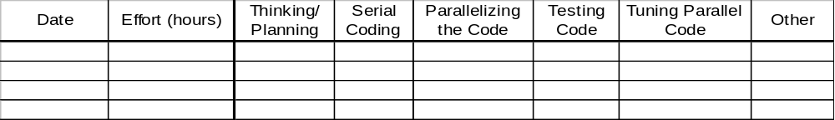
Effort Form
A form will be used to collect the amount of effort you spend on various tasks
Each time you work on the assignment, you complete one or more lines on the form

Slide 5
Compiler
When you compile your program, you will be prompted to indicate the reason for recompilation:
  Adding Functionality (serial code)
  Parallelizing Code
  Improving Performance (tuning)
  Debugging: Compile time error
  Debugging: Crashed on previous run
  Debugging: Hung on previous run
  Debugging: Incorrect behavior on previous run
  Restructuring/Cleanup
  Other

Slide 6
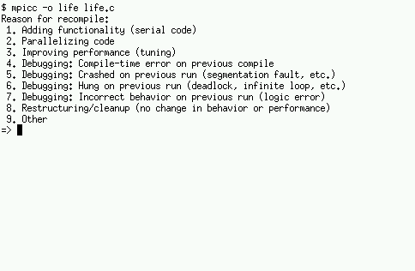
Compiler
Menu will look like:

Slide 7
Questions?
Email me:
  Jeff Carver carver@cs.umd.edu

