Slide 1
Appendix A: Digital Logic
By Miles Murdocca
Internet Institute USA

Slide 2
Chapter Contents
A.1 Combinational Logic
A.2 Truth Tables
A.3 Logic Gates
A.4 Boolean Algebra
A.5 SOP Forms, Logic Diagrams
A.6 POS Forms
A.7 Positive and Negative Logic
A.8 The Data Sheet
A.9 Digital Components
A.10 Simplification of Exprs.
A.11 Speed and Performance
A.12 Sequential Logic
A.13 JK and T Flip Flops
A.14 Design of Finite State
Machines
A.15 Mealy and Moore Machines
A.16 Registers
A.17 Counters

Slide 3
Some Definitions
Combinational logic: a digital logic circuit in which logical decisions are made based only on combinations of the inputs. e.g. an adder.
Sequential logic: a circuit in which decisions are made based on combinations of the current inputs as well as the past history of inputs. e.g. a memory unit.
Finite state machine: a circuit which has an internal state, and whose outputs are functions of both current inputs and its internal state. e.g. a vending machine controller.

Slide 4
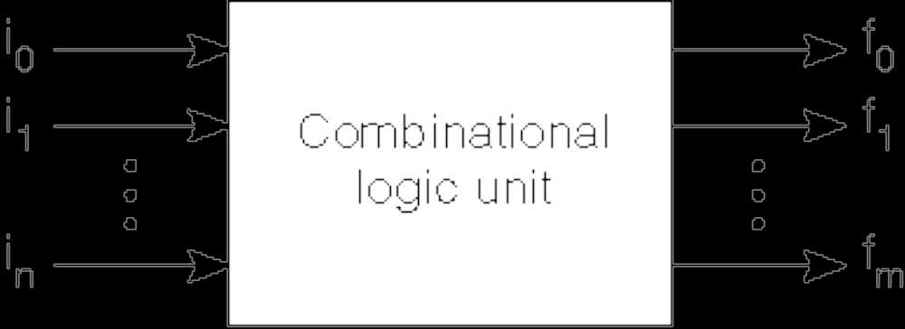
The Combinational Logic Unit
Translates a set of inputs into a set of outputs according to one or more mapping functions.
Inputs and outputs for a CLU normally have two distinct (binary) values: high and low, 1 and 0, 0 and 1, or 5 v. and 0 v. for example.
The outputs of a CLU are strictly functions of the inputs, and the outputs are updated immediately after the inputs change. A set of inputs i0 – in are presented to the CLU, which produces a set of outputs according to mapping functions f0 – fm
Fig A.1

Slide 5
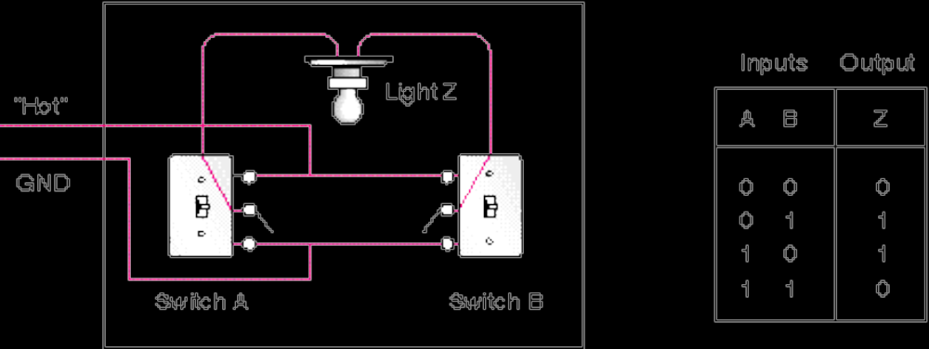
Truth Tables
Developed in 1854 by George Boole
Further developed by Claude Shannon (Bell Labs)
Outputs are computed for all possible input combinations (how many input combinations are there?
Consider a room with two light switches. How must they work†?
Fig. A.2
†Don't show this to your electrician, or wire your house this way. This circuit definitely violates the electric code. The practical circuit never leaves the lines to the light "hot" when the light is turned off. Can you figure how?

Slide 6
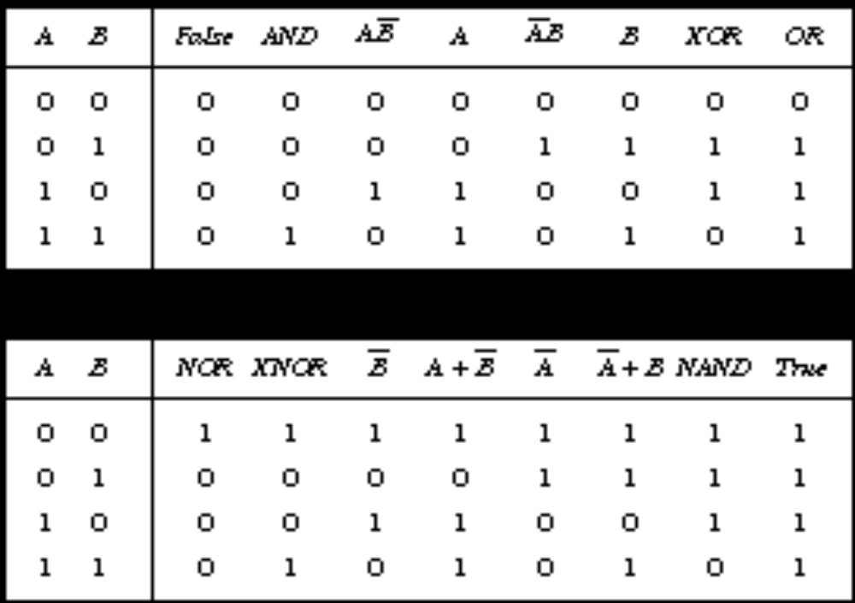
Truth Tables Showing All Possible Functions of Two Binary Variables
The more frequently used functions have names: AND, XOR, OR, NOR, XOR, and NAND. (Always use upper case spelling.)

Slide 7
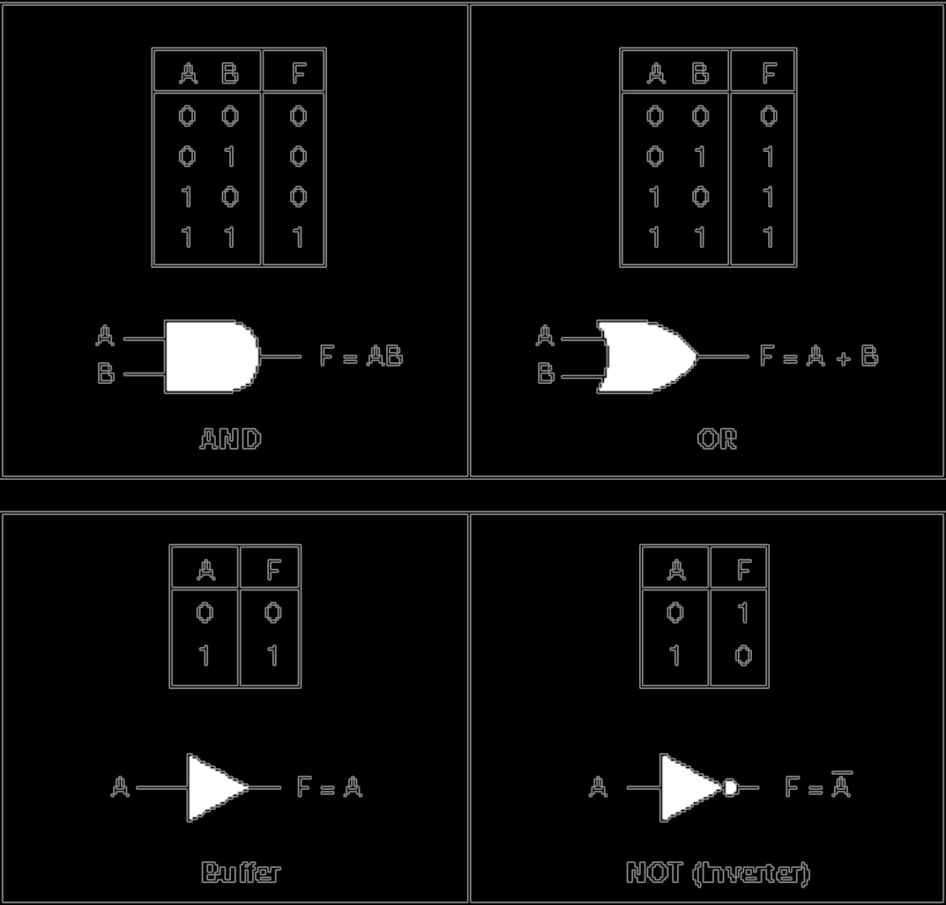
Logic Gates and Their Symbols
Fig. A.5 Logic symbols for AND, OR, buffer, and NOT Boolean functions
Note the use of the “inversion bubble.”
(Be careful about the “nose” of the gate when drawing AND vs. OR.)

Slide 8
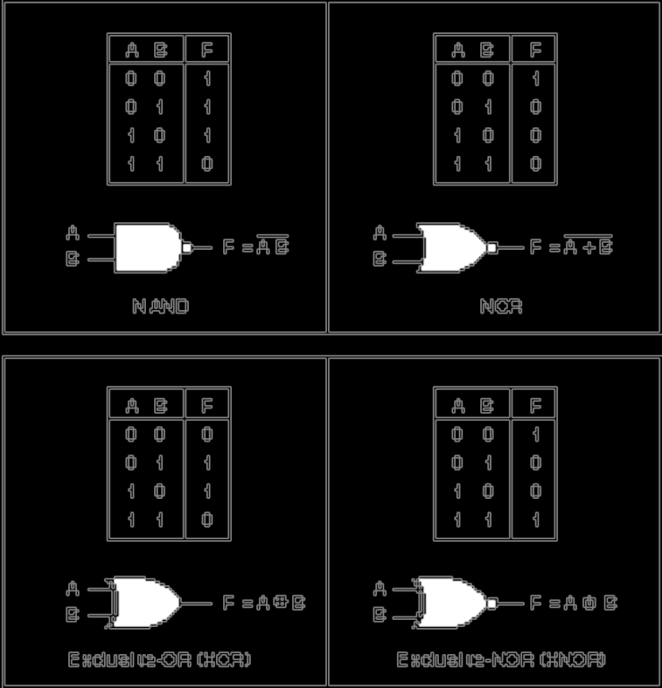
Logic symbols for NAND, NOR, XOR, and XNOR Boolean functions
Fig A.6

Slide 9
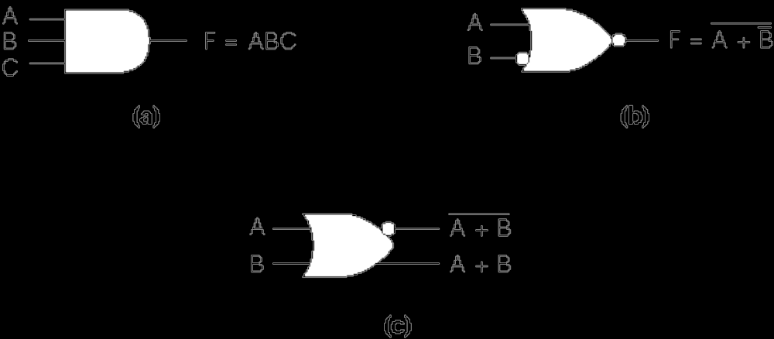
Fig A. 7 Variations of Basic Logic Gate Symbols
a) 3 inputs b) A Negated Input c) Complementary Outputs

Slide 10
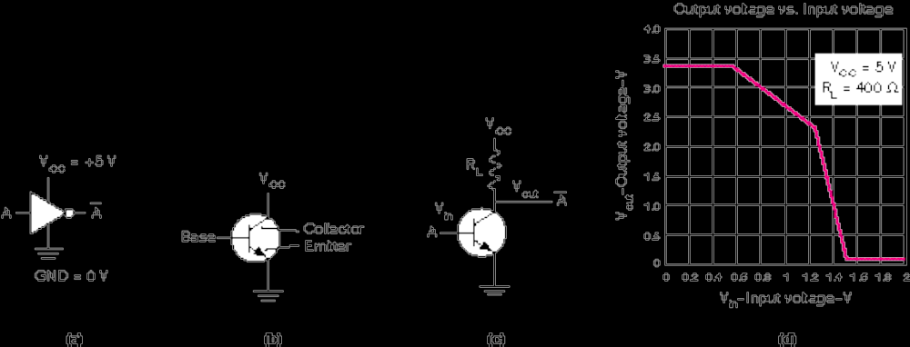
Fig A.8 The Inverter at the Transistor Level
Power
Terminals
Transistor
Symbol
A Transistor Used
as an Inverter
Inverter Transfer
Function

Slide 11
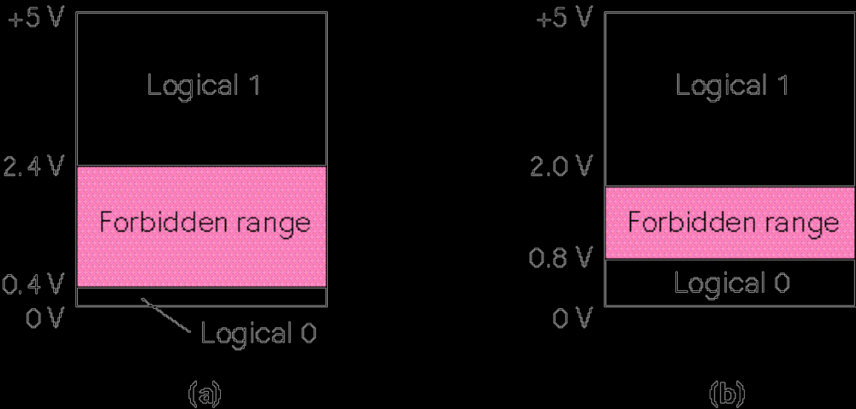
Fig A.9 Allowable Voltages in Transistor-Transistor-Logic (TTL)

Slide 12
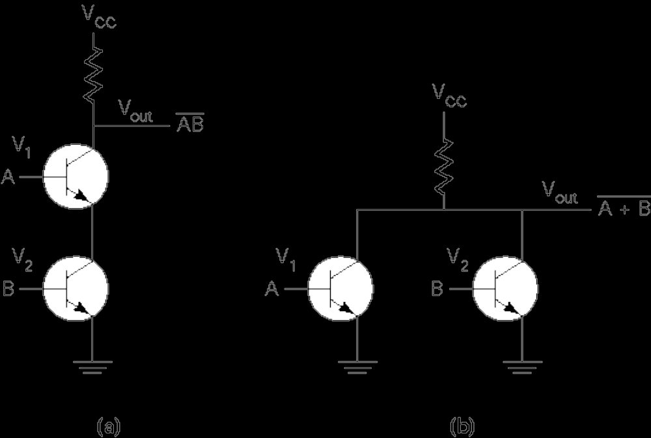
A.10 Transistor-Level Circuits For
2-Input a) NAND and b)NOR Gates

Slide 13
Tbl A.1 The Basic Properties of Boolean Algebra
Principle of duality: The dual of a Boolean function is gotten by replacing AND with OR and OR with AND, constant 1s by 0s, and 0s by 1s
Postulates
Theorems
A, B, etc. are Literals; 0 and 1 are constants.

Slide 14
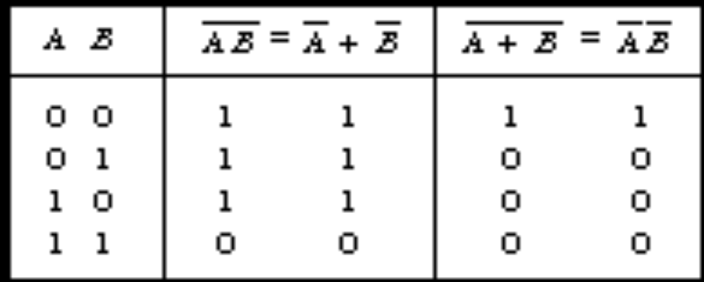
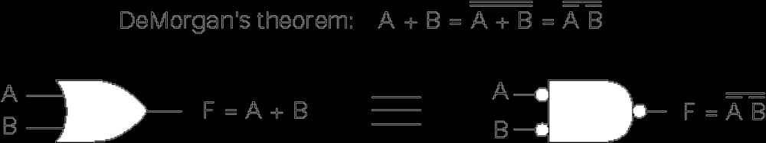
A.11 and A. 12 DeMorgan’s Theorem
Discuss: Applying DeMorgan’s theorem by “pushing the bubbles,” and “bubble tricks.”

Slide 15
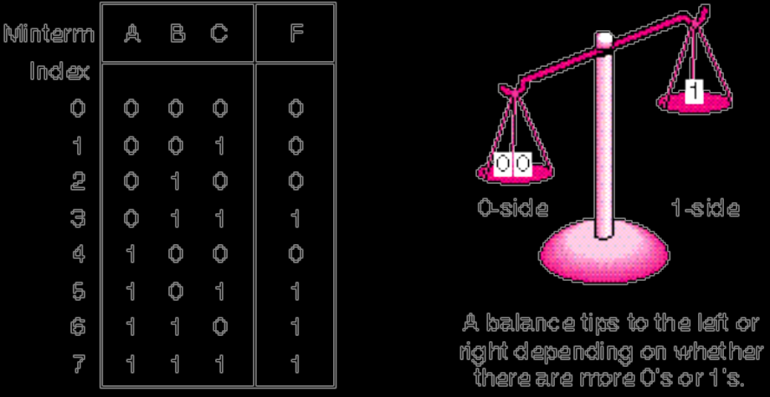
The Sum-of-Products (SOP) Form
Fig. A.14—Truth Table for The Majority Function
transform the function into a two-level AND-OR equation
implement the function with an arrangement of logic gates from the set {AND, OR, NOT}
M is true when A=0, B=1, and C=1, or when A=1, B=0, and C=1, and so on for the remaining cases.
Represent logic equations by using the sum-of-products (SOP) form

Slide 16
The SOP Form of the Majority Gate
The SOP form for the 3-input majority gate is:
M = ABC + ABC + ABC + ABC = m3 + m5 +m6 +m7 = Σ (3, 5, 6, 7)
Each of the 2^{n} terms are called minterms, running from 0 to 2^{n} - 1
Note the relationship between minterm number and boolean value.
Discuss: common-sense interpretation of equation.

Slide 17
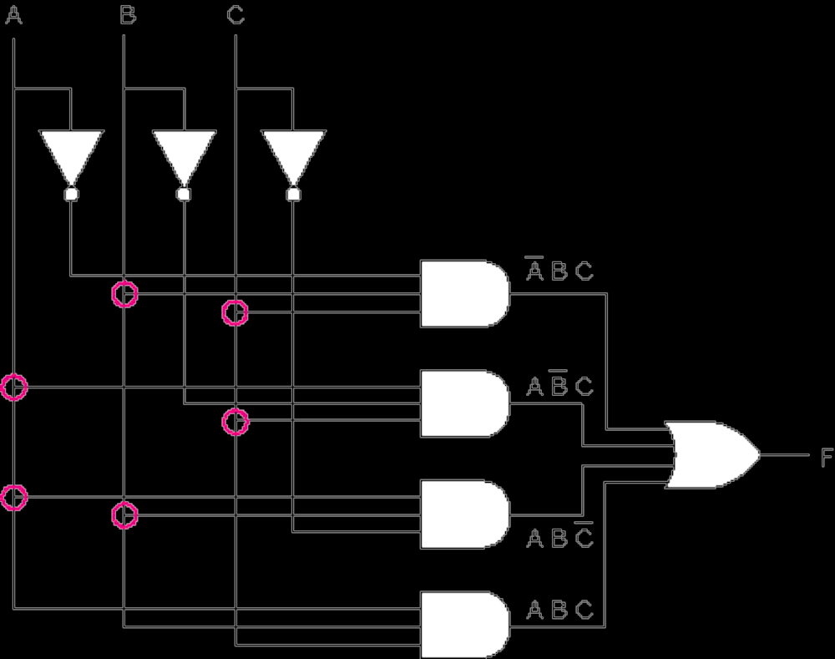
Fig A.15 A 2-Level AND-OR Circuit that Implements the Majority Function
Discuss: What is the Gate Count?

Slide 18
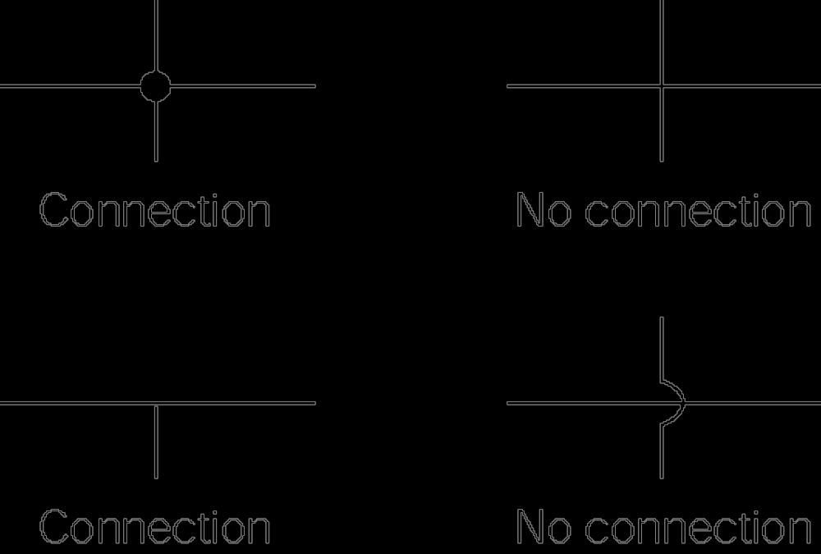
Fig A.16 Notation Used at Circuit Intersections

Slide 19
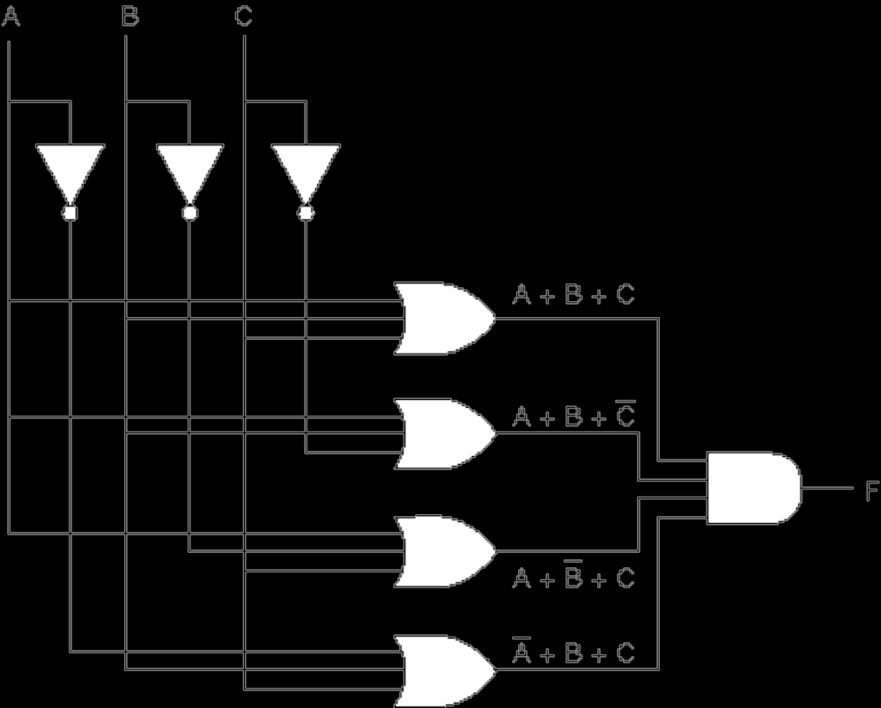
Fig A.17 A 2-Level OR-AND Circuit that Implements the Majority Function

Slide 20
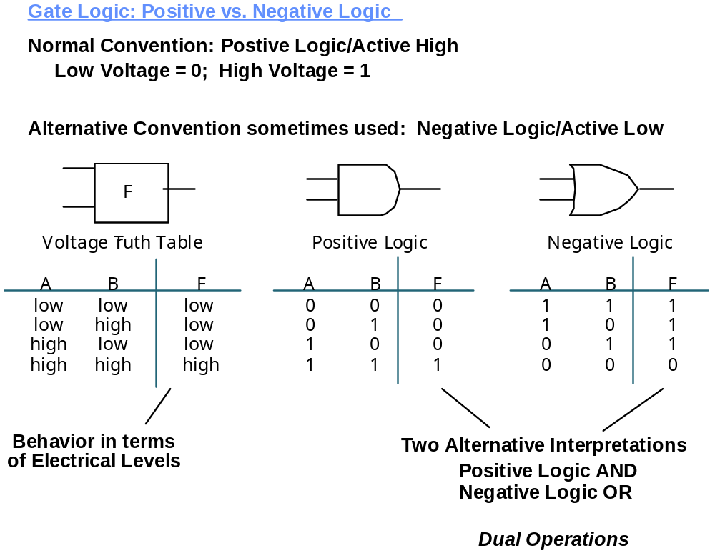
Positive vs. Negative Logic
Positive logic: truth, or assertion is represented by logic 1, higher voltage; falsity, de- or unassertion, logic 0, is represented by lower voltage.
Negative logic: truth, or assertion is represented by logic 0 , lower voltage; falsity, de- or unassertion, logic 1, is represented by lower voltage

Slide 21
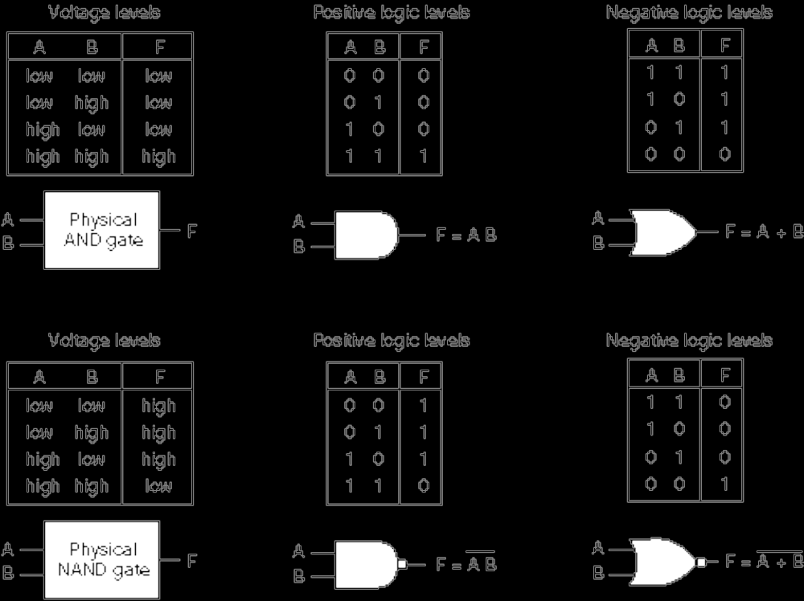
Fig A.18 Positive and Negative Logic (Cont’d.)

Slide 22
Bubble Matching
Active low signals are signified by a prime or overbar or /.
Active high: enable
Active low: enable’, enable, enable/
Discuss microwave oven control:
Active high: Heat = DoorClosed • Start
Active low: ? (hint: begin with AND gate as before.)

Slide 23
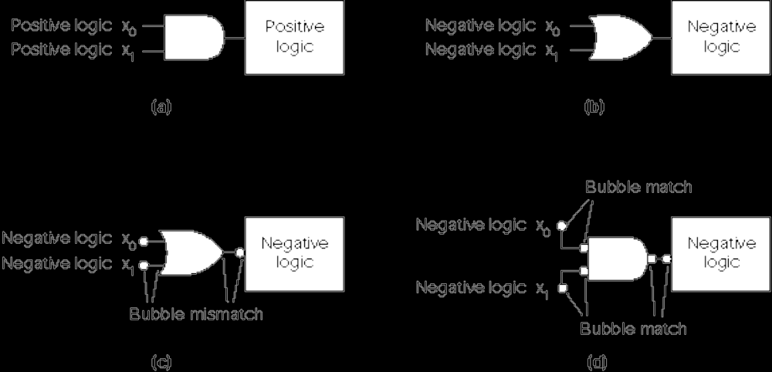
Fig. A.19 Bubble Matching (Cont’d.)

Slide 24
Digital Components
High level digital circuit designs are normally made using collections of logic gates referred to as components, rather than using individual logic gates. The majority function can be viewed as a component.
Levels of integration (numbers of gates) in an integrated circuit (IC):
small scale integration (SSI): 10-100 gates.
medium scale integration (MSI): 100 to 1000 gates.
Large scale integration (LSI): 1000-10,000 logic gates.
Very large scale integration (VLSI): 10,000-upward.
These levels are approximate, but the distinctions are useful in comparing the relative complexity of circuits.
Let us consider several useful MSI components:

Slide 25
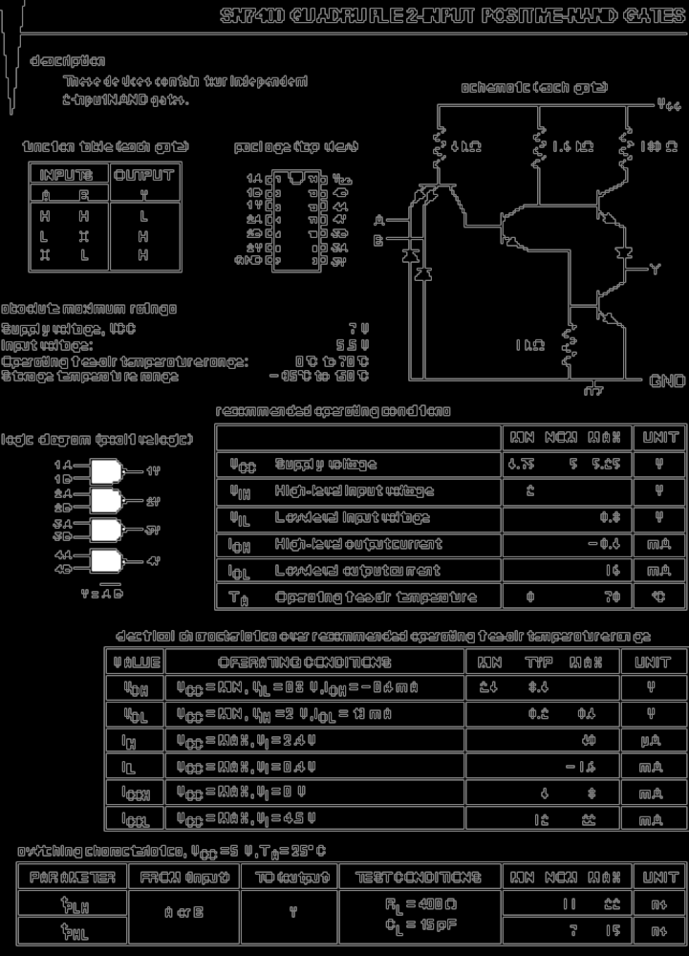
Fig A.20 The Data Sheet

Slide 26
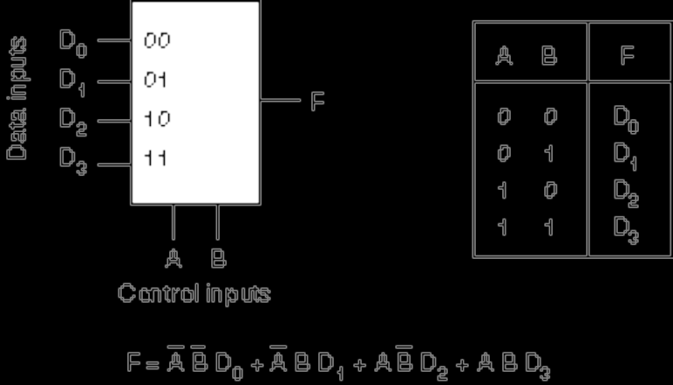
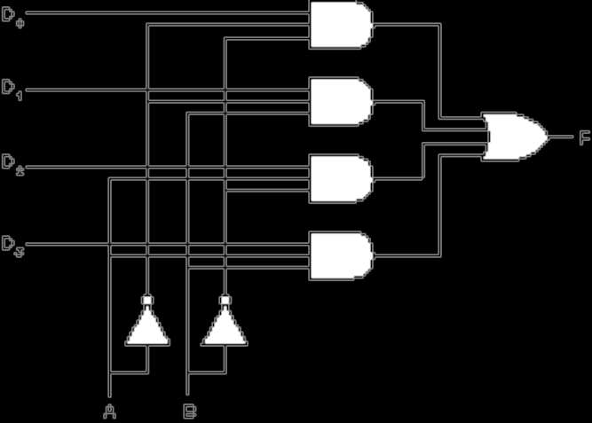
Figs A.21, A.22 The Multiplexer

Slide 27
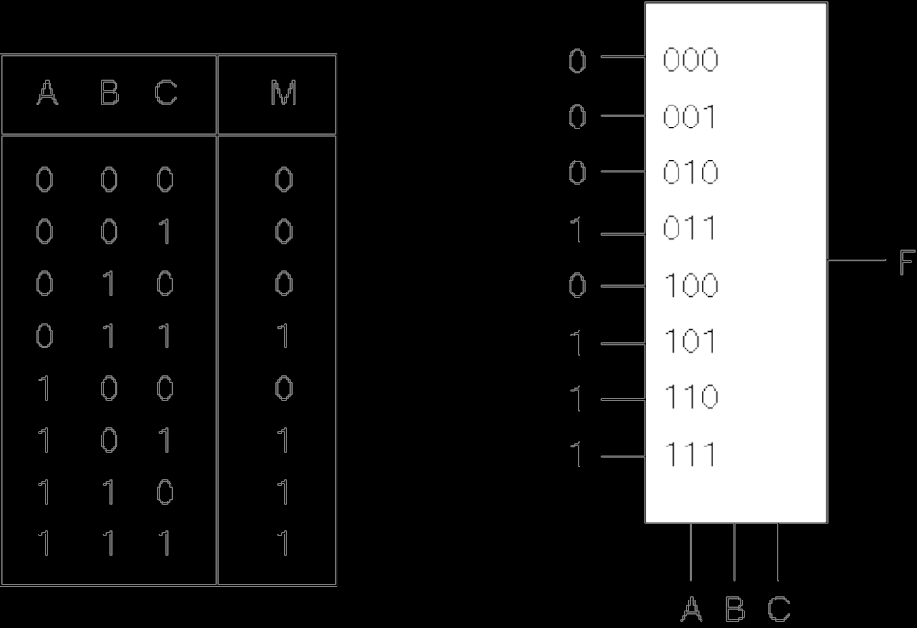
Fig A.23 Implementing the Majority Function with an 8-1 Mux
Principle: Use the mux select to pick out the selected minterms of the function.

Slide 28
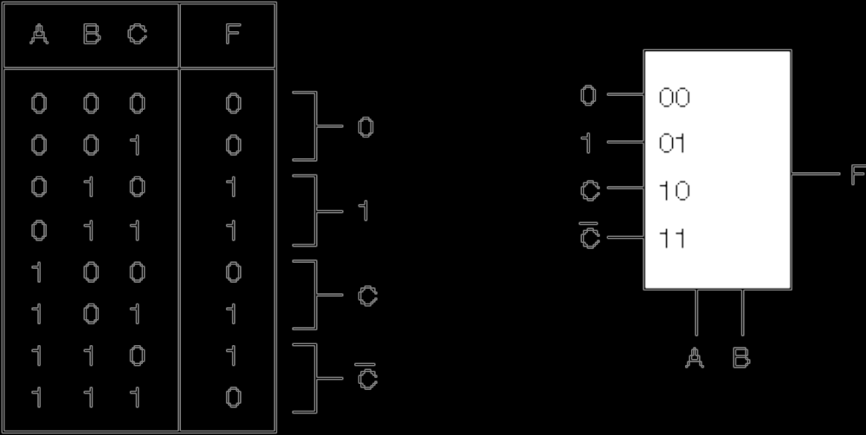
Fig. A.24 More Efficiency: Using a 4-1 Mux to Implement the Majority F’n.
Principle: Use the A and B inputs to select a pair of minterms. The value applied to the MUX input is selected from {0, 1, C, C} to pick the desired behavior of the minterm pair.

Slide 29
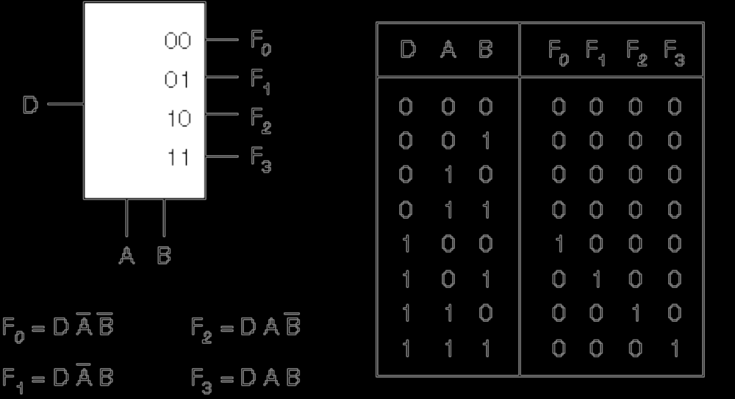
Fig. A.25 The Demultiplexer (DEMUX)

Slide 30
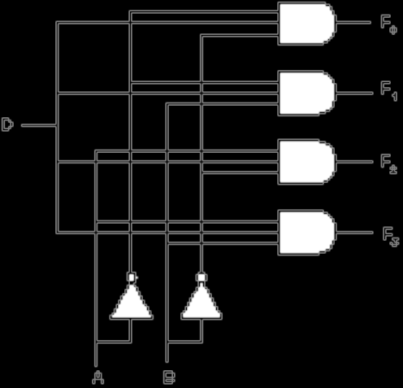
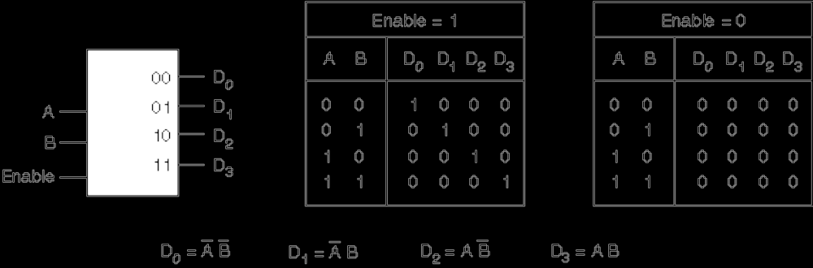
Fig’s. A.26 and A.27: The Demultiplexer is a Decoder with an Enable Input
Compare to
Fig A.28

Slide 31
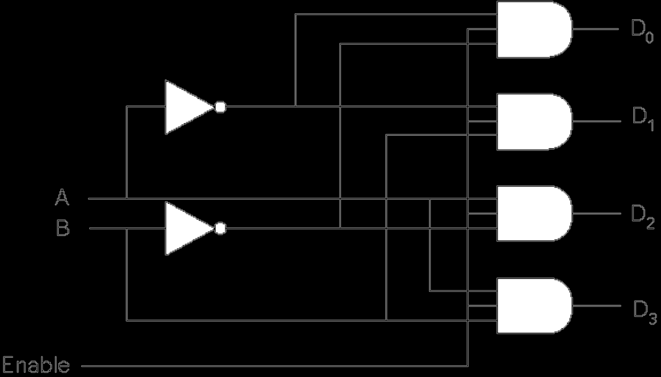
Fig A.28 A 2-4 Decoder
A.27

Slide 32
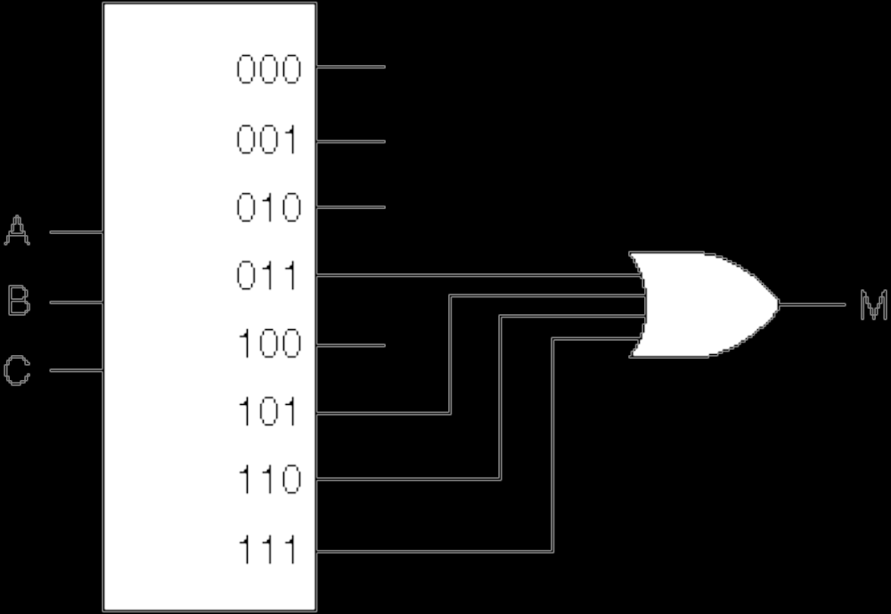
Fig A.29 Using a Decoder to Implement the Majority Function

Slide 33
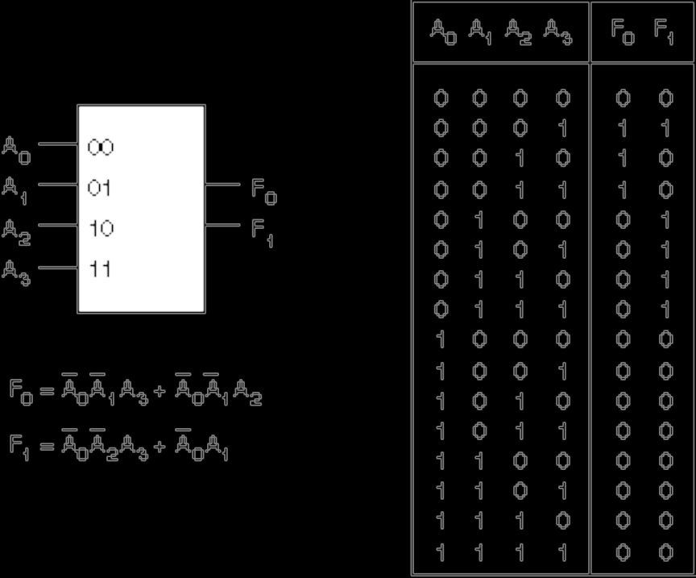
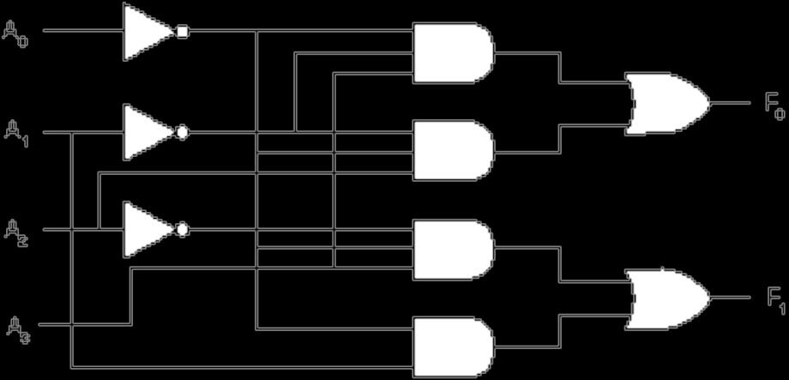
Figs A.30, 31, The Priority Encoder
An encoder translates a set of inputs into a binary encoding,
Can be thought of as the converse of a decoder.
A priority encoder imposes an order on the inputs.
A_{i} has a higher priority than A_{i+1}

Slide 34
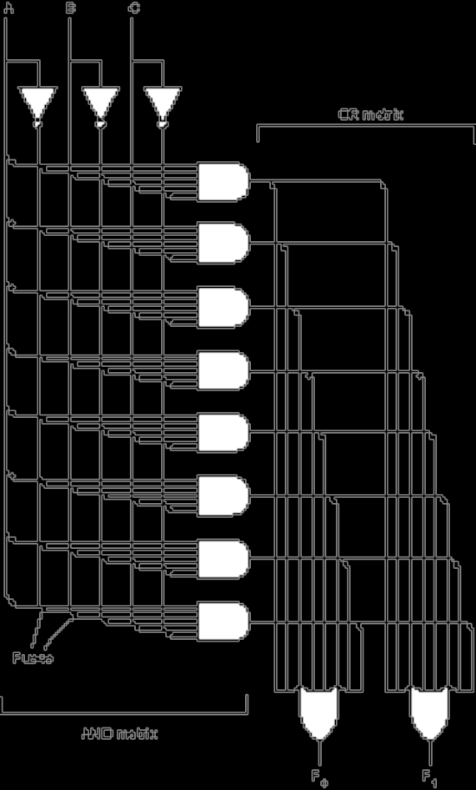
Fig A.32 Programmable Logic Arrays (PLAs)
A PLA is a customizable AND matrix followed by a customizable OR matrix:

Slide 35
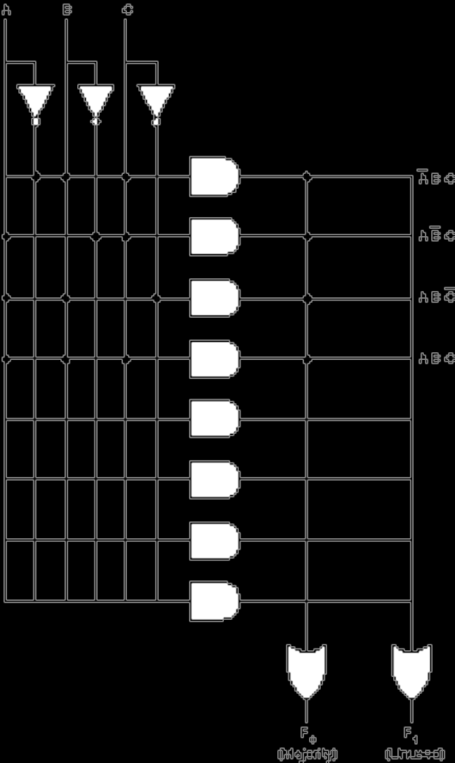
Fig. A.33 Using a PLA to Implement the Majority Function

Slide 36
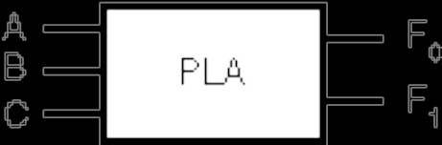
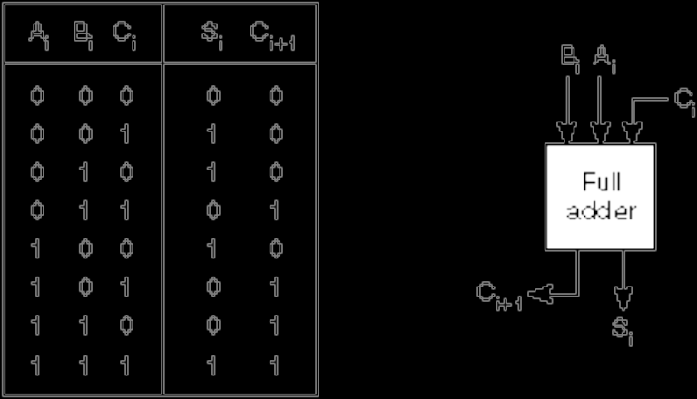
Using PLAs to Implement an Adder
Figs A.34-36

Slide 37
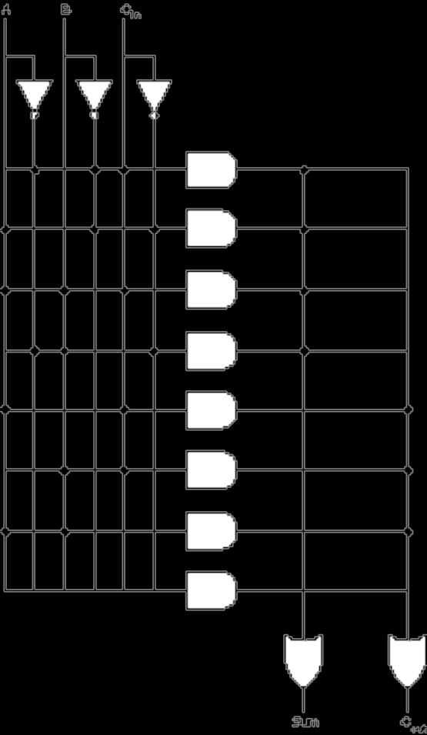
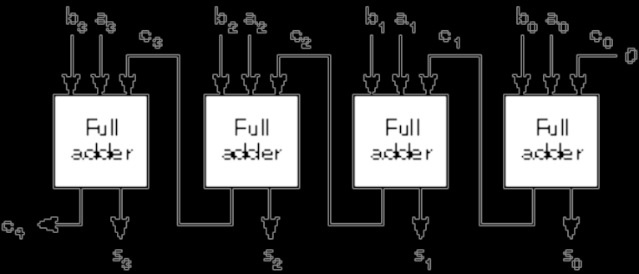
Fig A.37 A Multi-Bit Ripple-Carry Adder
Fig A.38 PLA Realization of a FA

Slide 38
Reduction (Simplification) of Boolean Expressions
It may be possible to simplify the canonical SOP or POS forms.
A smaller Boolean equation translates to a lower gate count in the target circuit.
We discuss two methods: algebraic reduction and Karnaugh map reduction.

Slide 39
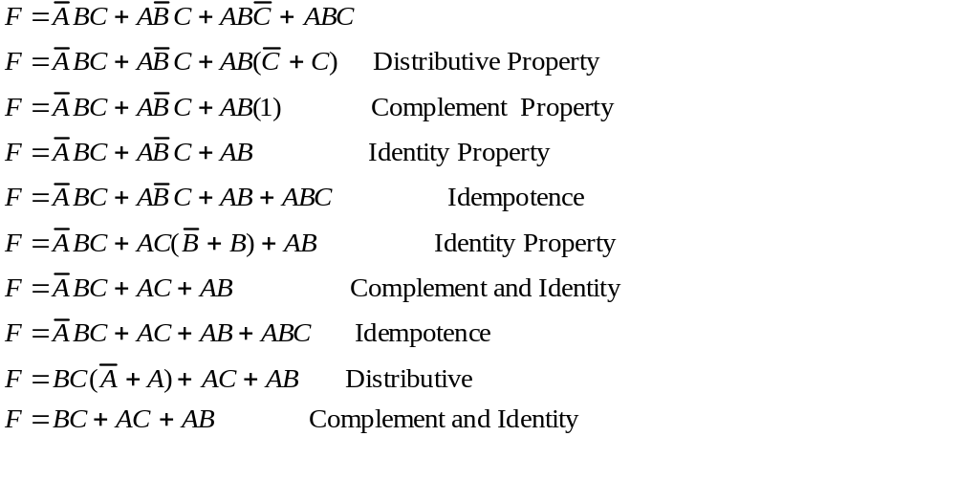
The Algebraic Method
Consider the majority function, F:

Slide 40
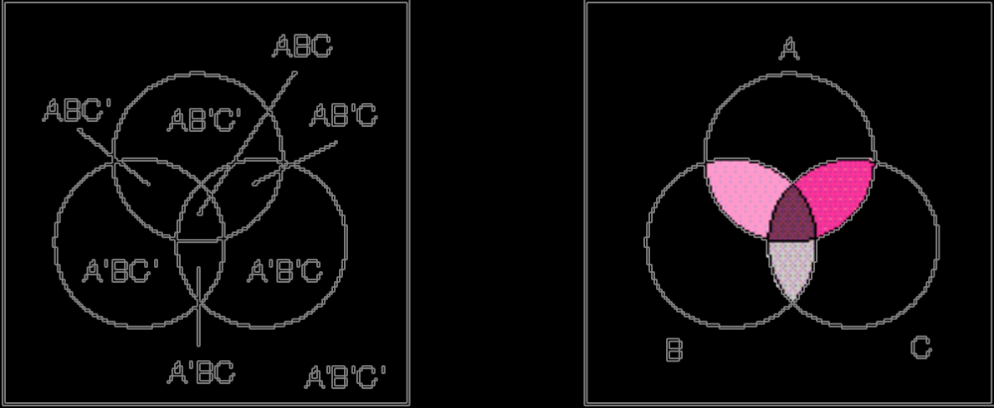
Fig A.40 Venn Diagrams
Each distinct region in the “Universe” represents a minterm.
This diagram can be transformed into a Karnaugh Map.

Slide 41
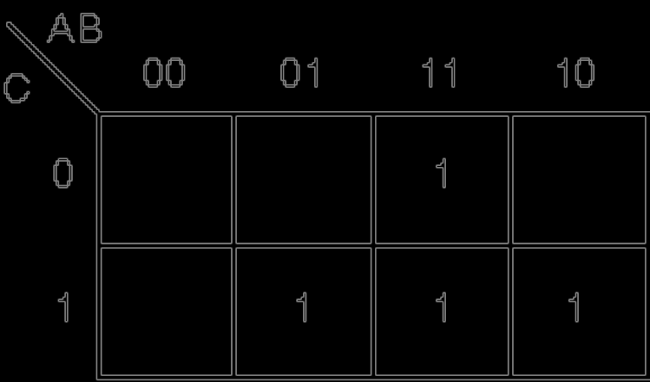
Fig A.41 A K-Map of the Majority Function
Place a “1” in each cell that has a that minterm.
Cells on the outer edge of the map “wrap around”
The map contains all the minterms. Adjacent 1’s in the K-Map satisfy the Complement property of Boolean Algebra.

Slide 42
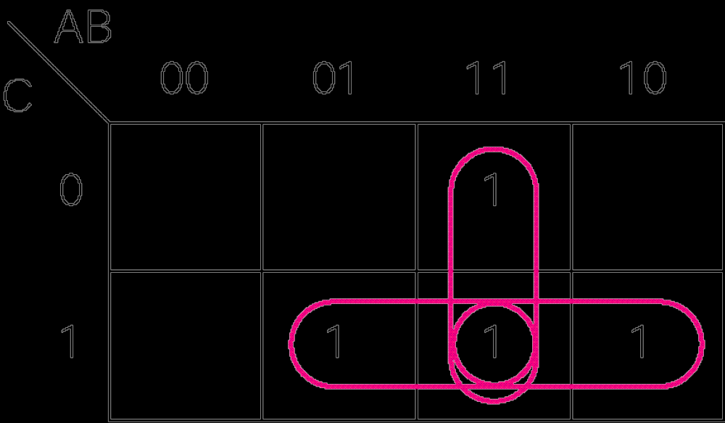
Fig A.42 Adjacency Groupings for the Majority Function
M= BC + AC + AB

Slide 43
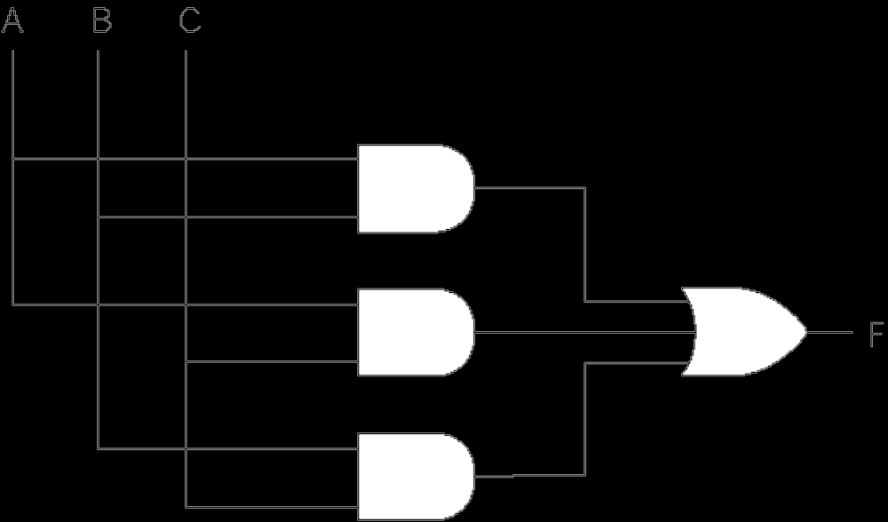
A.43 Minimized AND OR Circuit for the Majority Function
M= BC + AC + AB

Slide 44
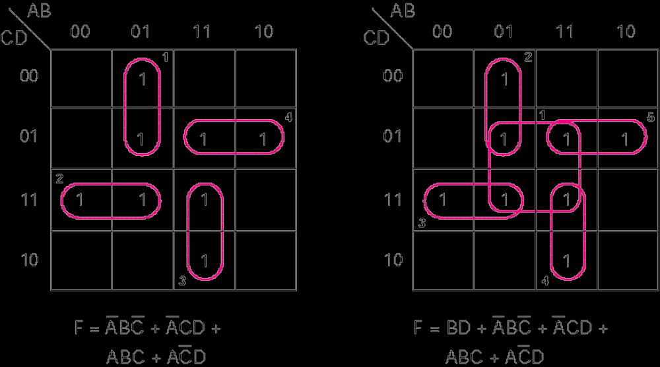
Fig A.44 Minimal and not Minimal Groupings

Slide 45
Fig A.44 Minimal and not Minimal Groupings

Slide 46
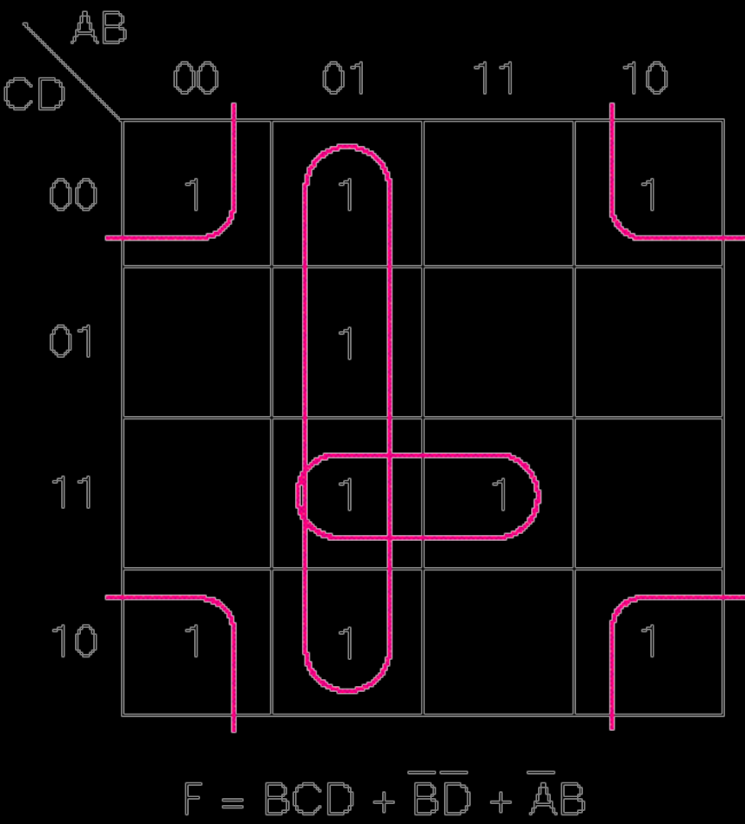
Fig A.45 The Corners are Logically Adjacent

Slide 47
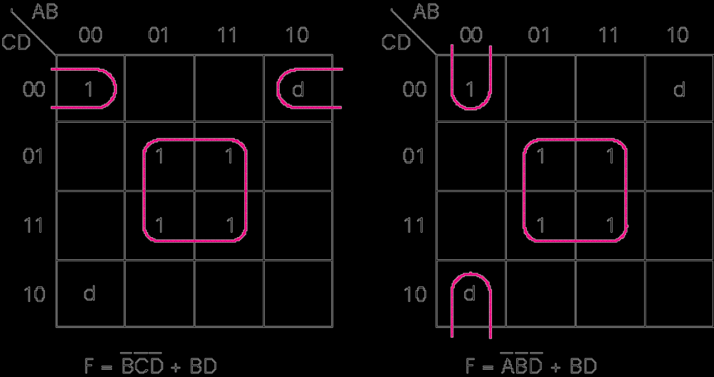
A.46 Two Different Minimized Equations

Slide 49
Speed and Performance
The speed of a digital system is governed by
  the propagation delay through the logic gates and
  the propagation across interconnections.

Slide 50
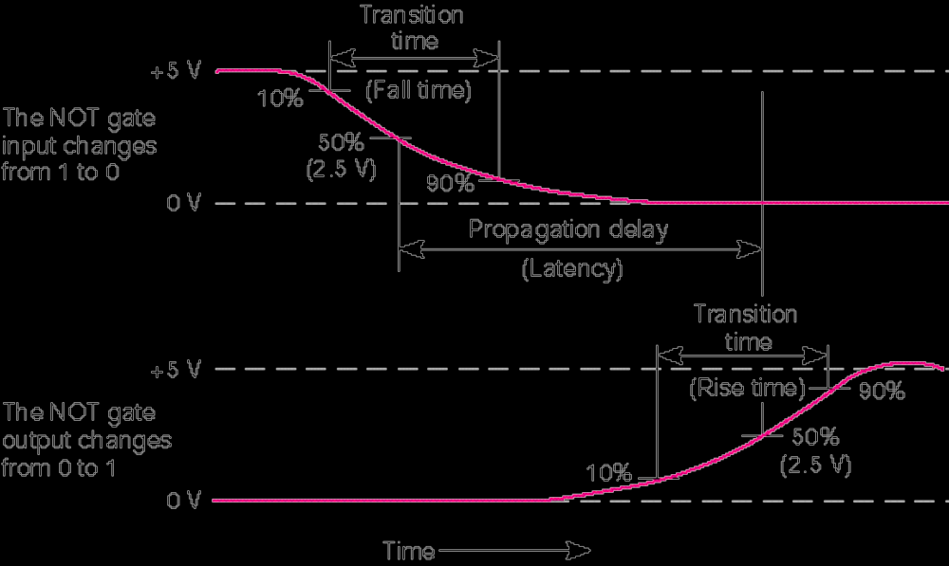
Fig A.47 Propagation Delay for a NOT Gate (From Hamacher et. al. 1990)

Slide 51
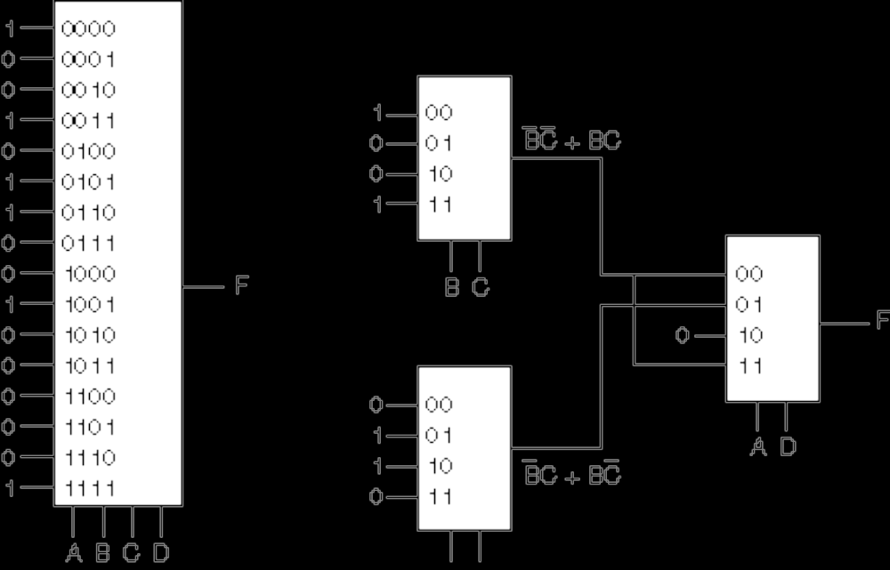
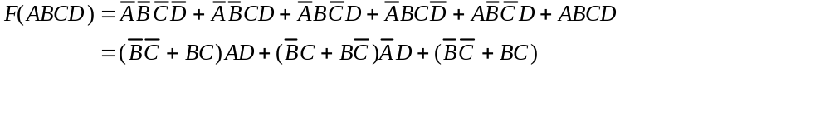
Circuit Depth Affects Propagation Delay—Fig A.48

Slide 52
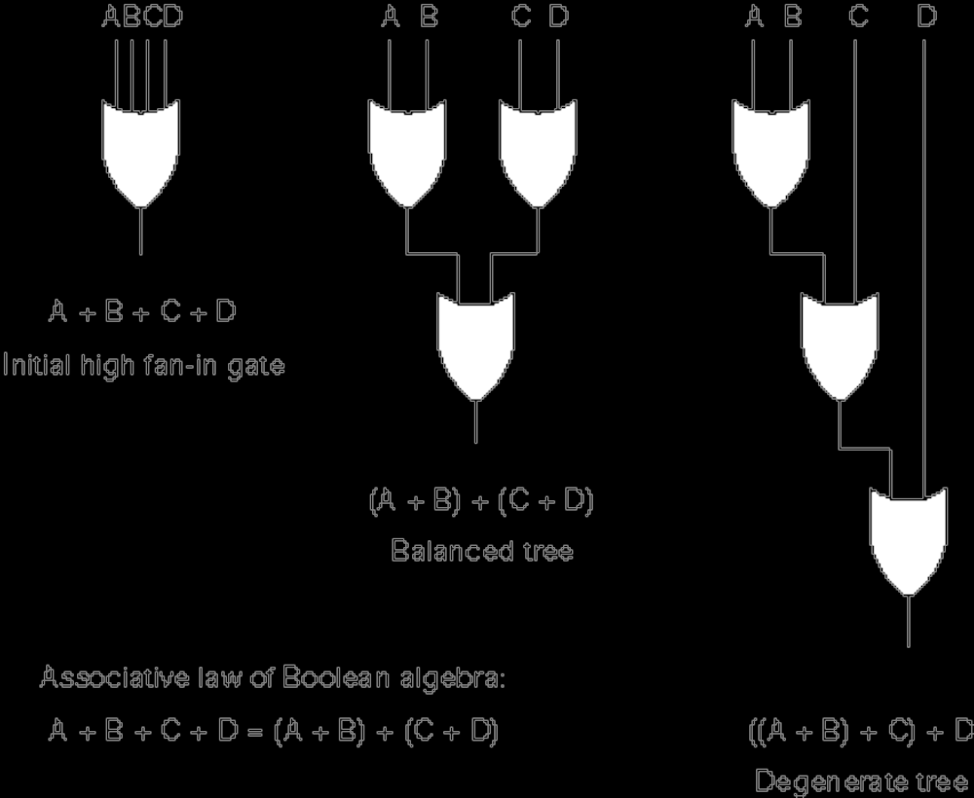
Fig A.49 Fan-in may Affect Circuit Depth

Slide 53
Sequential Logic
The combinational logic circuits we have been studying so far have no memory. The outputs always follow the inputs.
There is a need for circuits with a memory, which behave differently depending upon their previous state.
An example is the vending machine, which must remember how many and what kinds of coins have been inserted, and which behave according to not only the current coin inserted, but also upon how many and what kind of coins have been deposited previously.
These are referred to as finite state machines, because they can have at most a finite number of states.

Slide 54
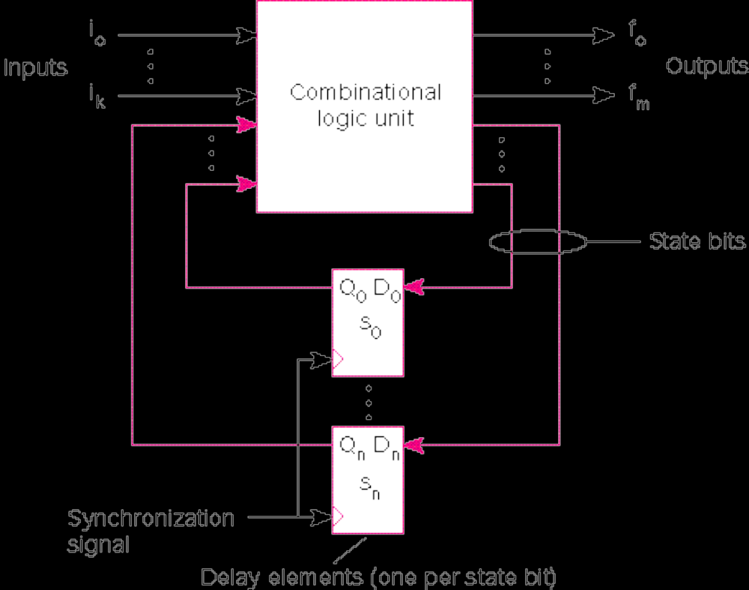
Fig A.50 Classical Model of a Finite State Machine (FSM)

Slide 55
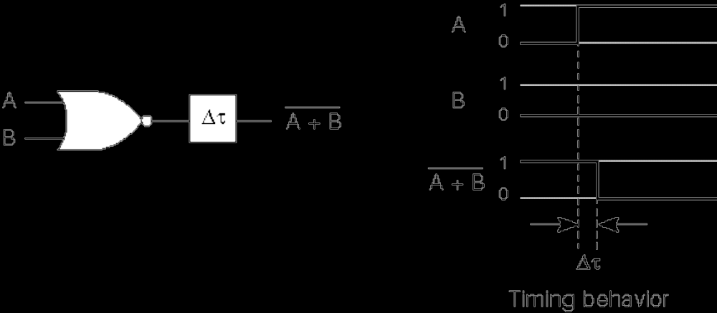
A.51 A NOR Gate with a Lumped Delay
This delay between input and output is at the basis of the functioning of an important memory element, the flip-flop.

Slide 56

A.52 The S-R (Set-Reset) Flip-Flop
The S-R flip-flop is an active high (positive logic) device.

Slide 57

Fig A.53 Converting a NOR S-R to an NAND S-R
Active High
NOR Impl.
Push Bubbles
(DeMorgan’s)
Rearrange
Bubbles
Convert
from Bubbles
to Active Low
Signal Names

Slide 58

Fig A.54 A Circuit with a Hazard
It is desirable to be able to “turn off”
the flip-flop so it does not respond to
such hazards.

Slide 59

Fig A.55 The Clock Paces the System
In a positive logic system, the “action”happens when the clock is high, or positive. The low part of the clock cycle allows propagation between subcircuits, so their inputs are stable at the correct value when the clock next goes high.

Slide 60

A.56 A Clocked S-R Flip-Flop
The clock signal, CLK, turns on the inputs to the flip-flop.

Slide 61

Fig A.57 The Clocked D (Data) Flip-Flop
The clocked D flip-flop, sometimes called a latch, has a potential problem: If D changes while the clock is high, the output will also change. The Master-Slave flip-flop solves this problem:

Slide 62

A.58 The Master-Slave Flip-Flop
The rising edge of the clock clocks new data into the Master, while the slave holds previous data. The falling edge clocks the new Master data into the Slave.

Slide 63

Fig A.59 The Basic J-K Flip-Flop
The J-L flip-flop eliminates the S=R=1 problem of the S-R flip-flop, because Q enables J while Q’ disables K, and vice-versa.
However there is still a problem. If J goes momentarily to 1 and then back to 0 while the flip-flop is active and in the reset, the flip-flop will “catch” the 1.
This is referred to as “1’s catching.”
The J-K Master-Slave flip-flop solves this problem.

Slide 64

Fig A.61 The Master-Slave J-K Flip-Flop

Slide 65

Fig A.60 The T (Toggle) Flip-Flop
The presence of a constant 1 at J and K means that the flip-flop will change its state from 0-1 or 1-0 each time it is clocked by the T (Toggle) input.

Slide 66

Fig A.62 The Negative Edge-Triggered D Flip-Flop
When the clock is high, the two input latches output 0, so the Main latch remains in its previous state, regardless of changes in D.
When the clock goes high-low, values in the two input latches will affect the state of the Main latch.
While the clock is low, D cannot affect the Main latch.

Slide 67

Fig A.63 Finite State Machine Design Example: The Modulo-4 Counter
Counter has a clock input, CLK, and a RESET input.
Has two output lines, which must take values of 00, 01, 10, and 11 on subsequent clock cycles.
It requires two flip-flops to store the state.

Slide 68

Fig A.64 State Transition Diagram for a Modulo(4) Counter
Next State
Present State RESET
0 1
A B/01 A/00
B C/10 A/00
C D/11 A/00
D A/00 A/00
State
Table
Present State RESET
0 1
A:00 01 00
B:01 10 00
C:10 11 00
D:11 00 00
State
Table
With
States
Assigned
The state diagram and state table tell “all there is to know” about the FSM, and are the basis for a provably correct design.

Slide 70

Fig A.67a
Develop equations from this truth table for s₀(t+1), s₁(t+1),
q₀(t+1), and q₁(t+1) from inputs r(t), s₀(t) and s₁(t)

Slide 71

Fig A.67b
Implement these equations

Slide 72

Fig A.68
Circuit for a 2-bit counter:
There are many simpler techniques for implementing counters.

Slide 73
Example A.2: A Sequence Detector
Design a machine that outputs a 1 when exactly 2 of the last 3 inputs are 1.
e.g. input sequence of 011011100 produces an output sequence of 001111010
Assume input is a 1-bit serial line.
Use D flip-flops and 8-1 Multiplexers
Begin by constructing a state transition diagram:

Slide 74


Fig A.69 State Transition Diagram for Sequence Detector
Design a machine that outputs a 1 when exactly 2 of the last 3 inputs are 1.
Convert table to truth table (how?).
Solve for s₂ s₁ s₀ and Z.
Discuss: the “meaning” of each state.

Slide 75

Fig A.72 Logic Diagram for Seq. Det.

Slide 76
Ex A.3 A Vending Machine Controller
Acepts nickel, dime, and quarter. When value of money inserted equals or exceeds twenty cents, machine vends item and returns change if any, and waits for next transaction.
Implement with PLA and D flip-flops.

Slide 77

Fig A.73 State Trans. Diagram for Vending Machine Controller

Slide 78

Fig A.75b Truth Table for Vending Machine

Slide 79

Fig A.75 a)FSM, b)Truth Table, c)PLA realization

Slide 80


Mealy vs. Moore Machines
Mealy Model: Outputs are functions of Inputs and Present State.
Previous FSM designs were Mealy Machines, because next state was computed from present state and inputs.
Moore Model: Outputs are functions of Present State only.
Both are equally powerful.

Slide 81

Fig A.77 Tri-state Buffers
There is a third state: High impedance. This means the gate output is essentially disconnected from the circuit.
This state is indicated by ∅ in the figure.

Slide 82


Fig A78, A79 Registers
Gate-Level View
Chip-Level View

Slide 83

Fig A.80 A Left-Right Shift Register with Parallel Read and Write

Slide 84

Fig A.81 A Modulo 8 (3-bit) Ripple Counter
Note the use of the T flip-flops. They are used to toggle the input of the next flip-flop when its output is 1.

