Slide 1
Assembly and Assemblers
What is an assembler?
  Translates from assembly language to machine language
Assembly language structure
Tasks of the assembler

Slide 2
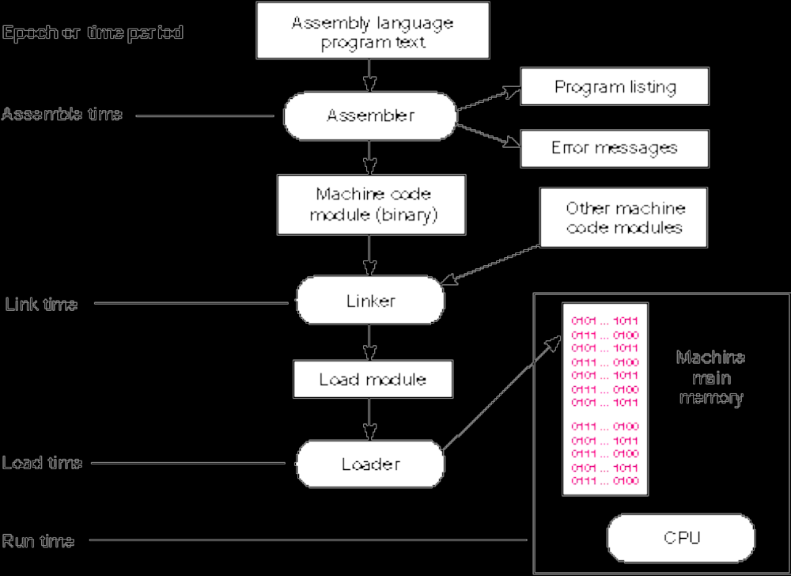
Fig C.1 Time Periods of Various Processes in Program Development

Slide 3
The Assembler Provides—
Access to all the machine’s resources by the assembled program. This includes access to the entire instruction set of the machine.
A means for specifying run-time locations of program and data in memory.
Provide symbolic labels for the representation of constants and addresses.
Perform assemble-time arithmetic.
Provide for the use of any synthetic instructions.
Emit machine code in a form that can be loaded and executed.
Report syntax errors and provide program listings
Provide an interface to the module linkers and program loader.
Expand programmer defined macro routines.

Slide 4
Assembler Syntax and Directives
Syntax: Label OPCODE Op1, Op2, ... ;Comments
Pseudo Operations (sometimes called “pseudos,” or directives are “Opcodes” that are actually instructions to the assembler, and that do not result in code being generated.
Assembler maintains several data structures
  Table that maps text of opcodes to op number and instruction format(s)
  “Symbol Table” that maps defined symbols to their value

Slide 5
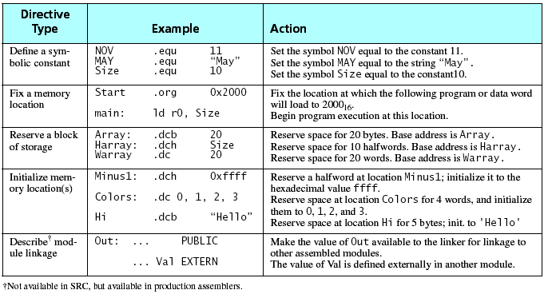
Table C.1 Assembler Directives

Slide 6
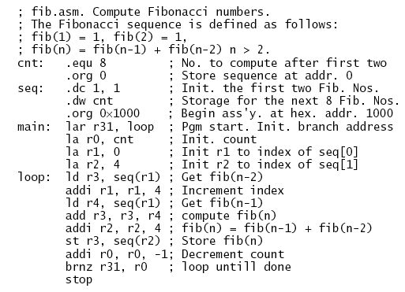
Figure C.2 Example Program fib.asm

Slide 7
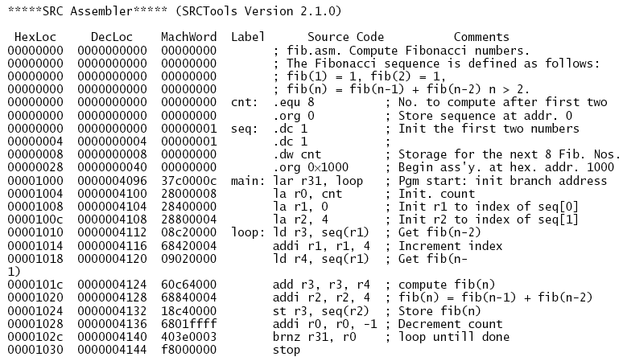
Figure C.3 Assembler listing file, fib.lst

Slide 8
The 2-Pass Assembly Process
Pass 1:
  Init. Location Counter (Assemble-Time “PC”) to 0
  Pass over program text: enter all symbols into symbol table
    May not be able to map all symbols on first pass
    (Definition before use is usually allowed)
  Determine size of each instruction, map to a location
    Uses pattern matching to relate opcode to pattern
    Increment location counter by size
    Change Location Counter in response to ORG pseudos.
Pass 2
  Insert binary code for each opcode and value
  “Fix up” forward references and variable-sizes instructions
    Examples include variable-sized branch offsets and constant fields.

Slide 9
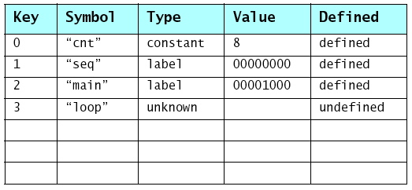
Table C.2 Snapshot of the Symbol Table Generated by the Assembler During Pass 1 at Address 0x1008

