Slide 1
Communications, Networking, and the Internet
Chapter Topics
  Network communications mechanisms and signal encoding
    Tasks, roles, and levels in the communications system
    Communications layer models—The OSI layer model
  Serial data communications and the RS-232 communications protocol
  Modern buses: USB and FireWire
  Local area networks—LANs; the Ethernet LAN
  The Internet: TCP/IP protocols, packet routing, and IP addresses
    Recovering wasted IP address space
      CIDR, NAT, and DHCP

Slide 2
Introduction - Communications Protocols
Modern computer communications spans the range from simple 1-1 communications to the Internet
Whenever there is communications, there must be a communications protocol—an agreement or contract.
Most communications protocols are decided by committee.

Slide 3
Network structures and channels
Three kinds of mechanisms
  Simplex. One way communications. Example: remote data logging.
  Half-duplex. Two way communications, but only one may talk at once
  (Example, the Police radio)
  Full duplex. Both may talk at once. Example: the Telephone.
Time division multiplexing (TDM)
  Divides the channel into “time slots.”
  Referred to as baseband systems.
Frequency division multiplexing (FDM)
  Has several “frequency bands.” Example: The TV Cable.
  Referred to as broadband systems.
Can have combinations: Several TDM signals transmitted on each band of a FDM system.

Slide 4
Fig 10.1 Baseband Bit Encoding Schemes
RZ:
  pulse encoding
NRZ:
  level encoding
NRZI:
  1: transition
  0: no transition
Manchester:
  0: hi-lo
  1: lo-hi
(There are many other schemes as well)

Slide 5
Packet vs. Circuit Switching
Packet Switching
  uses time slots to send a packet of information
  Packets may be from a few bytes to many KBytes
  Packet-switched networks route each packet independently.
  Examples: Ethernet, Token ring, Appletalk, Novell, Internet
Circuit Switching
  Establishes a circuit (route) ahead of time.
  Circuit may be a “virtual” circuit
  Guarantees a certain bandwidth to the user.
  Examples: the Telephone system, ATM (Asynch. Trans. Mode)

Slide 6
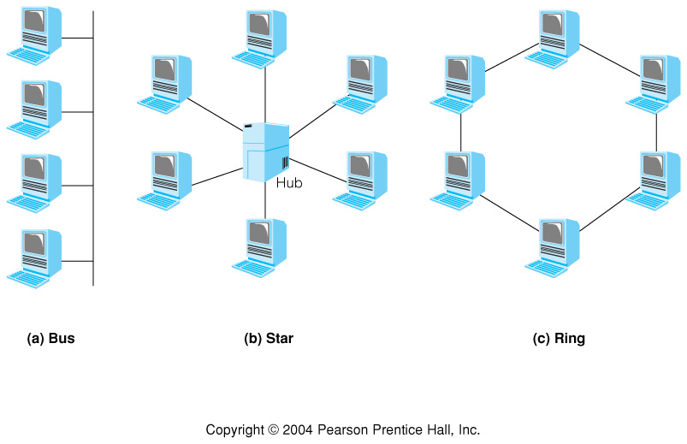
Fig 10.2 Three network topologies

Slide 7
Three Topologies Compared
Bus:
  No central controller, so continues to operate if station fails
  Possibility of contention and collision
Star:
  May use hub as switch to connect any two stations (Phone system)
  May use hub as broadcaster. (Star-Bus)
  May use hub as star-ring
Ring: Token Ring Protocol (IBM)
  Passes a data packet, the Token, around the ring.
  Receiving station removes the data, passes on an “empty” token.
  If a station receives an empty token, it may attach data to the token, destined for another station in the ring.
  Collision-free, but more susceptible to hardware failure if a node fails

Slide 8
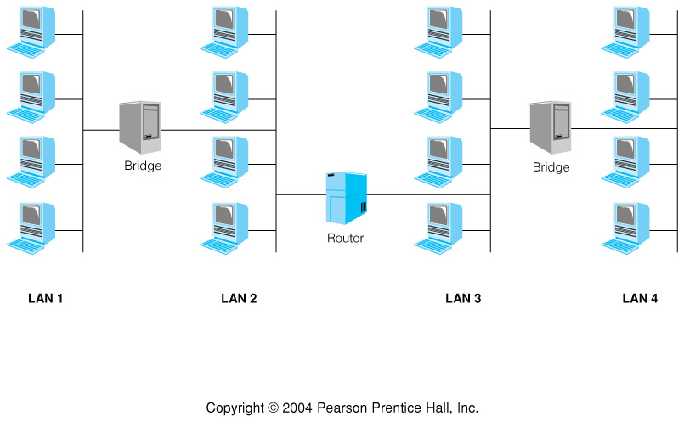
Fig 10.3 Several LAN's Interconnected with Bridges and Routers
Bridge: passes on only non-local traffic
Router: capable of Routing non-local traffic

Slide 9
Tasks required of all Communications Systems
Provide a high-level interface to the application
Establish, maintain, and terminate the session gracefully
Provide addressing and routing
Provide synchronization and flow control
Provide message formatting
Assure error-free reception (error detection and error correction)
Signal generation and detection

Slide 10
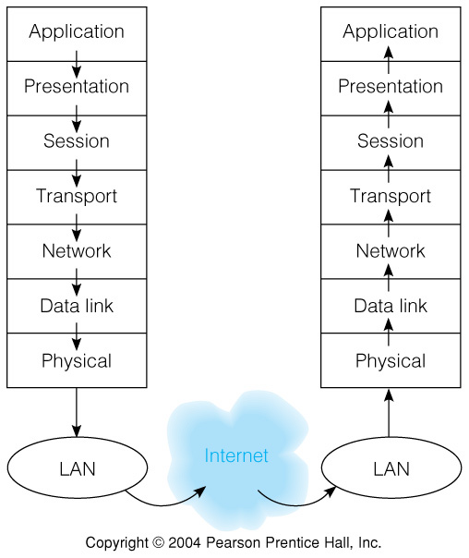
Fig 10.4 The OSI Layer Model
Application Layer
  Originator, final receiver of transmitted data
Presentation Layer
  encryption, format conversion (often not present)
Session layer
  Establish, maintain, terminate session
Transport layer
  Packetizes data, assures all packets are received, in order of transmission.
  Requests retransmission of lost data.
- more -

Slide 11
The OSI Layer Model (Cont’d)
Network Layer
  formats packets for the LAN
  removes LAN info at destination
Data Link Layer
  Final preparation for transmission
  Low level synchronization and flow control
Physical Layer
  wiring, transmitting and receiving
  signaling

Slide 12
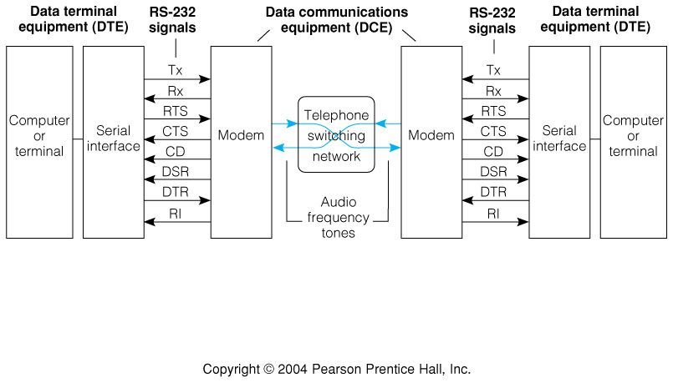
Fig 10.5 Telecommunications by modem—RS-232 Communications Protocol
Physical layer: 25-pin, 9-pin, or mini connector
Most use asynchronous communications
  No common clock—clock must be inferred from arriving data

Slide 13
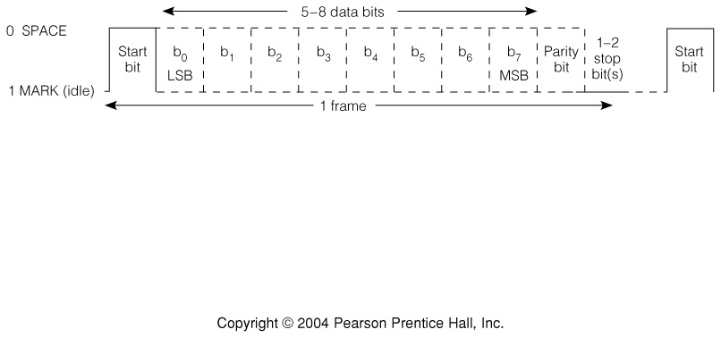
Fig 10.6 An Asynchronous Data Communications Frame—The Data Link Layer
(Physical Layer: MARK = -3 to -12 volts, SPACE = +3 to +12 VOLTS.)

Slide 14
RS-232 Signals and Pins
These signals are used at the data link and session levels. Exact protocols are complex.

Slide 15
MODEMS (MOdulator, DEModulator)
Convert DC signals for 0 and 1 to audio tones
  Telephone system frequency response is ~50-3500 Hz
Bit or bit per second (bps) rate is # bits sent per second
Baud (after J-M-E Baudot) rate is # of signal changes per second.
  Maximum Baud rate for the phone system is 2400.
It is possible to send multiple bits per baud, by signaling at different frequencies.
  Example: send one of 4 different signals, 2400 times per second:
  The four signals represent 00, 01, 01, or 11, so can send two bits per baud.
  bps rate = baud rate x log₂(n)

Slide 16
“Smart” Modems
Sometimes called “Hayes-compatible”
Computer controlled:
  dialing
  set bit rate
  program answering, redialing, etc.
  capable of data compression
Modems are still 2400 baud maximum
Highest bit rate available today, 56,000 bps, near the theoretical maximum rate

Slide 17
The ASCII Code
Notice tricks with x, X, and ^X, and with “1” and 1

Slide 18
The ASCII Control Characters

Slide 19
The ASCII Code “tricks”
^X: 001 1000
“X”: 101 1000
“x”: 111 1000
“1”: 011 0001
1: 000 0001

Slide 20
Local Area Networks
Not precisely defined, but generally taken to be:
“a network wholly contained within a building or
campus.”
Defined more by intended use: sharing resources within an organization.
Span the range from 230Kbps Apple Localtalk to Gigabit Ethernet.
Most LAN protocols are defined only at the data link and physical layers.

Slide 21
The Ethernet LAN
Developed at Xerox in 1970s, now the most popular LAN.
Physical layer can be coaxial cable, twisted pair (telephone cable), optical fiber
Data rates of 10, 100, 1000 Mbps possible
Data link layer: packets from 64 to 1518 bytes long.
Connectionless protocol
Broadcast medium: every controller receives and examines every packet. Collisions possible
Addresses are 48 bits long, organized as 6, 8-bit “octets”
Addresses guaranteed globally unique, formerly assigned by Xerox, now by IEEE

Slide 22
Ethernet Cabling

Slide 23
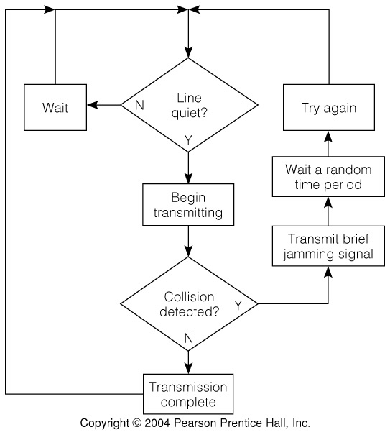
Fig 10.7 The Ethernet CSMA/CD† Medium Access Control Mechanism
† Carrier sense multiple access/collision detect

Slide 24
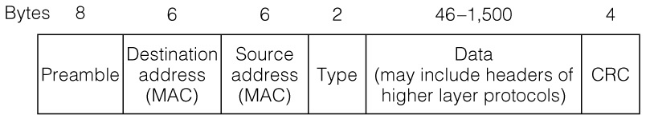
Fig 10.8 Ethernet Packet Structure
Error det’n. and corr’n.
Media Access Control—Determines local routing
Bit pattern allows recognition of packet

Slide 25
USB and FireWire†–Similarities
These two serial modern buses have several characteristics in common that set them apart from earlier bus protocols:
  Bus Power: each bus can supply a certain amount of power to attached devices, so some low-power devices do not need a power source.
  Hot Plugability: Unlike earlier buses, devices can be plugged and unplugged while the computer is running.
  Layer models similar to the ISO layer model, that simplify device programming and abstract details of the interface.
  Asynchronous and isochronous (guaranteed bandwidth) communications possible.
  †Also known as Sony iLink, and by the IEEE standards 1394 and 1394b.

Slide 26
USB and FireWire–Differences
USB requires a host computer as the controller, topology is a tree.
USB was designed primarily as a relatively inexpensive, relatively slow interface for computer peripherals such as mouse, keyboard, slow-speed disk drive.
FireWire does not require a host; topology is an acyclic graph that is reconfigured each time a device is plugged or unplugged.
  Example: A FireWire camcorder can be plugged into a VCR with a FireWire interface and the data loaded into the VCR from the camera.
FireWire was designed as a more expensive, higher-speed bus for interconnecting video and high-speed data.

Slide 27
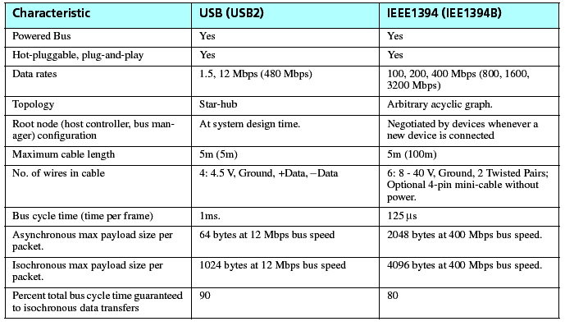
Table 10.4 USB and FireWire Characteristics

Slide 28
The Internet
Developed by ARPA, Advanced Research Projects Agency, a DOD agency.
First Experiments in 1969-74
Over 150 Million host computers on the net in 2003.
For public computer net communications, it is the “only game in town.”
Distributed, connectionless protocol.
Independent routers pass packets from source to destination.

Slide 29
The Internet
Does not include the Application or Presentation layers, the data link layer, or the physical layer.
Relies on other LAN protocols to transport its packets.
Can use Ethernet, Token Ring, Appletalk, dialup phone lines, or any other comm protocol.
Uses the TCP/IP (Transport Control Protocol/Internet Protocol)
Distributed protocol
TCP/IP
Layers

Slide 30
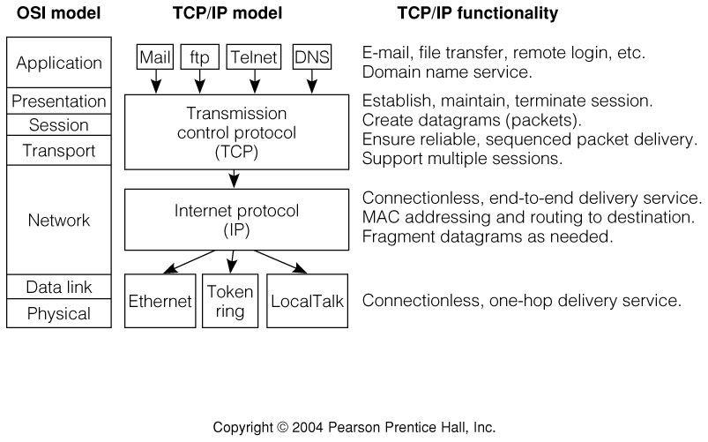
Fig 10.9 The TCP/IP Model related to the OSI Model

Slide 31
Internet Names and Addresses
For Humans
For Machines
DOMAIN NAME IP Address
riker.cs.colorado.edu ↔ 128.138.244.9
ucsu.colorado.edu ↔128.138.129.83
Assigned by one of several designated organizations
Network # . Host ID
Assigned by CU
Originating machine requests lookup of IP address from
a Domain Name Server, using Domain Name Service

Slide 32
Internet Names and Addresses Cont’d.
128.138.244.9 : “dotted decimal notation”
In the machine the IP address is a 32bit integer.
Each “dot” separates a byte:
128.138.244.9 ↔ 808AF409

Slide 33
The TCP/IP Protocol Revisited

Slide 34
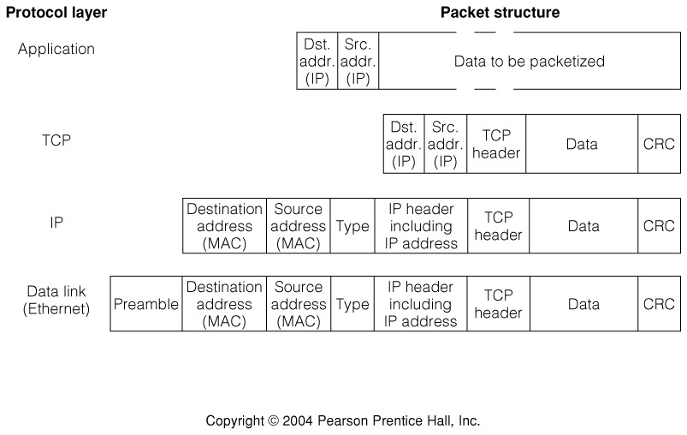
Fig 10.10 Data flow through the TCP/IP Protocol Stack
Each Layer adds/subtracts its own information:
Separation of Concerns/Principle of Abstraction

Slide 35
Fig 10.11 The Internet Routing Process (simplified)

Slide 36
Table 10.4 Class A, B, and C Internet addresses
IP Address Class Network#/Host# split Network#
A (MSB = 0) N.H.H.H N.0.0.0
B (MSBs = 10) N.N.H.H N.N.0.0
C (MSBs = 110) N.N.N.H N.N.N.0

Slide 37
Fig 10.12 Class A, B, and C Internet Addresses

Slide 38
Subnets and subnetting
The Internet routers outside colorado.edu care only about the network number, and do not care about the host ID. (It is masked off before routing)
The routers inside colorado.edu are free to interpret the “host ID” number in any way they wish.
CU might wish to have many LANs within its domain to cut down on traffic inside the domain.
CU is free to program its routers to interpret part of the Host ID as a network number.

Slide 39
Fig 10.13 Example of a Class B Network with a 6-bit Subnet

Slide 40
Fig 10.14 Subnetting a class B network a) an 8-bit subnet address b) a 10-bit subnet address

Slide 41
IP Address Space is Wasted by the Class A, B, C Scheme, and by Static IP Addresses
Class A, B, and C addressing wastes space:
  Each of the 126 class A networks consumes 16 million IP addresses, yet no single entity can use this many addresses.
  Each class B network consumes 65,534 IP addresses, yet most class B networks do not nead nearly that many.
  Likewise each class C network consumes 254 IP addresses.
Static IP addresses waste space:
  When a permanent, or Static IP address is assigned to a machine, that address is unavailable to others even if the given machine is off-line, retired from service, etc.

Slide 42
One Way of Regaining Lost IP Address Space: CIDR
CIDR, Classless Internet Domain Routing, does away with the class A, B, C system, replacing it with a system that uses the first n bits as the network number, where n can be between 13 and 27:
CIDR Block Prefix# Equivalent Class C # of Host Addresses
/27 1/8th of a Class C 32 hosts
/26 1/4th of a Class C 64 hosts
/25 1/2 of a Class C 128 hosts
/24 1 Class C 256 hosts
/23 2 Class C 512 hosts
/22 4 Class C 1,024 hosts
. . .
/16 256 Class C 65,536 hosts(= 1 Class B)
/15 512 Class C 131,072 hosts
/14 1,024 Class C 262,144 hosts
/13 2,048 Class C 524,288 hosts
For example, in the CIDR address 206.13.01.48/25, the "/25" indicates the first 25 bits are used to identify the unique network leaving the remaining bits to identify the specific host.

Slide 43
Two Ways of Making IP Addresses Go Further
NAT, Network Address Translation, uses a router to generate "fictitious" IP addresses within a domain, and translates one external IP address to one of the fictitious addresses internally, assigning each internal machine one of these unique addresses.
  The address ranges 10.0.0.0/8, 172.16.0.0/12, and 192.168.0.0/16 are permanently unassigned and are available for use in NAT applications.
DHCP, Dynamic Host Configuration Protocol, assigns a temporary IP address to a machine when it first comes on line. When the computer goes off line that address is reclaimed and can be assigned to another machine.
Both can be used in concert. For example, a household computing system with a high-speed DSL or Cable Modem connection may have only one external IP address, but the DSL router or cable modem translates that address to an internally unique address in one of the ranges above, and assigns it as needed using DHCP.

Slide 44
Internet Futures
CIDR, NAT, and DHCP only postpone the inevitable. The current 32-bit IP address is inadequate to handle future needs.
There are several proposals to expand IP address space, the most likely to be widely adopted is "IPv6," Internet Protocol version 6.
IPv6 extends the address from 32-bits to 128-bits. Not only does this provide more than enough address space for the forseeable future, it also provides several additional features
  Removes the need for NAT and DHCP, so each device may have its own externally-visible address.
  Increased security
  Routing information included in header
  Header can contain information about quality of service
Perhaps in the future wall plugs and wrist watches will have IP addresses!

