Slide 1
Computer Systems
Design and Architecture
Vincent P. Heuring
and
Harry F. Jordan
Department of Electrical and Computer Engineering
University of Colorado - Boulder

Slide 2
Course Goals: Understanding Structure and Function of Digital Computer at 3 Levels
Multiple levels of computer operation
  Application level
  High Level Language(s), HLL, level(s)
  Assembly/machine language level: instruction set
  System architecture level: subsystems & connections
  Digital logic level: gates, memory elements, buses
  Electronic design level
  Semiconductor physics level
Interactions and relations between levels
  View of machine at each level
  Tasks and tools at each level
Historical perspective
Trends and research activities
This
course

Slide 3
Real Course Goal: No Mysteries
The goal of CSDA is to treat the design and architecture of computer systems at a level of detail that leaves “no mysteries” in computer systems design.
This “no mysteries” approach is followed throughout the text, from instruction set design to the logic-gate-design of the CPU data path and control unit out to the memory, disk, and network.

Slide 4
Prerequisites
Experience with a high level language
  Pascal
  C, etc.
Assembly language programming
Digital logic circuits
  Appendix A summarizes logic design in sufficient detail so the text can be used in courses without digital logic circuits as a prerequisite.

Slide 5
Text Overview
1: The General Purpose Machine
2: Machines, Machine Languages, and Digital Logic
3: Some Real Machines
4: Processor Design at the Gate Level
5: Processor Design - Advanced Topics
6: Computer Arithmetic and the Arithmetic Unit
7: Memory System Design
8: Input and Output
9: Peripheral Devices
10: Communications, Networking and the Internet

Slide 6
Chapter 1 Summary
Views Views of the General Purpose Machine:
1.2 The User’s View
1.3 The Assembly/Machine Language Programmer’s View
  Instruction set architecture - ISA
    Registers, memory, and instructions
    The stored program
    The fetch execute cycle
1.4 The Computer Architect’s View
    System design & balance
1.5 The Digital Logic Designer’s View
    Realization of specified function—from concept to logic hardware
Also discussed: Historical Perspective, Trends and Research, Approach of the Text

Slide 7
Looking Ahead - Chapter 2
Explores the nature of machines and machine languages
Relationship of machines and languages
Generic 32 bit Simple RISC Computer - SRC
Register transfer notation - RTN
  The main function of the CPU is the Register Transfer
  RTN provides a formal specification of machine structure and function
  Maps directly to hardware
RTN and SRC will be used for examples in subsequent chapters
Provides a general discussion of addressing modes
Covers quantitative estimates of system performance
For students without digital logic design background Appendix A should be covered at this point.
Presents a view of logic design aimed at implementing registers and register transfers, including timing considerations.

Slide 8
Looking Ahead - Chapter 3
Treats two real machines of different types - CISC and RISC - in some depth
  Discusses general machine characteristics and performance
  Differences in design philosophies of
    CISC (Complex instruction Set Computer) and
    RISC (Reduced Instruction Set Computer) architectures
  CISC machine - Motorola MC68000
    Applies RTN to the description of real machines
  RISC machine - SPARC
Introduces quantitative performance estimation
Java-based simulators are available for subsets of both machines, MC68000 and SPARC subset, ARC.
  Run on PC, Mac OS X, Linux, and Unix

Slide 9
Looking Ahead - Chapter 4
This keystone chapter describes processor design at the logic gate level
Describes the connection between the instruction set and the hardware
Develops alternative 1- 2- and 3- bus designs of SRC at the gate level
RTN provides description of structure and function at low and high levels
Shows how to design the control unit that makes it all run
Describes two additional machine features:
  implementation of exceptions (interrupts)
  machine reset capability

Slide 10
Looking Ahead - Chapter 5
Important advanced topics in CPU design
General discussion of pipelining—having more than one instruction executing simultaneously
  requirements on the instruction set
  how instruction classes influence design
  pipeline hazards: detection & management
Design of a pipelined version of SRC
Instruction-level parallelism—issuing more than one instruction simultaneously
  Superscalar and VLIW designs
Design a VLIW version of SRC
Microcoding as a way to implement control

Slide 11
Looking Ahead - Chapter 6
The arithmetic and logic unit: ALU
Impact of the ALU on system performance
Digital number systems and arithmetic in an arbitrary radix
  number systems and radix conversion
  integer add, subtract, multiply, and divide
Time/space trade-offs: fast parallel arithmetic
Floating point representations and operations
Branching and the ALU
Logic operations
ALU hardware design

Slide 12
Looking Ahead - Chapter 7
The memory subsystem of the computer
Structure of 1-bit RAM and ROM cells
RAM chips, boards, and modules
SDRAM and DDR RAM
Concept of a memory hierarchy
  The nature and functioning of different levels
  The interaction of adjacent levels
Virtual memory
  Temporal and spatial locality are what makes it work
Cache design: matching cache & main memory
Memory as a complete system

Slide 13
Looking Ahead - Chapter 8
Computer input and output: I/O
Kinds of system buses, signals and timing
Serial and parallel interfaces
Interrupts and the I/O system
Direct memory access - DMA
DMA, interrupts, and the I/O system
The hardware/software interface: device drivers
Encoding signals with error detection and correction capabilities

Slide 14
Looking Ahead - Chapter 9
Structure, function and performance of peripheral devices
Disk drives
  Organization
  Static and dynamic properties
  Disk system reliability–SMART disk systems
  RAID disk arrays
Video display terminals
Memory mapped video
Printers
Mouse and keyboard
Interfacing to the analog world

Slide 15
Looking Ahead - Chapter 10
Computer communications, networking, and the Internet
Communications protocols; layered networks
The OSI layer model
Point to point communication: RS-232 & ASCII
Local area networks - LANs
  Example: Ethernet, including Gigabit Ethernet
Modern serial buses: USB and FireWire
Internetworking and the Internet
  TCP/IP protocol stack
  Packet routing and routers
  IP addresses: assignment and use
  Nets and subnets: subnet masks
  Reducing wasted IP address space: CIDR, NAT, and DHCP
Internet applications and futures

Slide 16
Appendices
Appendix A: Digital logic circuits
Appendix B: Complete SRC documentation
Appendix C: Assembly and assemblers
Appendix D: Selected problems and solutions

Slide 17
Problem Solving
There are four steps to problem solving:
1. UNDERSTAND THE PROBLEM!
2. Have an idea about how to go about solving it (pondering)
3. Show that your idea works
4. Then and only then work on the solution

Slide 18
Chapter 1 - A Perspective
Alan Turing showed that an abstract computer, a Turing machine, can compute any function that is computable by any means
A general purpose computer with enough memory is equivalent to a Turing machine
Over 50 years, computers have evolved
  from memory size of 1 kiloword (1024 words) and clock periods of 1 millisecond (0.001 s.)
  to memory size of a terabyte (2⁴⁰ bytes) and clock periods of 100 ps. (10⁻¹² s.) and shorter
More speed and capacity is needed for many applications, such as real-time 3D animation, various simulations

Slide 19
Scales, Units, and Conventions
Term
Normal Usage
As a power of 2
K (kilo-)
10
3
2
10
= 1024
M (mega-)
10
6
2
20
= 1,048,576
G (giga-)
10
9
2
30
= 1,073,741,824
T (tera-)
10
12
2
40
= 1,099,511,627,776
Term
Usage
Note the differences between usages. You should commit the powers of 2 and 10 to memory.
Powers of 2 are used to describe memory sizes.
m (milli-)
10
-3
μ
(micro-)
10
-6
n (nano-)
10
-9
p (pico-)
10
-12
Units: Bit (b), Byte (B), Nibble, Word (w), Double Word, Long Word
Second (s), Hertz (Hz)

Slide 20
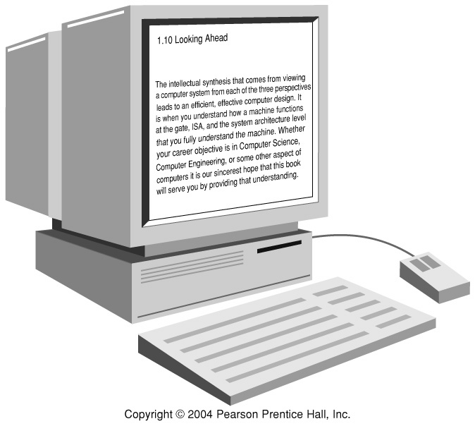
Fig 1.1 The User’s View of a Computer
The user sees software, speed, storage capacity,
and peripheral device functionality.

Slide 21
Machine/assembly Language Programmer’s View
Machine language:
  Set of fundamental instructions the machine can execute
  Expressed as a pattern of 1’s and 0’s
Assembly language:
  Alphanumeric equivalent of machine language
  Mnemonics more human oriented than 1’s and 0’s
Assembler:
  Computer program that transliterates (one-to-one mapping) assembly to machine language
  Computer’s native language is assembly/machine language
  “Programmer”, as used in this course, means assembly/machine language programmer

Slide 22
Machine and Assembly Language
The assembler converts assembly language to machine language. You must also know how to do this.
Op code
Data reg. #5
Data reg. #4
MC68000 Assembly Language
Machine Language
MOVE.W D4, D5
0011 101 000 000 100
ADDI.W #9, D2
00000001 10 111 100
0000 0000 0000 1001
Table 1.2 Two Motorola MC68000 instructions

Slide 23
The Stored Program Concept
The stored program concept says that the program
is stored with data in the computer’s memory. The
computer is able to manipulate it as data—for
example, to load it from disk, move it in memory,
and store it back on disk.
It is the basic operating principle for every computer.
It is so common that it is taken for granted.
Without it, every instruction would have to be initiated manually.

Slide 24
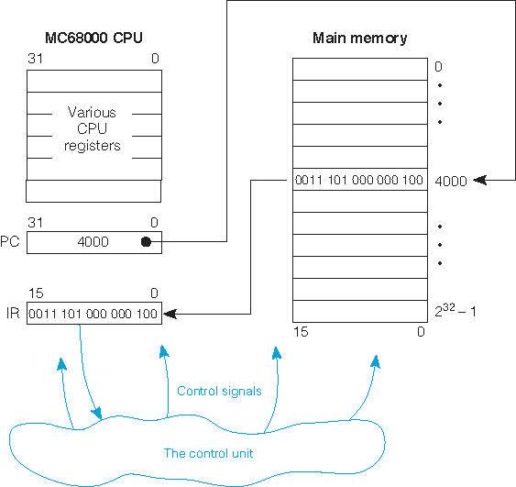
Fig 1.2 The Fetch-Execute Cycle

Slide 25
Programmer’s Model:
Instruction Set Architecture (ISA)
Instruction set: the collection of all machine operations.
Programmer sees set of instructions, along with the machine resources manipulated by them.
ISA includes
  instruction set,
  memory, and
  programmer accessible registers of the system.
There may be temporary or scratch-pad memory used to implement some function is not part of ISA.
  “Non Programmer Accessible.”

Slide 26
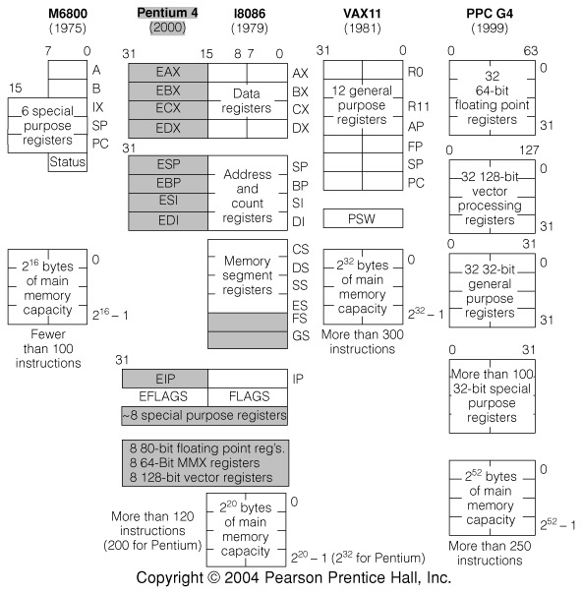
Fig 1.3 Programmer’s Models of 4 commercial machines

Slide 27
Machine, Processor, and Memory State
The Machine State: contents of all registers in system, accessible to programmer or not
The Processor State: registers internal to the CPU
The Memory State: contents of registers in the memory system
“State” is used in the formal finite state machine sense
Maintaining or restoring the machine and processor state is important to many operations, especially procedure calls and interrupts

Slide 28
Data Type: HLL Versus Machine Language
HLL’s provide type checking
  Verifies proper use of variables at compile time
  Allows compiler to determine memory requirements
  Helps detect bad programming practices
Most machines have no type checking
  The machine sees only strings of bits
  Instructions interpret the strings as a type: usually limited to signed or unsigned integers and FP #s
  A given 32 bit word might be an instruction, an integer, a FP #, or four ASCII characters

Slide 29
Tbl 1.3 Examples of HLL to Assembly Language Mapping
This compiler:
  Maps C integers to 32 bit VAX integers
  Maps C assign, *, and + to VAX MOV, MPY, and ADD
  Maps C goto to VAX BR instruction
The compiler writer must develop this mapping for each language-machine pair

Slide 30
Tools of the Assembly Language Programmer’s Trade
The assembler
The linker
The debugger or monitor
The development system

Slide 31
Who Uses Assembly Language
The machine designer
  must implement and trade-off instruction functionality
The compiler writer
  must generate machine language from a HLL
The writer of time or space critical code
  Performance goals may force program specific optimizations of the assembly language
Special purpose or imbedded processor programmers
  Special functions and heavy dependence on unique I/O devices can make HLL’s useless

Slide 32
The Computer Architect’s View
Architect is concerned with design & performance
Designs the ISA for optimum programming utility and optimum performance of implementation
Designs the hardware for best implementation of the instructions
Uses performance measurement tools, such as benchmark programs, to see that goals are met
Balances performance of building blocks such as CPU, memory, I/O devices, and interconnections
Meets performance goals at lowest cost

Slide 33
Buses as Multiplexers
Interconnections are very important to computer
Most connections are shared
A bus is a time-shared connection or multiplexer
A bus provides a data path and control
Buses may be serial, parallel, or a combination
  Serial buses transmit one bit at a time
  Parallel buses transmit many bits simultaneously on many wires

Slide 34
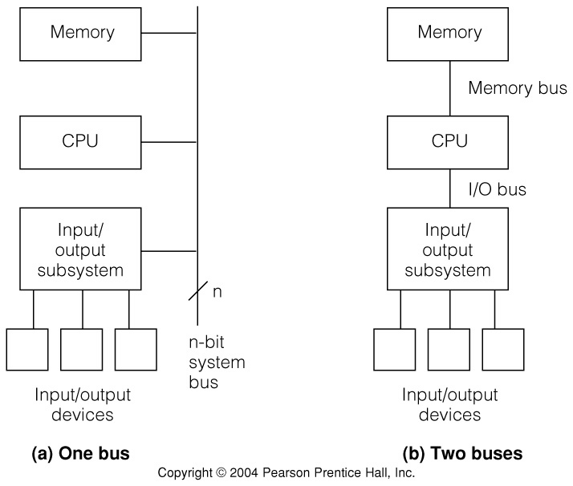
Fig 1.4 One and Two Bus Architecture Examples

Slide 35
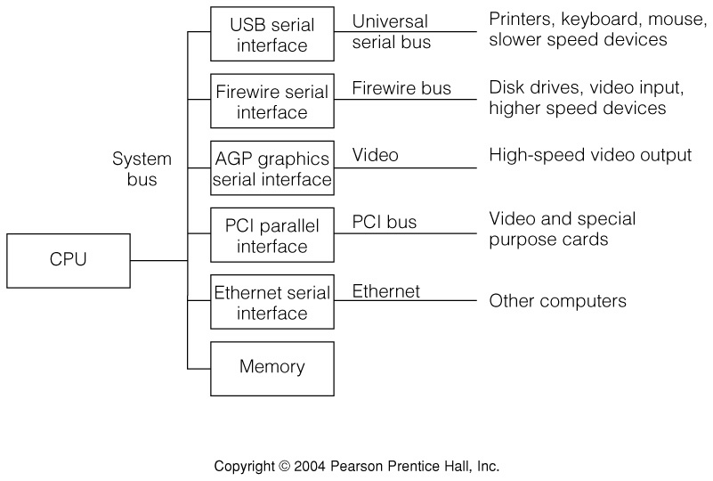
Fig 1.5 Getting Specific:
The Apple PowerMac G4 Bus (simplified)

Slide 36
Fig 1.6 The Memory Hierarchy
Modern computers have a hierarchy of memories
  Allows tradeoffs of speed/cost/volatility/size, etc.
CPU sees common view of levels of the hierarchy.

Slide 37
Tools of the Architect’s Trade
Software models, simulators and emulators
Performance benchmark programs
Specialized measurement programs
Data flow and bottleneck analysis
Subsystem balance analysis
Parts, manufacturing, and testing cost analysis

Slide 38
Logic Designer’s View
Designs the machine at the logic gate level
The design determines whether the architect meets cost and performance goals
Architect and logic designer may be a single person or team

Slide 39
Implementation Domains
An implementation domain is the collection of
devices, logic levels, etc. which the designer uses.
Possible implementation domains:
VLSI on silicon
TTL or ECL chips
Gallium Arsenide chips
PLA’s or sea-of-gates arrays
Fluidic logic or optical switches

Slide 40
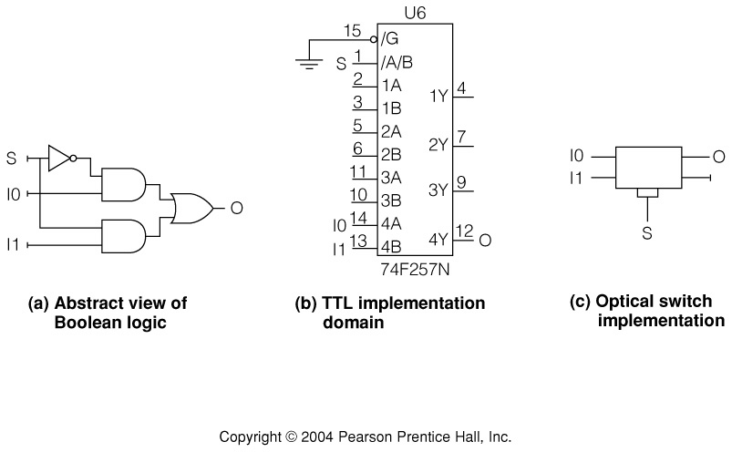
Fig 1.7 Three Different Implementation Domains
2 to 1 multiplexer in three different implementation domains
  generic logic gates (abstract domain)
  National Semiconductor FAST Advanced Schottky TTL (vlsi on Si)
  Fiber optic directional coupler switch (optical signals in LiNbO3)

Slide 41
The Distinction between Classical Logic Design and Computer Logic Design
The entire computer is too complex for traditional FSM design techniques
  FSM techniques can be used “in the small”
There is a natural separation between data and control
  Data path: storage cells, arithmetic, and their connections
  Control path: logic that manages data path information flow
Well defined logic blocks are used repeatedly
  Multiplexers, decoders, adders, etc.

Slide 42
Two Views of the CPU PC Register
31
0
Programmer:
PC
Logic Designer
(Fig 1.8):

Slide 43
Tools of the Logic Designer’s Trade
Computer aided design tools
  Logic design and simulation packages
  Printed circuit layout tools
  IC (integrated circuit) design and layout tools
Logic analyzers and oscilloscopes
Hardware development system

Slide 44
Historical Generations
1st Generation: 1946-59 vacuum tubes, relays, mercury delay lines
2nd generation: 1959-64 discrete transistors and magnetic cores
3rd generation: 1964-75 small and medium scale integrated circuits
4th generation: 1975-present, single chip microcomputer
Integration scale: components per chip
  Small: 10-100
  Medium: 100-1,000
  Large: 1000-10,000
  Very large: greater than 10,000

Slide 45
Summary
Three different views of machine structure and function
Machine/assembly language view: registers, memory cells, instructions.
  PC, IR,
  Fetch-execute cycle
  Programs can be manipulated as data
  No, or almost no data typing at machine level
Architect views the entire system
  Concerned with price/performance, system balance
Logic designer sees system as collection of functional logic blocks.
  Must consider implementation domain
  Tradeoffs: speed, power, gate fanin, fanout

