Slide 1
Chapter 2: Machines, Machine Languages, and Digital Logic
Instruction sets, SRC, RTN, and the mapping of register transfers to digital logic circuits

Slide 2
Chapter 2 Topics
2.1 Classification of Computers and Instructions
2.2 Kinds and Classes of Instruction Sets
2.3 Informal Description of the Simple RISC Computer, SRC
  Students may wish to consult Appendix C, Assembly and Assemblers for information about assemblers and assembly.
2.4 Formal Description of SRC using Register Transfer Notation (RTN)
2.5 RTN Description of Addressing Modes
2.6 Register Transfers and Logic Circuits: from Behavior to Hardware
  Students may wish to consult Appendix A, Digital Logic for additional information about Digital Logic circuits.

Slide 3
What are the components of an ISA?
Sometimes known as The Programmers Model of the machine
Storage cells
  General and special purpose registers in the CPU
  Many general purpose cells of same size in memory
  Storage associated with I/O devices
The Machine Instruction Set
  The instruction set is the entire repertoire of machine operations
  Makes use of storage cells, formats, and results of the fetch/execute cycle
  i. e. Register Transfers
The Instruction Format
  Size and meaning of fields within the instruction
The nature of the Fetch/Execute cycle
  Things that are done before the operation code is known

Slide 4
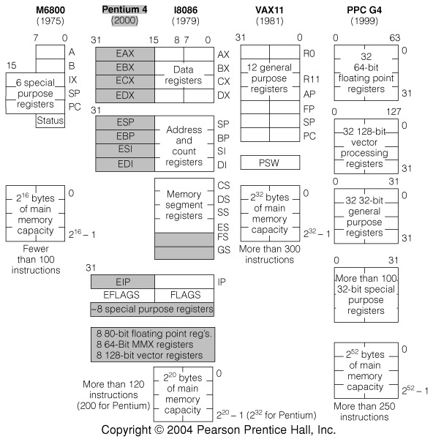
Fig. 2.1 Programmer’s Models of Various Machines
We saw in Chap. 1 a variation in number and type of storage cells

Slide 5
What Must an Instruction Specify?
Data Flow
Which operation to perform: add r0, r1, r3
  Ans: Op code: add, load, branch, etc.
Where to find the operand or operands add r0, r1, r3
  In CPU registers, memory cells, I/O locations, or part of instruction
Place to store result add r0, r1, r3
  Again CPU register or memory cell
Location of next instruction add r0, r1, r3
br endloop
The default is usually memory cell pointed to by program counter—PC: the next instruction in sequence
Sometimes there is no operand, or no result, or no next instruction. Can you think of examples?

Slide 6
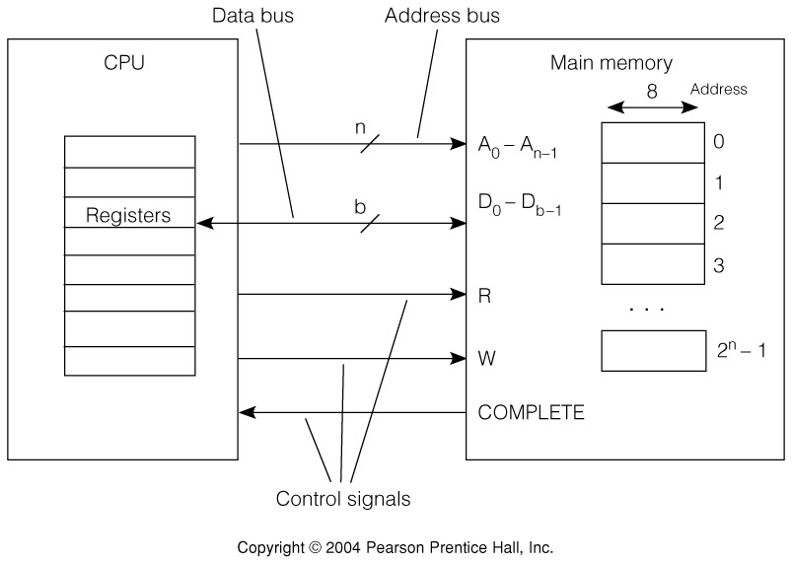
Fig. 2.2 Accessing Memory—Reading from Memory
For a Memory Read:
CPU applies desired address to Address lines A₀-A_{n-1}
CPU issues Read command, R
Memory returns the value at that address on Data lines D₀-D_{b-1} and asserts the COMPLETE signal

Slide 7
Figure 2.2 Accessing Memory—Writing to Memory
For a Memory Write:
CPU applies desired address to Address lines A₀-A_{n-1} and and data to be written on Data lines D₀-D_{b-1}
CPU issues Write command, W
Memory asserts the COMPLETE signal when the data has been written to memory.

Slide 8
Instructions Can Be Divided into 3 Classes
Data movement instructions
  Move data from a memory location or register to another memory location or register without changing its form
  Load—source is memory and destination is register
  Store—source is register and destination is memory
Arithmetic and logic (ALU) instructions
  Changes the form of one or more operands to produce a result stored in another location
  Add, Sub, Shift, etc.
Branch instructions (control flow instructions)
  Any instruction that alters the normal flow of control from executing the next instruction in sequence
  Br Loc, Brz Loc2,—unconditional or conditional branches

Slide 9
Tbl. 2.1 Examples of Data Movement Instructions
Lots of variation, even with one instruction type
Notice differences in direction of data flow left-to-right or right-to-left

Slide 10
Tbl 2.2 Examples of ALU
(Arithmetic and Logic Unit) Instructions
Instruction Meaning Machine
MULF A, B, C multiply the 32-bit floating point values at VAX11
mem loc’ns. A and B, store at C
nabs r3, r1 Store abs value of r1 in r3 PPC601
ori $2, $1, 255 Store logical OR of reg $ 1 with 255 into reg $2 MIPS R3000
DEC R2 Decrement the 16-bit value stored in reg R2 DEC PDP11
SHL AX, 4 Shift the 16-bit value in reg AX left by 4 bits Intel 8086
Notice again the complete dissimilarity of both syntax and semantics

Slide 11
Tbl 2.3 Examples of Branch Instructions
Instruction Meaning Machine
BLSS A, Tgt Branch to address Tgt if the least significant VAX11
bit of mem loc’n. A is set (i.e. = 1)
bun r2 Branch to location in R2 if result of previous PPC601
        floating point computation was Not a Number (NAN)
beq $2, $1, 32 Branch to location (PC + 4 + 32) if contents MIPS R3000
        of $1 and $2 are equal
SOB R4, Loop Decrement R4 and branch to Loop if R4 ≠ 0 DEC PDP11
JCXZ Addr Jump to Addr if contents of register CX = 0. Intel 8086

Slide 12
CPU Registers Associated with Flow of Control—Branch Insts.
Program counter usually contains the address of, or "points to" the next instruction
Condition codes may control branch
Branch targets may be contained in separate registers

Slide 13
HLL Conditionals Implemented by Control Flow Change
Conditions are computed by arithmetic instructions
Program counter is changed to execute only instructions associated with true conditions
;the comparison
;conditional branch
;action if true
;action if false

Slide 14
CPU Registers may have a “personality”
Architecture classes are often based on how where the operands and result are located and how they are specified by the instruction.
They can be in CPU registers or main memory

Slide 15
3, 2, 1, & 0 Address Instructions
The classification is based on arithmetic instructions that have two operands and one result
The key issue is “how many of these are specified by memory addresses, as opposed to being specified implicitly”
A 3 address instruction specifies memory addresses for both operands and the result: R ← Op1 op Op2
A 2 address instruction overwrites one operand in memory with the result: Op2 ← Op1 op Op2
A 1 address instruction has a register, called the accumulator register to hold one operand & the result (no address needed):
Acc ← Acc op Op1
A 0 address + uses a CPU register stack to hold both operands and the result: TOS ← TOS op SOS where TOS is Top Of Stack, SOS is Second On Stack)
The 4-address instruction, hardly ever seen, also allows the address of the next instruction to specified explicitly.

Slide 16
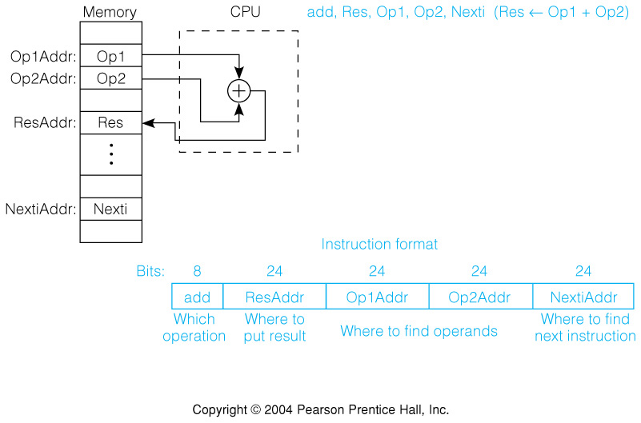
Fig. 2.3 The 4 Address Instruction
Explicit addresses for operands, result & next instruction
Example assumes 24-bit addresses
  Discuss: size of instruction in bytes

Slide 17
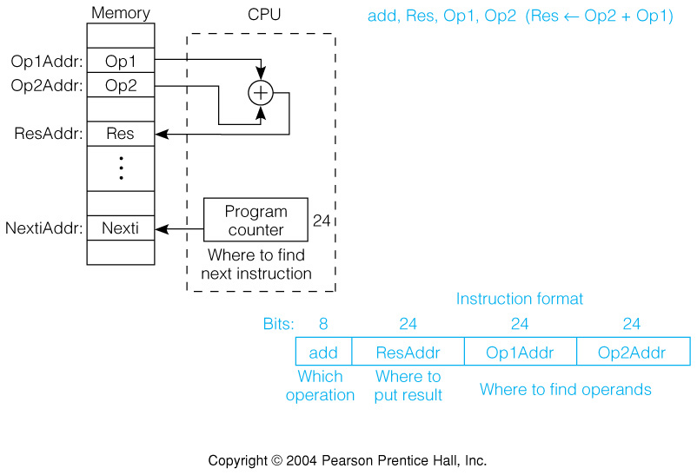
Fig 2.4 The 3 Address Instruction
Address of next instruction kept in a processor state register—the PC (Except for explicit Branches/Jumps)
Rest of addresses in instruction
  Discuss: savings in instruction word size

Slide 18
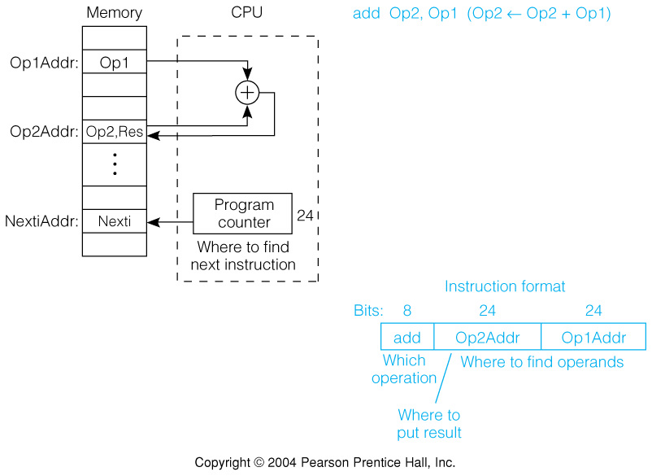
Fig. 2.5 The 2 Address Instruction
Be aware of the difference between address, Op1Addr, and data stored at that address, Op1.
Result overwrites Operand 2, Op2, with result, Res
This format needs only 2 addresses in the instruction but there is less choice in placing data

Slide 19
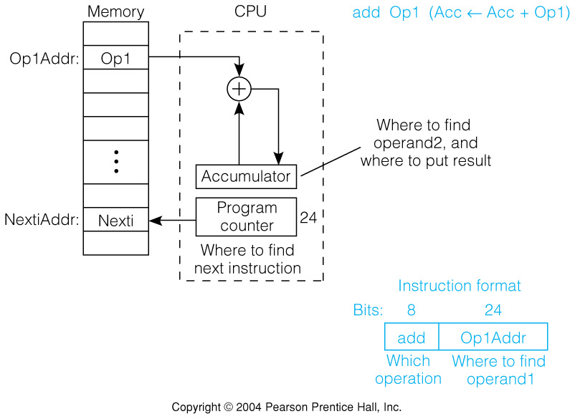
Fig. 2.6 1 Address Instructions
We now need instructions to load and store operands:
LDA OpAddr
STA OpAddr
Special CPU register, the accumulator, supplies 1 operand and stores result
One memory address used for other operand

Slide 20
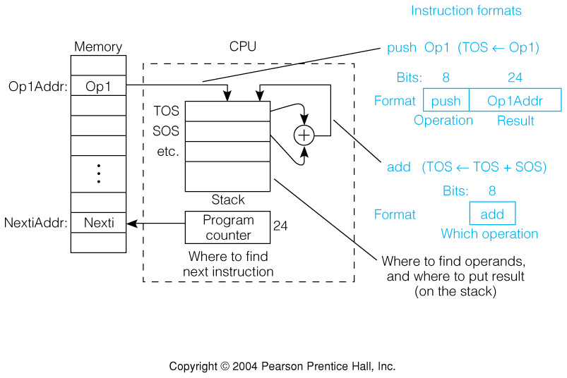
Fig. 2.7 The 0 Address Instruction
Uses a push down stack in CPU
Arithmetic uses stack for both operands. The result replaces them on the TOS
Computer must have a 1 address instruction to push and pop operands to and from the stack

Slide 21
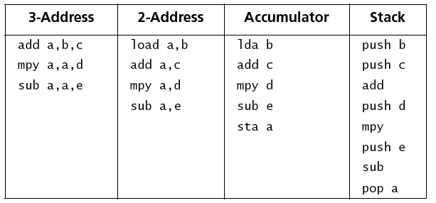
Example 2.1 Expression evaluation for 3-0 address instructions.
Evaluate a = (b+c)*d-e for 3- 2- 1- and 0-address machines.
# of instructions & # of addresses both vary
Discuss as examples: size of code in each case

Slide 22
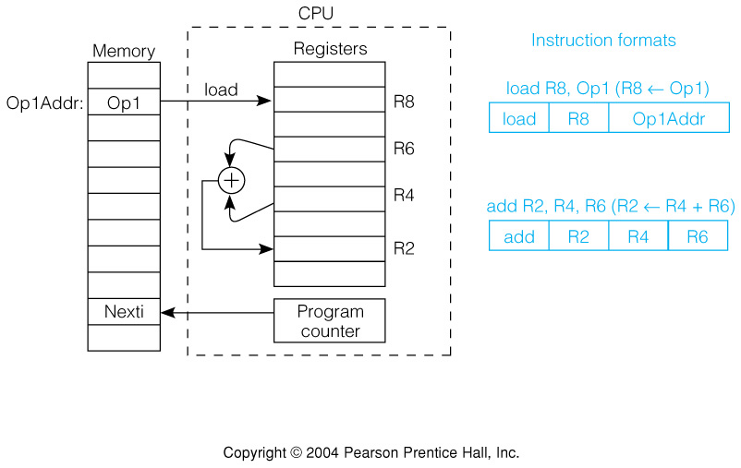
Fig. 2.8 General Register Machines
It is the most common choice in today’s general purpose computers
Which register is specified by small “address” (3 to 6 bits for 8 to 64 registers)
Load and store have one long & one short address: 1 1/2 addresses
2-Operand arithmetic instruction has 3 “half” addresses

Slide 23
Real Machines are Not So Simple
Most real machines have a mixture of 3, 2, 1, 0, 1 1/2 address instructions
A distinction can be made on whether arithmetic instructions use data from memory
If ALU instructions only use registers for operands and result, machine type is load-store
  Only load and store instructions reference memory
Other machines have a mix of register-memory and memory-memory instructions

Slide 24
Addressing Modes
An addressing mode is hardware support for a useful way of determining a memory address
Different addressing modes solve different HLL problems
  Some addresses may be known at compile time, e.g. global vars.
  Others may not be known until run time, e.g. pointers
  Addresses may have to be computed: Examples include:
    Record (struct) components:
      variable base(full address) + const.(small)
    Array components:
      const. base(full address) + index var.(small)
  Possible to store constant values w/o using another memory cell by storing them with or adjacent to the instruction itself.

Slide 25
HLL Examples of Structured Addresses
C language: rec -> count
  rec is a pointer to a record: full address variable
  count is a field name: fixed byte offset, say 24
C language: v[i]
  v is fixed base address of array: full address constant
  i is name of variable index: no larger than array size
Variables must be contained in registers or memory cells
Small constants can be contained in the instruction
Result: need for “address arithmetic.”
  E.g. Address of Rec -> Count is address of Rec + offset of count.
Count
Rec →
V[i]
V →

Slide 26
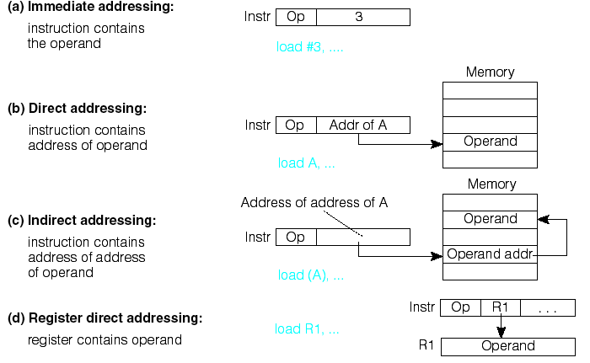
Fig 2.9 Common Addressing Modes a-d

Slide 27
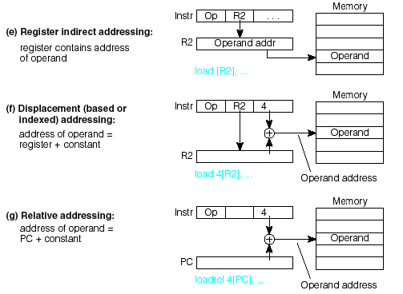
Fig 2.9 Common Addressing Modes e-g

Slide 28
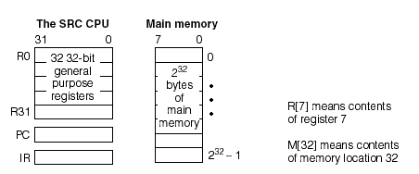
Fig. 2.10a Example Computer, SRC
Simple RISC Computer
32 general purpose registers of 32 bits
32 bit program counter, PC and instruction reg., IR
2³² bytes of memory address space

Slide 29
SRC Characteristics
(=) Load-store design: only way to access memory is through load and store instructions
(–) Operation on 32-bit words only, no byte or half-word operations.
(=) Only a few addressing modes are supported
(=) ALU Instructions are 3-register type
(–) Branch instructions can branch unconditionally or conditionally on whether the value in a specified register is = 0, <> 0, >= 0, or < 0.
(–) Branch-and-link instructions are similar, but leave the value of current PC in any register, useful for subroutine return.
(–) Can only branch to an address in a register, not to a direct address.
(=) All instructions are 32-bits (1-word) long.
(=) – Similar to commercial RISC machines
(–) – Less powerful than commercial RISC machines.

Slide 30
SRC Basic Instruction Formats
There are three basic instruction format types
The number of register specifier fields and length of the constant field vary
Other formats result from unused fields or parts
Details of formats:

Slide 31
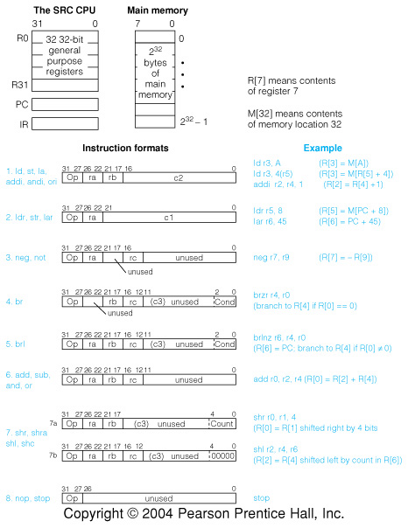
Fig 2.10 cont'd. SRC instructions

Slide 32
Tbl 2.4 Example Load & Store Instructions: Memory Addressing
Address can be constant, constant+register, or constant+PC
Memory contents or address itself can be loaded
I
n
s
t
r
u
c
t
i
o
n
o
p
r
a
r
b
c
1
M
e
a
n
i
n
g
A
d
d
r
e
s
s
i
n
g
M
o
d
e
l
d
r
1
,
3
2
1
1
0
3
2
D
i
r
e
c
R
t
[
1
]
←
M
[
3
2
]
l
d
r
2
2
,
2
4
(
r
4
)
1
2
2
4
2
4
D
i
s
p
l
a
c
e
m
e
n
R
t
[
2
2
]
←
M
[
2
4
+
R
[
4
]
]
s
t
r
4
,
0
(
r
9
)
3
4
9
0
R
e
g
i
s
t
e
r
i
n
d
i
r
e
c
M
t
[
R
[
9
]
]
←
R
[
4
]
l
a
r
7
,
3
2
5
7
0
3
2
I
m
m
e
d
i
a
t
R
e
[
7
]
←
3
2
l
d
r
r
1
2
,
-
4
8
2
1
2
–
-
4
8
R
e
l
a
t
i
v
R
e
[
1
2
]
←
M
[
P
C
-
4
8
]
l
a
r
r
3
,
0
6
3
–
0
R
e
g
i
s
t
e
r
(
!
R
)
[
3
]
←
P
C
(note use of la to load a constant)

Slide 33
Assembly Language Forms of Arithmetic and Logic Instructions
Format Example Meaning
neg ra, rc neg r1, r2 ;Negate (r1 = -r2)
not ra, rc not r2, r3 ;Not (r2 = r3´ )
add ra, rb, rc add r2, r3, r4 ;2’s complement addition
sub ra, rb, rc ;2’s complement subtraction
and ra, rb, rc ;Logical and
or ra, rb, rc ;Logical or
addi ra, rb, c2 addi r1, r3, 1 ;Immediate 2’s complement add
andi ra, rb, c2 ;Immediate logical and
ori ra, rb, c2 ;Immediate logical or
Immediate subtract not needed since constant in addi may be negative

Slide 34
Branch Instruction Format
There are actually only two branch op codes:
br rb, rc, c3<2..0> ;branch to R[rb] if R[rc] meets
; the condition defined by c3<2..0>
brl ra, rb, rc, c3<2..0> ; R[ra] ← PC; branch as above
It is c3<2..0>, the 3 lsbs of c3, that governs what the branch condition is:
lsbs condition Assy language form Example
000 never brlnv brlnv r6
001 always br, brl br r5, brl r5
010 if rc = 0 brzr, brlzr brzr r2, r4
011 if rc ≠ 0 brnz, brlnz
100 if rc ≥ 0 brpl, brlpl
101 if rc < 0 brmi, brlmi
Note that branch target address is always in register R[rb].
It must be placed there explicitly by a previous instruction.

Slide 35
Tbl. 2.6 Branch Instruction Examples

Slide 36
Branch Instructions—Example
C: goto Label3
SRC:
lar r0, Label3 ; put branch target address into tgt reg.
br r0 ; and branch
• • •
Label3 • • •

Slide 37
Example of conditional branch
in C: #define Cost 125
if (X<0) then X = -X;
in SRC:
Cost .equ 125 ;define symbolic constant
.org 1000 ;next word will be loaded at address 1000₁₀
X: .dw 1 ;reserve 1 word for variable X
.org 5000 ;program will be loaded at location 5000₁₀
lar r31, Over ;load address of “false” jump location
ld r1, X ;load value of X into r1
brpl r31, r1 ;branch to Else if r1≥0
neg r1, r1 ;negate value
Over: • • • ;continue

Slide 38
RTN (Register Transfer Notation)
Provides a formal means of describing machine structure and function
Is at the “just right” level for machine descriptions
Does not replace hardware description languages.
Can be used to describe what a machine does (an Abstract RTN) without describing how the machine does it.
Can also be used to describe a particular hardware implementation (A Concrete RTN)

Slide 39
RTN Notation (Cont’d.)
At first you may find this “meta description” confusing, because it is a language that is used to describe a language.
You will find that developing a familiarity with RTN will aid greatly in your understanding of new machine design concepts.
We will describe RTN by using it to describe SRC.

Slide 40
Some RTN Features—
Using RTN to describe a machine’s static properties
Static Properties
Specifying registers
  IR⟨31..0⟩ specifies a register named “IR” having 32 bits numbered 31 to 0
“Naming” using the := naming operator:
  op⟨4..0⟩ := IR⟨31..27⟩ specifies that the 5 msbs of IR be called op, with bits 4..0.
  Notice that this does not create a new register, it just generates another name, or “alias” for an already existing register or part of a register.

Slide 41
Using RTN to describe
Dynamic Properties
Dynamic Properties
Conditional expressions:
  (op=12) → R[ra] ← R[rb] + R[rc]: ; defines the add instruction
“if” condition “then” RTN Assignment Operator
This fragment of RTN describes the SRC add instruction. It says,
“when the op field of IR = 12, then store in the register specified
by the ra field, the result of adding the register specified by the
rb field to the register specified by the rc field.”

Slide 42
Using RTN to describe the SRC (static) Processor State
Processor state
PC⟨31..0⟩: program counter
        (memory addr. of next inst.)
IR⟨31..0⟩: instruction register
Run: one bit run/halt indicator
Strt: start signal
R[0..31]⟨31..0⟩: general purpose registers

Slide 43
RTN Register Declarations
General register specifications shows some features of the notation
Describes a set of 32 32-bit registers with names R[0] to R[31]
R[0..31]⟨31..0⟩:
Colon separates
statements with
no ordering
Name of
registers
Register #
in square
brackets
msb #
lsb#
Bit # in
angle
brackets
.. specifies
a range of
indices

Slide 44
Memory Declaration:
RTN Naming Operator
Defining names with formal parameters is a powerful formatting tool
Used here to define word memory (big endian)
Main memory state
Mem[0..2³² - 1]⟨7..0⟩: 2³² addressable bytes of memory
M[x]⟨31..0⟩ := Mem[x]#Mem[x+1]#Mem[x+2]#Mem[x+3]:
Dummy
parameter
Naming
operator
Concatenation
operator
All bits in
register if no
bit index given

Slide 45
RTN Instruction Formatting Uses Renaming of IR Bits
Instruction formats
op⟨4..0⟩ := IR⟨31..27⟩: operation code field
ra⟨4..0⟩ := IR⟨26..22⟩: target register field
rb⟨4..0⟩ := IR⟨21..17⟩: operand, address index, or
branch target register
rc⟨4..0⟩ := IR⟨16..12⟩: second operand, conditional
test, or shift count register
c1⟨21..0⟩ := IR⟨21..0⟩: long displacement field
c2⟨16..0⟩ := IR⟨16..0⟩: short displacement or
immediate field
c3⟨11..0⟩ := IR⟨11..0⟩: count or modifier field

Slide 46
Specifying dynamic properties of SRC:
RTN Gives Specifics of Address Calculation
Effective address calculations (occur at runtime):
disp⟨31..0⟩ := ((rb=0) → c2⟨16..0⟩ {sign extend}: displacement
(rb≠0) → R[rb] + c2⟨16..0⟩ {sign extend, 2's comp.} ): address
rel⟨31..0⟩ := PC⟨31..0⟩ + c1⟨21..0⟩ {sign extend, 2’s comp.}: relative address
Renaming defines displacement and relative addrs.
New RTN notation is used
  condition → expression means if condition then expression
  modifiers in { } describe type of arithmetic or how short numbers are extended to longer ones
  arithmetic operators (+ - * / etc.) can be used in expressions
Register R[0] cannot be added to a displacement

Slide 47
Detailed Questions Answered by the RTN for Addresses
What set of memory cells can be addressed by direct addressing (displacement with rb=0)
  If c2⟨16⟩=0 (positive displacement) absolute addresses range from 00000000H to 0000FFFFH
  If c2⟨16⟩=1 (negative displacement) absolute addresses range from FFFF0000H to FFFFFFFFH
What range of memory addresses can be specified by a relative address
  The largest positive value of C1⟨21..0⟩ is 2²¹-1 and its most negative value is -2²¹, so addresses up to 2²¹-1 forward and 2²¹ backward from the current PC value can be specified
Note the difference between rb and R[rb]

Slide 48
Instruction Interpretation: RTN Description of Fetch/Execute
Need to describe actions (not just declarations)
Some new notation
Logical NOT
Logical AND
instruction_interpretation := (
¬Run∧Strt → Run ← 1:
Run → (IR ← M[PC]: PC ← PC + 4; instruction_execution) );
Register transfer
Separates statements
that occur in sequence

Slide 49
RTN Sequence and Clocking
In general, RTN statements separated by : take place during the same clock pulse
Statements separated by ; take place on successive clock pulses
This is not entirely accurate since some things written with one RTN statement can take several clocks to perform
More precise difference between : and ;
  The order of execution of statements separated by : does not matter
  If statements are separated by ; the one on the left must be complete before the one on the right starts

Slide 50
More about Instruction Interpretation RTN
In the expression IR ← M[PC]: PC ← PC + 4; which value of PC applies to M[PC] ?
The rule in RTN is that all right hand sides of “:” - separated RTs are evaluated before any LHS is changed
  In logic design, this corresponds to “master-slave” operation of flip-flops
We see what happens when Run is true and when Run is false but Strt is true. What about the case of Run and Strt both false?
  Since no action is specified for this case, the RTN implicitly says that no action occurs in this case

Slide 51
Individual Instructions
instruction_interpretation contained a forward reference to instruction_execution
instruction_execution is a long list of conditional operations
  The condition is that the op code specifies a given inst.
  The operation describes what that instruction does
Note that the operations of the instruction are done after (;) the instruction is put into IR and the PC has been advanced to the next inst.

Slide 52
RTN Instruction Execution for Load and Store Instructions
instruction_execution := (
ld (:= op= 1) → R[ra] ← M[disp]: load register
ldr (:= op= 2) → R[ra] ← M[rel]: load register relative
st (:= op= 3) → M[disp] ← R[ra]: store register
str (:= op= 4) → M[rel] ← R[ra]: store register relative
la (:= op= 5 ) → R[ra] ← disp: load displacement address
lar (:= op= 6) → R[ra] ← rel: load relative address
The in-line definition (:= op=1) saves writing a separate definition ld := op=1 for the ld mnemonic
The previous definitions of disp and rel are needed to understand all the details

Slide 53
SRC RTN—The Main Loop
ii := instruction_interpretation:
ie := instruction_execution :
ii := ( ¬Run∧Strt → Run ← 1:
Run → (IR ← M[PC]: PC ← PC + 4;
ie) );
ie := (
ld (:= op= 1) → R[ra] ← M[disp]: Big switch
ldr (:= op= 2) → R[ra] ← M[rel]: statement
. . . on the opcode
stop (:= op= 31) → Run ← 0:
); ii
Thus ii and ie invoke each other, as coroutines.

Slide 54
Use of RTN Definitions:
Text Substitution Semantics
ld (:= op= 1) → R[ra] ← M[disp]:
disp⟨31..0⟩ := ((rb=0) → c2⟨16..0⟩ {sign extend}:
(rb≠0) → R[rb] + c2⟨16..0⟩ {sign extend, 2's comp.} ):
ld (:= op= 1) → R[ra] ← M[
((rb=0) → c2⟨16..0⟩ {sign extend}:
(rb≠0) → R[rb] + c2⟨16..0⟩ {sign extend, 2's comp.} ):
]:
An example:
  If IR = 00001 00101 00011 00000000000001011
  then ld → R[5] ← M[ R[3] + 11 ]:

Slide 55
RTN Descriptions of SRC Branch Instructions
Branch condition determined by 3 lsbs of inst.
Link register (R[ra]) set to point to next inst.
cond := ( c3⟨2..0⟩=0 → 0: never
c3⟨2..0⟩=1 → 1: always
c3⟨2..0⟩=2 → R[rc]=0: if register is zero
c3⟨2..0⟩=3 → R[rc]≠0: if register is nonzero
c3⟨2..0⟩=4 → R[rc]⟨31⟩=0: if positive or zero
c3⟨2..0⟩=5 → R[rc]⟨31⟩=1 ): if negative
br (:= op= 8) → (cond → PC ← R[rb]): conditional branch
brl (:= op= 9) → (R[ra] ← PC:
        cond → (PC ← R[rb]) ): branch and link

Slide 56
RTN for Arithmetic and Logic
add (:= op=12) → R[ra] ← R[rb] + R[rc]:
addi (:= op=13) → R[ra] ← R[rb] + c2⟨16..0⟩ {2's comp. sign ext.}:
sub (:= op=14) → R[ra] ← R[rb] - R[rc]:
neg (:= op=15) → R[ra] ← -R[rc]:
and (:= op=20) → R[ra] ← R[rb] ∧ R[rc]:
andi (:= op=21) → R[ra] ← R[rb] ∧ c2⟨16..0⟩ {sign extend}:
or (:= op=22) → R[ra] ← R[rb] ∨ R[rc]:
ori (:= op=23) → R[ra] ← R[rb] ∨ c2⟨16..0⟩ {sign extend}:
not (:= op=24) → R[ra] ← ¬R[rc]:
Logical operators: and ∧ or ∨ and not ¬

Slide 57
RTN for Shift Instructions
Count may be 5 lsbs of a register or the instruction
Notation: @ - replication, # - concatenation
n := ( (c3⟨4..0⟩=0) → R[rc]⟨4..0⟩:
(c3⟨4..0⟩≠0) → c3⟨4..0⟩ ):
shr (:= op=26) → R[ra]⟨31..0⟩ ← (n @ 0) # R[rb]⟨31..n⟩:
shra (:= op=27) → R[ra]⟨31..0⟩ ← (n @ R[rb]⟨31⟩) # R[rb]⟨31..n⟩:
shl (:= op=28) → R[ra]⟨31..0⟩ ← R[rb]⟨31-n..0⟩ # (n @ 0):
shc (:= op=29) → R[ra]⟨31..0⟩ ← R[rb]⟨31-n..0⟩ # R[rb]⟨31..32-n⟩:

Slide 58
Example of Replication and Concatenation in Shift
Arithmetic shift right by 13 concatenates 13 copies of the sign bit with the upper 19 bits of the operand
shra r1, r2, 13
R[2]=
1001 0111 1110 1010 1110 1100 0001 0110
13@R[2]⟨31⟩
#
R[2]⟨31..13⟩
R[1]=
1111 1111 1111 1
100 1011 1111 0101 0111

Slide 59
Assembly Language for Shift
Form of assembly language instruction tells whether to set c3=0
shr ra, rb, rc ;Shift rb right into ra by 5 lsbs of rc
shr ra, rb, count ;Shift rb right into ra by 5 lsbs of inst
shra ra, rb, rc ;AShift rb right into ra by 5 lsbs of rc
shra ra, rb, count ;AShift rb right into ra by 5 lsbs of inst
shl ra, rb, rc ;Shift rb left into ra by 5 lsbs of rc
shl ra, rb, count ;Shift rb left into ra by 5 lsbs of inst
shc ra, rb, rc ;Shift rb circ. into ra by 5 lsbs of rc
shc ra, rb, count ;Shift rb circ. into ra by 5 lsbs of inst

Slide 60
End of RTN Definition of instruction_execution
nop (:= op= 0) → : No operation
stop (:= op= 31) → Run ← 0: Stop instruction
); End of instruction_execution
instruction_interpretation.
We will find special use for nop in pipelining
The machine waits for Strt after executing stop
The long conditional statement defining instruction_execution ends with a direction to go repeat instruction_interpretation, which will fetch and execute the next instruction (if Run still =1)

Slide 61
Confused about RTN and SRC?
SRC is a Machine Language
  It can be interpreted by either hardware or software simulator.
RTN is a Specification Language
  Specification languages are languages that are used to specify other languages or systems—a metalanguage.
  Other examples: LEX, YACC, VHDL, Verilog
Figure 2.10 may help clear this up...

Slide 62
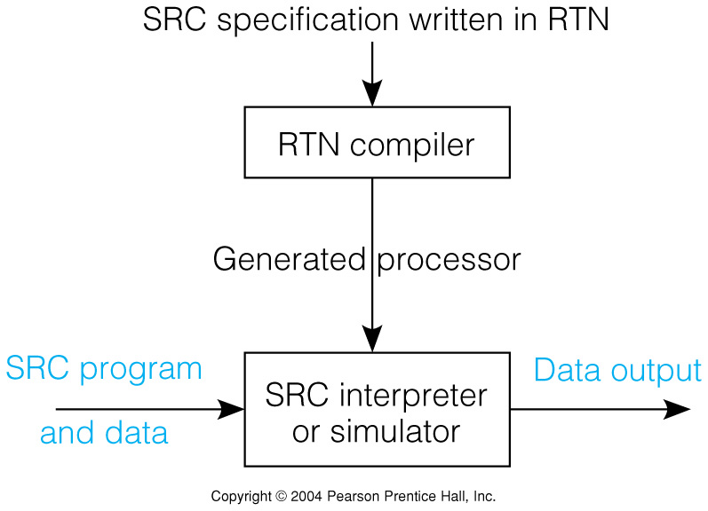
Fig 2.11 The Relationship of RTN to SRC

Slide 63
A Note about Specification Languages
They allow the description of what without having to specify how.
They allow precise and unambiguous specifications, unlike natural language.
They reduce errors:
  errors due to misinterpretation of imprecise specifications written in natural language
  errors due to confusion in design and implementation - “human error.”
Now the designer must debug the specification!
Specifications can be automatically checked and processed by tools.
  An RTN specification could be input to a simulator generator that would produce a simulator for the specified machine.
  An RTN specification could be input to a compiler generator that would generate a compiler for the language, whose output could be run on the simulator.

Slide 64
Addressing Modes Described in RTN (Not SRC)
Target register
Mode name Assembler RTN meaning Use
Syntax
Register Ra R[t] ← R[a] Tmp. Var.
Register indirect (Ra) R[t] ← M[R[a]] Pointer
Immediate #X R[t] ← X Constant
Direct, absolute X R[t] ← M[X] Global Var.
Indirect (X) R[t] ← M[ M[X] ] Pointer Var.
Indexed, based, X(Ra) R[t] ← M[X + R[a]] Arrays, structs
or displacement
Relative X(PC) R[t] ← M[X + PC] Vals stored w pgm
Autoincrement (Ra)+ R[t] ← M[R[a]]; R[a] ← R[a] + 1 Sequential
Autodecrement - (Ra) R[a] ← R[a] - 1; R[t] ← M[R[a]] access.

Slide 65
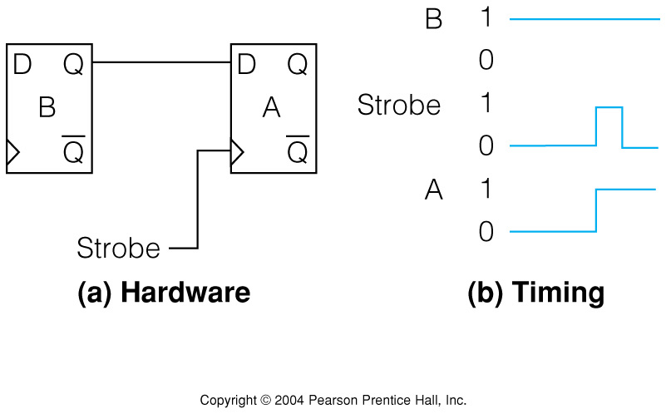
Fig. 2.12 Register transfers can be mapped to Digital Logic Circuits.
Implementing the RTN statement A ← B

Slide 66
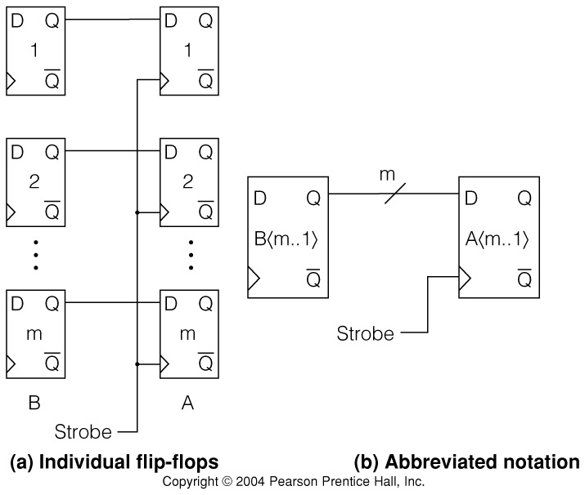
Fig. 2.13 Multiple Bit Register Transfer
Implementing A⟨m..1⟩ ← B⟨m..1⟩

Slide 67
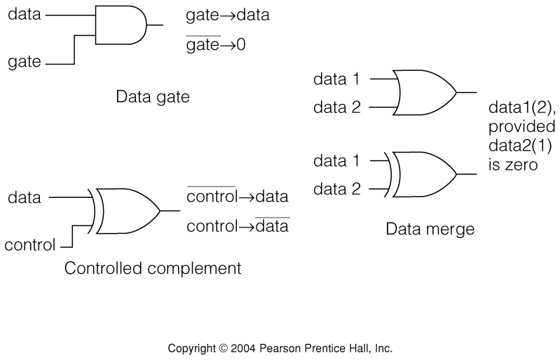
Fig. 2.14 Data Transmission View of Logic Gates
Logic gates can be used to control the transmission of data:

Slide 68
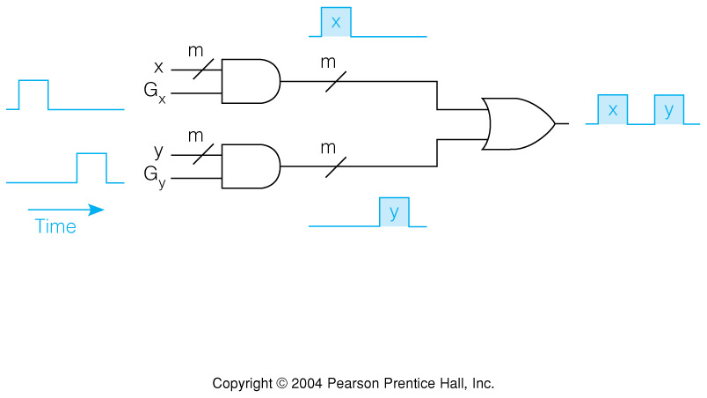
Fig. 2.15 Multiplexer as a 2 Way Gated Merge
Data from multiple sources can be selected for transmission

Slide 69
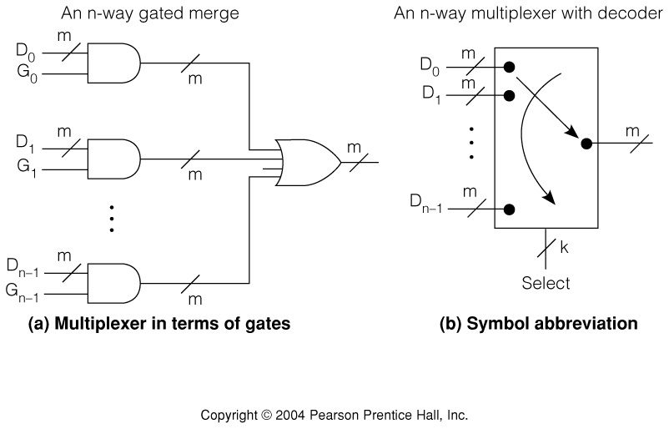
Fig. 2.16 m-bit Multiplexer and Symbol
Multiplexer gate signals G_{i} may be produced by a binary to one-out-of-n decoder

Slide 70
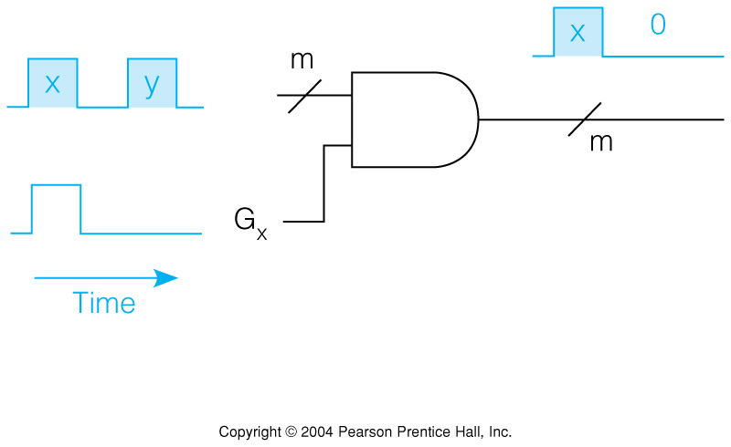
Fig. 2.17 Separating Merged Data
Merged data can be separated by gating at the right time
It can also be strobed into a flip-flop when valid

Slide 71
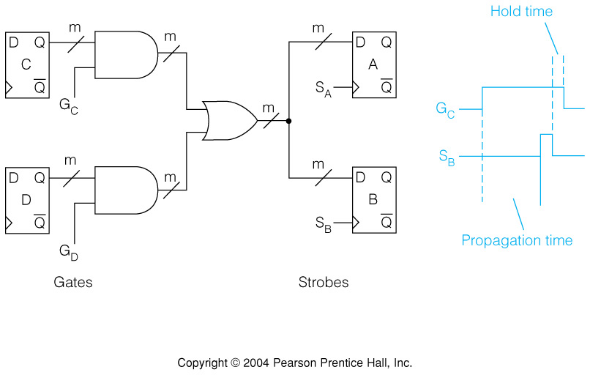
Fig. 2.18 Multiplexed Register Transfers using Gates and Strobes
Selected gate and strobe determine which Register is Transferred to where.
A←C, and B←C can occur together, but not A←C, and B←D

Slide 72
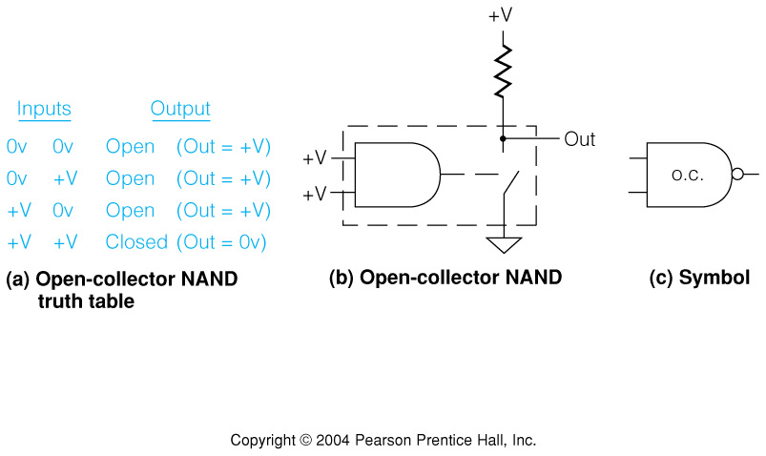
Fig. 2.19 Open-Collector NAND Gate Output Circuit

Slide 73
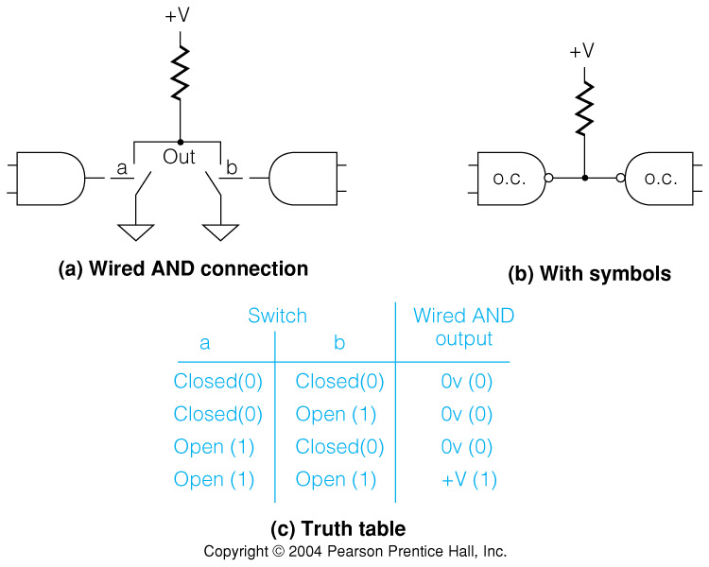
Fig. 2.20 Wired AND Connection of Open-Collector Gates

Slide 74
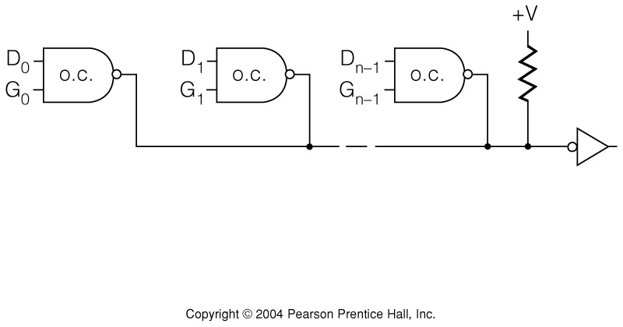
Fig. 2.21 Open Collector Wired OR Bus
DeMorgan’s OR by not of AND of nots
Pull-up resistor removed from each gate - open collector
One pull-up resistor for whole bus
Forms an OR distributed over the connection

Slide 75
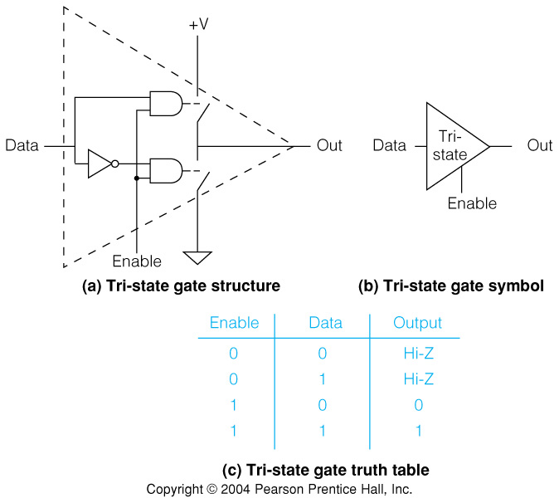
Fig. 2.22 Tri-state Gate Internal Structure and Symbol

Slide 76
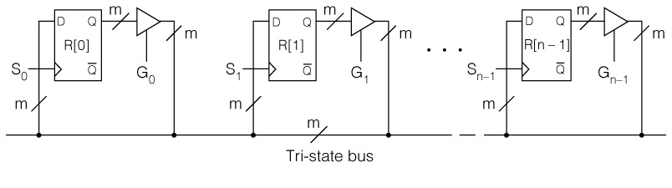
Fig. 2.23 Registers Connected by a
Tri-state Bus
Can make any register transfer R[i]←R[j]
Can’t have G_{i} = G_{j} = 1 for i≠j
Violating this constraint gives low resistance path from power supply to ground—with predictable results!

Slide 77
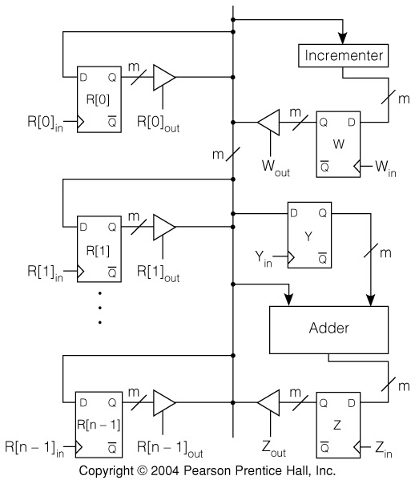
Fig. 2.24 Registers and Arithmetic Connected by One Bus
Example
Abstract RTN
R[3] ← R[1]+R[2];
Concrete RTN
Y ← R[2];
Z ← R[1]+Y;
R[3] ← Z;
Control Sequence
R[2]_{out}, Y_{in};
R[1]_{out}, Z_{in};
Z_{out}, R[3]_{in};
Combinational
Logic—no memory
Notice that what could be described in one step in the abstract RTN took three steps on this particular hardware

Slide 78
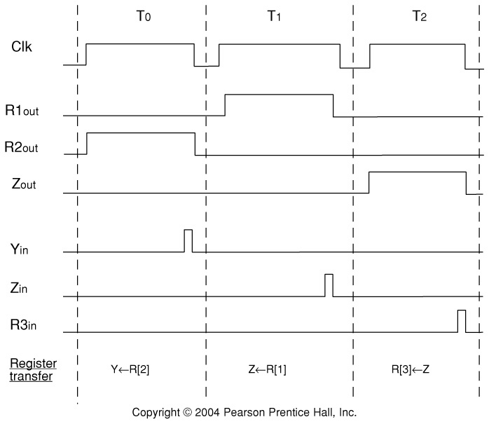
Figure 2.25 Timing of the Register Transfers
Discuss: difference between gating signals and strobing signals
Discuss factors influencing minimum clock period.

Slide 79
RT’s Possible with the One Bus Structure
R[i] or Y can get the contents of anything but Y
Since result different from operand, it cannot go on the bus that is carrying the operand
Arithmetic units thus have result registers
Only one of two operands can be on the bus at a time, so adder has register for one operand
R[i] ← R[j] + R[k] is performed in 3 steps: Y←R[k]; Z←R[j] + Y; R[i]←Z;
R[i] ← R[j] + R[k] is high level RTN description
Y←R[k]; Z←R[j] + Y; R[i]←Z; is concrete RTN
Map to control sequence is: R[2]_{out}, Y_{in}; R[1]_{out}, Z_{in}; Z_{out}, R[3]_{in};

Slide 80
From Abstract RTN to Concrete RTN to Control Sequences
The ability to begin with an abstract description, then describe a hardware design and resulting concrete RTN and control sequence is powerful.
We shall use this method in Chapter 4 to develop various hardware designs for SRC

Slide 81
Chapter 2 Summary
Classes of computer ISAs
Memory addressing modes
SRC: a complete example ISA
RTN as a description method for ISAs
RTN description of addressing modes
Implementation of RTN operations with digital logic circuits
Gates, strobes, and multiplexers

