Slide 1
Chapter 3 Topics
3.1 Machine characteristics and performance
3.2 RISC vs. CISC
3.3 A CISC microprocessor: The Motorola MC68000
3.4 The SPARC: a RISC architecture

Slide 2
Practical Aspects of Machine Cost-Effectiveness
Cost for useful work is fundamental issue
Mounting, case, keyboard, etc. are dominating the cost of integrated circuits
Upward compatibility preserves software investment
  Binary compatibility
  Source compatibility
  Emulation compatibility
Performance: strong function of application

Slide 3
Performance Measures
MIPS: Millions of Instructions Per Second
  Same job may take more instructions on one machine than on another
MFLOPS: Million Floating Point OPs Per Second
  Other instructions counted as overhead for the floating point
Whetstones: Synthetic benchmark
  A program made-up to test specific performance features
Dhrystones: Synthetic competitor for Whetstone
  Made up to “correct” Whetstone’s emphasis on floating point
SPEC: Selection of “real” programs
  Taken from the C/Unix world

Slide 4
Quantitative Performance Measurement
Consider two auto routes, the old one, which allowed an average speed of 34 mph, and the new one, which permitted 46 mph. What is the speedup of the new one over the old one?
Conventionally the speedup is calculated as follows:
For a speedup of 0.35, or 35%.
Alternately, the % speedup can be calculated directly:

Slide 5
Quantitative Performance Measurement
Many measurements are in terms of the time, T, it takes to accomplish some task. Recall that Time, T, is the reciprocal of Speed, S= 1/T. If the improvement is measured by recording travel time rather than travel speed the equation changes as follows:
Once again, the % speedup can be calculated directly:

Slide 6
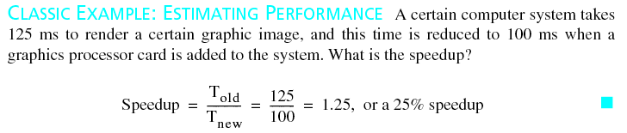
A Classic Example

Slide 7
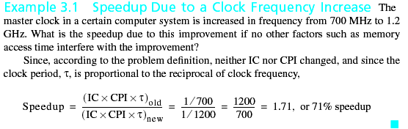
Getting Finer-Grained
The execution time can be calculated from the count of how many instructions have executed, IC, the average number of clock cycles per instruction, CPI, and the clock period, τ.
This is an important equation that will be used throughout the text.

Slide 8
CISC Versus RISC Designs
CISC: Complex Instruction Set Computer
  Many complex instructions and addressing modes
  Some instructions take many steps to execute
  Not always easy to find best instruction for a task
RISC: Reduced Instruction Set Computer
  few, simple instructions, addressing modes
  usually one word per instruction
  may take several instructions to accomplish what CISC can do in one
  complex address calculations may take several instructions
  usually has load-store, general register ISA

Slide 9
Design Characteristics of RISCs
Simple instructions can be done in few clocks
  Simplicity may even allow a shorter clock period
A pipelined design can allow an instruction to complete in every clock period
Fixed length instructions simplify fetch & decode
The rules may allow starting next instruction without necessary results of the previous
  Unconditionally executing the instruction after a branch
  Starting next instruction before register load is complete

Slide 10
Other RISC Characteristics
Prefetching of instructions. (Similar to I8086)
Pipelining: beginning execution of an instruction before the previous instruction(s) have completed. (Will cover in detail in Chapter 5.)
Superscalar operation—issuing more than one instruction simultaneously. (Instruction-level parallelism. Also covered in Chapter 5.)
Delayed loads, stores, and branches. Operands may not be available when an instruction attempts to access them.
Register Windows—ability to switch to a different set of CPU registers with a single command. Alleviates procedure call/return overhead. Discussed with SPARC in this Chapter.

Slide 11
Tbl. 3.1 Developing an Instruction Set Architecture
Memories: structure of data storage in the computer
  Processor state registers
  Main memory organization
Formats and their interpretation: meanings of register fields
  Data types
  Instruction format
  Instruction address interpretation
Instruction interpretation: things done for all instructions
  The fetch-execute cycle
  Exception handling (sometimes deferred)
Instruction execution: behavior of individual instructions
  Grouping of instructions into classes
  Actions performed by individual instructions

Slide 12
CISC: The Motorola MC68000
Introduced in 1979
One of first 32 bit microprocessors
  Means that most operations are on 32 bit internal data
  Some operations may use different number of bits
  External data paths may not all be 32 bits wide
    MC68000 had a 24 bit address bus
Complex Instruction Set Computer - CISC
  Large instruction set
  14 addressing modes

Slide 13
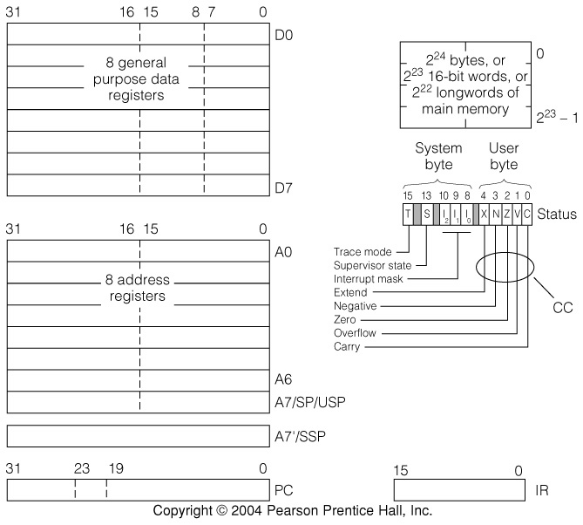
Fig. 3.1 MC68000 Programmer’s Model

Slide 14
Features of the 68000 Processor State
Distinction between 32 bit data registers and 32 bit address registers
16 bit instruction register
  Variable length instructions handled 16 bits at a time
Stack pointer registers
  User stack pointer is one of the address registers
  System stack pointer is a separate single register
    Discuss: Why a separate system stack.
Condition code register: System & User bytes
  Arithmetic status (N, Z, V, C, X) is in user status byte
  System status has Supervisor & Trace mode flags, as well as the Interrupt Mask

Slide 15
RTN Processor State for the MC68000
D[0..7]⟨31..0⟩: General purpose data registers;
A[0..7]⟨31..0⟩: Address registers;
A7´⟨31..0⟩: System stack pointer;
PC⟨23..0⟩: Program counter in original MC68000
IR⟨15..0⟩: Instruction register;
Status⟨15..0⟩: System status byte and user status byte;
SP := A[7]: User stack pointer, also called USP;
SSP := A7´: System stack pointer;
C := Status⟨0⟩: V := Status⟨1⟩: Carry and oVerflow flags;
Z := Status⟨2⟩: N := Status⟨3⟩: Zero and Negative flags;
X := Status⟨4⟩: Extend flag;
INT⟨2..0⟩ := Status⟨10..8⟩: Interrupt mask in system status byte;
S := Status⟨13⟩: T := Status⟨15⟩:Supervisor state and Trace mode flags;

Slide 16
Main Memory in the MC68000
Main memory:
  Mb[0..2²⁴-1]⟨7..0⟩: Memory as bytes
  Mw[ad]⟨15..0⟩ := Mb[ad]#Mb[ad+1]: Memory as words
  Ml[ad]⟨31..0⟩ := Mw[ad]#Mw[ad+2]: Memory as long words
The word and longword forms are “big-endian”
  The lowest numbered byte contains the most significant bit (big end) of the word
Words and longwords have “hard” alignment constraints not described in the above RTN
  Word addresses must end in one binary 0
  Longword addresses must end in two binary zeros

Slide 17
MC68000 Supports Several Operand Types
Like many CISC machines, the 68000 allows one instruction to operate on several types
  MOVE.B for bytes, MOVE.W for words, and MOVE.L for longwords; also ADD.B, ADD.W, ADD.L, etc.
  The default, ADD, for example, is Word operands.
  Operand length is encoded into the instruction word
Bits coding operand type vary with instruction
  For use with RTN descriptions, we assume a function d := datalen(IR) that returns 1, 2, or 4 for operand length

Slide 18
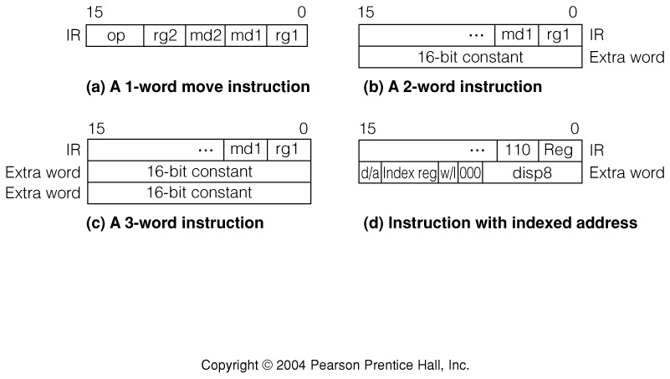
Fig. 3.2 Some MC68000 Instruction Formats

Slide 19
General Form of Addressing Modes in the MC68000
A general address of an operand or result is specified by a 6-bit field with mode and register numbers
5
4
3
2
1
0
mode
reg
Provides access paths to operands
Not all operands and results can be specified by a general address: some must be in registers.
Not all modes are legal in all parts of an inst.
Exception: when specifying the destination of a MOVE instruction the mode and reg fields are reversed.

Slide 20
MC68000 Addressing Modes
5
4
3
2
1
0
mode
reg

Slide 21
RTN Description of MC68000 Addressing
5
4
3
2
1
0
mode
reg
The addressing modes interpret many items
  The instruction: in the IR register
  The following 16 bit word: described as Mw[PC]
  The D and A registers in the CPU
Many addressing modes calculate an effective memory address
Some modes designate a register
Some modes result in a constant operand
There are restrictions on the use of some modes

Slide 22
RTN Formatting for Effective Address Calculation
XR[0..15]⟨31..0⟩ :=
D[0..7]⟨31..0⟩ # A[0..7]⟨31..0⟩: Index register can be D or A;
xr⟨3..0⟩ := Mw[PC]⟨15..12⟩: Index specifier for index mode;
wl := Mw[PC]⟨11⟩: Short or long index flag;
dsp8⟨7..0⟩ := Mw[PC]⟨7..0⟩: Displacement for index mode;
index := ( (wl=0) → XR[xr]⟨15..0⟩: Short or
(wl=1) → XR[xr]⟨31..0⟩): long index value;
Either an A or a D register can be used as an index
A 4-bit field in the 2nd instruction word specifies the index register
Low order 8-bits of 2nd word are used as offset
Either 16 or 32 bits of index register may be used
d
/
a
I
n
d
e
x
r
e
g
w
/
l
0
0
0
d
i
s
p
8
=
l
d
i
s
p
1
5
1
4
1
3
1
2
1
1
1
0
9
8
7
0
0 = 16 bit index
1 = 32 bit index
0: index is in data reg.
1: index is in address reg.

Slide 23
Modes That Calculate a Memory Address Using a Register
5
4
3
2
1
0
010 - 110
000 - 111
md and rg are the 3-bit mode and reg. fields.
ea stands for effective address
5
4
3
2
1
0
mode
reg
ea(md, rg) := (
(md = 2) → A[rg⟨2..0⟩]: Mode 2 is register indirect;
(md = 3) → Mode 3 is
(A[rg⟨2..0⟩]; A[rg⟨2..0⟩] ← A[rg⟨2..0⟩] + d): autoincrement;
(md = 4) → Mode 4 is
(A[rg⟨2..0⟩] ← A[rg⟨2..0⟩] - d; A[rg⟨2..0⟩]): autodecrement;
(md = 5) → Mode 5 is based
(A[rg⟨2..0⟩] + Mw[PC]; PC ← PC + 2): or offset addressing;
(md = 6) → Mode 6 is based
(A[rg⟨2..0⟩] + index + dsp8; PC ← PC + 2): indexed addressing;

Slide 24
Mode 7 Uses the reg Field to Expand the Number of Modes
5
4
3
2
1
0
1 1 1
reg
These modes still calculate a memory address
ea (md, rg) :=
. . .
(md = 7 ∧ rg = 0) → Mode 7, register 0 is
(Mw[PC]{sign extend to 32 bits}; PC ← PC + 2): short absolute;
(md = 7 ∧ rg = 1) → Mode 7, register 1 is
(Ml[PC]; PC ← PC + 4): long absolute;
(md = 7 ∧ rg = 2) → Mode 7, register 2 is
(PC + Mw[PC]{sign extend to 32 bits}; program counter
PC ← PC + 2): relative addressing;
(md = 7 ∧ rg = 3) → Mode 7, register 3 is
(PC + index + dsp8; PC ← PC + 2) ): relative indexed.

Slide 25
Fig. 3.3 Mode 2: Address Register Indirect
5
4
3
2
1
0
0 1 0
reg
Same picture for autoincrement or decrement
  Address register incremented after address obtained in autoincrement
  Address register decremented before address obtained in autodecrement

Slide 26
Fig. 3.4 Mode 6: Based Indexed Addressing
5
4
3
2
1
0
1 1 0
reg
Three things are added to get the address

Slide 27
Modes 7-0 and 7-1: Absolute Addressing
5
4
3
2
1
0
1 1 1
000 (16-bit)
001 (32-bit)
Absolute addresses can be 16 or 32 bits

Slide 28
Mode 7-3 Relative Indexed Addressing
5
4
3
2
1
0
1 1 1
0 1 1
M
a
i
R
n
e
l
a
t
i
v
e
i
n
d
e
x
e
d
a
d
d
r
e
s
s
i
n
g
m
e
m
o
r
.
.
.
y
1
1
1
0
1
1
d
/
a
I
n
d
e
x
r
e
g
w
/
l
0
0
0
d
i
s
p
8
=
l
d
i
s
p
P
r
o
g
r
a
m
c
o
u
n
t
e
r
1
5
1
4
1
3
1
2
1
1
1
0
9
8
7
0
+
Operand
0 = 16 bit index
1 = 32 bit index
0: index is in data reg.
1: index is in address reg.
I
D0-D7
n
d
e
x
(
1
6
o
r
3
2
E
)
x
:
M
O
V
E
.
W
L
D
I
S
P
(
P
C
,
D
4
)
,
.
.
.
A0-A7
Same as indexed mode but uses PC instead of A register as base

Slide 29
Operands in Registers or Memory can Have Different Lengths
memval(md, rg) := A memory address is
( (md⟨2..1⟩ = 1) ∨ (md⟨2..1⟩ = 2) ∨ (md⟨2..0⟩ = 6) ∨ used with these
((md⟨2..0⟩ = 7) ∧ (rg⟨2⟩ =0)) ): modes only;
opnd(md, rg) := ( The operand length in
(d=1) → opndb(md, rg): (d=2) → opndw(md, rg): the instruction tells
(d=4) → opndl(md, rg) ): which to use.
opndl(md, rg)⟨31..0⟩ := ( A long operand can be
. . . ): . . .
opndw(md, rg)⟨15..0⟩ := ( A word operand is
memval(md, rg) → Mw[ea(md, rg)]⟨15..0⟩: similar but needs only
md =0 → D[rg]⟨15..0⟩: a 16 bit immediate
md = 1 → A[rg]⟨15..0⟩: following the
(md = 7 ∧ rg = 4) → (Mw[PC]⟨15..0⟩: PC ← PC+2) ): instruction word;
opndb(md, rg)⟨7..0⟩ := ( Byte operands
. . . . . .
(md = 7 ∧ rg = 4) → (Mw[PC]⟨7..0⟩: PC ← PC+2) ): instruction word.

Slide 30
Modes 0 and 1: Register Direct Addressing
5
4
3
2
1
0
0 0 0 (D)
0 0 1 (A)
reg
The register itself provides a place to store a result or a place to get an operand
There is no memory address with this mode

Slide 31
Fig. 3.5 Mod 7-4: Immediate Addressing: Operands are stored in the instruction
5
4
3
2
1
0
1 1 1
1 0 0
Instruction word and 1 or 2 following words
Data length is specified by the opcode field, not the Mode/Reg field

Slide 32
Not Every Addressing Mode Can Be Used for Results
rsltadr(md, rg) := memval(md, rg) ∧ ¬(md=7 ∧(rg=2∨rg=3)):
The MC68000 disallows relative addressing (md7 rg 2 or 3) for results
This is captured in RTN by defining a function that is true (=1) if the memory address specified by the mode is legal for results
Register immediate is also legal for results, but will be handled separately

Slide 33
Result Modes Must Have a Place to Write Data: Memory or Register
rsltl(md, rg)⟨31..0⟩ := ( 32 bit result;
rsltadr(md, rg) → Ml[ea(md, rg)]⟨31..0⟩:
md = 0 → D[rg]⟨31..0⟩:
md = 1 → A[rg]⟨31..0⟩):
rsltw(md, rg)⟨15..0⟩ := ( 16 bit result;
rsltadr(md, rg) → Mw[ea(md, rg)]⟨15..0⟩:
md = 0 → D[rg]⟨15..0⟩:
md = 1 → A[rg]⟨15..0⟩):
rsltb(md, rg)⟨7..0⟩ := ( 8 bit result.
rsltadr(md, rg) → Mb[ea(md, rg)]⟨7..0⟩:
md = 0 → D[rg]⟨7..0⟩:
md = 1 → A[rg]⟨7..0⟩):
rslt(md, rg) := ( The result length in the
(d=1) → rsltb(md, rg): (d=2) → rsltw(md, rg): instruction tells
(d=4) → rsltl(md, rg) ): which to use.

Slide 34
MC68000 Instruction Interpretation
Instruction interpretation is simple when exceptions are ignored
Instruction_interpretation := (
Run → ( (IR⟨15..0⟩ ← Mw[PC]⟨15..0⟩: PC ← PC + 2);
instruction_execution ); ):
Instructions are fetched 16 bits at a time
  PC is advanced by 2 as each 16-bit word is fetched
  Addressing mode may advance it a total of 2 or 4 or more words, under command from the control unit.

Slide 35
Tbl. 3.3 Data Movement Instructions in the MC68000
The op code location and size depends on the instruction (Compare to SRC).

Slide 36
RTN for a Typical MC68000 Move Instruction
The instruction format for Move includes mode and register for source and destination addresses
op⟨3..0⟩ := IR⟨15..12⟩: rg1⟨2..0⟩ := IR⟨2..0⟩: md1⟨2..0⟩ := IR⟨5..3⟩:
rg2⟨2..0⟩ := IR⟨11..9⟩: md2⟨2..0⟩ := IR⟨8..6⟩:
tmp⟨31..0⟩:
move (:= op⟨3..2⟩ := 0) → (
tmp ← opnd(md1, rg1);
    ( Z ← (tmp=0): N ← (tmp<0): V ← 0: C ← 0 ):
    rslt(md2, rg2) ← tmp ):
The temporary register tmp is used because every invocation of opnd() causes another fetch

Slide 37
MC68000 Integer Arithmetic and Logic Instructions
Op. Operands Inst. word X N Z V C Operation Sizes
ADD EA,Dn 1101rrrmmmaaaaaa x x x x x dst←dst+src b, w, l
SUB EA,Dn 1001rrrmmmaaaaaa x x x x x dst←dst-src b, w, l
CMP EA,Dn 1011rrrxxxaaaaaa - x x x x dst-src b, w,l
CMPI #dat,EA 00001100wwaaaaaa - x x x x dst-imm.data b, w, l
MULS EA, Dn 1100rrr111aaaaaa - x x 0 0 Dn←Dn*src l←w*w
MULU EA,Dn 1100rrr011aaaaaa - x x 0 0 Dn←Dn*src l←w*w
DIVS EA,Dn 1000rrr111aaaaaa - x x x 0 Dn←Dn/src l←l/w
DIVU EA,Dn 1000rrr011aaaaaa - x x x 0 Dn←Dn/src l←l/w
AND EA,Dn 1100rrrmmmaaaaaa - x x 0 0 dst←dst∧src b, w, l
OR EA,Dn 1000rrrmmmaaaaaa - x x 0 0 dst←dst∨src b, w, l
EOR EA,Dn 1011rrrwwwaaaaaa - x x 0 0 dst←dst⊕src b, w, l
CLR EAs 01000010wwaaaaaa - 0 1 0 0 dst←0 b, w, l
NEG EAs 01000100wwaaaaaa - x x x x dst←0-dst b, w, l
TST EAs 01001010wwaaaaaa - x x 0 0 dst−0 b, w, l
NOT EAs 01000110wwaaaaaa - x x x x dst← ¬dst b, w, l
aaaaaa is the 6-bit addressing mode specifier mmmrrr
www: B–100, W–101, L–110
xxx: B–000, W–001, L–010

Slide 38
Notes on MC68000 Arithmetic and Logic Instructions
All 2-operand ALU instructions are either D → EA or EA → D. Which is it?
Only one operand uses EA
The other operand is always accessed by Data register direct
The 3-bit mmm field specifies whether D is the source or destination, and whether it is B, W, or L
Byte Word Long Destination
000 001 010 Dn
100 101 110 EA
Ex: SUB EA, Dn: 1011 rrr mmm aaaaaa
op Dn tbl abv. EA
Note: There are several exceptions to the rule above. See text and Mfr. Data sheet.

Slide 39
RTN Description of a Typical MC68000 Arithmetic Instruction
Subtract is a typical arithmetic instruction
Need a temporary register to hold an address
tmp⟨31..0⟩:temporary register for address
sub (:= op=9) → (
(md2⟨2⟩ =0) → D[rg2] ← D[rg2] - opnd(md1, rg1):
(md2⟨2⟩ =1) → (memval(md1, rg1) → (tmp ← ea(md1, rg1);
        M[tmp] ← M[tmp] - D[rg2] ):
¬memval(md1, rg1) → rslt(md1, rg1) ← rslt(md1, rg1) - D[rg2]) ):
This definition does not handle the condition codes

Slide 40
MC68000 Arithmetic Shifts and Single Word Rotates
Op. Operands Inst. word XNZVC
ASd EA 1110000d11aaaaaa xxxxx
ASd #cnt,Dn 1110cccdww000rrr xxxxx
ASd Dm,Dn 1110RRRdww100rrr xxxxx
ROd EA 1110011d11aaaaaa -xx0x
ROd #cnt,Dn 1110cccdww011rrr -xx0x
ROd Dm,Dn 1110RRRdww111rrr -xx0x
d is L or R for left or right shift, respectively
EA form has shift count of 1
ww is word size: 00–Byte, 01–Word, 10–Long Word

Slide 41
MC68000 Logical Shifts and Extended Rotates
Op. Operands Inst. word XNZVC
LSd EA 1110001d11aaaaaa xxx0x
LSd #cnt,Dn 1110cccdww001rrr xxx0x
LSd Dm,Dn 1110RRRdww101rrr xxx0x
ROXd EA 1110010d11aaaaaa xxx0x
ROXd #cnt,Dn 1110cccdww010rrr xxx0x
ROXd Dm,Dn 1110RRRdww110rrr xxx0x
Field ww specifies byte, word, or longword
N & Z set according to result, C= last bit shifted out

Slide 42
MC68000 Conditional Branch and Test Instructions
Op. Operands Inst. word Operation
Bcc disp 0110ccccdddddddd if (cond) then
DDDDDDDDDDDDDDDD PC ← PC + disp
DBcc Dn,disp 0101cccc11001rrr if ¬(cond) then Dn←Dn-1
if (Dn≠-1) then PC←PC+disp)
else PC ← PC + 2
Scc EA 0101cccc11aaaaaa if (cond) then (EA) ← FFH
else (EA) ← 00H
disp is dddddddd unless dddddddd =0, in which case it is contained in the extra word DDDDDDDDDDDDDDDD
DBcc is used for counted loops with an optional end condition.
  "Decrement and branch until cond."
Scc sets a byte to the outcome of a test

Slide 43
Conditions That Can Be Evaluated for Branch, Etc.
Code Meaning Name Flag expression
0000 true T 1
0001 false F 0
0100 carry clear CC C
0101 carry set CS C
0111 equal EQ Z
0110 not equal NE Z
1011 minus MI N
1010 plus PL N
0011† low or same LS C+Z
1101 less than LT N·V+N·V
1100 greater or equal GE N·V+N·V
1110 greater than GT N·V·Z+N·V·Z
1111 less or equal LE N·V+N·V+Z
0010† high HI C·Z
1000 overflow clear VC V
1001 overflow set VS V
†Assumes unsigned operands

Slide 44
Conditional Branches First Set Condition Codes, Then Branch
if ( X = 0 ) goto LOC
    TST X ;ands X with itself and sets N and Z
    BEQ LOC ;branch to LOC if X=0
    .
    .
    .
LOC:
EQ tests the right condition codes for =0, as above, or A=B following a compare, CMP A,B

Slide 45
MC68000 Unconditional Control Transfers
Op. Operands Inst.word Operation
BRA disp 01100000dddddddd PC ← PC + disp
DDDDDDDDDDDDDDDD
BSR disp 01100001dddddddd -(SP) ← PC; PC ← PC + disp
DDDDDDDDDDDDDDDD
JMP EA 0100111011aaaaaa PC ← EA
JSR EA 0100111010aaaaaa -(SP) ← PC; PC ← EA
Subroutine links push the return address onto the stack pointed to by A7 = SP

Slide 46
MC68000 Subroutine Return Instructions
Op. Operands Inst. word Operation
RTR 0100111001110111 CC ← (SP)+; PC ← (SP)+
RTS 0100111001110101 PC ← (SP)+
LINK An,disp 0100111001010rrr -(SP) ← An; An ← SP;
DDDDDDDDDDDDDDDD SP ← SP + disp
UNLK An 0100111001011rrr SP ← An; An ← (SP)+
Subroutine linkage uses stack for return address
LINK and UNLK allocate and de-allocate multiple word stack frames

Slide 47
Figure 3.6 Example Program to Search an Array
CR EQU 13 ;Define return character.
LEN EQU 132 ;Define line length.
ORG $1000 ;Locate LINE at 1000H.
LINE DS.B LEN ;Reserve LEN bytes of storage.
MOVE.B #LEN-1,D0 ;Initialize D0 to count-1.
MOVEA.L #LINE,A0 ;A0 gets start address of array.
LOOP CMPI.B (A0)+,#CR ;Make the comparison.
DBEQ D0,LOOP ;Double test: if LINE[131-D0]≠13
<next instruction> ; then decr. D0; if D0≠-1 branch
; to LOOP, else to next inst.
Program searches an array of bytes to find the first carriage return, ASCII code 13

Slide 48
Pseudo Operations in the MC68000 Assembler
A Pseudo Operation is one that is performed by the assembler at assembly time, not by the CPU at run time.
EQU defines a symbol to be equal to a constant. Substitution is made at assemble time.
  Pi EQU 3.14
DS.B (.W or .L) defines a block of storage
  Any label is associated with the first word of the block
  Line DS.B 132
  The program loader (part of the operating system) accomplishes this
-more-

Slide 49
Pseudo Operations in the MC68000 Assembler (cont’d.)
#symbol indicates the value of the symbol instead of a location addressed by the symbol
  MOVE.L #1000, D0 ;moves 1000 to D0
  MOVE.L 1000, D0 ;moves value at addr. 1000 to D0
  The assembler detects the difference and assembles the appropriate instruction.
ORG specifies a memory address as the origin where the following code will be stored
  Start ORG $4000 ;next instruction/data will be loaded at
  ;address 4000H.
  The Motorola assembler uses $ in front of a number to indicate hexadecimal
Character constants are in single quotes: ‘X’

Slide 50
Review of Assembly, Link, Load, and Run Times
At assemble time, assembly language text is converted to (binary) machine language
  They may be generated by translating instructions, hexadecimal or decimal numbers, characters, etc.
  Addresses are translated by way of a symbol table
  Addresses are adjusted to allow for blocks of memory reserved for arrays, etc.
At link time, separately assembled modules are combined & absolute addresses assigned
At load time, the binary words are loaded into memory
At run time, the PC is set to the starting address of the loaded module. (Usually the O.S. makes a jump or procedure call to that address.)

Slide 51
MC68000 Assembly Language Example: Clear a Block
MAIN …
MOVE.L #ARRAY, A0 ;Base of array
MOVE.W #COUNT, D0 ;Number of words to clear
JSR CLEARW ;Make the call
…
CLEARW BRA LOOPE ;Branch for init. Decr.
LOOPS CLR.W (A0)+ ;Autoincrement by 2 .
LOOPE DBF D0, LOOPS ;Dec.D0,fall through if -1
RTS ;Finished.
Subroutine expects block base in A0, count in D0
Linkage uses the stack pointer, so A7 cannot be used for anything else

Slide 52
Exceptions: Changes to Sequential Instruction Execution
Exceptions, also called interrupts, cause next instruction fetch from other than PC location
  Address supplying next instruction called exception vector
Exceptions can arise from instruction execution, hardware faults, and external conditions
  Externally generated exceptions usually called interrupts
  Arithmetic overflow, power failure, I/O operation completion, and out of range memory access are some causes
A trace bit =1 causes an exception after every instruction
  Used for debugging purposes

Slide 53
Steps in Handling MC68000 Exceptions
1) Status change
  Temporary copy of status register is made
  Supervisor mode bit S is set, trace bit T is reset
2) Exception vector address is obtained
  Small address made by shifting 8 bit vector number left 2
  Contents of the longword at this vector address is the address of the next instruction to be executed
  The exception handler or interrupt service routine starts there
3) Old PC and Status register are pushed onto supervisor stack, addressed by A7’ = SSP
4) PC is loaded from exception vector address
Return from handler is done by RTE
  Like RTR except restores Status reg. instead of CCs

Slide 54
Exception Priorities
When several exceptions occur at once, which exception vector is used?
Exceptions have priorities, and highest priority exception supplies the vector
MC68000 allows 7 levels of priority
Status register contains current priority
Exceptions with priority ≤ current are ignored

Slide 55
Exceptions and Reset Both Affect Instruction Interpretation
More processor state needed to describe reset and exception processing
Reset: Reset input
exc_req: Single bit exception request
exc_lev⟨2..0⟩: Exception Level
vect⟨7..0⟩ : Vector address for this exception
exc := exc_req ∧ (exc_lev⟨2..0⟩ > INT⟨2..0⟩): There is a request, and the request
level is > current mask in status reg.
exc_lev is the highest priority of any pending exception

Slide 56
Exceptions are Sensed Before Fetching Next Instruction
Instruction_interpretation := (
Run ∧ ¬(Reset ∨ exc) → (IR ← Mw[PC] : PC ← PC + 2); Normal execution state
Reset → (INT⟨2..0⟩ ← 7 : S ← 1 : T ← 0: Machine reset
SSP ← Ml[0] : PC ← Ml[4] :
Reset ← 0 : Run ← 1 );
Run ∧ ¬Reset ∧exc → (SSP ← SSP - 4; Ml[SSP] ← PC; Exception handling
SSP ← SSP - 2; Mw[SSP] ← Status;
S ← 1 : T ← 0 : INT⟨2..0⟩ ← exc_lev⟨2..0⟩ :
PC ← Ml[vect⟨7..0⟩#00₂] );
instruction_execution ).
Reset starts the computer with a stack pointer from location 0 at the address from location 4

Slide 57
Memory Mapped I/O
No separate I/O space. Part of cpu memory space is devoted/reserved for I/O instead of RAM or ROM.
Example: MC68000 has a total 24-bit address space. Suppose the top 32K is reserved for I/O:
FFFFFFH
. . .
FF8000H
FF7FFFH
. . .
000000H
}
I/O Space
}
Memory Space
Notice that top 32K can be addressed by a negative 16-bit value.

Slide 58
Memory Mapped I/O in the MC68000
Memory mapped I/O allows μprocessor chip to have one bus for both memory and I/O
  Multiple wires for both address and data
I/O uses address space that could otherwise contain memory
  Not popular with machines having limited address bits
Sizes of I/O & memory “spaces” independent
  Many or few I/O devices may be installed
  Much or little memory may be installed
Spaces are separated by putting I/O at top end of the address space

Slide 59
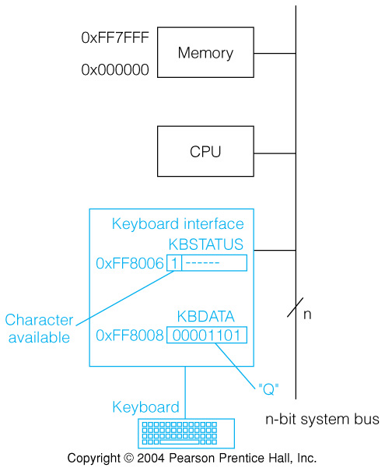
Fig. 3.8 A Memory Mapped Keyboard Interface
MC68000 has a 24 bit address bus
Address space runs from 000000H
up to FFFFFFH.
A 16 bit address constant can be
positive - and sign extend to an
address running from 000000H up
to the maximum positive value,
or negative - and sign extend to an
address running from FFFFFFH
down to the last negative 16 bit value.
I/O addresses in latter range can
be accessed by a 16 bit constant.

Slide 60
The SPARC (Scalable Processor Architecture) as a RISC Microprocessor Architecture
The SPARC is a general register, Load/Store architecture
It has only two addressing modes. Address =
  (Reg+Reg), or (Reg + 31-bit constant)
Instructions are all 32 bits in length
SPARC has 69 basic instructions
Separate floating point register set
First implementation had a 4 stage pipeline
Some important features not inherently RISC
  Register windows:separate but overlapping register sets available to calling and called routines
  32 bit address, big-endian organization of memory

Slide 61
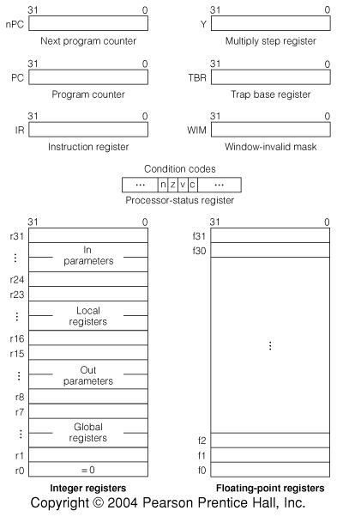
Fig. 3.9 The SPARC Processor State

Slide 62
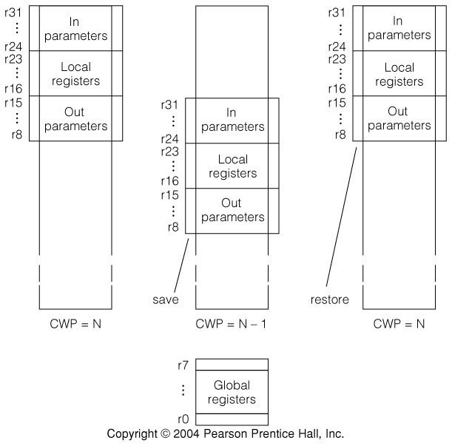
Fig. 3.10 Register Windows: an Important Concept in SPARC

Slide 63
SPARC Memory
RTN for the SPARC memory:
Mb[0..2³²-1]⟨7..0⟩: Byte memory;
Mh[a] ⟨15..0⟩ := Mb[a] ⟨7..0⟩#Mb[a+1] ⟨7..0⟩: Halfword memory;
M[a] ⟨31..0⟩ := Mh[a] ⟨15..0⟩#Mh[a+2] ⟨15..0⟩: Word memory.

Slide 64
Register Windows Format the General Registers
32 general integer and address registers are accessible at any one time
  Global registers G0..G7 are not in any window
  G0 is always zero: writes to G0 are ignored, reads return 0
  The other 24 are in a movable window from a total set of 120
On subroutine call, the starting point changes so that 24-31 before call become 8-15 after
Regs. 8-15 are used for incoming parameters
Regs. 24-31 are for outgoing parameters
Current Window Pointer CWP locates reg. 8
Overflow of reg. space causes trap

Slide 65
SAVE, RESTORE and the Current Window Pointer
CWP points to the register currently called G8
SAVE moves it to point of the old G24
  This makes the old G24..G31 into the new G8..G15
If parameters are placed in G24..G31 by the caller, the callee can get them from G8..G15
When all windows are used, SAVE traps to a routine that saves registers to memory
Windows wrap around in the available registers
  Window overflow “spills” the first window & reuses its space

Slide 66
SPARC Operand Addressing
One mode computes address as sum of 2 registers; G0 gives zero if used
The other mode adds sign extended 13 bit constant to a register
These can serve several purposes
  Indexed: base in one reg., index in another
  Register indirect: G0+Gn
  Displacement: Gn+const, n≠0
  Absolute: G0+const.
Absolute addressing can only reach the bottom or top 4K bytes of memory

Slide 67
RTN for SPARC Instruction Formats
op⟨1..0⟩ := IR⟨31..30⟩: Instruction class, op code for format 1;
disp30⟨29..0⟩ := IR⟨29..0⟩: Word displacement for call, format 1;
a := IR⟨29⟩: Annul bit for branches, format 2a;
cond⟨3..0⟩ := IR⟨28..25⟩: Branch condition select, format 2a;
rd⟨4..0⟩ := IR⟨29..25⟩: Destination register for formats 2b & 3;
op2⟨2..0⟩ := IR⟨24..22⟩: Op code for format 2;
disp22⟨21..0⟩ := IR⟨21..0⟩: Constant for branch displacement or sethi;
op3⟨5..0⟩ := IR⟨24..19⟩: Op code for format 3;
rs1⟨4..0⟩ := IR⟨18..14⟩: Source register 1 for format 3;
opf⟨8..0⟩ := IR⟨13..5⟩: Sub-op code for floating point, format 3a;
i := IR⟨13⟩: Immediate operand indicator, formats 3b & c;
simm13⟨12..0⟩ := IR⟨12..0⟩: Signed immediate operand for format 3c;
rs2⟨4..0⟩ := IR⟨4..0⟩: Source register 2 for format 3b.

Slide 68
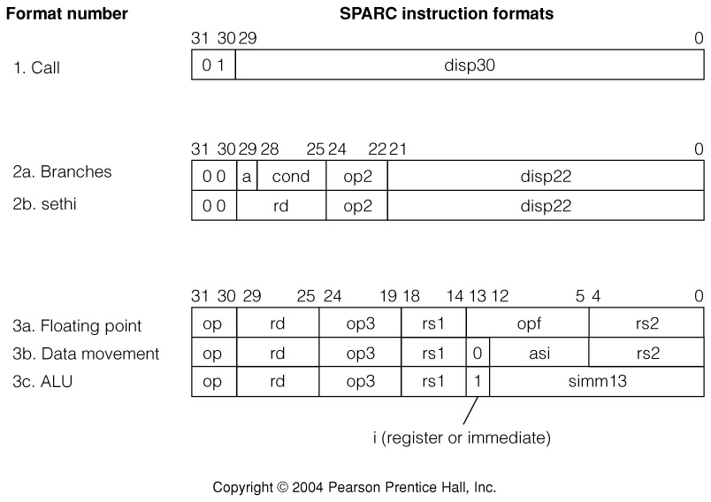
Fig. 3.11 SPARC Instruction Formats
Three basic formats with variations

Slide 69
RTN For SPARC Addressing Modes
adr⟨31..0⟩ := (i=0 → r[rs1] + r[rs2]: Address for load, store,
i=1 → r[rs1] + simm13⟨12..0⟩ {sign ext.}): and jump;
calladr⟨31..0⟩ := PC⟨31..0⟩ + disp30⟨29..0⟩ #002: Call relative address;
bradr⟨31..0⟩ := PC⟨31..0⟩ + disp22⟨21..0⟩ #002{sign ext.}: Branch address.

Slide 70
RTN For SPARC Instruction Interpretation
instruction_interpretation := (IR ← M[PC]; instruction_execution;
update_PC_and_nPC; instruction_interpretation):

Slide 71
Tbl. 3.8 SPARC Data Movement Instructions
Inst. Op. OPCODE Meaning
ldsb 11 00 1001 Load signed byte
ldsh 11 00 1010 Load signed halfword
ldsw 11 00 1000 Load signed word
ldub 11 00 0001 Load unsigned byte
lduh 11 00 0010 Load unsigned halfword
ldd 11 00 0011 Load doubleword
stb 11 00 0101 Store byte
sth 11 00 0110 Store halfword
stw 11 00 0100 Store word
std 11 00 0111 Store double word
swap 11 00 1111 Swap register with memory
ar 10 00 0010 Rdst ← Rsrc1 OR Rsrc2 (or immediate)
sethi 00 Op2=100 High order 22 bits of Rdst ← disp22

Slide 72
Register and Immediate Moves in the SPARC
OR is used with a G0 operand to do register to register moves
To load a register with a 32 bit constant, a 2 instruction sequence is used
  SETHI #upper22, R17
  OR R17, #lower10, R17
Double words are loaded into an even register and the next higher odd one
Floating point instructions are not covered, but the 32 FP registers can hold single length numbers, or 16 64-bit FP, or 8 128-bit FP numbers

Slide 73
Tbl. 3.9 Typical SPARC Arithmetic Instructions
Inst. OPCODE Meaning
add 0X 0000 Add or add and set condition codes
addc 0X 1000 Add with carry: set CCs or not
sub 0X 0100 Subtract: set CCs or not
subc 0X 1100 Subtract with borrow: set CCs or not
mulscc 10 1100 Do one step of multiply
All are format 3, Op=10
CCs are set if X=1 and not if X=0
Both register and immediate forms are available
Multiply is done by software using MULSCC or using floating point instructions
  Multiply is hard to do in one clock but multiply step is not

Slide 74
Tbl. 3.10 SPARC Logical and Shift Instructions
Inst. OPCODE Meaning
AND 0S 0001 AND, set CCs if S=1 or not if S=0
ANDN 0S 0101 NAND, set CCs or not
OR 0S 0010 OR, set CCs or not
ORN 0S 0110 NOR, set CCs or not
XOR 0S 0011 XNOR(Equiv), set CCs or not
SLL 10 0101 Shift left logical, count in RSRC2 or imm13
SRL 10 0110 Shift right logical, count in RSRC2 or imm13
SRA 10 0111 Shift right arithmetic, count as above
All instructions use format 3 with op=10
  Both register and immediate forms are available
Condition codes set if S=1 & undisturbed if S=0

Slide 75
Tbl. 3.11 SPARC Branch and Control Instructions
Inst. Fmt. Op OPCODE Meaning
or Op2
ba 2 00 010 Unconditional branch
bcc 2 00 010 Conditional branch
call 1 01 Call & save PC in R15
jmpl 3 11 1000 Jmp to EA, save PC in Rdst
save 3 11 1100 New register window, & ADD
restore 3 11 1101 Restore reg. window, & ADD
Some condition fields:
Inst. COND Inst. COND Inst. COND Inst. COND
ba 1000 bne 1001 be 0001 ble 0010
bcc 1101 bcs 0101 bneg 0110 bvc 1111
bvs 0111

Slide 76
Fig. 3.12 Example SPARC Code: add two integers
.begin
.org
progl: ldw [x], %r1 ! load a word from M[x] into register %r1
ldw [y], %r2 ! load a word from M[y] into register %r2
addcc %r1, %r2, %r3 !%r3 ← %r1 + %r2 ; set CCs
st %r3, [z] ! store sum into M[z]
jmpl %r15, +8, %r0 ! return to caller
nop ! branch delay slot
x: 15 ! reserve storage for x, y, and z
y: 9
z: 0
Note different syntax for SPARC.
Note r15 contains return address—placed there by the OS in this case.

Slide 77
Fig. 3.13 Example of Subroutine Linkage in the SPARC
.begin
.org
prog: ld [x], %o0 !Pass parameters in
ld [y], %o1 ! first 3 output registers.
call add3 !Call subroutine to put result in %o0.
mov -17, %o2 !Set last parameter in delay slot
st %o0, [z] !Store returned result.
...
x: 15
y: 9
z: 0
add3: save %sp,-(16*4),%sp !Get new window and adjust stack pointer.
add %i0, %i1, %l0 !Add parameters that now appear in
add %l0, %i3, %l0 ! input registers using a local.
ret !Return. Short for jmp %i7+8.
restore %l0, 0, %o0 !Result moved to caller’s %o0.
.end

Slide 78
Pipelining of the SPARC Architecture
Many aspects of the SPARC design are in support of a pipelined implementation
  Simple addressing modes, simple instructions, delayed branches, load/store architecture
Simplest form of pipelining is fetch/execute overlap—fetching next inst. while executing current inst.
Pipelining breaks inst. processing into steps
  A step of one instruction overlaps different steps for others
A new inst. is started (issued) before previously issued instructions are complete
Instructions guaranteed to complete in order

Slide 79
Fig. 3.14 The SPARC MB86900 Pipeline
4 pipeline stages are Fetch, Decode, Execute, and Write
Results are written to registers in Write stage

Slide 80
Pipeline Hazards
Will be discussed later, but main issue is:
Branch or jump change the PC as late as Exec. or Write, but next inst. has already been fetched
  One solution is ‘Delayed Branch’
  One (maybe 2) instruction following branch is always executed, regardless of whether branch is taken
  SPARC has a delayed branch with one ‘delay slot”, but also allows the delay slot instruction to be annulled (have no effect on the machine state) if the branch is not taken
Registers to be written by one instruction may be needed by another already in the pipeline, before the update has happened (Data Hazard)

Slide 81
CISC vs. RISC: Recap
CISCs supply powerful instructions tailored to commonly used operations, stack operations, subroutine linkage, etc.
RISCs require more instructions to do the same job
CISC instructions take varying lengths of time
RISC instructions can all be executed in the same, few cycle, pipeline
RISCs should be able to finish (nearly) one instruction per clock cycle

Slide 82
Key Concepts: RISC vs. CISC
While a RISC machine may possibly have fewer instructions than a CISC, the instructions are always simpler. Multi-step arithmetic operations are confined to special units.
Like all RISCs, the SPARC is a load/store machine. Arithmetic operates only on values in registers.
A few, regular, instruction formats and limited addressing modes make instruction decode and operand determination fast.
Branch delays are quite typical of RISC machines and arise from the way a pipeline processes branch instructions.
The SPARC does not have a load delay, which some RISCs do, and does have register windows, which many RISCs do not.

Slide 83
Chapter Summary
Machine price/performance are the driving forces.
  Performance can be measured in many ways: MIPS, execution time, Whetstone, Dhrystone, SPEC benchmarks.
CISC machines have fewer instructions that do more.
  Instruction word length may vary widely
  Addressing modes encourage memory traffic
  CISC instructions are hard to map onto modern architectures
RISC machines usually have
  One word per instruction
  Load/store memory access
  Simple instructions and addressing modes
  Result in allowing higher clock cycles, prefetching, etc.

