Slide 1
Chapter 4 Topics
The Design Process
A 1-bus Microarchitecture for SRC
Data Path Implementation
Logic Design for the 1-bus SRC
The Control Unit
The 2- and 3-bus Processor Designs
The Machine Reset Process
Machine Exceptions

Slide 2
Abstract and Concrete Register Transfer Descriptions
The abstract RTN for SRC in Chapter 2 defines “what,” not “how”
A concrete RTN uses a specific set of real registers and buses to accomplish the effect of an abstract RTN statement
Several concrete RTNs could implement the same ISA

Slide 3
A Note on the Design Process
In this chapter presents several SRC designs
We started in Chap. 2 with an informal description
In this chapter we will propose several block diagram architectures to support the abstract RTN, then we will:
  Write concrete RTN steps consistent with the architecture
  Keep track of demands made by concrete RTN on the hardware
Design data path hardware and identify needed control signals
Design a control unit to generate control signals

Slide 4
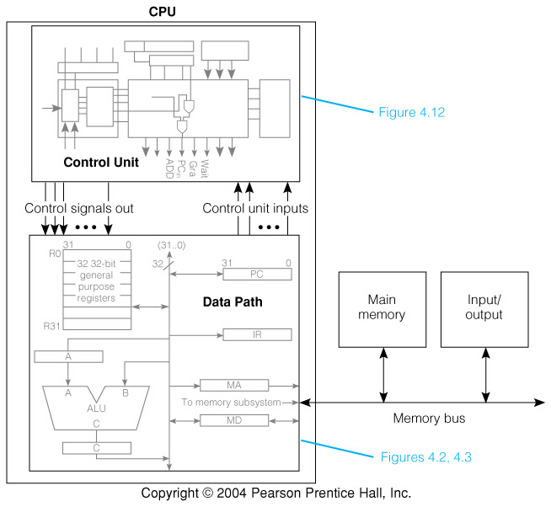
Fig. 4.1 Block Diagram of 1-bus SRC

Slide 5
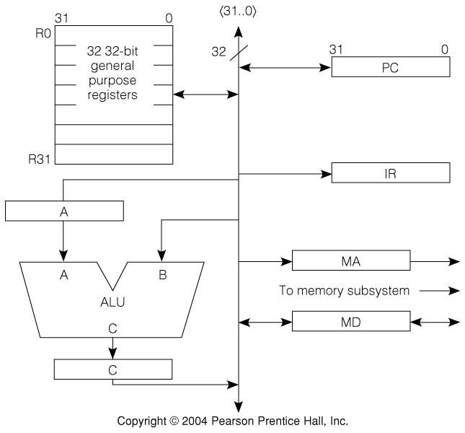
Fig. 4.2 High-Level View of the 1-Bus SRC Design
EA
ADD
SUB
AND
OR
SHR
SHRA
SHL
SHC
NOT
NEG
C=B
INC4
12

Slide 6
Constraints Imposed by the Microarchitecture
One bus connecting most registers allows many different RTs, but only one at a time
Memory address must be copied into MA by CPU
Memory data written from or read into MD
First ALU operand always in A, result goes to C
Second ALU operand always comes from bus
Information only goes into IR and MA from bus
  A decoder (not shown) interprets contents of IR
  MA supplies address to memory, not to CPU bus

Slide 7
Abstract and Concrete RTN for SRC add Instruction
Abstract RTN: (IR ← M[PC]: PC ← PC + 4; instruction_execution);
instruction_execution := ( • • •
add (:= op= 12) → R[ra] ← R[rb] + R[rc]:
Tbl 4.1 Concrete RTN for add:
Step RTN
T0. MA ← PC: C ← PC + 4;
T1. MD ← M[MA]: PC ← C;
T2. IR ← MD;
T3. A ← R[rb];
T4. C ← A + R[rc];
T5. R[ra] ← C;
IF
IEx.
Parts of 2 RTs (IR ← M[PC]: PC ← PC + 4;) done in T0
Single add RT takes 3 concrete RTs (T3, T4, T5)

Slide 8
Concrete RTN Gives Information about Sub-units
The ALU must be able to add two 32-bit values
ALU must also be able to increment B input by 4
Memory read must use address from MA and return data to MD
Two RTs separated by : in the concrete RTN, as in T0 and T1, are operations at the same clock
Steps T0, T1, and T2 constitute instruction fetch, and will be the same for all instructions
With this implementation, fetch and execute of the add instruction takes 6 clock cycles

Slide 9
Concrete RTN for Arithmetic Instructions: addi
Abstract RTN:
addi (:= op= 13) → R[ra] ← R[rb] + c2⟨16..0⟩ {2's comp. sign extend} :
Tbl 4.2 Concrete RTN for addi:
Step RTN
T0. MA ← PC: C ← PC + 4;
T1. MD ← M[MA]; PC ← C;
T2. IR ← MD;
T3. A ← R[rb];
T4. C ← A + c2⟨16..0⟩ {sign ext.};
T5. R[ra] ← C;
Differs from add only in step T4
Establishes requirement for sign extend hardware

Slide 10
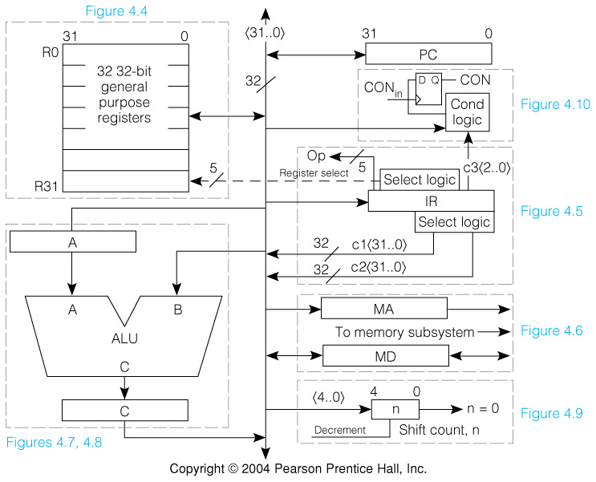
Fig. 4.3 More Complete view of Registers and Buses in 1-bus SRC Design—Including Some Control Signals
Concrete RTN lets us add detail to the data path
  Instruction register logic & new paths
  Condition bit flip-flop
  Shift count register
Keep this slide in
mind as we discuss
concrete RTN of instructions.

Slide 11
Abstract and Concrete RTN for Load and Store
  ld (:= op= 1) → R[ra] ← M[disp] :
  st (:= op= 3) → M[disp] ← R[ra] :
where
  disp⟨31..0⟩ := ((rb=0) → c2⟨16..0⟩ {sign ext.} :
(rb≠0) → R[rb] + c2⟨16..0⟩ {sign extend, 2's comp.} ) :
Tbl 4.3
Step RTN for ld RTN for st
T0-T2 Instruction fetch
T3. A ← (rb=0 → 0: rb≠0 → R[rb]);
T4. C ← A + (16@IR⟨16⟩#IR⟨15..0⟩);
T5. MA ← C;
T6. MD ← M[MA]; MD ← R[ra];
T7. R[ra] ← MD; M[MA] ← MD;

Slide 12
Notes for Load and Store RTN
Steps T0 through T2 are the same as for add and addi, and for all instructions
In addition, steps T3 through T5 are the same for ld and st, because they calculate disp
A way is needed to use 0 for R[rb] when rb=0
15 bit sign extension is needed for IR⟨16..0⟩
Memory read into MD occurs at T6 of ld
Write of MD into memory occurs at T7 of st

Slide 13
Concrete RTN for Conditional Branch
br (:= op= 8) → (cond → PC ← R[rb]):
cond := ( c3⟨2..0⟩=0 → 0: never
c3⟨2..0⟩=1 → 1: always
c3⟨2..0⟩=2 → R[rc]=0: if register is zero
c3⟨2..0⟩=3 → R[rc]≠0: if register is nonzero
c3⟨2..0⟩=4 → R[rc]⟨31⟩=0: if positive or zero
c3⟨2..0⟩=5 → R[rc]⟨31⟩=1 ): if negative
Tbl 4.4
Step Concrete RTN
T0-T2 Instruction fetch
T3. CON ← cond(R[rc]);
T4. CON → PC ← R[rb];

Slide 14
Notes on Conditional Branch RTN
c3⟨2..0⟩ are just the low order 3 bits of IR
cond() is evaluated by a combinational logic circuit having inputs from R[rc] and c3⟨2..0⟩
The one bit register CON is not accessible to the programmer and only holds the output of the combinational logic for the condition
If the branch succeeds, the program counter is replaced by the contents of a general reg.

Slide 15
Abstract and Concrete RTN for SRC Shift Right
shr (:= op = 26) → R[ra]⟨31..0⟩ ← (n @ 0) # R[rb]⟨31..n⟩ :
n := ( (c3⟨4..0⟩=0) → R[rc]⟨4..0⟩ : shift count in reg.
(c3⟨4..0⟩≠0) → c3⟨4..0⟩ ): or const. field
Tbl 4.5
Step Concrete RTN
T0-T2 Instruction fetch
T3. n ← IR⟨4..0⟩;
T4. (n=0) → (n ← R[rc]⟨4..0⟩);
Τ5.C ← R[rb];
T6. Shr (:= (n≠0) → (C⟨31..0⟩ ← 0#C⟨31..1⟩: n ← n-1; Shr) );
T7. R[ra] ← C;
step T6 is repeated n times

Slide 16
Notes on SRC Shift RTN
In the abstract RTN, n is defined with :=
In the concrete RTN, it is a physical register
n not only holds the shift count but is used as a counter in step T6
Step T6 is repeated n times as shown by the recursion in the RTN
The control for such repeated steps will be treated later

Slide 17
Data Path/Control Unit Separation
Interface between data path and control consists of gate and strobe signals
A gate selects one of several values to apply to a common point, say a bus
A strobe changes the values of the flip-flops in a register to match new inputs
The type of flip-flop used in regs. has much influence on control and some on data path
  Latch: simpler hardware, but more complex timing
  Edge triggering: simpler timing, but about 2× hardware

Slide 18
Reminder on Latch and Edge-Triggered Operation
Latch output follows input while strobe is high
D
D
Q
C
C
Q
Edge triggering samples input at edge time
D
D
Q
C
C
Q

Slide 19
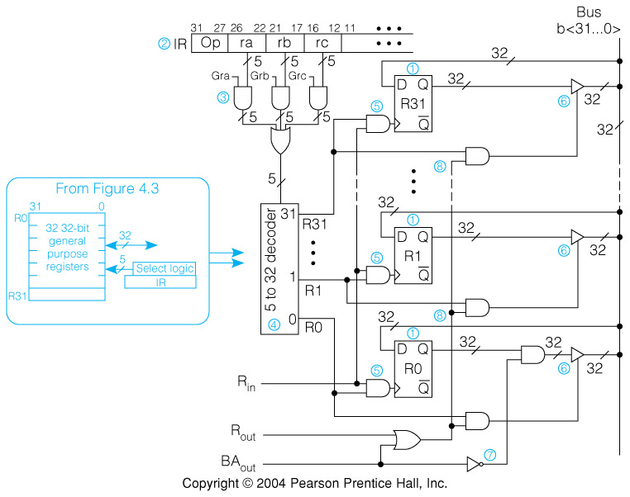
Fig. 4.4 The SRC Register File and Its Control Signals
R_{out} gates selected reg. onto bus
R_{in} strobed selected reg. from bus
BA_{out} differs from R_{out} by gating 0 when R[0] is selected
BA = Base Address

Slide 20
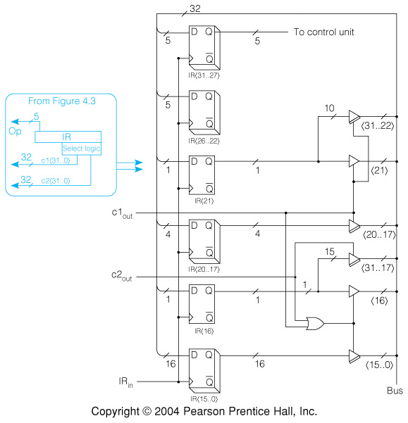
Fig. 4.5 Extracting c1, c2, and op from the Instruction Register
I⟨21⟩ is the sign bit of C1 that must be extended
I⟨16⟩ is the sign bit of C2 that must be extended
Sign bits are fanned out from one to several bits and gated to bus

Slide 21
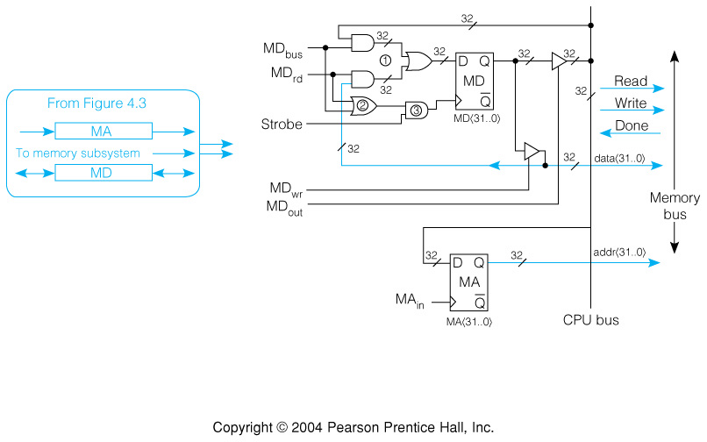
Fig. 4.6 CPU to Memory Interface: MA and MD Registers
MD is loaded from memory bus or from CPU bus
MD can drive CPU bus or memory bus

Slide 22
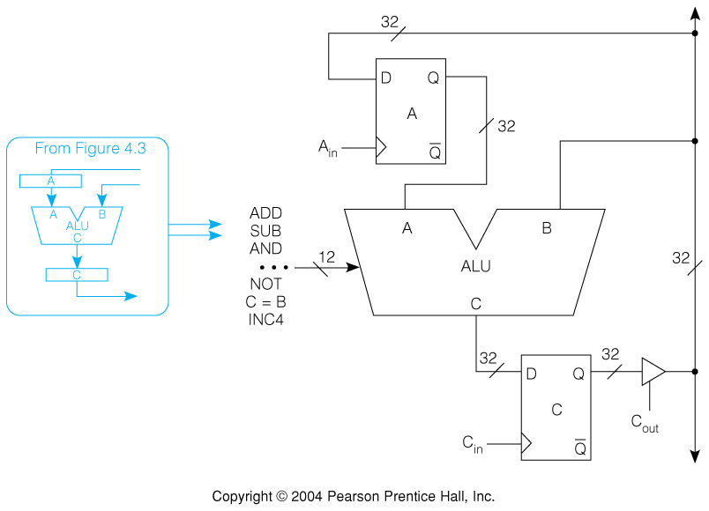
Fig. 4.7 The ALU and Its Associated Registers

Slide 23
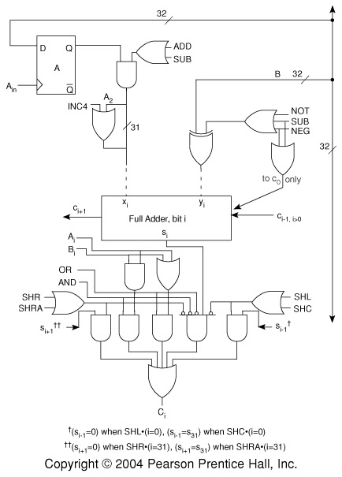
Figure 4.8. A Logic-Level Design for One Bit of the 1-Bus SRC ALU

Slide 24
From Concrete RTN to Control Signals: The Control Sequence
Tbl 4.6—The Instruction Fetch
Step Concrete RTN Control Sequence
T0. MA ← PC: C ← PC+4; PC_{out}, MA_{in}, Inc4, C_{in}
T1. MD ← M[MA]: PC ← C; Read, C_{out}, PC_{in}, Wait
T2. IR ← MD; MD_{out}, IR_{in}
T3. Instruction_execution
The register transfers are the concrete RTN
The control signals that cause the register transfers make up the control sequence
Wait prevents the control from advancing to step T3 until the memory asserts Done

Slide 25
Control Steps, Control Signals, and Timing
Within a given time step, the order in which control signals are written is irrelevant
  In step T0, C_{in}, Inc4, MA_{in}, PC_{out} == PC_{out}, MA_{in}, Inc4, C_{in}
The only timing distinction within a step is between gates and strobes
The memory read should be started as early as possible to reduce the wait
MA must have the right value before being used for the read
Depending on memory timing, Read could be in T0

Slide 26
Control Sequence for the SRC add Instruction
add (:= op= 12) → R[ra] ← R[rb] + R[rc]:
Tbl 4.7 The Add Instruction
Step Concrete RTN Control Sequence
T0. MA ← PC: C ← PC+4; PC_{out}, MA_{in}, Inc4, C_{in}, Read
T1. MD ← M[MA]: PC ← C; C_{out}, PC_{in}, Wait
T2. IR ← MD; MD_{out}, IR_{in}
T3. A ← R[rb]; Grb, R_{out}, A_{in}
T4. C ← A + R[rc]; Grc, R_{out}, ADD, C_{in}
T5. R[ra] ← C; C_{out}, Gra, R_{in}, End
Note the use of Gra, Grb, & Grc to gate the correct 5 bit register select code to the regs.
End signals the control to start over at step T0

Slide 27
Control Sequence for the SRC addi Instruction
addi (:= op= 13) → R[ra] ← R[rb] + c2⟨16..0⟩ {2's comp., sign ext.} :
Tbl 4.8 The addi Instruction
Step Concrete RTN Control Sequence
T0. MA ← PC: C ← PC + 4; PC_{out}, MA_{in}, Inc4, C_{in}, Read
T1. MD ← M[MA]; PC ← C; C_{out}, PC_{in}, Wait
T2. IR ← MD; MD_{out}, IR_{in}
T3. A ← R[rb]; Grb, R_{out}, A_{in}
T4. C ← A + c2⟨16..0⟩ {sign ext.}; c2_{out}, ADD, C_{in}
T5. R[ra] ← C; C_{out}, Gra, R_{in}, End
The c2_{out} signal sign extends IR⟨16..0⟩ and gates it to the bus

Slide 28
Control Sequence for the SRC st Instruction
  st (:= op= 3) → M[disp] ← R[ra] :
  disp⟨31..0⟩ := ((rb=0) → c2⟨16..0⟩ {sign ext.} :
(rb≠0) → R[rb] + c2⟨16..0⟩ {sign extend, 2's comp.} ) :
The st Instruction
Step Concrete RTN Control Sequence
T0-T2 Instruction fetch Instruction fetch
T3. A ← (rb=0) → 0: rb≠0 → R[rb]; Grb, BA_{out}, A_{in}
T4. C ← A + c2⟨16..0⟩ {sign ext.}; c2_{out}, ADD, C_{in}
T5. MA ← C; C_{out}, MA_{in}
T6. MD ← R[ra]; Gra, R_{out}, MD_{in}, Write
T7. M[MA] ← MD; Wait, End
} address arithmetic
Note BA_{out} in T3 compared to R_{out} in T3 of addi

Slide 29
Fig. 4.9 The Shift Counter
The concrete RTN for shr relies upon a 5 bit register to hold the shift count
It must load, decrement, and have an = 0 test

Slide 30
Tbl 4.10 Control Sequence for the SRC shr Instruction—Looping
Step Concrete RTN Control Sequence
T0-T2 Instruction fetch Instruction fetch
T3. n ← IR⟨4..0⟩; c1_{out}, Ld
T4. (n=0) → (n ← R[rc]⟨4..0⟩); n=0 → (Grc, R_{out}, Ld)
T5. C ← R[rb]; Grb, R_{out}, C=B, C_{in}
T6. Shr (:= (n≠0) → n≠0 → (C_{out}, SHR, C_{in},
    (C⟨31..0⟩ ← 0#C⟨31..1⟩: Decr, Goto6)
    n ← n-1; Shr) );
T7. R[ra] ← C; C_{out}, Gra, R_{in}, End
Conditional control signals and repeating a control step are new concepts

Slide 31
Branching
cond := ( c3⟨2..0⟩=0 → 0:
c3⟨2..0⟩=1 → 1:
c3⟨2..0⟩=2 → R[rc]=0:
c3⟨2..0⟩=3 → R[rc]≠0:
c3⟨2..0⟩=4 → R[rc]⟨31⟩=0:
c3⟨2..0⟩=5 → R[rc]⟨31⟩=1 ):
This is equivalent to the logic expression
cond = (c3⟨2..0⟩=1) ∨ (c3⟨2..0⟩=2)∧(R[rc]=0) ∨
(c3⟨2..0⟩=3)∧¬(R[rc]=0) ∨ (c3⟨2..0⟩=4)∧¬R[rc]⟨31⟩ ∨
(c3⟨2..0⟩=5)∧R[rc]⟨31⟩

Slide 32
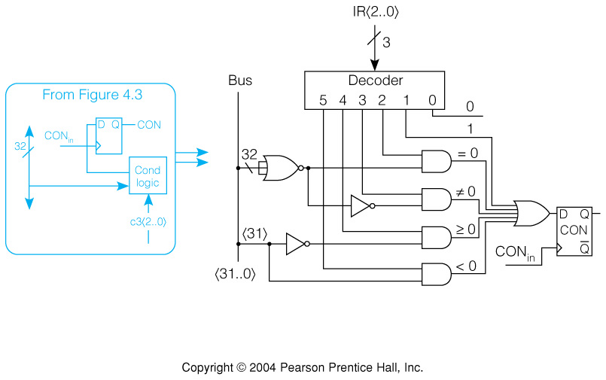
Fig. 4.10 Computation of the Conditional Value CON
NOR gate does =0 test of R[rc] on bus

Slide 33
Tbl 4.11 Control Sequence for SRC Branch Instruction, br
br (:= op= 8) → (cond → PC ← R[rb]):
Step Concrete RTN Control Sequence
T0-T2 Instruction fetch Instruction fetch
T3. CON ← cond(R[rc]); Grc, R_{out}, CON_{in}
T4. CON → PC ← R[rb]; Grb, R_{out}, CON → PC_{in}, End
Condition logic is always connected to CON, so R[rc] only needs to be put on bus in T3
Only PC_{in} is conditional in T4 since gating R[rb] to bus makes no difference if it is not used

Slide 34
Summary of the Design Process
Informal description ⇒ formal RTN description ⇒ block diagram arch. ⇒ concrete RTN steps ⇒ hardware design of blocks ⇒ control sequences ⇒ control unit and timing
At each level, more decisions must be made
  These decisions refine the design
  Also place requirements on hardware still to be designed
The nice one way process above has circularity
  Decisions at later stages cause changes in earlier ones
  Happens less in a text than in reality because
    Can be fixed on re-reading
    Confusing to first time student

Slide 35
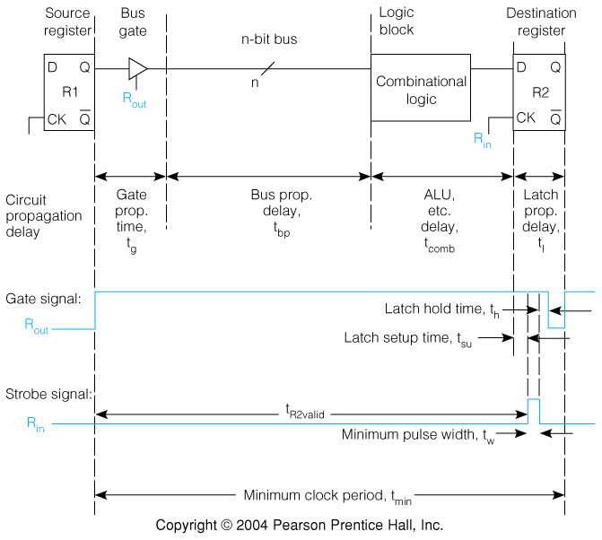
Fig. 4.11 Clocking the Data Path: Register Transfer Timing
t_{R2valid} is the period from begin of gate signal till inputs to R2 are valid
t_{comb} is delay through combinational logic, such as ALU or cond logic

Slide 36
Signal Timing on the Data Path
Several delays occur in getting data from R1 to R2
Gate delay through the 3-state bus driver—t_{g}
Worst case propagation delay on bus—t_{bp}
Delay through any logic, such as ALU—t_{comb}
Set up time for data to affect state of R2—t_{su}
Data can be strobed into R2 after this time
t_{R2valid} = t_{g} + t_{bp} + t_{comb} + t_{su}
Diagram shows strobe signal in the form for a latch. It must be high for a minimum time—t_{w}
There is a hold time, t_{h}, for data after strobe ends

Slide 37
Effect of Signal Timing on Minimum Clock Cycle
A total latch propagation delay is the sum
T_{l} = t_{su} + t_{w} + t_{h}
  All above times are specified for latch
  t_{h} may be very small or zero
The minimum clock period is determined by finding longest path from ff output to ff input
  This is usually a path through the ALU
  Conditional signals add a little gate delay
Using this path, the minimum clock period is
t_{min} = t_{g} + t_{bp} + t_{comb} + t_{l}

Slide 38
Latches Versus Edge Triggered or Master Slave Flip-Flops
During the high part of a strobe a latch changes its output
If this output can affect its input, an error can occur
This can influence even the kind of concrete RTs that can be written for a data path
If the C register is implemented with latches, then
C ← C + MD; is not legal
If the C register is implemented with master-slave or edge triggered flip-flops, it is OK

Slide 39
The Control Unit
The control unit’s job is to generate the control signals in the proper sequence
Things the control signals depend on
  The time step Ti
  The instruction op code (for steps other than T0, T1, T2)
  Some few data path signals like CON, n=0, etc.
  Some external signals: reset, interrupt, etc. (to be covered)
The components of the control unit are: a time state generator, instruction decoder, and combinational logic to generate control signals

Slide 40
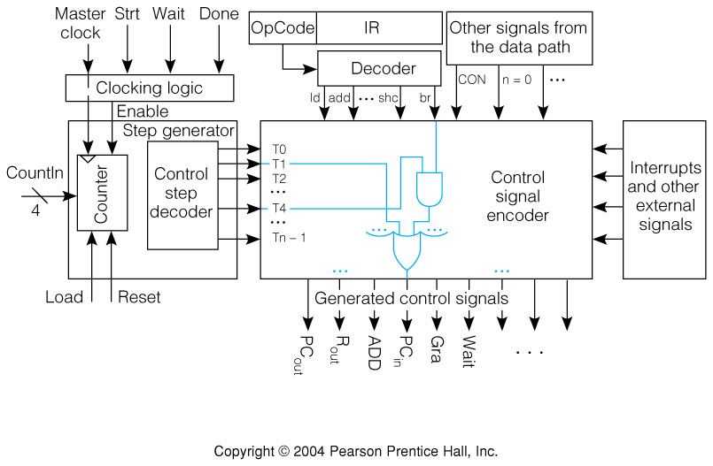
Fig. 4.12 Control Unit Detail with Inputs and Outputs
.

Slide 41
Synthesizing Control Signal Encoder Logic
Step
C
o
n
t
r
o
l
S
e
q
u
e
n
c
e
T0.
P
C
,
M
A
,
I
n
c
4
,
C
,
R
e
a
o
d
u
t
i
n
i
T1.
C
,
n
P
C
,
W
a
i
o
t
u
t
i
T2.
M
n
D
,
I
o
R
u
t
i
n
a
d
d
a
d
d
i
s
t
s
h
r
Step
C
o
n
t
r
o
l
S
e
q
u
e
n
c
e
Step
C
o
n
t
r
o
l
S
e
q
u
e
n
c
e
Step
C
o
n
t
r
o
l
S
e
q
u
e
n
c
e
Step
C
o
n
t
r
o
l
S
e
q
u
e
n
c
e
T3.
G
T3.
T3.
T3.
r
b
,
R
,
A
G
r
b
,
R
,
A
G
r
b
,
B
A
,
A
c
1
,
L
o
d
u
t
i
n
o
u
t
i
n
o
u
t
i
n
o
u
T4.
T4.
T4.
T4.
t
G
r
c
,
R
,
A
D
D
,
C
c
2
,
A
D
D
,
C
c
2
,
A
D
D
,
C
n
=
0
→
(
G
r
c
,
R
,
L
d
o
)
u
t
i
n
o
u
t
i
n
o
u
t
i
n
o
u
G
t
r
a
,
G
r
a
T5.
T5.
,
T5.
C
,
T5.
M
A
G
r
b
,
R
,
C
=
C
,
R
,
B
E
n
d
C
,
R
,
E
n
d
o
u
t
i
n
o
u
o
t
u
t
i
n
o
u
t
i
n
G
r
a
T6.
,
T6.
n
≠
0
→
(
C
,
S
H
R
,
R
,
C
,
M
D
,
W
r
i
t
e
o
u
t
i
o
n
u
t
i
n
D
e
c
r
,
G
o
t
o
7
T7.
W
)
a
i
t
,
E
n
d
G
r
a
T7.
C
,
,
R
,
E
n
o
d
u
t
i
n
Design process:
Comb through the entire set of control sequences.
Find all occurrences of each control signal.
Write an equation describing that signal.
Example: Gra = T5·(add + addi) + T6·st + T7·shr + ...

Slide 42
Use of Data Path Conditions in Control Signal Logic
Step
C
o
n
t
r
o
l
S
e
q
u
e
n
c
e
T0.
P
C
,
M
A
,
I
n
c
4
,
C
,
R
e
a
o
d
u
t
i
n
i
T1.
C
,
n
P
C
,
W
a
i
o
t
u
t
i
T2.
M
n
D
,
I
o
R
u
t
i
n
a
d
d
a
d
d
i
s
t
s
h
r
Step
C
o
n
t
r
o
l
S
e
q
u
e
n
c
e
Step
C
o
n
t
r
o
l
S
e
q
u
e
n
c
e
Step
C
o
n
t
r
o
l
S
e
q
u
e
n
c
e
Step
C
o
n
t
r
o
l
S
e
q
u
e
n
c
e
T3.
G
T3.
T3.
T3.
r
b
,
R
,
A
G
r
b
,
R
,
A
G
r
b
,
B
A
,
A
c
1
,
L
o
d
u
t
i
n
o
u
t
i
n
o
u
t
i
n
o
u
G
t
r
c
T4.
,
T4.
T4.
n
=
0
→
(
G
r
c
c
,
2
,
A
D
D
,
C
c
2
,
A
D
D
,
R
,
C
T4.
A
D
D
,
C
o
u
t
i
n
o
u
t
i
o
n
u
t
i
n
R
,
L
d
o
)
u
T5.
T5.
C
,
T5.
t
G
r
a
,
R
,
E
n
d
C
,
M
C
,
A
T5.
G
r
a
,
R
,
E
n
d
o
u
t
i
n
o
u
t
i
n
G
r
b
,
R
,
C
=
o
B
u
t
i
n
o
u
T6.
G
T6.
t
r
a
,
R
,
M
D
,
W
r
i
t
o
e
u
t
i
n
n
≠
0
→
(
C
,
S
H
R
,
o
C
,
u
t
i
T7.
D
n
e
c
r
,
G
o
t
o
7
W
)
a
i
t
,
E
n
d
T7.
C
,
G
r
a
,
R
,
E
n
o
d
u
t
i
n
Example: Grc = T4·add + T4·(n=0)·shr + ...

Slide 43
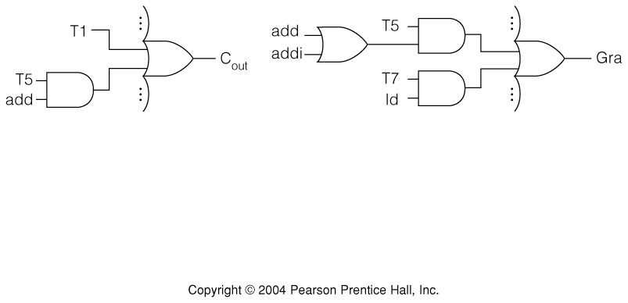
Fig. 4.13 Generation of the logic for C_{out} and G_{ra}

Slide 44
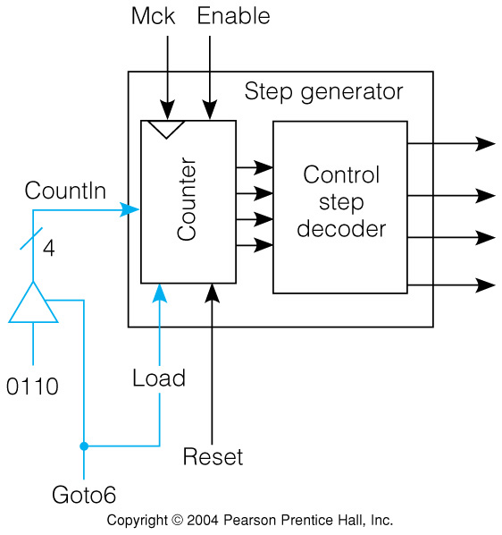
Fig. 4.14 Branching in the Control Unit
.
3-state gates allow 6 to be applied to counter input
Reset will synchronously reset counter to step T0

Slide 45
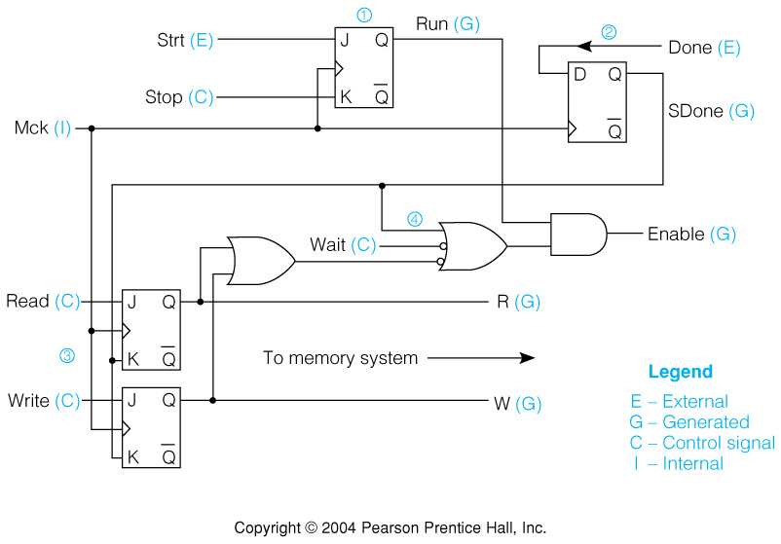
Fig. 4.15 Clocking Logic: Start, Stop, and Memory Synchronization
Mck is master clock oscillator

Slide 46
Have Completed One-Bus Design of SRC
High level architecture block diagram
Concrete RTN steps
Hardware design of registers and data path logic
Revision of concrete RTN steps where needed
Control sequences
Register clocking decisions
Logic equations for control signals
Time step generator design
Clock run, stop, and synchronization logic

Slide 47
Other Architectural designs will require a different RTN
More data paths allow more things to be done in one step
Consider a two bus design
By separating input and output of ALU on different buses, the C register is eliminated
Steps can be saved by strobing ALU results directly into their destinations

Slide 48
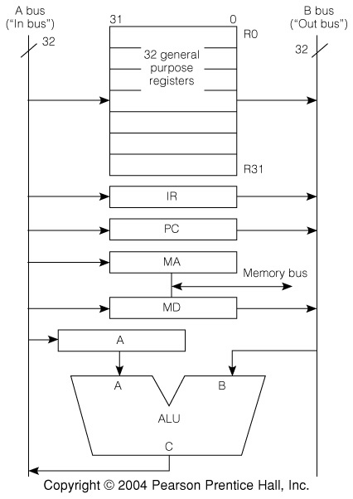
Fig. 4.16 The 2-bus Microarchitecture
Bus A carries data going into registers
Bus B carries data being gated out of registers
ALU function C=B is used for all simple register transfers

Slide 49
Tbl 4.13 Concrete RTN and Control Sequence for 2-bus SRC add
Step Concrete RTN Control Sequence
T0. MA ← PC; PC_{out}, C=B, MA_{in}, Read
T1. PC ← PC + 4: MD ← M[MA]; PC_{out}, Inc4, PC_{in}, Wait
T2. IR ← MD; MD_{out}, C=B, IR_{in}
T3. A ← R[rb]; Grb, R_{out}, C=B, A_{in}
T4. R[ra] ← A + R[rc]; Grc, R_{out}, ADD, Sra, R_{in}, End
Note the appearance of Grc to gate the output of the register rc onto the B bus and Sra to select ra to receive data strobed from the A bus
Two register select decoders will be needed
Transparent latches will be required for MA at step T0

Slide 50
Performance and Design

Slide 51
Speedup Due To Going to 2 Buses
Assume for now that IC and t don’t change in going from 1 bus to 2 buses
Naively assume that CPI goes from 8 to 7 clocks.
Class Problem:
How will this speedup change if clock period of 2-bus machine is increased by 10%?

Slide 52
3-bus Architecture Shortens Sequences Even More
A 3-bus architecture allows both operand inputs and the output of the ALU to be connected to buses
Both the C output register and the A input register are eliminated
Careful connection of register inputs and outputs can allow multiple RTs in a step

Slide 53
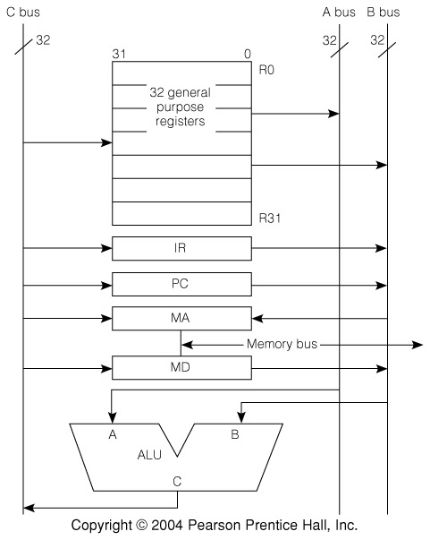
Fig. 4.17 The 3-Bus SRC Design
A-bus is ALU operand 1, B-bus is ALU operand 2, and C-bus is ALU output
Note MA input connected to the B-bus

Slide 54
Tbl 4.15 SRC add Instruction for the
3-bus Microarchitecture
Step Concrete RTN Control Sequence
T0. MA ← PC: PC ← PC + 4: PC_{out}, MA_{in}, Inc4, PC_{in},
MD ← M[MA]; Read, Wait
T1. IR ← MD; MD_{out}, C=B, IR_{in}
T2. R[ra] ← R[rb] + R[rc]; GArc, RA_{out}, GBrb, RB_{out},
ADD, Sra, R_{in}, End
Note the use of 3 register selection signals in step T2: GArc, GBrb, and Sra
In step T0, PC moves to MA over bus B and goes through the ALU Inc4 operation to reach PC again by way of bus C
  PC must be edge triggered or master-slave
Once more MA must be a transparent latch

Slide 55
Performance and Design
How does going to three buses affect performance?
Assume average CPI goes from 8 to 4, while τ increases by 10%:

Slide 56
Processor Reset Function
Reset sets program counter to a fixed value
  May be a hardwired value, or
  contents of a memory cell whose address is hardwired
The control step counter is reset
Pending exceptions are prevented, so initialization code is not interrupted
It may set condition codes (if any) to known state
It may clear some processor state registers
A “soft” reset makes minimal changes: PC, T (T-step counter)
A “hard” reset initializes more processor state

Slide 57
SRC Reset Capability
We specify both a hard and soft reset for SRC
The Strt signal will do a hard reset
  It is effective only when machine is stopped
  It resets the PC to zero
  It resets all 32 general registers to zero
The Soft Reset signal is effective when the machine is running
  It sets PC to zero
  It restarts instruction fetch
  It clears the Reset signal
Actions are described in instruction_interpretation

Slide 58
Abstract RTN for SRC Reset and Start
Processor State
Strt: Start signal
Rst: External reset signal
instruction_interpretation := (
  ¬Run∧Strt → (Run ← 1: PC, R[0..31] ← 0);
Run∧¬Rst → (IR ← M[PC]: PC ← PC + 4;
  instruction_execution):
Run∧Rst → ( Rst ← 0: PC ← 0); instruction_interpretation):

Slide 59
Resetting in the Middle of Instruction Execution
The abstract RTN implies that reset takes effect after the current instruction is done
To describe reset during an instruction, we must go from abstract to concrete RTN
Questions for discussion:
  Why might we want to reset in the middle of an instruction?
  How would we reset in the middle of an instruction?

Slide 60
Tbl 4.17 Concrete RTN Describing Reset During add Instruction Execution
Step Concrete RTN
T0 ¬Reset → (MA ← PC: C ← PC + 4):
Reset → (Reset ← 0: PC ← 0: T ←0):
T1 ¬Reset → (MD ← M[MA]: P ← C):
Reset → (Reset ← 0: PC ← 0: T ← 0):
T2 ¬Reset → (IR ← MD):
Reset → (Reset ← 0: PC ← 0: T ← 0):
T3 ¬Reset → (A ← R[rb]):
Reset → (Reset ← 0: PC ← 0: T ← 0):
T4 ¬Reset → (C ← A + R[rc]):
Reset → (Reset ← 0: PC ← 0: T ← 0):
T5 ¬Reset → (R[ra ] ← C):
Reset → (Reset ← 0: PC ← 0: T ← 0):

Slide 61
Control Sequences Including the Reset Function
Step Control Sequence
T0. ¬Reset → (PC_{out}, MA_{in}, Inc4, C_{in}, Read):
Reset → (ClrPC, ClrR, Goto0):
T1 ¬Reset → (C_{out}, PC_{in}, Wait):
Reset → (ClrPC, ClrR, Goto0):
• • •
ClrPC clears the program counter to all zeros, and ClrR clears the one bit Reset flip-flop
Because the same reset actions are in every step of every instruction, their control signals are independent of time step or op code

Slide 62
General Comments on Exceptions
An exception is an event that causes a change in the program specified flow of control
Because normal program execution is interrupted, they are often called interrupts
We will use exception for the general term and use interrupt for an exception caused by an external event, such as an I/O device condition
The usage is not standard. Other books use these words with other distinctions, or none

Slide 63
Combined Hardware/Software Response to an Exception
The system must control the type of exceptions it will process at any given time
The state of the running program is saved when an allowed exception occurs
Control is transferred to the correct software routine, or “handler” for this exception
This exception, and others of less or equal importance are disallowed during the handler
The state of the interrupted program is restored at the end of execution of the handler

Slide 64
Hardware Required to Support Exceptions
To determine relative importance, a priority number is associated with every exception
Hardware must save and change the PC, since without it no program execution is possible
Hardware must disable the current exception lest is interrupt the handler before it can start
Address of the handler is called the exception vector and is a hardware function of the exception type
Exceptions must access a save area for PC and other hardware saved items
  Choices are special registers or a hardware stack

Slide 65
New Instructions Needed to Support Exceptions
An instruction executed at the end of the handler must reverse the state changes done by hardware when the exception occurred
There must be instructions to control what exceptions are allowed
  The simplest of these enable or disable all exceptions
If processor state is stored in special registers on an exception, instructions are needed to save and restore these registers

Slide 66
Kinds of Exceptions
System reset
Exceptions associated with memory access
  Machine check exceptions
  Data access exceptions
  Instruction access exceptions
  Alignment exceptions
Program exceptions
Miscellaneous hardware exceptions
Trace and debugging exceptions
Non-maskable exceptions
External exceptions—interrupts

Slide 67
An Interrupt Facility for SRC
The exception mechanism for SRC handles external interrupts
There are no priorities, but only a simple enable and disable mechanism
The PC and information about the source of the interrupt are stored in special registers
  Any other state saving is done by software
The interrupt source supplies 8 bits that are used to generate the interrupt vector
It also supplies a 16 bit code carrying information about the cause of the interrupt

Slide 68
SRC Processor State Associated with Interrupts
Processor interrupt mechanism
ireq: interrupt request signal
iack: interrupt acknowledge signal
IE: one bit interrupt enable flag
IPC⟨31..0⟩: storage for PC saved upon interrupt
II⟨15..0⟩: info. on source of last interrupt
Isrc_info⟨15..0⟩: information from interrupt source
Isrc_vect⟨7..0⟩: type code from interrupt source
Ivect⟨31..0⟩:= 20@0#Isrc_vect⟨7..0⟩#4@0:
From Dev.→
To Dev. →
Internal →
to CPU →
“ →
From Dev.→
From Dev →
Internal →
Ivect⟨31..0⟩
000 . . . 0
Isrc_vect⟨7..0⟩
0000
31
12
11
4
3
0

Slide 69
SRC Instruction Interpretation Modified for Interrupts
instruction_interpretation :=
(¬Run∧Strt → Run ← 1:
Run∧¬(ireq∧IE) → (IR ← M[PC]: PC ← PC + 4; instruction_execution):
Run∧(ireq∧IE) → (IPC ← PC⟨31..0⟩:
II⟨15..0⟩ ← Isrc_info⟨15..0⟩: iack ← 1:
IE ← 0: PC ← Ivect⟨31..0⟩; iack ← 0);
instruction_interpretation);
If interrupts are enabled, PC and interrupt info. are stored in IPC and II, respectively
  With multiple requests, external priority circuit (discussed in later chapter) determines which vector & info. are returned
Interrupts are disabled
The acknowledge signal is pulsed

Slide 70
SRC Instructions to Support Interrupts
Return from interrupt instruction
rfi (:= op = 29 ) → (PC ← IPC: IE ← 1):
Save and restore interrupt state
svi (:= op = 16) → (R[ra]⟨15..0⟩ ← II⟨15..0⟩: R[rb] ← IPC⟨31..0⟩):
ri (:= op = 17) → (II⟨15..0⟩ ← R[ra]⟨15..0⟩ : IPC⟨31..0⟩ ← R[rb]):
Enable and disable interrupt system
een (:= op = 10 ) → (IE ← 1):
edi (:= op = 11 ) → (IE ← 0):
The 2 rfi actions are indivisible, can’t een & branch

Slide 71
Concrete RTN for SRC Instruction Fetch with Interrupts
Step ¬(ireq∧IE) Concrete RTN (ireq∧IE)
T0. (¬(ireq∧IE) → ( (ireq∧IE) → (IPC ← PC: II ← Isrc_info:
MA ← PC: C ← PC+4): IE ← 0: PC← 20@0#Isrc_vect⟨7..0⟩#0000:
Iack←1);
T1. MD ← M[MA] : PC ← C; Iack ← 0: End;
T2. IR ← MD;
PC could be transferred to IPC over the bus
II and IPC probably have separate inputs for the externally supplied values
Iack is pulsed, described as ←1; ←0, which is easier as a control signal than in RTN

Slide 72
Exceptions During Instruction Execution
Some exceptions occur in the middle of instructions
  Some CISCs have very long instructions, like string move
  Some exception conditions prevent instruction completion, like uninstalled memory
To handle this sort of exception, the CPU must make special provision for restarting
  Partially completed actions must be reversed so the instruction can be re-executed after exception handling
  Information about the internal CPU state must be saved so that the instruction can resume where it left off
We will see that this problem is acute with pipeline designs—always in middle of instructions.

Slide 73
Recap of the Design Process: the Main Topic of Chap. 4
SRC
Informal description
Chapter 2
formal RTN description
block diagram architecture
concrete RTN steps
Chapter 4
hardware design of blocks
Control sequences
control unit and timing

Slide 74
Chapter 4 Summary
Chapter 4 has done a non pipelined data path, and a hardwired controller design for SRC
The concepts of data path block diagrams, concrete RTN, control sequences, control logic equations, step counter control, and clocking have been introduced
The effect of different data path architectures on the concrete RTN was briefly explored
We have begun to make simple, quantitative estimates of the impact of hardware design on performance
Hard and soft resets were designed
A simple exception mechanism was supplied for SRC

