Slide 1
Chapter 6 Overview
Number Systems and Radix Conversion
Fixed point arithmetic
Seminumeric Aspects of ALU Design
Floating Point Arithmetic

Slide 2
Digital Number Systems
Digital number systems have a base or radix b
We will only cover bases 2, 8, 10, and 16
Using positional notation, an m digit base b number is written
x = x_{m-1} x_{m-2} ... x₁ x₀
0 ≤ x_{i} ≤ b-1, 0 ≤ i < m
The value of this unsigned integer is
Eq. 6.1

Slide 3
Fractions and Fixed Point Numbers
Moving binary point one place left divides by 2
  For fixed binary point position in word, this is a right shift of word
Moving binary point one place right multiplies by b
  For fixed binary point position in word, this is a left shift of word
Examples…

Slide 4
Non-terminating Fractions
The division in the algorithm may give a non-terminating fraction in the calculator’s base
This is a general problem: a fraction of m digits in one base may have any number of digits in another base
The calculator will normally keep only a fixed number of digits
  Number should make base c accuracy about that of base b
This problem appears in generating base b digits of a base c fraction
  The algorithm can continue to generate digits unless terminated

Slide 5
Conversion Between Related Bases by Digit Grouping
Let base b = c^{k}; for example b = c²
Then base b number x₁x₀ is base c number y₃y₂y₁y₀, where x₁ base b = y₃y₂ base c and x₀ base b = y₁y₀ base c
Examples: 102130₄ = 10 21 30₄ = 49C₁₆
49C₁₆ = 0100 1001 1100₂
102130₄ = 01 00 10 01 11 00₂
010010011100₂ = 010 010 011 100₂ = 2234₈

Slide 6
Table 6.2 Base 2 Complement Representations
8 Bit 2’s Complement
8 Bit 1’s Complement
Number
Representation
Number
Representation
0
0
0
0 or 255
0<x<128
x
0<x<128
x
-128≤x<0
256 - |x|
-127≤x<0
255 - |x|
In 1’s complement, 255 = 11111111₂ is often called -0
In 2’s complement, -128 = 10000000₂ is a legal value, but trying to negate it gives overflow

Slide 7
Negation in Complement Number Systems
Except for -b^{m}/2 in the b’s comp. system, the negative of any m digit value is also m digits
The negative of any number x, positive or negative, in the b’s or b-1’s complement system is obtained by applying the b’s or b-1’s complement operation to x, respectively
The 2 complement operations are related by
x^{c} = (x^{c} + 1) mod b^{m}
Thus an easy way to compute one of them will give an easy way to compute both

Slide 8
Scaling Complement Numbers by Powers of the Base
Roughly, multiplying by b corresponds to moving radix point one place right or shifting number one place left
Dividing by b roughly corresponds to a right shift of the number or a radix point move to the left one place
There are 2 new issues for complement numbers
1) What is new left digit on right shift?
2) When does a left shift overflow?

Slide 9
Right Shifting a Complement Number to Divide by b
For positive x_{m-1}x_{m-2}...x₁x₀, dividing by b corresponds to right shift with zero fill
0x_{m-1}x_{m-2}...x₁
For negative x_{m-1}x_{m-2}...x₁x₀, dividing by b corresponds to right shift with b-1 fill
(b-1)x_{m-1}x_{m-2}...x₁
This holds for both b’s and b-1’s comp. systems
For even b, the rule is: fill with 0 if x_{m-1} < b/2 and fill with (b-1) if x_{m-1} ≥ b/2

Slide 10
Complement Number Overflow on Left Shift to Multiply by b
For positive numbers, overflow occurs if any digit other than 0 shifts off left end
Positive numbers also overflow if the digit shifted into left position makes number look negative, i.e. digit ≥ b/2 for even b
For negative numbers, overflow occurs if any digit other than b-1 shifts off left end
Negative numbers also overflow if new left digit makes number look positive, i.e. digit<b/2 for even b

Slide 11
Left Shift Examples With Radix Complement Numbers
Non-overflow cases:
Left shift of 762₈ = 620₈, -14₁₀ becomes -112₁₀
Left shift of 031₈ = 310₈, 25₁₀ becomes 200₁₀
Overflow cases:
Left shift of 241₈ = 410₈ shifts 2≠0 off left
Left shift of 041₈ = 410₈ changes from + to -
Left shift of 713₈ = 130₈ changes from - to +
Left shift of 662₈ = 620₈ shifts 6≠7 off left

Slide 12
Fixed Point Addition and Subtraction
If the radix point is in the same position in both operands, addition or subtraction act as if the numbers were integers
Addition of signed numbers in radix complement system needs only an unsigned adder
So we only need to concentrate on the structure of an m digit, base b unsigned adder
To see this let x be a signed integer and rep(x) be its 2’s complement representation
The following theorem summarizes the result

Slide 13
Theorem on Signed Addition in a Radix Complement System
Theorem: Let s be unsigned sum of rep(x) & rep(y). Then s = rep(x+y), except for overflow
Proof sketch: Case 1, signs differ, x≥0, y<0. Then x+y = x-|y| and s = (x+b^{m}-|y|) mod b^{m}.
If x-|y|≥0, mod discards b^{m}, giving result, if
x-|y|<0, then rep(x+y) = (b-| x-|y| |) mod b^{m}.
Case 3, x<0, y<0. s = (2b^{m} - |x| - |y|) mod b^{m}, which reduces to s = (b^{m} - |x+y|) mod b^{m}. This is rep(x+y) provided the result is in range of an m digit b’s comp. representation. If it is not, the unsigned s<b^{m}/2 appears positive.

Slide 14
Overflow Detection in Complement Add & Subtract
We saw that all cases of overflow in complement addition came when adding numbers of like signs, and the result seemed to have the opposite sign
For even b, the sign can be determined from the left digit of the representation
Thus an overflow detector only needs x_{m-1}, y_{m-1}, s_{m-1}, and an add/subtract control
It is particularly simple in base 2

Slide 15
Fig. 6.3 2’s Complement Adder/Subtracter
A multiplexer to select y or its complement becomes an exclusive OR gate

Slide 16
Speeding Up Addition With Carry Lookahead
Speed of digital addition depends on carries
A base b = 2^{k} divides length of carry chain by k
Two level logic for base b digit becomes complex quickly as k increases
If we could compute the carries quickly, the full adders compute result with 2 more gate delays
Carry lookahead computes carries quickly
It is based on two ideas:
—a digit position generates a carry
—a position propagates a carry in to the carry out

Slide 17
Binary Propagate and Generate Signals
In binary, the generate for digit j is G_{j} = x_{j}⋅y_{j}
Propagate for digit j is P_{j} = x_{j}+y_{j}
  Of course x_{j}+y_{j} covers x_{j}⋅y_{j} but it still corresponds to a carry out for a carry in
Carries can then be written: c₁ = G₀ + P₀⋅c₀
c₂ = G₁ + P₁⋅G₀ + P₁⋅P₀⋅c₀
c₃ = G₂ + P₂⋅G₁ + P₂⋅P₁⋅G₀ + P₂⋅P₁⋅P₀⋅c₀
c₄ = G₃ + P₃⋅G₂ + P₃⋅P₂⋅G₁ + P₃⋅P₂⋅P₁⋅G₀ + P₃⋅P₂⋅P₁⋅P₀⋅c₀
In words, the c₂ logic is: c₂ is one if digit 1 generates a carry, or if digit 0 generates one and digit 1 propagates it, or if digits 0&1 both propagate a carry in

Slide 18
Speed Gains With Carry Lookahead
It takes one gate to produce a G or P, two levels of gates for any carry, & 2 more for full adders
The number of OR gate inputs (terms) and AND gate inputs (literals in a term) grows as the number of carries generated by lookahead
The real power of this technique comes from applying it recursively
For a group of, say 4, digits an overall generate is G¹₀ = G₃ + P₃⋅G₂ + P₃⋅P₂⋅G₁ + P₃⋅P₂⋅P₁⋅G₀
An overall propagate is P¹₀ = P₃⋅P₂⋅P₁⋅P₀

Slide 19
Recursive Carry Lookahead Scheme
If level 1 generates G¹_{j} and propagates P¹_{j} are defined for all groups j, then we can also define level 2 signals G²_{j} and P²_{j} over groups of groups
If k things are grouped together at each level, there will be log_{k}m levels, where m is the number of bits in the original addition
Each extra level introduces 2 more gate delays into the worst case carry calculation
k is chosen to trade-off reduced delay against the complexity of the G and P logic
It is typically 4 or more, but the structure is easier to see for k=2

Slide 20
Fig. 6.4 Carry Lookahead Adder for Group Size k = 2

Slide 21
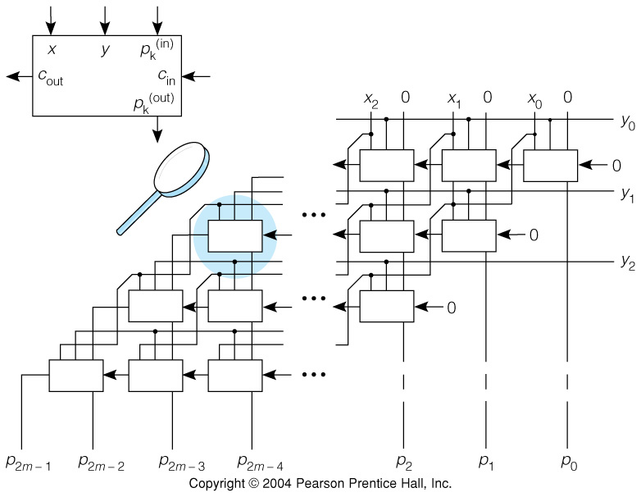
Fig. 6.6 Parallel Array Multiplier for Unsigned Base b Numbers

Slide 22
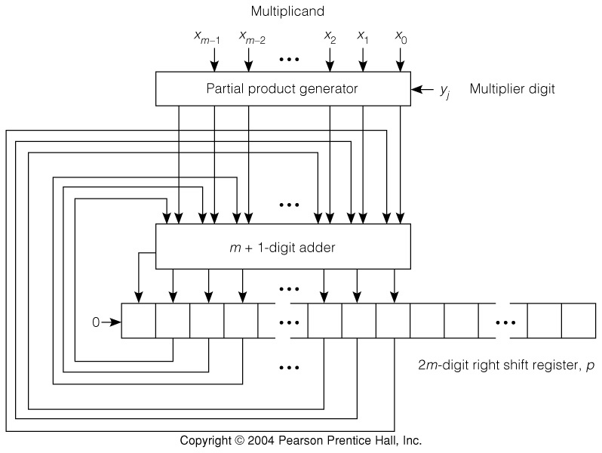
Fig. 6.7 Unsigned Series-Parallel Multiplication Hardware

Slide 23
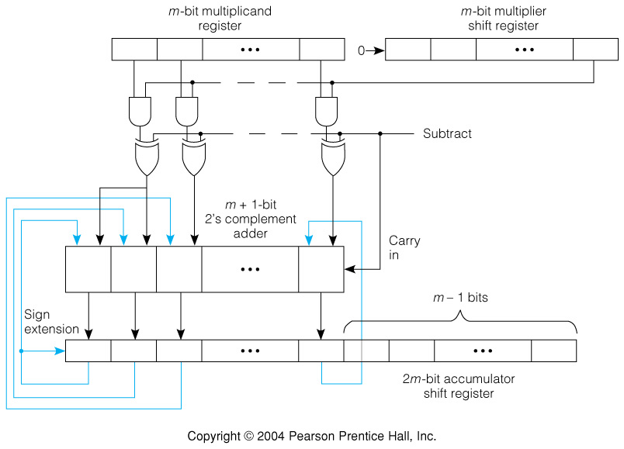
Fig. 6.8 2’s Complement Signed Multiplier Hardware

Slide 24
Booth Recoding and Similar Methods
Forms the basis for a number of signed multiplication algorithms
Based upon recoding the multiplier, y, to a recoded value, z.
The multiplicand remains unchanged.
Uses signed digit (SD) encoding:
Each digit can assume three values instead of just 2:
+1, 0, and -1, encoded as 1, 0, and 1. This is known as signed digit (SD) notation.

Slide 25
A 2’s Complement Integer’s Value can be Represented as:
This means that the value can be computed by adding the weighted values of all the digits except the most significant, and subtracting that digit.

Slide 26
Example: Represent -5 in SD Notation

Slide 27
The Booth Algorithm (Sometimes Known as "Skipping Over 1's.)
The Booth method is:
1. Working from lsb to msb, replace each 0 digit of the original number with 0 in the recoded number until a 1 is encountered.
2. When a 1 is encountered, insert a 1 in that position in the recoded number, and skip over any succeeding 1's until a 0 is encountered.
3. Replace that 0 with a 1. If you encounter the msb without encountering a 0, stop and do nothing.

Slide 28
Example of Booth Recoding

Slide 29
Tbl 6.4 Booth Recoding Table
Consider pairs of numbers, y_{i}, y_{i-1}. Recoded value is z_{i}.
Algorithm can be done in parallel.
Examine the example of multiplication 6.11 in text.

Slide 30
Recoding using Bit Pair Recoding
Booth method may actually increase number of multiplies.
Consider pairs of digits, and recode each pair into 1 digit.
Derive Table 6.5, pg. 279 on the blackboard to show how bit pair recoding works.
Demonstrate Example 6.13 on the blackboard as an example of multiplication using bit pair recoding.
There are many variants on this approach.

Slide 31
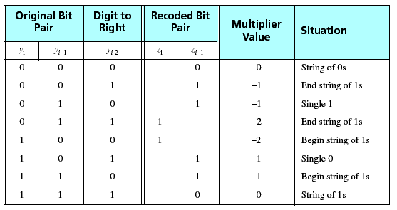
Table 6.5 Radix-4 Booth Encoding
(Bit-Pair Encoding)

Slide 32
Digital Division: Terminology and Number Sizes
A dividend is divided by a divisor to get a quotient and a remainder
A 2m digit dividend divided by an m digit divisor does not necessarily give an m digit quotient and remainder
If the divisor is 1, for example, an integer quotient is the same size as the dividend
If a fraction D is divided by a fraction d, the quotient is only a fraction if D<d
If D≥d, a condition called divide overflow occurs in fraction division

Slide 33
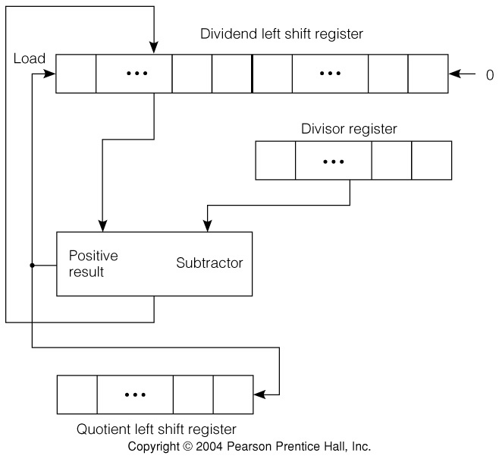
Fig 6.9 Unsigned Binary Division Hardware
2m bit dividend register
m bit divisor
m bit quotient
Divisor can be subtracted from dividend, or not

Slide 34
Use of Division Hardware for Integer Division
1) Put dividend in lower half of register and clear upper half. Put divisor in divisor register. Initialize quotient bit counter to zero.
2) Shift dividend register left one bit.
3) If difference positive, shift 1 into quotient and replace upper half of dividend by difference. If negative, shift 0 into quotient.
4) If fewer than m quotient bits, repeat from 2.
5) m bit quotient is an integer, and an m bit integer remainder is in upper half of dividend register.

Slide 35
Use of Division Hardware for Fraction Division
1) Put dividend in upper half of dividend register and clear lower half. Put divisor in divisor register. Initialize quotient bit counter to zero.
2) If difference positive, report divide overflow.
3) Shift dividend register left one bit.
4) If difference positive, shift 1 into quotient and replace upper part of dividend by difference. If negative, shift 0 into the quotient.
5) If fewer than m quotient bits, repeat from 3.
6) m bit quotient has binary point at the left, and remainder is in upper part of dividend register.

Slide 36
Integer Binary Division Example: D=45, d=6, q=7, r=3
D 0 0 0 0 0 0 1 0 1 1 0 1
d 0 0 0 1 1 0
Init. D 0 0 0 0 0 1 0 1 1 0 1 -
d 0 0 0 1 1 0
diff(-) D 0 0 0 0 1 0 1 1 0 1 - - q 0
d 0 0 0 1 1 0
diff(-) D 0 0 0 1 0 1 1 0 1 - - - q 0 0
d 0 0 0 1 1 0
diff(-) D 0 0 1 0 1 1 0 1 - - - - q 0 0 0
d 0 0 0 1 1 0
diff(+) D 0 0 1 0 1 0 1 - - - - - q 0 0 0 1
d 0 0 0 1 1 0
diff(+) D 0 0 1 0 0 1 - - - - - - q 0 0 0 1 1
d 0 0 0 1 1 0
diff(+) rem. 0 0 0 0 1 1 q 0 0 0 1 1 1

Slide 37
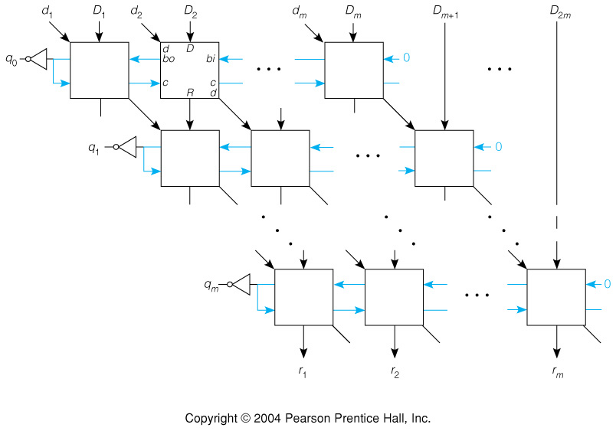
Fig 6.10 Parallel Array Divider
Borrow always
computed
R := (c → D:
¬c → (D-d-bi) mod 2

Slide 38
Branching on Arithmetic Conditions
An ALU with two m bit operands produces more than just an m bit result
The carry from the left bit and the true/false value of 2’s complement overflow are useful
There are 3 common ways of using outcome of compare (subtract) for a branch condition
1) Do the compare in the branch instruction
2) Set special condition code bits and test them in the branch
3)Set a general register to a comparison outcome and branch on this logical value

Slide 39
Drawbacks of Condition Codes
Condition codes are extra processor state; set, and overwritten, by many instructions
Setting and use of CCs also introduces hazards in a pipelined design
CCs are a scarce resource, they must be used before being set again
  The PowerPC has 8 sets of CC bits
CCs are processor state that must be saved and restored during exception handling

Slide 40
Drawbacks of Comparison in Branch and Set General Register
Branch instruction length: it must specify 2 operands to be compared, branch target, and branch condition (possibly place for link)
Amount of work before branch decision: it must use the ALU and test its output—this means more branch delay slots in pipeline
Setting a general register to a particular outcome of a compare, say ≤ unsigned, uses a register of 32 or more bits for a true/false value

Slide 41
Use of Condition Codes: Motorola 68000
The HLL statement:
if (A > B) then C = D
translates to the MC68000 code:
For 2’s comp. A & B For unsigned A & B
MOVE.W A, D0 MOVE.W A, D0
CMP.W B, D0 CMP.W B, D0
BLE Over BLS Over
MOVE.W D, C MOVE.W D, C
Over: . . . Over: . . .

Slide 42
Standard Condition Codes: NZVC
Assume compare does the subtraction s = x-y
N: negative result, s_{m-1} = 1 if
Z: zero result, s = 0
V: 2’s comp. overflow, C: carry from leftmost bit position, s_{m} = 1
Information in N, Z, V, and C determines several signed & unsigned relations of x & y

Slide 43
Correspondence of Conditions and NZVC Bits
Condition Unsigned Integers Signed Integers
carry out C C
overflow C V
negative n.a. N
> C⋅Z (N⋅V+N⋅V)⋅Z
≥ C N⋅V+N⋅V
= Z Z
≠ Z Z
≤ C+Z (N⋅V+N⋅V)+Z
< C N⋅V+N⋅V

Slide 44
Branches That Do Not Use Condition Codes
SRC compares a single number to zero
The simple comparison can be completed in pipeline stage 2
The MIPS R2000 compares 2 numbers using a branch of the form: bgtu R1, R2, Lbl
Different branch instructions are needed for each signed or unsigned condition
The MIPS R2000 also allows setting a general register to 1 or 0 on a compare outcome
sgtu R3, R1, R2

Slide 45
ALU Logical, Shift and Rotate Instructions
Shifts are often combined with logic to extract bit fields from, or insert them into, full words
A MC68000 example extracts bits 30..23 of a 32 bit word (exponent of a floating point #)
MOVE.L D0, D1 ;Get # into D1
ROL.L #9, D1 ;exponent to bits 7..0
ANDI.L #FFH, D1 ;clear bits 31..8
MC68000 shifts take 8+2n clocks, where n = shift count, so ROL.L #9 is better then SHR.L #23 in the above example

Slide 46
Types and Speed of Shift Instructions
Rotate right is equivalent to rotate left with a different shift count
Rotates can include the carry or not
Two right shifts, one with sign extend, are needed to scale unsigned and signed numbers
Only a zero fill left shift is needed for scaling
Shifts whose execution time depends on the shift count use a single bit ALU shift repeatedly, as we did for SRC in Chap. 4
Fast shifts, important for pipelined designs, can be done with a barrel shifter

Slide 47
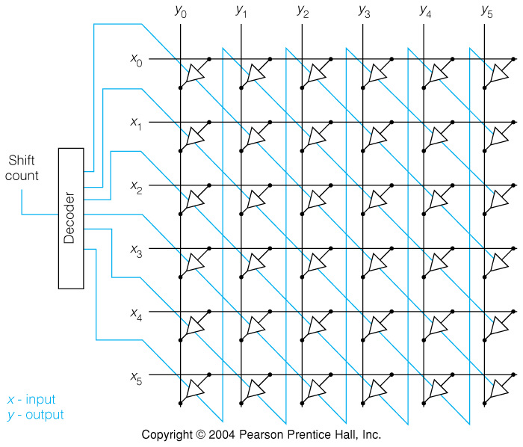
Fig 6.11 A 6 Bit Crossbar Barrel Rotator for Fast Shifting

Slide 48
Properties of the Crossbar Barrel Shifter
There is a 2 gate delay for any length shift
Each output line is effectively an n way multiplexer for shifts of up to n bits
There are n² 3-state drivers for an n bit shifter
  For n = 32, this means 1024 3-state drivers
For 32 bits, the decoder is 5 bits to 1 out of 32
The minimum delay but large number of gates in the crossbar prompts a compromise:
the logarithmic barrel shifter

Slide 49
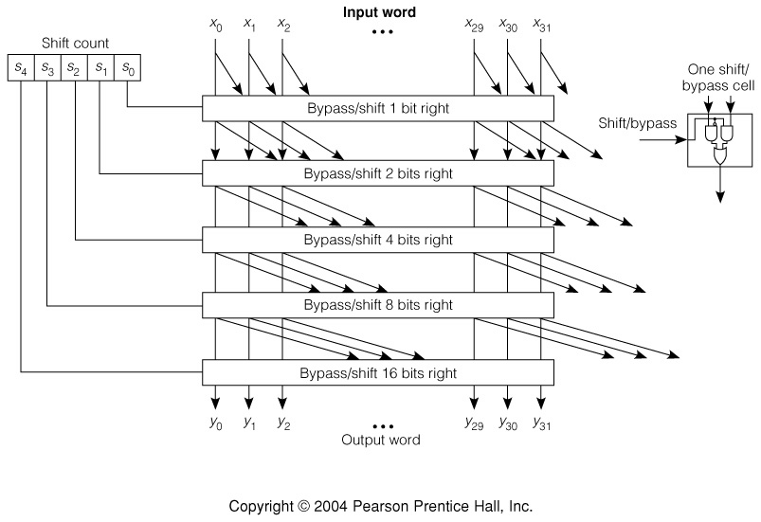
Fig 6.12 Barrel Shifter with a Logarithmic Number of Stages

Slide 50
Elements of a Complete ALU
In addition to the arithmetic hardware, there must be a controller for multi-step operations, such as series parallel multiply
The shifter is usually a separate unit, and may have lots of gates if it is to be fast
Logic operations are usually simple
The arithmetic unit may need to produce condition codes as well as a result number
Multiplexers select the result and condition codes from the correct sub-unit

Slide 51
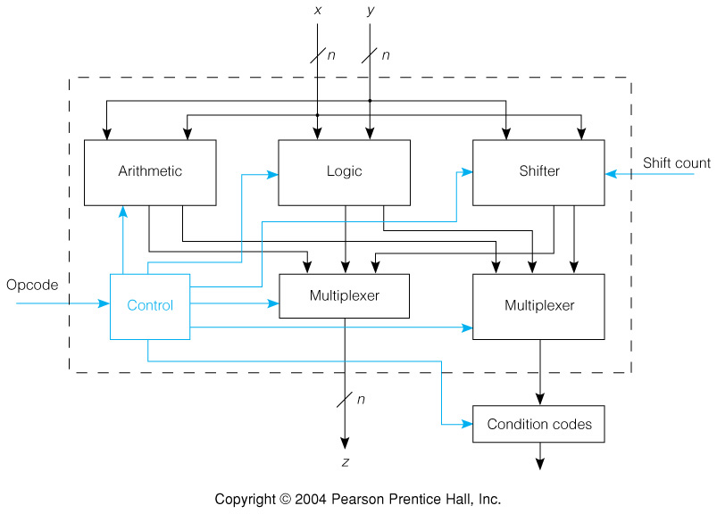
Fig 6.13 Complete Arithmetic Logic Unit Block Diagram

Slide 52
Floating Point Preliminaries: Scaled Arithmetic
Software can use arithmetic with a fixed binary point position, say left end, and keep a separate scale factor e for a number f×2e
Add or subtract on numbers with same scale is simple, since f×2e + g×2e = (f+g)×2e
Even with same scale for operands, scale of result is different for multiply and divide
(f×2e)⋅(g×2e) = (f⋅g)×2^{2e}; (f×2e)÷(g×2e) = f÷g
Since scale factors change, general expressions lead to a different scale factor for each number—floating point representation

Slide 53
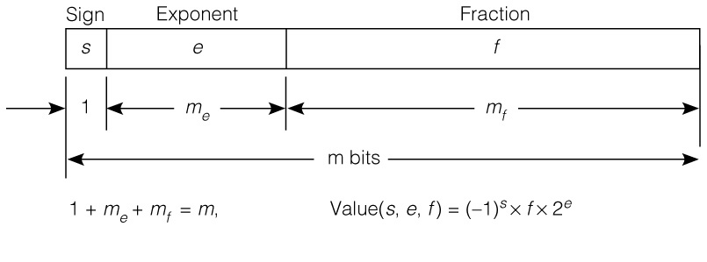
Fig 6.14 Floating Point Numbers Include Scale & Number in One Word
All floating-point formats follow a scheme similar to the one above
s is sign, e is exponent, and f is significand
We will assume a fraction significand, but some representations have used integers

Slide 54
Signs in Floating Point Numbers
Both significand and exponent have signs
A complement representation could be used for f, but sign-magnitude is most common now
The sign is placed at the left instead of with f so test for negative always looks at left bit
The exponent could be 2’s complement, but it is better to use a biased exponent
If -e_{min} ≤ e ≤ e_{max}, where e_{min}, e_{max} > 0, then
e = e_{min} + e is always positive, so e replaced by e
We will see that a sign at the left & a positive exponent left of the significand, helps compare
^
^

Slide 55
Exponent Base and Floating Point Number Range
In a floating point format using 24 out of 32 bits for significand, 7 would be left for exponent
A number x would have a magnitude 2⁻⁶⁴≤x≤2⁶³, or about 10⁻¹⁹≤x≤10¹⁹
For more exponent range, bits of significand would have to be given up with loss of accuracy
An alternative is an exponent base >2
IBM used exponent base 16 in the 360/370 series for a magnitude range about 10⁻⁷⁵≤x≤10⁷⁵
Then 1 unit change in e corresponds to a binary point shift of 4 bits

Slide 56
Normalized Floating Point Numbers
There are multiple representations for a FP #
If f₁ and f₂ = 2^{d}f₁ are both fractions & e₂ = e₁-d, then (s, f₁, e₁) & (s, f₂, e₂) have same value
Scientific notation example: .819×10³ = .0819×10⁴
A normalized floating point number has a leftmost digit non-zero (exponent small as possible)
With exponent base b, this is a base b digit: for the IBM format the leftmost 4 bits (base 16) are ≠0
Zero cannot fit this rule; usually written as all 0s
In norm. base 2 left bit =1, so it can be left out
  So called hidden bit

Slide 57
Comparison of Normalized Floating Point Numbers
If normalized numbers are viewed as integers, a biased exponent field to the left means an exponent unit is more than a significand unit
The largest magnitude number with a given exponent is followed by the smallest one with the next higher exponent
Thus normalized FP numbers can be compared for <,≤,>,≥,=,≠ as if they were integers
This is the reason for the s,e,f ordering of the fields and the use of a biased exponent, and one reason for normalized numbers

Slide 58
Fig 6.15 IEEE Single-Precision Floating Point Format
^
e e Value Type
255 none none Infinity or NaN
254 127 (-1)^{s}×(1.f₁f₂...)×2¹²⁷ Normalized
... ... ... ...
2 -125 (-1)^{s}×(1.f₁f₂...)×2⁻¹²⁵ Normalized
1 -126 (-1)^{s}×(1.f₁f₂...)×2⁻¹²⁶ Normalized
0 -126 (-1)^{s}×(0.f₁f₂...)×2⁻¹²⁶ Denormalized
Exponent bias is 127 for normalized #s

Slide 59
Special Numbers in IEEE Floating Point
An all zero number is a normalized 0
Other numbers with biased exponent e = 0 are called denormalized
Denorm numbers have a hidden bit of 0 and an exponent of -126; they may have leading 0s
Numbers with biased exponent of 255 are used for ±∞ and other special values, called NaN (not a number)
For example, one NaN represents 0/0

Slide 60
Fig 6.16 IEEE Standard Double Precision Floating Point
Exponent bias for normalized #s is 1023
The denorm biased exponent of 0 corresponds to an unbiased exponent of -1022
Infinity and NaNs have a biased exponent of 2047
Range increases from about 10⁻³⁸≤|x|≤10³⁸ to about 10⁻³⁰⁸≤|x|≤10³⁰⁸

Slide 61
Decimal Floating Point Add and Subtract Examples
Operands Alignment Normalize & round
6.144 ×10² 0.06144 ×10⁴ 1.003644 ×10⁵
+9.975 ×10⁴ +9.975 ×10⁴ + .0005 ×10⁵
10.03644 ×10⁴ 1.004 ×10⁵
Operands Alignment Normalize & round
1.076 ×10⁻⁷ 1.076 ×10⁻⁷ 7.7300 ×10⁻⁹
-9.987 ×10⁻⁸ -0.9987 ×10⁻⁷ + .0005 ×10⁻⁹
0.0773 ×10⁻⁷ 7.730 ×10⁻⁹

Slide 62
Floating Add, FA, and Floating Subtract, FS, Procedure
Add or subtract (s₁, e₁, f₁) and (s₂, e₂, f₂)
1) Unpack (s, e, f); handle special operands
2) Shift fraction of # with smaller exponent right by |e₁-e₂| bits
3) Set result exponent e_{r} = max(e₁, e₂)
4) For FA & s₁=s₂ or FS & s₁≠s₂, add significands, otherwise subtract them
5) Count lead zeros, z; carry can make z=-1; shift left z bits or right 1 bit if z=-1
6) Round result, shift right & adjust z if round OV
7) e_{r} ← e_{r}-z; check over- or underflow; bias & pack

Slide 63
Fig 6.17 Floating Point Add & Subtract Hardware
Adders for exponents and significands
Shifters for alignment and normalize
Multiplexers for exponent and swap of significands
Lead zeros counter

Slide 64
Decimal Floating Point Examples for Multiply & Divide
Multiply fractions and add exponents
These examples assume normalzed result is 0.xxx
Sign, fraction & exponent Normalize & round
( -0.1403 ×10⁻³) -0.4238463 ×10²
×(+0.3021 ×10⁶ ) -0.00005 ×10²
-0.04238463 ×10⁻³⁺⁶ -0.4238 ×10²
Divide fractions and subtract exponents
Sign, fraction & exponent Normalize & round
( -0.9325 ×10²) +0.9306387 ×10⁹
÷( -0.1002 ×10⁻⁶ ) +0.00005 ×10⁹
+9.306387 ×10²⁻⁽⁻⁶⁾ +0.9306 ×10⁹

Slide 65
Floating Point Multiply of Normalized Numbers
Multiply (s_{r}, e_{r}, f_{r}) = (s₁, e₁, f₁)×(s₂, e₂, f₂)
1) Unpack (s, e, f); handle special operands
2) Compute s_{r} = s₁⊕s₂; e_{r} = e₁+e₂; f_{r} = f₁×f₂
3) If necessary, normalize by 1 left shift & subtract 1 from e_{r}; round & shift right if round OV
4) Handle overflow for exponent too positive and underflow for exponent too negative
5) Pack result, encoding or reporting exceptions

Slide 66
Floating Point Divide of Normalized Numbers
Divide (s_{r}, e_{r}, f_{r}) = (s₁, e₁, f₁)÷(s₂, e₂, f₂)
1) Unpack (s, e, f); handle special operands
2) Compute s_{r} = s₁⊕s₂; e_{r} = e₁- e₂; f_{r} = f₁÷f₂
3) If necessary, normalize by 1 right shift & add 1 to e_{r}; round & shift right if round OV
4) Handle overflow for exponent too positive and underflow for exponent too negative
5) Pack result, encoding or reporting exceptions

Slide 67
Chapter 6 Summary
Digital number representations and algebraic tools for the study of arithmetic
Complement representation for addition of signed numbers
Fast addition by large base & carry lookahead
Fixed point multiply and divide overview
Non-numeric aspects of ALU design
Floating point number representations
Procedures and hardware for float add & sub
Floating multiply and divide procedures

