Slide 1
Chapter 7- Memory System Design
Introduction
RAM structure: Cells and Chips
Memory boards and modules
Two-level memory hierarchy
The cache
Virtual memory
The memory as a sub-system of the computer

Slide 2
Introduction
So far, we’ve treated memory as an array of words limited in size
only by the number of address bits. Life is seldom so easy...
Real world issues arise:
  cost
  speed
  size
  power consumption
  volatility
  etc.
What other issues can you think of that will influence memory design?

Slide 3
In This Chapter we will cover–
Memory components:
  RAM memory cells and cell arrays
  Static RAM–more expensive, but less complex
  Tree and Matrix decoders–needed for large RAM chips
  Dynamic RAM–less expensive, but needs “refreshing”
    Chip organization
    Timing
    Commercial RAM products" SDRAM and DDR RAM
  ROM–Read only memory
Memory Boards
  Arrays of chips give more addresses and/or wider words
  2-D and 3-D chip arrays
Memory Modules
  Large systems can benefit by partitioning memory for
    separate access by system components
    fast access to multiple words
  –more–

Slide 4
In This Chapter we will also cover–
The memory hierarchy: from fast and expensive to slow and cheap
  Example: Registers->Cache–>Main Memory->Disk
  At first, consider just two adjacent levels in the hierarchy
  The Cache: High speed and expensive
    Kinds: Direct mapped, associative, set associative
  Virtual memory–makes the hierarchy transparent
    Translate the address from CPU’s logical address to the
      physical address where the information is actually stored
    Memory management - how to move information back and forth
    Multiprogramming - what to do while we wait
    The “TLB” helps in speeding the address translation process
  Will discuss temporal and spatial locality as basis for success of cache and virtual memory techniques.
Overall consideration of the memory as a subsystem.

Slide 5
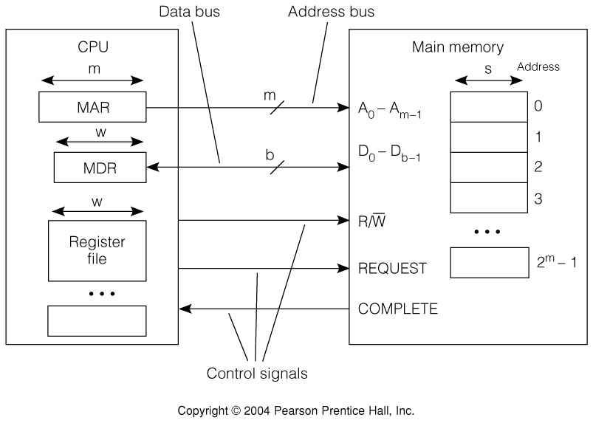
Fig. 7.1 The CPU–Main Memory Interface
Sequence of events:
  Read:
    1. CPU loads MAR, issues Read, and REQUEST
    2. Main Memory transmits words to MDR
    3. Main Memory asserts COMPLETE.
  Write:
    1. CPU loads MAR and MDR, asserts Write, and REQUEST
    2. Value in MDR is written into address in MAR.
    3. Main Memory asserts COMPLETE.

Slide 6
The CPU–Main Memory Interface - cont'd.
Additional points:
  if b<w, Main Memory must make w/b b-bit transfers.
  some CPUs allow reading and writing of word sizes <w.
    Example: Intel 8088: m=20, w=16,s=b=8.
    8- and 16-bit values can be read and written
  If memory is sufficiently fast, or if its response is predictable,
  then COMPLETE may be omitted.
  Some systems use separate R and W lines, and omit REQUEST.

Slide 7
Table 7.1 Some Memory Properties
Symbol Definition Intel Intel IBM/Moto.
8088 8086 601
w CPU Word Size 16bits 16bits 64 bits
m Bits in a logical memory address 20 bits 20 bits 32 bits
s Bits in smallest addressable unit 8 8 8
b Data Bus size 8 16 64
2^{m} Memory wd capacity, s-sized wds 2²⁰ 2²⁰ 2³²
2^{m}xs Memory bit capacity 2²⁰x8 2²⁰x8 2³²x8

Slide 8
Big-Endian and Little-Endian Storage
When data types having a word size larger than the smallest
addressable unit are stored in memory the question arises,
  “Is the least significant part of the word stored at the
  lowest address (little Endian, little end first) or–
  is the most significant part of the word stored at the
  lowest address (big Endian, big end first)”?
Example: The hexadecimal 16-bit number ABCDH, stored at address 0:
msb ... lsb
AB
CD
Little Endian
Big Endian
1
AB
1
CD
0
CD
0
AB

Slide 9
Table 7.2 Memory Performance Parameters
Symbol Definition Units Meaning
t_{a} Access time time Time to access a memory word
t_{c} Cycle time time Time from start of access to start of next
access
k Block size words Number of words per block
b Bandwidth words/time Word transmission rate
t_{l} Latency time Time to access first word of a sequence
of words
t_{bl} = Block time Time to access an entire block of words
t_{l} + k/b access time
(Information is often stored and moved in blocks at the cache and disk level.)

Slide 10
Table 7.3 The Memory Hierarchy, Cost, and Performance
Compo-
nent
Access Random Random Random Direct Sequential
Capa- 64-1024+ 8KB-8MB 64MB-2GB 8GB 1TB
city,
bytes
Latency .4-10ns .4-20ns 10-50ns 10ms 10ms-10s
Block 1 word 16 words 16 words 4KB 4KB
size
Band- System System 10-4000 50MB/s 1MB/s
width clock Clock MB/s
    Rate rate-80MB/s
Cost/MB High $10 $.25 $0.002 $0.01
C
P
U
T
a
p
Some Typical Values:†
C
e
a
c
h
e
M
a
i
n
M
e
m
o
r
y
D
i
s
k
M
e
m
o
r
y
M
e
m
o
r
y
†As of 2003-4. They go out of date immediately.

Slide 11
Fig. 7.3 Memory Cells - a conceptual view
Regardless of the technology, all RAM memory cells must provide
these four functions: Select, DataIn, DataOut, and R/W.
Select
≡
DataIn
DataOut
R/W
This “static” RAM cell is unrealistic.
We will discuss more practical designs later.

Slide 12
Fig. 7.4 An 8-bit register as a 1D RAM array
The entire register is selected with one select line, and uses one R/W line
Data bus is bi-directional, and buffered. (Why?)

Slide 13
Fig. 7.5 A 4x8 2D Memory Cell Array
2-4 line decoder selects one of the four 8-bit arrays
2-bit
address
R/W is common
to all.
Bi-directional 8-bit buffered data bus

Slide 14
Fig. 7.6 A 64Kx1 bit static RAM (SRAM) chip
~square array fits IC design
paradigm
Selecting rows separately
from columns means only
256x2=512 circuit elements
instead of 65536 circuit
elements!
CS, Chip Select, allows chips in arrays to be selected individually
This chip requires 21 pins including power and ground, and so
will fit in a 22 pin package.

Slide 15
Fig 7.7 A 16Kx4 SRAM Chip
There is little difference between this chip and the previous one, except that there are 4, 64-1 Multiplexers instead of 1, 256-1 Multiplexer.
This chip requires 24 pins including power and ground, and so will require a 24 pin pkg. Package size and pin count can dominate chip cost.

Slide 16
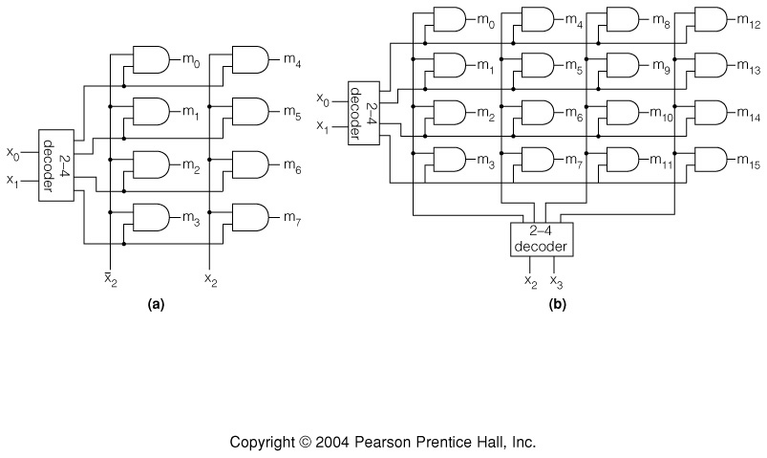
Fig 7.8 Matrix and Tree Decoders
2-level decoders are limited in size because of gate fanin.
Most technologies limit fanin to ~8.
When decoders must be built with fanin >8, then additional levels
of gates are required.
Tree and Matrix decoders are two ways to design decoders with large fanin:
3-to-8 line tree decoder constructed
from 2-input gates.
4-to-16 line matrix decoder
constructed from 2-input gates.

Slide 17
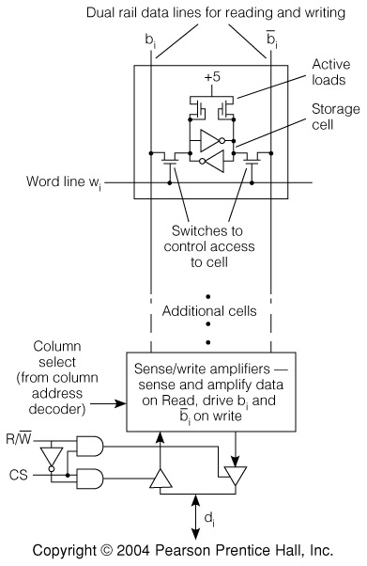
Fig 7.9 A 6 Transistor static RAM cell
This is a more practical
design than the 8-gate
design shown earlier.
A value is read by
precharging the bit
lines to a value 1/2
way between a 0 and
a 1, while asserting the
word line. This allows the
latch to drive the bit lines
to the value stored in
the latch.

Slide 18
Figs 7.10 Static RAM Read Timing
Access time from Address– the time required of the RAM array to decode the address and provide value to the data bus.

Slide 19
Figs 7.11 Static RAM Write Timing
Write time–the time the data must be held valid in order to decode address and store value in memory cells.

Slide 20
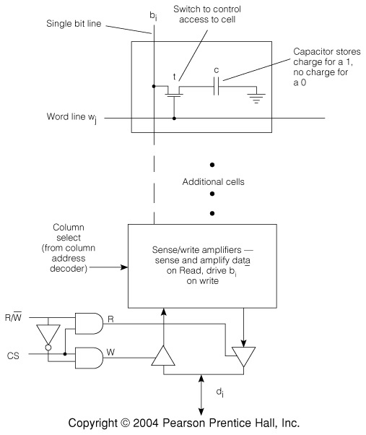
Fig 7.12 A Dynamic RAM (DRAM) Cell
Capacitor will
discharge in 4-15ms.
Refresh capacitor by reading (sensing) value on bit line, amplifyingacitor.
Write: place value on bit line
and assert word line.
Read: precharge bit line,
assert word line, sense value
on bit line with sense/amp.
This need to refresh the storage cells of dynamic RAM chips complicates
DRAM system design.

Slide 21
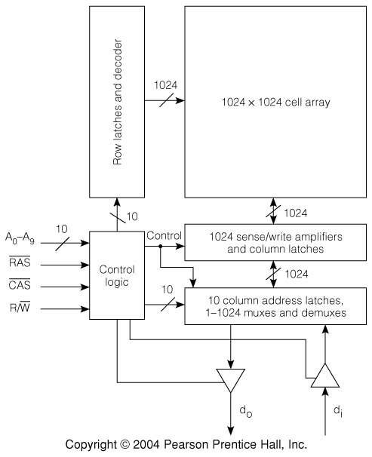
Fig 7.13 DRAM Chip organization
Addresses are time-multiplexed on address bus using RAS and CAS as strobes of rows and columns.
CAS is normally used as the CS function.
Notice pin counts:
Without address multiplexing: 27 pins including power and ground.
With address multiplexing: 17 pins including power and ground.

Slide 22
Figs 7.14, 7.15 DRAM Read and Write cycles
Typical DRAM Read operation
Typical DRAM Write operation
Access time Cycle time
Notice that it is the bit line precharge
operation that causes the difference
between access time and cycle time.
Data hold from RAS.

Slide 23
DRAM Refresh and row access
Refresh is usually accomplished by a “RAS-only” cycle. The row address
is placed on the address lines and RAS asserted. This refreshed the entire row. CAS is not asserted. The absence of a CAS phase signals the chip that a
row refresh is requested, and thus no data is placed on the external data lines.
Many chips use “CAS before RAS” to signal a refresh. The chip has an internal counter, and whenever CAS is asserted before RAS, it is a signal to refresh the row pointed to by the counter, and to increment the counter.
Most DRAM vendors also supply one-chip DRAM controllers that encapsulate
the refresh and other functions.
Page mode, nibble mode, and static column mode allow rapid access to
the entire row that has been read into the column latches.
Video RAMS, VRAMS, clock an entire row into a shift register where it can
be rapidly read out, bit by bit, for display.

Slide 24
Fig 7.16 A CMOS ROM Chip
2-D CMOS ROM Chip
00
1
0
1
0

Slide 25
Tbl 7.4 Kinds of ROM
ROM Type Cost Programmability Time to program Time to erase
Mask pro- Very At the factory Weeks (turn around) N/A
grammed inexpensive
PROM Inexpensive Once, by end Seconds N/A
user
EPROM Moderate Many times Seconds 20 minutes
Flash Expensive Many times 100 us. 1s, large
EPROM block
EEPROM Very Many times 100 us. 10 ms,
expensive byte

Slide 26
Memory boards and modules
There is a need for memories that are larger and wider than a single chip
Chips can be organized into “boards.”
  Boards may not be actual, physical boards, but may consist of
  structured chip arrays present on the motherboard.
A board or collection of boards make up a memory module.
Memory modules:
  Satisfy the processor–main memory interface requirements
  May have DRAM refresh capability
  May expand the total main memory capacity
  May be interleaved to provide faster access to blocks of words.

Slide 27
Fig 7.17 General structure of memory chip
This is a slightly different view of the memory chip than previous.
Multiple chip selects ease the assembly of
chips into chip arrays. Usually provided
by an external AND gate.
C
h
i
p
S
e
l
e
c
t
s
A
d
d
r
e
s
s
A
d
d
r
e
s
s
D
e
c
o
d
e
m
r
C
R
S
/
W
R
/
M
W
e
m
o
r
y
m
C
e
l
l
A
d
d
r
e
s
s
A
r
r
a
y
D
a
t
s
a
I
/
O
s
s
s
M
u
l
t
i
p
l
e
x
e
r
s
D
a
t
a
Bi-directional data bus.

Slide 28
Fig 7.18 Word Assembly from Narrow Chips
All chips have common CS, R/W, and Address lines.
P chips expand word size from s bits to p x s bits.

Slide 29
Fig 7.19 Increasing the Number of Words by a Factor of 2^{k}
The additional k address bits are used to select one of 2^{k} chips,
each one of which has 2^{m} words:
Word size remains at s bits.

Slide 30
Fig 7.20 Chip Matrix Using Two Chip Selects
Multiple chip select lines
are used to replace the
last level of gates in this
matrix decoder scheme.
This scheme
simplifies the
decoding from
use of a (q+k)-bit
decoder
to using one
q-bit and one
k-bit decoder.

Slide 31
Fig 7.21 A 3-D DRAM Array
CAS is used to enable top decoder in decoder tree.
Use one 2-D array for each bit. Each 2-D array on separate board.

Slide 32
Fig 7.22 A Memory Module interface
Must provide–
  Read and Write signals.
  Ready: memory is ready to accept commands.
  Address–to be sent with Read/Write command.
  Data–sent with Write or available upon Read when Ready is asserted.
  Module Select–needed when there is more than one module.
Bus Interface:
Control signal generator:
for SRAM, just strobes
data on Read, Provides
Ready on Read/Write
For DRAM–also provides
CAS, RAS, R/W, multiplexes
address, generates refresh
signals, and provides Ready.

Slide 33
Fig 7.23 DRAM module with refresh control

Slide 34
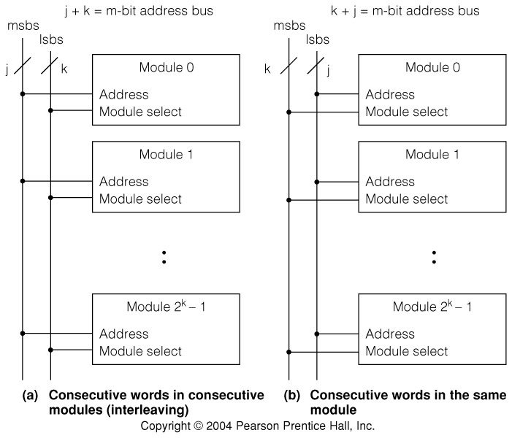
Fig 7.24 Two Kinds of Memory Module Organization.
Memory Modules are used to allow access to more than one word simultaneously.
•Scheme (a) supports filling a cache line.
•Scheme (b) allows multiple processes or processors to access memory at once.

Slide 35
Fig 7.25 Timing of Multiple Modules on a Bus
If time to transmit information over bus, t_{b}, is < module cycle time, t_{c},
it is possible to time multiplex information transmission to several
modules;
Example: store one word of each cache line in a separate module.
Main Memory Address:
Word Module No.
This provides successive words in successive modules.
Timing:
With interleaving of 2^{k} modules, and t_{b} < t_{b}/2k, it is possible to get a 2^{k}-fold
increase in memory bandwidth, provided memory requests are pipelined.
DMA satisfies this requirement.

Slide 36
Memory system performance
Breaking the memory access process into steps:
For all accesses:
  transmission of address to memory
  transmission of control information to memory (R/W, Request, etc.)
  decoding of address by memory
For a read:
  return of data from memory
  transmission of completion signal
For a write:
  Transmission of data to memory (usually simultaneous with address)
  storage of data into memory cells
  transmission of completion signal
The next slide shows the access process in more detail --

Slide 37
Fig 7.26 Static and dynamic RAM timing
“Hidden refresh” cycle. A normal cycle would exclude the
pending refresh step.
-more-

Slide 38
Example SRAM timings (using unrealistically long timing)
Approximate values for static RAM Read timing:
  Address bus drivers turn-on time: 40 ns.
  Bus propagation and bus skew: 10 ns.
  Board select decode time: 20 ns.
  Time to propagate select to another board: 30 ns.
  Chip select: 20ns.
PROPAGATION TIME FOR ADDRESS AND COMMAND TO REACH CHIP: 120 ns.
  On-chip memory read access time: 80 ns
  Delay from chip to memory board data bus: 30 ns.
  Bus driver and propagation delay (as before): 50 ns.
TOTAL MEMORY READ ACCESS TIME: 280 ns.
Moral: 70ns chips to not necessarily provide 70ns access time!

Slide 39
Considering any two adjacent levels of the memory hierarchy
Some definitions:
Temporal locality: the property of most programs that if a given memory
location is referenced, it is likely to be referenced again, “soon.”
Spatial locality: if a given memory location is referenced, those locations
near it numerically are likely to be referenced “soon.”
Working set: The set of memory locations referenced over a fixed period of
time, or in a time window.
Notice that temporal and spatial locality both work to assure that the contents
of the working set change only slowly over execution time.
Defining the Primary and Secondary levels:
Faster,
smaller
Slower,
larger
Primary
level
Secondary
level
CPU
• • •
• • •
two adjacent levels in the hierarchy

Slide 40
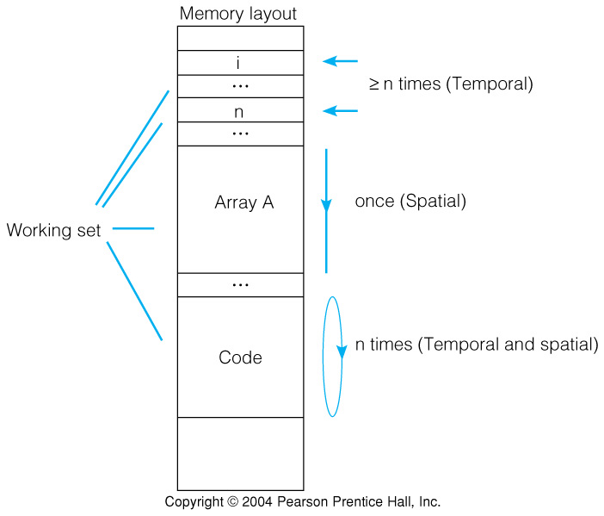
Figure 7.28 Temporal and Spatial Locality Example
Consider the C for loop:
for ((I=0); I<n; I++)
A[I] = 0;

Slide 41
Primary and secondary levels of the memory hierarchy
Speed between levels defined by latency: time to access first word, and
bandwidth, the number of words per second transmitted between levels.
Primary
level
Secondary
level
Typical latencies:
cache latency: a few clocks
Disk latency: 100,000 clocks
The item of commerce between any two levels is the block.
Blocks may/will differ in size at different levels in the hierarchy.
  Example: Cache block size ~ 16-64 bytes.
        Disk block size: ~ 1-4 Kbytes.
As working set changes, blocks are moved back/forth through the
hierarchy to satisfy memory access requests.
A complication: Addresses will differ depending on the level.
  Primary address: the address of a value in the primary level.
  Secondary address: the address of a value in the secondary level.

Slide 42
Primary and secondary address examples
Main memory address: unsigned integer
Disk address: track number, sector number, offset of word in sector.

Slide 43
Fig 7.29 Addressing and Accessing a 2-Level Hierarchy
The computer system, HW or SW,
must perform any address translation
that is required:
Two ways of forming the address: Segmentation and Paging.
Paging is more common. Sometimes the two are used together,
one “on top of” the other. More about address translation and paging later...

Slide 44
Fig 7.30 Primary Address Formation

Slide 45
Hits and misses; paging; block placement
Hit: the word was found at the level from which it was requested.
Miss: the word was not found at the level from which it was requested.
(A miss will result in a request for the block containing the word from
the next higher level in the hierarchy.)
Hit ratio (or hit rate) = h = number of hits
Miss ratio: 1 - hit ratio
t_{p} = primary memory access time. t_{s} = secondary memory access time
Access time, t_{a} = h • t_{p} + (1-h) • t_{s}.
Page: commonly, a disk block. Page fault: synonymous with a miss.
Demand paging: pages are moved from disk to main memory only when
a word in the page is requested by the processor.
Block placement and replacement decisions must be made each time a
block is moved.
total number of references

Slide 46
Virtual memory
a Virtual Memory is a memory hierarchy, usually consisting of at least main memory and disk, in which the processor issues all memory references as effective addresses in a flat address space. All translations to primary and secondary addresses are handled transparently to the process making the address reference, thus providing the illusion of a flat address space.
Recall that disk accesses may require 100,000 clock cycles to complete, due to the slow access time of the disk subsystem. Once the processor has, through mediation of the operating system, made the proper request to the disk subsystem, it is available for other tasks.
Multiprogramming shares the processor among independent programs that are resident in main memory and thus available for execution.

Slide 47
Decisions in designing a
2-level hierarchy
Translation procedure to translate from system address to primary address.
Block size–block transfer efficiency and miss ratio will be affected.
Processor dispatch on miss–processor wait or processor multiprogrammed.
Primary level placement–direct, associative, or a combination. Discussed later.
Replacement policy–which block is to be replaced upon a miss.
Direct access to secondary level–in the cache regime, can the processor
directly access main memory upon a cache miss?
Write through–can the processor write directly to main memory upon a cache
miss?
Read through–can the processor read directly from main memory upon a
cache miss as the cache is being updated?
Read or write bypass–can certain infrequent read or write misses be satisfied
by a direct access of main memory without any block movement?

Slide 48
Fig 7.31 The Cache Mapping Function
Example: 256KB 16words 32MB
The cache mapping function is responsible for all cache operations:
  Placement strategy: where to place an incoming block in the cache
  Replacement strategy: which block to replace upon a miss
  Read and write policy: how to handle reads and writes upon cache misses.
Mapping function must be implemented in hardware. (Why?)
Three different types of mapping functions:
  Associative
  Direct mapped
  Block-set associative

Slide 49
Memory fields and address translation
Example of processor-issued 32-bit virtual address:
31
0
32 bits
That same 32-bit address partitioned into two fields, a block field,
and a word field. The word field represents the offset into the block
specified in the block field:
Block Number
Word
26
6
2²⁶ 64 word blocks
Example of a specific memory reference: word 11 in block 9.
00 ••• 001001 001011

Slide 50
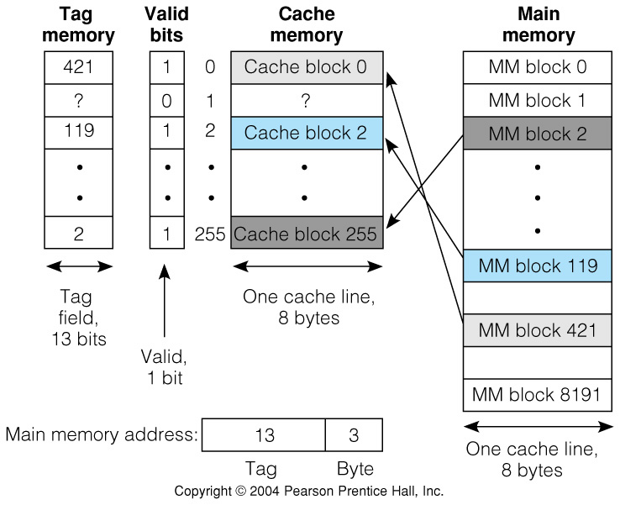
Fig 7.32 Associative mapped caches
Associative mapped cache model: any block from main memory can be put anywhere in the cache.
Assume a 16-bit main memory.*
*16 bits, while unrealistically small, simplifies the examples

Slide 51
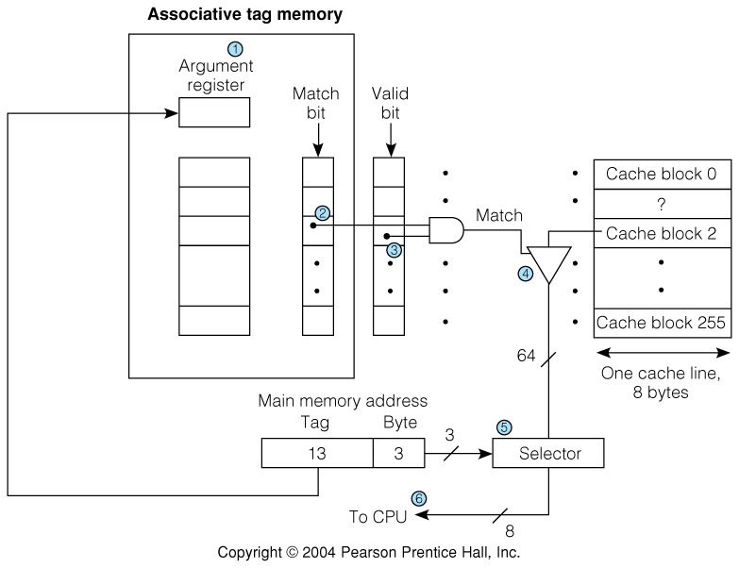
Fig 7.33 Associative cache mechanism
Because any block can reside anywhere in the cache, an associative, or content addressable memory is used. All locations are searched simultaneously.

Slide 52
Advantages and disadvantages of the associative mapped cache.
Advantage
  Most flexible of all–any MM block can go anywhere in the cache.
Disadvantages
  Large tag memory.
  Need to search entire tag memory simultaneously means lots of
  hardware.
Replacement Policy is an issue when the cache is full. –more later–
Q.: How is an associative memory implemented? Hint: Think XNOR gates.
–next–
Direct mapped caches simplify the hardware by allowing each MM block
to go into only one place in the cache.

Slide 53
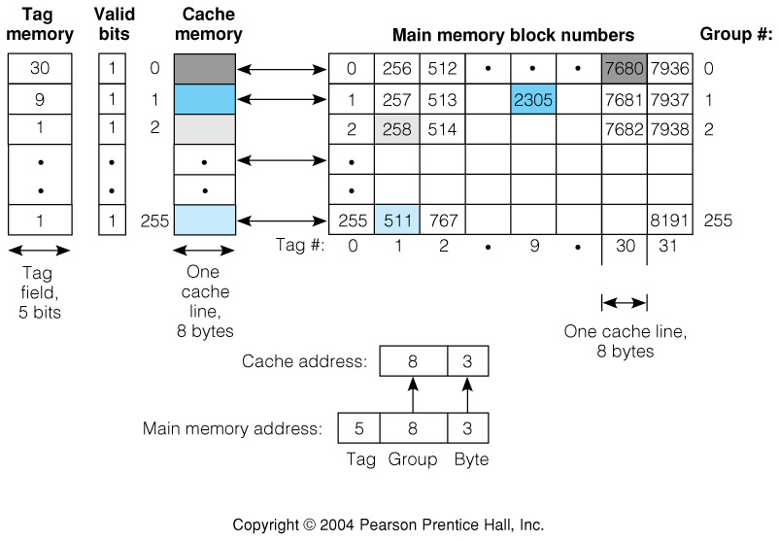
Fig 7.34 The direct mapped cache
Key Idea: all the MM blocks from a given group can go into only one location in the cache, corresponding to the group number.
Now the cache needs only examine the single group
that its reference specifies.

Slide 54
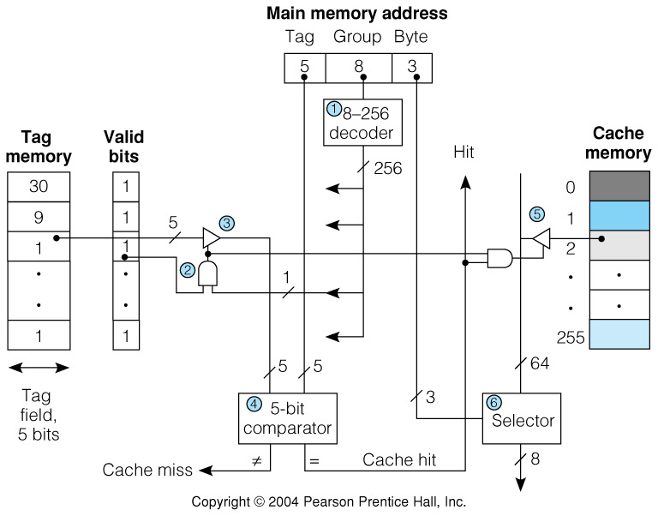
Fig 7.35 Direct Mapped Cache Operation
1. Decode the group number of the incoming MM address to select the group
2. If Match
AND Valid
3. Then gate out the tag field
4. Compare cache tag with incoming tag
5. If a hit, then gate out the cache line,
6. and use the word field to
select the desired word.

Slide 55
Direct mapped caches
The direct mapped cache uses less hardware, but is much more restrictive in block placement.
If two blocks from the same group are frequently referenced, then the cache will “thrash.” That is,
repeatedly bring the two competing blocks into and out of the cache. This will cause a performance degradation.
Block replacement strategy is trivial.
Compromise - allow several cache blocks in each group–the Block Set Associative Cache. –next–

Slide 56
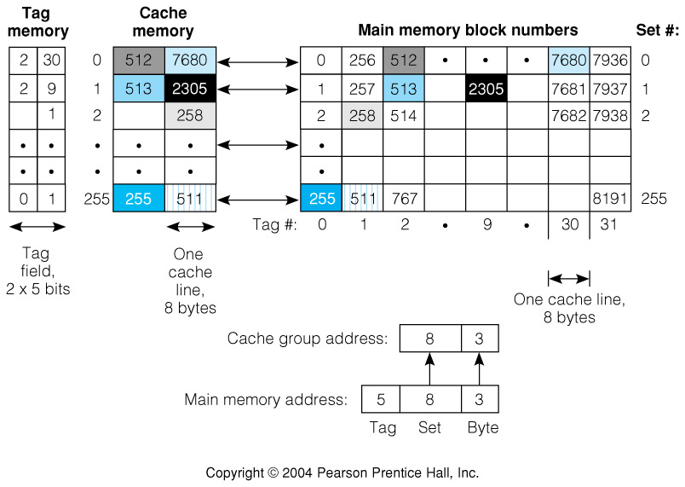
Fig 7.36 2-Way Set Associative Cache
Example shows 256 groups, a set of two per group.
Sometimes referred to as a 2-way set associative cache.

Slide 57
Getting Specific:
The Intel Pentium Cache
The Pentium actually has two separate caches–one for instructions and
one for data. Pentium issues 32-bit MM addresses.
  Each cache is 2-way set associative
  Each cache is 8K=2¹³ bytes in size
  32 = 2⁵ bytes per line.
  Thus there are 64 or 2⁶ bytes per set, and therefore 2¹³/2⁶ or 2⁷=128 groups
  This leaves 32-5-7 = 20 bits for the tag field:
Tag Set (group) Word
20 7 5
31
0
This “cache arithmetic” is important, and deserves your mastery.

Slide 58
Cache Read and Write policies
Read and Write cache hit policies
  Write-through–updates both cache and MM upon each write.
  Write back–updates only cache. Updates MM only upon block removal.
    “Dirty bit” is set upon first write to indicate block must be written back.
Read and Write cache miss policies
  Read miss - bring block in from MM
    Either forward desired word as it is brought in, or
    Wait until entire line is filled, then repeat the cache request.
  Write miss
    Write allocate - bring block into cache, then update
    Write - no allocate - write word to MM without bringing block into cache.

Slide 59
Block replacement strategies
Not needed with direct mapped cache
Least Recently Used (LRU)
  Track usage with a counter. Each time a block is accessed:
    Clear counter of accessed block
    Increment counters with values less than the one accessed
    All others remain unchanged
  When set is full, remove line with highest count.
Random replacement - replace block at random.
  Even random replacement is a fairly effective strategy.

Slide 60
Cache performance
Recall Access time, t_{a} = h • t_{p} + (1-h) • t_{s} for Primary and Secondary levels.
For t_{p} = cache and t_{s} = MM,
t_{a} = h • t_{C} + (1-h) • t_{M}
We define S, the speedup, as S= T_{without}/T_{with} for a given process,
where T_{without} is the time taken without the improvement, cache in
this case, and T_{with} is the time the process takes with the improvement.
Having a model for cache and MM access times, and cache line fill time,
the speedup can be calculated once the hit ratio is known.

Slide 61
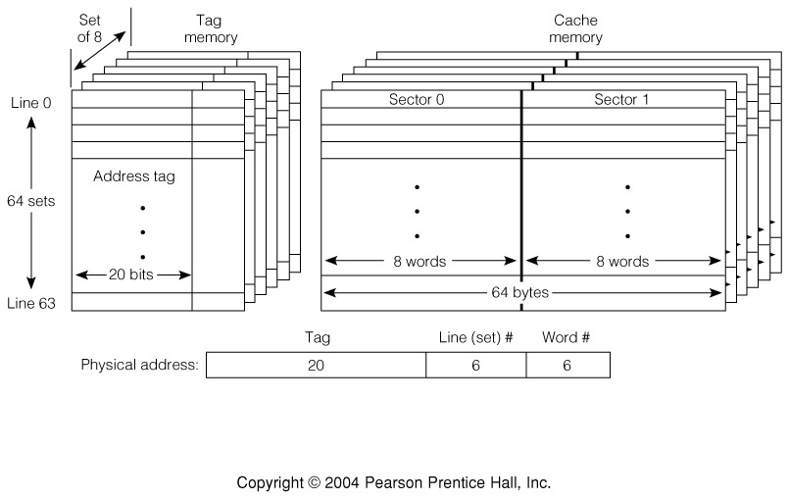
Fig 7.37 Getting Specific: The PowerPC 601 Cache
The PPC 601 has a unified cache - that is, a single cache for both instructions and data.
It is 32KB in size, organized as 64x8block set associative, with blocks being 8 8-byte words organized as 2 independent 4 word sectors for convenience in the updating process
A cache line can be updated in two single-cycle operations of 4 words each.
Normal operation is write back, but write through can be selected on a per line basis via software. The cache can also be disabled via software.

Slide 62
Virtual memory
The Memory Management Unit, MMU is responsible for mapping logical
addresses issued by the CPU to physical addresses that are presented to
the Cache and Main Memory.
CPU Chip
A word about addresses:
Effective Address - an address computed by by the processor while executing a program. Synonymous with Logical Address
  The term Effective Address is often used when referring to activity inside the CPU. Logical Address is most often used when referring to addresses when viewed from outside the CPU.
Virtual Address - the address generated from the logical address by the Memory Management Unit, MMU.
Physical address - the address presented to the memory unit.
(Note: Every address reference must be translated.)

Slide 63
Virtual addresses - why
The logical address provided by the CPU is translated to a virtual address by the MMU. Often the virtual address space is larger than the logical address, allowing program units to be mapped to a much larger virtual address space.
Getting Specific: The PowerPC 601
  The PowerPC 601 CPU generates 32-bit logical addresses.
  The MMU translates these to 52-bit virtual addresses, before
  the final translation to physical addresses.
  Thus while each process is limited to 32 bits, the main memory
  can contain many of these processes.
  Other members of the PPC family will have different logical
  and virtual address spaces, to fit the needs of various members
  of the processor family.

Slide 64
Virtual addressing - advantages
Simplified. Each program unit can be compiled into its own memory space, beginning at address 0 and potentially extending far beyond the amount of physical memory present in the system.
  No address relocation required at load time.
  No need to fragment the program to accommodate
Cost effective use of physical memory.
  Less expensive secondary (disk) storage can replace primary storage.
  (The MMU will bring portions of the program into physical memory as required)
Access control. As each memory reference is translated, it can be simultaneously checked for read, write, and execute privileges.
  This allows access/security control at the most fundamental levels.
  Can be used to prevent buggy programs and intruders from causing damage to other users or the system.
This is the origin of those “bus error” and “segmentation fault" messages

Slide 65
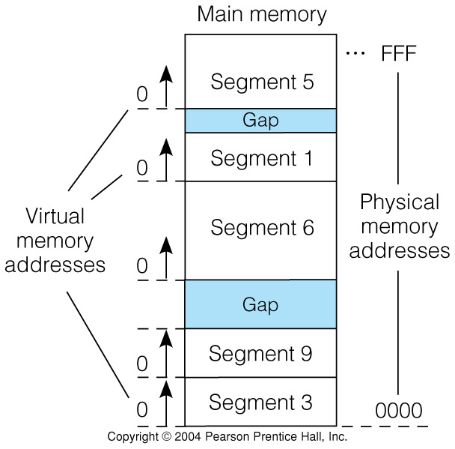
Fig 7.39 Memory management by Segmentation
Notice that each segment’s virtual address and out of physical memory will result in gaps between segments. This is called external fragmentation.

Slide 66
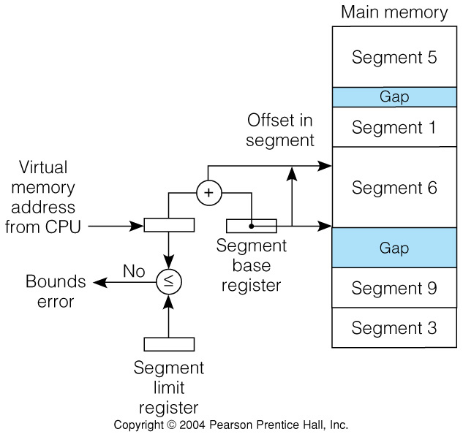
Fig 7.40 Segmentation Mechanism
The computation of physical address from virtual address requires an integer addition for each memory reference, and a comparison if segment limits are checked.
Q: How does the MMU switch references from one segment to another?

Slide 67
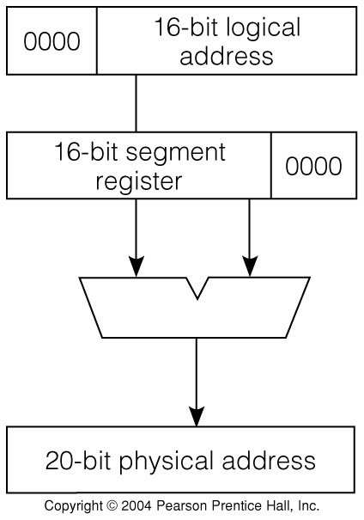
Fig 7.41 The Intel 8086 Segmentation Scheme
The first popular 16-bit processor, the Intel 8086 had a primitive segmentation
scheme to “stretch” its 16-bit logical address to a 20-bit physical address:
The CPU allows 4 simultaneously active segments,
CODE, DATA, STACK, and EXTRA. There are 4 16-bit segment base
registers.

Slide 68
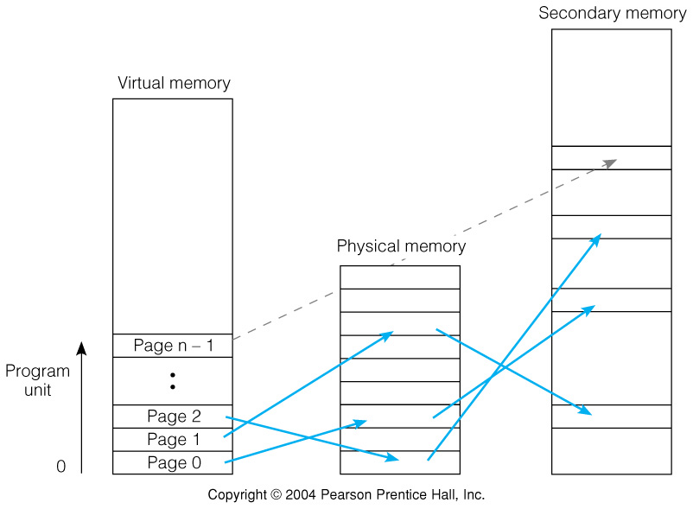
Fig 7.42 Memory management by paging
This figure shows the mapping between virtual memory pages, physical memory pages, and pages in secondary memory. Page n-1 is not present in physical memory, but only in secondary memory.
The MMU that manages this mapping. -more-

Slide 69
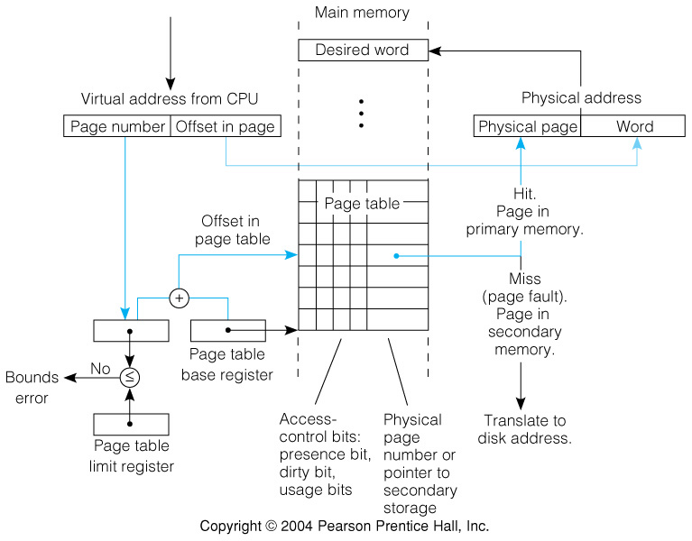
Fig 7.43 The Virtual to Physical Address Translation Process
1 table per user per program unit
One translation per memory access
Potentially large page table
A page fault will result in 100,000 or more cycles passing before the page
has been brought from secondary storage to MM.

Slide 70
Page Placement and Replacement
Page tables are direct mapped, since the physical page is computed
directly from the virtual page number.
But physical pages can reside anywhere in physical memory.
Page tables such as those on the previous slide result in large page
tables, since there must be a page table entry for every page in the
program unit.
Some implementations resort to hash tables instead, which need have
entries only for those pages actually present in physical memory.
Replacement strategies are generally LRU, or at least employ a “use bit”
to guide replacement.

Slide 71
Fast address translation: regaining lost ground
The concept of virtual memory is very attractive, but leads to considerable overhead:
  There must be a translation for every memory reference
  There must be two memory references for every program reference:
    One to retrieve the page table entry,
    one to retrieveMost caches are addressed by physical address, so there must be a virtual to physical translation before the cache can be accessed.
The answer: a small cache in the processor that retains the last few virtual
to physical translations: A Translation Lookaside Buffer, TLB.
The TLB contains not only the virtual to physical translations, but also the
valid, dirty, and protection bits, so a TLB hit allows the processor to access
physical memory directly.
The TLB is usually implemented as a fully associative cache. -more-

Slide 72
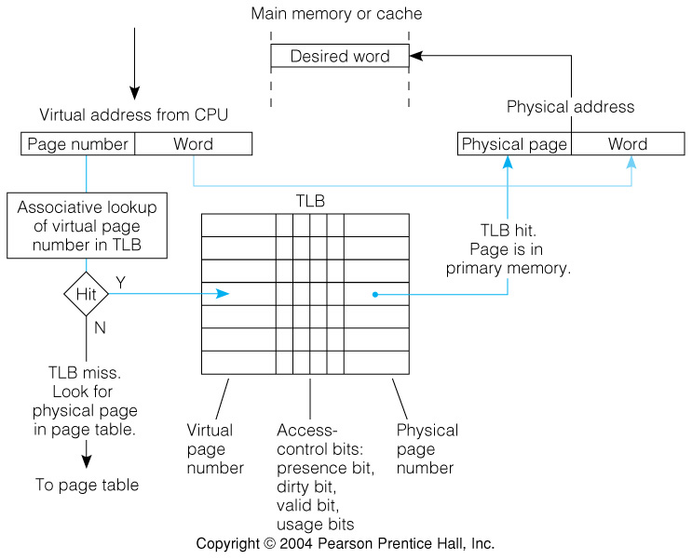
Fig 7.44 TLB Structure and Operation

Slide 73
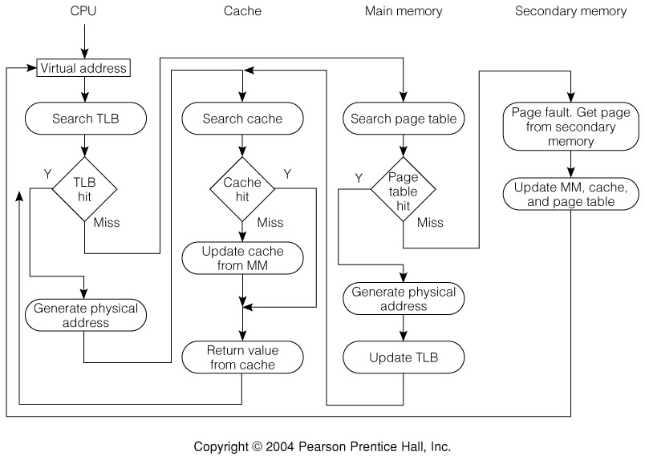
Fig 7.45 Operation of the Memory Hierarchy

Slide 74
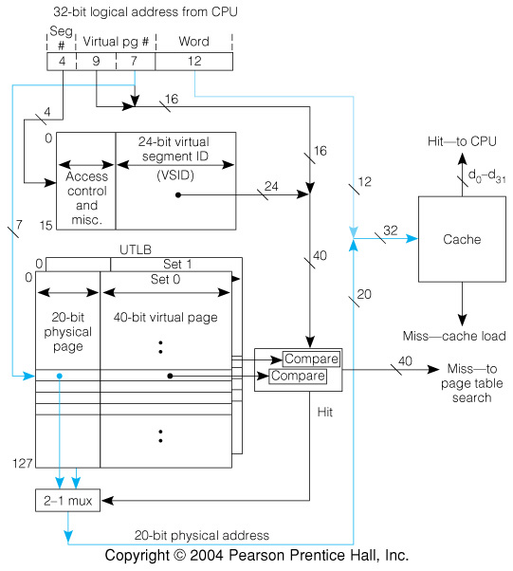
Fig 7.46 The PowerPC 601 MMU Operation
“Segments” are actually more akin to
large (256 MB) blocks.

Slide 75
Fig 7.47 I/O Connection to a Memory with a Cache
The memory system is quite complex, and affords many possible tradeoffs.
  The only realistic way to chose among these alternatives is to study a typical workload, using either simulations or prototype systems.
  Instruction and data accesses usually have different patterns.
It is possible to employ a cache at the disk level, using the disk hardware.
Traffic between MM and disk is I/O, and Direct Memory Access, DMA can be used to speed the transfers:

