Slide 1
Chapter 8 Overview
The I/O subsystem
  I/O buses and addresses
Programmed I/O
  I/O operations initiated by program instructions
I/O interrupts
  Requests to processor for service from an I/O device
Direct Memory Access (DMA)
  Moving data in and out without processor intervention
I/O data format change and error control
  Error detection and correction coding of I/O data

Slide 2
Three Requirements of I/O Data Transmission
1) Data location
  Correct device must be selected
  Data must be addressed within that device
2) Data transfer
  Amount of data varies with device & may need be specified
  Transmission rate varies greatly with device
  Data may be output, input, or either with a given device
3) Synchronization
  For an output device, data must be sent only when the device is ready to receive it
  For an input device, the processor can read data only when it is available from the device

Slide 3
Location of I/O Data
Data location may be trivial once the device is determined
  Character from a keyboard
  Character out to a serial printer
Location may involve searching
  Record number on a tape drive
  Track seek and rotation to sector on a disk
Location may not be simple binary number
  Drive, platter, track, sector, word on a disk cluster

Slide 4
Fig 8.1 Amount and Speed of Data Transfer
Keyboard delivers one character about every 1/10 second at the fastest
Rate may also vary, as in disk rotation delay followed by block transfer

Slide 5
Synchronization—I/O Devices are not Timed by Master Clock
Not only can I/O rates differ greatly from processor speed, but I/O is asynchronous
Processor will interrogate state of device and transfer information at clock ticks
I/O status and information must be stable at the clock tick when it is accessed
Processor must know when output device can accept new data
Processor must know when input device is ready to supply new data

Slide 6
Reducing Location and Synch. to Data Transfer
Since the structure of device data location is device dependent, device should interpret it
  The device must be selected by the processor, but
  Location within the device is just information passed to the device
Synchronization can be done by the processor reading device status bits
  Data available signal from input device
  Ready to accept output data from output device
Speed requirements will require us to use other forms of synchronization: discussed later
  Interrupts and DMA are examples

Slide 7
Fig 8.2 Separate Memory and I/O Connections to Processor
Allows tailoring bus to its purpose, but
Requires many connections to CPU (pins)
Memory & I/O access can be distinguished
Timing and synch. can be different for each
Least expensive option
Speed penalty

Slide 8
Memory Mapped I/O
Combine memory control and I/O control lines to make one unified bus for memory and I/O
This makes addresses of I/O device registers appear to the processor as memory addresses
Reduces the number of connections to the processor chip
  Increased generality may require a few more control signals
Standardizes data transfer to and from the processor
  Asynchronous operation is optional with memory, but demanded by I/O devices

Slide 9
Fig 8.3 Address Space of a Computer Using Memory Mapped I/O

Slide 10
Programmed I/O
Requirements for a device using programmed I/O
  Device operations take many instruction times
  One word data transfers—no burst data transmission
Program instructions have time to test device status bits, write control bits, and read or write data at the required device speed
Example status bits:
  Input data ready
  Output device busy or off-line
Example control bits:
  Reset device
  Start read or start write

Slide 11
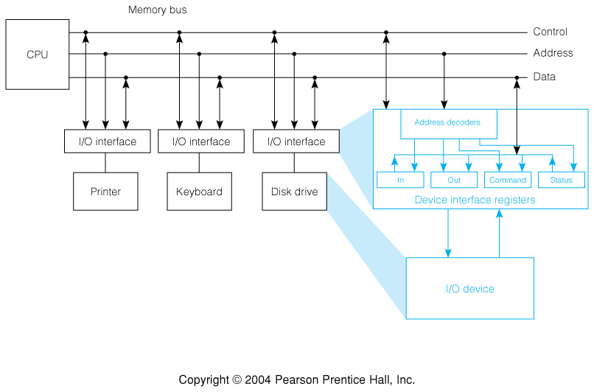
Fig 8.4 Programmed I/O Device Interface Structure
Focus on the interface between the unified I/O and memory bus and an arbitrary device Several device registers (memory addresses) share address decode and control logic

Slide 12
Fig 8.5 SRC I/O Register Address Decoder
Assumes SRC addresses above FFFFF000₁₆ are reserved for I/O registers
  Allows for 1024 registers of 32 bits
  Is in range FFFF0000₁₆ to FFFFFFFF₁₆ addressable by negative displacement
Selects the
I/O space
Selects this device

Slide 13
Fig 8.6 Interface Design for SRC Character Output

Slide 14
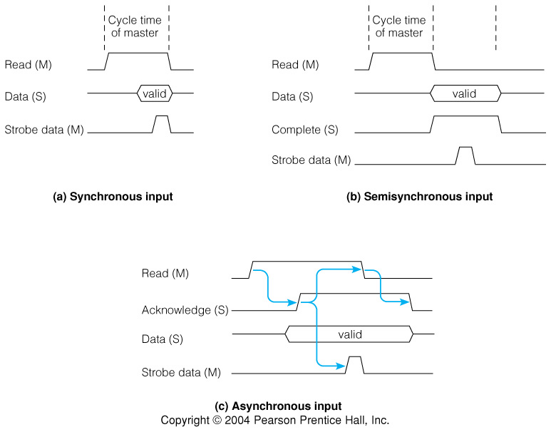
Fig 8.7 Synchronous and Semi-synchronous Data Input
Used for memory to CPU read with few cycle memory
Used for register to register inside CPU
Used for I/O over longer distances (feet)

Slide 15
Fig 8.7c Asynchronous Data input
Yes, you may.
You’re welcome.
May I?
Thanks.

Slide 16
Example: Programmed I/O Device Driver for Character Output
Device requirements:
  8 data lines set to bits of an ASCII character
  Start signal to begin operation
  Data bits held until device returns Done signal
Design decisions matching bus to device
  Use low order 8 bits of word for character
  Make loading of character register signal Start
  Clear Ready status bit on Start & set it on Done
  Return Ready as sign of status register for easy testing
31
7
0
Output Register
Unused
Character
Status Register
Unused
Ready

Slide 17
Fig 8.8 Character Output Program Fragment
Status register COSTAT = FFFFF110H
Output register COUT = FFFFF114H
lar r3, Wait ;Set branch target for wait.
ldr r2, Char ;Get character for output.
Wait: ld r1, COSTAT ;Read device status register,
brpl r3, r1 ; test for ready, and repeat if not.
st r2, COUT ;Output character and start device.
For readability: I/O registers are all caps., program locations have initial cap., and instruction mnemonics are lower case
A 10 MIPS SRC would execute 10,000 instructions waiting for a 1,000 character/sec printer

Slide 18
Program Fragment for 80 Character per Line Printer
Status Register LSTAT = FFFFF130H
Output Register LOUT = FFFFF134H
Command Register LCMD = FFFFF138H
lar r1, Buff ;Set pointer to character buffer.
la r2, 80 ;Initialize character counter and
lar r3, Wait ; branch target.
Wait: ld r0, LSTAT ;Read Ready bit,
brpl r3, r0 ; test, and repeat if not ready.
ld r0, 0(r1) ;Get next character from buffer,
st r0, LOUT ; and send to printer.
addi r1, r1, 4 ;Advance character pointer, and
addi r2, r2, -1 ; count character.
brnz r3, r2 ;If not last, go wait for ready.
la r0, 1 ;Get a print line command,
st r0, LCMD ; and send it to the printer.

Slide 19
Multiple Input Device Driver Software
32 low speed input devices
  Say, keyboards at ≈10 characters/sec
  Max rate of one every 3 ms
Each device has a control/status register
  Only Ready status bit, bit 31, is used
  Driver works by polling (repeatedly testing) Ready bits
Each device has an 8 bit input data register
  Bits 7..0 of 32 bit input word hold the character
Software controlled by pointer and Done flag
  Pointer to next available location in input buffer
  Device’s done is set when CR received from device
  Device is idle until other program (not shown) clears done

Slide 20
Driver Program Using Polling for 32 Input Devices
FFFFF300
Dev 0 CTL
32 pairs of control/status and input data registers
r0 - working reg r1 - input char.
r2 - device index r3 - none active
FFFFF304
Dev 0 IN
FFFFF308
Dev 1 CTL
FFFFF30C
Dev 1 IN
FFFFF310
Dev 2 CTL
CICTL .equ FFFFF300H ;First input control register.
CIN .equ FFFFF304H ;First input data register.
CR .equ 13 ;ASCII carriage return.
Bufp: .dcw 1 ;Loc. for first buffer pointer.
Done: .dcw 63 ;Done flags and rest of pointers.
Driver: lar r4, Next ;Branch targets to advance to next
lar r5, Check ; character, check device active,
lar r6, Start ; and start a new polling pass.

Slide 21
Polling Driver for 32 Input Devices—continued
Start: la r2, 0 ;Point to first device, and
la r3, 1 ; set all inactive flag.
Check: ld r0,Done(r2) ;See if device still active, and
brmi r4, r0 ; if not, go advance to next device.
ld r3, 0 ;Clear the all inactive flag.
ld r0,CICTL(r2) ;Get device ready flag, and
brpl r4, r0 ; go advance to next if not ready.
ld r0,CIN(r2) ;Get character and
ld r1,Bufp(r2) ; correct buffer pointer, and
st r0, 0(r1) ; store character in buffer.
addi r1,r1,4 ;Advance character pointer,
st r1,Bufp(r2) ; and return it to memory.
addi r0,r0,-CR ;Check for carriage return, and
brnz r4, r0 ; if not, go advance to next device.
la r0, -1 ;Set done flag to -1 on
st r0,Done(r2) ; detecting carriage return.
Next: addi r2,r2,8 ;Advance device pointer, and
addi r0,r2,-256 ; if not last device,
brnz r5, r0 ; go check next one.
brzr r6, r3 ;If a device is active, make a new pass.

Slide 22
Characteristics of the Polling Device Driver
If all devices active and always have char. ready,
Then 32 bytes input in 547 instructions
This is data rate of 585KB/s in a 10MIPS CPU
But, if CPU just misses setting of Ready, 538 instructions are executed before testing it again
This 53.8 μsec delay means that a single device must run at less than 18.6Kchars/s to avoid risk of losing data
Keyboards are thus slow enough

Slide 23
Tbl 8.1 The Centronics Printer Interface
Name In/Out Description
STROBE Out Data out strobe
D0 Out Least significant data bit
D1 Out Data bit
… … …
D7 Out Most significant data bit
ACKNLG In Pulse on done with last char.
BUSY In Not ready
PE In No paper when high
SLCT In Pulled high
AUTOFEEDXT Out Auto line feed
INIT Out Initialize printer
ERROR In Can’t print when low
SLCTIN Out Deselect protocol

Slide 24
Fig 8.11 Centronics Interface Timing
Minimum times specified for output signals
Nominal times specified for input signals

Slide 25
I/O Interrupts
Key idea: instead of processor executing wait loop, device requests interrupt when ready
In SRC the interrupting device must return the vector address and interrupt information bits
Processor must tell device when to send this information—done by acknowledge signal
Request and acknowledge form a communication handshake pair
It should be possible to disable interrupts from individual devices

Slide 26
Fig 8.12 Simplified Interrupt Interface Logic
Request and enable flags per device
Returns vector and interrupt information on bus when acknowledged

Slide 27
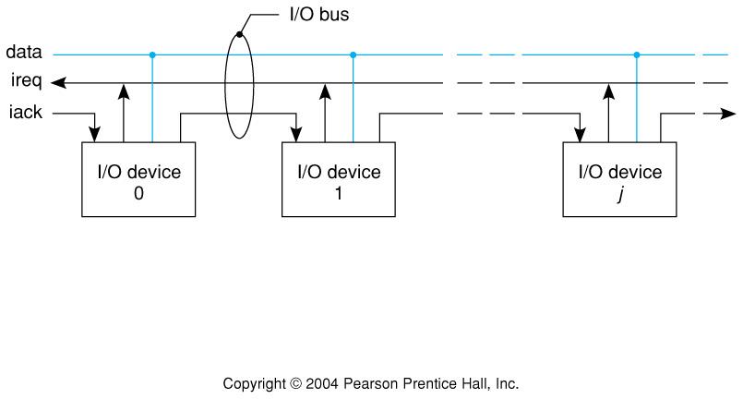
Fig 8.13 Daisy-Chained Interrupt Acknowledge Signal
How does acknowledge signal select one and only one device to return interrupt info.?
One way is to use a priority chain with acknowledge passed from device to device

Slide 28
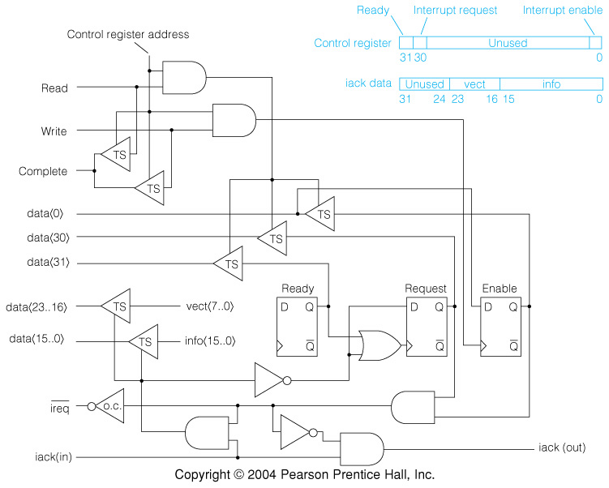
Fig 8.14 Interrupt Logic for an SRC I/O Interface
Request set by Ready, cleared by acknowledge
iack only sent out if this device not requesting

Slide 29
Getline Subroutine for Interrupt Driven Character I/O
;Getline is called with return address in R31 and a pointer to a
;character buffer in R1. It will input characters up to a carriage
;return under interrupt control, setting Done to -1 when complete.
CR .equ 13 ;ASCII code for carriage return.
CIvec .equ 01F0H ;Character input interrupt vector address.
Bufp: .dw 1 ;Pointer to next character location.
Save: .dw 2 ;Save area for registers on interrupt.
Done: .dw 1 ;Flag location is -1 if input complete.
Getln: st r1, Bufp ;Record pointer to next character.
edi ;Disable interrupts while changing mask.
la r2, 1F1H ;Get vector address and device enable bit
st r2, CICTL ; and put into control register of device.
la r3, 0 ;Clear the
st r3, Done ; line input done flag.
een ;Enable Interrupts
br r31 ; and return to caller.

Slide 30
Interrupt Handler for SRC Character Input
.org CIvec ;Start handler at vector address.
str r0, Save ;Save the registers that
str r1, Save+4 ; will be used by the interrupt handler.
ldr r1, Bufp ;Get pointer to next character position.
ld r0, CIN ;Get the character and enable next input.
st r0, 0(r1) ;Store character in line buffer.
addi r1, r1, 4 ;Advance pointer and
str r1, Bufp ; store for next interrupt.
lar r1, Exit ;Set branch target.
    addi r0,r0, -CR ;Carriage return? addi with minus CR.
brnz r1, r0 ;Exit if not CR, else complete line.
la r0, 0 ;Turn off input device by
st r0, CICTL ; disabling its interrupts.
la r0, -1 ;Get a -1 indicator, and
str r0, Done ; report line input complete.
Exit: ldr r0, Save ;Restore registers
ldr r1, Save+4 ; of interrupted program.
rfi ;Return to interrupted program.

Slide 31
General Functions of an Interrupt Handler
1) Save the state of the interrupted program
2) Do programmed I/O operations to satisfy the interrupt request
3) Restart or turn off the interrupting device
4) Restore the state and return to the interrupted program

Slide 32
Interrupt Response Time
Response to another interrupt is delayed until interrupts re-enabled by rfi
Character input handler disables interrupts for a maximum of 17 instructions
If the CPU clock is 20MHz, it takes 10 cycles to acknowledge an interrupt, and average execution rate is 8 CPI
Then 2nd interrupt could be delayed by
(10 + 17×8) / 20 = 7.3μsec

Slide 33
Nested Interrupts—Interrupting an Interrupt Handler
Some high speed devices have a deadline for interrupt response
  Longer response times may miss data on a moving medium
  A real time control system might fail to meet specifications
To meet a short deadline, it may be necessary to interrupt the handler for a slow device
The higher priority interrupt will be completely processed before returning to the interrupted handler
Hence the designation nested interrupts
Interrupting devices are priority ordered by shortness of their deadlines

Slide 34
Steps in the Response of a Nested Interrupt Handler
1) Save the state changed by interrupt (IPC & II);
2) Disable lower priority interrupts;
3) Re-enable exception processing;
4) Service interrupting device;
5) Disable exception processing;
6) Re-enable lower priority interrupts;
7) Restore saved interrupt state (IPC & II)
8) Return to interrupted program and re-enable exceptions

Slide 35
Fig 8.16 Interrupt Masks for Executing device j Handler
Conceptually, a priority interrupt scheme could be managed using device enable bits
Order the bits from left to right in order of increasing priority to form an interrupt mask
Value of the mask when executing device j interrupt handler is

Slide 36
Fig 8.17 Priority Interrupt System with m = 2^{k} Levels

Slide 37
Direct Memory Access (DMA)
Allows external devices to access memory without processor intervention
Requires a DMA interface device
Must be “set up” or programmed, and transfer initiated.

Slide 38
Steps a DMA Device Interface Must Take to Transfer A Block of Data
1. Become bus master
2. Send memory address and R/W signal
3. Synch. sending and receiving of data using complete
4. Release bus as needed (perhaps after each xfer)
5. Advance memory address to point to next data item
6. Count number of items transferred, check for end of data block
7. Repeat if more data to be transferred

Slide 39
Fig 8.18 I/O Interface Architecture for a DMA Device

Slide 40
Fig 8.19 Multiplexer and Selector DMA Channels

Slide 41
Error Detection and Correction
Bit Error Rate, BER, is the probability that, when read, a given bit will be in error.
BER is a statistical property
Especially important in I/O, where noise and signal integrity cannot be so easily controlled
10⁻¹⁸ inside processor
10⁻⁸ - 10⁻¹² or worse in outside world
Many techniques
  Parity check
  SECDED Encoding
  CRC

Slide 42
Parity Checking
Add a Parity Bit to the word
Even Parity: Make the parity bit 1 bit if needed to make number 1 of bits even, else make it 0
Odd Parity: Make the parity bit a 1 bit if needed to make number of 1 bits odd, else make it 0
Example: for word 10011010, to add odd parity bit: 100110101

Slide 43
Hamming Codes
Hamming codes are a class of codes that use combinations of parity checks to both detect and correct errors.
They add a group of parity check bits to the data bits.
For ease of visualization, intersperse the parity bits within the data bits; reserve bit locations whose bit numbers are powers of 2 for the parity bits. Number the bits from l to r, starting at 1
A given parity bit is computed from data bits whose bit numbers contain a 1 at the parity bit number.

Slide 44
Fig 8.20: Multiple Parity Checks Making up a Hamming Code
Add parity bits, P_{i}, to data bits, D_{i}
Reserve bit numbers that are a power of 2 for Parity Bits
Example: P₁=001, P₂ = 010, P₄=100, etc.
Each parity bit, P_{i}, is computed over those data bits that have a "1" at the bit number of the parity bit.
Example: P₂(010) is computed from D₃ (011), D₆ (110), D₇(111), ...
Thus each bit takes part in a different combination of parity checks.
When the word is checked, if only one bit is in error, all the parity bits that use it in their computation will be incorrect.

Slide 45
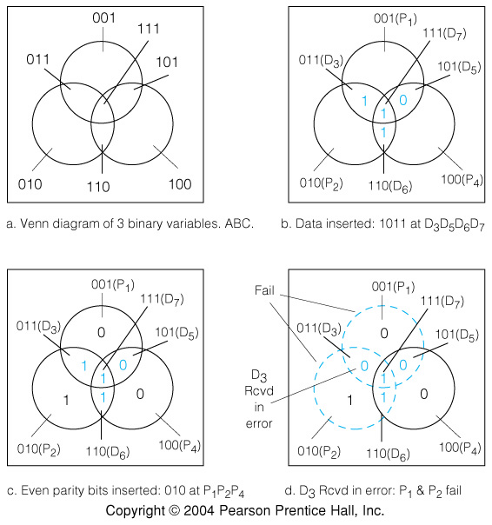
Figure 8.21 Motivating Example: use the Venn Diagram to Explain Error Detection and Correction using the Hamming Code
b. insert data
c. Sender omputes and inserts even parity bits
d. Receiver recomputes parity bits, detects and corrects error.

Slide 46
Example 8.1 Encode 1011 Using the Hamming Code and Odd Parity
Insert the data bits: P₁ P₂ 1 P₄ 0 1 1
P₁ is computed from P₁ ⊕ D₃ ⊕ D₅ ⊕ D₇ = 1, so P₁ = 1.
P₂ is computed from P₂ ⊕ D₃ ⊕ D₆ ⊕ D₇ = 1, so P₁ = 0.
P₄ is computed from P₁ ⊕ D₅ ⊕ D₆ ⊕ D₇ = 1, so P₁ = 1.
The final encoded number is 1 0 1 1 0 1 1.
Note that the Hamming encoding scheme assumes that at most one bit is in error.

Slide 47
SECDED (Single Error Correct, Double Error Detect)
Add another parity bit, at position 0, which is computed to make the parity over all bits, data and parity, even or odd.
If one bit is in error, a unique set of Hamming checks will fail, and the overall parity will also be wrong.
Let c_{i} be true if check i fails, otherwise true.
In the case of a 1-bit error, the string c_{k-1}, . . ., c₁, c₀ will be the binary index of the erroneous bit.
For Example if the c_{i} string is 0110 then bit at position 6 is in error.
If two bits are in error, one or more Hamming checks will fail, but the overall parity will be correct.
Thus the failure of one or more Hamming checks, coupled with correct overall parity means that 2 bits are in error.
This assumes that the probability of 3 or more bits being in error is negligible.

Slide 48
Example 8.2 Compute the odd parity SECDED encoding of the 8-bit value 01101011
The 8 data bits 01101011 would have 5 parity bits added to them to make the 13-bit value
P₀ P₁ P₂ 0 P₄ 1 1 0 P₈ 1 0 1 1.
Now P₁ = 0, P₂ = 1, P₄ = 0, and P₈ = 0, and we can compute that P₀, overall parity, = 1, giving the encoded value:
1 0 1 0 0 1 1 0 0 1 0 1 1

Slide 49
Example 8.3 Extract the Correct Data Value from the SECDED-Encoded String 0110101101101, Assuming odd Parity
The string shows even parity, so there must be a single bit in error.
Checks c₂ and c₄ fail, giving the binary index of the erroneous bits as 0110 = 6, so D6 is in error.
It should be 0 instead of 1

Slide 50
Cyclic Redundancy Check, CRC
When data is transmitted serially over communications lines, the pattern of errors usually results in several or many bits in error, due to the nature of line noise.
The "crackling" of telephone lines is this kind of noise.
Parity checks are not as useful in these cases.
Instead CRC checks are used.
The CRC can be generated serially.
It usually consists of XOR gates.

Slide 51
Fig 8.22 CRC Generator Based on the Polynomial x¹⁶ + x¹² + x⁵ + 1.
The number and position of XOR gates is determined by the polynomial
CRC does not support error correction but the CRC bits generated can be used to detect multi-bit errors.
The CRC results in extra CRC bits, which are appended to the data word and sent along.
The receiving entity can check for errors by recomputing the CRC and comparing it with the one that was transmitted.

Slide 52
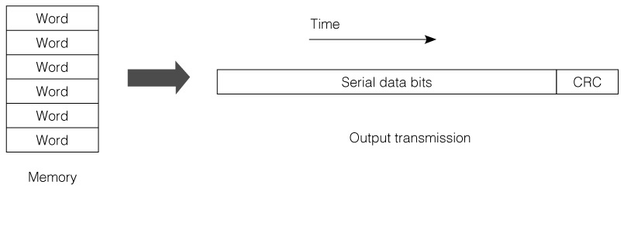
Fig 8.23 Serial Data Transmission with Appended CRC Code

