Slide 1
Chapter 9: Peripheral Devices—Overview
Magnetic disk drives: ubiquitous and complex
  Other moving media devices: tape and CD ROM
Display devices
  Video monitors: analog characteristics
  Video terminals
  Memory mapped video displays
  Flat panel displays
Printers: dot matrix, laser, inkjet
Manual input: keyboards and mice
A to D and D to A converters: the analog world

Slide 2
Tbl 9.1 Some Common Peripheral Interface Standards
Bus Standard Data Rate Bus Width
Centronics ~50KB/s 8-bit parallel
EIA RS232/422 30-20K B/s bit-serial
SCSI 10-500 MB/s 16-bit parallel
Ethernet 10-1000 Mb/s bit-serial
USB 1.5-12 Mb/s bit-serial
USB-2 480 Mb/s bit-serial
FireWire† 100-400 Mb/s bit-serial
FireWire-800† 800 Mb/s bit-serial
†Also known as Sony iLink, or IEEE1394 and 1394b, respectively

Slide 3
Disk Drives—Moving Media Magnetic Recording
High density and non-volatile
  Densities approaching semiconductor RAM on an inexpensive medium
  No power required to retain stored information
Motion of medium supplies power for sensing
More random access than tape: direct access
  Different platters selected electronically
  Track on platter selected by head movement
  Cyclic sequential access to data on a track
Structured address of data on disk
  Drive: Platter: Track: Sector: Byte

Slide 4
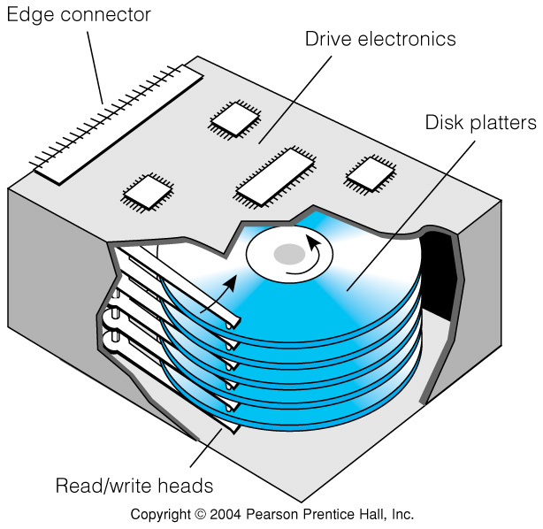
Fig 9.3 Cutaway View of a Multi-Platter Hard Disk Drive

Slide 5
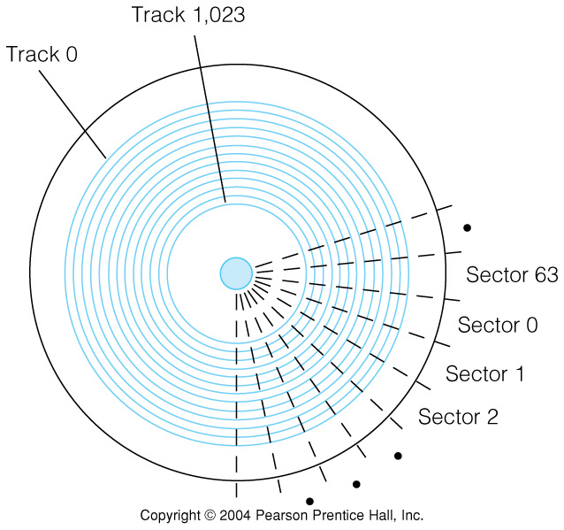
Fig 9.4 Simplified View of Disk Track and Sector Organization
An integral number of sectors are recorded around a track
A sector is the unit of data transfer to or from the disk

Slide 6
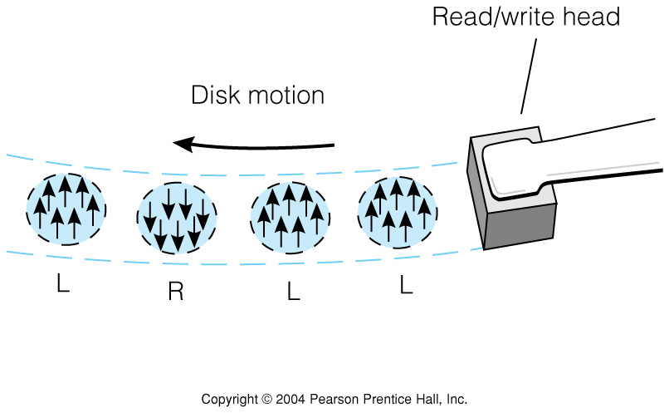
Figure 9.5 Simplified View of Individual Bits Encoded on a Disk Track
Inside tracks are shorter & thus have higher densities or fewer words
All sectors contain the same number of bytes
  Inner portions of a platter may have fewer sectors per track
Small areas of the disk are magnetized in different directions
Change in magnetization direction is what is detected on read

Slide 7
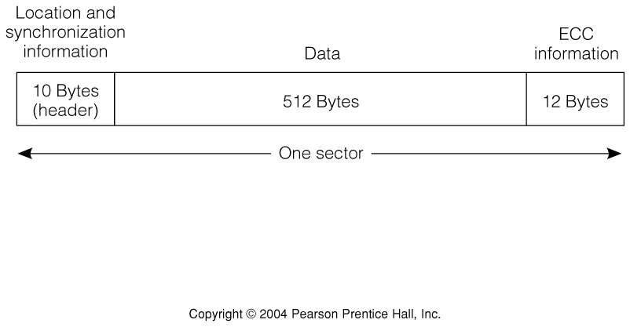
Fig 9.6 Typical Hard Disk Sector Organization
Serial bit stream has header, data, & error code
Header synchronizes sector read and records sector address
Data length is usually power of 2 bytes
Error detection/correction code needed at end

Slide 8
Disk Formatting
Disks are pre-formatted with track and sector address written in headers
Disk surface defects may cause some sectors to be marked unusable for the software

Slide 9
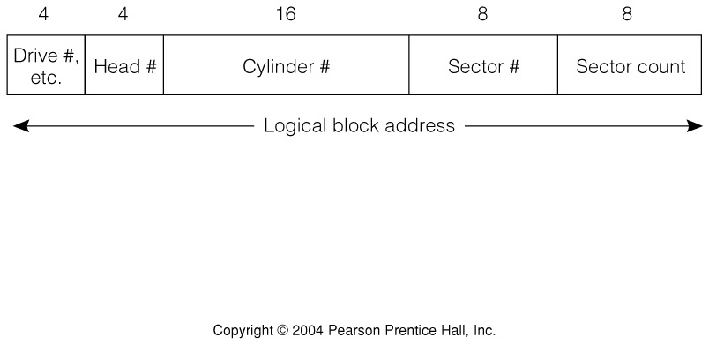
Fig 9.7 The PC AT Block Address for Disk Access
Head number determines platter surface
Cylinder is track number for all heads
Count sectors, up to a full track, can be accessed in one operation

Slide 10
The Disk Access Process
1. OS Communicates LBA to the disk interface, and issues a READ command.
2. Drive seeks to the correct track by moving heads to correct position, and enabling the appropriate head. 3. Sector data and ECC stream into buffer. ECC is done "on the fly."
4. When correct sector is found data is streamed into a buffer.
5. Drive communicates "data ready" to the OS
6. OS reads data byte by byte or by using DMA.

Slide 11
Static Disk Characteristics
Areal density of bits on surface
density = 1/(bit spacing × track spacing)
Maximum density: density on innermost track
Unformatted capacity: includes header and error control bits
Formatted capacity:
bytes
sectors
tracks
capacity =
×
×
×
# of surfaces
sector
track
surface

Slide 12
Dynamic Disk Characteristics
Seek time: time to move heads to cylinder
Track-to-track access: time to adjacent track
Rotational latency: time for correct sector to come under read/write head
Average access time: seek time + rotational latency
Burst rate (maximum transfer bandwidth)
revs
sectors
bytes
burst rate =
×
×
sec
rev
sector

Slide 13
Improving Disk Reliability: RAID, Redundant Array of Inexpensive Disks
Raid LEVEL 0: Speed improvement only, by "striping" data across several disks so they can be accessed in parallel.
RAID Level 1: "Mirroring," writing the exact same data to two different disk drives. If one drive fails, the other can be used.
RAID Level 2: Data is striped at the bit level across several disks with additional ECC bits to recover data if one drive fails.
RAID Level 3: Striped as in level 0, but at the byte level, and ECC data is written to a separate drive.
RAID Level 4: Same as level 3, but blocks are used instead of bytes, and data are written asynchronously. Often used in transaction-based systems, such as in airline reservation systems.
RAID Level 5: Similar to level 4, but both data and ECC bits are both striped across 3 or more drives.

Slide 14
Video Monitors
Color or black and white
Image is traced on screen a line at a time in a raster format
Screen dots, or pixels, are sent serially to the scanning electron beam
Beam is deflected horizontally & vertically to form the raster
About 60 full frames are displayed per second
Vertical resolution is # of lines: ≈500
Horiz. resolution is dots per line: ≈700
Dots per sec. ≈ 60×500×700 ≈ 21M

Slide 15
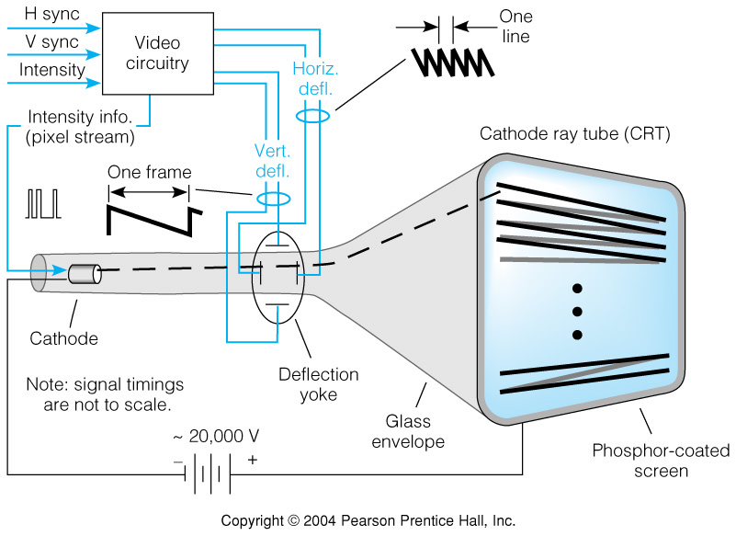
Fig 9.8 Schematic View of a Black-and-White Video Monitor

Slide 16
Two Video Display Types: Terminal & Memory Mapped
Video monitor can be packaged with display memory and keyboard to form a terminal
Video monitor can be driven from display memory that is memory mapped
Video display terminals are usually character oriented devices
  Low bandwidth connection to the computer
Memory mapped displays can show pictures and motion
  High bandwidth connection to memory bus allows fast changes

Slide 17
Fig 9.9 a) The Video Display Terminal
(Character-oriented, not often seen)

Slide 18
Fig 9.9 b) Memory Mapped Video Display
(Pixel-oriented)

Slide 19
Memory Representations of Displayed Information
Bit mapped displays
  Each pixel represented by a memory datum
  Black & white displays can use a bit per pixel
  Gray scale or color needs several bits per pixel
Character oriented (alphanumeric) displays
  Only character codes stored in memory
  Character code converted to pixels by a character ROM
  A character generates several successive pixels on several successive lines

Slide 20
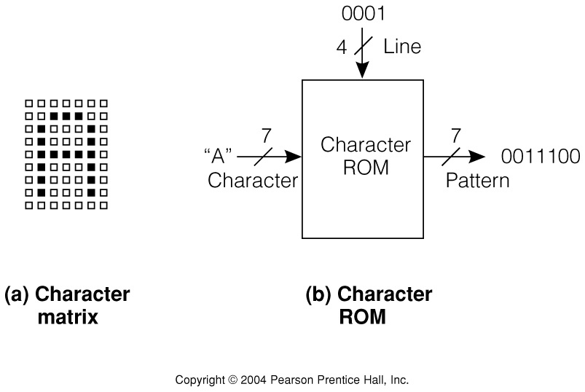
Fig 9.10 Character ROM for 5×7 Character in a 7×9 Field
Bits of a line are read out serially
Accessed 9 times at same horizontal position and successive vertical positions

Slide 21
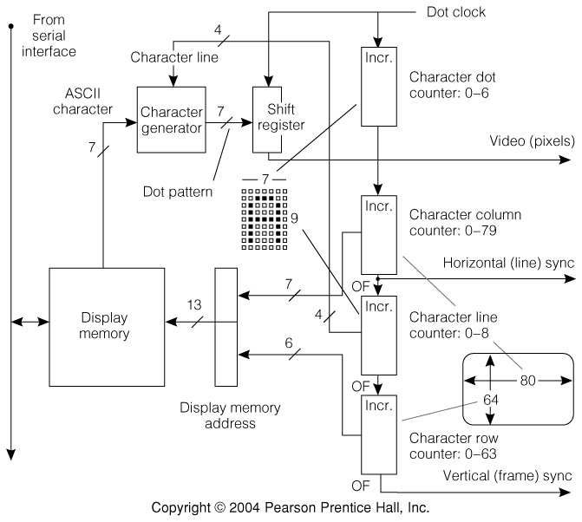
Fig 9.11 Video Controller for an Alphanumeric Display
Counters count the 7 dots in a char.,
the 80 characters across a screen,
the 9 lines in a character, and
the 67 rows of characters from top to bottom

Slide 22
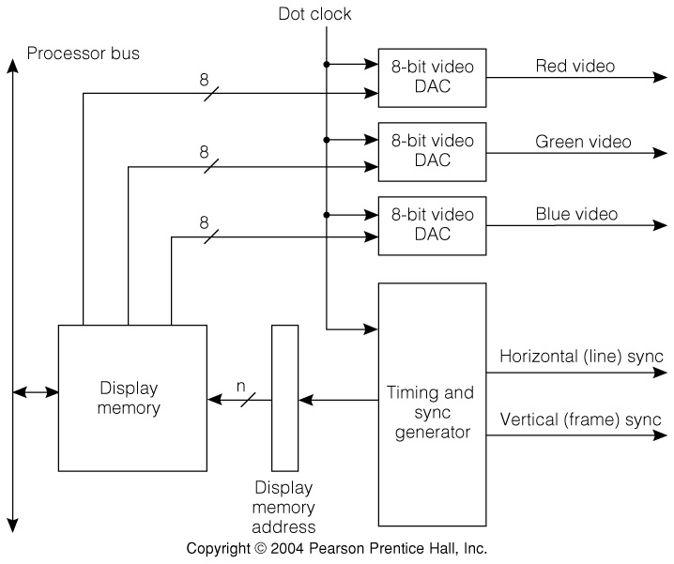
Fig 9.12 Memory-Mapped Video Controller for a 24-bit Color Display
Memory must store 24 bits per pixel for 256 level resolution
At 20M dots per sec. the memory bandwidth is very high
Place for video RAM

Slide 23
Flat Panel Displays
Allow electrical control over the transparency of a liquid crystal material sandwiched between glass plates, dot by dot
3 dots per pixel for color, one for black&white
Dots are scanned in a raster format, so controller similar to that for video monitor
Passive matrix has X & Y drive transistors at edges
Active matrix has one (or 3) transistor per dot

Slide 24
Printers—Ways of Getting Ink on Paper
Dot matrix printer:
  Row of solenoid actuated pins, could be height of char. matrix
  Inked ribbon struck by pin to mark paper
  Low resolution
Laser printer:
  Positively charged drum scanned by laser to discharge individual pixels
  Ink adheres to remaining positive surface portions
  300 to 1200 dots per inch resolution
Ink-jet printers:
  Ultrasonic transducer squirts very small jet of ink at correct pixels as head moves across paper
  Intermediate between the 2 in price and resolution

Slide 25
Fig 9.13 Character Generation in Dot Matrix Printers
Can print a column at a time from a character ROM
ROM is read out parallel by column instead of serial by row, as in alphanumeric video displays

Slide 26
Manual Input Input Devices—Keyboards and Mice
Very slow input rates
10 characters of 8 bits per sec. on keyboard
Mouse tracking somewhat faster: few X & Y position change bits per millisecond
Mouse click: bit per 1/10 second
Main thrust in manual input design is to reduce number of moving parts

Slide 27
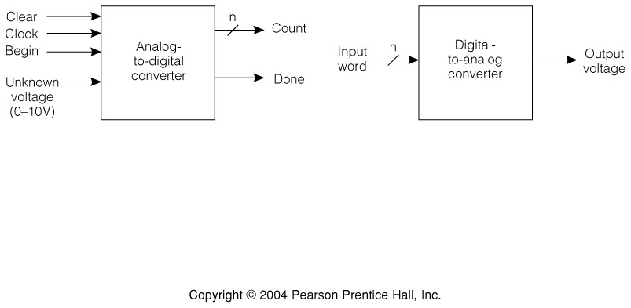
Fig 9.14 ADC and DAC Interfaces
Begin and Done synchronize A to D conversion, which can take several clock cycles
D to A conversion is usually fast in comparison

Slide 28
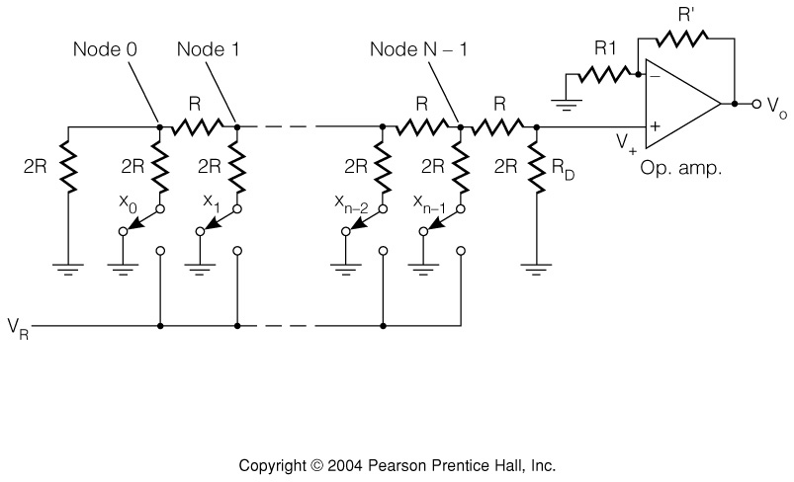
Fig 9.15 R-2R Ladder DAC—Voltage Out Proportional to Binary Number x
1
1
1
V₀ = ( x_{n-1} +
x_{n-2} +
x_{n-3} + … +
x₀ ) kV_{R}
2
4
2^{n-1}

Slide 29
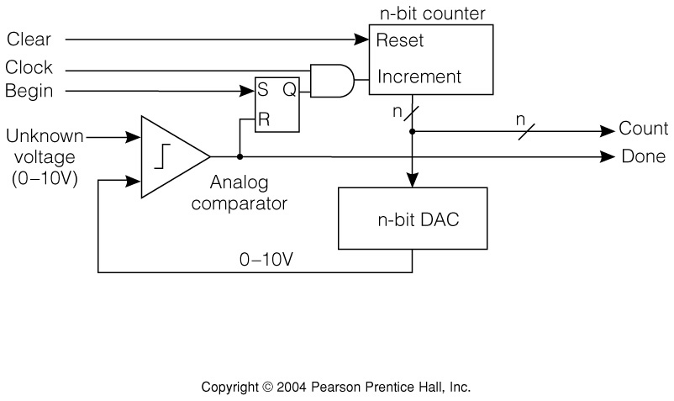
Fig 9.16 Counting Analog-to-Digital Converter
Counter increments until DAC output becomes just greater than unknown input
Conversion time ∝ 2^{n} for an n-bit converter

Slide 30
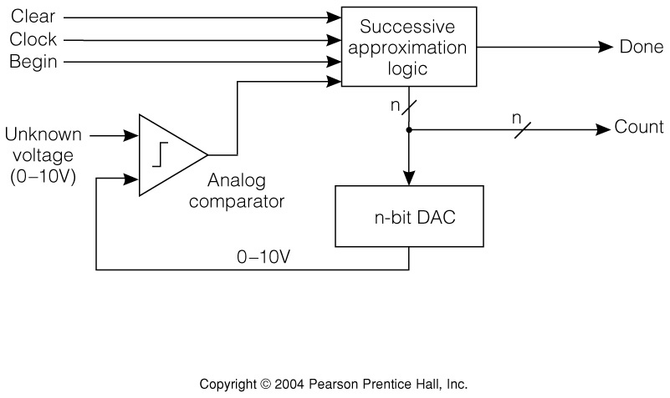
Fig 9.17 Successive-Approximation ADC
Successive approximation logic uses binary chopping method to get n bit result in n steps

Slide 31
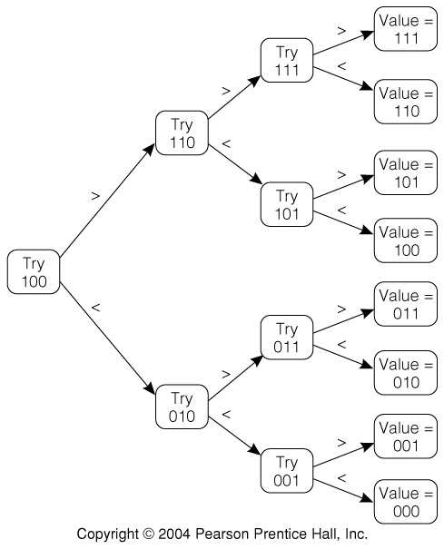
Fig 9.18 Successive Approximation Search Tree
Each trial determines one bit of result
Trial also determines next comparison level
For specific input, one path from root to leaf in binary tree is traced
Conversion time ∝ n for an n-bit converter

Slide 32
Errors in ADC and DAC
Full scale error: voltage produced by all 1’s input in DAC or voltage producing all 1’s in ADC
Offset error: DAC output voltage with all 0’s input
Missing codes: digital values that are never produced by an ADC (skips over as voltage increased)
Lack of monotonicity:DAC monotonicity means voltage always increases as value increases
Quantization error: always present in DAC or ADC as a theoretical result of conversion process

Slide 33
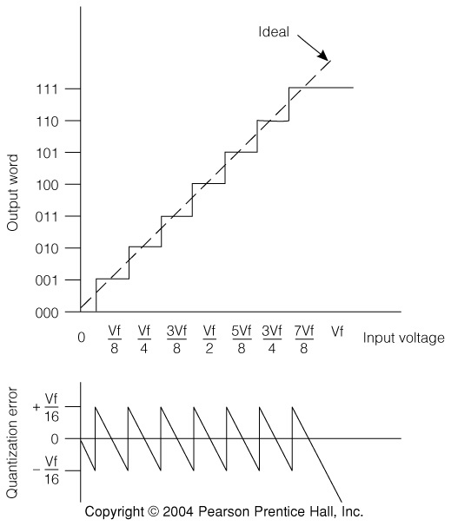
Fig 9.19 Signal Quantization and Quantization Error in an ADC
Ideal output of the ADC for a linearly increasing input
Error signal corresponding to the ideal ADC output
Quantization error = ±Vf/2^{n+1}

Slide 34
Chapter 9 Recap
Structure and characteristics of moving magnetic media storage, especially disks
Display devices:
  Analog monitor characteristics
  Video display terminals
  Memory mapped video displays
Printers: dot matrix, laser, & ink jet
Manual input devices: keyboards & mice
Digital to analog and analog to digital conversion

