Slide 1
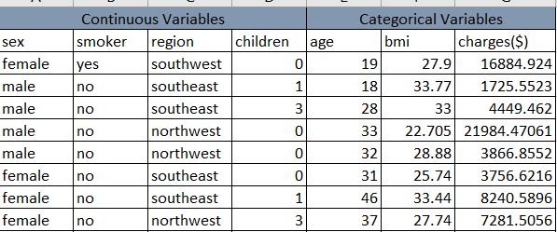
1. a) Identify the categorical and continuous variables ?
In this data the continuous variables are:
Smoker
Sex
Region
Children
→Then , Categorical Variables are:
Age
Bmi
Charges

Slide 2
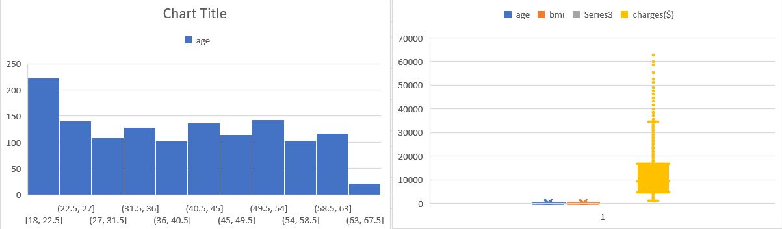
b) Make Histograms and box plots (univariate analysis) for continuous variables and do a correlation analysis (multivariate analysis)

Slide 3
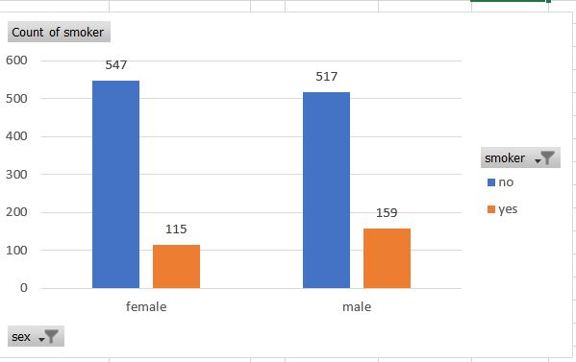
1. c) Make relevant Pivot tables and charts for: I . Male/Female ratio and share information on which gender has more smokers ?
According to this data female has the more smoking habits.

Slide 4
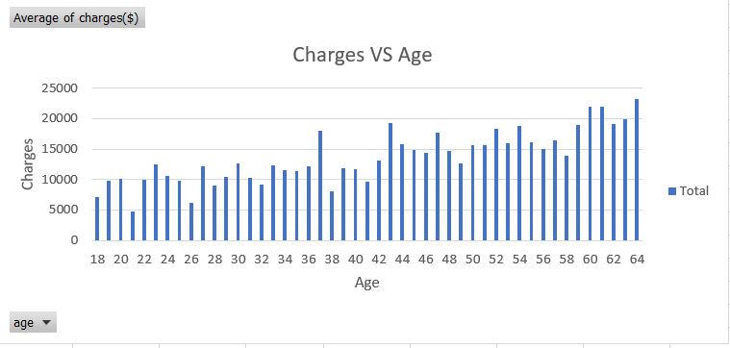
ii. Charges vs Age

Slide 5
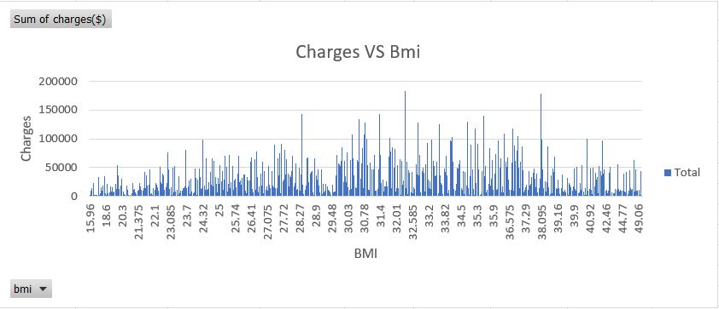
iii. Charges vs BMI

Slide 6
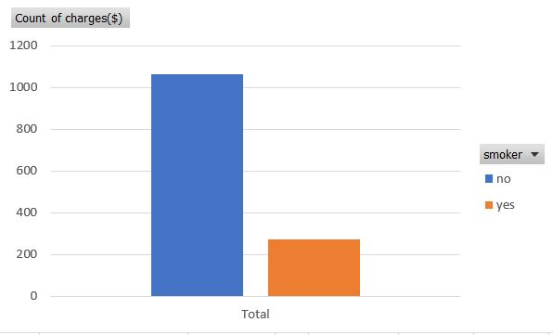
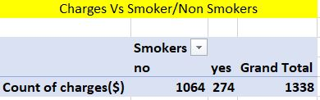
iv. Charges for Smokers vs Non-smokers

Slide 7
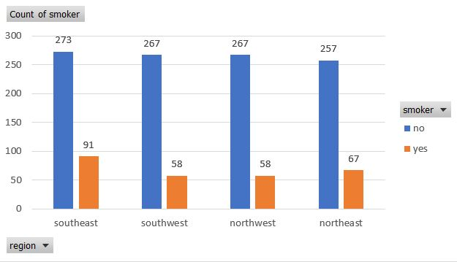
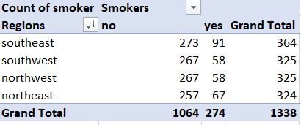
d) Region-wise smokers vs Non-smokers analysis with one or more pivot table and charts

Slide 8
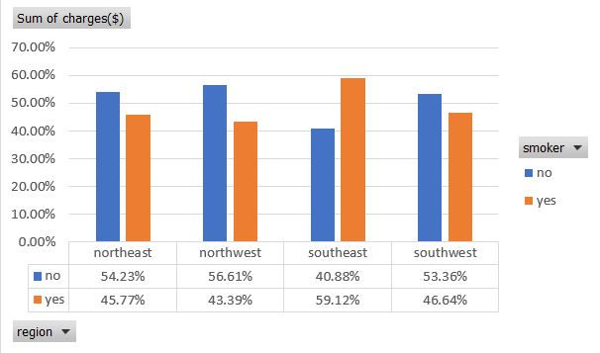
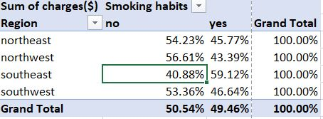
e) Region-wise charges for smokers vs non-smokers

Slide 9
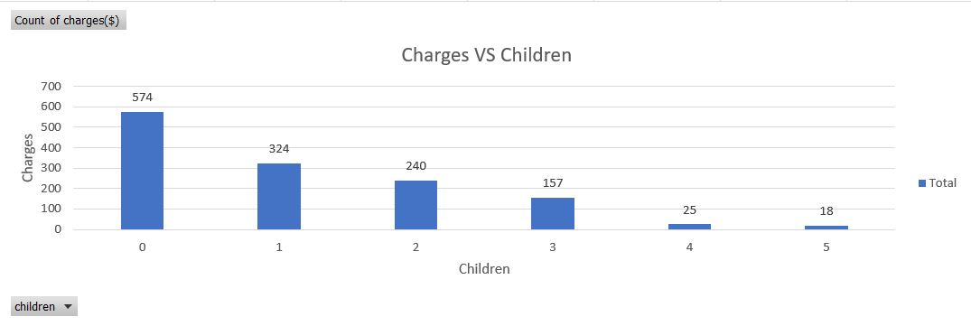
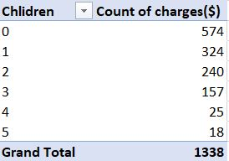
This data tells about How all are claimed the insurances charges for number of childrens.
f) Has charges got something to do with the number of dependents ?

Slide 10
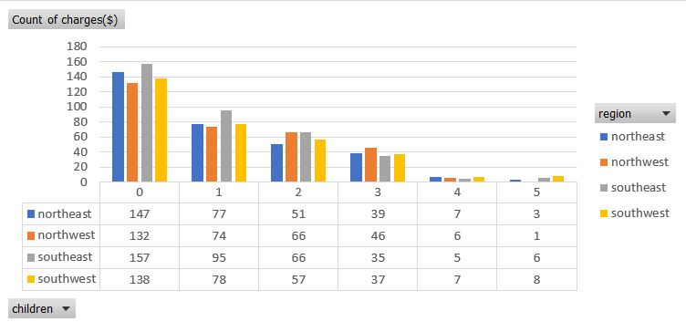
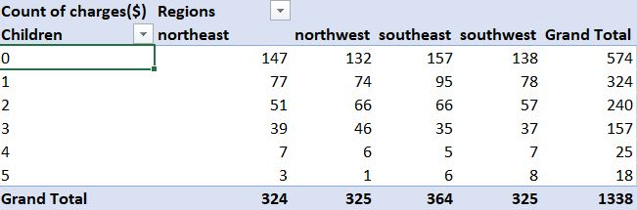
g) Do a similar dependents-charges analysis, Region-wise?
Previous charts represents How all are claimed the insurances charges for number of Childrens.
In this charts its shows region wise how all are claimed the insurances.

Slide 11
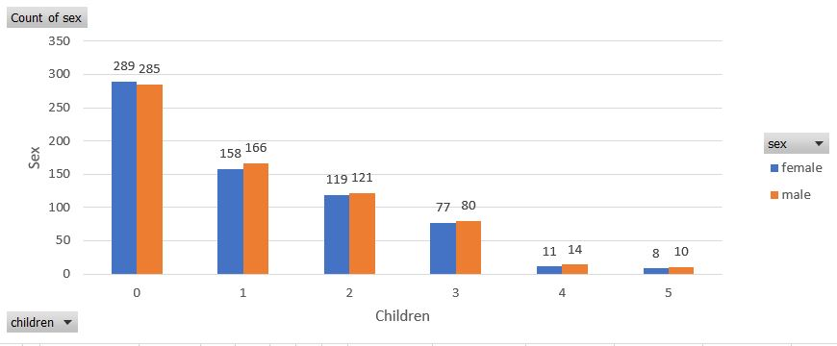
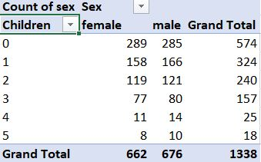
h) Do at least one more pivot table and chart of your own choice on the remaining variables
I took children and sex data's because I want to known how many males and females in the dataset.

Slide 12
j) Give your interpretation for observations made in point (c)
In Gender Vs Smoker :
→Female has the more smoking habits.
In Charges Vs Age :
→I took charges as average in pivot table ,whoever in age 21 they has charges less and highest charges collected in age 64.
In Charges Vs Bmi :
→Based on health they have the charges and they claimed insurances.
In Charges Vs Smoker :
→I took charges as count in pivot table , based on that Non smoker count is 1064 and Smoker count is 274.

Slide 13
2. Edit the data as following, to obtain dummy variables: a) Sex : Replace all the “Males” with “1” and “Females” with “0”
So, I took male as “1” and females as “0”.
I'm used find & replace method , first select the Sex column.
Then , Ctrl+F, in find box , put male and in replace box put 1 click ok it will change. Same process for female also but in replace box put 0.
b) Smoker: Replace all the “Smokers” with “1” and “Non-smokers” with “0”.
Same process to follow for this question also.
Click Ctrl+F, in find box , put Smokers and in replace box put 1 click ok it will change. Same process for non Smokers also but in replace box put 0.

Slide 14
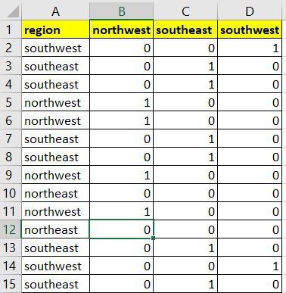
c) Region: We always create one less category column for the dummy data w.r.t the categories available for that original variable. So for Region, we will create three dummy columns, assuming “Northeast” as zero and omit the column for it. Now create three columns for “northwest”, “Southeast”, “Southwest”. Whichever row has “northwest” region as an entry will take “1” as an entry otherwise “0” in “northwest” column. Similarly in the “Southeast” column, whichever row had “southeast” as an entry will take “1” as the new entry and “0” for the rest of the column (Southeast).
In this I'm using if condition , formula is if(b$1=a2,1,0).
Based on region and column wise the formula will change.

Slide 15
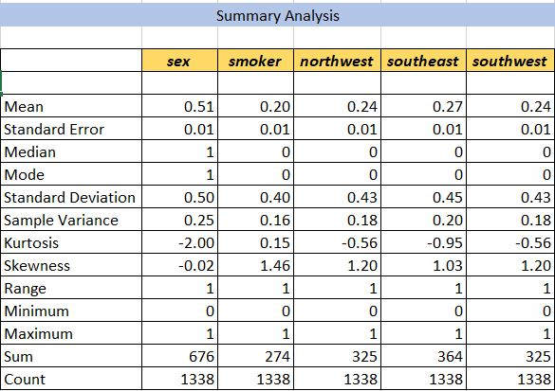
3. Do a descriptive summary analysis for the edited data.
I did the analysis in that Mean of sex is 0.51, Smoker 0.20,Northwest 0.24,Southeast 0.27 and Southwest 0.24.

Slide 16
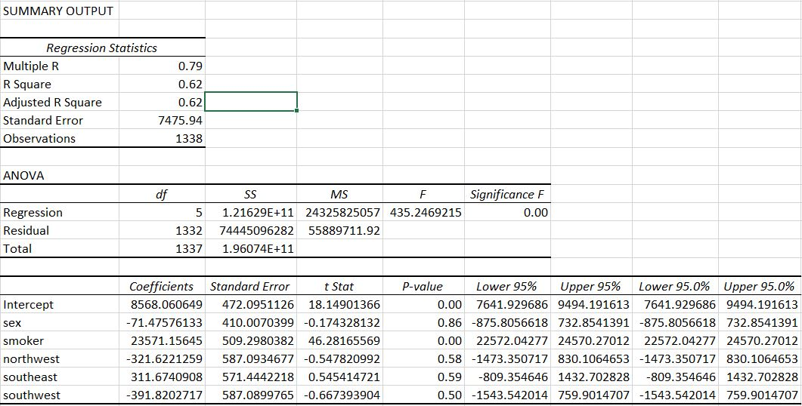
3. b) Perform a Multiple Linear Regression analysis to identify which variables decide the insurance charges/billed insurance claim.
It has R Square is 0.62 in multi linear regression.
Smoker is significant which is p value is less than 0.05 other variables are not significant.

