Slide 1
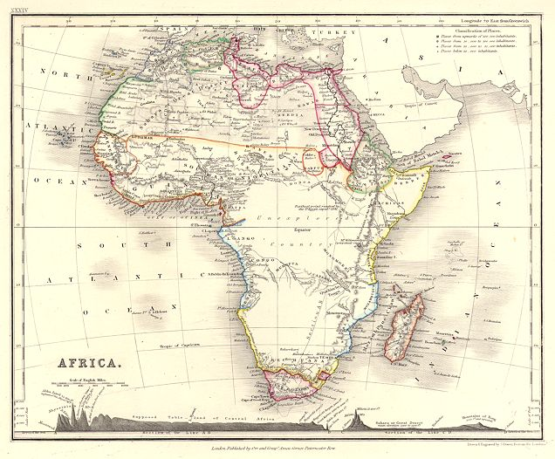
Into
Africa
a
Ishughun and Mark’s Trip to the Dark Continent

Slide 2
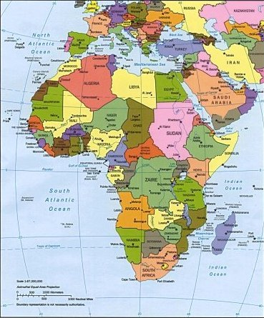
Africa
Nigeria

Slide 3
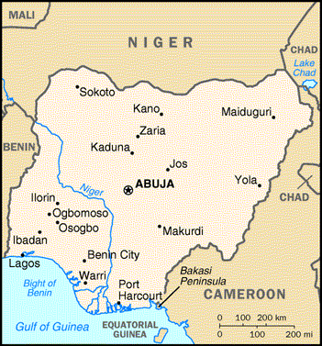
Nigeria

Slide 4
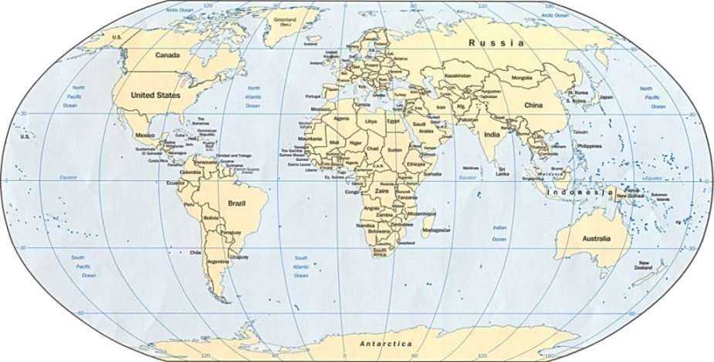
Day One:
Tuesday, December 7, 1999
Chicago to London (Heathrow)

Slide 5
Day Two:
Wednesday, December 8, 1999
London (Gatwick) to Lagos

Slide 6
Day Three:
Thursday, December 9, 1999
Fly from Lagos to Jos
Nigeria

Slide 7
Day Four:
Friday, December 10, 1999
Drive from Jos to Makurdi…
…where we spend the
weekend with the
extended Orkar
family and have
a reunion of sorts.
Nigeria

Slide 8
Day Seven:
Monday, December 13, 1999
Drive from Makurdi to Jos …
…where we’ll visit for
a couple days with friends
of the family and see the
sites around Jos.
Nigeria

Slide 9
Day Ten:
Thursday, December 16, 1999
Drive from Jos to Abuja
Nigeria

Slide 10
Day Eleven:
Friday, December 17, 1999
Fly from Abuja to Lagos
Nigeria

Slide 11
Day Eleven:
Friday, December 17, 1999
Lagos to London (Gatwick)

Slide 12
Day Twelve:
Saturday, December 18, 1999
London (Heathrow) to Chicago

