Slide 1

Influence of Kuroshio Current Transport on Tropical Cyclone Intensity in the East China Sea
Dept. of Convergence Study on the Ocean Science and Technology
Gunwoo Do, Hyeong-Seog Kim
Notes:
Hello, I am Gunwoo Do from Korea Maritime and Ocean University.
My talk is "Influence of Kuroshio Current Transport on Tropical Cyclone Intensity in the East China Sea.“
I would like to let you know that the title has been little changed. I apologize about that and I appreciate your understanding.

Slide 2
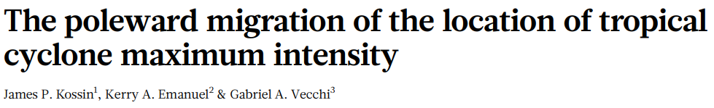
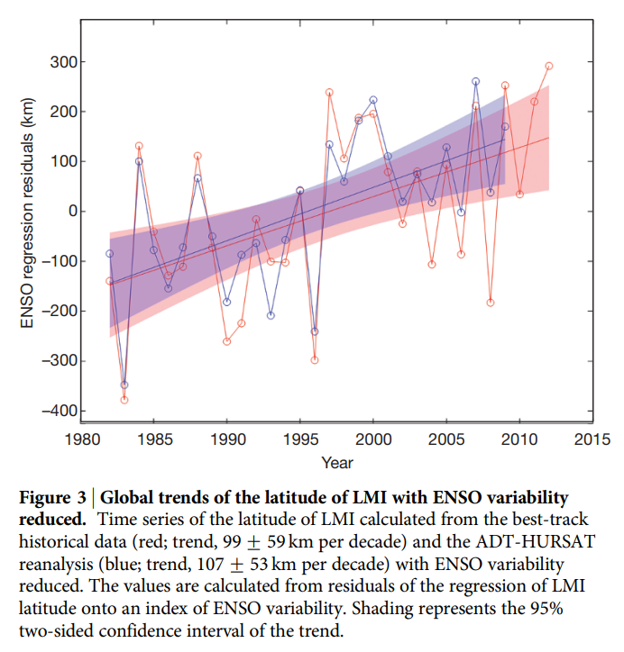
1. Motivation
83
LMI poleward migration rate
(NHEM)
(Kossin et al., 2014)
km/decade
$1.5B
Typhoon Hinnamnor (2022)
POSCO Pohang steel mill flooded
USD loss
19.7
Tropical Cyclone (TC) exposure shift northward in China (2006-2020)
(Qin et al., 2024)
km/yr
IPCC AR6
~ their peak intensity has shifted northward. these changes cannot be explained by internal variability alone
Notes:
Many studies have reported that tropical cyclone activity has been moving poleward in recent years. especially, Kossin et al. 2014 found that the latitude of lifetime maximum intensity in the Northern Hemisphere has been moving poleward at a rate of 83 km per decade.
The IPCC report said that these trends cannot be explained by internal variability alone.
So, the importance of tropical cyclone research in the mid-latitude region is getting bigger.

Slide 3
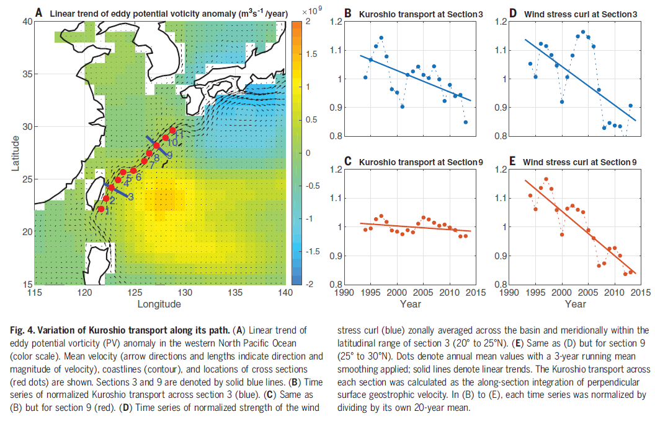
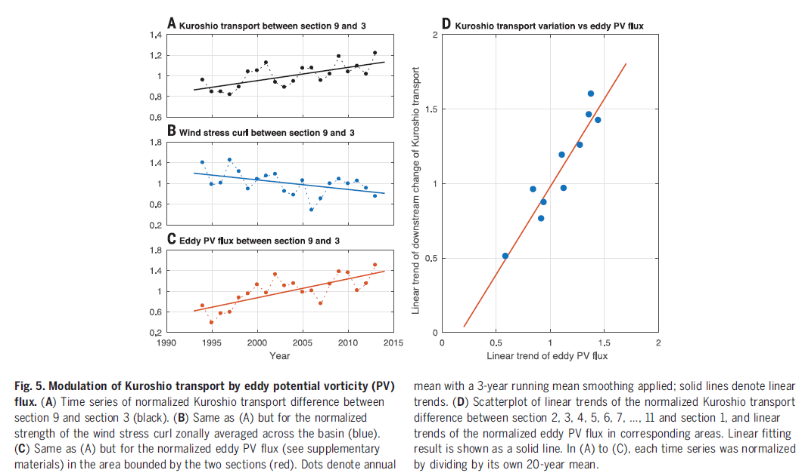
2. Literature Review
Role of Kuroshio Current & TC
Zhang et al., (2020): As the western boundary current of the North Pacific Ocean, the Kuroshio serves as a conduit for transporting warm water northward from its equatorial source region, thus playing a crucial role in modulating the ocean and climate in mid to high latitudes [1,2].
H.Bryden, S. Imawaki, Ocean Circulation and Climate, G. Siedler, J. Church, J. Gould, Eds. (Academic Press, 2001), pp.455–474.
Y.-O. Kwon et al., J.Clim. 23, 3249–3281
Eddy potential vorticity generated by TCs can increase Kuroshio Current (KC) transport
Notes:
Zhang et al. 2020 said that the Kuroshio Current plays an important role in transporting heat from low latitudes to high latitudes.
Tropical cyclones also move heat energy from low latitudes to high latitudes, just like the Kuroshio Current.
Zhang et al. said that Eddy PV from tropical cyclones has been increasing in figure C, and this is what drives the increase in Kuroshio transport.
By the way, it has been hard to find studies that looked at the effect of Kuroshio Current transport on tropical cyclone intensity, which is the opposite direction from previous studies.
So, In this study, we investigated the effect of Kuroshio Current transport on tropical cyclone intensity unlike previous studies.

Slide 4
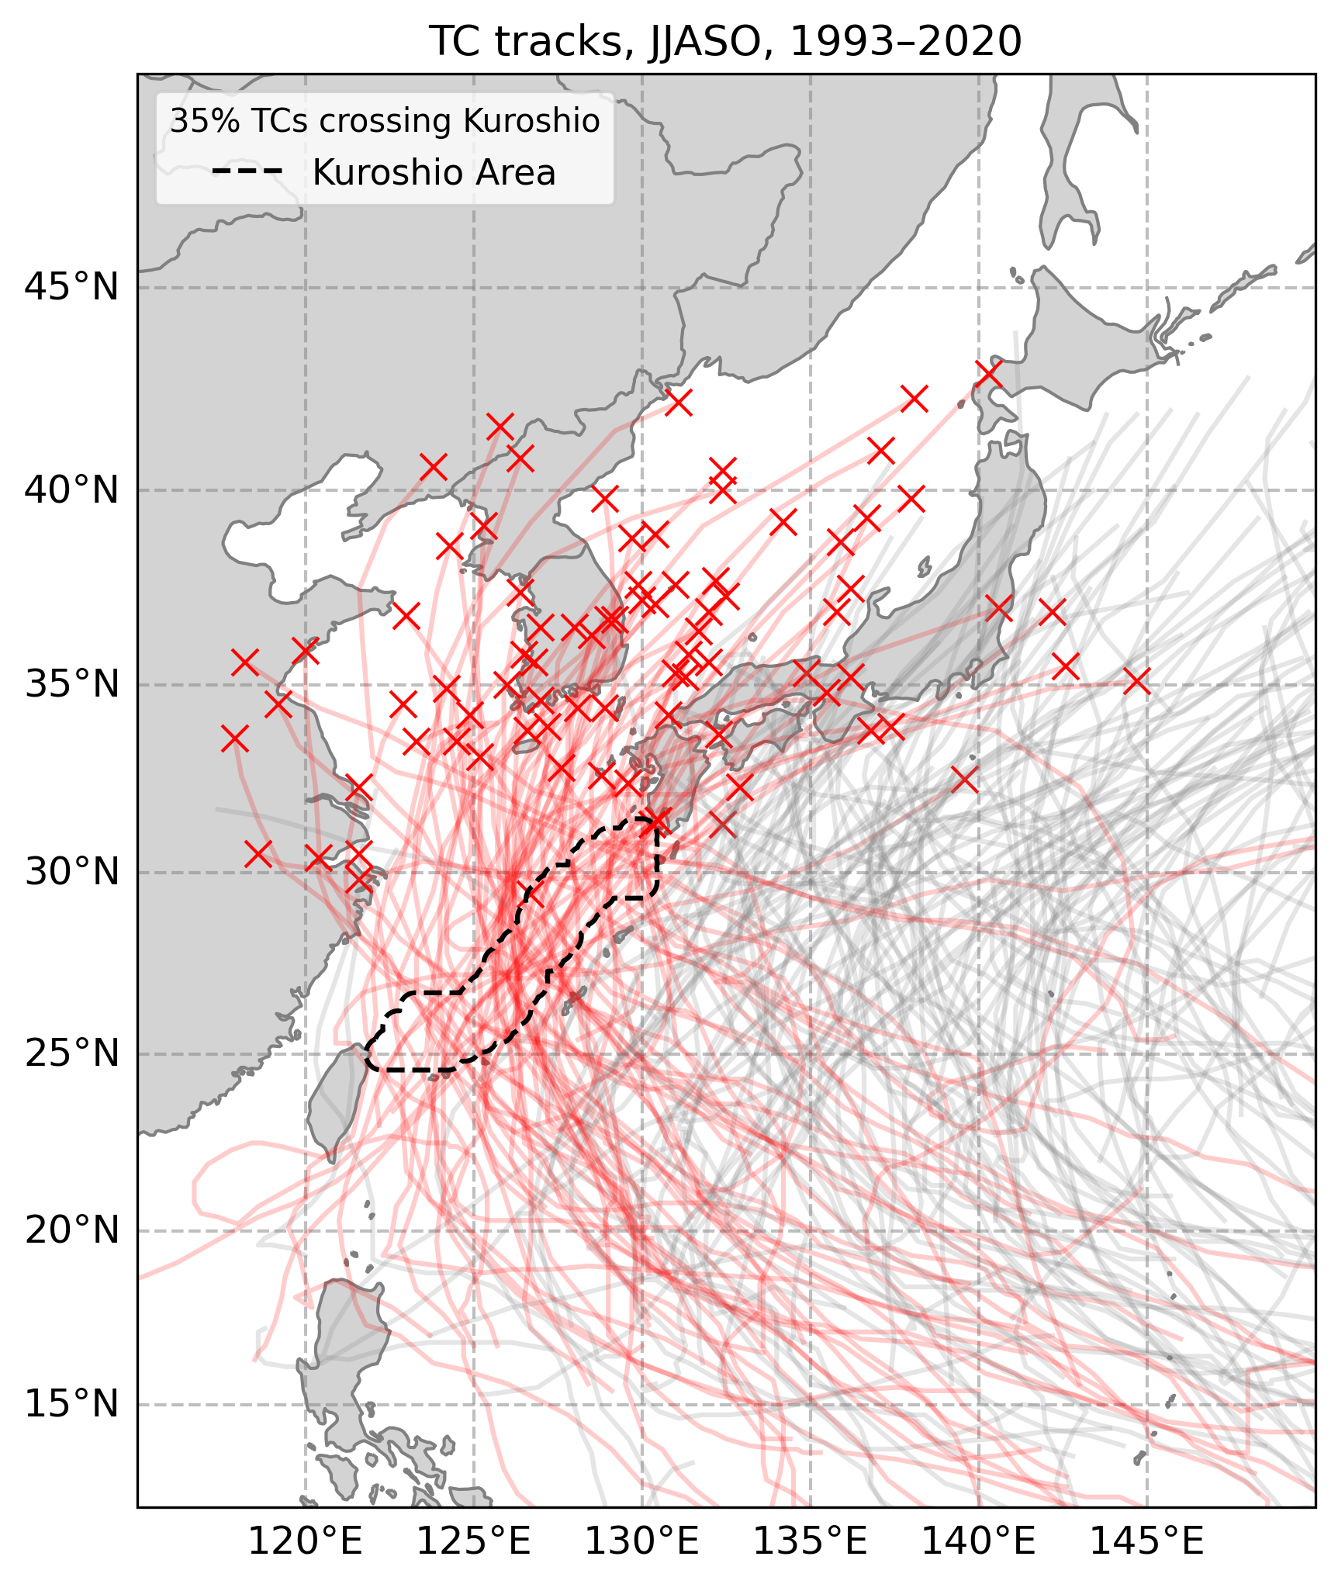
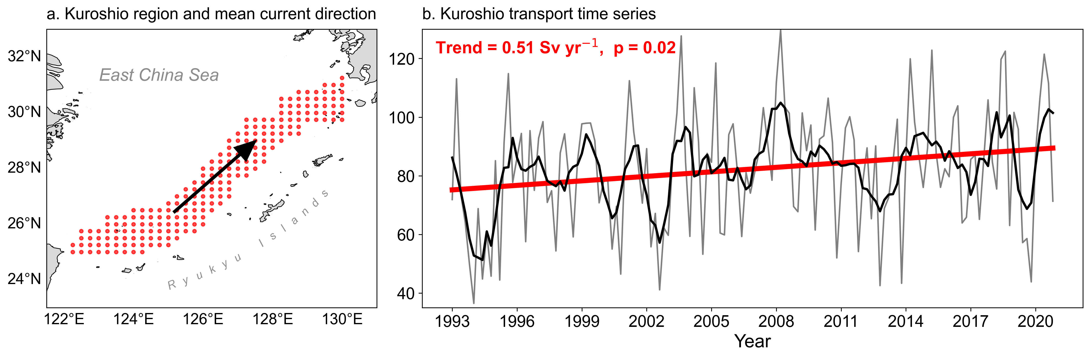
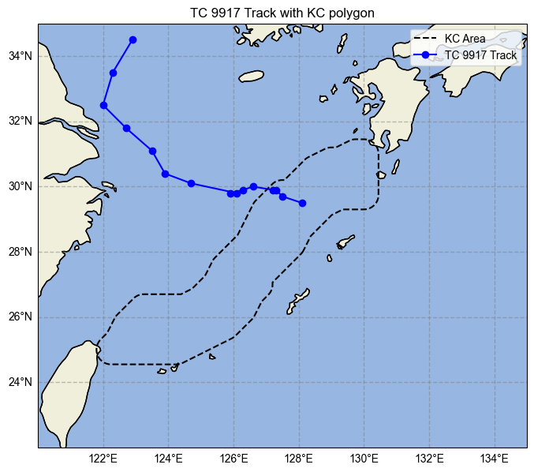
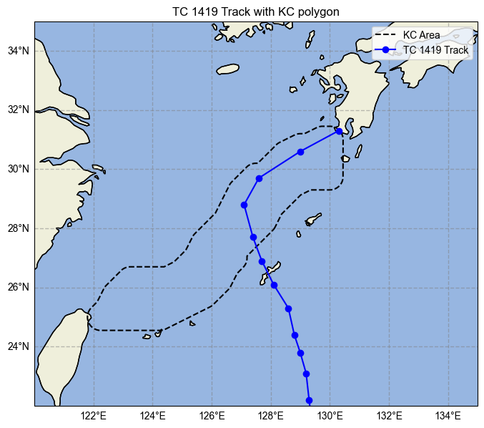
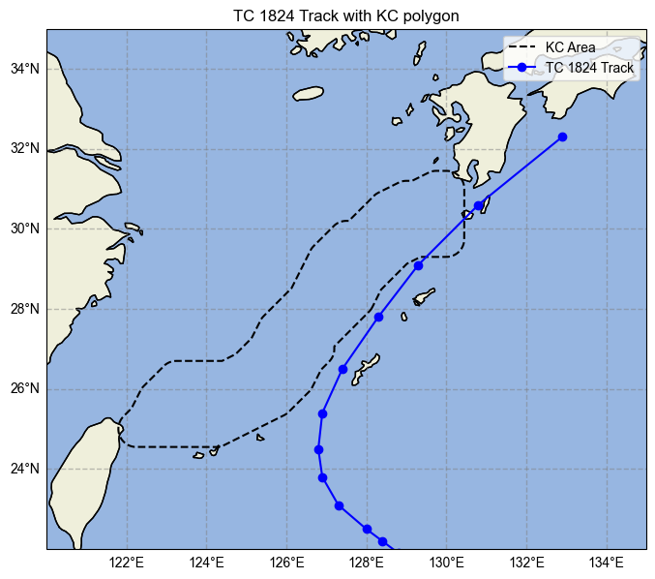


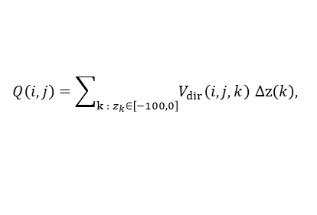

3. Data & Method
TC Best-Track
Total WNP TCs over TS grade (Jun-Oct)
237
RSMC Tokyo (JMA)
▼
6-hourly data during June-October 1993-2020
Crossing Kuroshio region
83
▼
Ocean Reanalysis
Elimination
15
GLORYS12V1 (Copernicus)
Monthly, 1/12° grid, 50 levels, June-October, 1993-2020
▼
After quality screening
68
▼
Atmospheric Reanalysis
TC in High Transport (HT)
31
ERA5 (ECMWF)
June-October 1993-2020, 0.25° grid
▼
TC in Low Transport (LT)
37
Transport Calculation
$$V_{\text{dir}}\left(i,j,k\right)=\overline{u}\left(i,j,k\right)cos{θ}+\overline{v}\left(i,j,k\right)sin{θ,}$$
$$Q\left(i,j\right)=\sum_{k : z_{k}∈\left[−100,0\right]}{V_{dir}\left(i,j,k\right)} Δz\left(k\right),$$
$$W\left(i,j\right)=\sqrt{{\left(Δx_{grid}\left(i,j\right)\right)}^{2}+{\left(Δy_{grid}\left(i,j\right)\right)}^{2}},$$
∴
$$T\left(i,j\right)=Q\left(i,j\right)×W\left(i,j\right).$$
Pan et al., (2013), Zhang et al., (2024)
Notes:
We used data shown upper-left.
Kuroshio Current transport was calculated as shown in the bottom left.
The Kuroshio Current region was selected using grid points with current speeds at or above the 85th percentile of monthly ocean current data, which can well capture the Kuroshio Current. Sensitivity tests from the 80th to 90th percentile showed that the results were not strongly affected by the threshold.
Out of 237 tropical cyclones above TS grade, 83 passed through the Kuroshio region. Among these, we removed cases where track data did not exist before or after crossing the Kuroshio, where the tropical cyclone made landfall right after crossing, or where it did not pass through the central axis of the Kuroshio Current. As a result, 68 tropical cyclones were selected.
We divided the tropical cyclones into two groups based on the median of Kuroshio transport anomaly. The group with higher transport was defined as HT and the group with lower transport was defined as LT.
31 tropical cyclones were assigned to the HT group and 37 to the LT group.

Slide 5
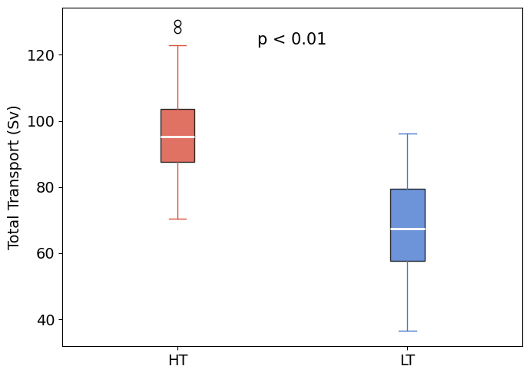
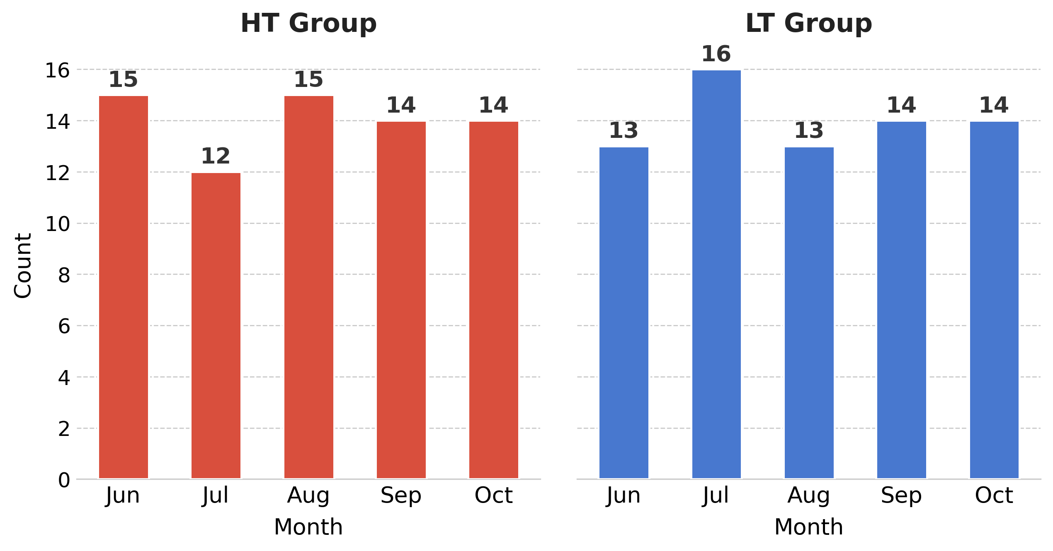
4. Results: monthly KC transport and distribution
Kuroshio transport time series
Box plots of KC transport for the HT and LT
Monthly distribution of HT and LT months in the KC region
Key results
KC transport in summer has been increasing over time
HT, LT groups do not show a big difference in their monthly distribution
HT, LT groups show a significant difference in KC transport
June–October 1993–2020 (total = 140 months, n = 70 months per group)
Notes:
The top left figure shows the time series of Kuroshio Current transport in the Kuroshio region. The gray line shows the monthly raw data, the black line shows the one-year running mean, and the thick red line shows the trend. Kuroshio Current transport has been increasing at a rate of 0.51 Sverdrups per year, with a p-value of 0.02, showing a significant increasing trend.
The bottom left figure shows the monthly distribution of the HT and LT groups. The results show that each group is evenly distributed across the seasons.
The top right figure is a box plot comparing Kuroshio transport between the two groups. The two groups show a significant difference in Kuroshio Current transport.
So, Kuroshio Current transport has been increasing, and the two groups appear to be properly classified based on their transport values.

Slide 6
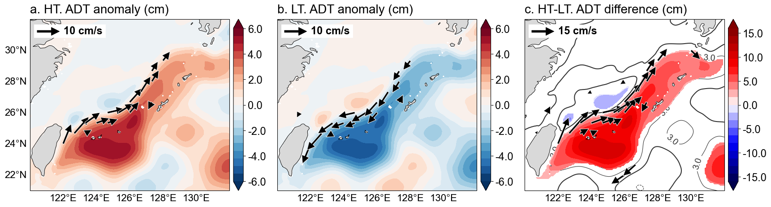
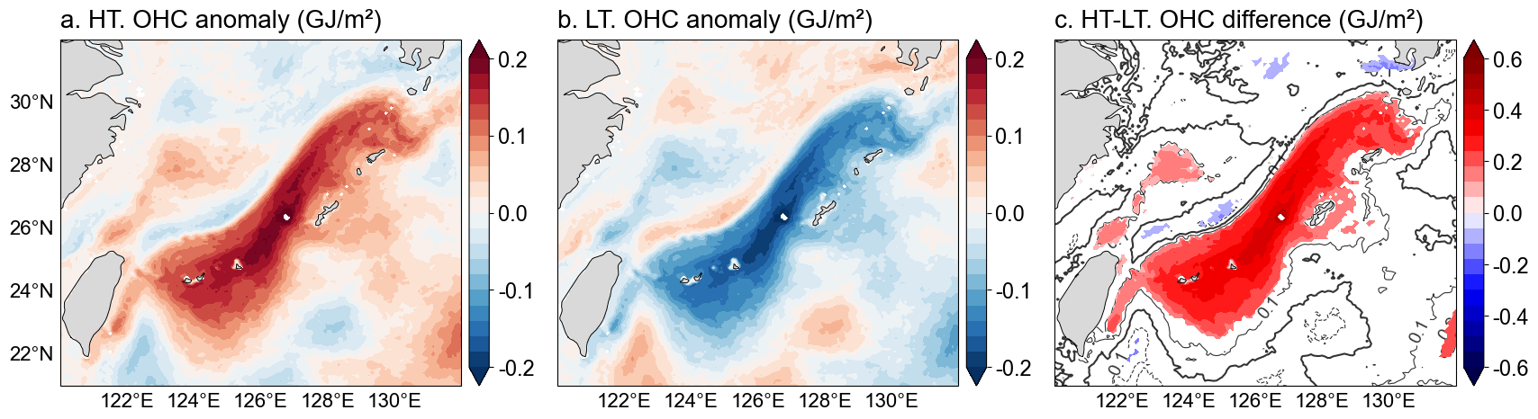
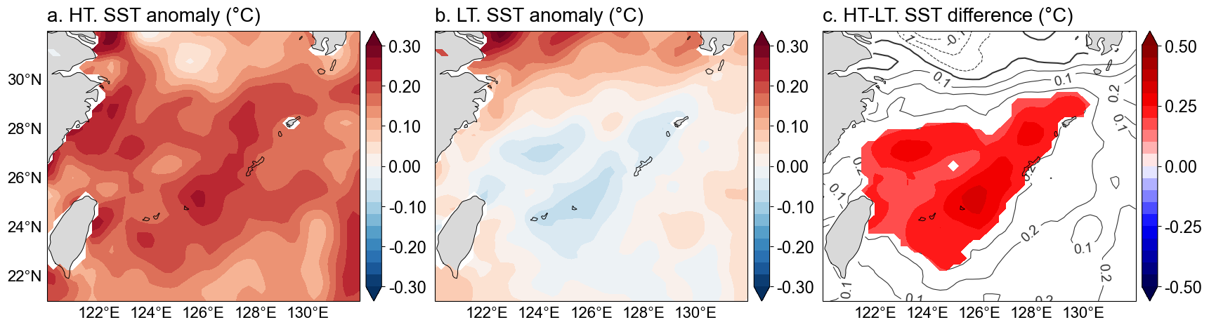
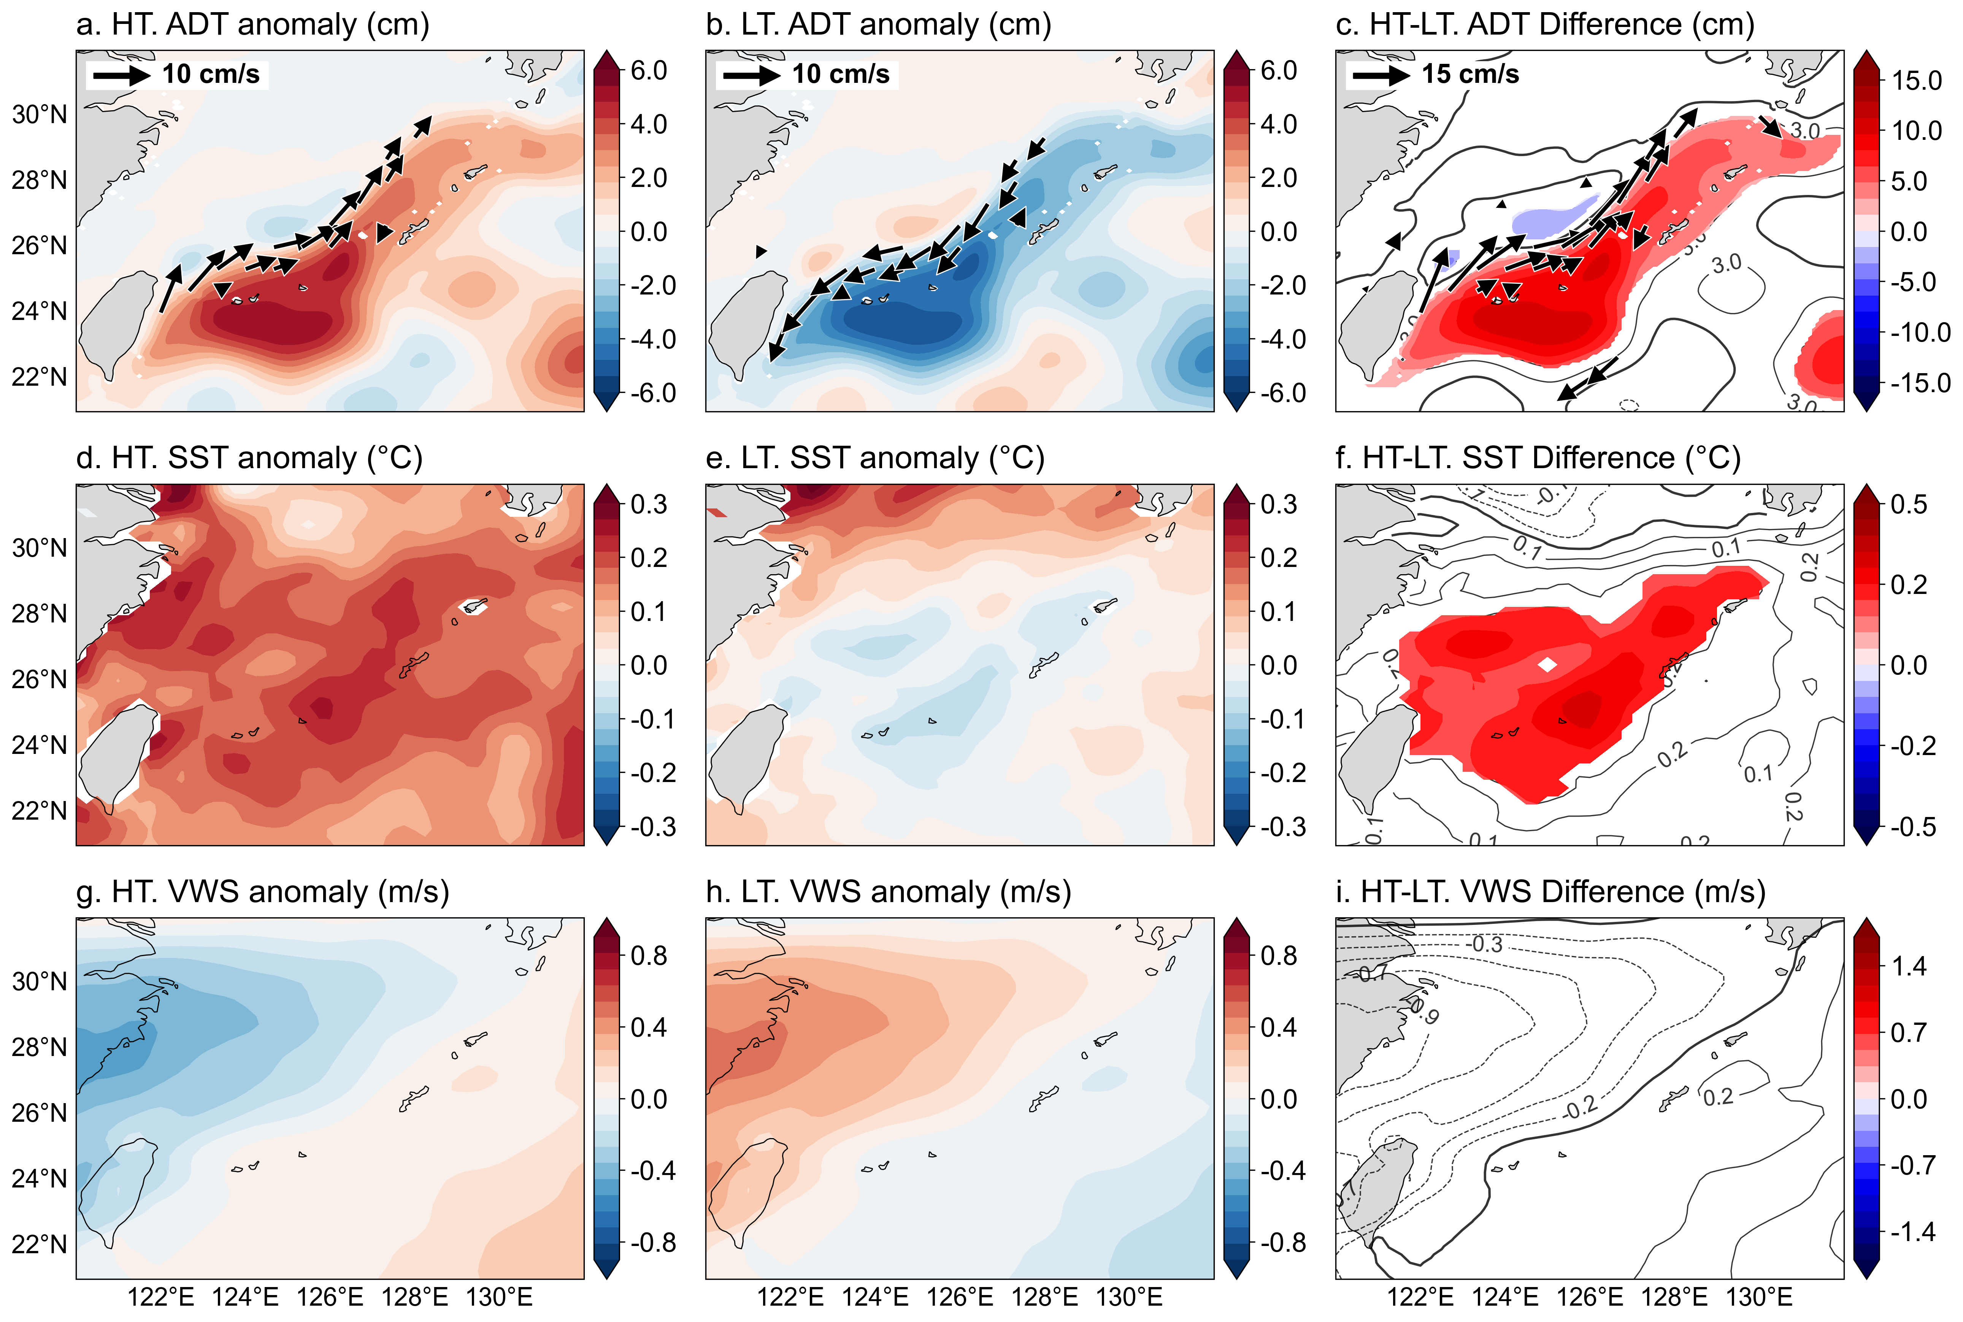
4. Results: monthly ADT, SST, OHC and VWS comparison by group
a. HT VWS anomaly (m/s)
b. HT VWS anomaly (m/s)
c. HT-LT VWS difference (m/s)
The HT group showed higher Absoulte Dynamic Topography (ADT), Sea Surface Temperature (SST), and Ocean Heat Content. Overall, ocean current and heat energy was higher in the HT group.
For Vertical Wind Shear (VWS), no significant difference was found between the HT and LT groups.
Notes:
The top left figures show Absolute Dynamic Topography. The left figure is the ADT for the HT group, the middle figure is for the LT group, and the right figure shows the difference between HT and LT.
In all figures, only significant vectors are shown. In the difference figure, only significant areas are shaded, with positive values shown as solid lines, zero as bold solid lines, and negative values as dashed lines.
For ADT, the HT group showed significantly higher ADT than the LT group in the Kuroshio region by about +5.67 cm on average. Ocean current vectors in the direction of the Kuroshio Current also showed significantly faster speeds.
The bottom left figures show Sea Surface Temperature with same format. For SST, the HT group showed warmer SST in the Kuroshio region.
The top right figures show Ocean Heat Content. For OHC, the HT group showed higher values in the Kuroshio region.
The bottom right figures show Vertical Wind Shear. VWS was calculated as the wind speed difference between 200 hPa and 850 hPa. For VWS, no significant difference was found between the two groups.
In summary, the HT group showed generally higher heat energy in the Kuroshio region. VWS, which is a key atmospheric factor affecting tropical cyclone intensity in the mid-latitude region, showed no siginificant difference between the two groups. Therefore, we can more independently evaluate the effect of Kuroshio transport by limited influence of VWS.

Slide 7
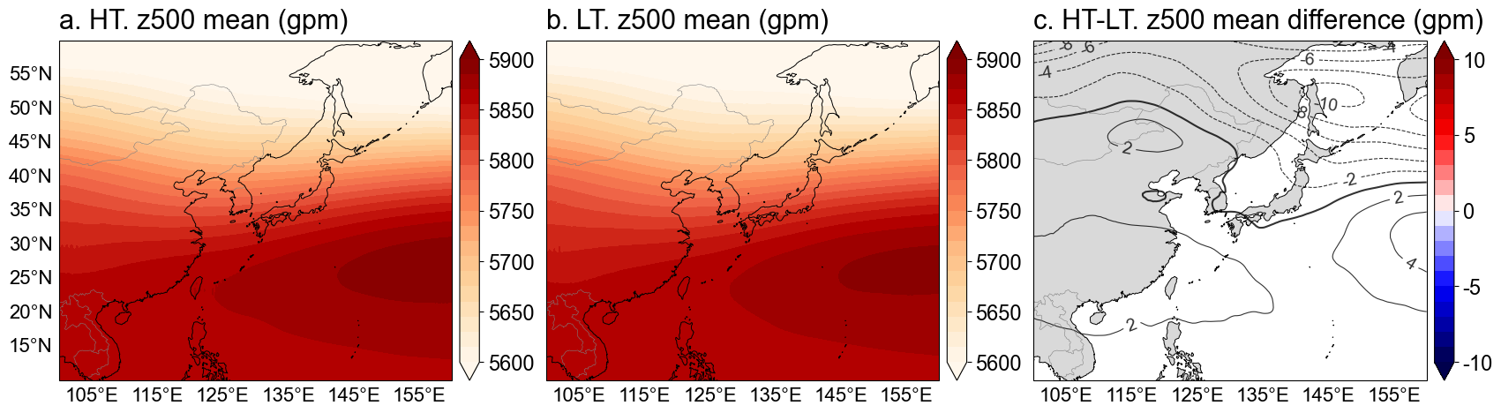
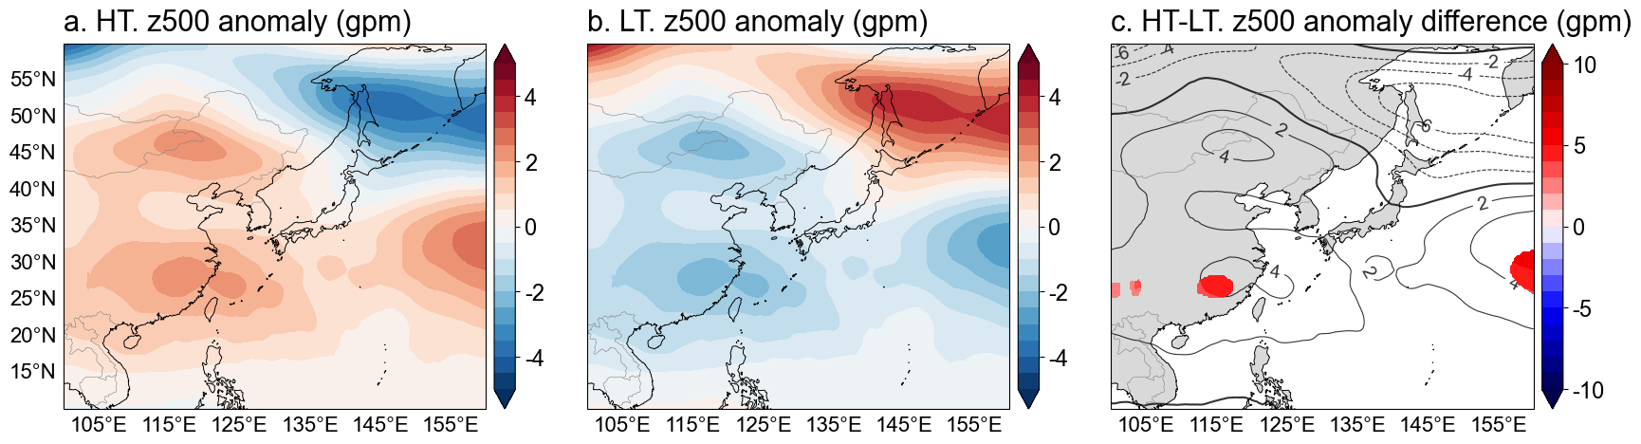
4. Results: monthly z500 mean and anomaly
z500 mean
z500 anomaly
No significant difference in subtropical high pressure by group
It is possible to evaluate the effect of upper-level KC transport more independently.
Notes:
We also compared the 500 hPa geopotential height across groups. The first row shows the mean field, and the second row shows the anomaly field.
No significant differences were found between the two groups. Therefore, similar to the VWS results, we believe this further supports that the effect of Kuroshio Current transport can be more clearly identified.

Slide 8
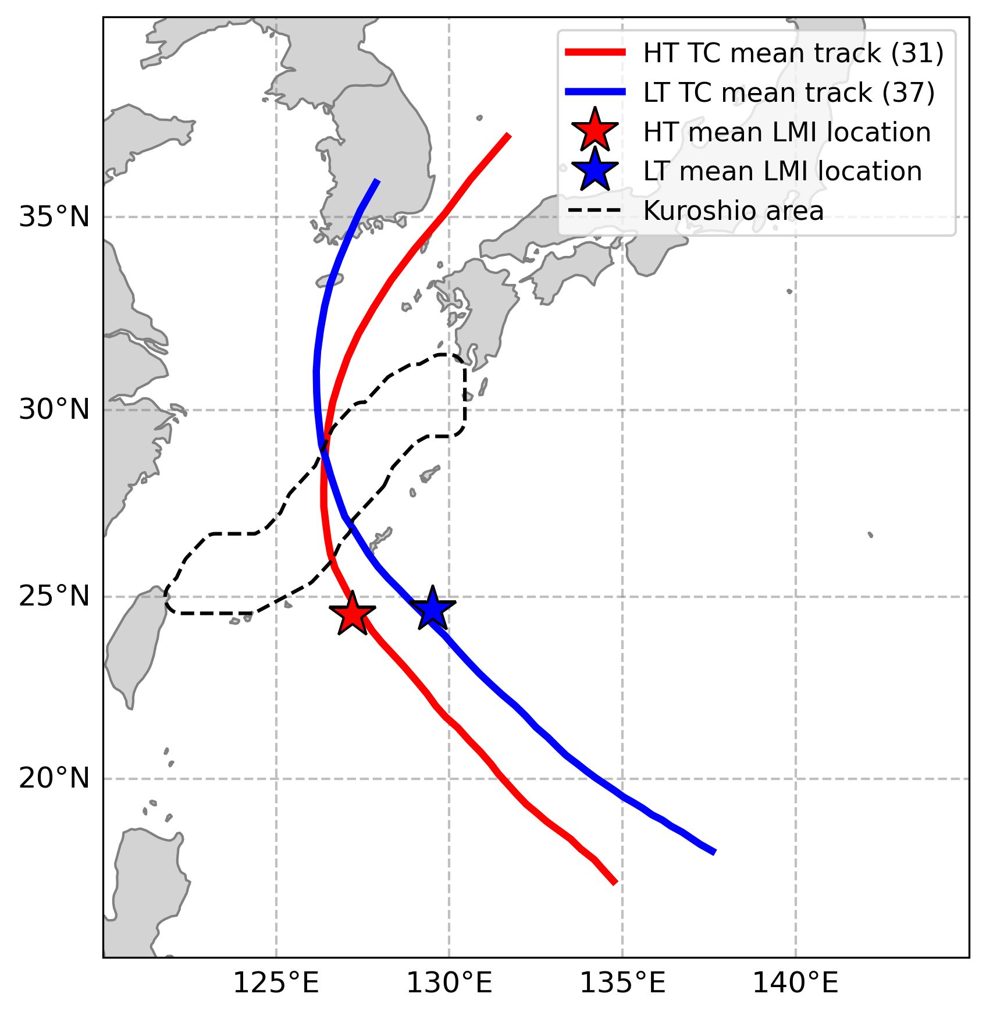
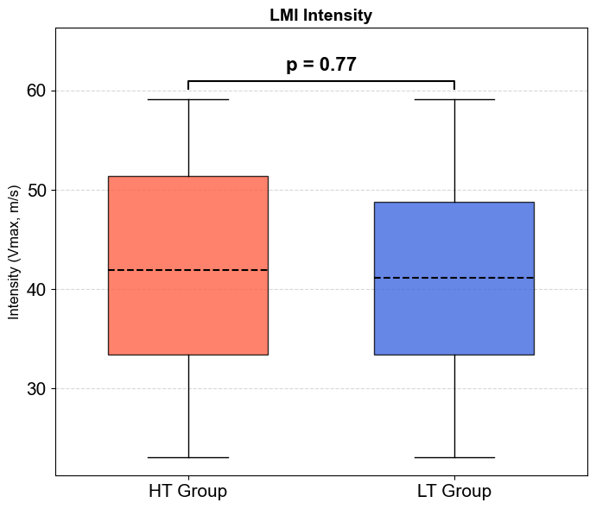
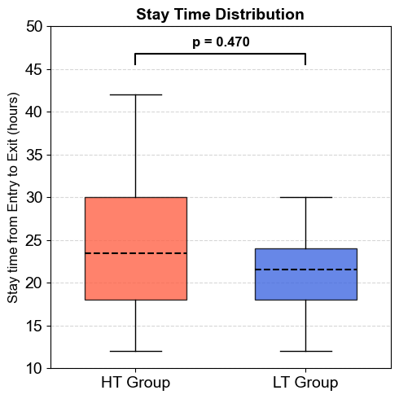
4. Results: TC tracks, LMI and stay duration by group
a. Mean TC tracks
b. Lifetime maximum intensity
c. Stay duration in Kuroshio region
The HT and LT groups showed similar TC genesis locations and Lifetime Maximum Intensity (LMI) latitudes.
The HT and LT groups showed no significant difference in LMI intensity, and the time spent crossing the KC was also not significantly different.
Notes:
The figure on the left shows the mean TC tracks of the HT and LT groups. HT is in red, and LT is in blue. The Kuroshio region is represented by a black dashed line, and the LMI location for each group is indicated by a star marker. The genesis and LMI latitudes of the two groups appear similar.
The center figure is a box plot of LMI for the two groups. It was found that there was no significant difference in LMI between the two groups.
The figure on the right is a box plot showing the time taken for the two groups to pass through the Kuroshio region. There was no significant difference in pass through the Kuroshio region.
So, there was no significant difference in the LMI between the two groups, and the time taken to pass through the current was also similar. This result provides a basis for assessing the influence of the Kuroshio Current's transport on TC intensity more independently.

Slide 9
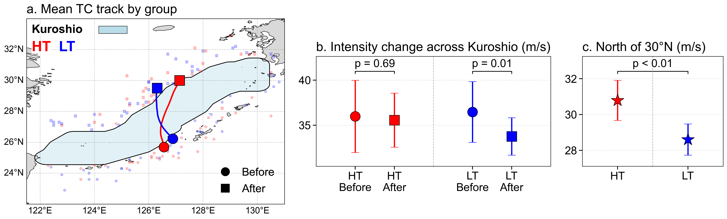
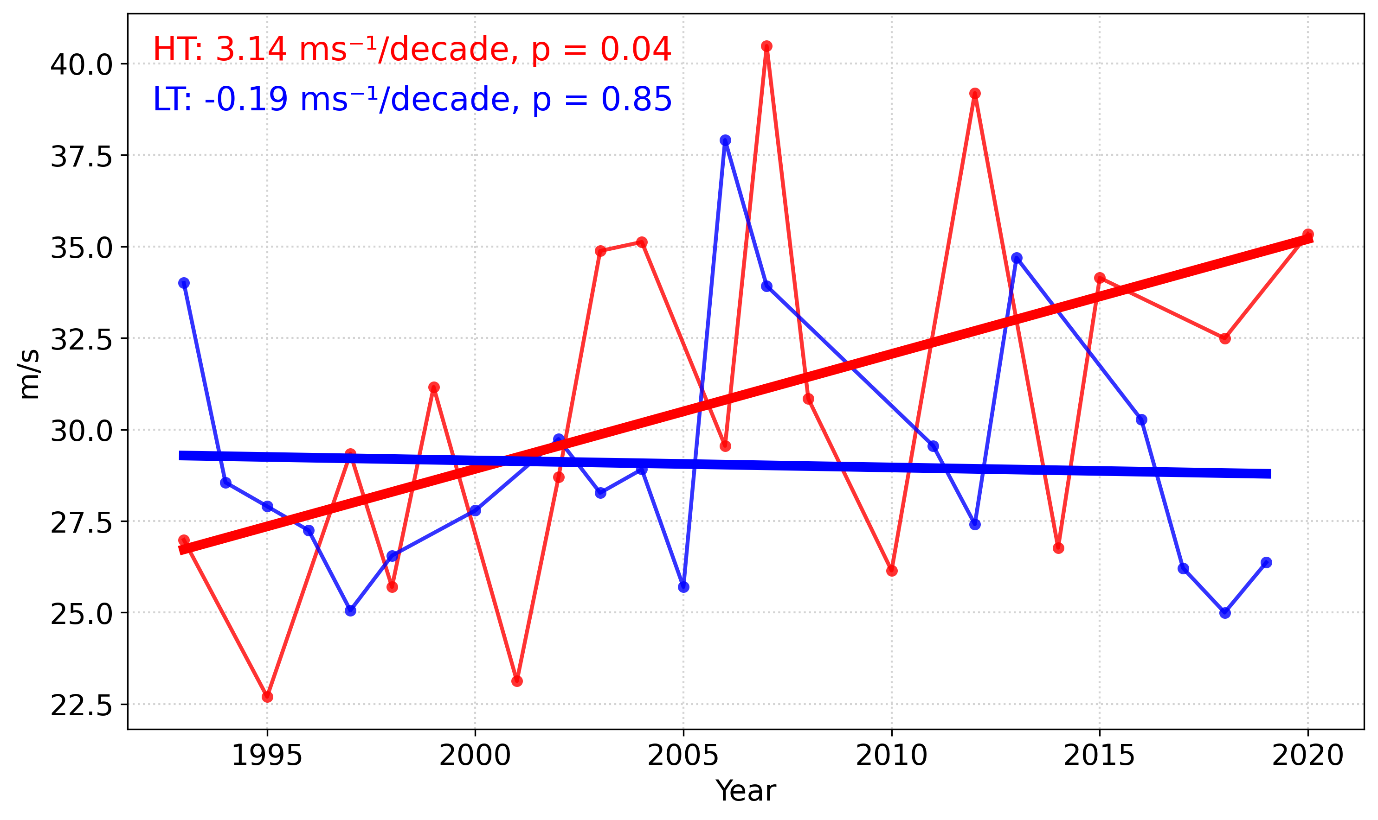
4. Results: Comparison of TC intensity by group
d. Annual Mean TC intensity north of 30°N
The HT group showed no significant difference in TC intensity before and after crossing the Kuroshio region.
The LT group showed a significant decrease in TC intensity before and after crossing the Kuroshio region.
North of 30°N, the HT group maintained significantly stronger TC intensity than the LT group.
North of 30°N, the HT group showed a significant increasing trend in mean TC intensity (3.14 m/s per decade, p=0.04).
Notes:
The top left figure shows the Kuroshio region and the mean tracks of the HT and LT groups passing through it.
HT is shown in red and LT in blue. Positions before crossing are shown with circle markers, and positions after crossing are shown with square markers. Both groups passed through the central part of the Kuroshio region.
The bottom left figure shows the TC intensity of each group before and after crossing the Kuroshio region. The markers indicate the mean intensity, and the range is shown with 95% confidence intervals.
The HT group showed no significant decrease in TC intensity after crossing the Kuroshio Current. On the other hand, the LT group showed a significant decrease in TC intensity after crossing the Kuroshio Current.
The bottom right figure compares the mean TC intensity north of 30°N. The HT group showed significantly stronger than the LT group.
The top right figure shows the time series of annual mean TC intensity north of 30°N. The thick lines show the trend for each group. The HT group showed a significant increasing trend at a rate of 3.14 m/s per decade. The LT group showed a non-significant decreasing trend at a rate of -0.19 m/s per decade.
In summary, in the HT group, which has a high transport of Kuroshio Current, the intensity was well maintained before and after the passage of the Kuroshio Current, and showed significantly strong intensity even north of 30°N. In addition, the annual mean intensity north of 30°N showed a significantly increasing trend.
Therefore, if these trends continue, tropical cyclones affecting East Asian countries such as Korea, Japan, and China may become stronger when Kuroshio Current transport is high in summer.

Slide 10
5. Conclusion & Discussion
To summarize the results, KC transport in the East China Sea during summer showed a significant increasing trend. In the HT group, which had higher KC transport, ADT, SST, and OHC were significantly higher.
VWS showed no significant difference between the HT and LT groups.
The LMI intensity of the HT and LT groups showed no significant difference, and the time spent crossing the KC region was also not significantly different between the HT and LT groups.
Therefore, we were able to more clearly evaluate the effect of KC transport on TC intensity passing through the KC region.
The HT group showed no significant decrease in TC intensity after crossing the KC region. However, the LT group showed a significant decrease in TC intensity after crossing.
Therefore, it is considered that the KC transport influences the maintenance of TC intensity passing through KC region.
The HT group showed significantly stronger TC intensity than the LT group, and showed a significant increasing trend in mean annual TC intensity north of 30°N.
Therefore, if these trends persist, TCs affecting East Asian countries such as Korea, Japan, and China may become stronger when KC transport is high in summer.
Notes:
To summarize the results, Kuroshio Current transport in summer showed an increasing trend, and the HT group showed higher ADT, SST, and OHC than the LT group.
VWS, which is a key atmospheric factor affecting TC intensity in the mid-latitude region, showed no significant difference between the HT and LT groups.
The TCs in the HT and LT groups had similar LMI locations and similar time spent crossing the Kuroshio region.
Therefore, we were able to better understand the effect of Kuroshio Current transport by limiting the influence of other factors.
The HT group showed no significant difference in TC intensity before and after crossing the Kuroshio region, while the LT group showed a significant decrease in TC intensity after crossing.
The HT group showed stronger mean TC intensity north of 30°N than the LT group. In addition, the HT group also showed a significant increasing trend in mean annual TC intensity.
Therefore, if these trends continue, the risk of TC damage in East Asia may become greater when Kuroshio Current transport is high in summer.

Slide 11
5. Conclusion & Discussion
Significance of the Study
We investigated the effect of KC transport on TC intensity.
We used long-term reanalysis data instead of model experiments or single case studies.
We suggest that KC transport is a variable worth considering in TC intensity research in the East Asia.
(Omitted) When looking at the yearly distribution of HT and LT events, no significant trend was found, which suggests that the influence of climate change is limited.
(Omitted) PDO/ONI indices and KC transport showed no significant correlation in lag correlation analysis, which suggests that the influence of PDO/ONI is limited.
Limitation & Future work
More samples are needed to verify the results.
The cause of the increasing KC transport is not yet known.
It is also necessary to investigate how these changes will occur in future climate using future climate scenarios.
Notes:
In this study, we investigated the effect of Kuroshio Current transport on TC intensity unlike previous studies.
We suggest that Kuroshio Current transport is a variable considering in TC intensity research in East Asia.
Although not included in the results, we confirmed that the yearly distribution trend of the HT and LT groups was not significant, which means that the influence of climate change on Kuroshio Current transport was limited at least during the study period.
In addition, the Pacific Decadal Osilliation (PDO) and Oceanic Nino Index (ONI) distribution of the HT and LT groups showed no significant difference, and the lag correlation between Kuroshio Current transport and PDO/ONI was also not significant. This means that the influence of PDO/ONI on Kuroshio Current transport was limited at least during the study period.
However, further research with more samples is needed, and we also need to investigate why Kuroshio Current transport is increase in summer, and how these results may change under future climate.

Slide 12
Thank You
Questions & Answer
Dept. of Convergence Study on the Ocean Science and Technology
Gunwoo Do, Hyeong-Seog Kim
Notes:
<KC 증가하는데 SST가 왜 상승하냐>
Sasaki and Umeda (2021) said that increased acceleration of the Kuroshio Current and increased ocean thermal advection cause an increase in SST along the Kuroshio path. If the transport volume of the Kuroshio Current increases, thermal advection by the Kuroshio also increases, which can lead to SST warming. And Sasaki and Umeda (2021) said that negative WSCs at low latitudes can cause an increase in Kuroshio speed.

Slide 13
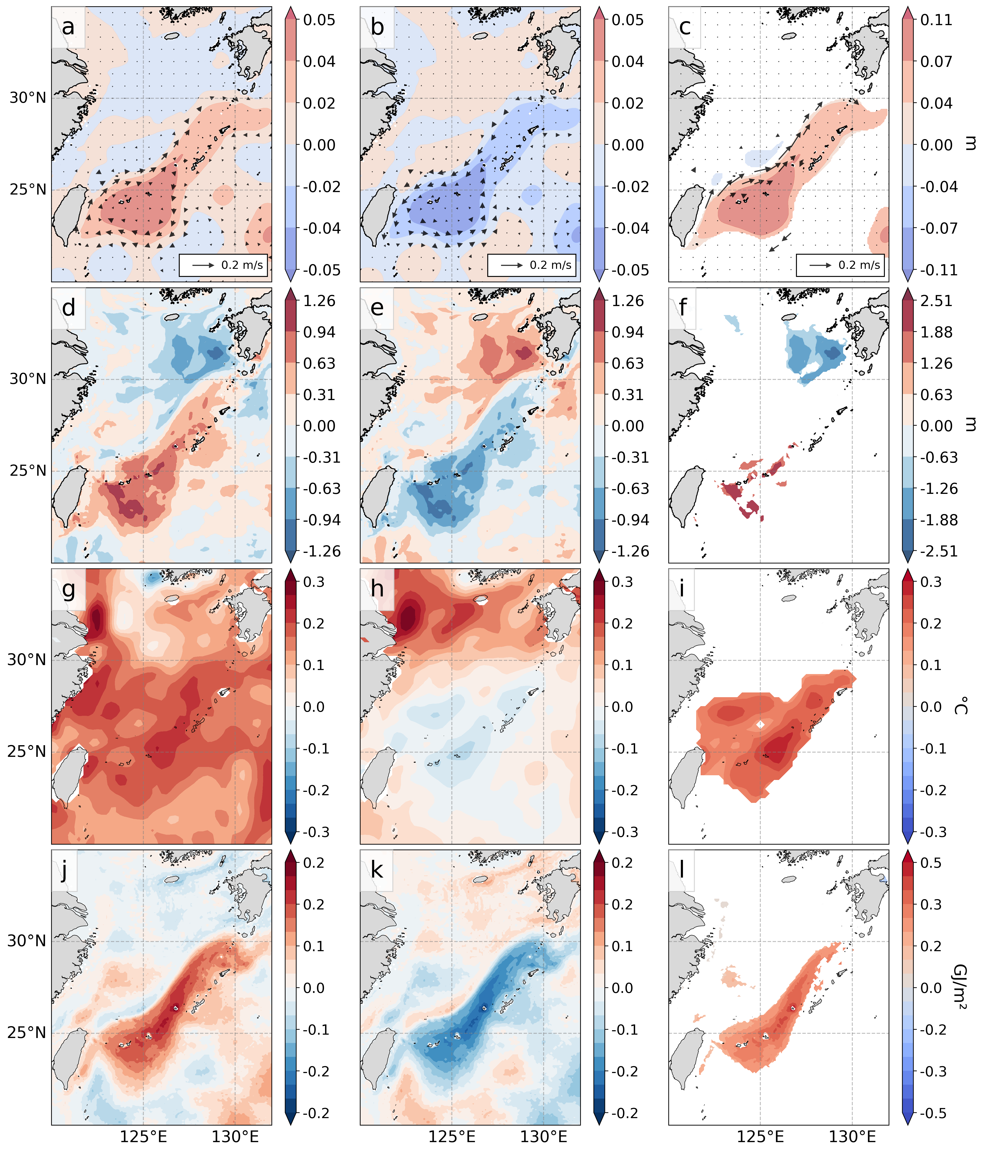
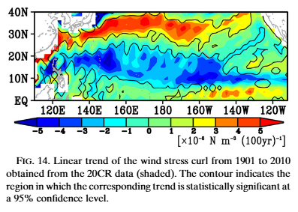
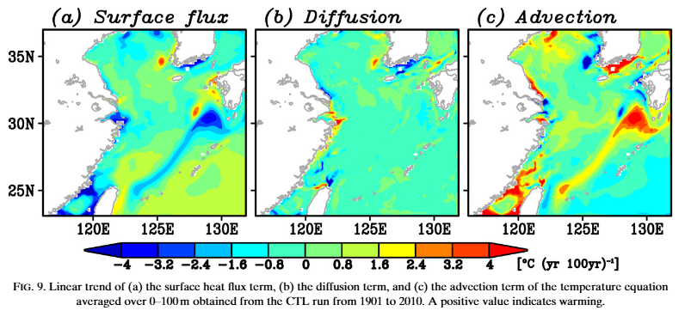
6. Supplementary data
Mixed Layer Depth (HT, LT, HT-LT)
Sasaki and Umeda (2021)
Sasaki and Umeda (2021) said that negative WSCs at low latitudes can cause an increase in Kuroshio speed.
Thermal advection is driving SST warming in relation to the increase in Kuroshio velocity.
Notes:
<쿠로시오 수송량이 왜 증가함?>
A negative WSC east of Taiwan can strengthen the northward-current flow, potentially increasing Kuroshio Current transport volume.
<KC 증가하는데 SST가 왜 상승하냐>
Sasaki and Umeda (2021) said that increased acceleration of the Kuroshio Current and increased ocean thermal advection cause an increase in SST along the Kuroshio path. If the transport volume of the Kuroshio Current increases, thermal advection by the Kuroshio also increases, which can lead to SST warming. And Sasaki and Umeda (2021) said that negative WSCs at low latitudes can cause an increase in Kuroshio speed.
If the warming of SST were caused by heating or convection, the mixed layer depth should increase, but there is little difference between the two groups. And, Sasaki and Umeda (2021) also said that advection caused by the increased speed of the Kuroshio Current led the SST warming. So, in this situation, I think that I can tell the influence of KC on TC intensity in ECS.

Slide 14
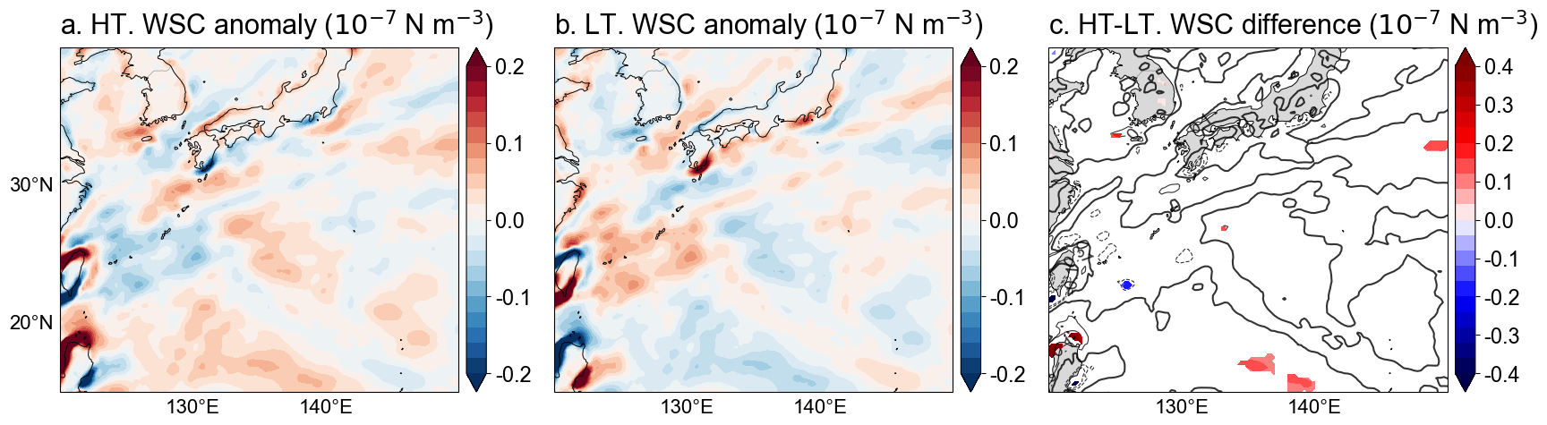
6. Supplementary data
Wind stress curl by group
Sasaki and Umeda (2021)
Sasaki and Umeda (2021) said that negative WSCs at low latitudes can cause an increase in Kuroshio speed.
Thermal advection is driving SST warming in relation to the increase in Kuroshio velocity.

