Slide 1
10/17 Agenda
Map Symbology
Binning and Hexbin maps
Lab 4 & Q & A

Slide 2
Map Symbology
Graduated colors
Graduated & proportional symbols

Slide 3
Graduated Colors
Use some color scheme to represent magnitude
Graduated colors may be applied to points, lines, polygons (i.e., choropleth), and rasters to represent some data values
Click the hyperlinks above to view examples for each

Slide 4
Things to consider
Use of Colors
Better to follow cartographic conventions (see the readings)
Classification Methods
Natural breaks, quantile, equal interval, standard deviation (see the readings)

Slide 5
Specific considerations for polygon data (choropleth)
Normalize/standardize your data!
e.g., use population density, as apposed to total population
Choose appropriate mapping units or scale
e.g., states, counties, census districts

Slide 6
Graduated & Proportional Symbols
Both represent magnitude by varying the size of symbols (points and lines)
Graduated symbols
Classify the data and then each class is drawn with the same symbol
Proportional symbols
Size of each symbol is proportion to the actual data value (unclassified)
Click the hyperlinks above to view examples for each

Slide 7
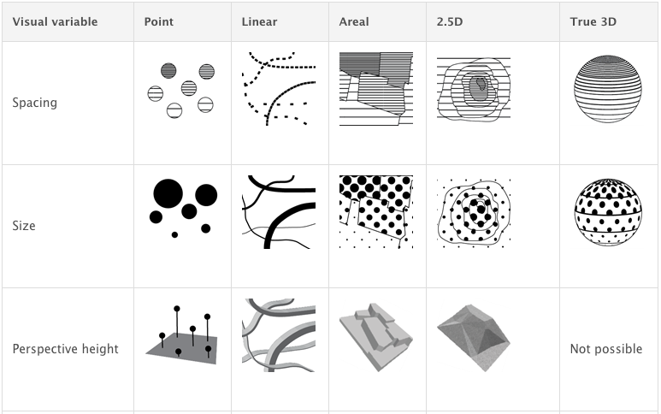
Symbolization (ESRI)

Slide 8
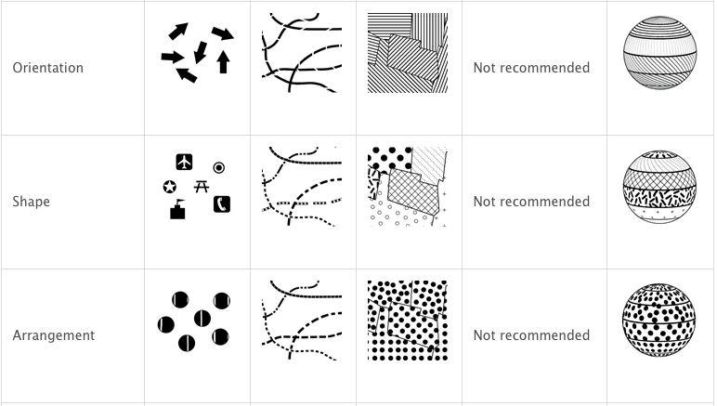

Slide 9
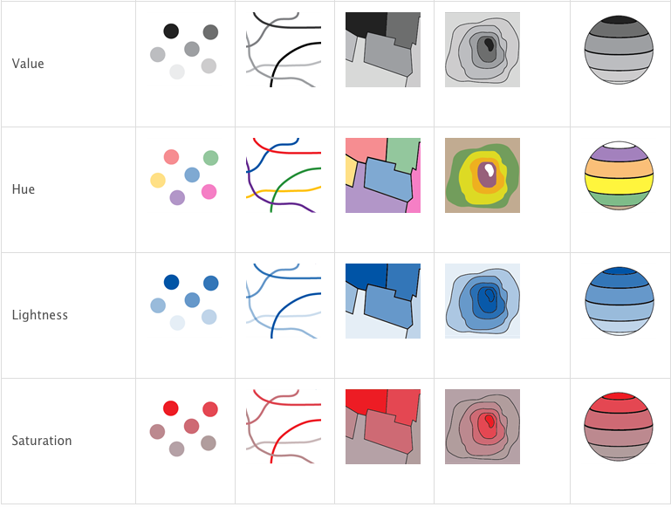

Slide 10
Binning and Hexbin maps

Slide 11
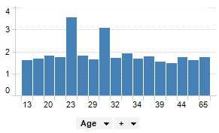
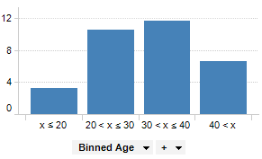
Data Binning
Binning is a data aggregation technique that group a dataset’s values into fewer groups, i.e., "bins".
The histogram example:
https://docs.tibco.com/pub/spotfire/7.0.1/doc/html//bin/bin_what_is_binning.htm

Slide 12
Binning in GIS
In GIS, binning is defined as the process of grouping pairs of locations based on their distance from one another (“spatial histogram”)
Some simple binning methods include the rectangular binning and hexagonal binning
Help reveal patterns when working with large point data sets

Slide 13
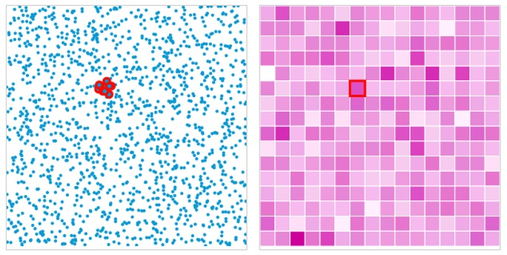
Rectangular Binning
Step 1: Create a gridded surface
Step 2: Count the number of points that fall within a rectangle or hexagon
Step 3: Symbolize the rectangles or hexagons based on the count

Slide 14
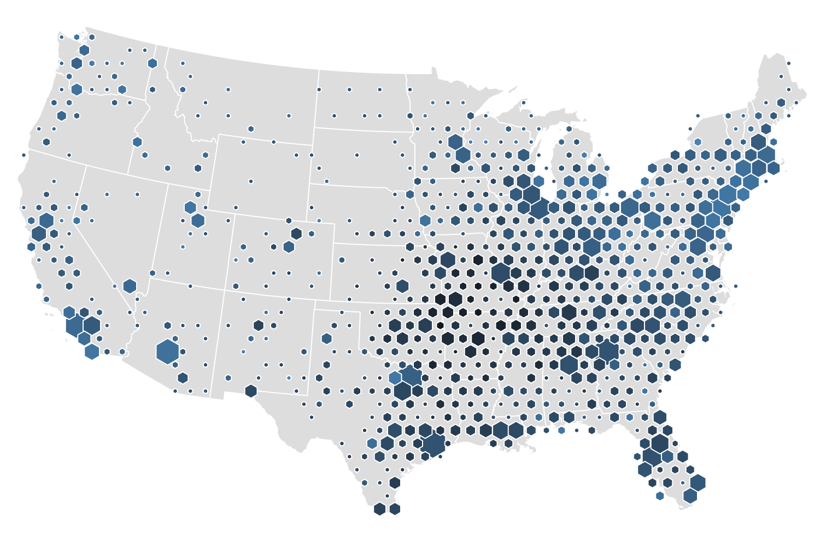
Hexagonal Binning (Hexbin)
Bivariate Hexbin Map: ~ 3,000 locations of Walmart stores are shown
size of hexagon represents the number of stores that fall into each bin
color represents the median age of Walmart stores in that area, with the oldest stores in black and the youngest stores in blue

Slide 15
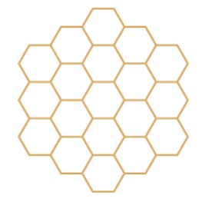
Why Hexagon?
What types of polygons can be used to create a gridded surface?
Hexagon is the most efficient and compact division of 2D space
http://www.meccanismocomplesso.org/en/hexagonal-binning/

