Slide 1
10/24 Agenda
Charts for Data Visualization
Discussion: Hexbin Maps

Slide 2
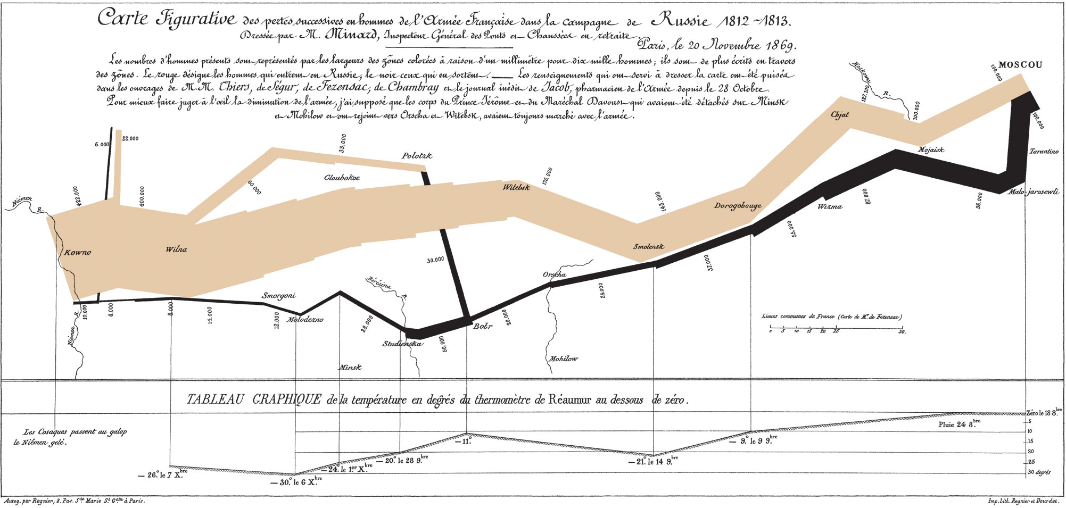
Charles Minard's map of Napoleon's Russian campaign of 1812
Notes:
http://www.masswerk.at/minard/

Slide 3
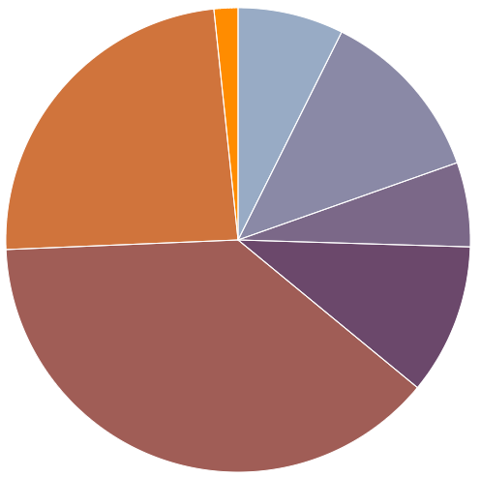
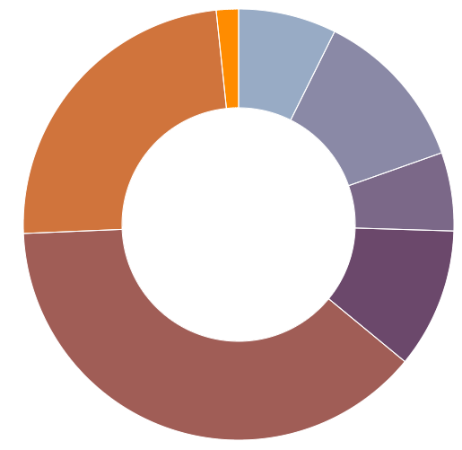
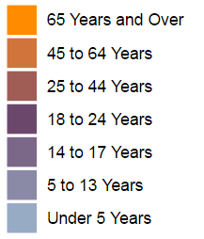
Pie/Donut Chart
How categories represent part of a whole

Slide 4
Pie/Donut Chart: Dos and Don’ts
Make sure the total sum of all segments equals 100 percent
NOT meant to compare individual segments
Less is more: don’t illustrate too many categories

Slide 5
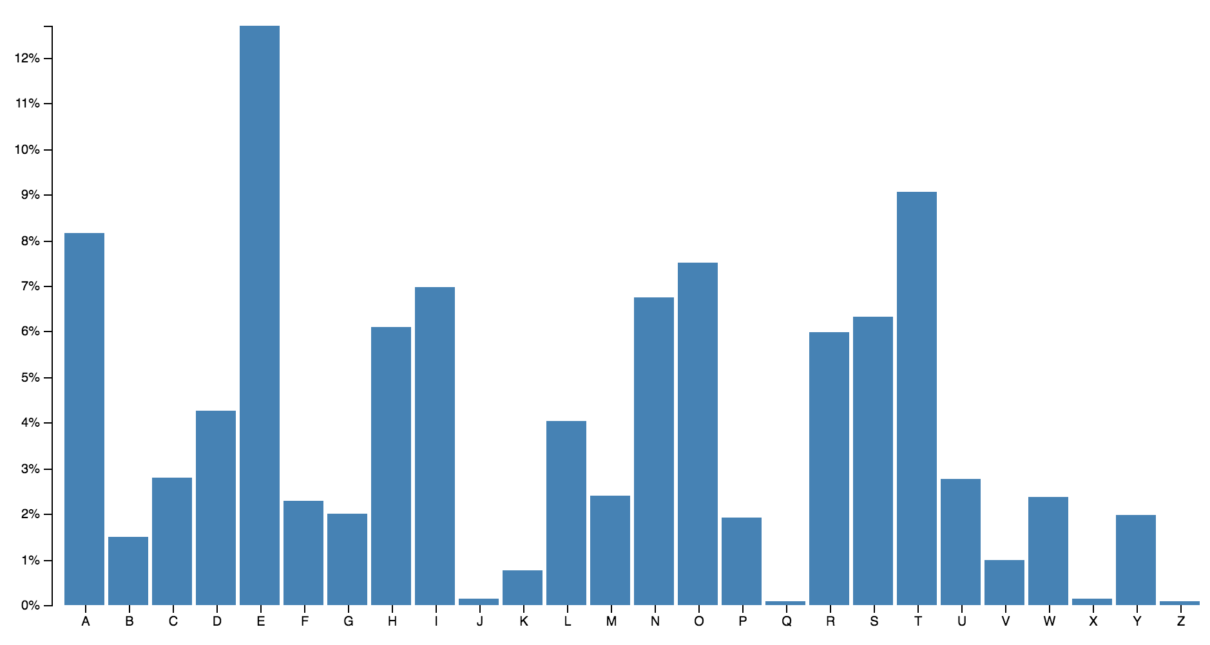
Column Chart
Show comparison among different items, or changes over time
Frequency of letters in the English language
For the interactive version, check out: https://bl.ocks.org/mbostock/raw/3885304/

Slide 6
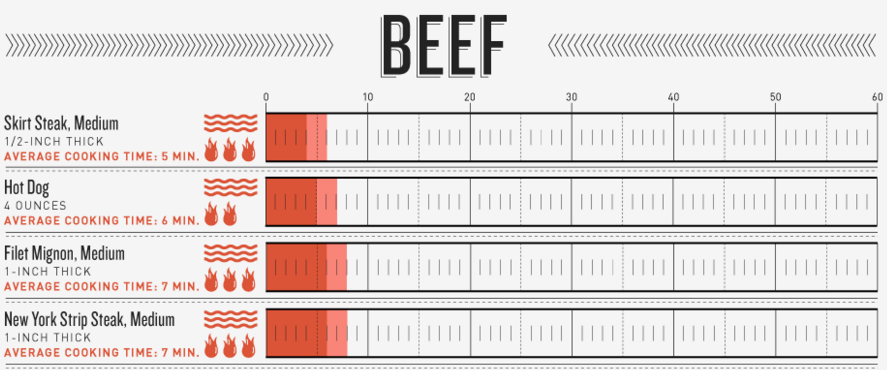
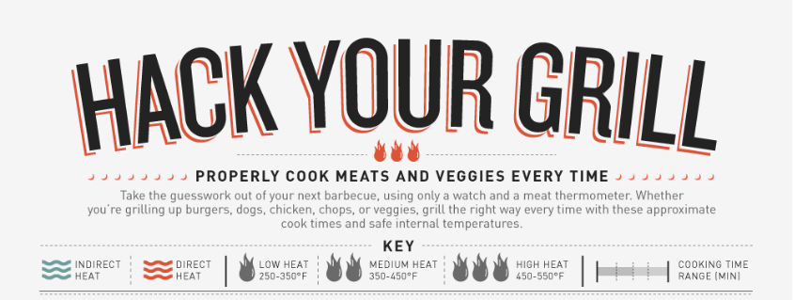
Bar Chart
Basically a horizontal
column chart
https://www.columnfivemedia.com/work-items/hack-your-grill-a-foolproof-guide-to-grilling

Slide 7
Column & Bar Chart: Dos and Don’ts
Use consistent colors for the bars or columns
May highlight meaningful data points using accent colors
The numerical axis must start at zero

Slide 8
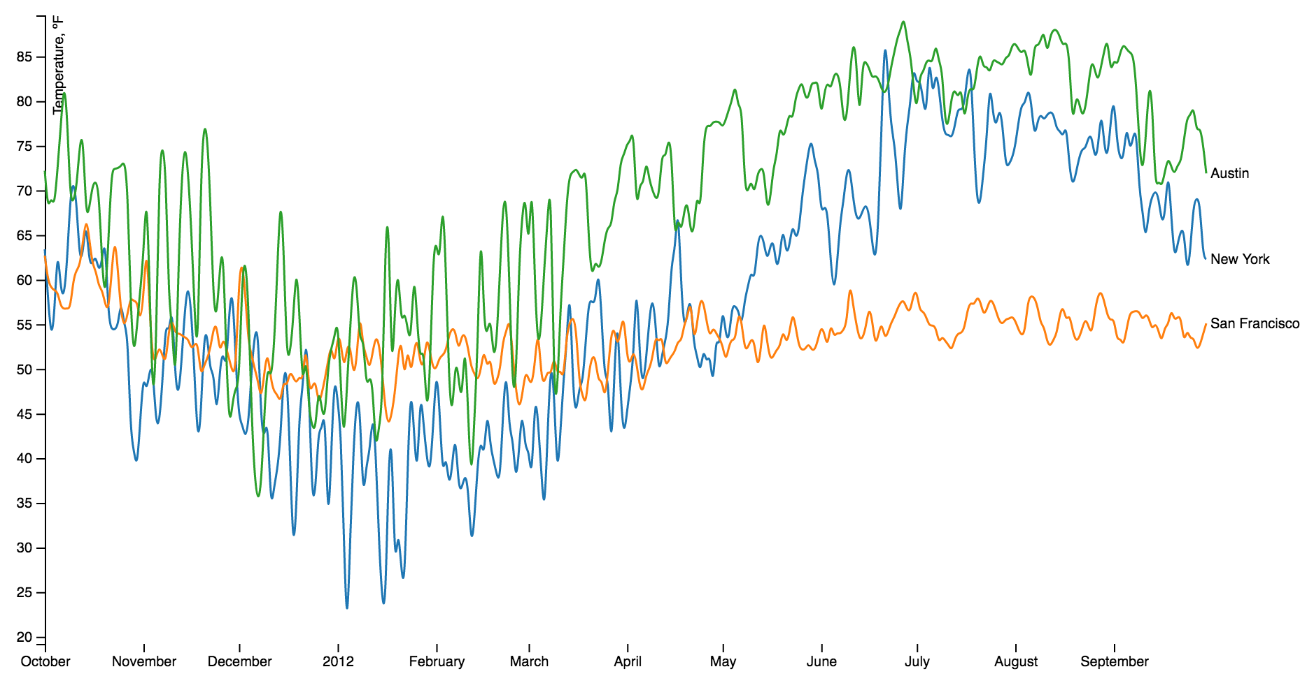
Line Chart
Show trends over time
Daily average temperatures of New York, San Francisco and Austin

Slide 9
Line Chart: Dos and Don’ts
Use solid lines
May be used to show different categories (multiple lines); But avoid plotting too many lines

Slide 10
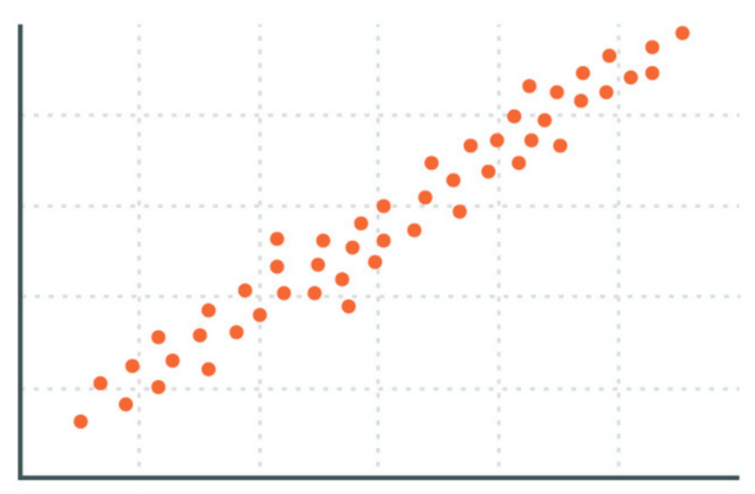
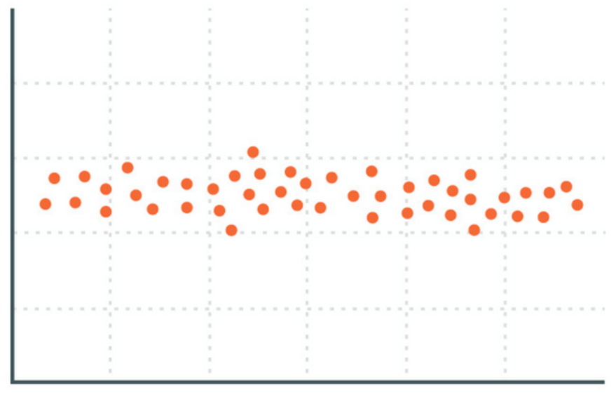
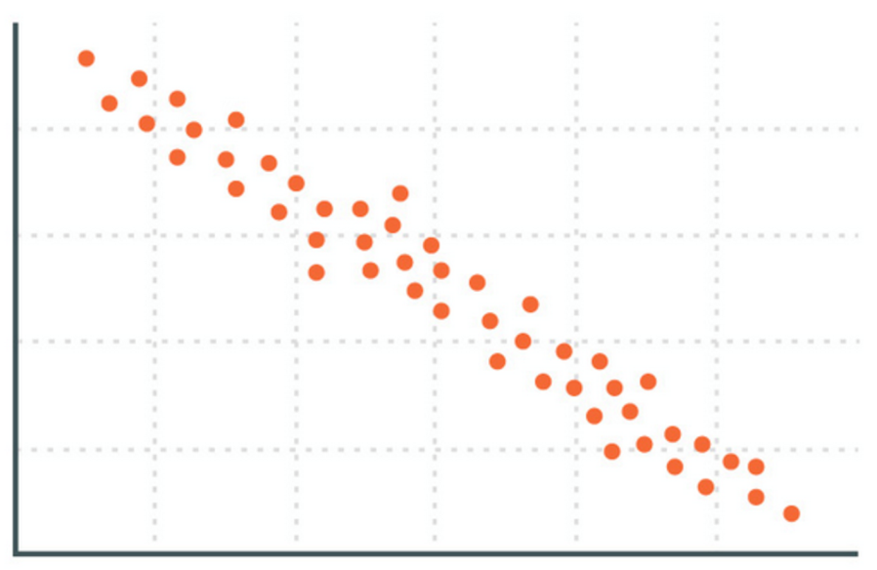
Scatter Plot
positive correlation
no correlation
negative correlation
Show relationship between two numerical variables

Slide 11
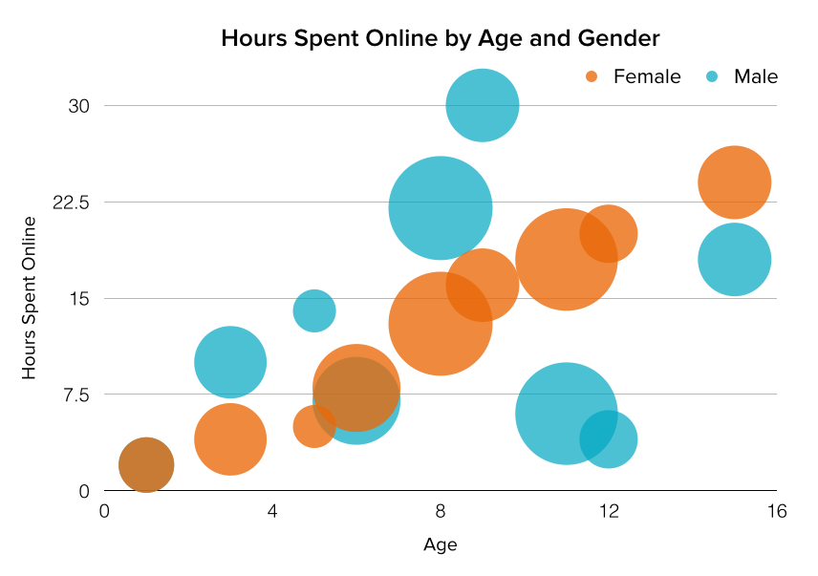
Bubble Chart
Similar to scatter plot;
Can represent a third numerical variable by the size of the bubbles
https://www.youtube.com/watch?v=jbkSRLYSojo

Slide 12
Scatter Plot/Bubble Chart: Dos and Don’ts
The x and y axes are used to visualize relationships between numerical data
For bubble chart, scale bubbles according to area, not diameter

Slide 13
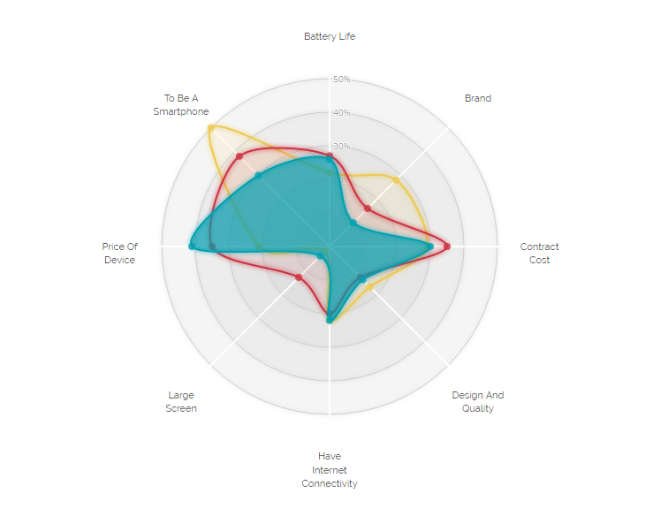
Radar (Spider) Chart
iPhone
Samsung
Nokia
Battery Life
Compare items based on multiple criteria
To Be A Smartphone
50%
Brand
40%
30%
Price Of Device
Contract
Cost
Large Screen
Design And Quality
Have Internet Connectivity
For the interactive version, check out: http://www.visualcinnamon.com/2015/10/different-look-d3-radar-chart.html

Slide 14
Radar Chart: Dos and Don’ts
Each spoke represents quantitative variables using a common scale
Good for showing outliers and commonality
Hard to visually compare lengths of different spokes

Slide 15
More Examples
Interactive scatterplot
Radar Chart
D3 Gallery (interactive data visualization)
Iceland’s energy use
Chinese tourism

