Slide 1
Introduction to
K Nearest Neighbors

Slide 2
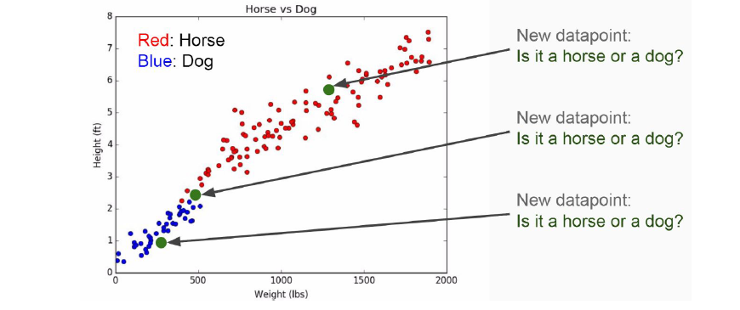

Slide 3
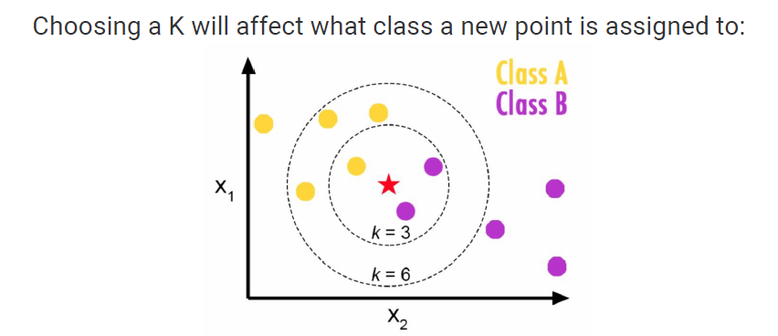

Slide 4
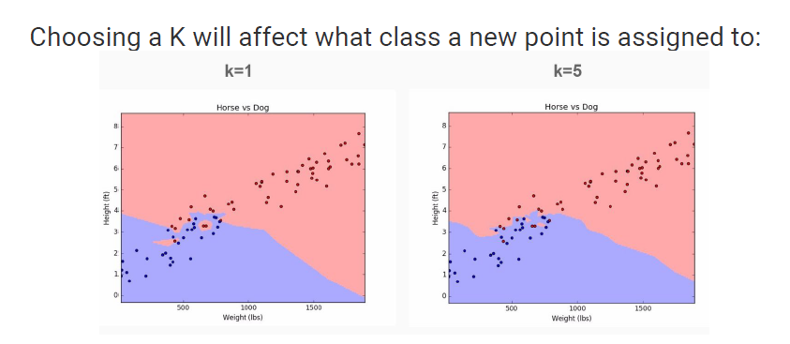

Slide 5
