Slide 1
Introduction to
K Means Clustering

Slide 2
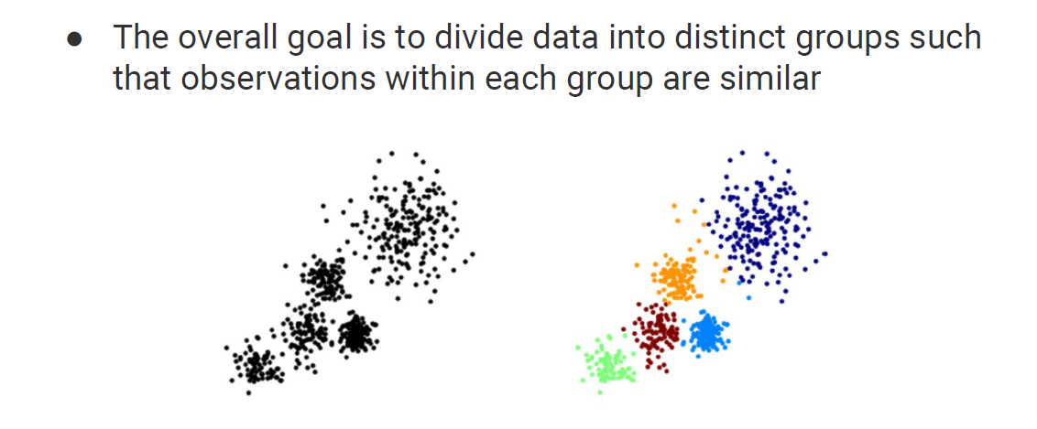

Slide 3
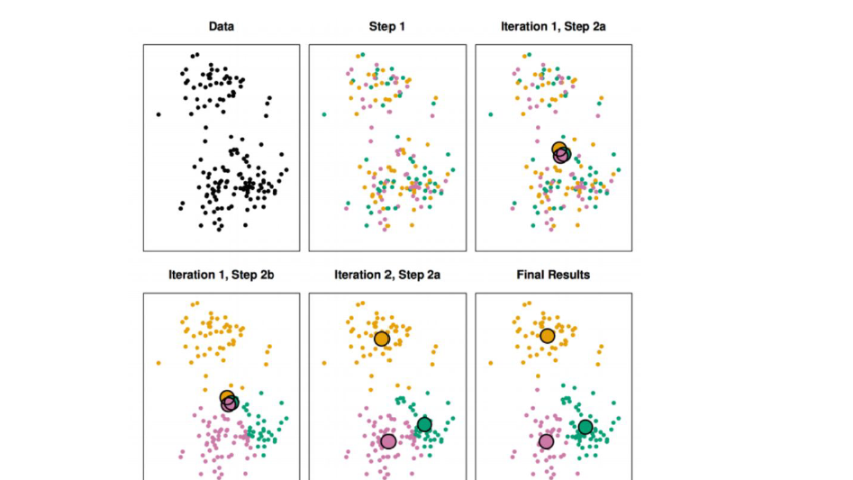
Choosing a K-value

Slide 4
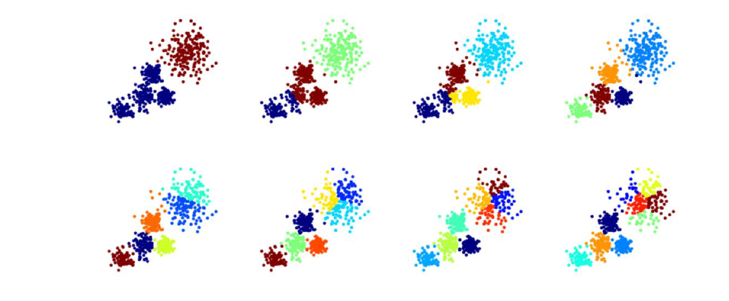
Choosing a K-value

Slide 5
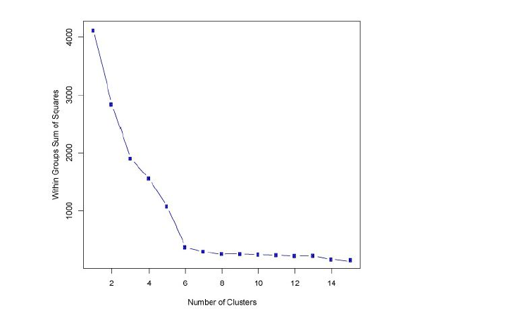
Choosing a K-value

