Slide 1


United States Gas Prices Comparison (last 10 years)
Robert Soriano
Paul Bih
Ray Rappa

Slide 2
Our questions and ideas!!!!
The inflation rate in the price of gas has recently increased drastically and we wanted to compare the last 10 years of prices to see if we can see any trends in the data.
We wanted to have a chart to selectable by City and state but we found was the breakdown of the data is by a specific PADD Region.
The Petroleum Administration for Defense Districts established these 5 regions in 1942 during WWII for the allocation of fuels during the war. This role was taken over by the United States Department of the Interiors Oils and Gas Division in 1954.

Slide 3
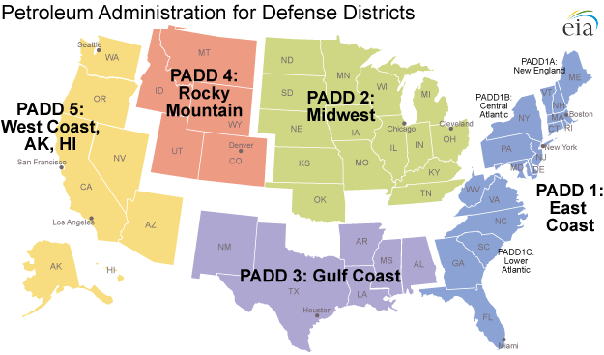
PADD Regions

Slide 4
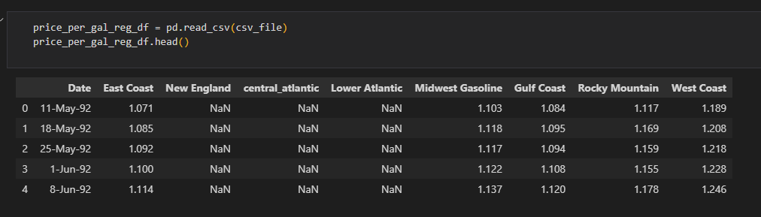
SQL Database
After downloading the data from the EIA website and importing into PostGRES SQL we needed to conduct some data manipulation and cleaning.

Slide 5
Data Cleaning
First the date was changed to a more friendly Year-Month-day format.
Then older than 23NOV2021 was deleted.
Columns that were not needed were dropped.
Columns were renamed to a proper naming convention.
Then the data was exported to a new CSV and SQL table.

