Slide 1
Table 1. Summary of probiotic trial information and sequencing data for all three trials.
 | Trial 1 | Trial 2 | Trial 3
Sample Types | Water, Swabs, Oysters | Water, Swabs, Oysters | Water
Sampling Days (0=spawn) | W:1,12 / OS:5,12 | W:1,9 / OS:6,9 | W: 5,8,12
Water Filtered | 410-750ml | 7-10ml | 1300-1700ml
Trial Dates | July 11-23, 2012 | Jan 9-18, 2013 | June 3-15, 2016
Bacterial reads from 12 water samples | 1.3 million | 1.8 million | 5.7 million
Methods | MoBio extraction MiSeq, 2x250 PE | MoBio extraction MiSeq, 2x250 PE | Puregene extraction HiSeq, 2x100 PE
16S region | V4 | V4 | V6

Slide 2
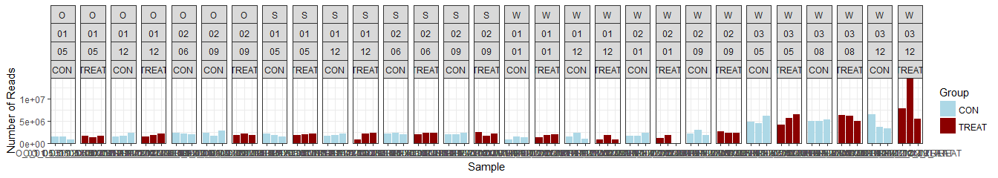
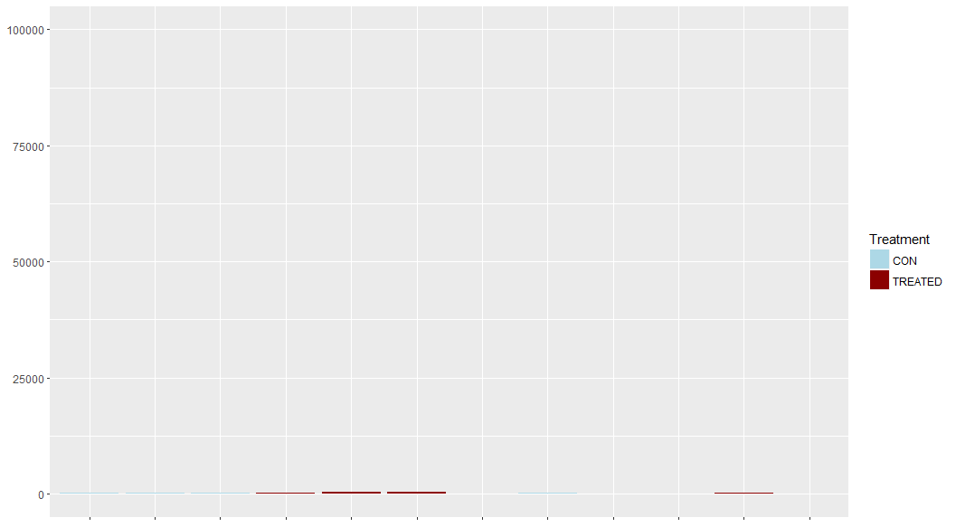
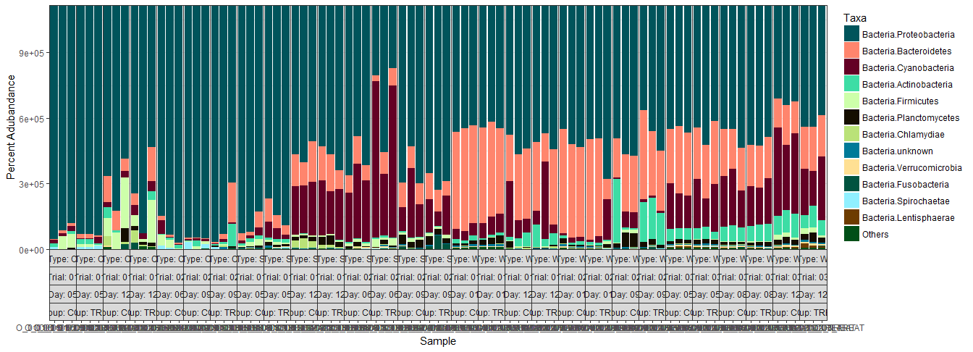
Group
1e+07
5e+06
0
5 |  | 12 |  | 6 | 9 |  |  | 5 |  | 12 |  | 6 |  | 9 |  |  | 1 |  | 12 |  | 1 |  | 9 |  | 5 |  | 8 |  | 12 |  | Day
1 |  |  |  | 2 |  |  |  | 1 |  |  |  | 2 |  |  |  |  | 1 |  |  |  | 2 |  |  |  | 3 |  |  |  |  |  | Trial
Oyster Larvae |  |  |  |  |  |  |  | Biofilm Swab |  |  |  |  |  |  |  |  | Rearing Water |  |  |  |  |  |  |  |  |  |  |  |  |  | Type
Read Abundance
Control
Treatment
Phylum
75
50
25
0
Proteobacteria
Bacteroidetes
Cyanobacteria
Actinobacteria
Firmicutes
Planctomycetes
Chlamydiae
Unknown
Verrucomicrobia
Fusobacteria
Spirochaetae
Lentispaerae
Others
Percent Abundance (%)
Figure 1. Percent abundances of the 12 most abundant phyla in all oyster larvae, biofilm swab, and rearing water samples from all 3 Trials based on 16S rDNA amplicon sequencing data (bottom). The total abundance of quality filtered sequencing reads is shown in the bar graph (top). The 12 dominant phyla include Actinobacteria, Bacteroidetes, Cyanobacteria, Deferribacteres, Firmicutes, Fusobacteria, Lentisphaerae, Planctomycetes, Proteobacteria, Spirochaetae, Verrucomicrobia, and Unknown. Note: there are no treated oyster larvae samples from Trial 2, Day 6.
Notes:
1344x486
1344x240

Slide 3
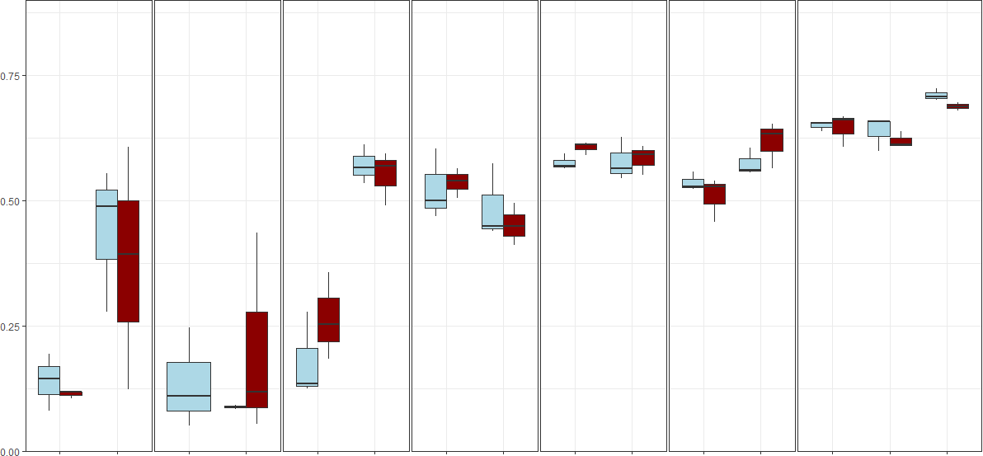
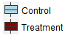
***
***
*
***
**
5 |  | 12 |  | 6 |  | 9 |  | 5 |  | 12 |  | 6 |  | 9 |  | 1 |  | 12 |  | 1 |  | 9 |  | 5 |  | 8 |  | 12 |  | Day
1 |  |  |  | 2 |  |  |  | 1 |  |  |  | 2 |  |  |  | 1 |  |  |  | 2 |  |  |  | 3 |  |  |  |  |  | Trial
Oyster Larvae |  |  |  |  |  |  |  | Biofilm Swab |  |  |  |  |  |  |  | Rearing Water |  |  |  |  |  |  |  |  |  |  |  |  |  | Type
Group
Simpson’s Diversity Index
***
Significance
* p<0.05
** p<0.01
*** p<0.001
***
Figure 2. Simpson’s index of diversity of bacterial communities in all samples from all 3 trials. The control group is indicated by light blue and the probiotic treated group is indicated by dark red. No significant differences were found between control and treatment samples, due to high variation in the replicate tanks. The diversity significantly increases over time in larvae, swab, and water samples from Trial 1, and water samples from Trial 3. The rearing water is significantly more diverse in Trial 3 than Trials 1 and 2. Note: there are no treated oyster larvae samples from Trial 2, Day 6.
Notes:
1344x650

Slide 4
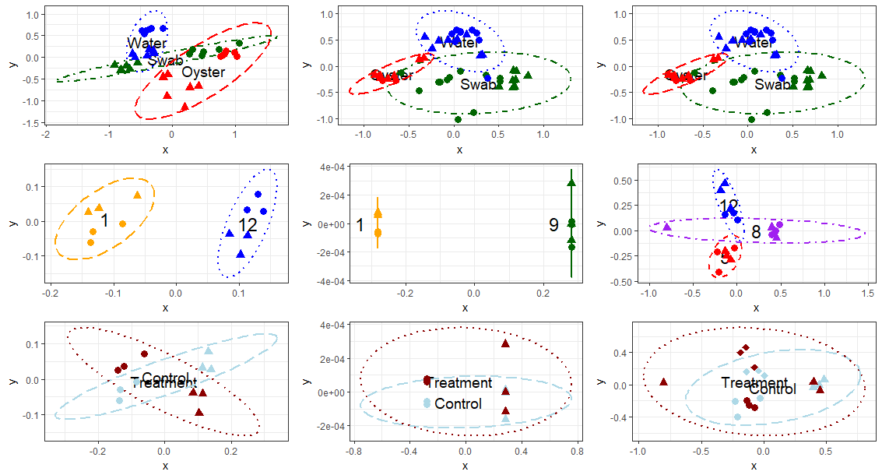
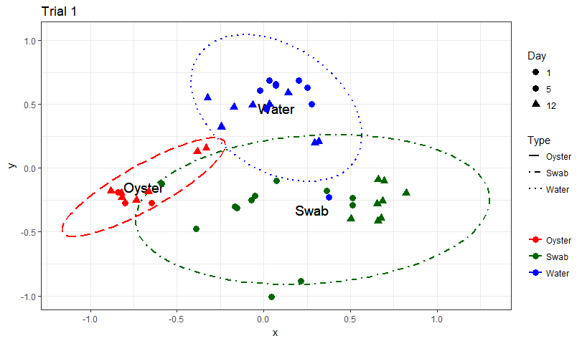
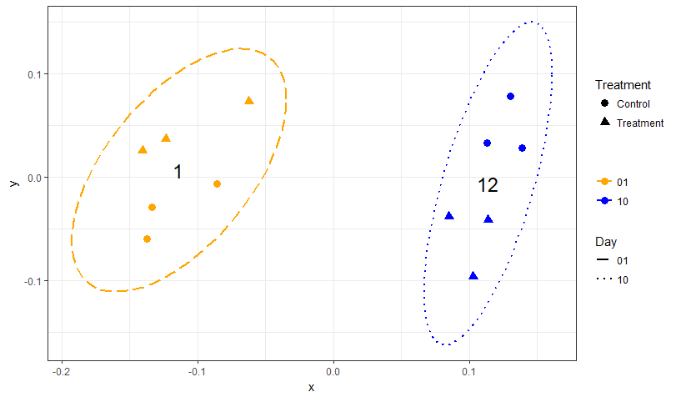
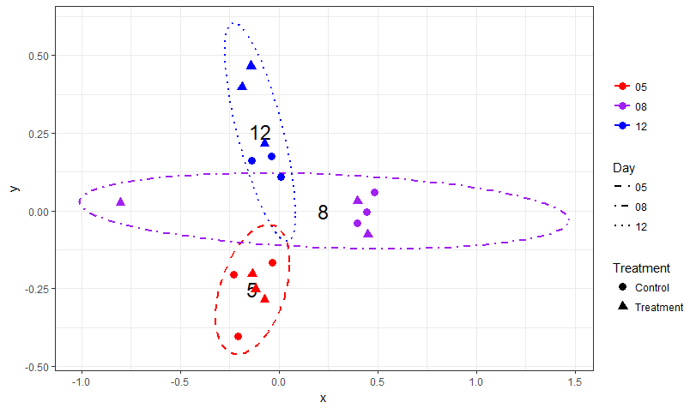
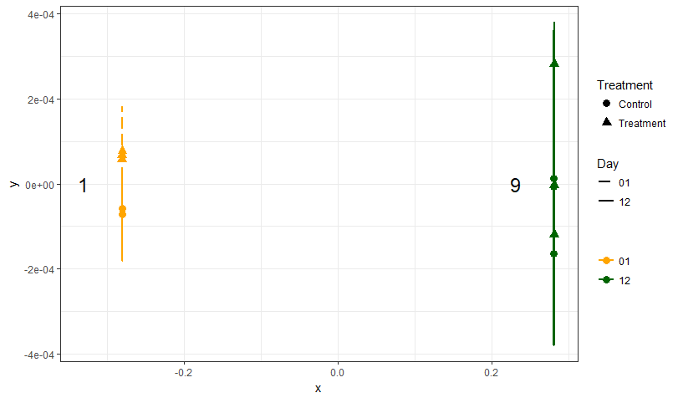
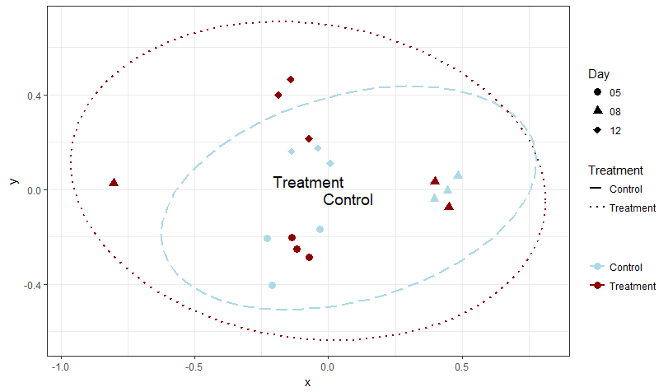
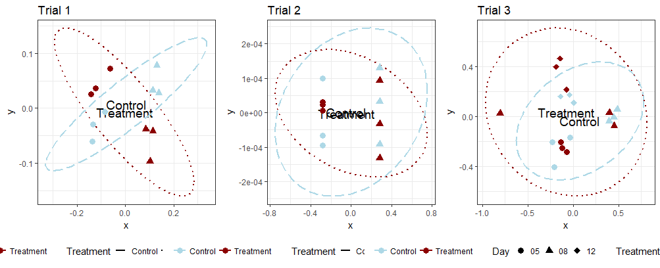
Trial 1
Trial 2
Trial 3
Oyster Swab Water
(a) Sample Type
Day 1/5/6 Day 9/12
Day 1
Day 5
Day 8
Day 9
Day 12
(b) Day
Control Treatment
Control Treatment
(c) Treatment Group
Day 1 12
Day 1 9
Day 5 8 12
Figure 3. NMDS plots calculated using Bray-Curtis beta-diversity (k=2) at the Order level by (a) Sample Type, (b) Sampling Day, and (c) Probiotic Treatment Group. (b) and (c) were calculated using only water samples. The ellipse lines show the 95% confidence interval. (a) The different types of samples are indicated by colors (Oyster=dashed red, Swab=dashdot green, Water=dotted blue) and the days are indicated by symbols (Timepoint 1=circle, Timepoint 2=triangle). The water and swab communities are significantly distinct from each other in both trials. (b) The sampling timepoints are indicated by colors (1=longdash yellow, 5=shortdash red, 8=dashdot purple, 9=solid green, 12=dotted blue) and the treatment group is indicated by symbols (Control=circle, Probiotic treatment=triangle). The water community is significantly different between timepoints. (c) The treatment group is indicated by colors (Control=light blue dashed, Probiotic treatment=dark red dotted) and sampling timepoints are indicated by symbols. The water community is not significantly different according to treatment.

Slide 5
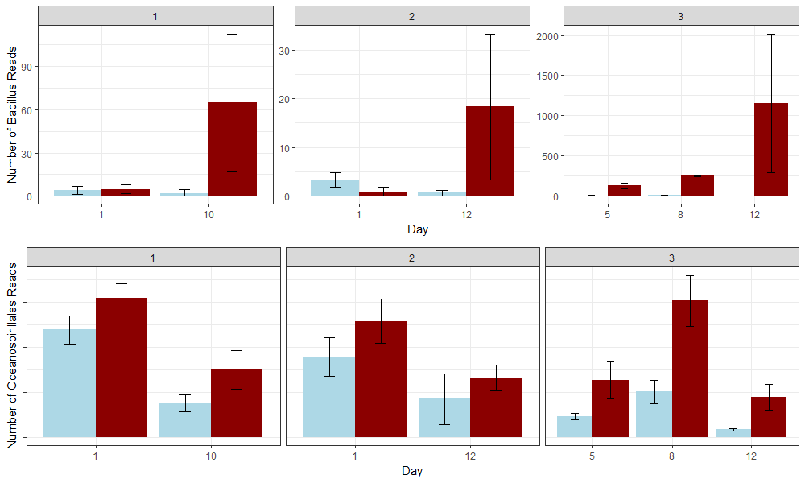
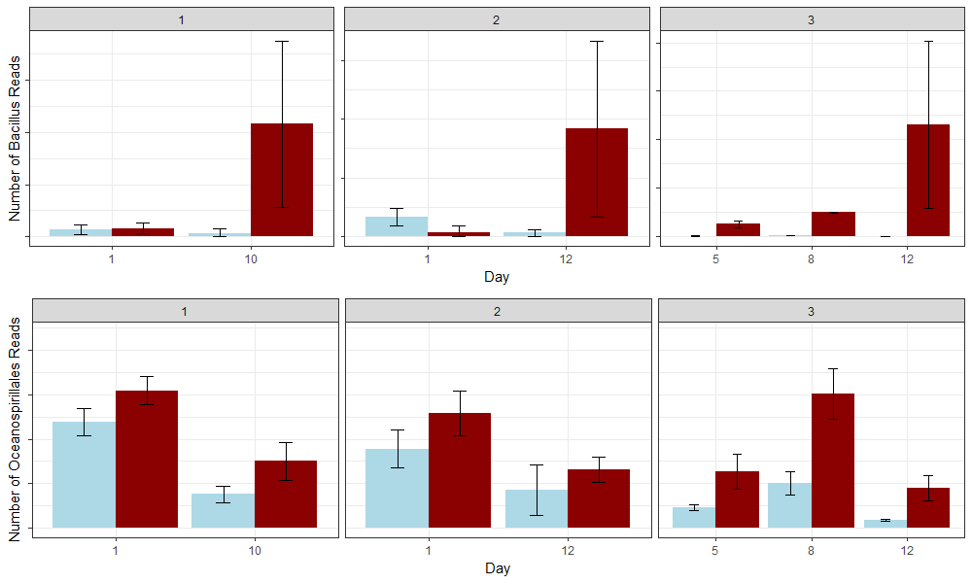
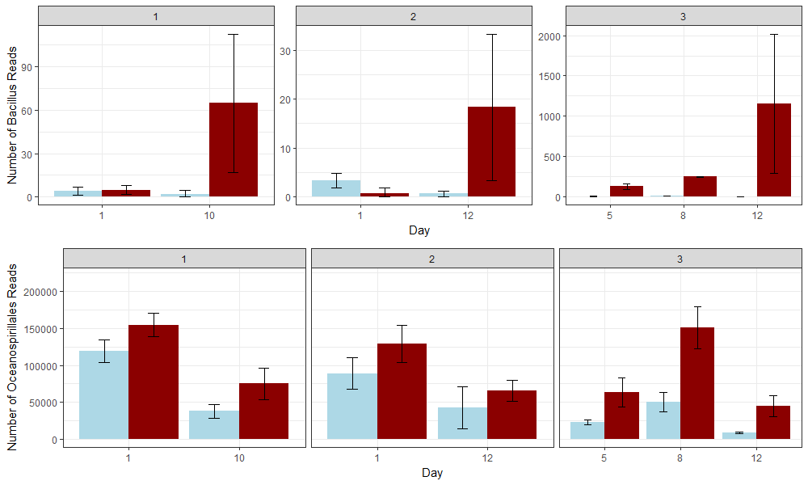
Trial 1
Trial 2
Trial 3
*
**
Control
Treatment
(a) Number of Bacillus Reads
*
***
Day 1 Day 9
Day 1 Day 12
Day 5 Day 8 Day 12
***
**
*
*
(b) Number of Oceanospirillales Reads
*
Significance: *p<0.05, **p<0.01, ***p<0.001
Figure 4. Number of (a) Bacillus and (b) Oceanospirillales reads in treated and control water samples (n=3) on Days 1 and 12 (Trial 1), Days 1 and 9 (Trial 2), and Days 5, 8 and 12 (Trial 3). Control is indicated by light blue boxplots and probiotic treatment is indicated by dark red boxplots. (a) Bacillus is significantly more abundant in the treated than the control water on the first and second timepoint in Trial 3, and increases over time. (b) Oceanospirallales are consistently more abundant in probiotic-treated tank rearing water, and decrease with time.
Notes:
1000x600

Slide 6
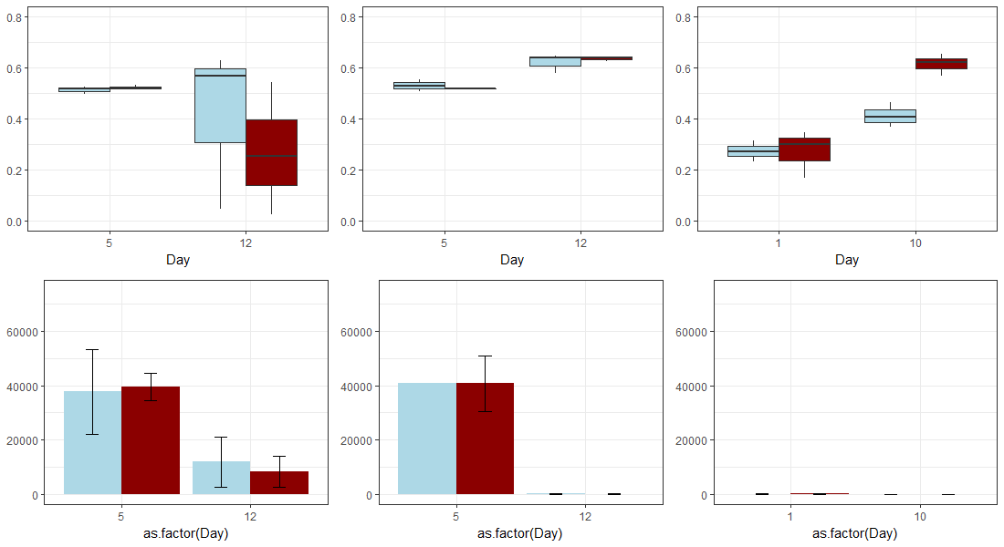
Oyster
Swab
Water
***
**
**
(a) Vibrio Simpson Diversity
Day 5 Day 12
Day 5 Day 12
Day 1 Day 12
***
*
Control
Treatment
(b) Number of Vibrio Reads
**
Significance: *p<0.05, **p<0.01, ***p<0.001
Figure 5. Total Vibrio read abundance (a, bar graph) and Simpson’s Index of Diversity (b, boxplots n=3) in all samples types on Days 1/5 and 12 from Trial 1. Total Vibrio reads are the most diverse in the tank biofilms (swab), and most abundant in the oyster and swab samples on Day 5. Total Vibrio reads are significantly more diverse over time in the swab and water samples, and significantly less abundant over time in all samples.
Notes:
900x600

Slide 7
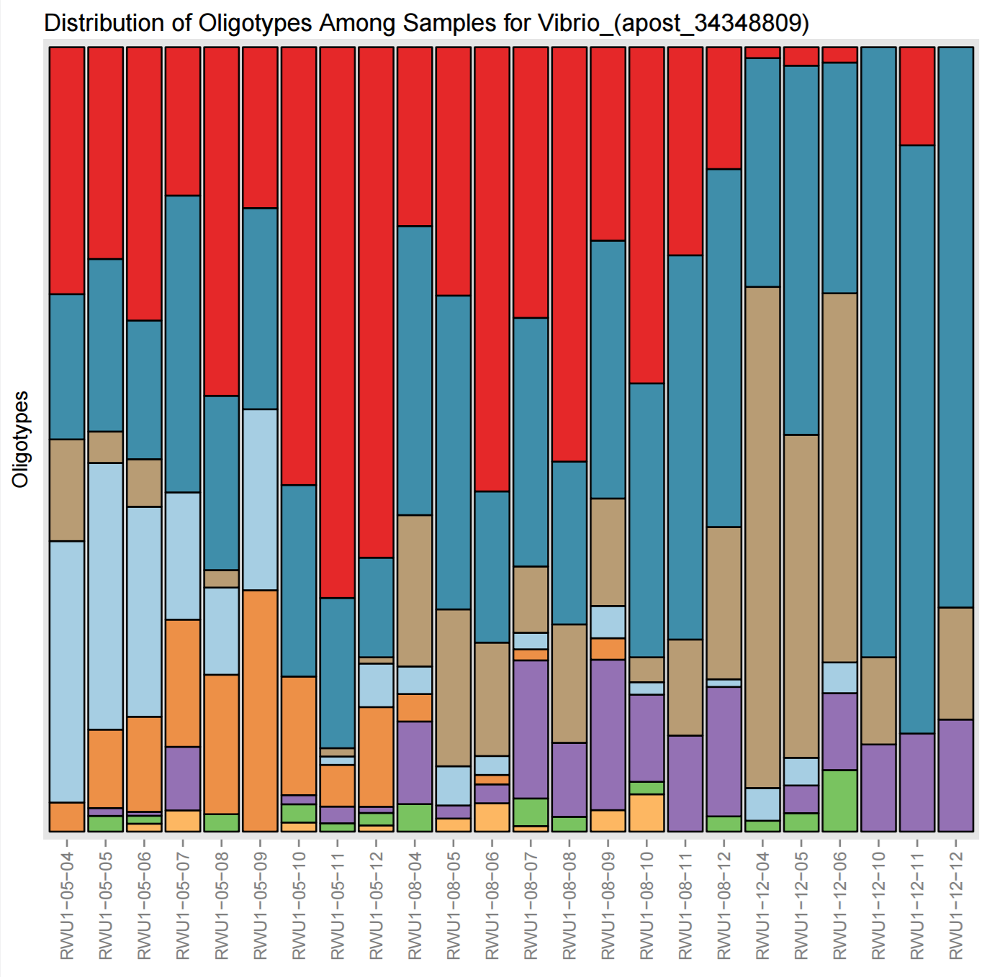
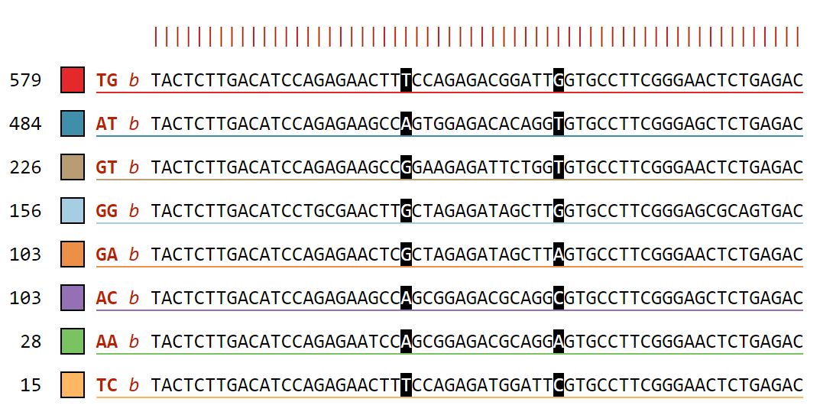
CON | T | CON | T | CON | T
Day 5 |  | Day 8 |  | Day 12
Oligotypes
TG: Vibrio alginolyticus strain WW1 16S ribosomal RNA gene GenBank: KX425011.1
AT: Vibrio celticus partial 16S rRNA gene, isolate 5OM18 GenBank: LN832936.1
GT: Vibrio orientalis partial 16S rRNA gene, isolate LK2HaP4 GenBank: LT221239.1
GG: Halovibrio sp. strain 5F5 16S ribosomal RNA gene, partial sequence GenBank: KY636397.1
Figure 6. Vibrio spp. oligotypes in Control (CON) and Treatment (T) water samples on Days 5, 8, and 12 from Trial 3. These 8 oligotypes were generated from changes in positions 23 and 37 in a total of 1727 sequences. Vibrio oligotypes show differences in succession of species over time between control and treatment rearing water.

Slide 8
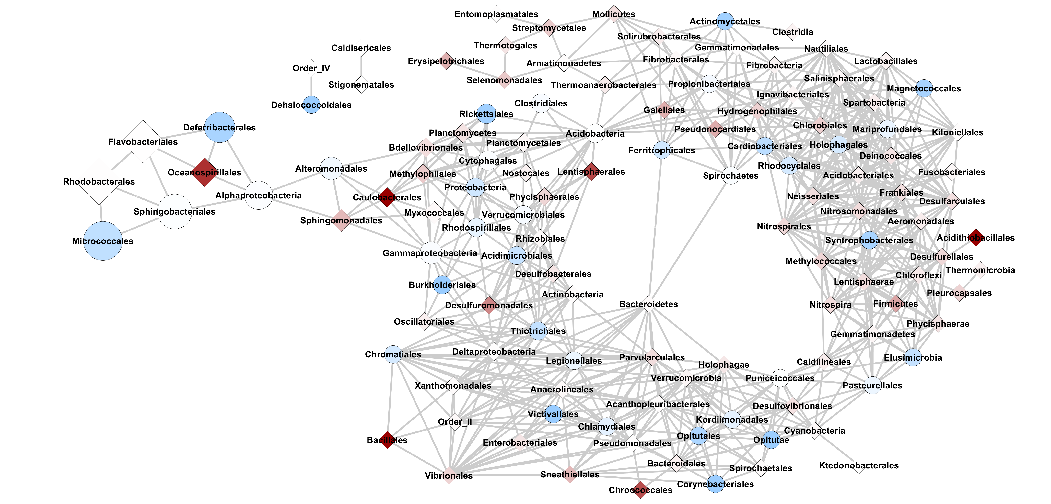


Occurrence
Number of Reads
10
1
0
2,880,000
1,440,000
770,000
2
$$\frac{Treatment}{Control}$$
Figure 7. Co-occurrence network analysis using Bray-Curtis dissimilarity metric (max distance =0.5, Order level) for water samples from Trial 3 (n=18). Taxa that change in the same way share an edge; nodes that have edges occur in the same proportions and in the same samples. Darker blue circle nodes indicate taxa that occurs in the Control significantly more than Treated water samples. White nodes have equal occurrence in treated and control water samples. Darker red diamond nodes indicated taxa that occurs in the Treated significantly more than Control water samples.

Slide 9
Chloroflexi;Anaerolineae;Anaerolineales
Proteobacteria;Alphaproteobacteria;Parvularculales
Cyanobacteria;empty_class;Oscillatoriales
Bacteroidetes;Cytophagia;Order_II
Proteobacteria;Gammaproteobacteria;Chromatiales
Proteobacteria;Gammaproteobacteria;Thiotrichales
Proteobacteria;Gammaproteobacteria;Xanthomonadales
Occurrence
10
1
0
$$\frac{Treatment}{Control}$$
Notes:
Figure 7 inset/zoom.

Slide 10
Supplementary Figures

Slide 11
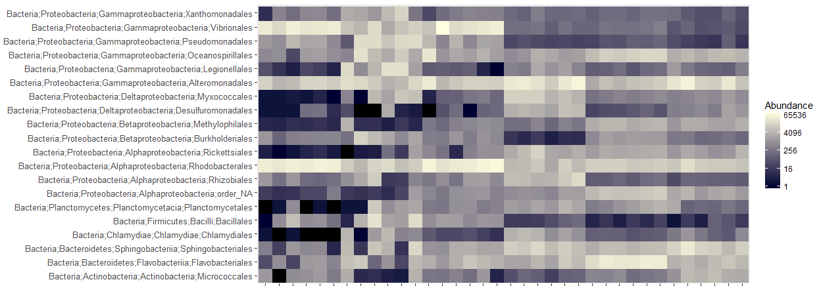
Day | 5 | 12 | 5 | 12 | 1 | 12
Sample Type | Oyster Larvae |  | Biofilm Swab |  | Rearing Water
Figure S1. The relative abundances of the 20 most abundant orders in oyster, swab, and water samples from Trial 1.
Notes:
Figure S1. The relative abundances of the 20 most abundant orders in oyster, swab, and water samples from Trial 1.
1275 x 602

Slide 12
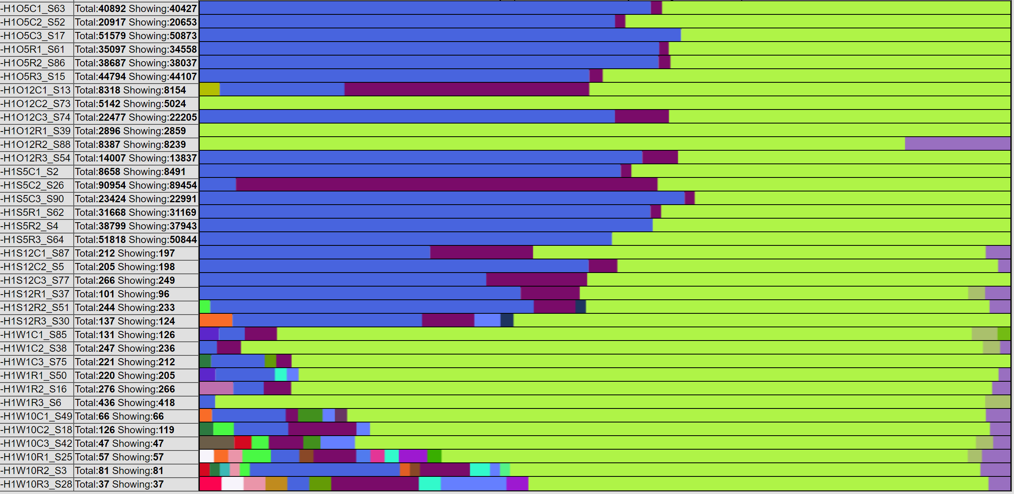
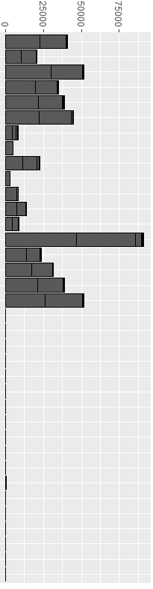

Type | Day | Group
Oyster Larvae | 5 | Con
 |  | Treat
 | 12 | Con
 |  | Treat
Biofilm Swab | 5 | Con
 |  | Treat
 | 12 | Con
 |  | Treat
Rearing Water | 1 | Con
 |  | Treat
 | 12 | Con
 |  | Treat
Abundance
Vibrio anguillarum
Vibrio diabolicus
Vibrio spp.
Vibrio splendidus
Vibrio vulnificus
Figure S2. Percent abundances of Vibrio species in all sample types in Trial 1. The total abundance of sequencing reads is shown in the bar graph. The structure of total Vibrios is different based on the sample type and time point.

Slide 13
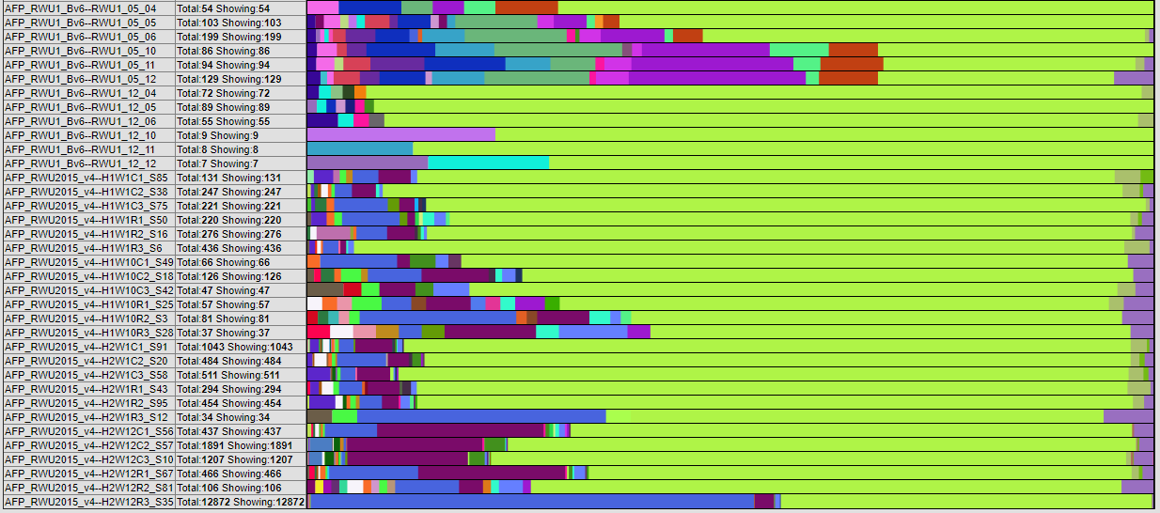
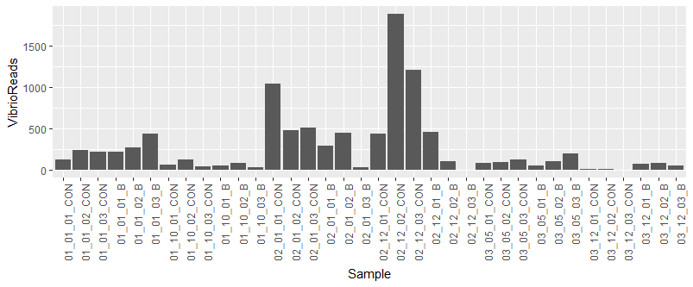
Trial | Day | Group
1 | 1 | Con
 |  | Treat
 | 12 | Con
 |  | Treat
2 | 1 | Con
 |  | Treat
 | 9 | Con
 |  | Treat
3 | 5 | Con
 |  | Treat
 | 12 | Con
 |  | Treat
Abundance
Vibrio anguillarum
Vibrio diabolicus
Vibrio spp.
Vibrio splendidus
Vibrio vulnificus
Figure S3. Percent abundances of Vibrio species in rearing water samples from all 3 Trials. The total abundance of sequencing reads is shown in the bar graph. The structure of total Vibrio counts in the rearing water is different between Trials and changes over time.

