Slide 1
Table 1. Summary of probiotic trial information and sequencing data. W=water, S=swabs, O=oysters
 | Trial 1 | Trial 2 | Trial 3
Sample Types | Water, Swabs, Oysters | Water, Swabs, Oysters | Water
Sampling Days (0=spawn) | W:1,12 / OS:5,12 | W:1,9 / OS:6,9 | W: 5,8,12
Water Filtered | 410-750ml | 7-10ml | 1300-1700ml
Trial Dates | July 11-23, 2012 | Jan 9-18, 2013 | June 3-15, 2016
Bacterial reads from 12 water samples | 1.3 million | 1.8 million | 5.7 million
Methods | MoBio extraction MiSeq, 2x250 PE | MoBio extraction MiSeq, 2x250 PE | Puregene extraction HiSeq, 2x100 PE
16S region | V4 | V4 | V6

Slide 2
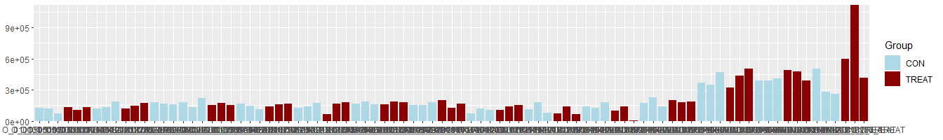
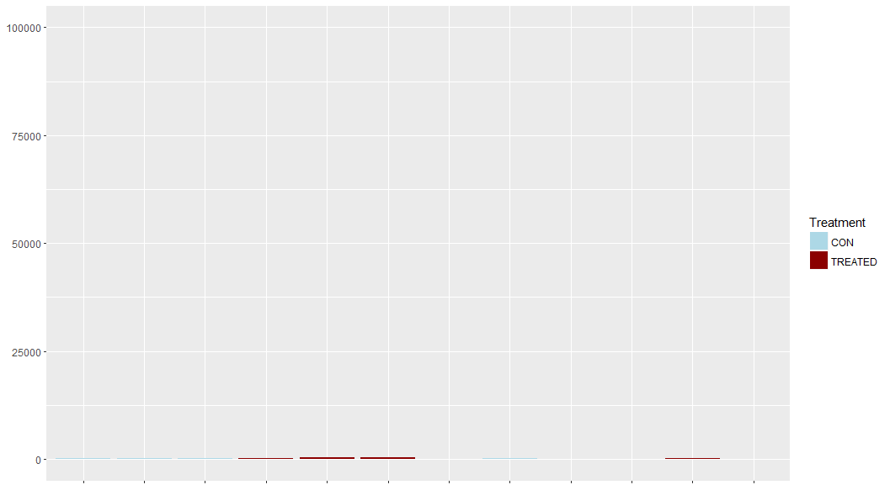
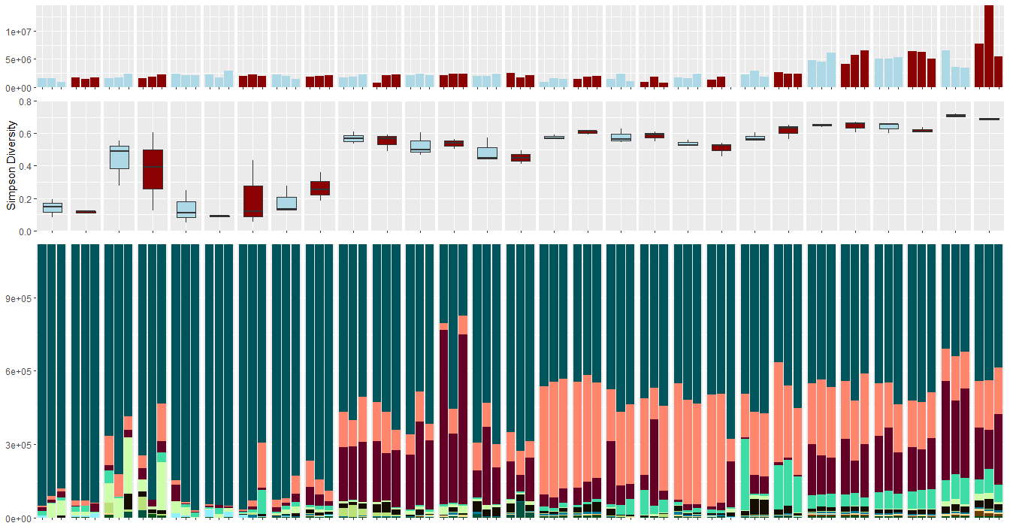
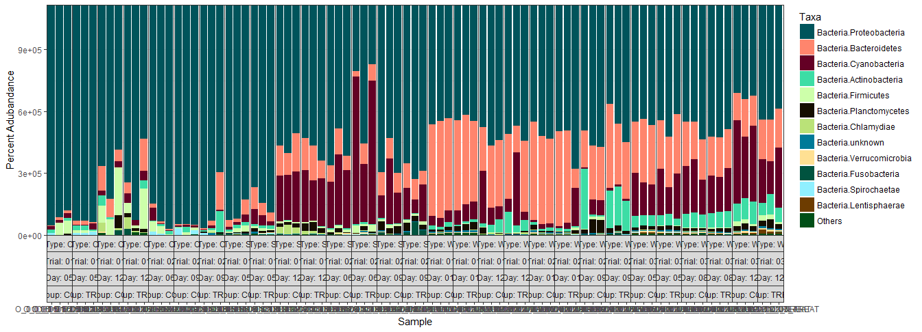
9x10⁵
6x10⁵
3x10⁵
0
5 |  | 12 |  | 6 | 9 |  |  | 5 |  | 12 |  | 6 |  | 9 |  |  | 1 |  | 12 |  | 1 |  | 9 |  | 5 |  | 8 |  | 12 |  | Day
1 |  |  |  | 2 |  |  |  | 1 |  |  |  | 2 |  |  |  |  | 1 |  |  |  | 2 |  |  |  | 3 |  |  |  |  |  | Trial
Oyster Larvae |  |  |  |  |  |  |  | Biofilm Swab |  |  |  |  |  |  |  |  | Rearing Water |  |  |  |  |  |  |  |  |  |  |  |  |  | Type
Group
Read Abundance
Control
Treatment
75
50
25
0
Phylum
Proteobacteria
Bacteroidetes
Cyanobacteria
Actinobacteria
Firmicutes
Planctomycetes
Chlamydiae
Unknown
Verrucomicrobia
Fusobacteria
Spirochaetae
Lentispaerae
Others
Percent Abundance (%)
Figure 1. Percent abundances of the 12 most abundant phyla in all oyster larvae, biofilm swab, and rearing water samples from all 3 Trials based on 16S rDNA amplicon sequencing data (bottom). The total abundance of quality filtered sequencing reads is shown in the bar graph (top). The 12 dominant phyla include Actinobacteria, Bacteroidetes, Cyanobacteria, Deferribacteres, Firmicutes, Fusobacteria, Lentisphaerae, Planctomycetes, Proteobacteria, Spirochaetae, Verrucomicrobia, and Unknown. Note: there are no treated oyster larvae samples from Trial 2, Day 6.
Notes:
1344x486
1344x240

Slide 3
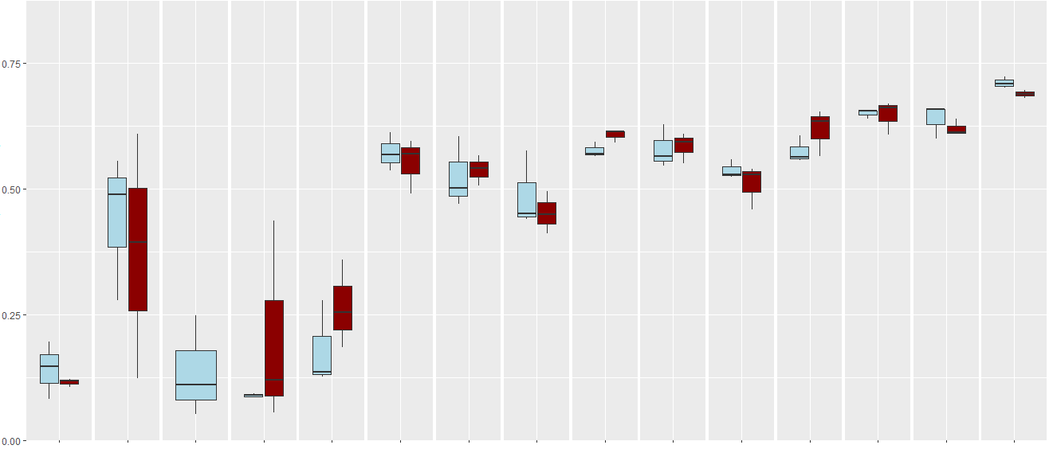
0.75
0.50
0.25
0.00
**
***
**
**
Group
5 |  | 12 |  | 6 |  | 9 |  | 5 |  | 12 |  | 6 |  | 9 |  | 1 |  | 12 |  | 1 |  | 9 |  | 5 |  | 8 |  | 12 |  | Day
1 |  |  |  | 2 |  |  |  | 1 |  |  |  | 2 |  |  |  | 1 |  |  |  | 2 |  |  |  | 3 |  |  |  |  |  | Trial
Oyster Larvae |  |  |  |  |  |  |  | Biofilm Swab |  |  |  |  |  |  |  | Rearing Water |  |  |  |  |  |  |  |  |  |  |  |  |  | Type
**
Control
Treatment
Significance
* p<0.05
** p<0.01
*** p<0.001
Simpson’s Diversity Index
***
***
Figure 2. Simpson’s index of diversity of bacterial communities by sample (larvae, swab, water) and trial (n=3). No significant differences in diversity were found between control (light blue) and treatment (dark red) within each sample type and trial. Bacterial community diversity significantly increased over time in larvae, swab, and water samples from Trial 1, and water samples from Trial 3. Diversity in water was significantly higher in Trial 3 than Trials 1 and 2. Note: there are no treated oyster larvae samples from Trial 2, Day 6.
Notes:
1344x650

Slide 4
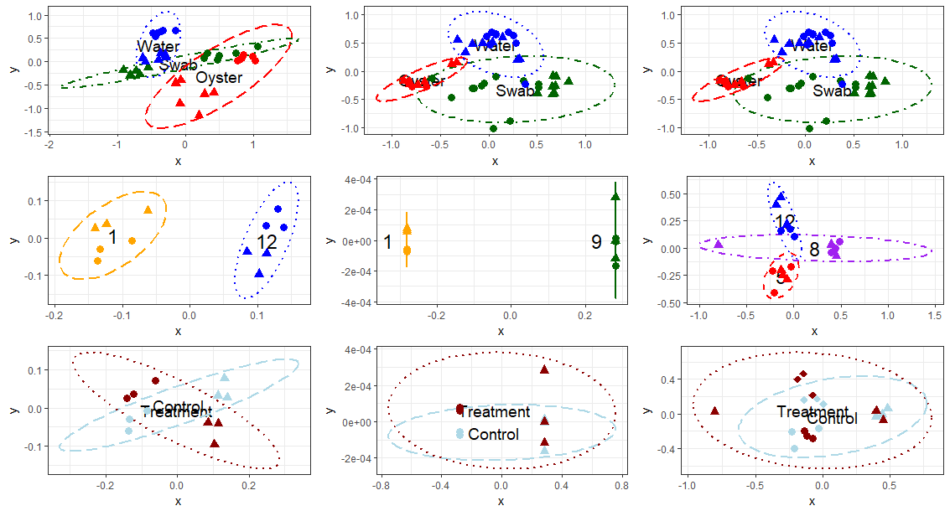
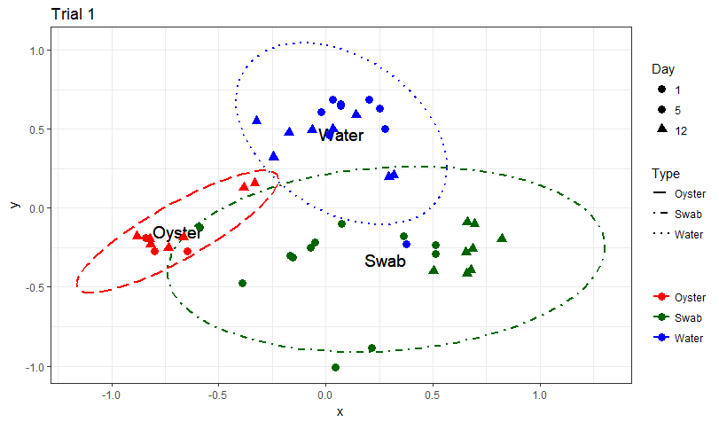
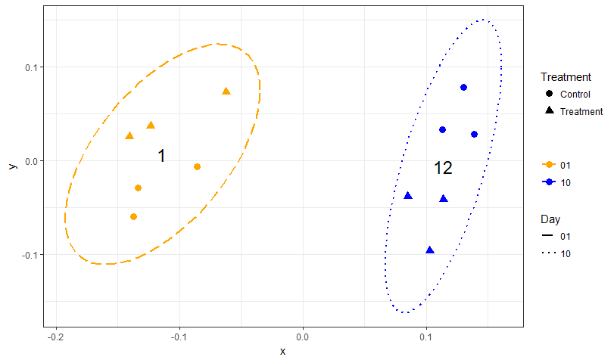
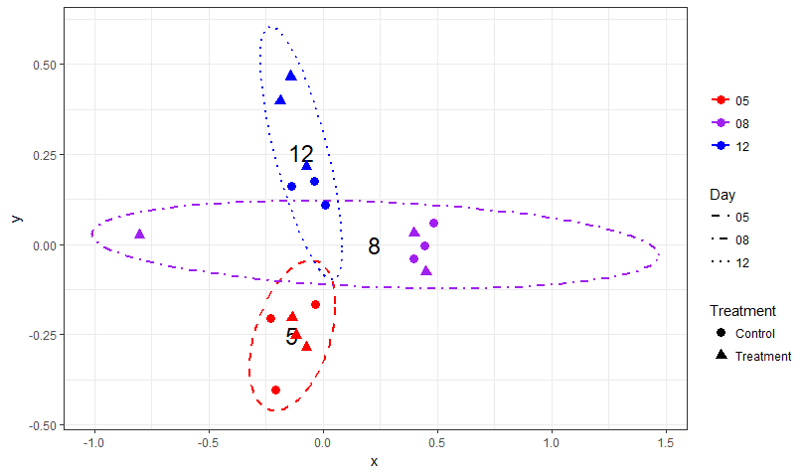
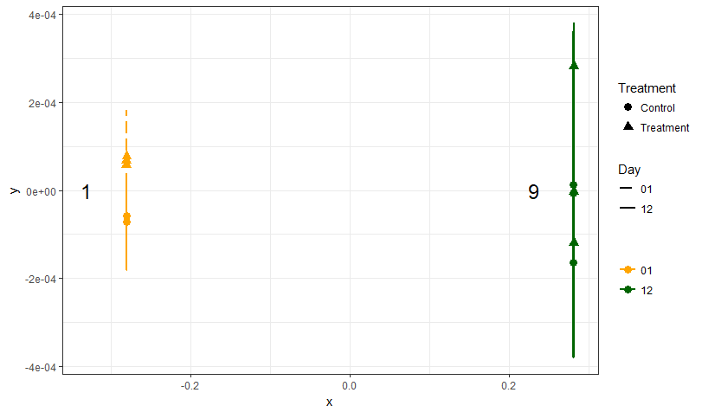
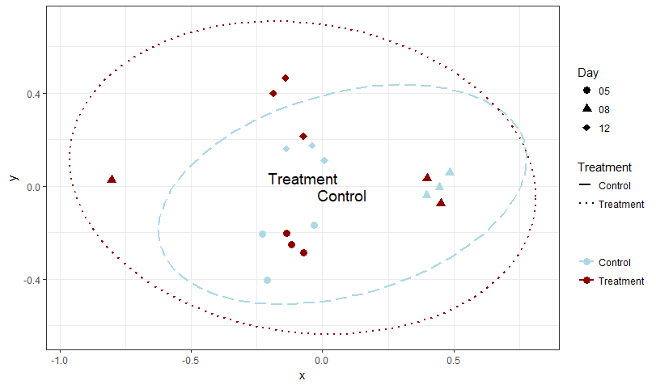
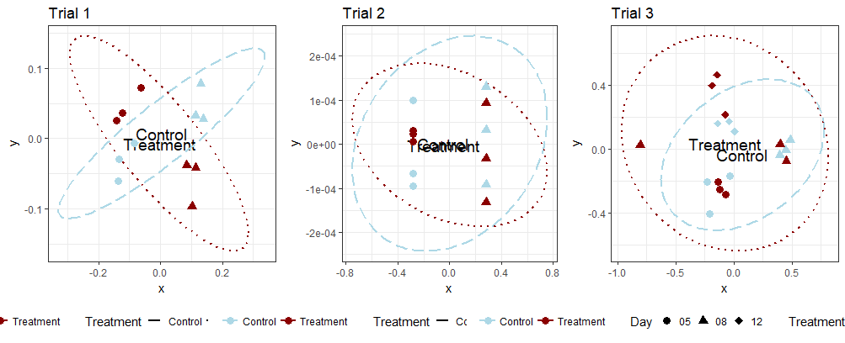
Trial 1
Trial 2
Trial 3
Oyster Swab Water
(a) Sample Type
Day 1/5/6 Day 9/12
Day 1
Day 5
Day 8
Day 9
Day 12
(b) Day
Control Treatment
Control Treatment
(c) Treatment Group
Day 1 12
Day 1 9
Day 5 8 12
Figure 3. NMDS plot visualization of Bray-Curtis beta-diversity (k=2) at the Order level by (a) sample Type, (b) sampling Day, and (c) treatment. (b) and (c) were calculated using only water samples. The ellipse lines show the 95% confidence interval. (a) The different types of samples are indicated by colors (Oyster=dashed red, Swab=dashdot green, Water=dotted blue) and the days are indicated by symbols (Timepoint 1=circle, Timepoint 2=triangle). The water and swab communities were significantly distinct from each other in both trials. (b) The sampling timepoints are indicated by colors (1=longdash yellow, 5=shortdash red, 8=dashdot purple, 9=solid green, 12=dotted blue) and the treatment group is indicated by symbols (control=circle, probiotic treatment=triangle). The water community was significantly different between timepoints. (c) The treatment group is indicated by colors (control=light blue dashed, probiotic treatment=dark red dotted) and sampling timepoints are indicated by symbols. No significant differences in community structure in water from control and probiotic-treated tanks was detected when samples from all time points were analyzed together.

Slide 5
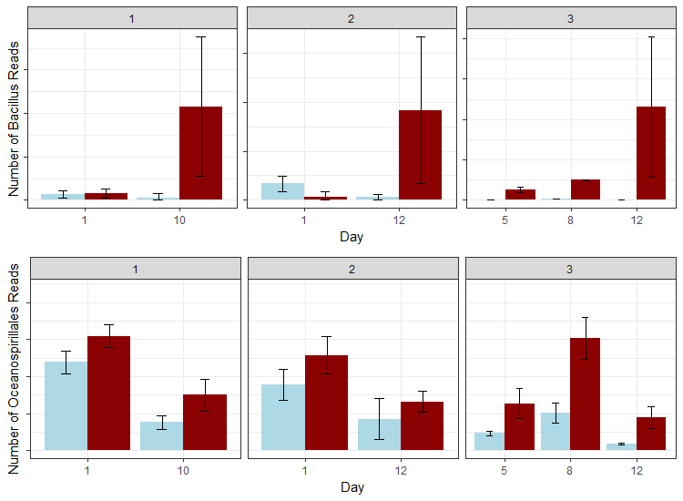
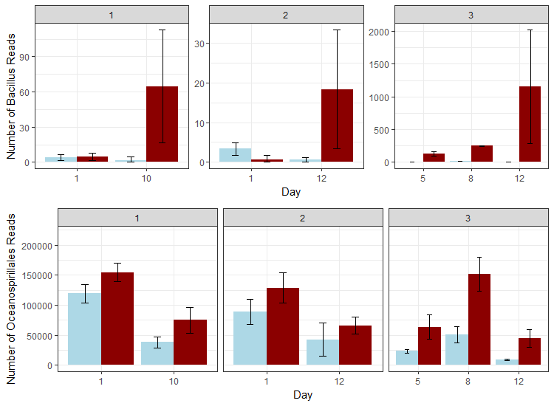
(a) Number of Bacillus Reads
(b) Number of Oceanospirillales Reads
Control
Treatment
***
**
Trial 1
**
Interaction p=0.056
Figure 4. Effect of probiotic treatment on abundance of (a) Bacillus and (b) Oceanospirillales in water. Number of reads in treated (dark red) and control (light blue) samples (n=3) are represented for each sampling day and trial. (a) Bacillus abundance was significantly higher in the treated than the control water after 5 days of treatment, and (b) Oceanospirillales were consistently more abundant in probiotic-treated tank rearing water, and decreased with time. Significance: *p<0.05, **p<0.01, ***p<0.001
Day 1 Day 9
Day 1 Day 9
Interaction p=0.048 *
**
*
*
Trial 2
Day 1 Day 12
Day 1 Day 12
*
*
*
**
Interaction p=0.019 *
Trial 3
**
**
**
**
Day 5 Day 8 Day 12
Day 5 Day 8 Day 12
Notes:
750x550

Slide 6
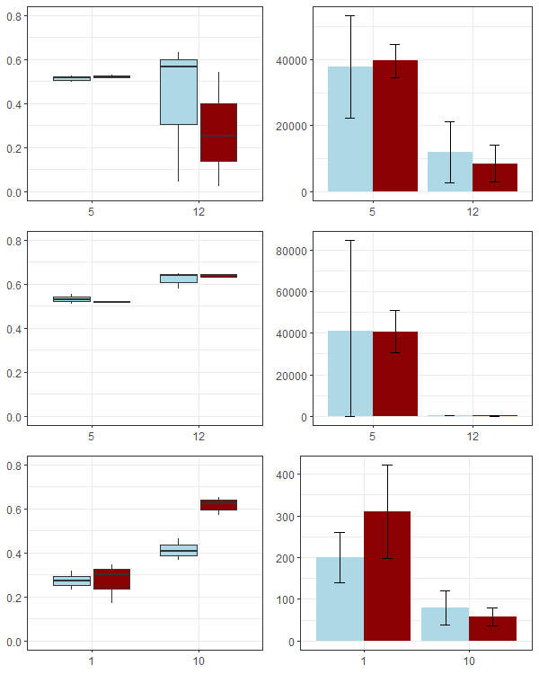
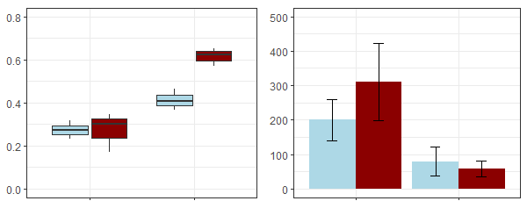
(a) Vibrio Simpson’s Diversity Index
(b) Number of Vibrio Reads
***
Oyster
Figure 5. Effect of treatment, time, and samples type on Simpson’s Index of Diversity for Vibrio (a, boxplots) and Total Vibrio read abundance (b, bar graph). Representative data from Trial 1 (n=3 tanks per treatment). Note different scales for (b). Significance: *p<0.05, **p<0.01, ***p<0.001
Day 5 Day 12
Day 5 Day 12
***
*
Swab
Control
Treatment
Day 5 Day 12
Day 5 Day 12
***
**
*
Water
Interaction p=0.019 *
Day 1 Day 12
Day 1 Day 12
Notes:
600x750

Slide 7
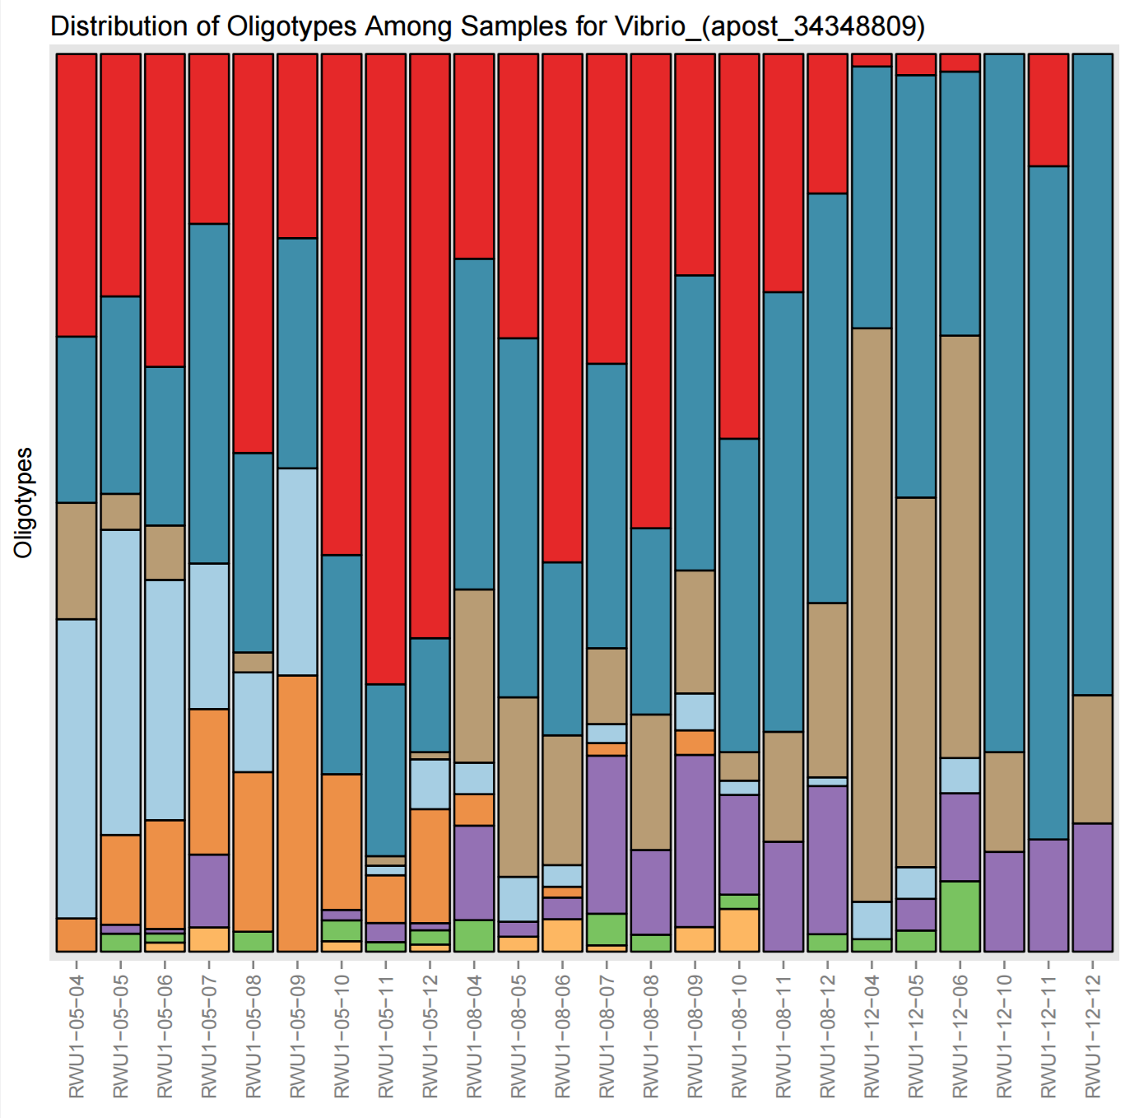
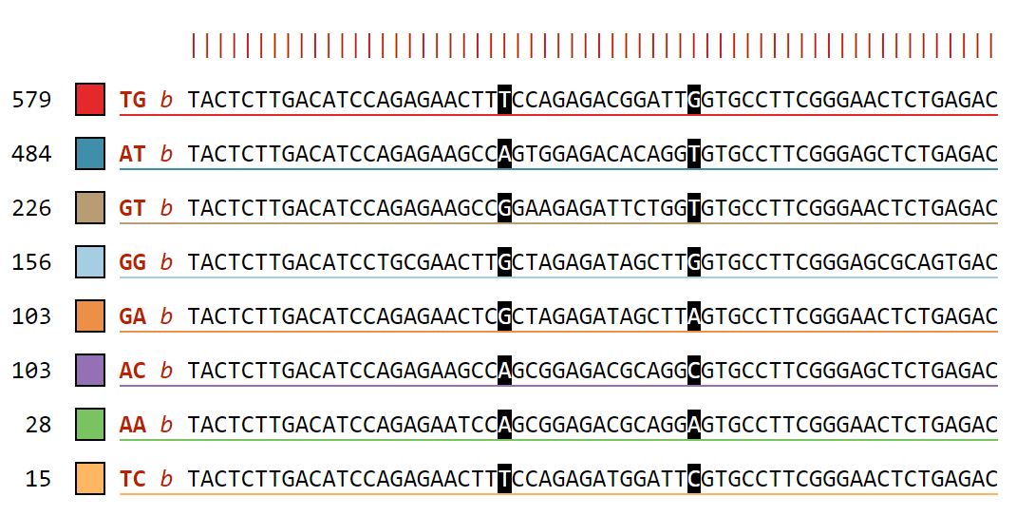
CON | T | CON | T | CON | T
Day 5 |  | Day 8 |  | Day 12
Oligotypes
Number of Sequences
Percent Abundance of Oligotypes
TG: Vibrio alginolyticus strain WW1; GenBank: KX425011.1
AT: Vibrio celticus, isolate 5OM18; GenBank: LN832936.1
GT: Vibrio orientalis, isolate LK2HaP4; GenBank: LT221239.1
GG: Halovibrio sp. strain 5F5; GenBank: KY636397.1
Figure 6. Vibrio spp. oligotypes in Control (CON) and Treatment (T) water samples on Days 5, 8, and 12 from Trial 3. These 8 oligotypes were generated from changes in positions 23 and 37 in a total of 1727 sequences, represented with the 2 letter abbreviations in the legend. The taxonomy of the 4 most abundant oligotypes is shown. Vibrio oligotypes showed differences in succession of species over time between control and treatment rearing water.

Slide 8
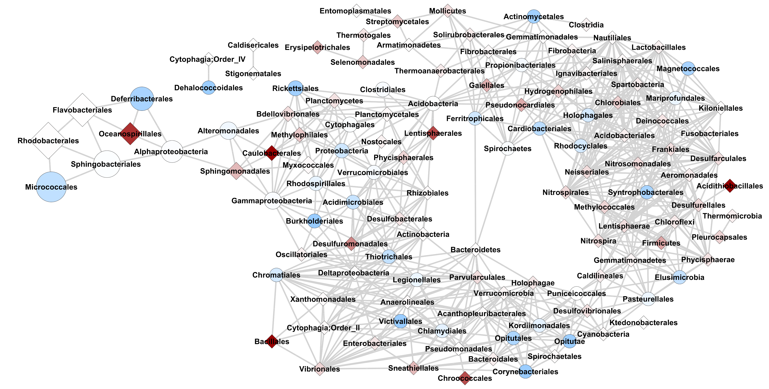


Occurrence
Number of Reads
3.6
1
0
2,700,000
1,350,000
675,000
2
$$\frac{Treatment}{Control}$$
Figure 7. Co-occurrence network analysis based on Bray-Curtis dissimilarity metric (max distance =0.5, Order level) for water samples from Trial 3 (n=18). Taxa that change in the same way share an edge; nodes that have edges occur in the same proportions and in the same samples. Darker blue circle nodes indicate taxa that occur in the Control significantly more than Treated water samples. White nodes have equal occurrence in treated and control water samples. Darker red diamond nodes indicated taxa that occurs in the Treated significantly more than Control water samples.

Slide 9
Supplementary Figures & Tables

Slide 10
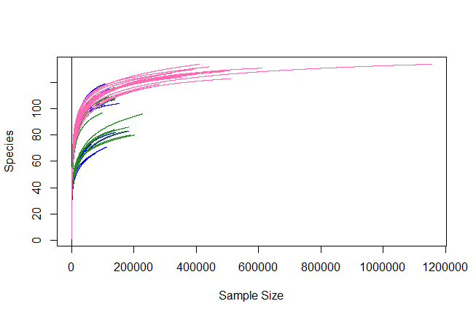
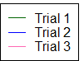
Number of Orders
Trial 1
Trial 2
Trial 3
Sample Size
Figure S1. Rarefaction curve from all water samples from all three Trials based on taxonomic classification at the order level.

Slide 11
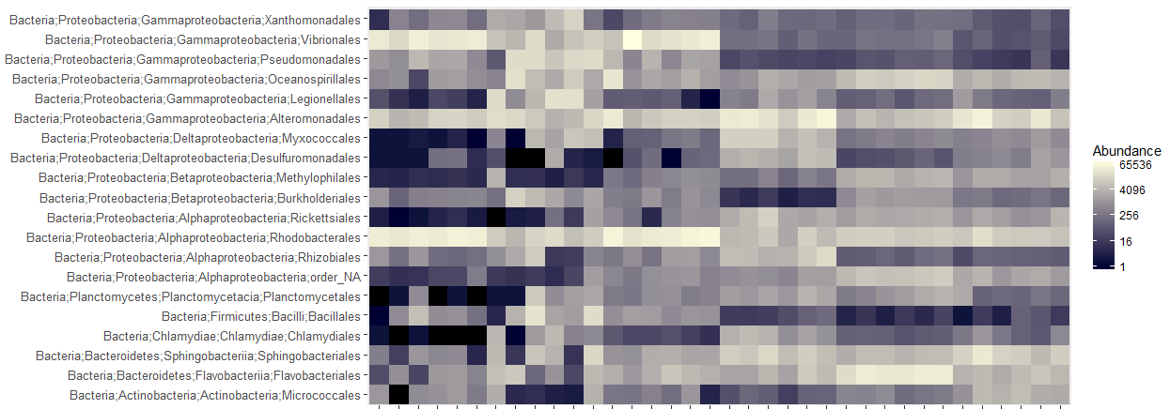
Day | 5 | 12 | 5 | 12 | 1 | 12
Sample Type | Oyster Larvae |  | Biofilm Swab |  | Rearing Water
Figure S2. The relative abundances of the 20 most abundant orders in oyster, swab, and water samples from Trial 1.
Notes:
1275 x 602

Slide 12
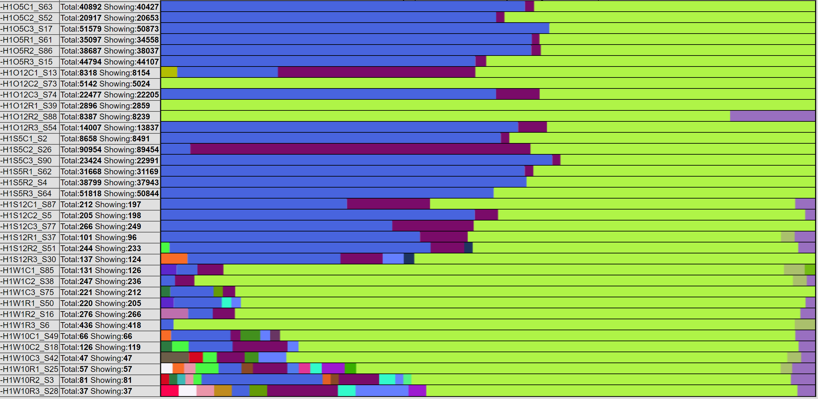
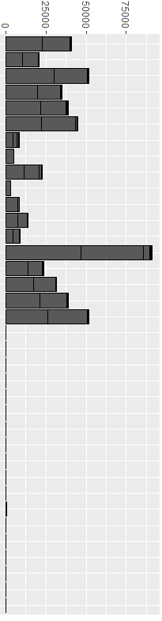

Type | Day | Group
Oyster Larvae | 5 | Con
 |  | Treat
 | 12 | Con
 |  | Treat
Biofilm Swab | 5 | Con
 |  | Treat
 | 12 | Con
 |  | Treat
Rearing Water | 1 | Con
 |  | Treat
 | 12 | Con
 |  | Treat
Abundance
Vibrio anguillarum
Vibrio diabolicus
Vibrio spp.
Vibrio splendidus
Vibrio vulnificus
Figure S3. Percent abundances of Vibrio species in all sample types in Trial 1. The total abundance of sequencing reads is shown in the bar graph. The structure of total Vibrios is different based on the sample type and time point.

Slide 13
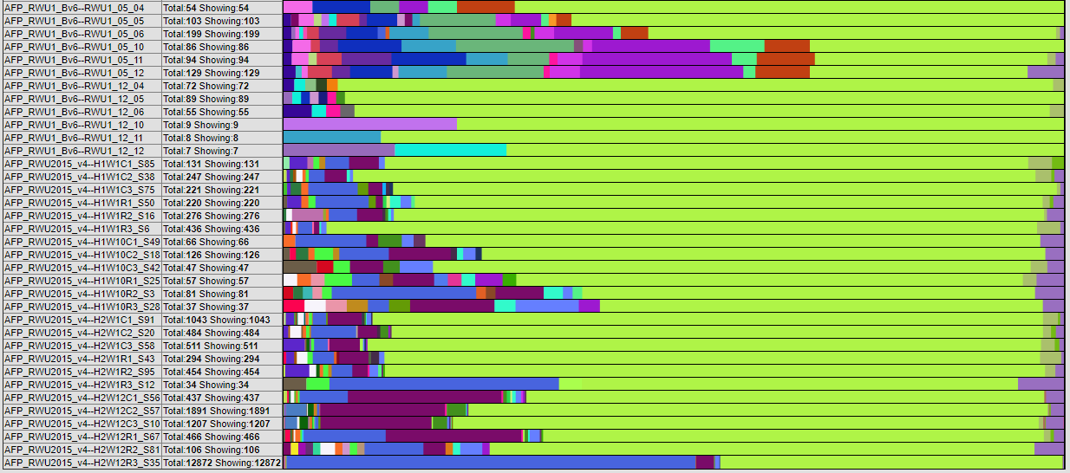
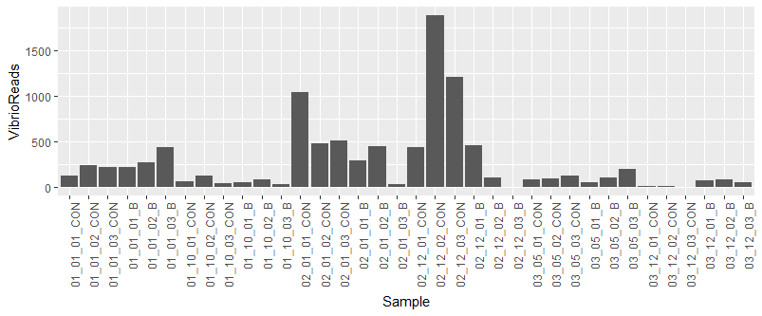
Trial | Day | Group
1 | 1 | Con
 |  | Treat
 | 12 | Con
 |  | Treat
2 | 1 | Con
 |  | Treat
 | 9 | Con
 |  | Treat
3 | 5 | Con
 |  | Treat
 | 12 | Con
 |  | Treat
Abundance
Vibrio anguillarum
Vibrio diabolicus
Vibrio spp.
Vibrio splendidus
Vibrio vulnificus
Figure S4. Percent abundances of Vibrio species in rearing water samples from all 3 Trials. The total abundance of sequencing reads is shown in the bar graph. The structure of total Vibrio counts in the rearing water is different between Trials and changes over time.

Slide 14
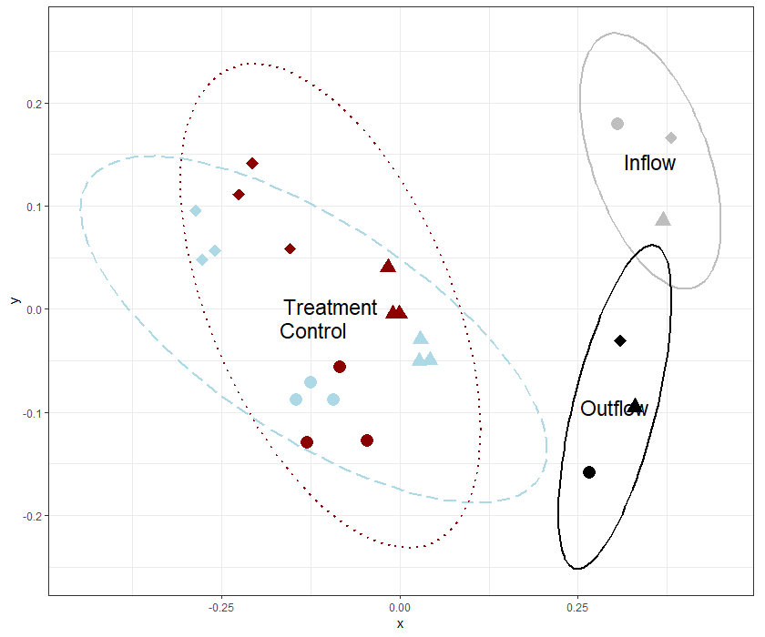
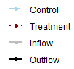
Water Group
Control
Treatment
Inflow
Outflow
Day
5
8
12
Figure S5. NMDS plot visualization of Bray-Curtis beta-diversity (k=2) at the Order level by Treatment or Water Source of water samples from Trial 3. The ellipse lines show the 95% confidence interval. The water group is indicated by colors (control=light blue dashed, probiotic treatment=dark red dotted, inflow=grey solid, outflow=black solid) and sampling timepoints are indicated by symbols. The inflow water (water piped directly from the environment into the hatchery) and outflow water (inflow water UV-treated and sterilized) are significantly distinct groups, separate from the experimental samples.

Slide 15
Table S1. ANOVA for abundance of Proteobacteria and Cyanobacteria by Sample Type.
< All Trials - Proteobacteria >
ANOVA table | DF | SS | MS | F | P value
Sample Type | 1 | 6.57E+11 | 6.57E+11 | 19.75 | 2.65E-05 | ***
Residuals | 85 | 2.83E+12 | 3.33E+10
< All Trials - Cyanobacteria >
ANOVA table | DF | SS | MS | F | P value
Sample Type | 1 | 4.35E+11 | 4.35E+10 | 2.24 | 0.138
Residuals | 85 | 1.65E+12 | 1.94E+10
Sample Type – no water | 1 | 9.19E+11 | 4.19E+11 | 23.51 | 1.66E-05 | ***
Residuals | 43 | 7.67E+11 | 1.78E+10

Slide 16
Table S2. Two-way ANOVAs for the Simpson’s Index of Diversity values by Trial, Sample Type, Day, and/or Treatment.
< All Trials – Simpson’s Index of Diversity >
ANOVA table | DF | SS | MS | F | P value
Trial | 1 | 0.5689 | 0.5689 | 43.4 | 4.16E-09 | ***
Type | 2 | 1.6714 | 0.8357 | 63.76 | < 2e-16 | ***
Trial:Type | 2 | 0.1628 | 0.0814 | 6.21 | 0.0031 | **
Residuals | 81 | 1.0617 | 0.0131
< All Trials – Simpson’s Index of Diversity >
ANOVA table | DF | SS | MS | F | P value
Day | 1 | 0.07 | 0.06988 | 1.72 | 0.193
Group | 1 | 0.016 | 0.01577 | 0.388 | 0.535
Day:Group | 1 | 0.007 | 0.00711 | 0.175 | 0.677
Residuals | 83 | 3.372 | 0.04063
< All Trials – Water Only – Simpson’s Index of Diversity >
ANOVA table | DF | SS | MS | F | P value
Trial | 1 | 0.04629 | 0.04629 | 19.46 | 7.55E-05 | ***
Residuals | 40 | 0.09514 | 0.00238

Slide 17
Table S3. Two-way ANOVAs for the Simpson’s Index of Diversity values by Day and Treatment in Trial 1.
< Trial 1 - Water >
ANOVA table | DF | SS | MS | F | P value
Day | 1 | 0.000277 | 0.0002775 | 0.35 | 0.571
Treatment | 1 | 9.36E-04 | 9.37E-04 | 1.18 | 0.309
Day:Treatment | 1 | 4.94E-04 | 4.94E-04 | 0.623 | 0.453
Residuals | 8 | 0.006347 | 0.0007933
< Trial 1 - Biofilm Swab >
ANOVA table | DF | SS | MS | F | P value
Day | 1 | 0.3443 | 0.3443 | 71.378 | 2.94E-05 | ***
Treatment | 1 | 0.0032 | 0.0032 | 0.663 | 0.439
Day:Treatment | 1 | 8.40E-03 | 8.40E-03 | 1.75 | 0.222
Residuals | 8 | 3.86E-02 | 4.80E-03
< Trial 1 - Oyster Larvae >
ANOVA table | DF | SS | MS | F | P value
Day | 1 | 0.2348 | 0.2348 | 11.312 | 0.00988 | **
Treatment | 1 | 0.00625 | 0.00625 | 0.301 | 0.59824
Day:Treatment | 1 | 0.00121 | 0.00121 | 0.058 | 0.8155
Residuals | 8 | 0.16606 | 0.02076

Slide 18
Table S4. Two-way ANOVAs for the Simpson’s Index of Diversity values by Day and Treatment in Trial 2.
< Trial 2 - Water >
ANOVA table | DF | SS | MS | F | P value
Day | 1 | 0.016033 | 0.016033 | 12.27 | 0.00805 | **
Treatment | 1 | 0.000141 | 0.000141 | 0.108 | 0.75137
Day:Treatment | 1 | 0.003703 | 0.003703 | 2.834 | 0.13078
Residuals | 8 | 0.010454 | 0.001307
< Trial 2 - Biofilm Swab >
ANOVA table | DF | SS | MS | F | P value
Day | 1 | 0.01117 | 0.01117 | 3.346 | 0.105
Treatment | 1 | 0.000421 | 0.000421 | 0.126 | 0.732
Day:Treatment | 1 | 0.001787 | 0.001787 | 0.535 | 0.485
Residuals | 8 | 0.026704 | 0.003338
< Trial 2 - Oyster Larvae >
ANOVA table | DF | SS | MS | F | P value
Day | 1 | 0.00021 | 0.000206 | 0.012 | 0.917
Treatment | 1 | 0.01966 | 0.019658 | 1.136 | 0.327
Resduals | 6 | 0.10379 | 0.017298

Slide 19
Table S5. Two-way ANOVA for the Simpson’s Index of Diversity values by Day and Treatment in Trial 3.
< Trial 3 - Water >
ANOVA table | DF | SS | MS | F | P value
Day | 1 | 0.009329 | 0.009329 | 10.68 | 0.00561 | **
Treatment | 1 | 0.001006 | 0.001006 | 1.152 | 0.30125
Day:Treatment | 1 | 0.000254 | 0.000254 | 0.291 | 0.59832
Residuals | 14 | 0.012229 | 0.000873

Slide 20
Table S6. Two-way ANOVAs for abundance of Bacillus spp. reads in water samples per Trial by Day and Treatment Group.
< Trial 1 – Bacillus spp. >
ANOVA table | DF | SS | MS | F | P value
Day | 1 | 2494 | 2494.1 | 4.282 | 7.23E-02 | .
Treatment | 1 | 3040 | 3040.1 | 5.219 | 0.0517 | .
Day:Treatment | 1 | 2.91E+03 | 2.91E+03 | 5.003 | 0.0557 | .
Residuals | 8 | 4.66E+03 | 5.83E+02
< Trial 2 – Bacillus spp. >
ANOVA table | DF | SS | MS | F | P value
Day | 1 | 168.8 | 168.75 | 2.956 | 0.1239
Treatment | 1 | 168.7 | 168.75 | 2.956 | 0.1239
Day:Treatment | 1 | 310.1 | 310.08 | 5.432 | 0.0481 | *
Residuals | 8 | 456.7 | 57.08
< Trial 3 – Bacillus spp. >
ANOVA table | DF | SS | MS | F | P value
Day | 1 | 834952 | 834952 | 6.866 | 0.02017 | *
Treatment | 1 | 1142568 | 1142568 | 9.395 | 0.00839 | **
Day:Treatment | 1 | 848829 | 848829 | 6.98 | 0.01933 | *
Residuals | 14 | 1702573 | 121612

Slide 21
Table S7. Two-way ANOVAs for abundance of Oceanospirillales reads in water samples per Trial by Day and Treatment Group.
< Trial 1 – Oceanospirillales >
ANOVA table | DF | SS | MS | F | P value
Day | 1 | 1.93E+10 | 1.93E+10 | 74.823 | 2.48E-05 | ***
Treatment | 1 | 3.91E+09 | 3.91E+09 | 15.202 | 0.00455 | **
Day:Treatment | 1 | 1.96E+06 | 1.96E+06 | 0.008 | 0.93269
Residuals | 8 | 2.06E+09 | 2.57E+08
< Trial 2 – Oceanospirillales >
ANOVA table | DF | SS | MS | F | P value
Day | 1 | 8.92E+09 | 8.92E+09 | 17.412 | 0.00311 | **
Treatment | 1 | 2.96E+09 | 2.96E+09 | 5.782 | 0.04287 | *
Day:Treatment | 1 | 2.09E+08 | 2.09E+08 | 0.408 | 0.54084
Residuals | 8 | 4.10E+09 | 5.12E+08
< Trial 3 – Oceanospirillales >
ANOVA table | DF | SS | MS | F | P value
Day | 1 | 1.56E+09 | 1.56E+09 | 0.921 | 0.35355
Treatment | 1 | 1.56E+10 | 1.56E+10 | 9.236 | 0.00884 | **
Day:Treatment | 1 | 7.84E+07 | 7.84E+07 | 0.046 | 0.83267
Residuals | 14 | 2.37E+10 | 1.69E+09

Slide 22
Table S8. Two-way ANOVAs for Simpson’s Index of Diversity of Vibrio reads in Trial 1 per Sample Type by Day and Treatment Group.
< All Samples – Vibrio diversity >
ANOVA table | DF | SS | MS | F | P value
Type | 2 | 0.2249 | 0.11245 | 7.261 | 0.00268 | **
Day | 1 | 0.0475 | 0.04752 | 3.069 | 0.09004 | .
Type:Day | 2 | 0.2494 | 0.12471 | 8.053 | 0.00159 | **
Residuals | 30 | 0.4646 | 0.01549
< Oyster Larvae– Vibrio diversity >
ANOVA table | DF | SS | MS | F | P value
Day | 1 | 0.0902 | 0.09025 | 2.118 | .184
Treatment | 1 | 1.27E-02 | 1.27E-02 | 0.298 | .600
Day:Treatment | 1 | 1.68E-02 | 1.68E-02 | 0.395 | 0.547
Residuals | 8 | 3.41E-01 | 4.26E-02
< Biofilm swab– Vibrio diversity >
ANOVA table | DF | SS | MS | F | P value
Day | 1 | 0.03264 | 0.03264 | 66.039 | 3.90E-05 | ***
Treatment | 1 | 0.00001 | 0.00001 | 0.02 | 0.891
Day:Treatment | 1 | 0.00064 | 0.00064 | 1.287 | 0.29
Residuals | 8 | 3.95E-03 | 4.90E-04
< Water – Vibrio diversity >
ANOVA table | DF | SS | MS | F | P value
Day | 1 | 0.17404 | 0.17404 | 48.177 | 0.000119 | ***
Treatment | 1 | 0.02997 | 0.02997 | 8.295 | 0.020507 | *
Day:Treatment | 1 | 0.03068 | 0.03068 | 8.493 | 0.019459 | *
Residuals | 8 | 2.89E-02 | 3.61E-03

Slide 23
Table S9. Two-way ANOVAs for abundance of Vibrio reads in Trial 1 per Sample Type by Day and Treatment Group.
< All Samples – Vibrio reads >
ANOVA table | DF | SS | MS | F | P value
Type | 2 | 4.08E+09 | 2.04E+09 | 12.62 | 0.000105 | ***
Day | 1 | 3.95E+09 | 3.95E+09 | 24.47 | 2.71E-05 | ***
Type:Day | 2 | 3.44E+09 | 1.72E+09 | 10.65 | 0.000319 | ***
Residuals | 30 | 4.85E+09 | 1.62E+08
< Oyster Larvae– Vibrio reads >
ANOVA table | DF | SS | MS | F | P value
Day | 1 | 2.43E+09 | 2.43E+09 | 25.417 | 1.00E-03 | ***
Treatment | 1 | 2.48E+06 | 2.48E+06 | 0.026 | 0.876
Day:Treatment | 1 | 2.09E+07 | 2.09E+07 | 0.219 | 0.653
Residuals | 8 | 7.65E+08 | 9.56E+07
< Biofilm swab– Vibrio reads >
ANOVA table | DF | SS | MS | F | P value
Day | 1 | 4.97E+09 | 4.97E+09 | 9.791 | 0.014 | *
Treatment | 1 | 7.55E+04 | 7.55E+04 | 0 | 0.991
Day:Treatment | 1 | 2.52E+04 | 2.52E+04 | 0 | 0.995
Residuals | 8 | 4.06E+09 | 5.07E+08
< Water – Vibrio reads >
ANOVA table | DF | SS | MS | F | P value
Day | 1 | 1.04E+05 | 1.04E+05 | 22.534 | 0.00145 | **
Treatment | 1 | 6.03E+03 | 6.03E+03 | 1.307 | 0.28601
Day:Treatment | 1 | 1.31E+04 | 1.31E+04 | 2.847 | 0.13005
Residuals | 8 | 3.69E+04 | 4.61E+03

