Slide 1
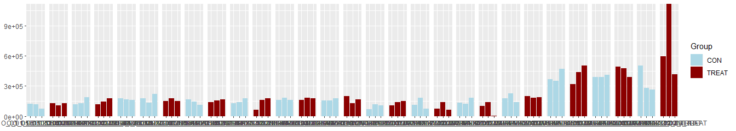
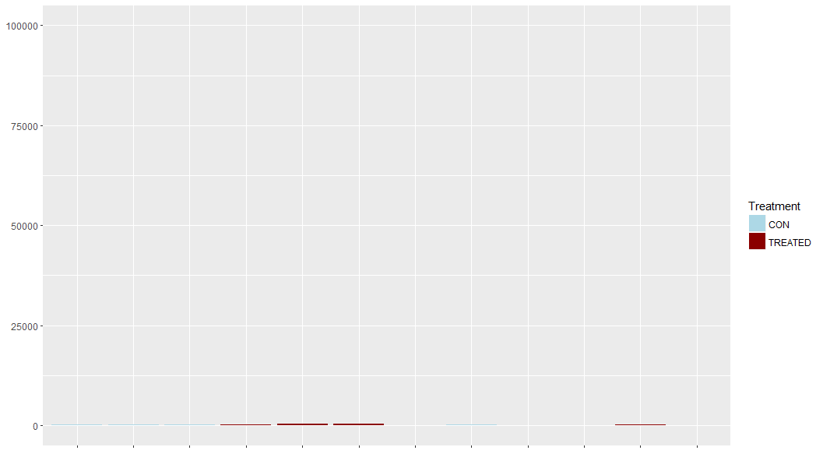
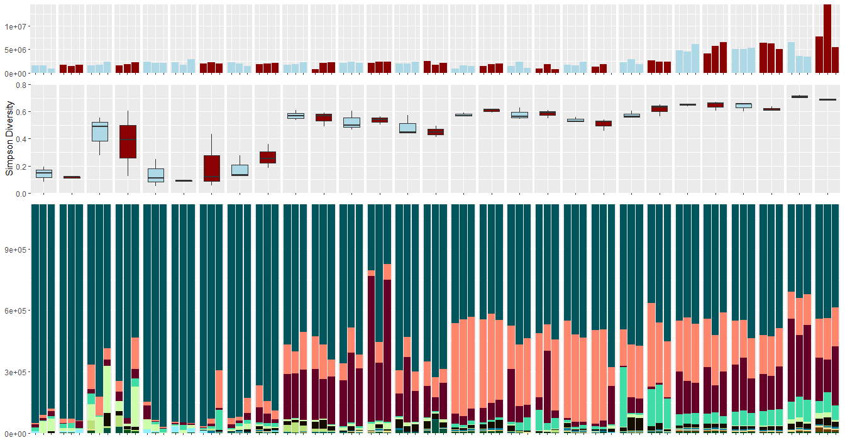
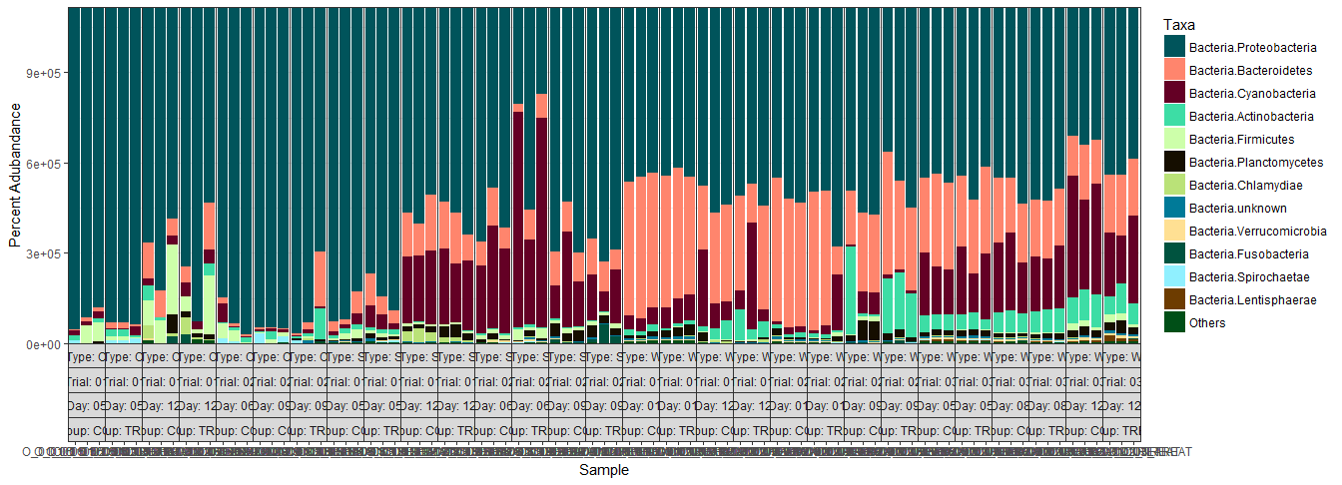
5 |  | 12 |  | 6 |  | 9 |  | 5 |  | 12 |  | 6 |  | 9 |  | 1 |  | 12 |  | 1 |  | 9 |  | 5 |  | 8 |  | 12 |  | Day
1 |  |  |  | 2 |  |  |  | 1 |  |  |  | 2 |  |  |  | 1 |  |  |  | 2 |  |  |  | 3 |  |  |  |  |  | Trial
Oyster Larvae |  |  |  |  |  |  |  | Biofilm Swab |  |  |  |  |  |  |  | Rearing Water |  |  |  |  |  |  |  |  |  |  |  |  |  | Type
9x10⁵
6x10⁵
3x10⁵
0
Group
Read Abundance
Control
Treatment
75
50
25
0
Phylum
Proteobacteria
Bacteroidetes
Cyanobacteria
Actinobacteria
Firmicutes
Planctomycetes
Chlamydiae
Unknown
Verrucomicrobia
Fusobacteria
Spirochaetae
Lentispaerae
Others
Percent Phyla Abundance (%)
Figure 1.
Notes:
1344x486
1344x240

Slide 2
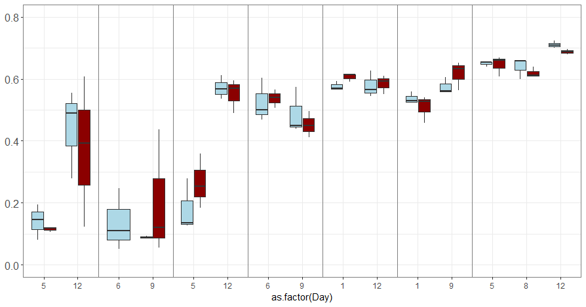
**
**
*
**
**
Group
5 |  | 12 |  | 6 |  | 9 |  | 5 |  | 12 |  | 6 |  | 9 |  | 1 |  | 12 |  | 1 |  | 9 |  | 5 |  | 8 |  | 12 |  | Day
1 |  |  |  | 2 |  |  |  | 1 |  |  |  | 2 |  |  |  | 1 |  |  |  | 2 |  |  |  | 3 |  |  |  |  |  | Trial
Oyster Larvae |  |  |  |  |  |  |  | Biofilm Swab |  |  |  |  |  |  |  | Rearing Water |  |  |  |  |  |  |  |  |  |  |  |  |  | Type
Control
Treatment
***
Significance
* p<0.05
** p<0.01
*** p<0.001
Simpson’s Diversity Index
***
Figure 2.
Notes:
1344x650
UPDATED Kruskal-willis stats.

Slide 3
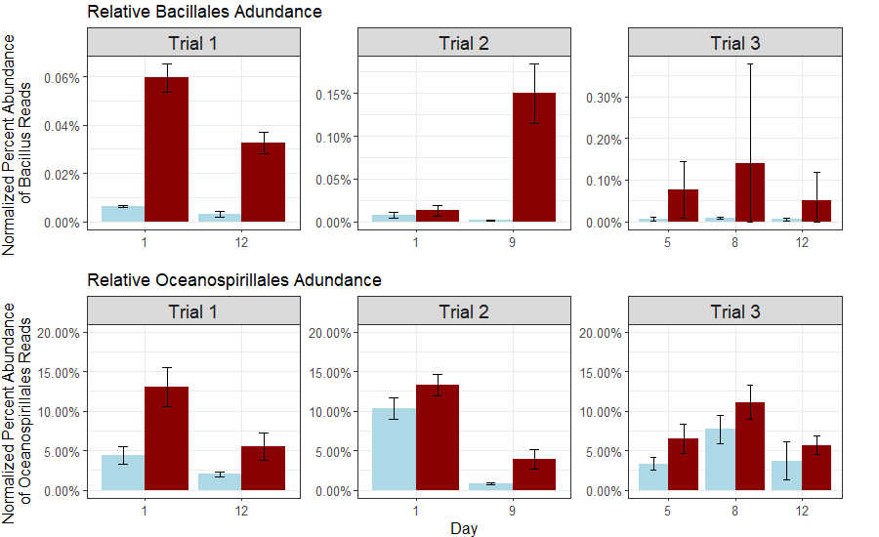
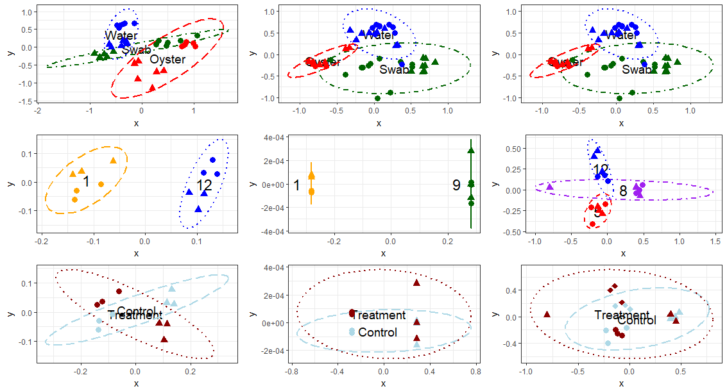
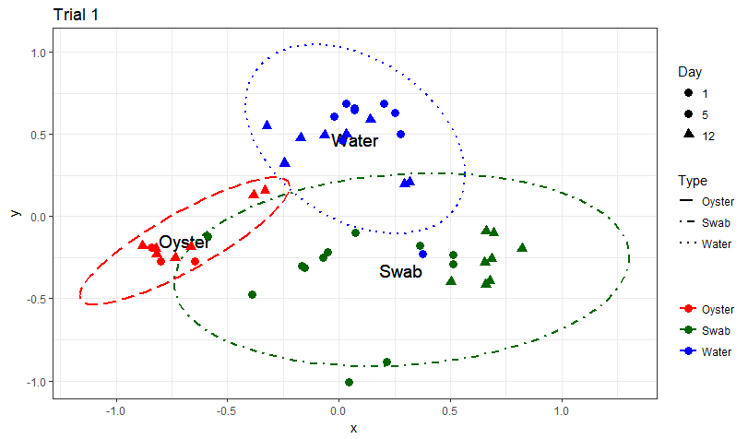
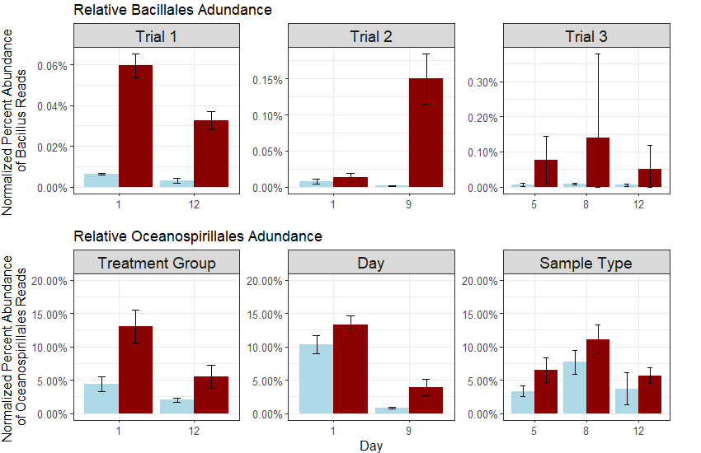
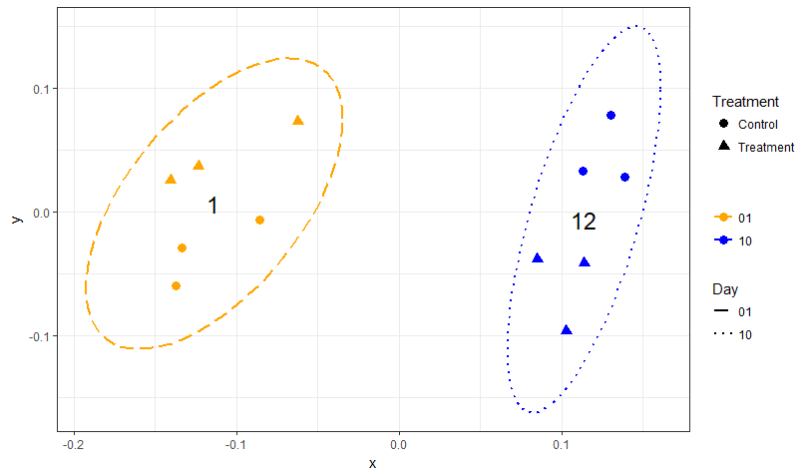
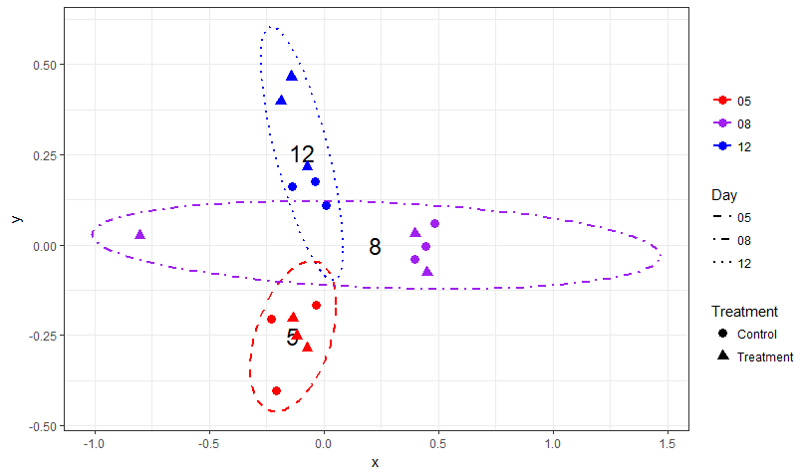
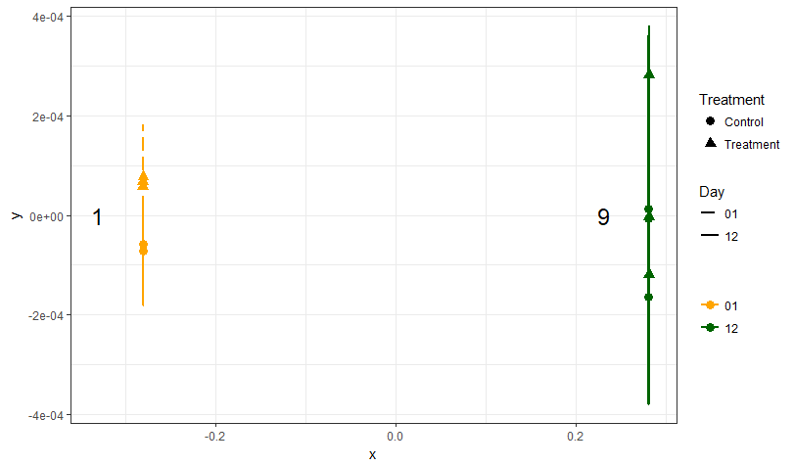
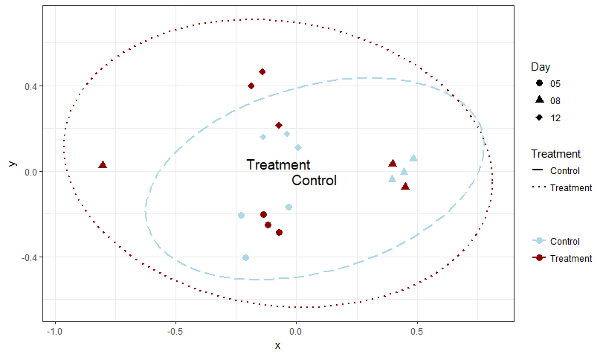
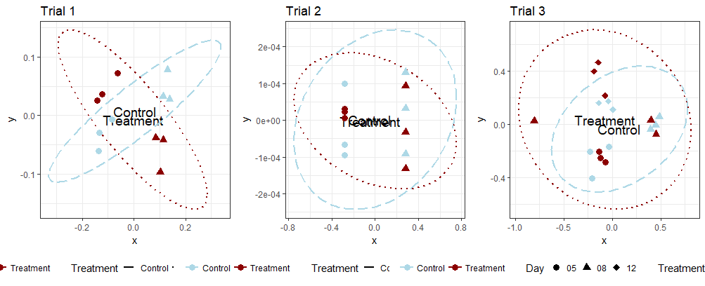
Trial 1
Trial 2
Trial 3
Oyster Swab Water
(A)
p=0.001***
p=0.001***
Day 1/5/6 Day 9/12
Day 1
Day 5
Day 8
Day 9
Day 12
(B)
p=0.006**
p=0.013*
p=0.002**
Control Treatment
Control Treatment
(C)
Day 1 12
Day 1 9
Day 5 8 12
p=0.719
p=0.316
p=0.337
Figure 3.
Notes:
UPDATE p-values.

Slide 4
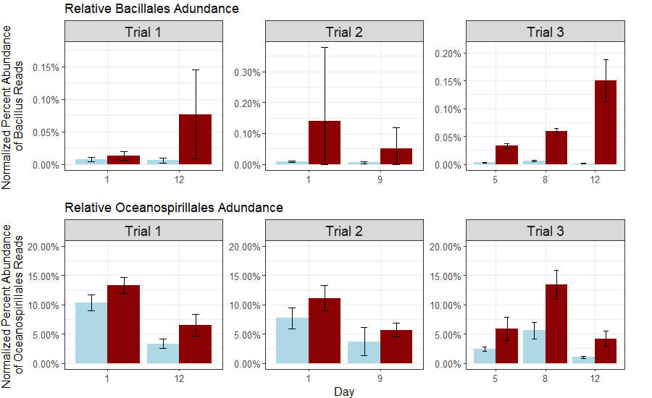
(A)
Control
Treatment
*
*
*
*
*
*
*
(B)
**
*
*
*
*
*
*
*
*
*
Figure 4.
Notes:
900x550
UPDATED Kruskal-willis stats.

Slide 5
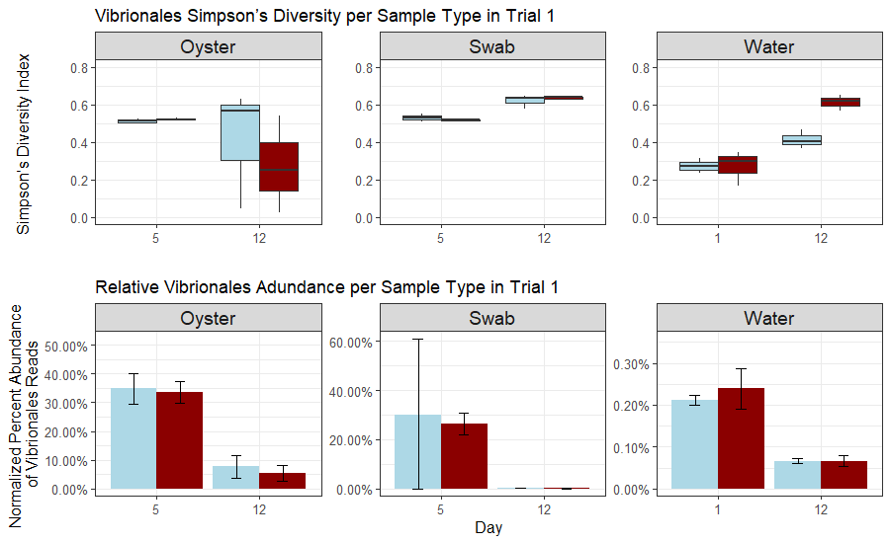
(A)
**
**
*
Control
Treatment
(B)
**
**
**
Figure 5.
Notes:
900x550
UPDATED Kruskal-willis stats.

Slide 6
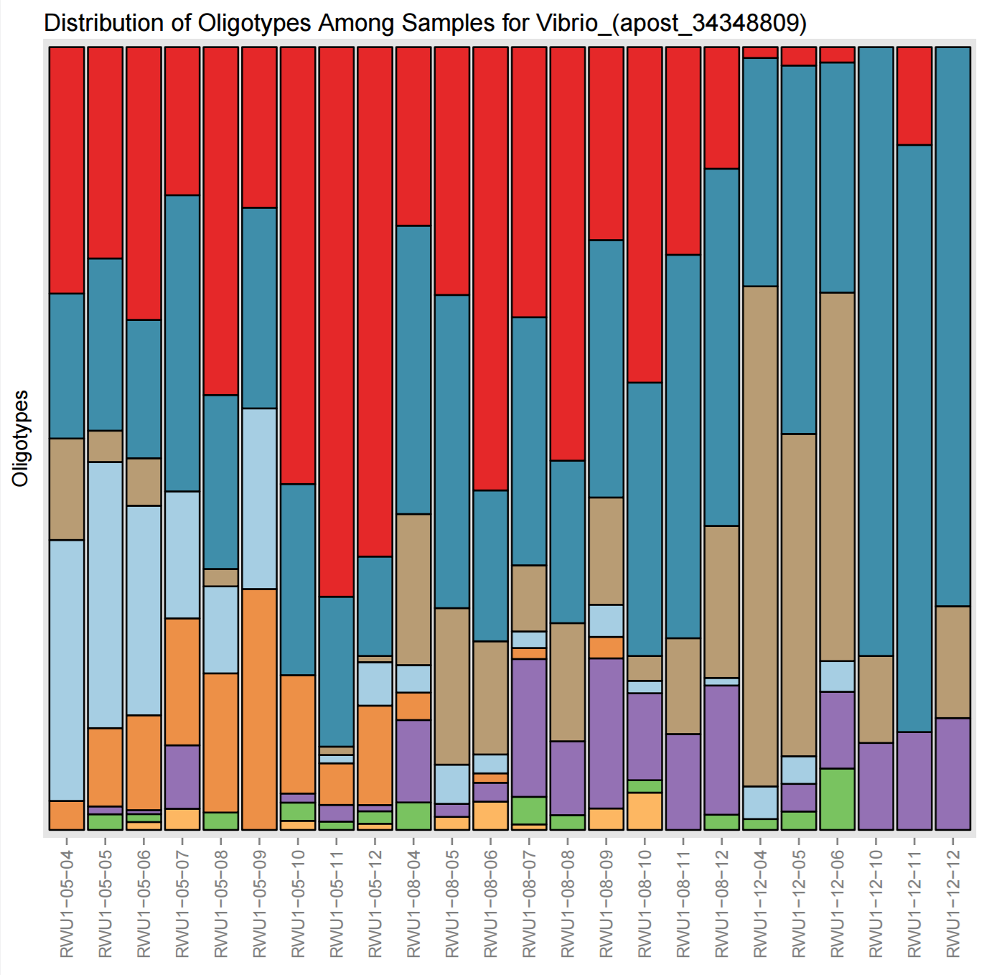
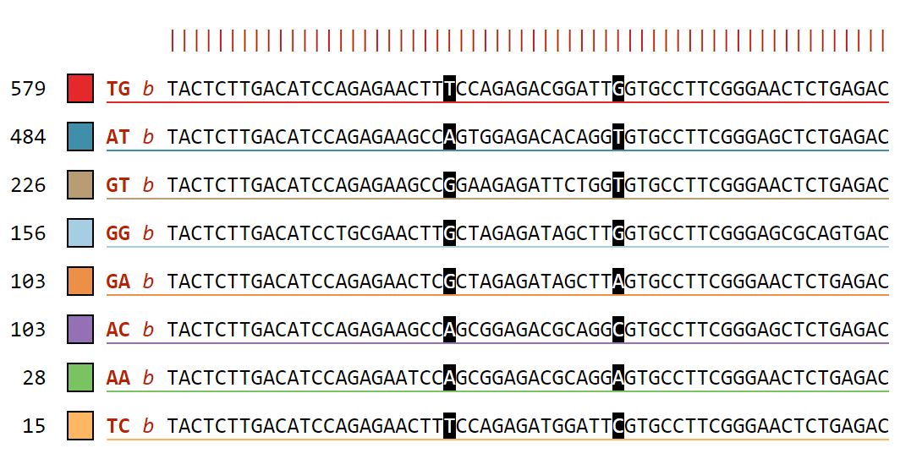
CON | T | CON | T | CON | T
Day 5 |  | Day 8 |  | Day 12
Oligotypes
Number of Sequences
Percent Abundance of Oligotypes
TG: Vibrio alginolyticus strain WW1; GenBank: KX425011.1
AT: Vibrio celticus, isolate 5OM18; GenBank: LN832936.1
GT: Vibrio orientalis, isolate LK2HaP4; GenBank: LT221239.1
GG: Halovibrio sp. strain 5F5; GenBank: KY636397.1
Figure 6.

Slide 7
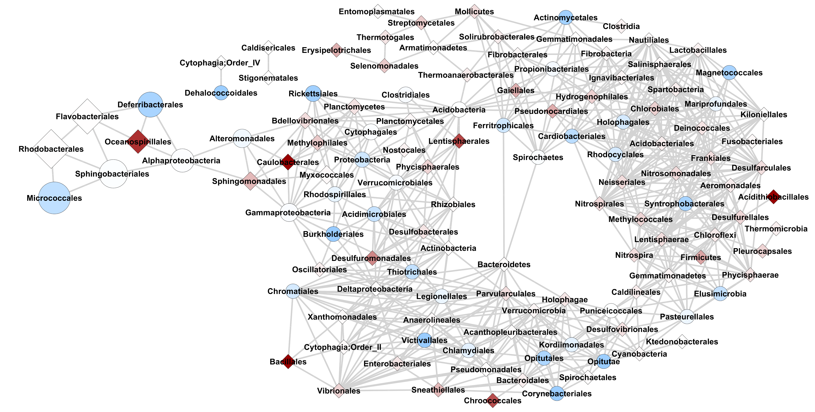


Occurrence
Number of Reads
3.6
1
0
2,700,000
1,350,000
675,000
2
$$\frac{Treatment}{Control}$$
Figure 7.

