Slide 1
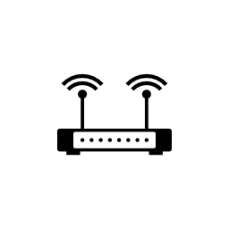


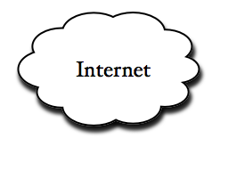
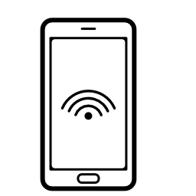
Client
Access
Point
Mesh
Router
Mesh
Router/ Gateway
Mesh Backbone
Client
Access
Point
Mesh
Router
Mesh
Router/ Gateway
Mesh Backbone

