Slide 1
The Vaibhav Gupta Show
So damn sexy these makes and models

Slide 2
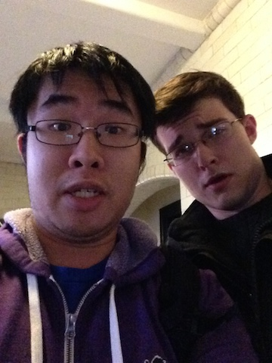

Slide 3
People be like I love Vaibhav because:
sexy ass mofucka

Slide 4
People be like I love Vaibhav because:
sexy ass mofucka
makes and models

Slide 5
People be like I love Vaibhav because:
sexy ass mofucka
makes and models
so damn goopy

Slide 6
compiler = '/Users/tommychen/anaconda/python.app/Contents/MacOS/python' command = compiler + ' build.py'

Slide 7
class AddCommand(sublime_plugin.TextCommand): def run(self, edit): global prev path = open(filename, 'ab') selection = sublime.Region(0, self.view.size()) if len(self.view.sel()) == 1: selection = self.view.sel()[0]

Slide 8
class AddCommand(sublime_plugin.TextCommand): def run(self, edit): global prev path = open(filename, 'ab') selection = sublime.Region(0, self.view.size()) if len(self.view.sel()) == 1: selection = self.view.sel()[0] code = self.view.substr(selection) if code != prev: path.write('\n--------\n') path.write(code) path.write('\n--------\n') path.close() prev = code execute(command)

