Slide 1

Runner solutions

Slide 2
Contents table
Introduction
Project definition
Conceptual and visual design of the interaction
Conclusions

Slide 3

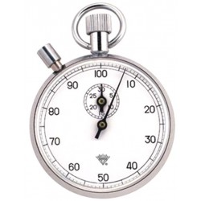
Introduction
Stressed
No time
Solution

Slide 4

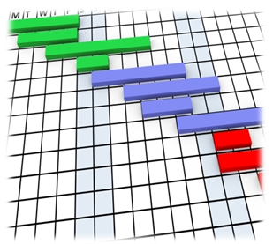


Project definition
Teamwork
Meeting schedule
Team organization
Team tools

Slide 5
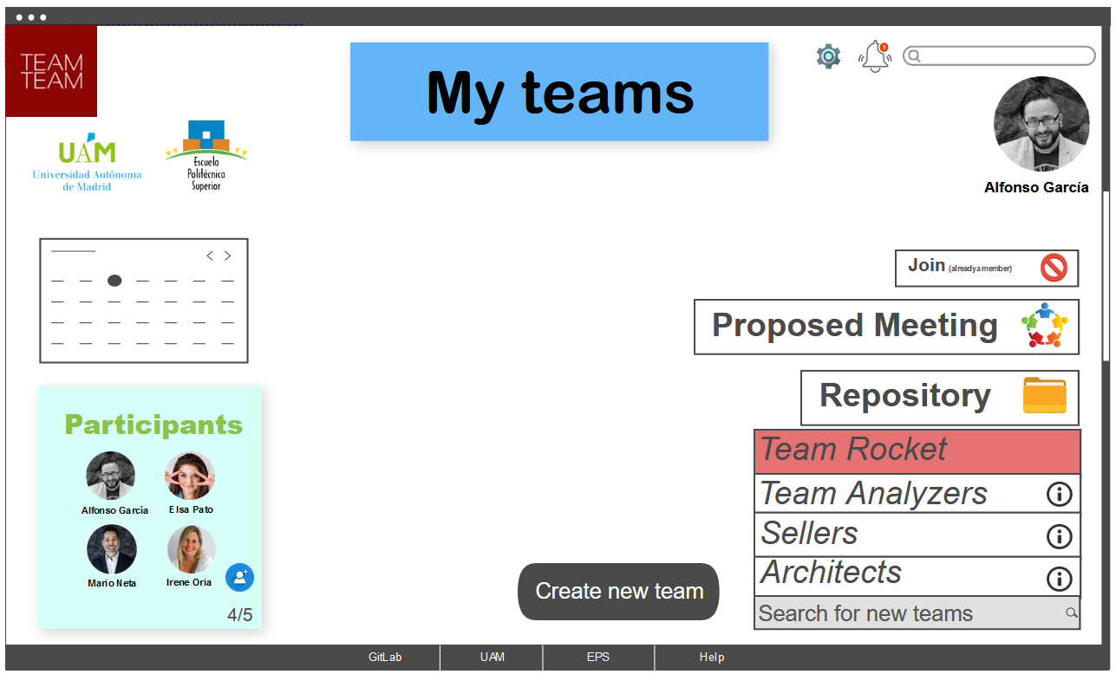
Conceptual and visual design of the interaction

Slide 6
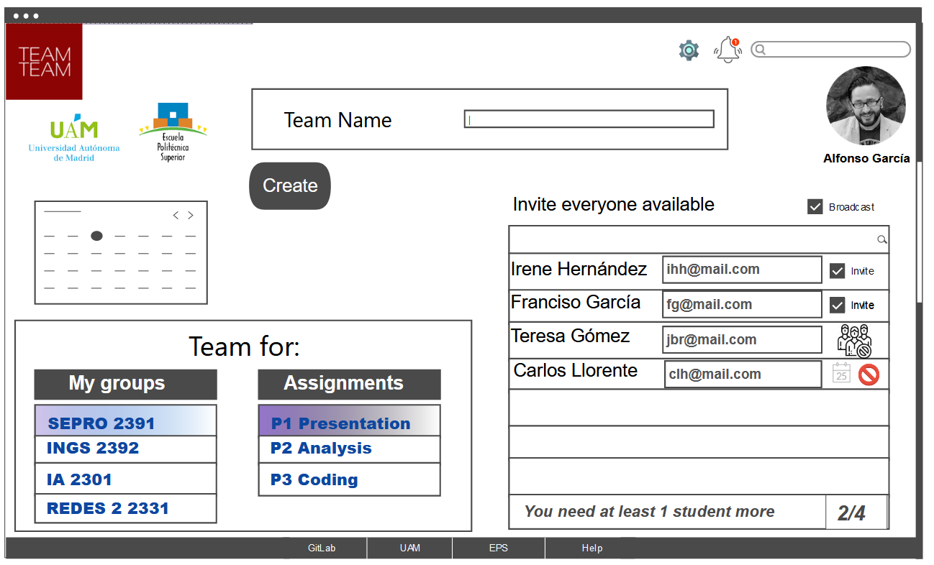
Conceptual and visual design of the interaction

Slide 7
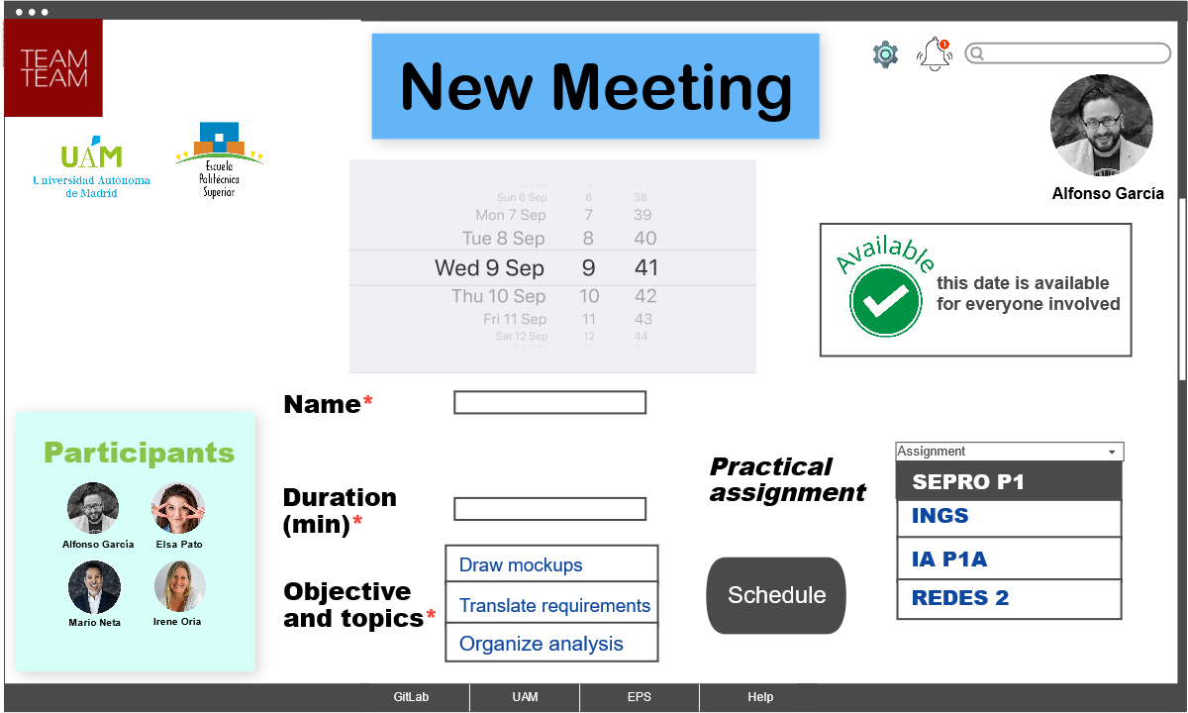
Conceptual and visual design of the interaction

Slide 8
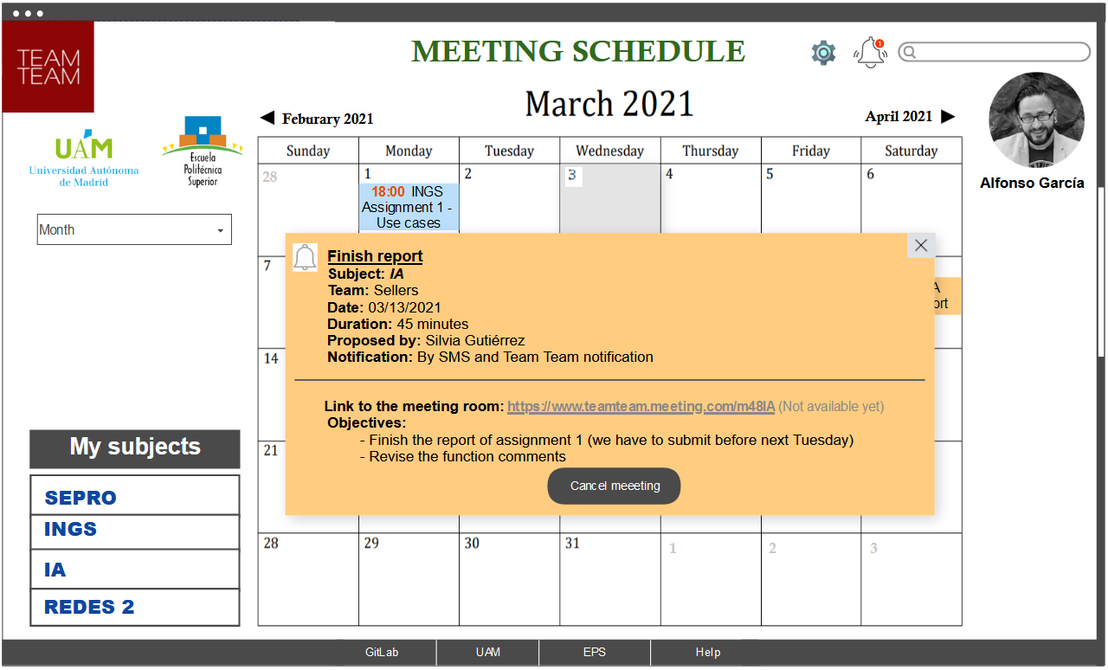
Conceptual and visual design of the interaction

Slide 9
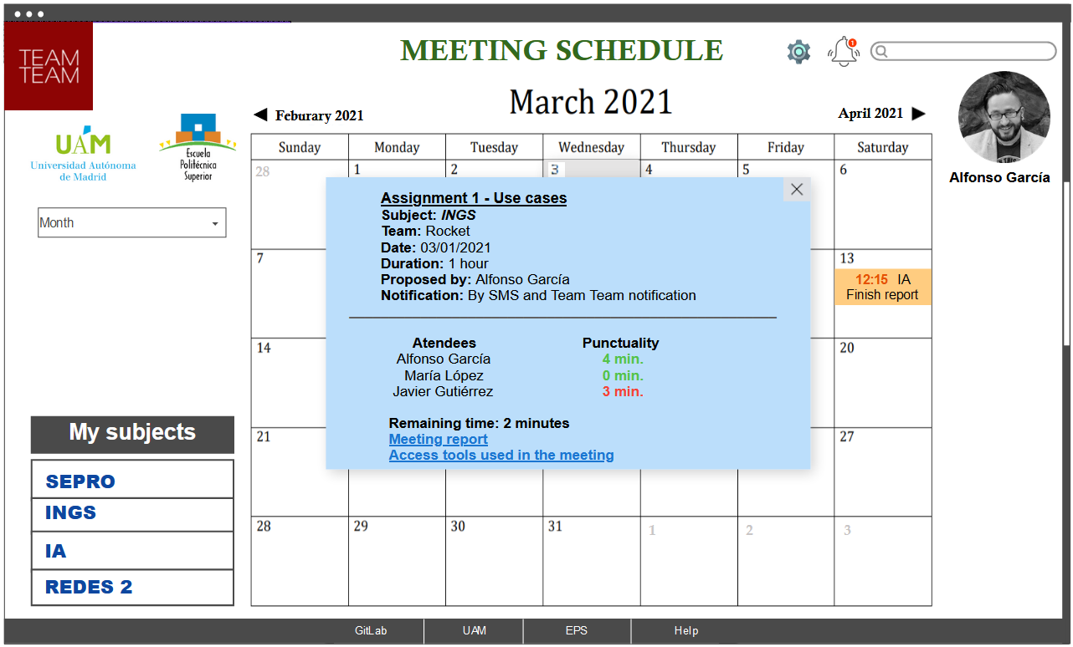
Conceptual and visual design of the interaction

Slide 10
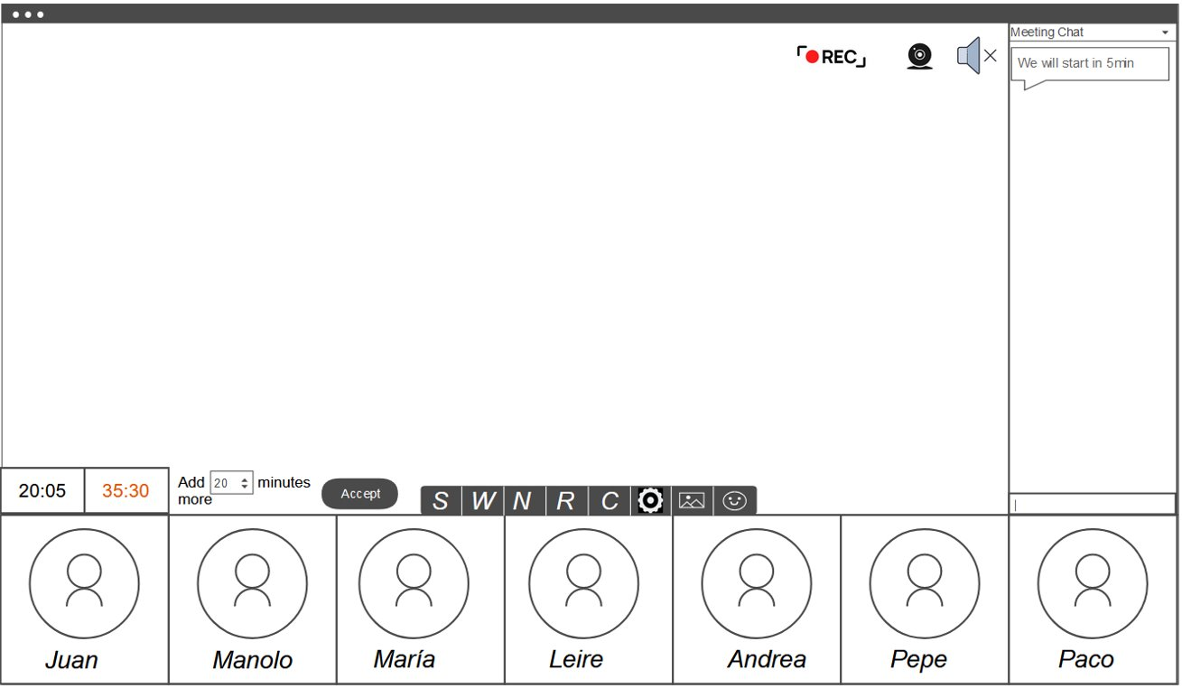
Conceptual and visual design of the interaction

Slide 11



CONCLUSIONS
=
Balance
User friendly
Solution

