Slide 1


Made by: Jorge Blanco Rey
Ángel Casanova Bienzobas
Rodrigo Juez Hernández Pablo Soëtard García
Group: 2391, team 2
Runner solutions

Slide 2
Contents table
Introduction
Project definition
Conceptual and visual design of the interaction
Conclusions
2/15

Slide 3

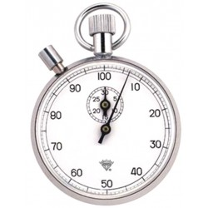
Introduction
Stressed
No time
Solution
3/15

Slide 4

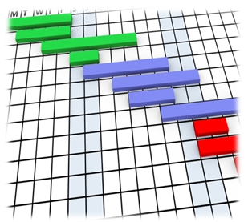


Project definition
Teamwork
Meeting schedule
Team organization
Team tools
4/15

Slide 5


SCOPE
WHAT WE SHALL DO | WHAT WE SHALL NOT DO
Toolbox for meetings | Videocall system
Load information from Moodle | User information
Teams and Meetings are stored in Moodle | Storage of teams and meetings
Integrate everything under the same roof | Reinvent the wheel
5/15

Slide 6
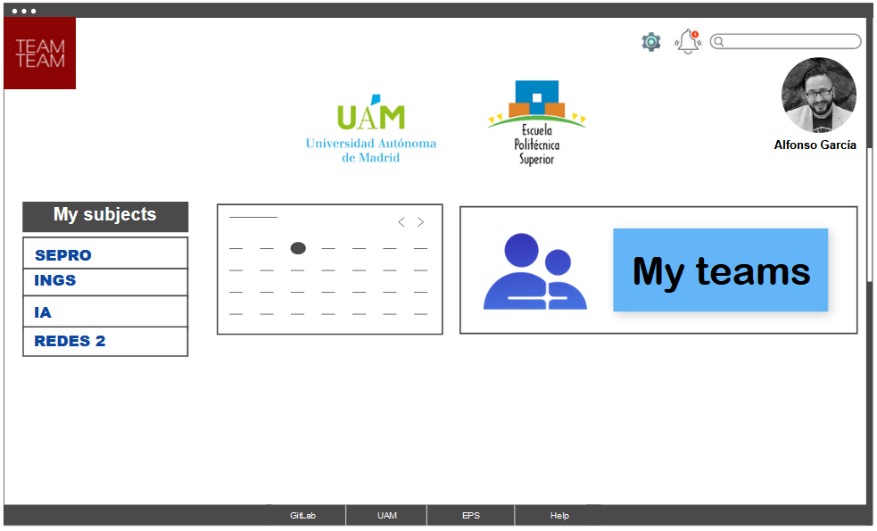
Conceptual and visual design of the interaction
Landing page
6/15

Slide 7
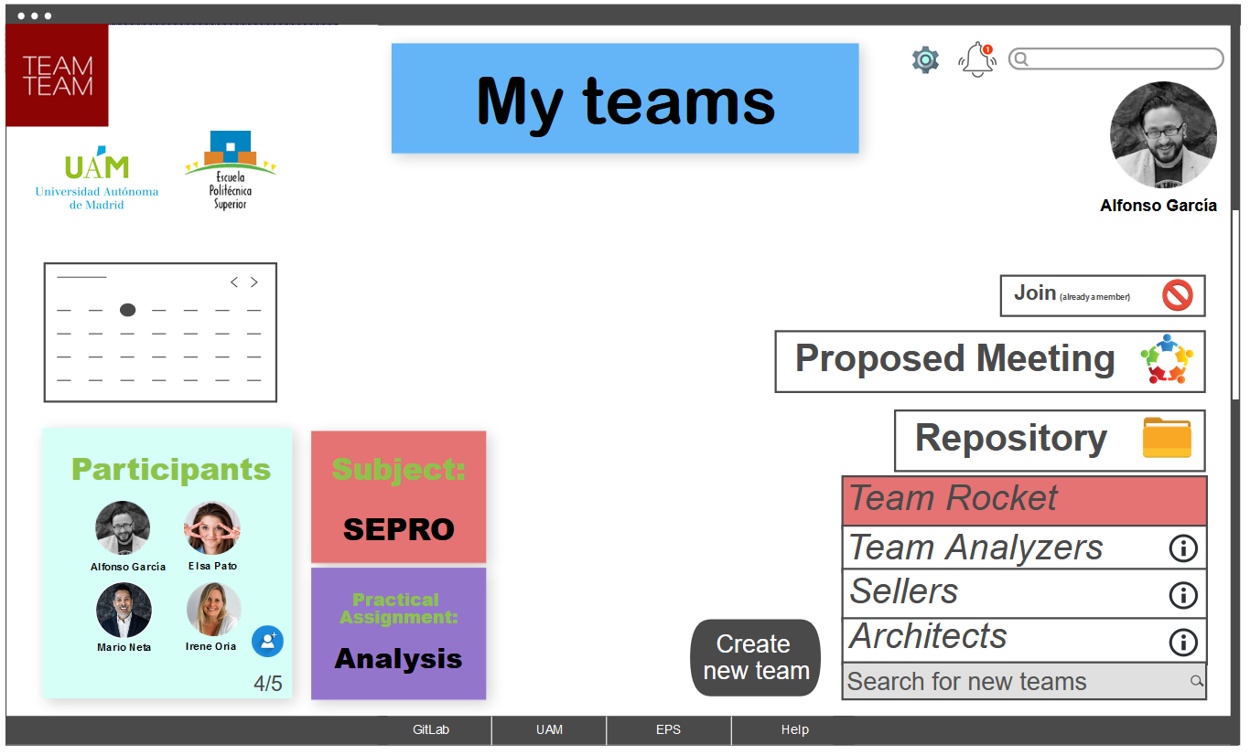
Conceptual and visual design of the interaction
Teams view
7/15

Slide 8
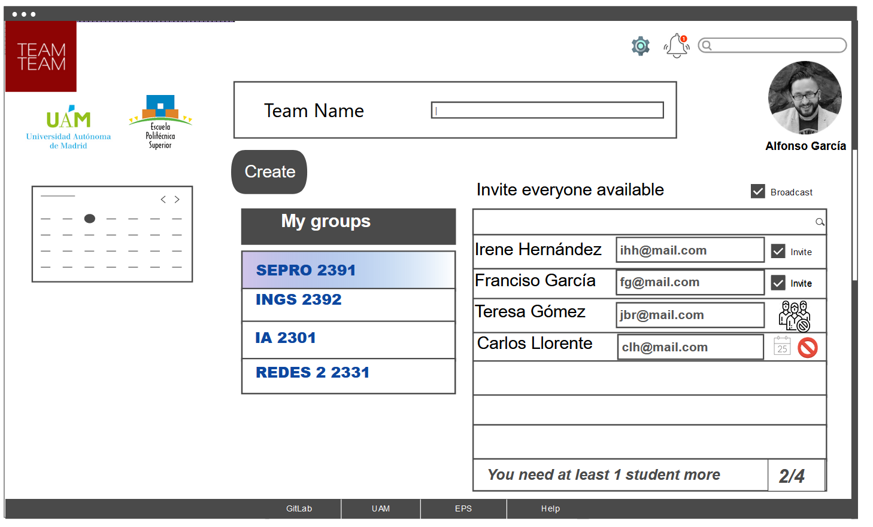
Conceptual and visual design of the interaction
Team creation
8/15

Slide 9
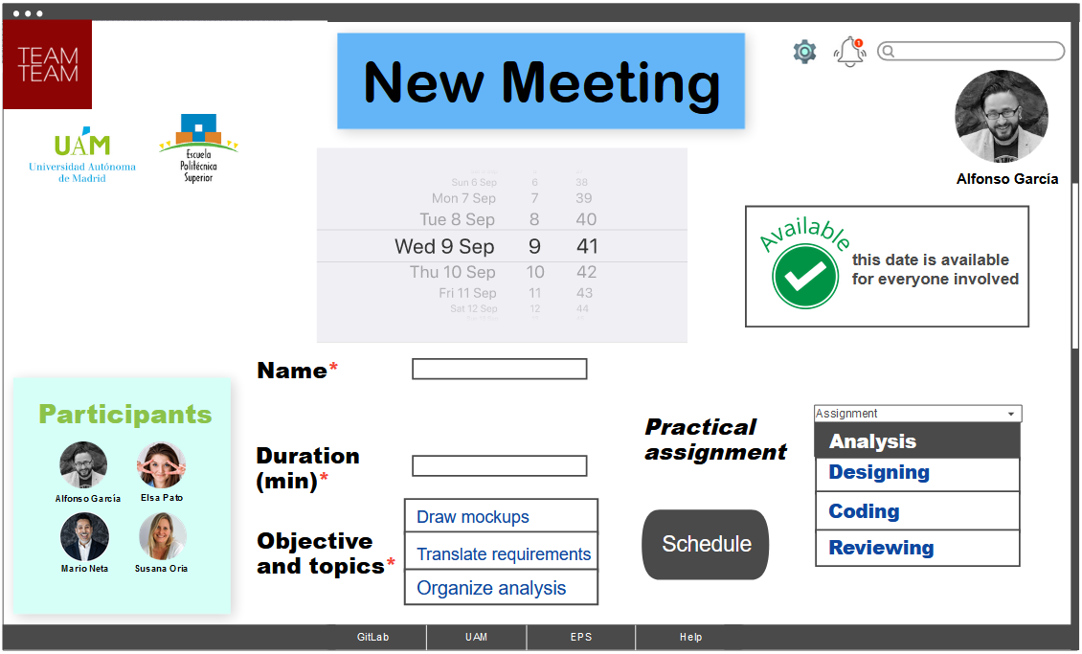
Conceptual and visual design of the interaction
Meeting creation
9/15

Slide 10
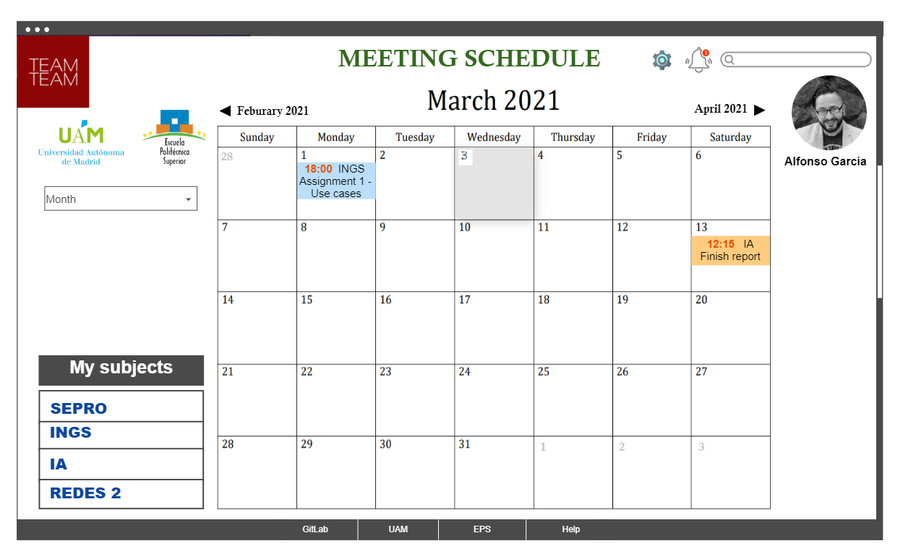
Conceptual and visual design of the interaction
Calendar
10/15

Slide 11
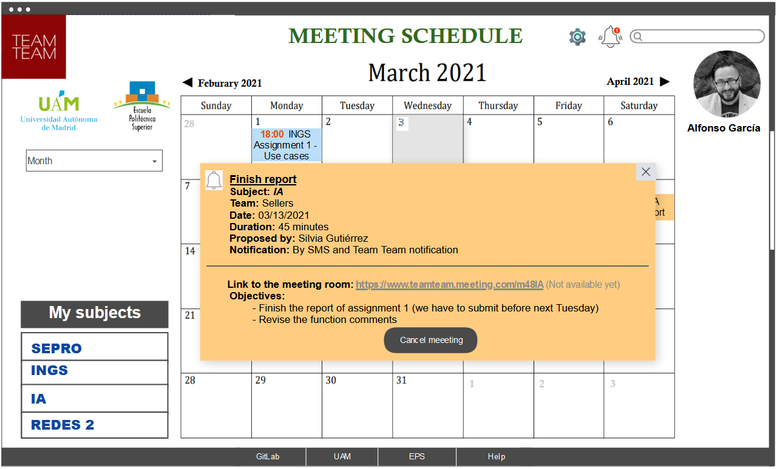
Conceptual and visual design of the interaction
Calendar
Future meeting
11/15

Slide 12
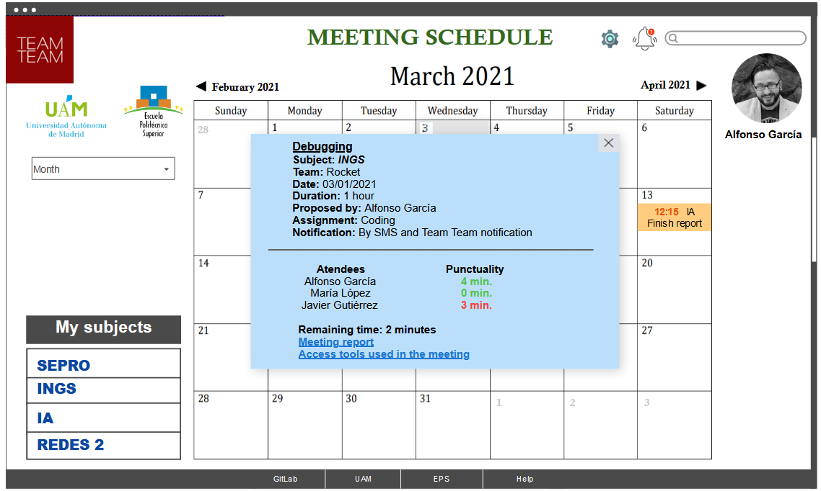
Conceptual and visual design of the interaction
Calendar
past meeting
12/15

Slide 13
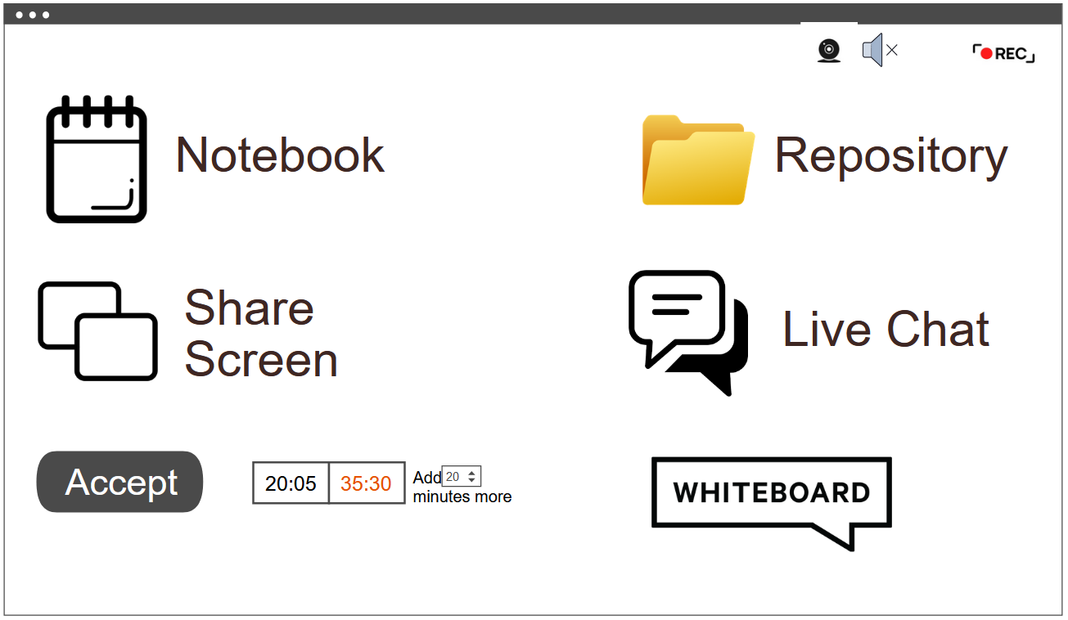
Conceptual and visual design of the interaction
Call view
13/15

Slide 14

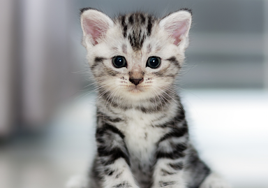

CONCLUSIONS
=
Balance
User friendly
Solution
14/15

Slide 15

Questions?
15/15

