Slide 1
Coding Koans: Best (and Worst) Practices
in Software Engineering
Richard Wareham,
University of Cambridge, Department of Engineering,
rjw57@cam.ac.uk, http://gplus.to/richwareham

Slide 2
The remote works!

Slide 3
An Apology

Slide 4


Slide 5
Hypocrite

Slide 6
Pictures
Words

Slide 7
Context
Wisdom

Slide 8
Distraction
Noise

Slide 9
About Me

Slide 10


Slide 11
Picture = Render( Model( Death ) )

Slide 12
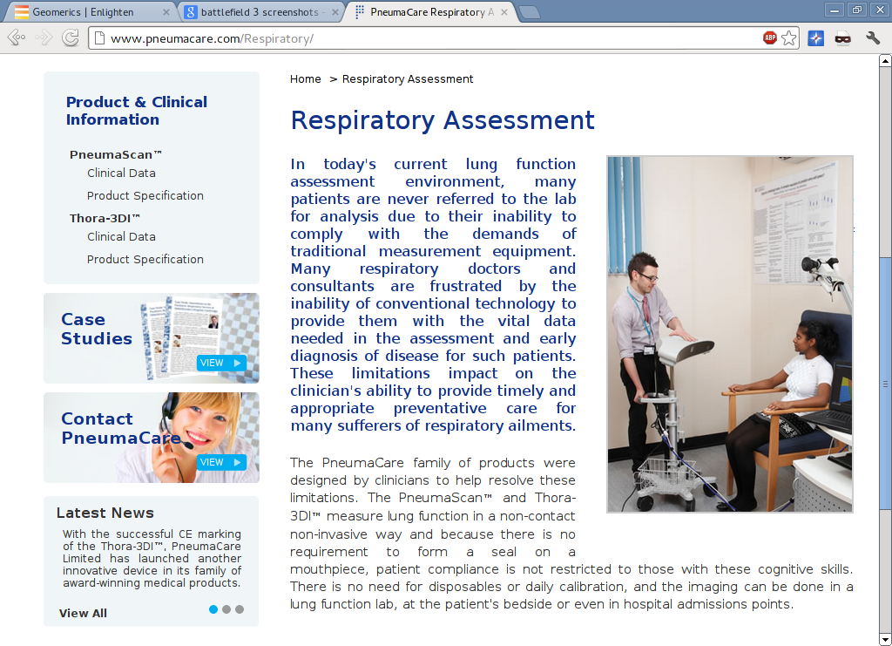

Slide 13
Life = Interpret( Vision( Picture ) )

Slide 14
Picture = Render( Model( Death ) )
Life = Interpret( Vision( Picture ) )
Render( Model( Death ) )
=
Vision⁻¹( Interpret⁻¹( Death⁻¹ ) )

Slide 15
Things I love too much
Software quality engineering
Anglo-Saxon poetry
Bacon
Amy Pond

Slide 16


Slide 17
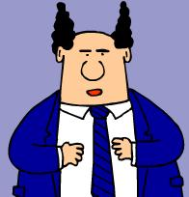

Slide 18
Use Source Control
(i.e. git)

Slide 19
Be lazy

Slide 20
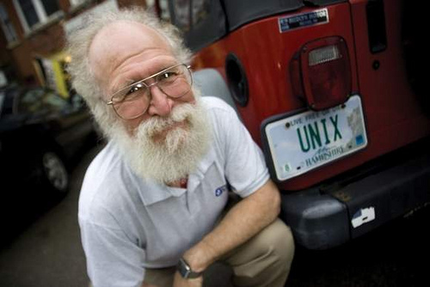

Slide 21
Be Lazy
WINDOWS
UNIX
Time
Task Iteration

Slide 22
Steal

Slide 23


Slide 24
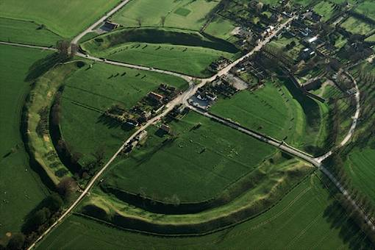
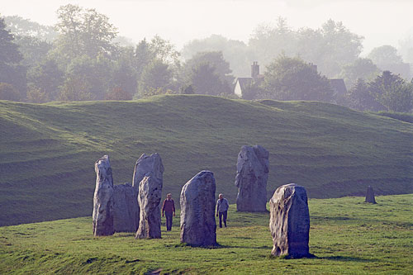

Slide 25
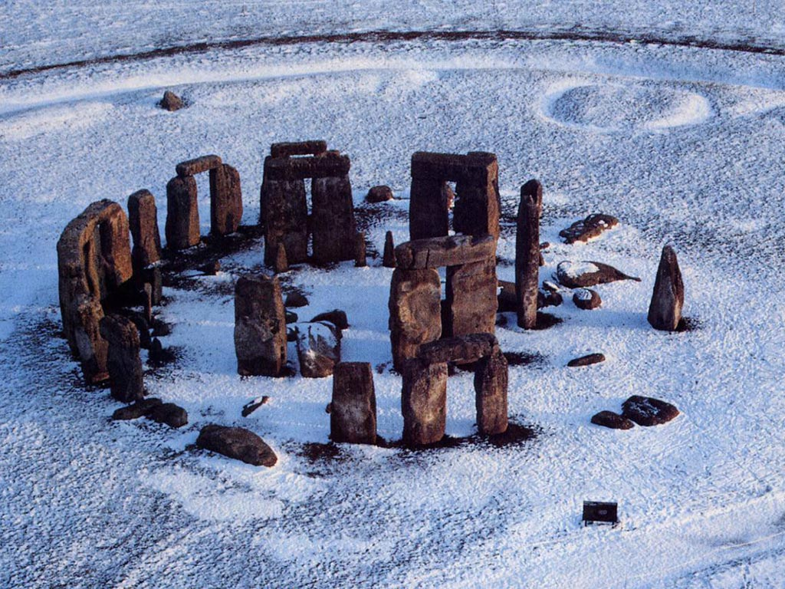

Slide 26
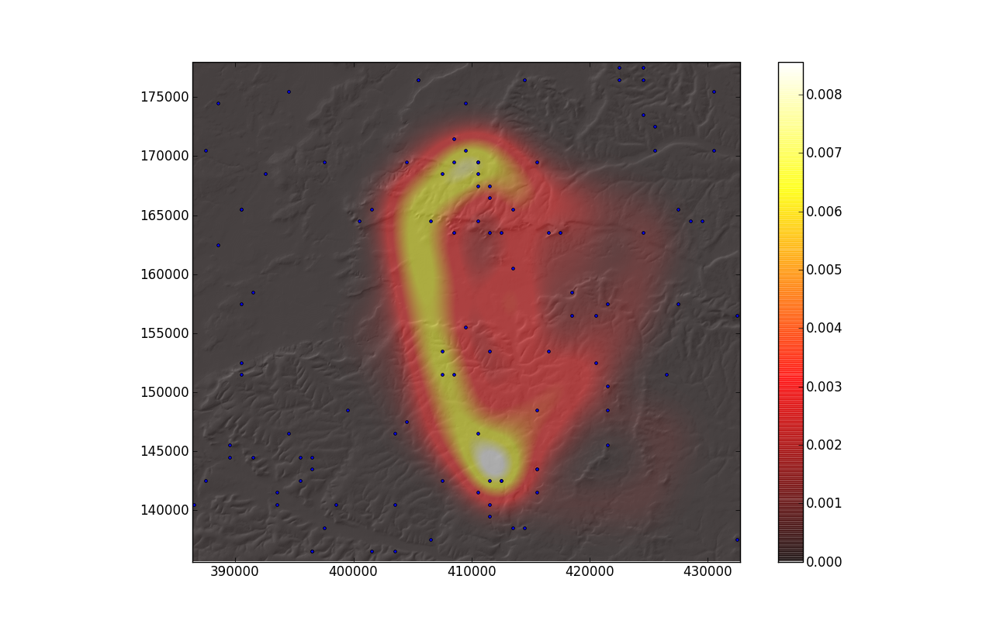
Avebury
Stonehenge

Slide 27
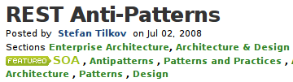
http://www.infoq.com/articles/rest-anti-patterns

Slide 28


Slide 29
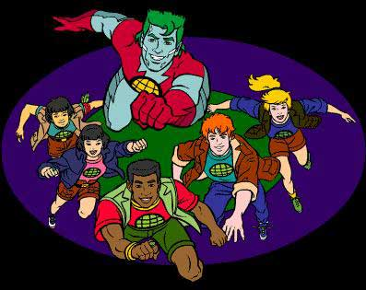

Slide 30

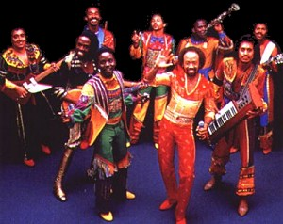
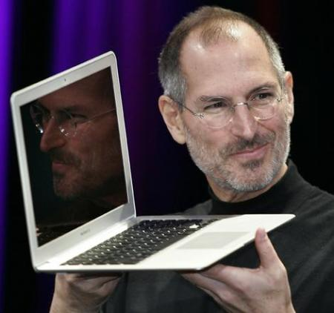

Slide 31
Call on Captain Planet

Slide 32
Gerrit and Jenkins
https://code.google.com/p/gerrit/
http://jenkins-ci.org/

Slide 33
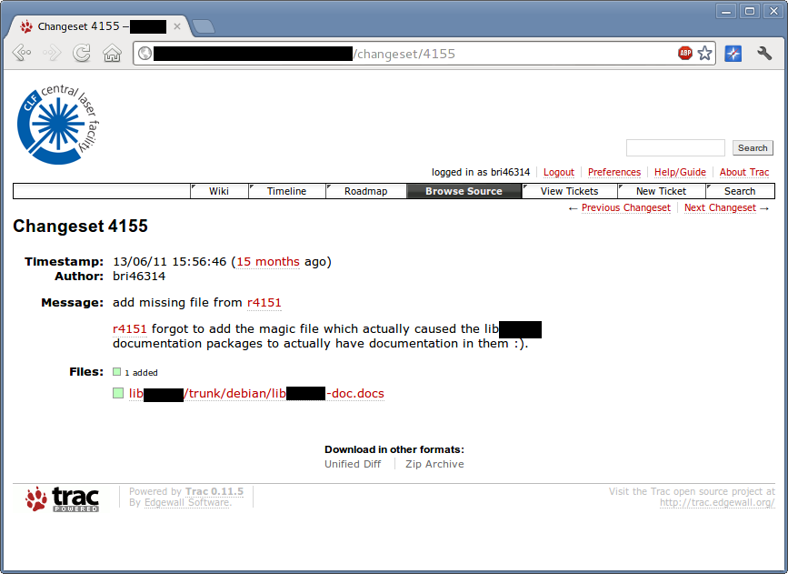
This is me

Slide 34
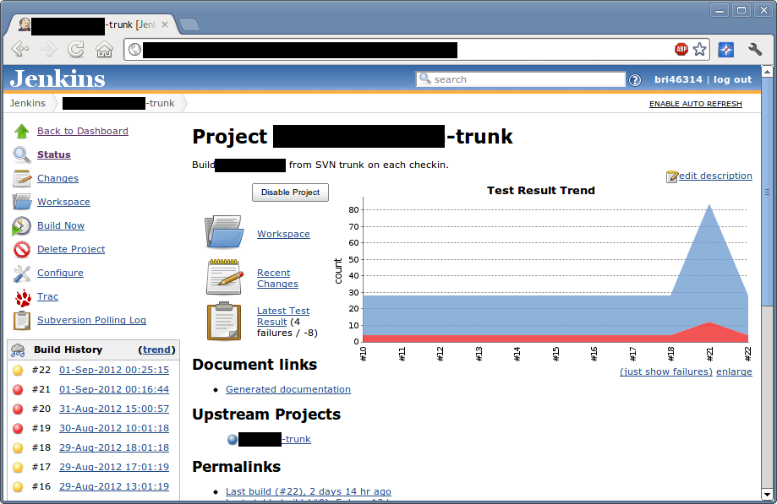
Let's just ignore these, shall we?

Slide 35
Use Code Review

Slide 36
Make Jenkins a Reviewer

Slide 37
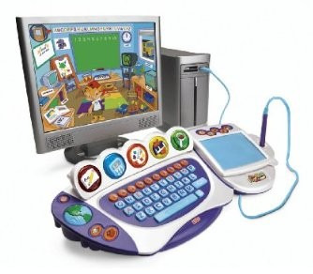
Make it easy to play with

Slide 38
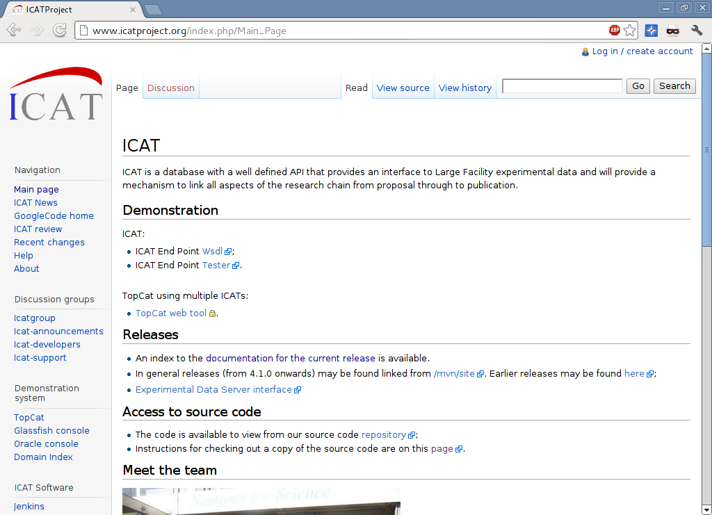

Slide 39
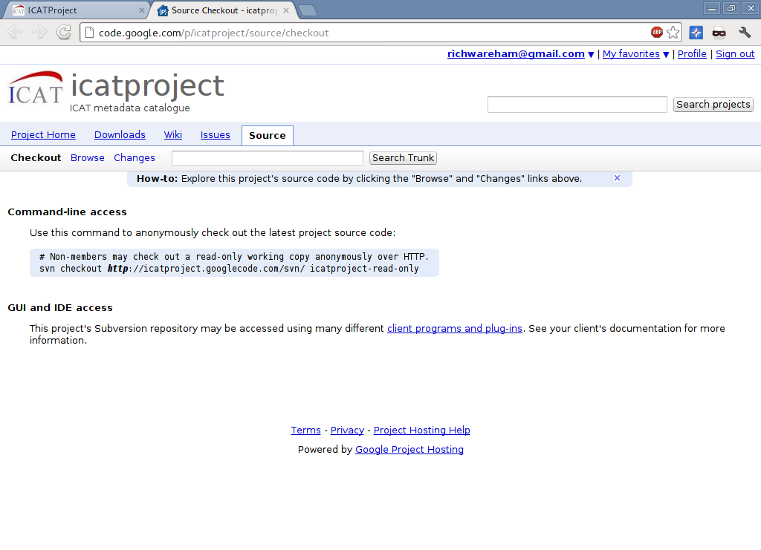

Slide 40
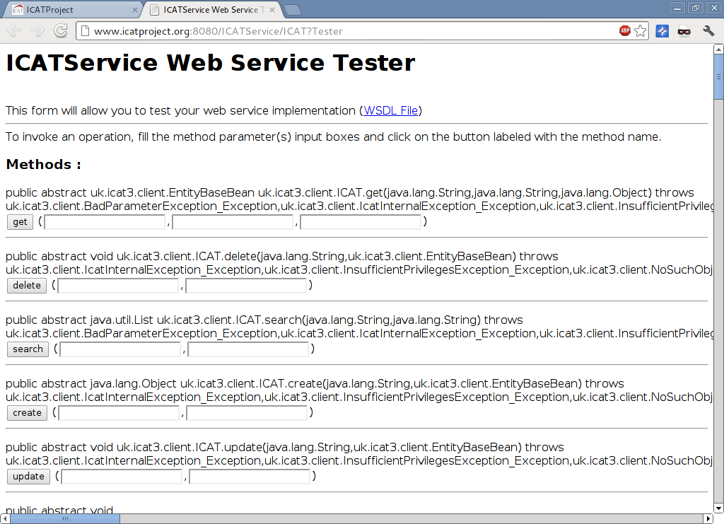

Slide 41
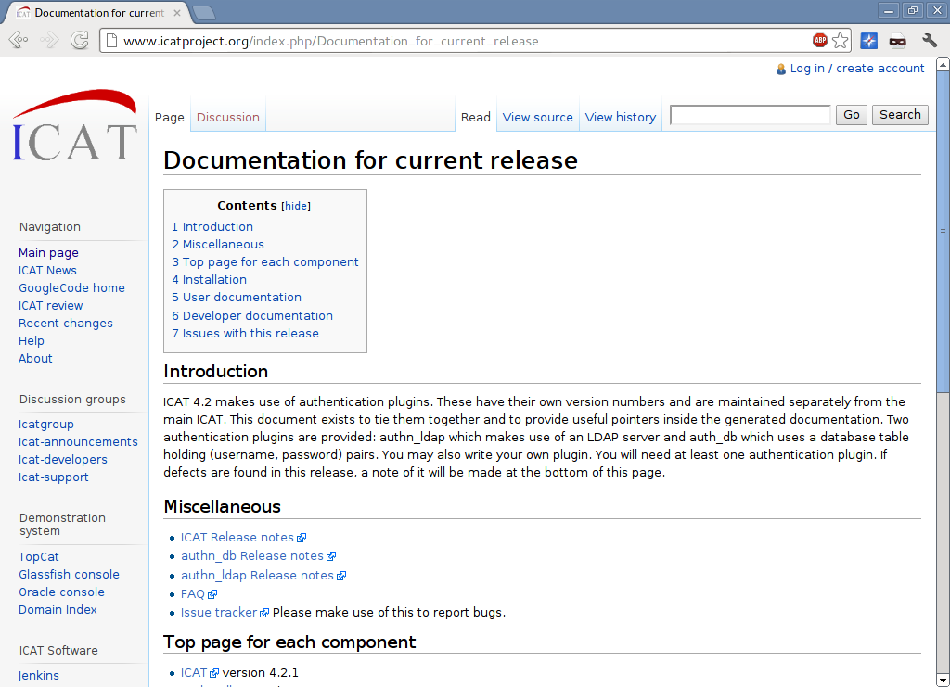

Slide 42
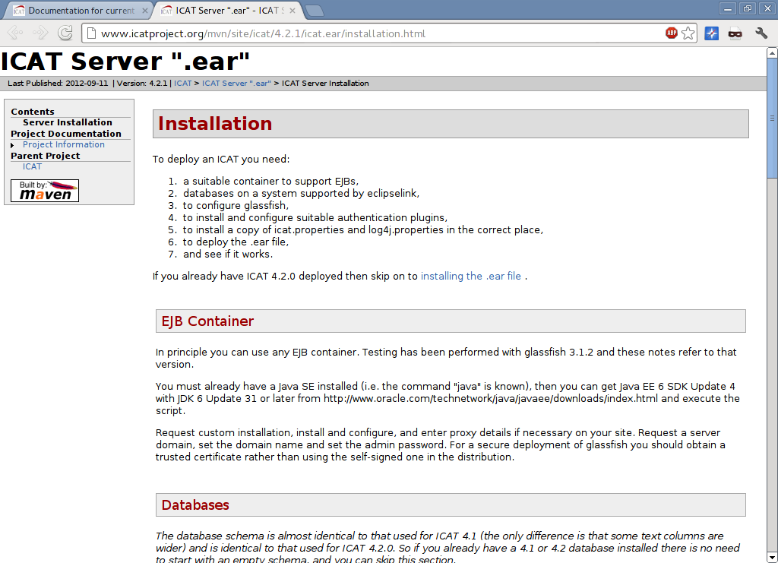

Slide 43
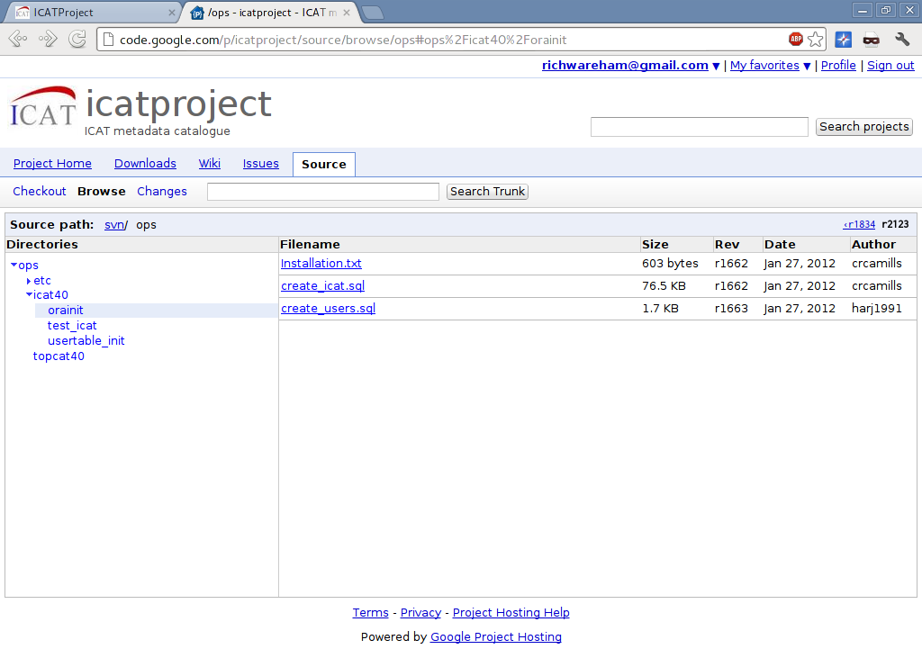

Slide 44
$ java -jar jenkins.war
$ xdg-open http://localhost:9080
$ java -jar gerrit.war init -d dir
$ dir/bin/gerrit.sh start
$ xdg-open http://localhost:9090

Slide 45
Finished rant!
See more at
http://gplus.to/richwareham

