Slide 1
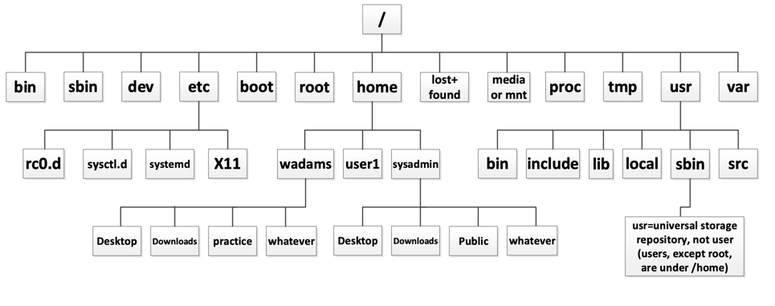
The Filesystem Hierarchy System (FHS)

Slide 2
/bin
Contains executable files necessary to manage and run the Linux system, including your shell executable files, such as for the bash shell. It also includes system utilities like cp, rm, mv, etc.

Slide 3
/boot
Contains your boot loader. The boot loader loads the operating system.

Slide 4
/dev
Contains special files that represent the various hardware devices that are installed on your system.

Slide 5
/etc
Contains text-based configuration tools to configure operating systems and services (daemons).

Slide 6
/home
Contains subdirectories for each system user. These subdirectories are the users’ home directories.

Slide 7
/media or /mnt
When we mount a removable device, it will appear as a directory beneath /media or /mnt (depending on your distro).

Slide 8
/proc
This directory doesn’t really exist – it’s a pseudo filesystem created whenever accessed. This directory contains information about processes running on your system. See: https://www.tecmint.com/exploring-proc-file-system-in-linux/

Slide 9
/root
The root user’s home directory. This is the only user home directory not inside /home

Slide 10
/sbin
Contains system administration utilities like fdisk, ifconfig, init, makefs, shutdown, halt, etc.

Slide 11
/tmp
Contains temporary files created by the system or created by the user. The kernel periodically clears the contents of this directory out, so don’t leave anything you want to keep in here.

Slide 12
/usr
Contains application files. Most application files used by your system are stored in a subdirectory within /usr

Slide 13
/var
Contains “variable” data – or data that changes. This type of data includes system logs, email/mail, spool (printer) files, etc.

