Slide 1
ANOVA
Analysis of Variance

Slide 2
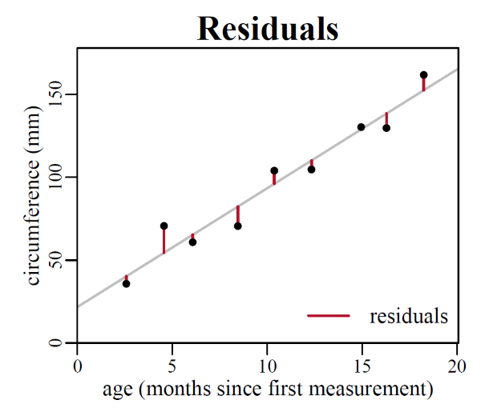
Residuals
Estimated Value (y-hat) - Actual value (y) = Residual (e)
Used to check model fit, assumptions, missing variables, etc.

Slide 3
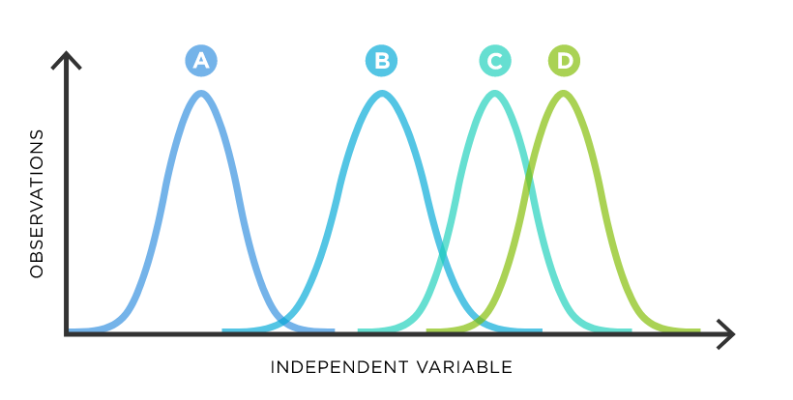
ANOVA
Used to compare the means of multiple groups
Similar to T-Test, just more than two groups compared.
Example: Three separate franchise restaurants have reported three separate average monthly cost figures.
Store 1: $15,000, Store 2: $21,000, Store 3:$ 18,000
Is this difference statistically significant, or are the differences being caused by random chance
Ho: All store means are identical (M1=M2=M3)
Ha: The mean of one or more stores is reporting different costs in a statistically significant way.

Slide 4
ANOVA Assumptions
Variables: Qualitative (categories) and Quantitative (numeric) - How are qualitative variables impacting quantitative variable
Independence: Samples are randomly selected and there is no overlap between samples
Normality: Residuals (Predictions - Actual) are normally distributed*
Homogenous variance: Variance must be the same in each group / category

Slide 5
ANOVA
ANOVA uses the F-Statistic and f-Distribution
We find the F-statistic by dividing the “between-group variability” by the within-group variability”

Slide 6
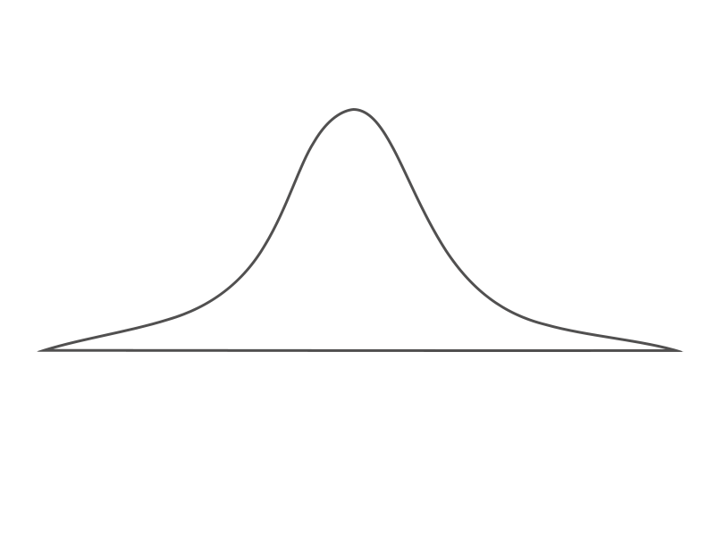
Within group variability (sum of squared differences between all observations and sample mean)
Grand Mean (Mean of group means)
Between group variability (sum of squared differences between group means and grand mean)

Slide 8
F
F = variation between sample means / variation within samples
F = SSW / SSB
If variance between samples is greater than the variance found inside values, we have evidence of unequal means
Degrees of freedom: N - k, or the sum of degrees of freedom from each group (n-1)
= number of degrees of freedom per sample (N - 1) minus number of samples

Slide 9
The Grand Mean and Between Group Variability
S1 = 1,2,3,4, Mean = 2.5
S2 = 2,4,8,10, Mean = 6
S3 = 10,10,10,10, Mean =10
2.5 + 6 + 10 =18.5
18.5 / 3 = 6.17
Between Group Variability:
Difference between group mean(s) and grand mean.

Slide 10

Within Group Variability
Take each value in the group and subtract the mean
Square the new values
Sum the squared values

Slide 11
Between
Add the square of the differences between each group mean and the grand mean, multiplied by sample size
Divide Between Sum of Squares by degrees of freedom
Degrees of freedom = sample size - 1

Slide 12
Within
Find variation of each observation from group mean
Add up differences, square them, then total them
This is the “Sum of Squares Within Groups”
SSR = s2group1 (ngroup1 – 1) + s2group2 (ngroup2 – 1) + s2group3 (ngroup3 – 1)

