Slide 1
Regression
(Origin of meaning unknown)

Slide 2
Regression
Regression analysis: A set of techniques used to estimate the relationships between variables
Simple linear regression finds the equation of a line that “best fits” the two variables
Remember the “slope-intercept” formula of a line “Y = M*X + B”?
We’re going to estimate the M (now called Bi) and the B (now called B0) for a given set of X’s and Y’s
Y = B0 + B1*X1

Slide 3
Simple Regression
Y = B0 + B1*X + E
Y: The dependent variable (vector)
Xi: The independent variable (vector(s))
B0: The constant value / Y-intercept
B1: The slope value / M in Y = MX + B
E: Stochastic error term

Slide 4
Regression Interpretation
Example estimated regression:
Sales = 33 + 0.15 * Inventory
Sales are equal to 33 + 0.15 * the number of units in inventory
When inventory = 50, sales equal…?
50 * .15 = 7.5, + 33 =
When inventory = 100, sales equal…?
A single unit increase in inventory corresponds to a 0.15 increase in sales

Slide 5
Multiple Regression
Just like the simple regression model, but less simple ;-)
Instead of a single X variable’s impact on Y, we use multiple X variables (Xi…Xn)
Now here’s the cool part…
…the coefficients (B1…Bn) are interpreted as the impact of each variable’s upon the dependent variable, holding all the other included variables “constant”

Slide 6
General Form and “Signs”
Y = f(X1) means Y is a function of X1
Y = f(X1…Xi) means Y is a function of X1 and all of the other included X variables
Sales = f(Prices, Competitor Prices, Advertising, Incomes…) means that we believe the number of sales likely to occur are some function of the listed variables
General form ignores functional form and is used to simplify notation

Slide 7
“Signs”
Sales = f(Prices, Competitor Prices, Advertising, Unemployment…) means that we believe the number of sales likely to occur are some function of the listed variables
What direction do we expect increases in each variable to move sales?
Variable | Theorized Relationship | Sign
Price | Negative | -
Competitor Prices | Positive | +
Advertising | Positive | +
Unemployment | Negative | -

Slide 8
Why signs?
Variable selection and assessment should be mainly based on established theory and logic.
If a demand model predicts that higher prices have a positive relationship with sales (a + sign), it probably isn’t correctly specified, since this is in direct opposition to economic theory, logic, and intuition.
We specify the signs to keep our thinking clear and coherent
HOWEVER, we may wish to keep the price variable if we want to test the existing theory against an alternative hypothesis (Giffen goods?)

Slide 9
Controls, or lack thereof
Example experiment:
How does adding some quantity of a given chemical alters the growth rates of crops?
Dependent variable: Growth rate
Independent variable: Quantity of chemical used
Control (also independent) variables: Sunlight, air pressure, longitude, latitude, temperature, researcher(s),
Why do we need controls?
Plant | Dosage | Growth | Sun Hours | Temperature
A | 50mg | 36in | 300 | 75
B | 55mg | 39in | 310 | 80

Slide 10
No controls = No science
Plant B grew 3 inches taller per month during the study and received 5mg more of the chemical being tested.
Did the chemical cause the growth?
Or was it the additional 10 hours of sunlight, 5 degrees of warmth, or both, or all of them AND the dosage???
Or what if dosage has a negative effect, but it’s overwhelmed by the effect of the additional sunlight and heat?
Plant | Dosage | Growth | Sun Hours | Temperature
A | 50mg | 36in/month | 300 | 75
B | 55mg | 39in/month | 310 | 80

Slide 11
But…social sciences often can’t run controlled experiments
We don’t have the luxury of controlling certain factors like we would if this were chemistry. Consider the question of stimulus spending efficacy during a recession…Does stimulus spending decrease unemployment
Country | Unemployment Rate | Interest Rate | Stimulus Spending | Shared Currency
US | 7 | 1 | 700b | 0
UK | 10 | 2 | 200b | 0
France | 13 | 1 | 500b | 1
Germany | 5 | 0.75 | 100b | 1

Slide 12
Multiple Regression = Statistical Controls
Kind of like converting prior table into the table below (setting all of each country’s attributes as the same, except for what we’re attempting to calculate, for each variable)
Country | Unemployment Rate | Interest Rate | Stimulus Spending | Shared Currency
US | 7 | 1 | 700b | 0
UK | 10 | 1 | 200b | 0
France | 13 | 1 | 100b | 0
Germany | 5 | 1 | 100b | 0
Unemployment = B0 + B1(Interest Rate) + B2(Stimulus Spending) + B3(Currency Type) + Error

Slide 13
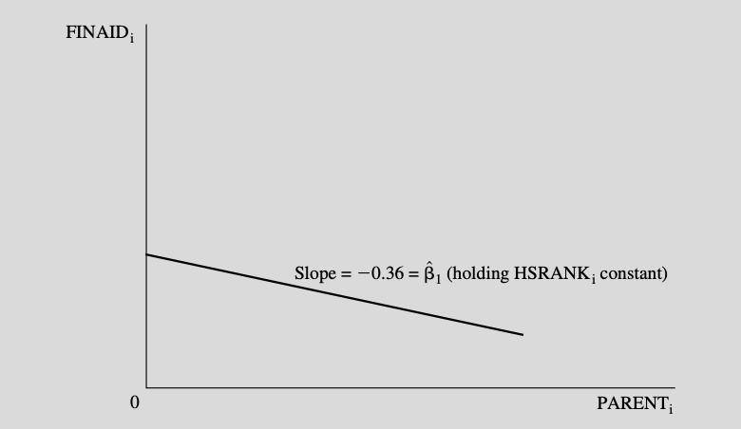
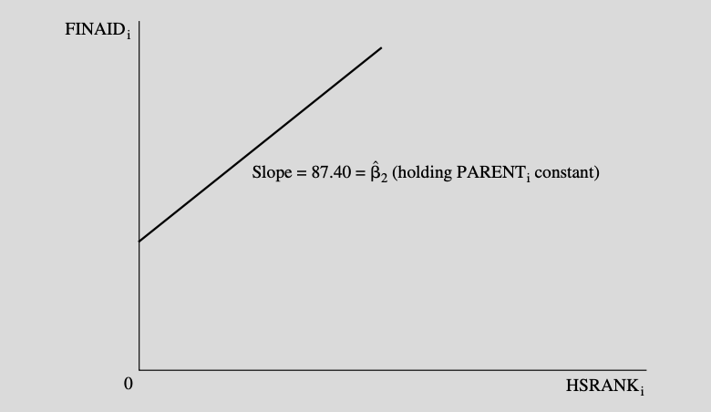
Multiple Regression & Ceteris Paribus

Slide 14
Interpretation
B0 = Constant (Do not interpret without a good reason, nor should you remove it)
B1 = Effect of a single point increase in interest rates, excluding the impact of stimulus spending and currency unions
B2 = Effect of a single unit increase in stimulus spending, excluding the impact of interest rates and currency unions
B3 = Effect of being in a currency union on unemployment, excluding the impact of stimulus spending and interest rates
E = The difference between the predicted value and the actual value
Unemployment =
B0 +
B1(Interest Rate) +
B2(Stimulus Spending) +
B3(Currency Type) +
Error

Slide 15
Classical Assumptions
Regression model is linear
The model is correctly specified,
The model includes an additive error term.
The error term has a zero population mean.
All explanatory variables are uncorrelated with the error term.
The error term values are not correlated with each other.
The error term values have constant variance.
No explanatory variable is a perfect linear function of any other explanatory variables

Slide 16
Assumption 1
Most important point: Y and X do not need to have a linear relationship, even though that’s what this sounds like
It basically means that B values cannot be transformed in any complex manor, if it all
Model is linear (in parameters)

Slide 17
Assumptions: Linear Equation
Equation must be a linear in its parameters
Y = B0 + B1x1 + B2x2 + B3x3 + E
Y = B0 + B1x1 + B1x1^2 is non-linear in variables, but not in parameters
Y = B0 + B1^2(x1) or Y = B0 + x1^B1 are not linear in their parameters
THIS IS NOT THE SAME AS SAYING X and Y must have a linear relationship
Different “functional forms” allow us to model lots of nonlinear relationships using a linear equation

Slide 18
Linear in Parameters vs Variables
Linear regression does not (strictly) require that the relationships between (X’s and Y) we’re estimating be linear.
We OLS methods allow us to fit all sorts of non-linear relationships between Y and Xi
The LINEAR part of linear regression is referencing the betas / coefficients
Y = B0 + Labor^B1 * Capital^B2 = NO GOOD
Sometimes logarithms solve this issue
Y=(Labor^B1)*(Capital^B2) = ln(Y) = B1(ln(Labor) + B2(ln(Capital))

Slide 19
Assumption 2
Variables selected belong there
No variables the belong are excluded
Functional form is based on logic and theory
Correct Specification

Slide 20
Selecting X Variables For Your Model
How do we select variables?
Theory: Does the relevant body of scientific theory suggest that a given variable is important in explaining Y, then you should really probably include it
Direction: Does the direction of the variable’s effect make sense / match theory? Price increases are unlikely to cause quantity demanded to rise, so a + relationship is a concern
T - Testing: Does the variable have any statistical significance?
Adjusted R^2: Does a variable’s inclusion raise or lower adjusted R^2
Bias (how much do other variables change when variable is added / removed)

Slide 21
Selecting X Variables For Your Model
Estimating sales at a car dealership
Theorize a general form equation
Sales = f(inventory +, pricing -, economic conditions *, competitor pricing +, advertising +, weather *, pandemic -, season or month *)
Find specific data and variables to operationalize your theory
Sold Units = f(Inventory at start of month, average difference of MSRP and sale price, local unemployment rate, average discount of MSRP and sale price (scraped from website), $ value of advertising budget, precipitation (rain or snow), month (all but one), and is the time period in question during the Covid pandemic.

Slide 22
Selecting X Variables For Your Model
Estimating sales at a car dealership
Theorize a general form equation
Sales = f(inventory +, pricing -, economic conditions *, competitor pricing +, advertising +, weather *, pandemic -, season or month *)
Find specific data and variables to operationalize your theory
Sold Units = f(Inventory at start of month, average difference of MSRP and sale price, local unemployment rate, average discount of MSRP and sale price (scraped from website), $ value of advertising budget, precipitation (rain or snow), month (all but one), and is the time period in question during the Covid pandemic.

Slide 23
Specification Error - Omitted X Variable
What happens if you fail to include a relevant explanatory variable?
If omitted variable is correlated with other independent variables, coefficients and standard errors will be biased and inconsistent
Example: Income = B0 + B1(Hourly Wage) + B2(Hours Worked)
Omitting Hours Worked would
Solutions?
Find the variable and data, and include it in your model - Duh!
Find a proxy variable and data, and include it in your model
Proxy variables: A variable that serves to capture the same effect as another, unavailable / difficult to measure variable.
Examples: ACT scores as a proxy for intelligence / IQ, Tree rings for age / environmental conditions, GDP per-capita for income

Slide 24
Specification Error - Omitted X Variable
Domestic GDP = Consumption + (Investment) + Government Spending
Variable | Coefficient | Std. Error | T-Ratio | P-Value
Consumption | 1.35435 | 0.00699856 | 190.7 | 5.43-e^230
Investment
Government | 0.559162 | 0.0223322 | 25.04 | 7.57-e^64
Variable | Coefficient | Std. Error | T-Ratio | P-Value
Consumption | 1.18199 (lower) | 0.0149414 (higher) | 79.11 (lower) | 2.02-e^153
Investment | 0.737060 | 0.0239936 | 30.72 | 7.34-e^78
Government | 0.431185 (lower) | 0.0392645 (higher) | 10.98 (lower) | 2.79-e^22

Slide 25
Stepwise Selection
Stepwise forward: Start with minimum number of variables needed and build up the model from there, adding more variables than you subtract
Stepwise backward: Start with the maximum number of (reasonable, logical, theoretical) variables and trim down the model from there, subtracting more variables than you add
Stepwise mixed: Both of the above
Comparison criteria: R^2 (+), Adjusted R^2 (+), AIC (-), BIC(-), T-Scores / P-Values of variables, signs of variables, F-Score / P-Value of full model
THERE ARE MULTIPLE “RIGHT” ANSWERS
Report all results, range of results, transformations, test statistics, etc
MOST IMPORTANTLY, IF A VARIABLE HAS NO THEORETICAL VALUE, IT SHOULD NOT BE IN THE MODEL, REGARDLESS OF SIGNIFICANCE, FIT, ETC.

Slide 26
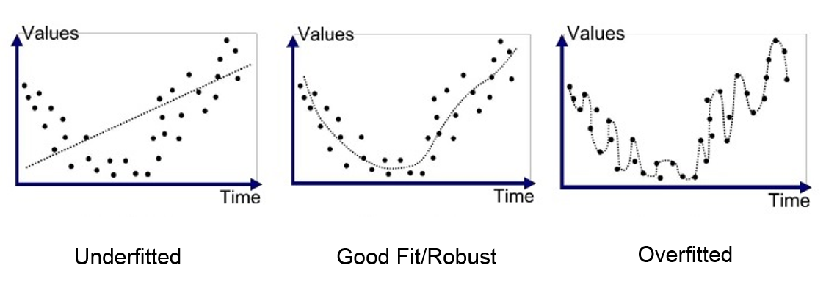
Specification Error - Including Irrelevant Variables
Overfitting means creating a statistical model that is extremely precise with your data, but fails when applied to other / out-of-sample data.
The best model is, all things being equal, the simplest model…since it will require the least amount of assumptions and data, and will be most generalizable to other studies and samples.

Slide 27
Specification Error - Including Irrelevant Variables
Coefficients will remain unbiased and efficient
Standard errors are unbiased, allowing for us to still test hypotheses
Standard errors will be larger
Spurious results
Solutions?
Drop irrelevant variables - Namely those lacking theoretical significance with respect to explaining the dependent variable
NEVER DROP THEORETICALLY IMPORTANT VARIABLES WITHOUT A REALLY GOOD REASON

Slide 28
Specification Error - Included Irrelevant X Variable
Domestic GDP = Consumption + (Investment) + Government Spending
Variable | Coefficient | Std. Error | T-Ratio | P-Value
Consumption | 1.35435 | 0.00699856 | 190.7 | 5.43-e^230
Government | 0.559162 | 0.0223322 | 25.04 | 7.57-e^64
Variable | Coefficient | Std. Error | T-Ratio | P-Value
Consumption | 1.33539 (lower) | 0.00737851 (higher) | 181 (lower) | 1.48e-224
Government | 0.553229 (lower) | 0.0258883 (higher) | 21.37 (lower) | 1.23e-53
Poisson | 1.03594 | 2.27349 | 0.4557 | 0.6491

Slide 29
FUNctional Form
Linear: Y = B0 + B1x + e
Log-linear: ln(Y) = B0 + B1*x + e
Linear-log: Y = B0 + B1*ln(x) + e
Double-log: ln(Y) = B0 +B1*ln(x) + e
Polynomial: Y = B0 + B1*x + B2*x^2 + e
Inverse: Y = B0 + B1*(1/x) + e
Interaction: Y = B0 + B1*x1 + B2*x2 + B3*(x1*x2) + e

Slide 30
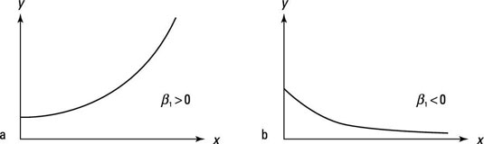
Log-Linear
Same as linear model, except dependent variable is the natural logarithm of the original dependent variable.
ln(Y) = A + B*x + e
One unit change in X leads to 100 * B percent change in Y

Slide 31
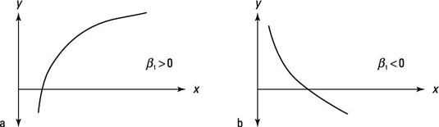
Linear-Log
Same as linear model, except independent variables are the natural logarithm of the original independent variables.
Y = A + B*ln(x) + e
Used to change non-linear equations into linear equations
One percent change in X leads to a B/100 unit change in Y

Slide 32
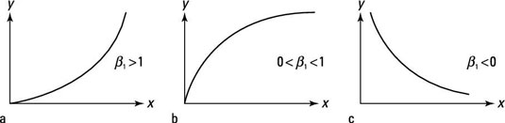
Log-Log
Same as linear model, except independent variables are the natural logarithm of the original independent variables.
ln(Y) = A + B*ln(x) + e
Used to change non-linear equations into linear equations -
A one % change in X leads to a B percent change in Y
Gives us elasticity

Slide 33
Polynomial / Quadratic Form
If a relationship between X and Y is concave or convex, a quadratic form may be needed
Y = B0 + B1(X1) + B2(X^2) + E
Example: Income ~ Age
As age rises (16-60) earned income rises too, but at a certain point, people retire and their earned income falls (60-100…)
A properly formed model would include an age^2 variable
Income ~ Age + Age^2
Can be more than quadratic polynomial, depending on inflection points (X^2 = 1 inflection point, X^3 = 2 inflection points)

Slide 34
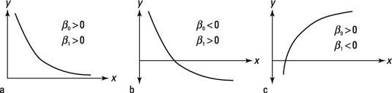
Inverse
Y = B0 + B1(1/X) + E

Slide 35
Diagnostics
Plot all x-variables against residuals

Slide 36
Assumption 3
Errors are captured by an error term at the end of the equation, and the error term is additive (as opposed to multiplicative, etc.)
Additive Error Term

Slide 37
Errors / Residuals
Y-Hat = B0 + B1(X1) + E
If Y-Hat = B0 + B1(X1), the model is perfectly predicting Y (as a function of X)
Since our model will most certainly not be perfect, we add an error term to account for…wait for it…error
E = Y-Hat - Y
Also called residuals (aka, what’s left over)

Slide 38
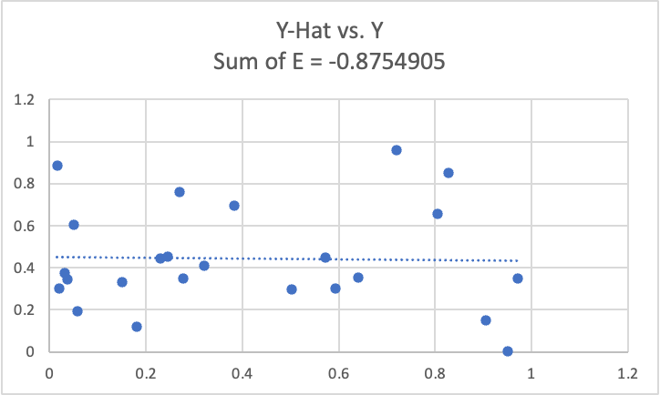

Slide 39
Assumption 4
Overestimates and underestimates are roughly equal in magnitude and frequency, summing to zero
Error in one direction is balanced by error in the other
The expected value of the error term is zero

Slide 40
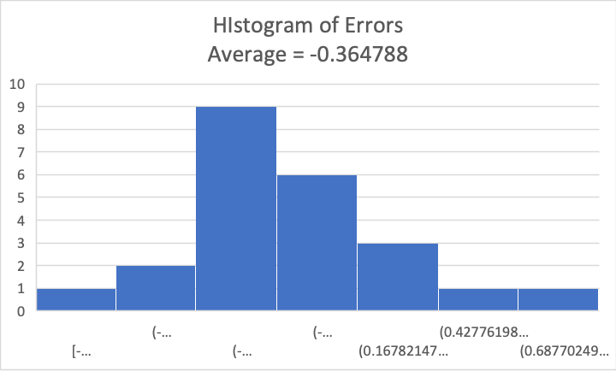

Slide 41
Assumption 5
The variance of errors is constant across observations (homoskedastic)
Non-heteroskedastic errors

Slide 42
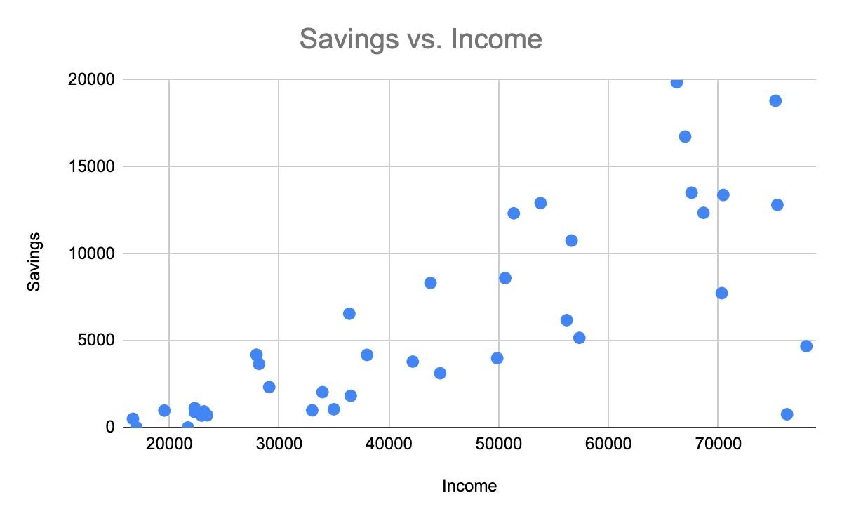
Heteroskedasticity in Savings Rates
In economics, we study consumption as a percentage of income, as a function of income.
The marginal propensity to consume is the percentage of income consumed vs saved.
Higher income households have more opportunities to save, but don’t necessarily save more than lower income households

Slide 43
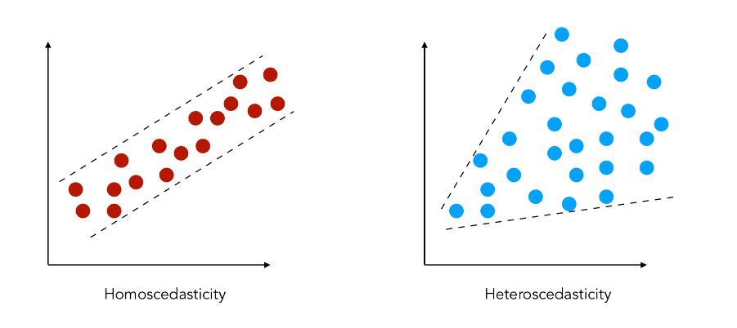
Assumptions: Homoscedasticity
Residuals / Error term must have constant variance
Why care?
Hypothesis testing is no longer valid
Test with White or Breusch-Pagan tests
Test with residual plots
Consequences:
Model is no longer minimum variance
Hypothesis tests are no longer reliable
Confidence intervals are no longer reliable

Slide 44
Assumption 6
Found in time series data
Error at T1 is unrelated to error at T-1 or T2
Errors are not correlated with each other

Slide 45
Consequences & Solutions of Autocorrelation
Detection
1) Durbin-Watson test, if test statistic <2, positive serial correlation exists, while if 2 < D < 4, negative autocorrelation exists
2) Plot residuals vs fitted values
Consequences
1)OLS regression is no longer minimum variance
2) Hypothesis testing is unreliable
3) Confidence intervals are unreliable
Solutions
1) Find and add an omitted variable
2) Change functional form
3) Use GLS or Newey-West standard errors

Slide 46
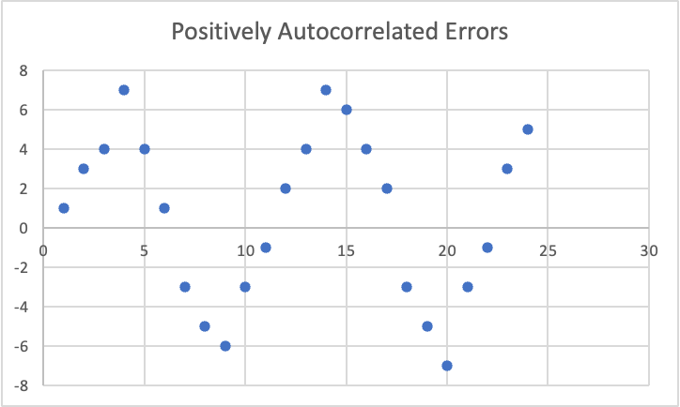
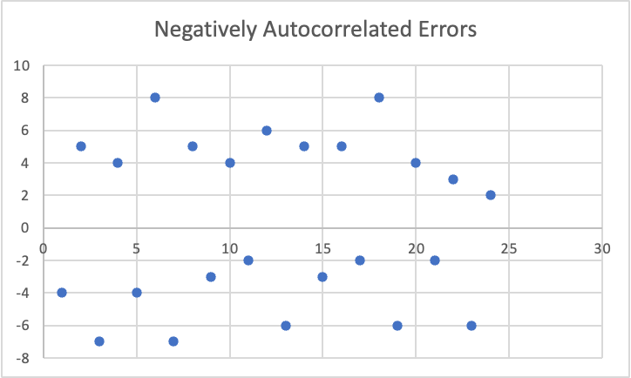

Slide 47
Assumption 7
X variables must not be perfectly (or strongly) correlated
No Total Multicollinearity (and little strong multicollinearity)

Slide 48
Assumptions: No Perfect Multicollinearity
Perfect multicollinearity: One or more independent variables is perfectly correlated with (correlation coefficient of r=1)
Y = f(monthly income, annual income)
Strong multicollinearity: One or more independent variables is strongly correlated with one or more independent variables (correlation coefficient with high r, but not r = 1)
Y = f(monthly income, hourly wage)
Detection:
Variance inflation factor test, >5 = small problem, > 10 equals large problem
Correlation matrix or plot of independent variables against one another (.8) or more is likely too much
Consequences of multicollinearity:
With perfect multicollinearity, OLS doesn’t work at all.
With strong multicollinearity, OLS is still “unbiased” and “efficient”, but coefficient standard errors will be inflated, A) making it harder to separate the effects of each variable independent of the other(s), and B) hypothesis testing is less accurate, if at all

Slide 49
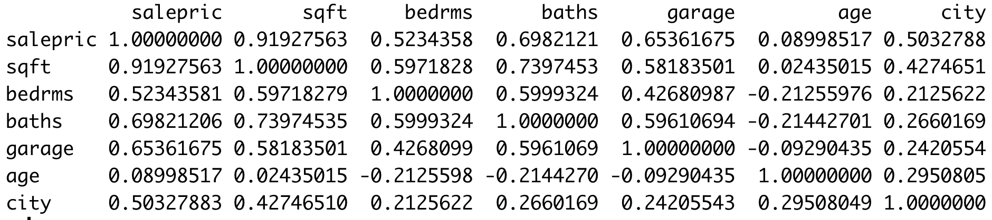
Finding Multicollinearity
Correlation Matrix
In R, use “vif(MODEL)”
VIF < 1, No worries
1 < VIF < 5, Maybe some worries
VIF > 5, Be concerned
VIF > 10, Serious problem
Variance Inflation Factor

Slide 50
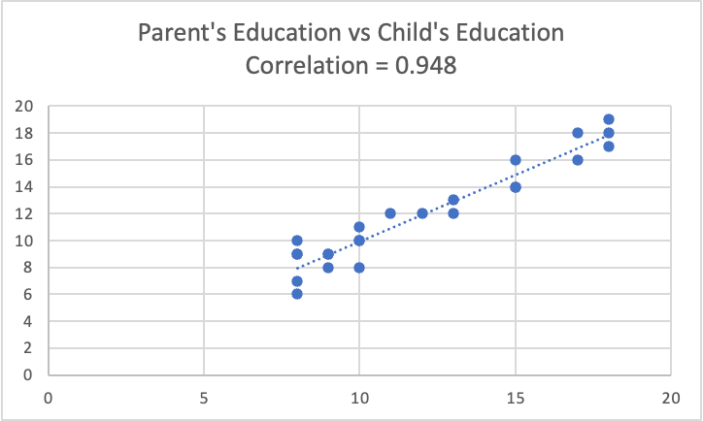

Slide 51
What to do about Multicollinearity?
Maybe nothing…
Gather more data
Remove one or more affected variables
Combine affected variables into a single variable (For example principal-component analysis, indices, etc.

Slide 52
What to do about Multicollinearity?
Detection:
VIF
Solutions
Maybe nothing…
Gather more data
Remove one or more affected variables
Combine affected variables into a single variable (For example principal-component analysis, indices, etc.

Slide 53
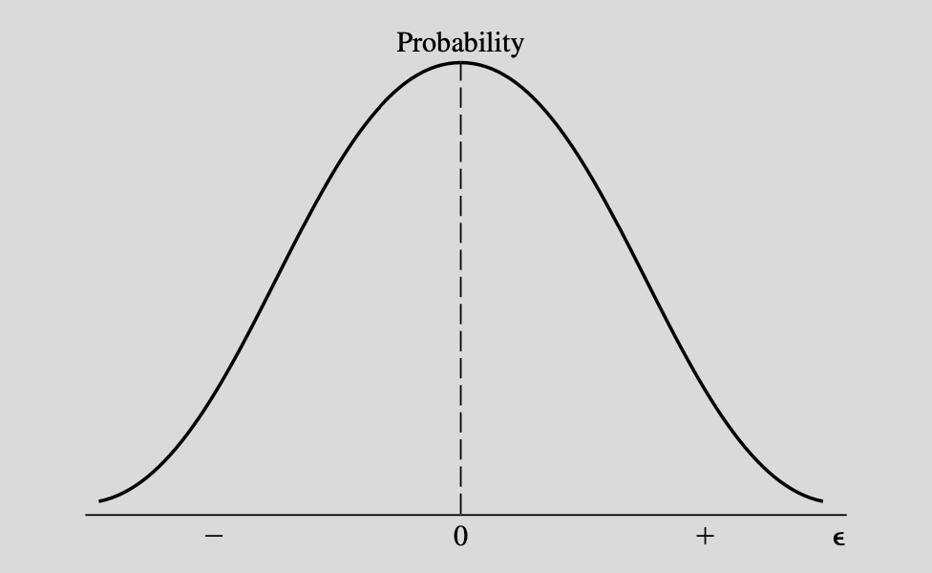
Assumptions: Error Term (Not strictly required)
The model includes an error term to account for measurement error, specification error, randomness, etc.
The error term must have an expected value of zero, with negative errors balanced by positive errors
Y = (10, 12, 14, 16)
y = (8, 13, 13, 18)
e = (-2, 1, -1, 2)
EV(e) = 0
E is uncorrelated with the explanatory variables
Use shapiro-wilk test for normality of error term

Slide 54
Dummy Variables
Dummy / Binary independent variables
Binary data takes one of two values, 0 or 1, which may also proxy for Yes/No, True/False, On/Off, etc
To code for each time the economy is in a recession, look up the recession dates from the NBER, then construct a variable with 0s in each row that the US is not in recession and 1s in each row the US is in a recession
The coefficient on the binary variable will be the effect of activating that variable
Seasonal Variables
What if we want to account for quarterly seasonality?
For four quarters we create THREE variables
Q2, Q3, and Q4 are created like dummy variables, but Q1 is omitted
Omitting Q1 is the baseline and the Bi’s for the Qi variables all are measuring the effect of being in Qi to the baseline of Q1
Sales = B0…Bi(Q2)... means that moving from being in Q2 results in Bi more sales than being in Q1

Slide 55
Assumptions: Correct Specification
All relevant explanatory variables are included in the equation
All irrelevant variables are excluded from the equation
Income = B0 + B1(Education) + B2(Had a goldfish as a child)
The fish variable is irrelevant, so it should be removed.
Assuming that income is perfectly described by Education, Parent’s Income, and Parent’s Education, the correct specification would include these variables (and no others)
Y = B0 + B1(Education) + B2(Parent’s Education) + B3(Parent’s Income)
This also requires the model to have the “correct” functional form

Slide 56
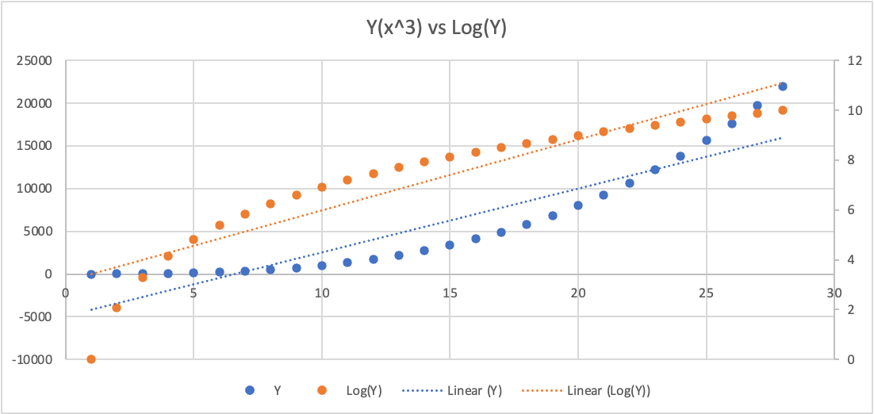
Other common transformations
Take logarithm to flatten out a curve

Slide 57
Dummy and Interaction Terms

Slide 58
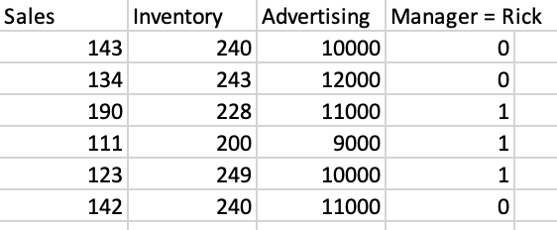
Dummy Variables
Binary variables indicating:
Yes or No
On or off
True or false
Event or not event
Anything or not-anything

Slide 59
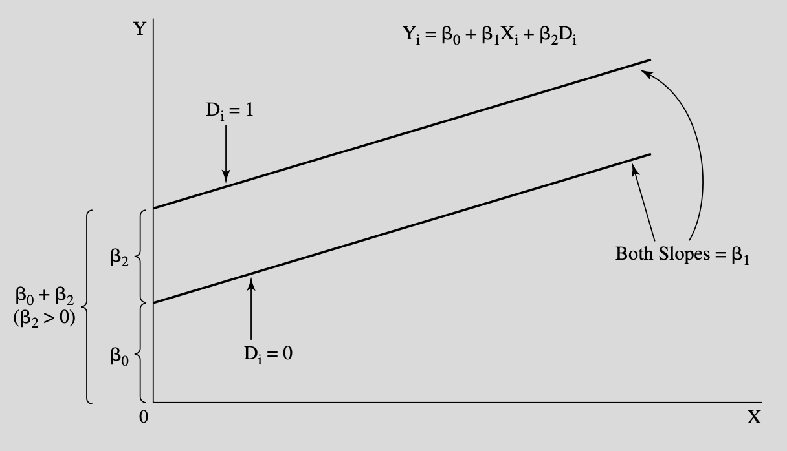

Slide 60
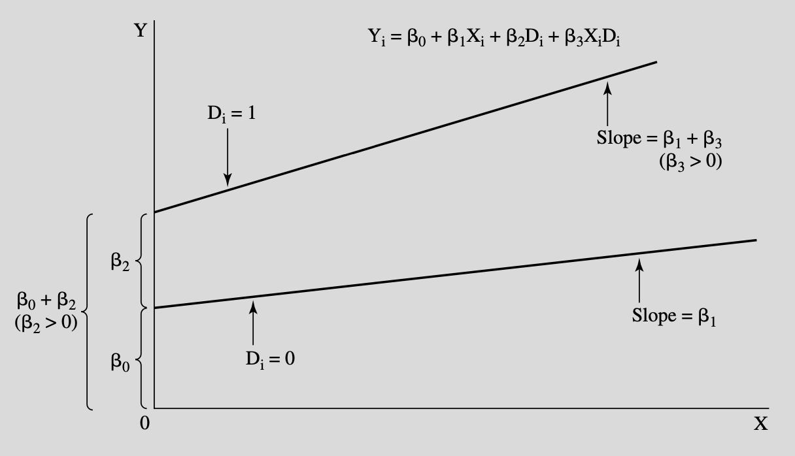
Interaction
X1 = Gender (1 if male, 0 if female)
X2 = Experience (years)
B(X1*X2) = Slope dummy indicating a difference in the way that experience relates to wage for me

Slide 61
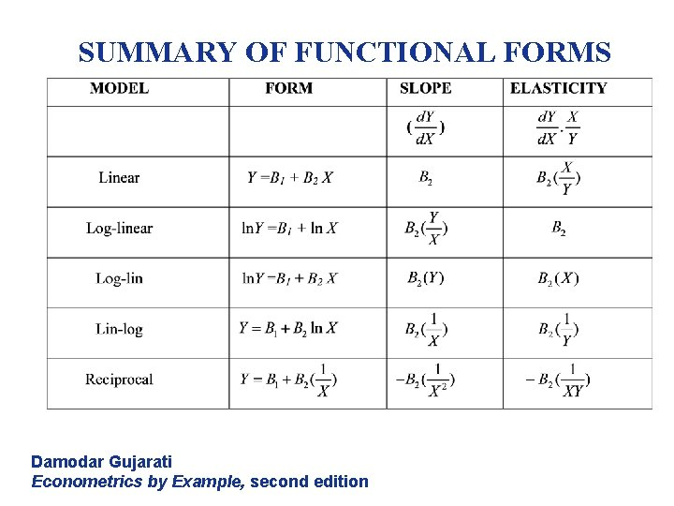

Slide 62
Ramsey’s RESET Test
Test for correct functional form and/or omitted variables
Provides hint of problem, but not insights for solution

Slide 63
Sensitivity Analysis & Full Reporting
Honest research likely requires publishing the results of many models
Summarize the coefficients, providing averages, ranges, or just a table of results
Create separate models to address different deficiencies and report their strengths and weaknesses.
Don’t hide methods or weaknesses.

Slide 64
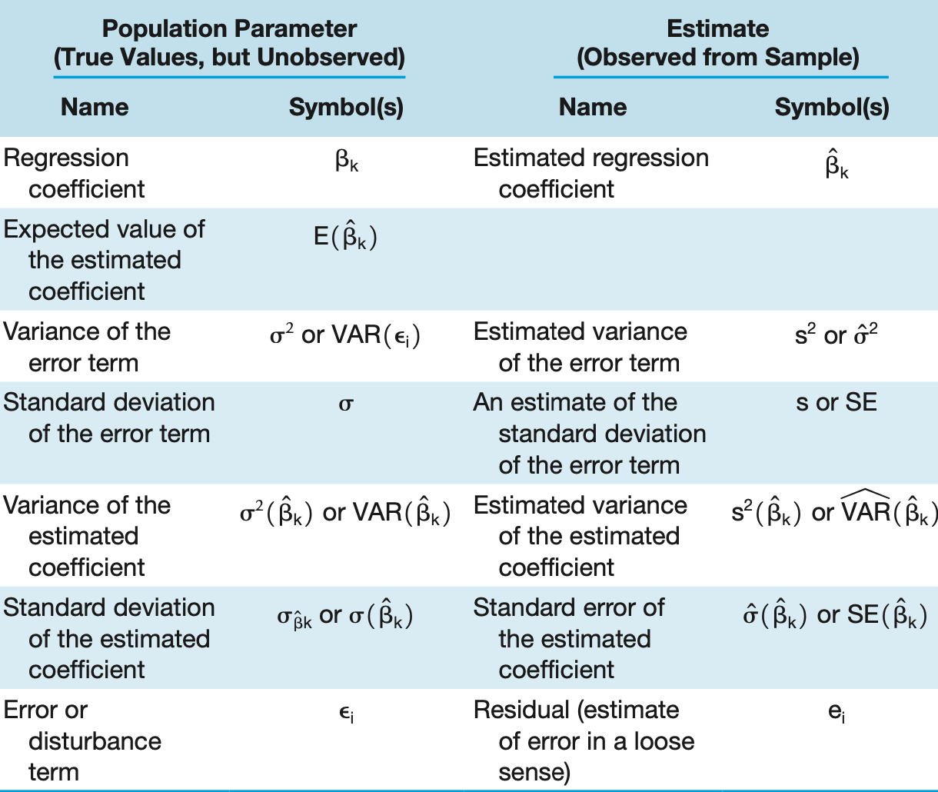

Slide 65
Assessing Models
Only include models that meet the OLS assumptions (for the most part)
Compare models using:
Match with theory
F-Test of overall significance
R^2 - Tells us percentage of variation in Y is explained by model
Adjusted R^2 - Like R^2, but penalized for adding variables
AIC and BIC tests (lower = better)
Out of sample testing - Leave some data out of fitting process, then see how well that data is predicted by the model
Other research
Report everything!

Slide 66
AIC / BIC
Compare multiple models with both
Akaike information criterion: Lower is better
Bayesian information criterion: Lower is better

Slide 67
The Role of Theory
Foremost, variables should be selected on the basis of established factual relationships, such as the relationship between quantity demanded and price
Next include high-confidence theoretical variables, such as quantity demanded and local housing-starts
Variables required as part of the methodology and/or study specifics, such as before / after categorical variables, or seasonal variables
Finally, variables being tested

Slide 68
Parsimony and Occam's Razor
Less is better, all things being equal
An equally effective model with less complexity is likely superior for practical and philosophical reasons
Overfitting: Creating a model so specific that it is perfect for describing the dataset used to train the model, but has much less value when tested “out of sample”
Less specificity means less chance of overfitting

Slide 69
Outliers

Slide 70
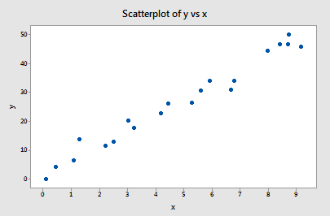
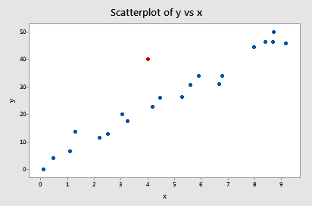
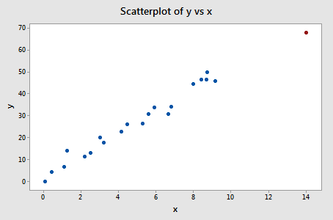
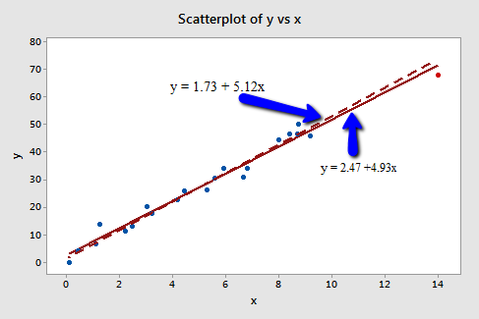
Outliers: data that does not follow the regression trend, such as quadrant 1
Leverage: data that has an extreme x value
Outlier + Leverage = Influence, which is possibly bad

Slide 71
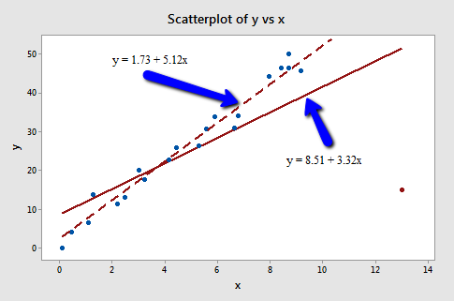

Slide 72
Consequences and Solutions: Outliers
Consequences:
Estimates are pulled in the direction of the outlier, possibly distorting the real signal being measured
HOWEVER, outliers should not necessarily be dropped without good reason / sound logic
Detection:
Cook’s D
Observations with Cook’s D > 3 x Mean might be outliers
Observations with Cook’s D > 4/n might be outiers
DFBeta:
Shows impact of removing single value on regression equation
Solution:
Drop outliers, but maybe not…

