Slide 1
ANOVA
Analysis of Variance
Testing Differences invThree or More Population Means

Slide 2
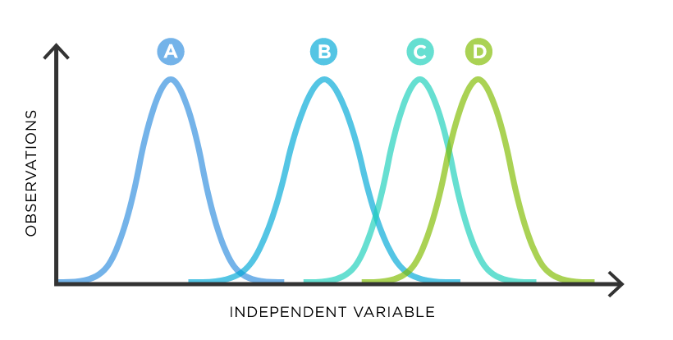
ANOVA Basics
Extension of two-sample hypothesis testing to three or more groups
Used when response variable is continuous and predictor variable is categorical
Factor: Categorical explanatory variable (Major)
Level: Categories within the factor (Economics, Marketing…)
One or more “factors” / categorical variables (school type, major)
Each factor contains two or more levels (public/private, engineering/biology/economics…)

Slide 3
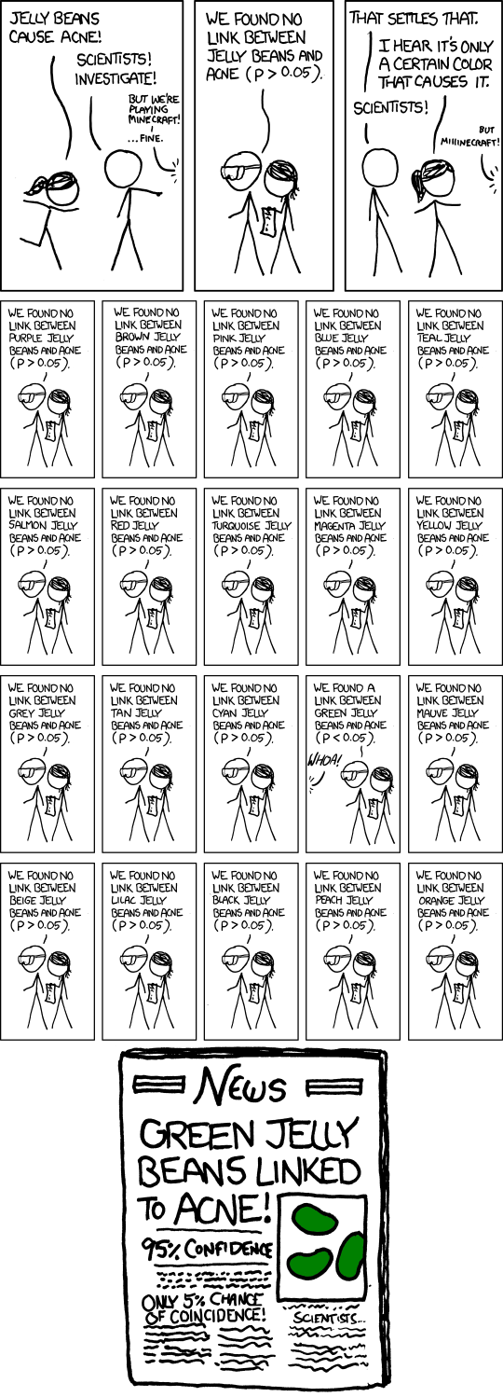
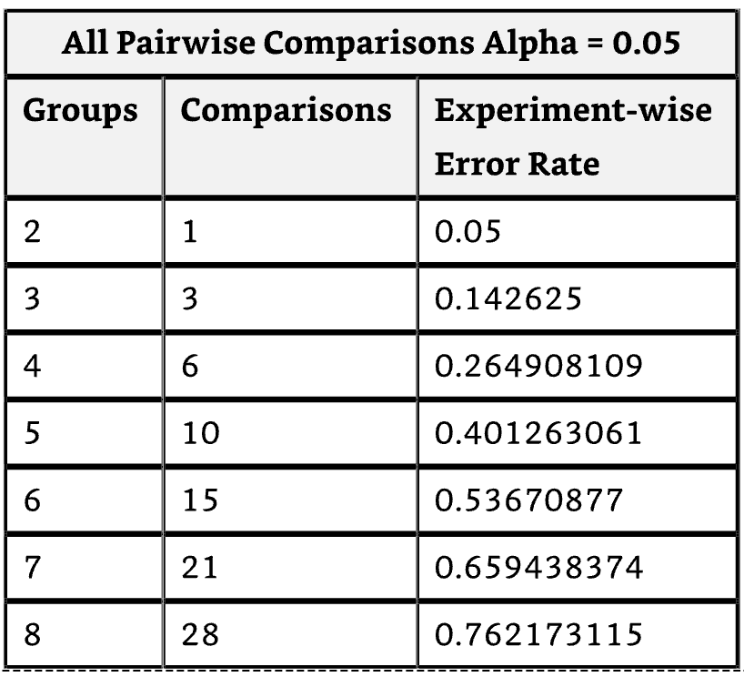
Why not lots of T tests?
Each t-test at alpha = 5% has a 5% type 1 error rate.
Running many pairwise t-tests increases the chance of getting at least one false positive
ANOVA tests the overall null hypothesis that all group means are equal while controlling the type 1 error rate (for that omnibus test)
ANOVA compares between-group variation to within-group variation

Slide 4
ANOVA Workflow
EDA: Summary statistics and graphics (box plots, histograms)
Fit the model
Check assumptions
Interpret F and p
Post hoc tests if needed
Effect sizes
Report results
Transform or different test if assumptions aren’t met

Slide 5
ANOVA Assumptions
Assumptions:
Observations are independent
Residuals are approximately normally distributed
Population variances are approximately equal
No extreme outliers
*If these assumptions are not met, ANOVA is probably still fine if n >30, but unequal variances and severe non-normality can still matter

Slide 6
ANOVA One- vs Two-Way
One-Way ANOVA: One categorical predictor
Example: Does income vary by major
Two-Way ANOVA: Two categorical predictors, plus possible interaction
Example: Does income vary by major, school type, and does the effect of major vary by school type

Slide 7
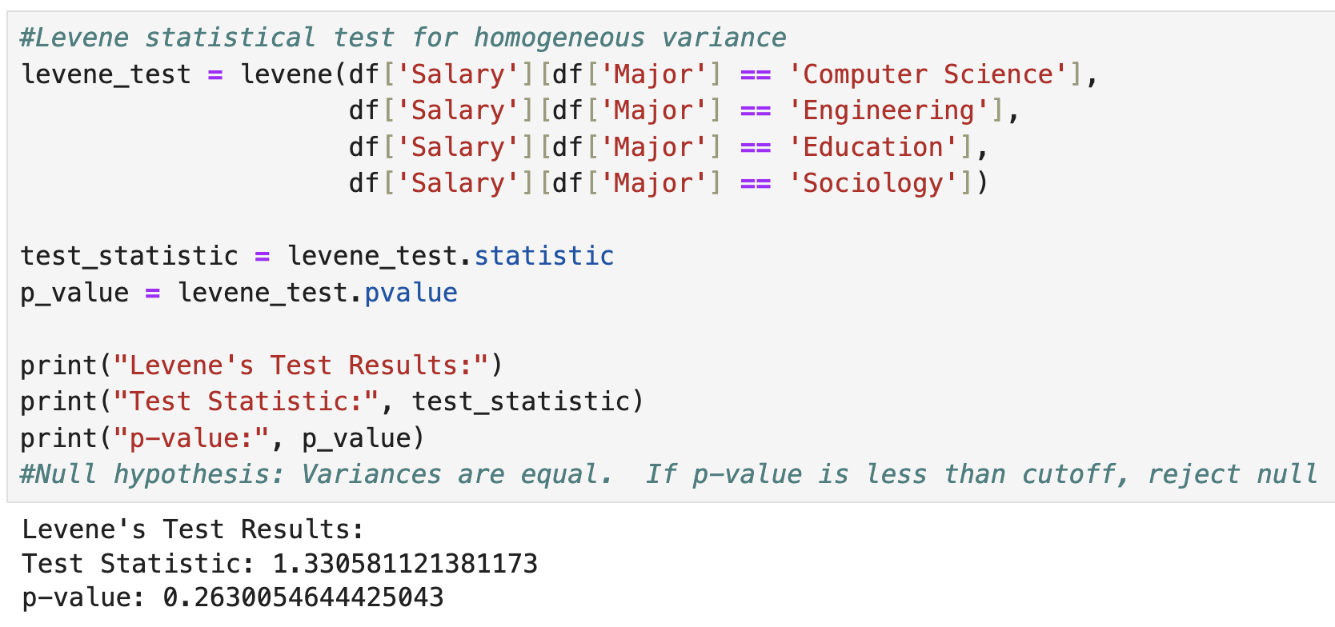
Levene’s Test For Equal Variances
If variances differ substantially, use Welch’s ANOVA
H0: Group variances are equal
HA: At least one group variance differs
P value < alpha = reject null of equal variance

Slide 8
One Way ANOVA
H0: Group 1 Mean = Group 2 Mean = Group 3 Mean
HA: At least one population mean differs
ANOVA tells us a difference exists, but not which groups differ

Slide 9
Variance Decomposition
Total Variation (SST) = Within Group Variation (SSW) + Among Group Variation (SSA)
Sum Of Squared Variation Within Groups (SSW)
Calculate the mean of each group
Calculate differences between each observation and its group’s mean
Square the differences
Add up all the squared differences = SSW
This is within-group variation
SSW = Unexplained / residual
Sum Of Squared Variation Among Groups (SSA)
Calculate the mean for all observations (grand mean)
Calculate the mean for each group
Calculate the differences between each group’s mean and the grand mean
Square the differences
Multiply each group’s squared difference by the number of observations in each group to weight the values
Add up all the multiplied squared differences = SSA
This is between group variation
SSA = Explained by group membership

Slide 10
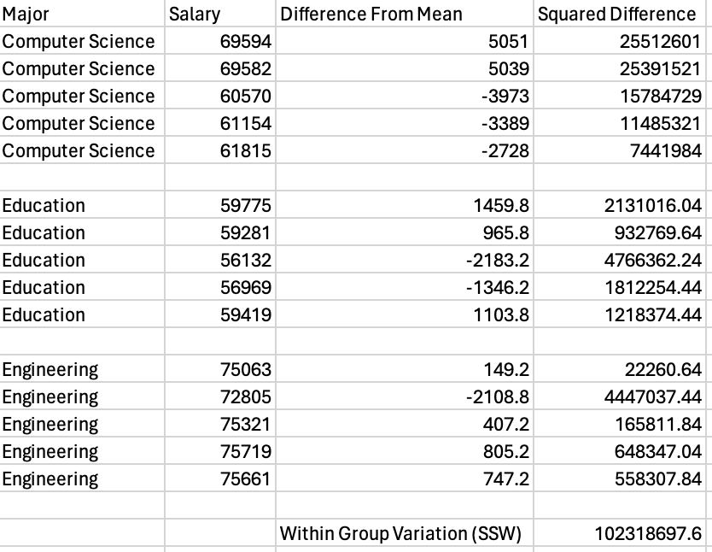
Example SSW (Within-Group Variation)
Variation inside each group
Measures natural variability in the data
Measures noise within groups
Steps:
Calculate mean of each group
Calculate each observation’s difference from its group mean
Square the differences
Sum them up!

Slide 11
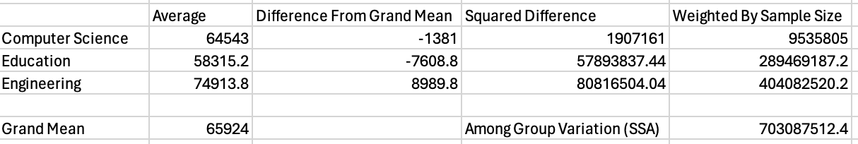
Example SSA (Between-Group Variation)
Variation between group means
Measures how far group means are from the grand mean
Compute the grand mean
Compute each group mean
Subtract the grand mean from each group mean
Square the differences
Multiply by the group sample size
Sum results
Large SSA means group means are far from the grand mean

Slide 12
Mean Squares and the F Statistic
Mean Square Among (MSA) = SSA / (c - 1), where c is the number of categories. (In our example, c =3)
Mean Square Within (MSW) = SSW / (n - c), where n is the total sample size from all groups and c is the number of categories. (In our example, n=15)
F Statistic = MSA / MSW
Interpretation: Large F = Between-group variation is large relative to within group variation = Evidence that group means differ
If group means are similar, MSA and MSW should be similar so F = 1

Slide 13
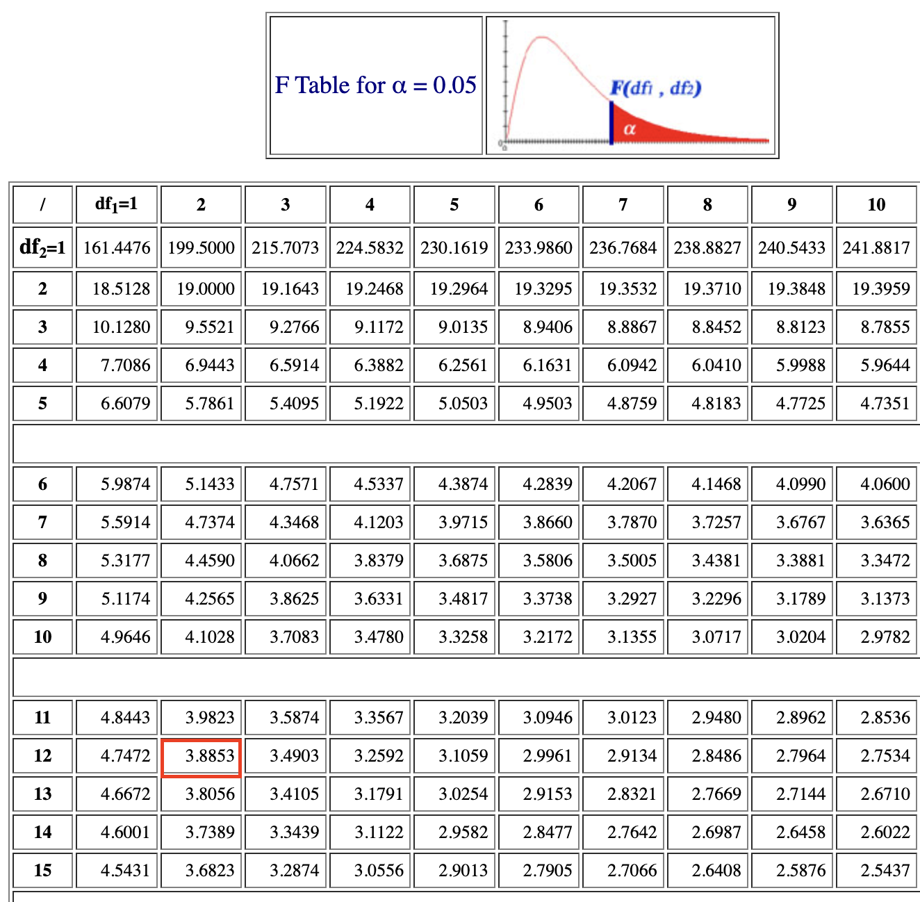
F Test
F distribution is right-skewed
Large F values indicate evidence against the null hypothesis
Df1 = c - 1 and df2 = n - c (where c = number of categories)
Given alpha, df1, and df2, find F critical value from the F dist
Reject H0 when F > CV or p < alpha
α
0
Do not
reject H₀
Reject H₀
F_{α}

Slide 14
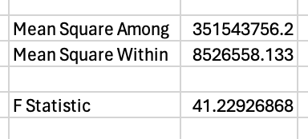
Example F-Statistic and Critical Value
F Statistic = MSA / MSW
Consult an F table for that level of confidence where df1 = c - 1 and df2 = n - c
F = 41.23 and CV = 3.89
Since F > CV reject the null hypothesis that all group means are equal.

Slide 15
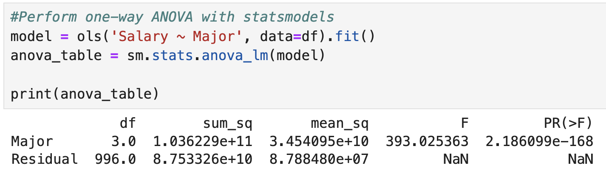
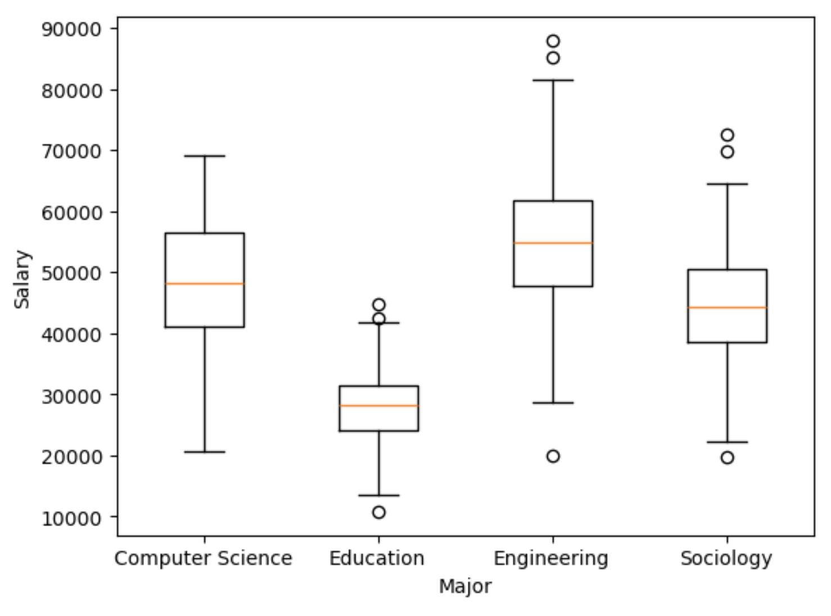
If p<alpha, reject null hypothesis that all group means are equal

Slide 16
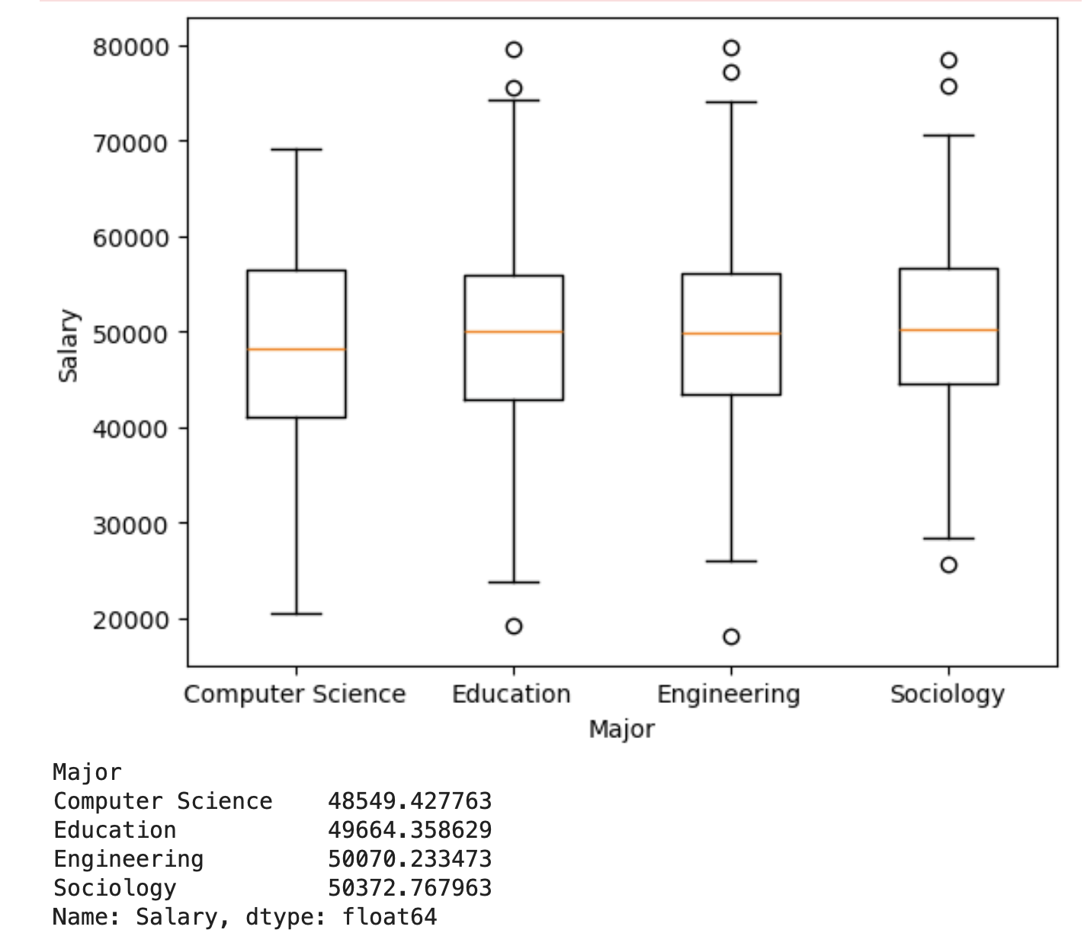
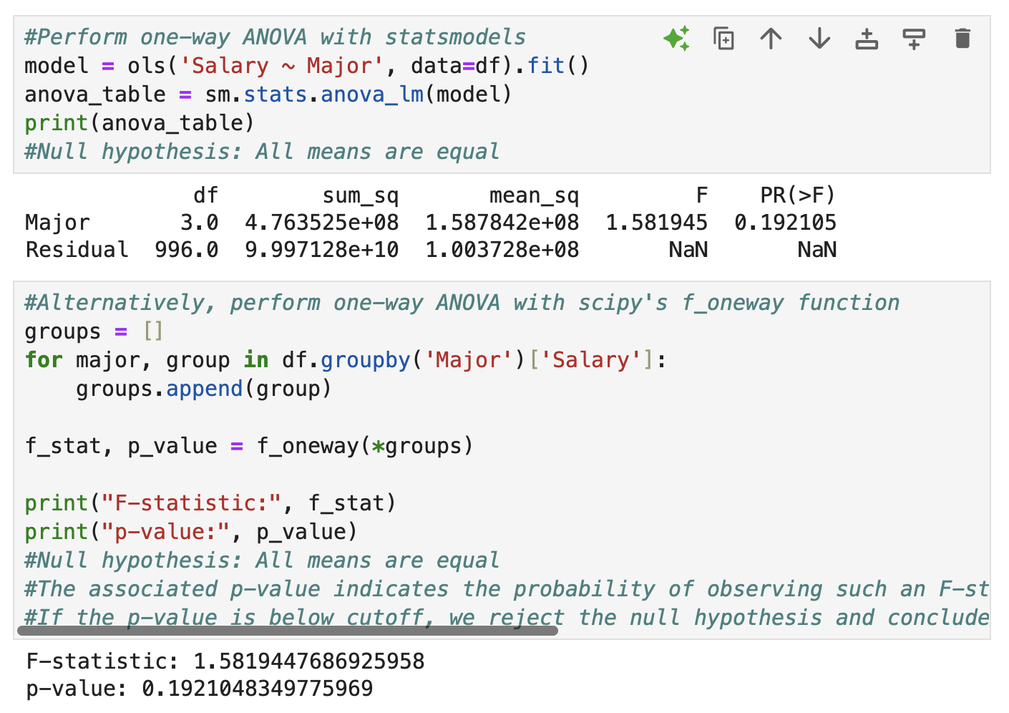
Fail to reject null since p > alpha

Slide 17
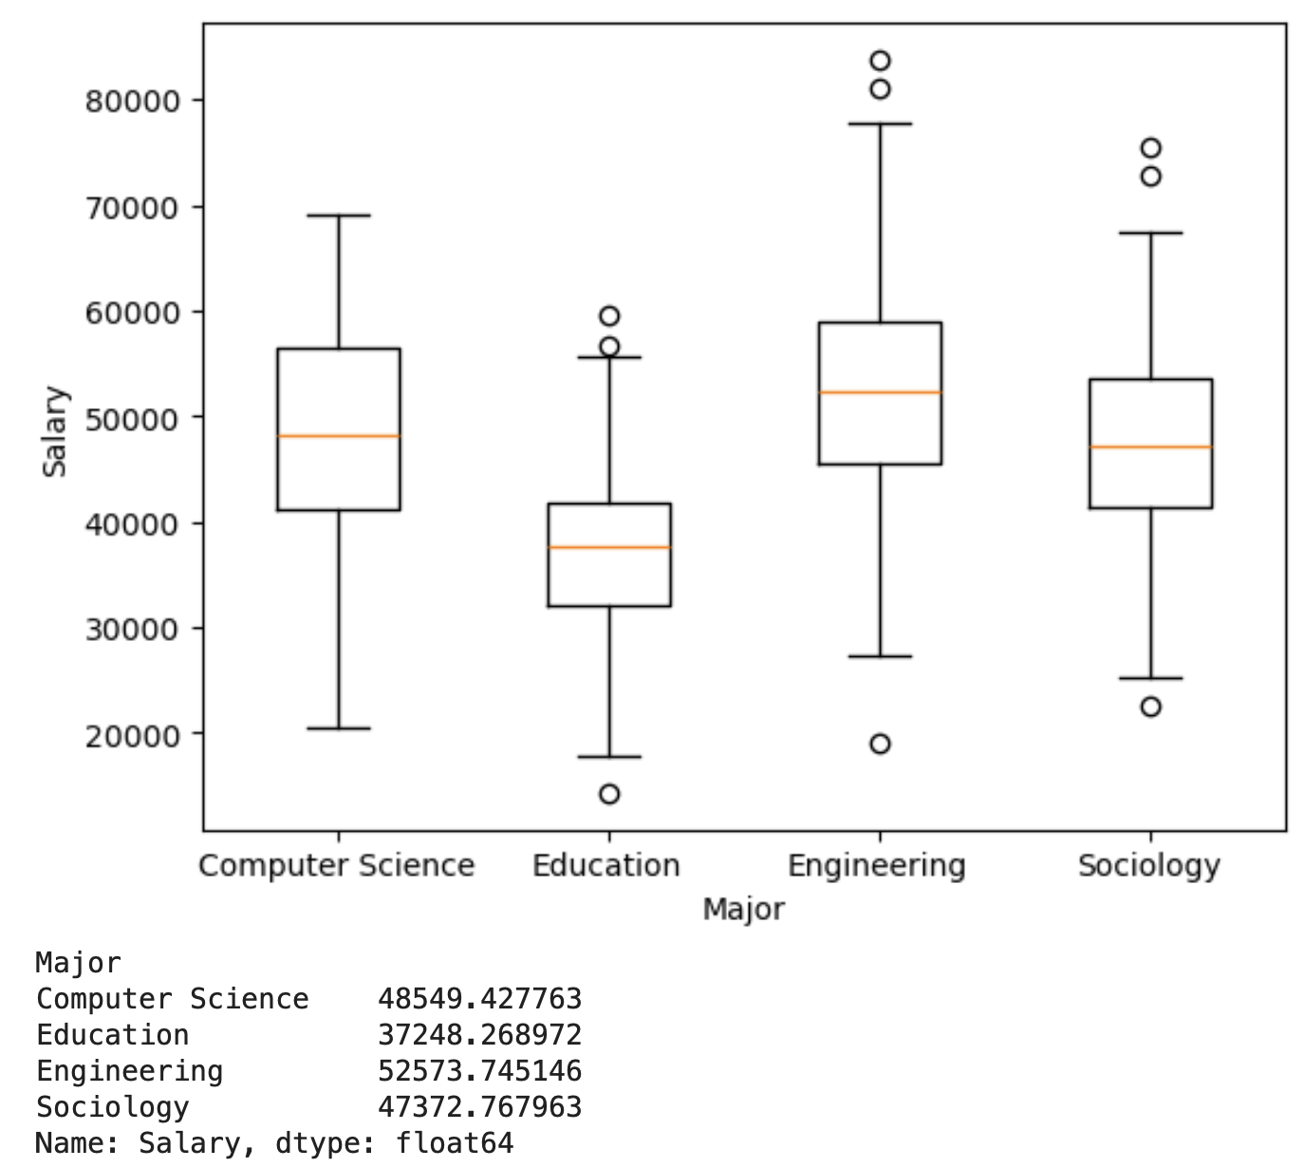
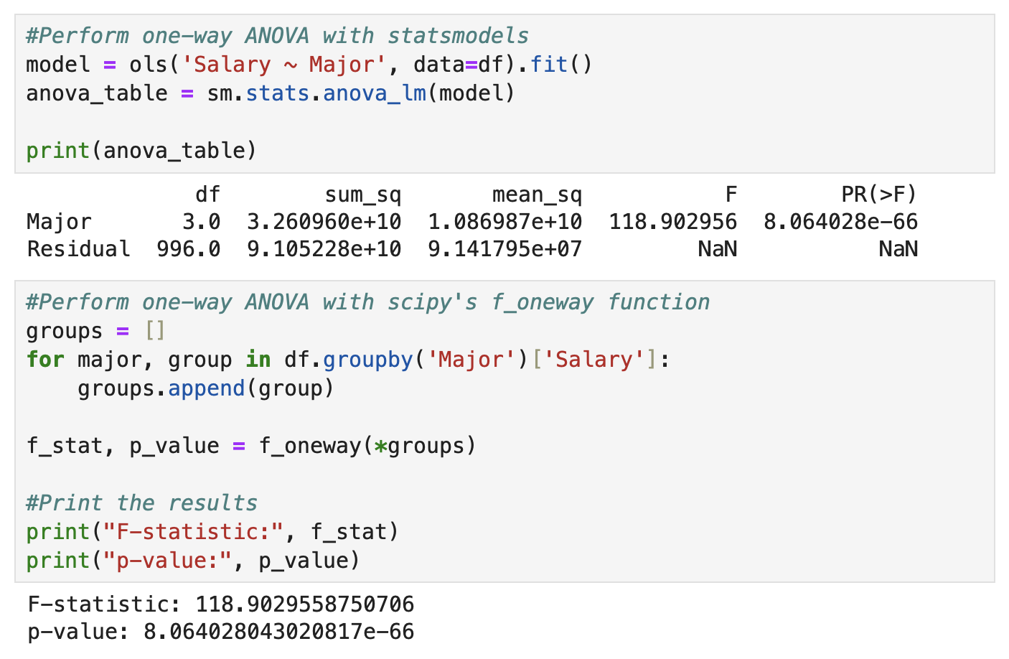
Reject the null since p < alpha

Slide 18
Post Hoc Testing: Tukey-Kramer
After a significant ANOVA result we need to determine which groups differ.
Tukey-Kramer:
Compares all pairwise differences
Controls familywise Type 1 error
Works with unequal sample sizes
Output shows:
Mean differences
Confidence intervals
Adjusted p-values

Slide 19
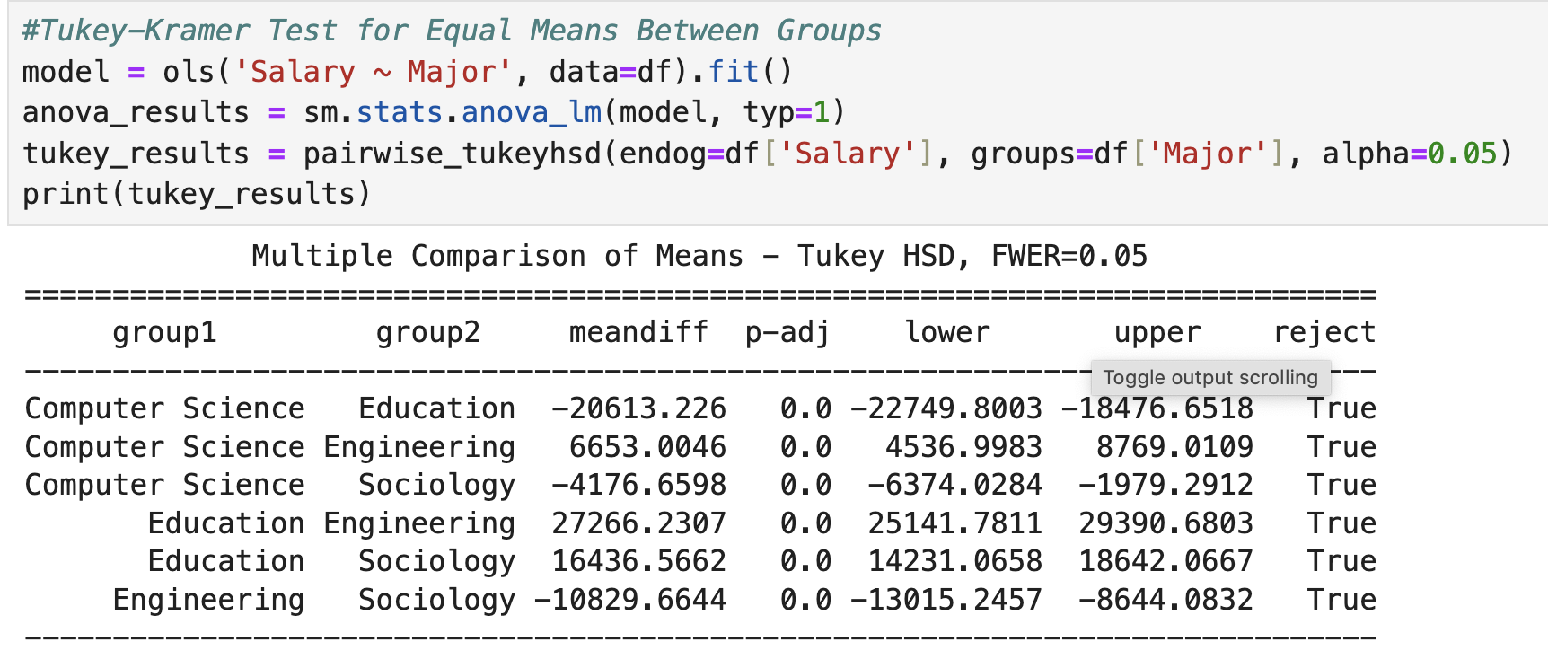
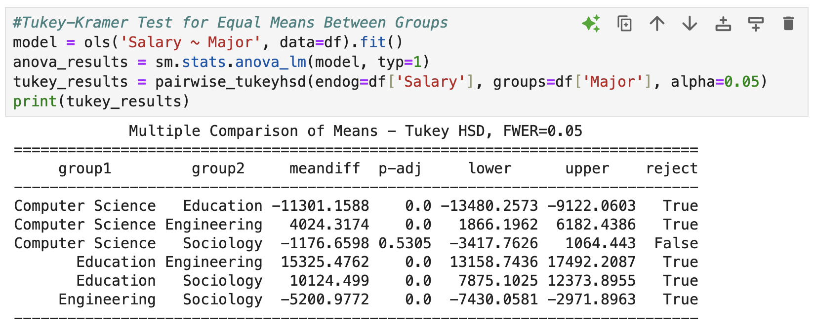
Tukey-Kramer
All differences are significant
Difference between CS and Sociology is insignificant
Tests each pairwise difference without inflating risk of type one error (as would be the case with six pairwise t-tests)

Slide 20
Effect Size in ANOVA
Differences can be statistically significant but practically insignificant
With huge samples, even tiny differences can be significant
ANOVA effect size tells us how much of the variation in the outcome is explained by the factors included in the model, not just whether the effect is statistically significant

Slide 21
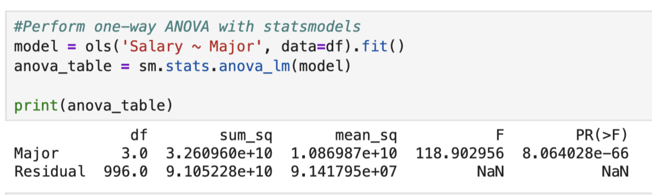
Effect Size in ANOVA
One-Way:
Eta-squared: SSA / SST
Ex:
SST = SSA + SSW
SST = 3.260960e10 + 9.105228e10 = 1.2366188e11
Eta-squared = 3.260960e10 / 1.2366188e11 = 0.264
Eta-squared = 0.264 = 26% of the variation in salary is explained by major

Slide 22
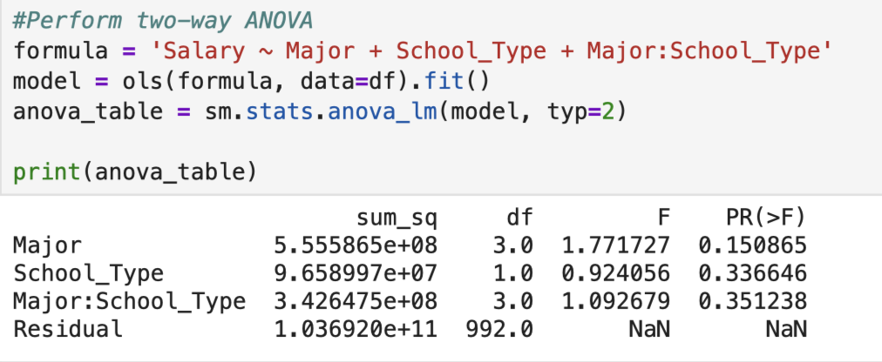
Effect Size in ANOVA
Two-Way:
Partial Eta-squared
SSeffect / (SSeffect + SSerror) =
5.555865e08 / (5.555865e08 + 1.036290e11) = 0.0053
Major explains 0.53% of the variance after controlling for the other factors

Slide 23
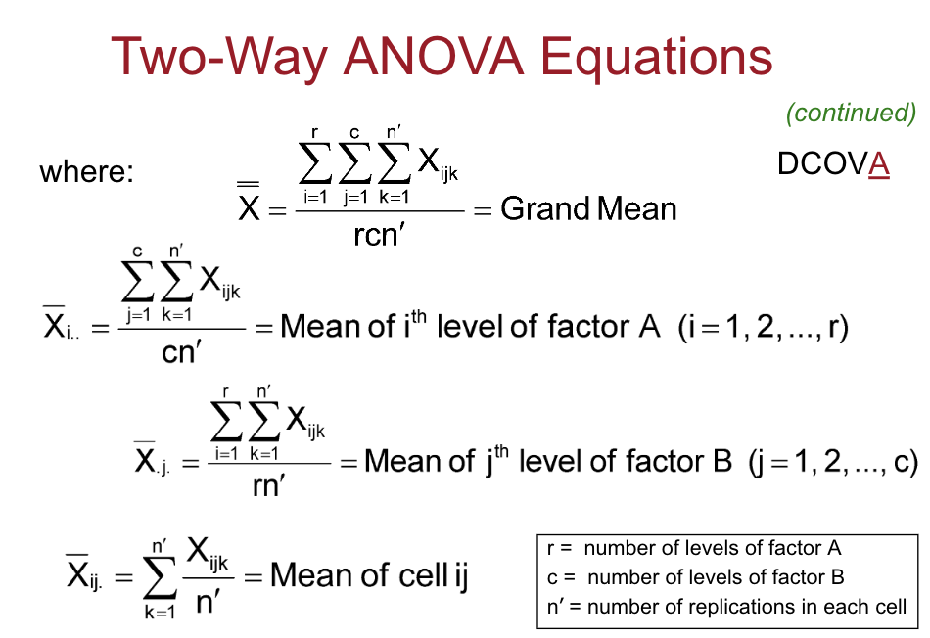
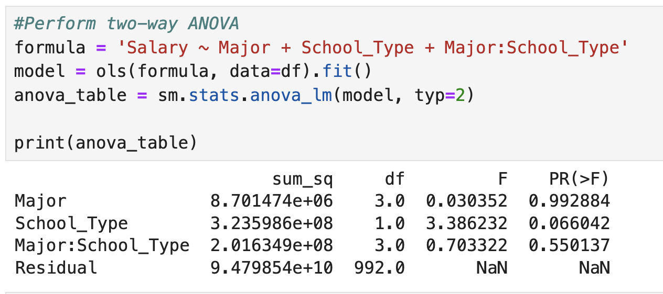
Two Way ANOVA
Used when there are two factors / categorical predictors (college major, school type)
Tests main effect of each factor
Also tests effect of interaction between factors
Example interaction: Does choice of major affect salaries differently for private school students than it does for public school students

Slide 24
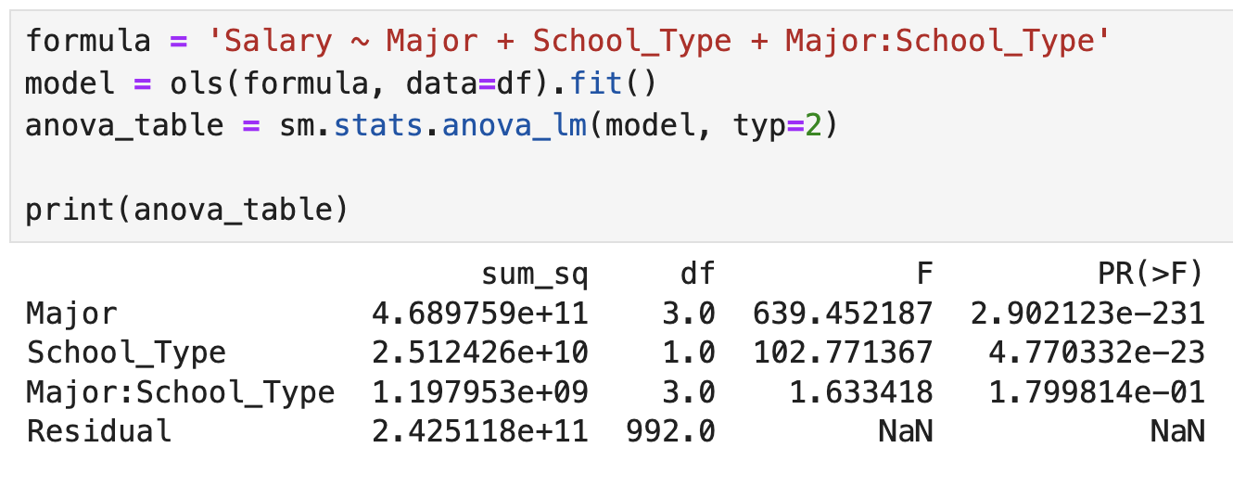
Insignificant differences
Significant differences for major and school type, not for interaction
This suggests the effect of major does not vary based on school type.

Slide 25
Interpreting
If p<alpha, reject null of equal means

Slide 26
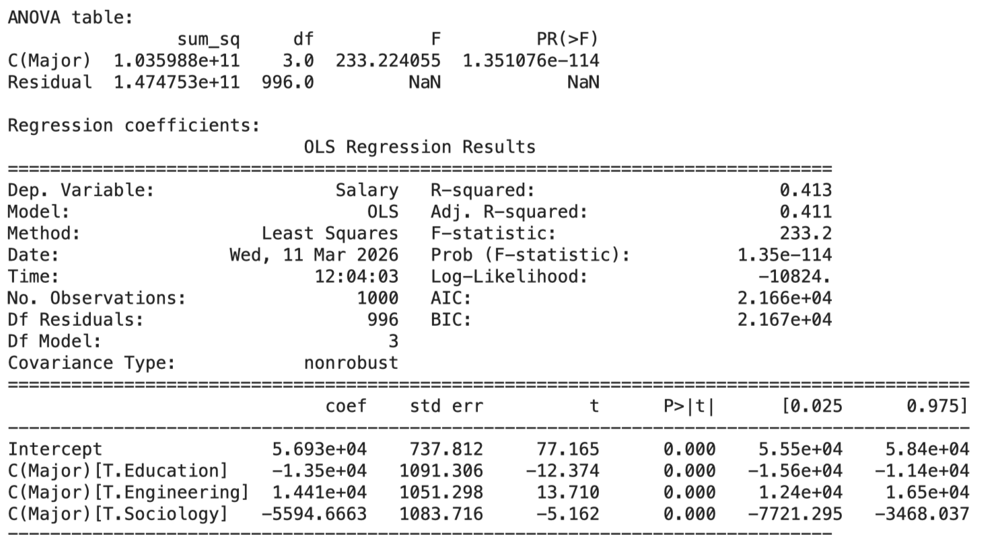
ANOVA as Regression
ANOVA for major (Education, Engineering,, Sociology) could be estimated as regression with dummy variables for all but one level
Salary = B0 + B1(Education) + B2(Engineering) + E
B0 = mean salary for omitted group, B1…Bn = differences from omitted group
F-Test for regression tests whether all non-reference groups equal zero

Slide 27
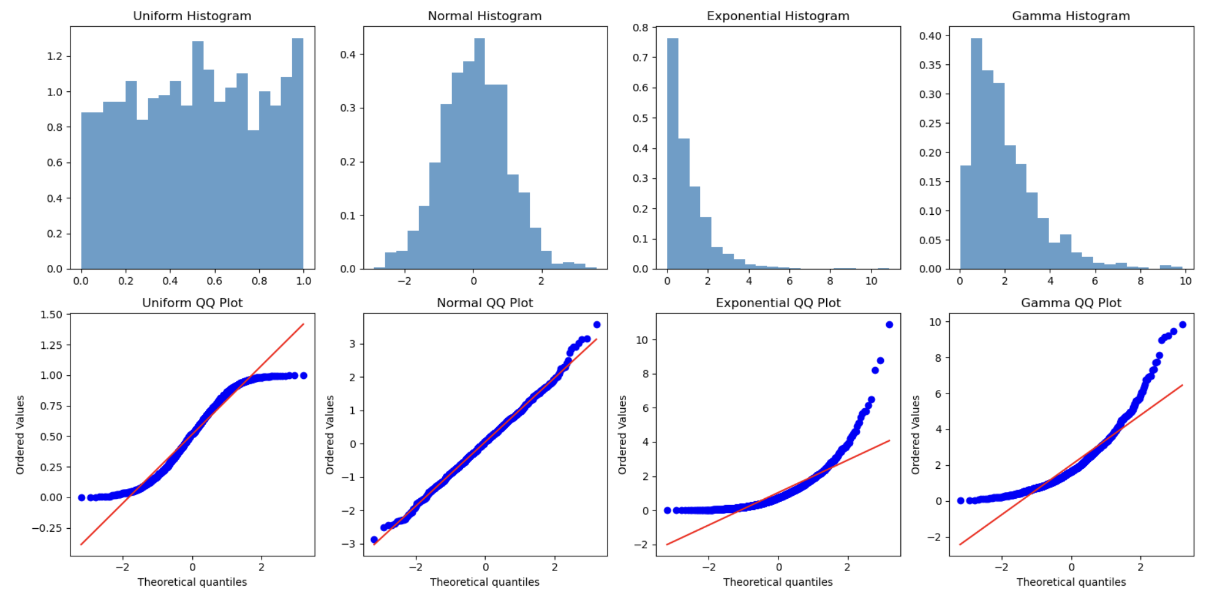
Q-Q Plot and Histogram For Residual Normality (Again)

Slide 28
Assumption Violations
Mild non-normality of residuals:: Probably not a problem (especially if sample sizes are large, group sizes are balanced, and no extreme outliers)
Non-normality driven by outliers: Check for data errors, decide if the outliers are worth keeping, consider “robust” methods
Strong skew or heavy tails: Transform the response variable via log or square-root transform
Use Welch ANOVA if variances are unequal
If the data are very non-normal or ordinal, consider non-parametric Kruskal-Wallis test
If response variable is highly non-normal, it may be best to use another model

Slide 29
Repeated Measures
If observations are paired, like with T-test, use repeated measures ANOVA instead of one-way
Standard ANOVA assumes independence, so it’s wrong!
Each object has its own baseline

Slide 30
Strong Non-Normality / Ordinal Outcome
Used Kruskal-Wallis as the non-parametric version of one-way ANOVA
H0: All groups come from same distribution
HA: At least one group differs
Often interpreted as median differences

