Slide 1
Regression

Slide 2
Variables
Dependent variable: The variable we are attempting to predict or explain
Independent variable(s): The variables we are using to predict or explain our dependent variable
Dependent Variable | Independent Variables
Price | Square feet, # of bedrooms, # of bathrooms….
Homicides | Average prison sentence, number of police…
Sales | Price, advertising budget, sales promotion…

Slide 3
Regression Analysis
Regression analysis: A set of statistical techniques used to estimate the relationships between a dependent variable and one or more independent variables
This allows us to:
A) Quantify the relationship between variables.
Example: What is the relationship between housing price and size? An additional 100 square feet of housing is worth approximately $x more.
B) Predict the values of one variable given the values of another.
Example: How expensive will a house that has 2,000 sqft be? It will be approximately $x.
C) Test hypotheses about relationships between variables.
Example: Does proximity to a park / power plant make a home more / less valuable? There is a statistically significant negative relationship between housing prices and proximity to a power plant.

Slide 4
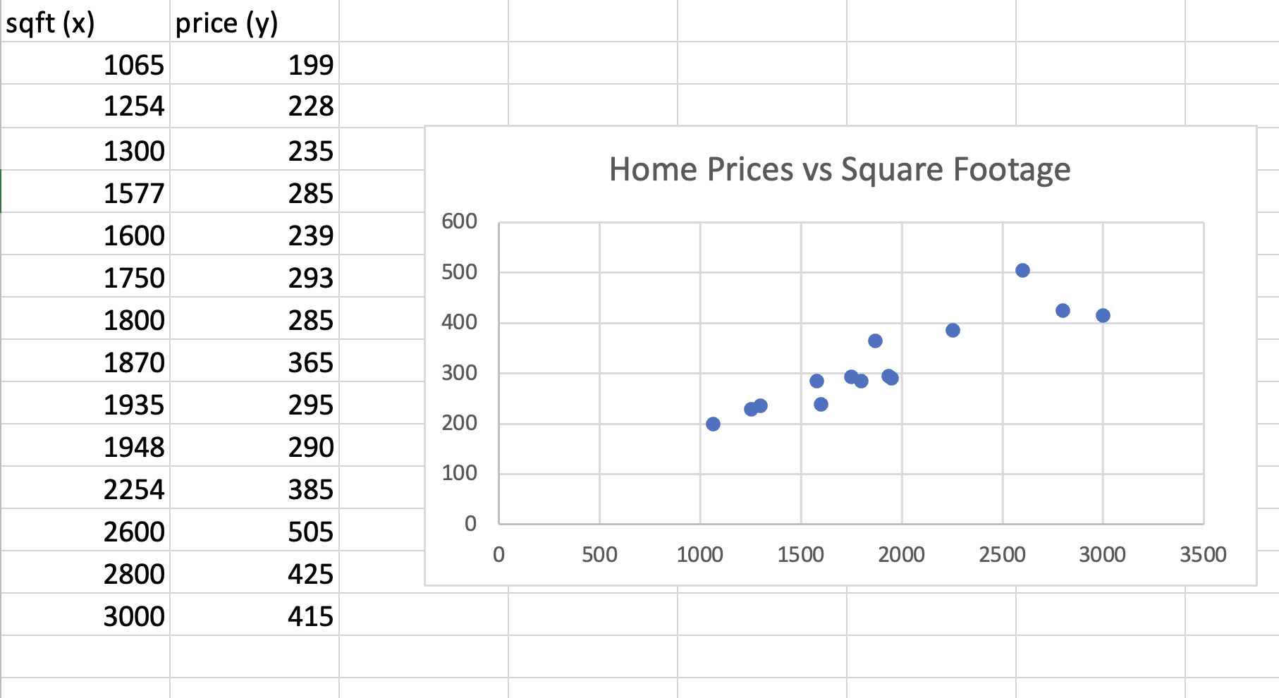
Housing Prices vs. Size
Notes:
https://docs.google.com/spreadsheets/d/1wqjOjf7lZ38MH8qTfnSt7Mgys-fS0sdpJRLiyVBBWIQ/edit?usp=sharing

Slide 5
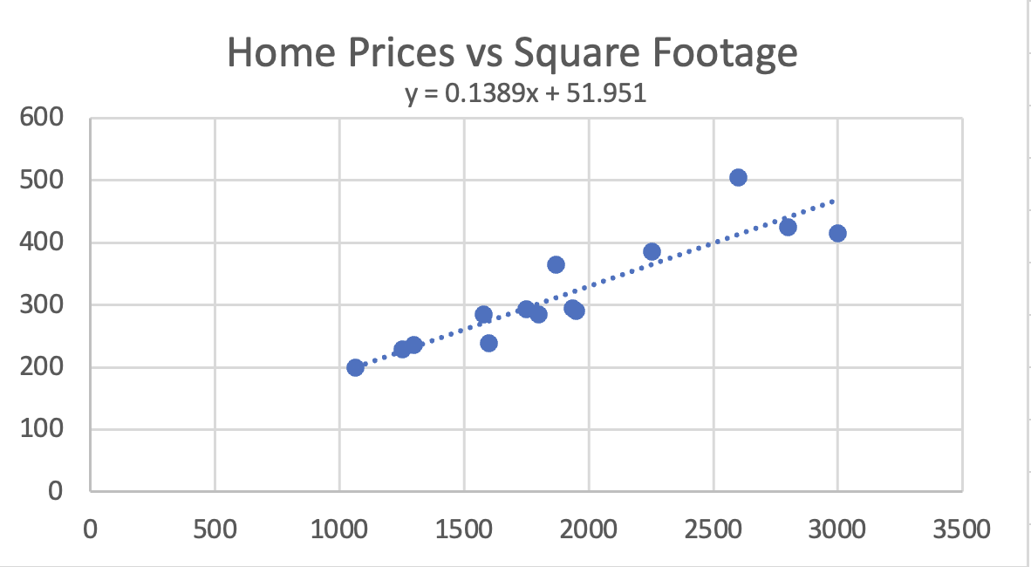
Regression Line = The Line That “Best” Fits The Data
Notes:
https://docs.google.com/spreadsheets/d/1wqjOjf7lZ38MH8qTfnSt7Mgys-fS0sdpJRLiyVBBWIQ/edit?usp=sharing

Slide 6
Simple Linear Regression Equation
Y = B0 + B1X + E
Y: The dependent variable
X: The independent variable
B0: The constant value (Y-intercept)
B1: The slope value
E: Stochastic error term
Note that this is essentially the same as the equation of a line:
y = mx + b, where m is the slope and b is the y-intercept

Slide 7
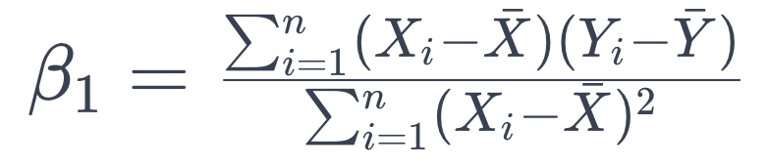
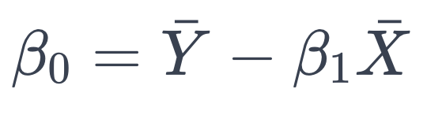
Regression Math

Slide 8
Simple Regression Beta Coefficient Interpretation
B0: The value of the dependent variable when the independent variable equals zero (not always a coherent interpretation)
B1: The change in the dependent variable associated with a single unit increase in the independent variable
Price (Thousands of Dollars) = 51.951 + 0.1389 * Square Feet
B0: 51.951 - When a house has zero square footage, price is equal to $51k
B1: 0.1389 - A single additional square foot is worth $138.9
*When variables are transformed, interpretations change.

Slide 10
Regression Confidence Intervals - Coefficients
Interpretation:
If the intervals were constructed repeatedly on different samples, 95% of the intervals would contain the actual population parameter
(Can also be done with y-hat*)
Formula: B +/- t * SE(B)
Alpha = 1 - confidence level
Degrees of freedom = n - k - 1, where k is the number of predictors
If interval contains zero, variable is statistically insignificant

Slide 11
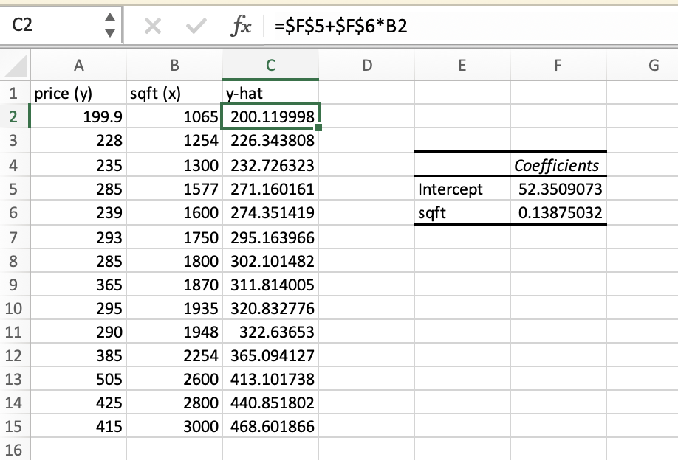

Fitted Values / Predicted Values / Y-Hat
Fitted values are the estimated values of the dependent variable given each value of the independent variable(s)
They’re the points on the regression line that correspond to each value of x in the data set
Y values found by plugging the X values into the regression equation
You can essentially think of them as the model’s predictions for each observation

Slide 12
Regression Prediction
To predict values of the dependent variable using a regression equation, plug values in for the independent variable(s) in the estimated regression equation
Price = 50.951 + 0.1389 * Square Footage
When square feet = 1000, price equals…?
50.951 + 0.1389 * 1000 = 189.851
When square feet = 2000, price equals…?
50.951 + 0.1389 * 2000 = 328.751
Be careful when using or estimating values outside of the range of your sample. The relationships that exist within your sample may not exist outside of it!

Slide 13
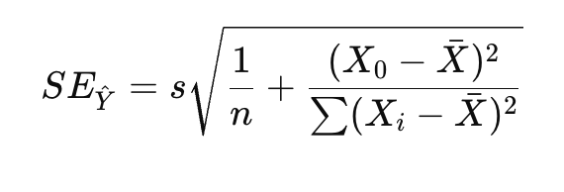
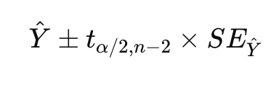
Confidence Intervals for Y-Hat
We are 95% confident that the true mean of Y when X = 10 lies between Yl and Yh

Slide 14
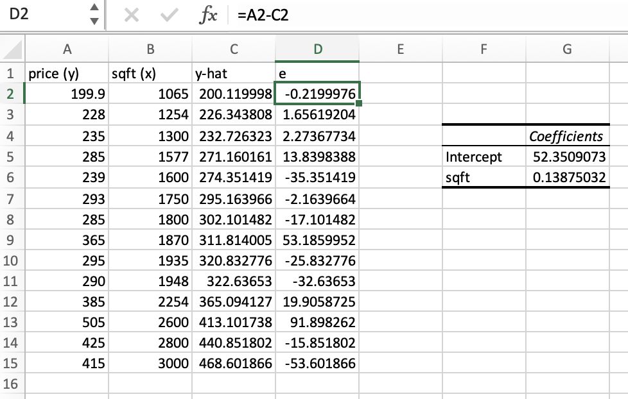
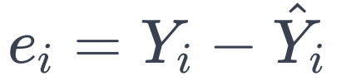
Residuals / Errors
Residuals are the difference between the actual values of the dependent variable (Y) and the predicted/fitted values of the dependent variable (Y-hat)
They are also known as errors
Found by subtracting Y-hat from Y

Slide 15
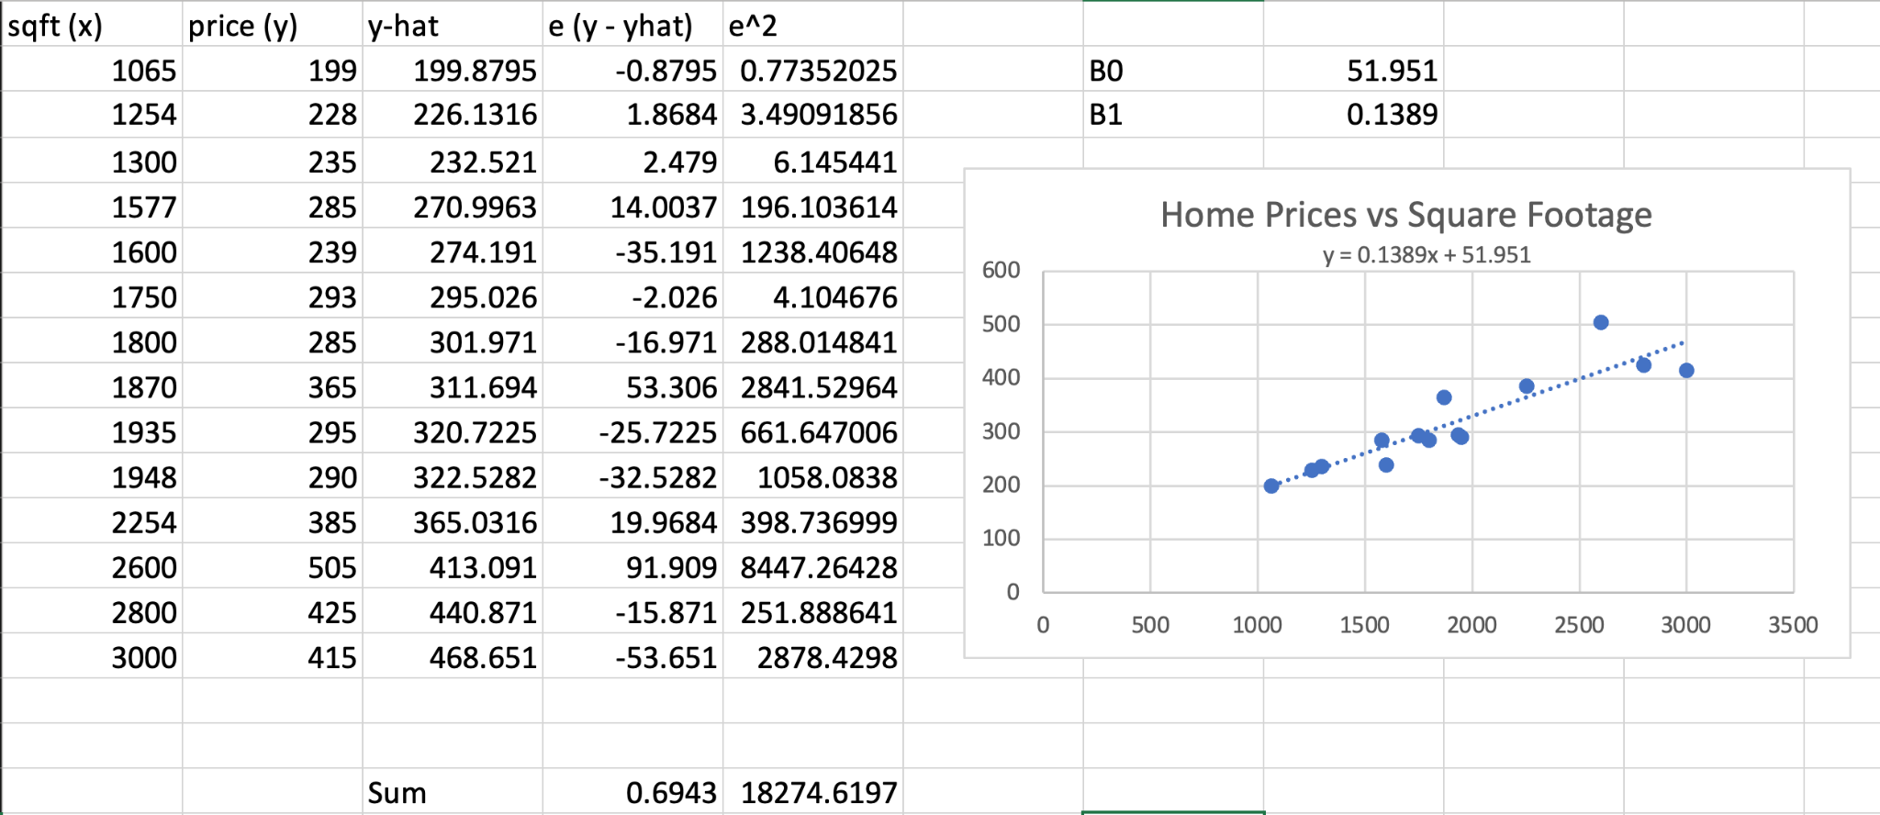
Best Fit = Line That Minimizes The Sum Of Squared Residuals / Errors…Hence “Least Squares”
Notes:
https://docs.google.com/spreadsheets/d/1wqjOjf7lZ38MH8qTfnSt7Mgys-fS0sdpJRLiyVBBWIQ/edit?usp=sharing

Slide 16
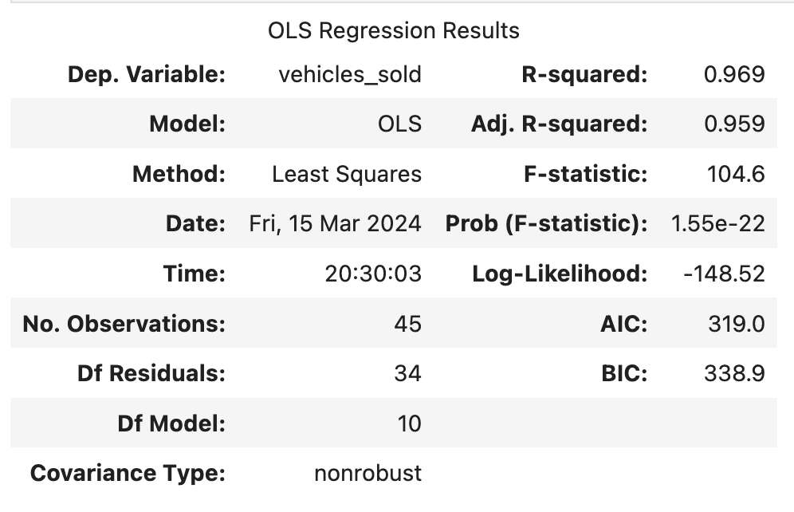
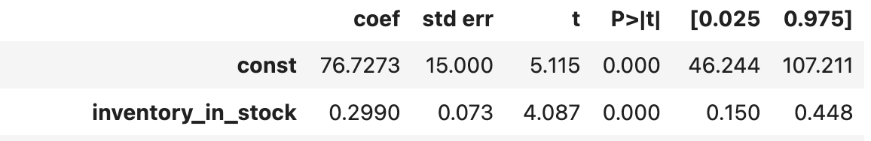
Understanding Regression Output
R^2*: The percentage of variation in Y explained by X
Adjusted R^2: R^2, but penalized for the inclusion of potentially irrelevant variables
Standard Error (of the Regression): A measure of the average distance that the observed values fall from the regression line
Beta Coefficient(s): The relationship between the X variables and Y variable (holding other variables constant*)
T-Statistic: B / SE(B)
P-Values: The p-value associated with the null-hypothesis that the regression coefficient is actually equal to zero (meaningless), based on the T-Statistic
Confidence Intervals: Bands around which we can be 95% confident the true value is*** = Bj +/- T(alpha/2)*SE(Bj)

Slide 17
R-Squared (R^2)
Total Sum of Squares (SST) = Variation of Y values around their Mean
= Sum((Yi - Y-Bar)^2)
Regression Sum of Squares (SSR) = Variation attributable to the relationship between X and Y
= Sum((Y-Hat - Y-Bar)^2)
Error Sum of Squares (SSE) = Variation in Y attributable to factors other than X
= Sum((Yi - Y-Hat)^2)
R^2 = SSR / SST
R^2 almost always increases with the inclusion of new variables.
This doesn’t mean the model is better!
Do not focus on maximizing R^2.
Also, don’t compare R^2 between models with different or transformed dependent variables!

Slide 18
R-Squared (R^2)
If goal is inference (coefficient values, confidence intervals, hypothesis testing, etc.), R^2 is not terribly important
If goal is prediction (future values), R^2 is more important, but you’d still likely be better off using other metrics (RMSE, MAE, Test R^2)
Common R^2 Values by Field
Physics: 0.9-0.99
Economics: 0.2-0.6
Psychology: 0.05-0.3
Marketing: 0.01-0.2
Many well-established relationships have significant variable coefficients but low R^2 values.

Slide 19
F-Test For Overall Significance
Used to test for the statistical significance of the entire model.
Tests the model vs a model with no independent variables
H0: B1 = B2 = B3…= BN = 0
HA: At least one coefficient =/= 0
k = number of independent variables
n - k -1 = degrees of freedom
MSR: Mean Square Regression
MSR = SSR / k
MSE: Mean Square Error
MSE = SSE / n - k - 1
F = MSR / MSE

Slide 20
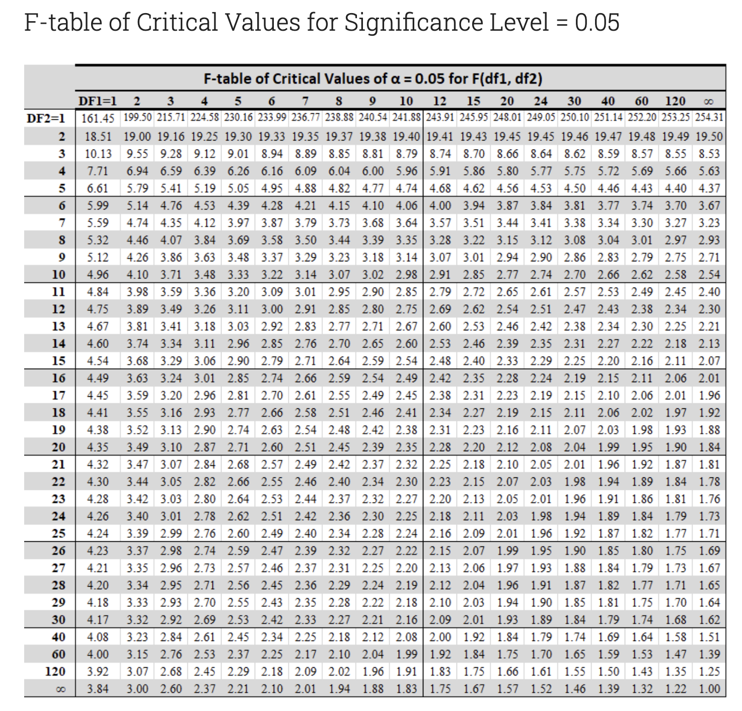
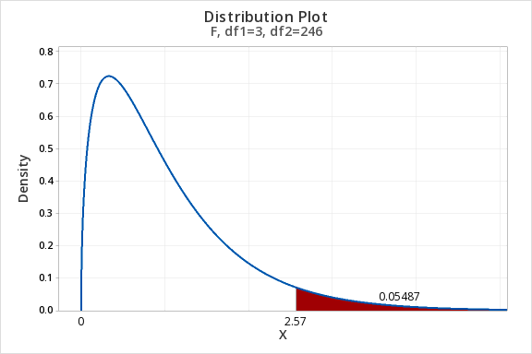
F Test / Table
Select table based on alpha
k = number of independent variables
DF1 / DFN = k -1
DF2 / DFD = n - k -1

Slide 21
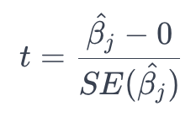
T Test for Coefficient Significance
Test slope coefficients for statistical significance
Is the slope coefficient actually different that zero?
T = B / Standard Error (B)
DoF = n - k - 1, where k is number of independent variables
Get critical values from T Distribution
Most stats software outputs T values and associated p-values for null hypothesis of no linear relationship (B = 0)
Test slope coefficients for difference from hypothetical value
Is the slope coefficient actually different than x?
T = (B - Value) / Standard Error (B)
DoF = n - k - 1

Slide 22
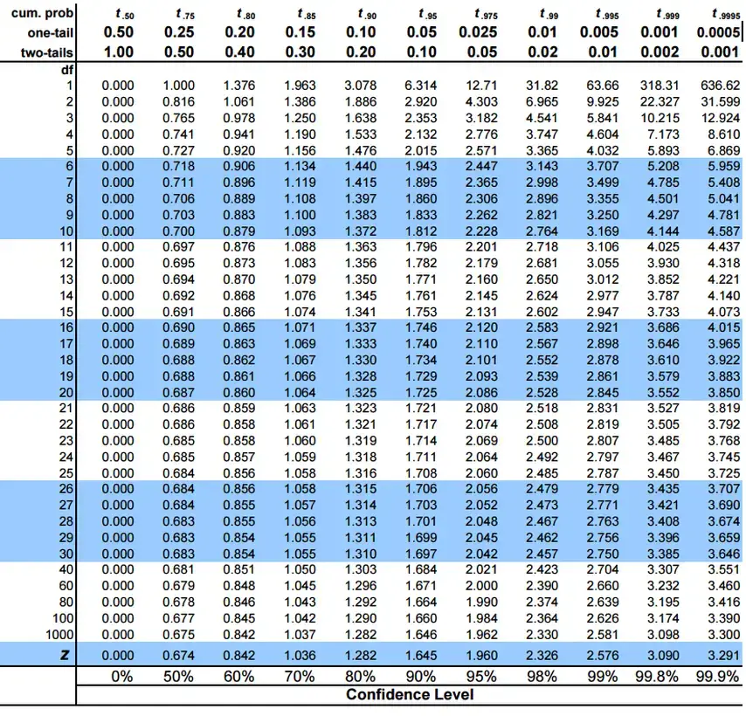
T Table (Again)

Slide 23
Multiple Regression

Slide 24
No controls = No science
Plant B grew 3 inches taller per month during the study and received 5mg more of the chemical being tested.
Did the chemical cause the growth?
Or was it the additional 10 hours of sunlight, 5 degrees of warmth, or both, or all of them AND the dosage???
Or what if dosage has a negative effect, but it’s overwhelmed by the effect of the additional sunlight and heat?
Plant | Dosage | Growth | Sun Hours | Temperature
A | 50mg | 6 inches/month | 300 | 75
B | 55mg | 9 inches/month | 310 | 80

Slide 25
But…in real life / business / social sciences we often can’t run controlled experiments
We don’t have the luxury of controlling certain factors like we would if this were chemistry. Consider the question of stimulus spending efficacy during a recession…Does stimulus spending decrease unemployment?
Country | Unemployment Rate | Interest Rate | Stimulus Spending | Shared Currency
US | 7 | 1 | 700b | 0
UK | 10 | 2 | 200b | 0
France | 13 | 1 | 500b | 1
Germany | 5 | 0.75 | 100b | 1

Slide 26
Multiple Regression
Just like the simple regression model, but not so simple!
Instead of measuring a single independent variable’s impact on a dependent variable, we measure the impact of multiple independent variables (Xi…Xn)
Now here’s the cool part…
…the coefficients (B1…Bn) are interpreted as the impact of each variable upon the dependent variable, holding all the other included variables “constant”

Slide 27
Multiple Regression = Statistical Controls
Kind of like converting prior table into the table below (setting all of each country’s attributes as the same, except for what we’re attempting to calculate, for each variable)
Country | Unemployment Rate | Interest Rate | Stimulus Spending | Shared Currency
US | 7 | 1 | 700b | 0
UK | 10 | 1 | 200b | 0
France | 13 | 1 | 100b | 0
Germany | 5 | 1 | 100b | 0
Unemployment = B0 + B1(Interest Rate) + B2(Stimulus Spending) + B3(Currency Type) + Error

Slide 28
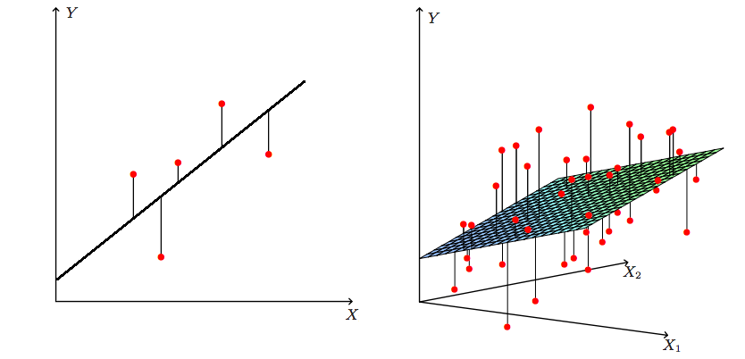
Y vs X (2D), Y vs X1 and X2 (3D)

Slide 29
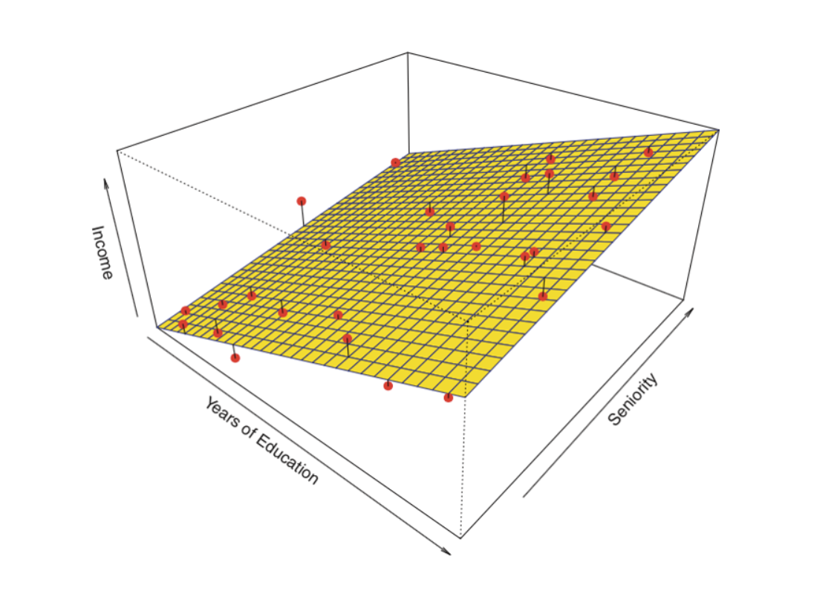

Slide 30
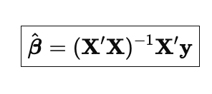
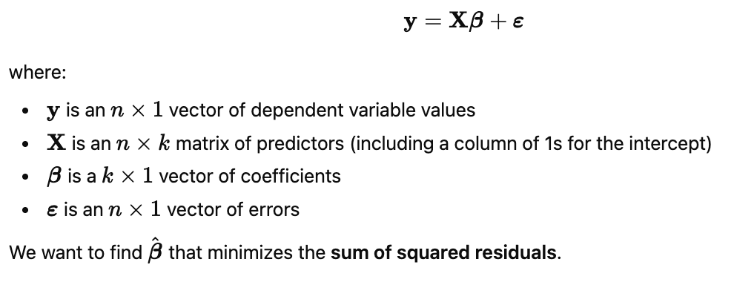
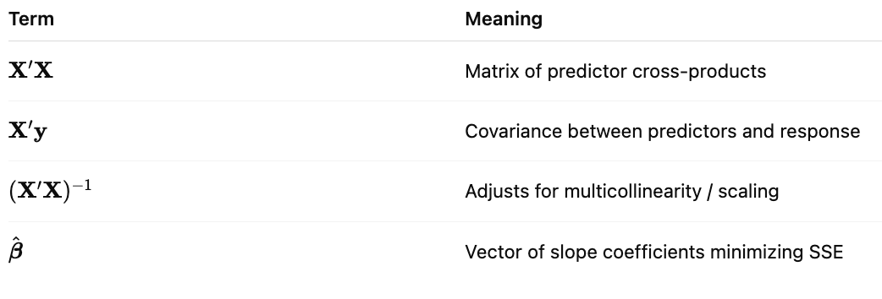
What about 4+ variables?
There is no way to visualize 4+ dimensions in a universe with 3 spatial dimensions
We need matrix algebra

Slide 31
Interpretation
B0 = Constant (Do not interpret without a good reason, nor should you remove it)
B1 = Effect of a single point increase in interest rates, controlling for the impact of stimulus spending and currency unions
B2 = Effect of a single unit increase in stimulus spending, controlling for the impact of interest rates and currency unions
B3 = Effect of being in a currency union on unemployment, controlling for the impact of stimulus spending and interest rates
E = Error term capturing omitted influences on unemployment
Unemployment =
B0 +
B1(Interest Rate) +
B2(Stimulus Spending) +
B3(Currency Type) +
Error

Slide 32
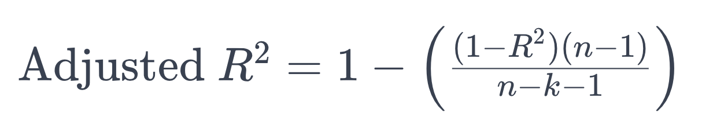
Adjusted R^2
Like R^2, but increases only if additional variables provide additional predictive power / penalizes the inclusion of irrelevant variables
Better than R^2 for selecting between models
n = sample size
k = number of predictors

Slide 33
Functional Form and Variable Transformations

Slide 34
Functional Forms
Functional form is the shape of the relationship you assume between the independent variable and the dependent variable
Not every relationship is a straight line. Some relationships are curved, percentage-based, diminishing, accelerating, or leveling off. Functional forms let us model those different shapes.
Altering functional forms from the linear model are achieved by transforming variables or adding new terms (interactions, dummy variables, lagged variables, etc.)

Slide 35
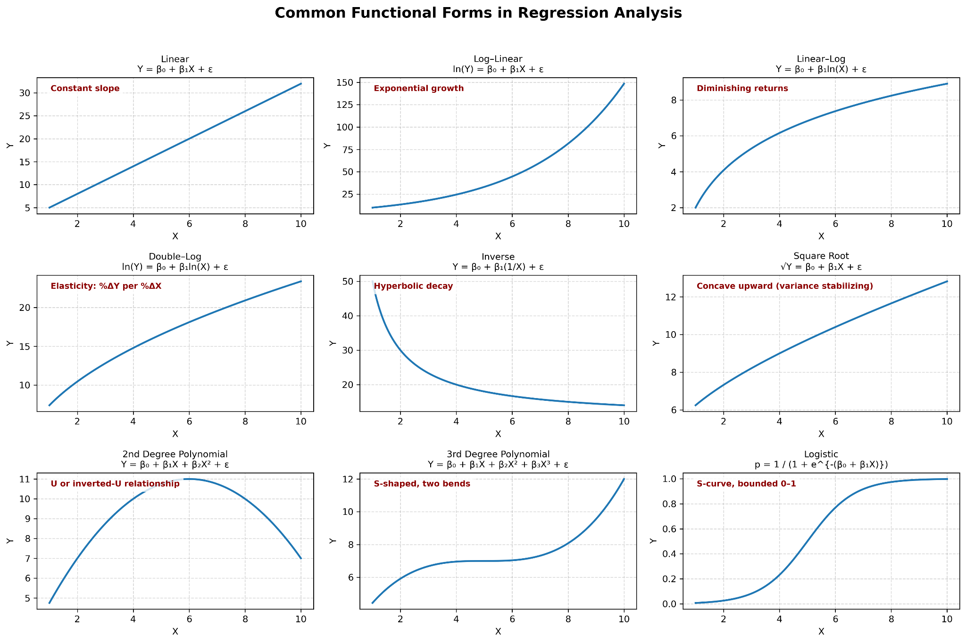
FUNctional Form
Linear: Y = B0 + B1x + e
Log-linear: ln(Y) = B0 + B1*x + e
Linear-log: Y = B0 + B1*ln(x) + e
Double-log: ln(Y) = B0 +B1*ln(x) + e
Polynomial (2nd): Y = B0 + B1*x + B2*x^2 + e
Polynomial (Nth): Y = B0 + B1*x + B2*x^2…Bn*x^n + e
Inverse: Y = B0 + B1*(1/x) + e
Square Root: Sqrt(Y) = B0 + B1*x1 + e
Interaction: Y = B0 + B1*x1 + B2*x2 + B3*(x1*x2) + e
Logistic* (NOT OLS)

Slide 37
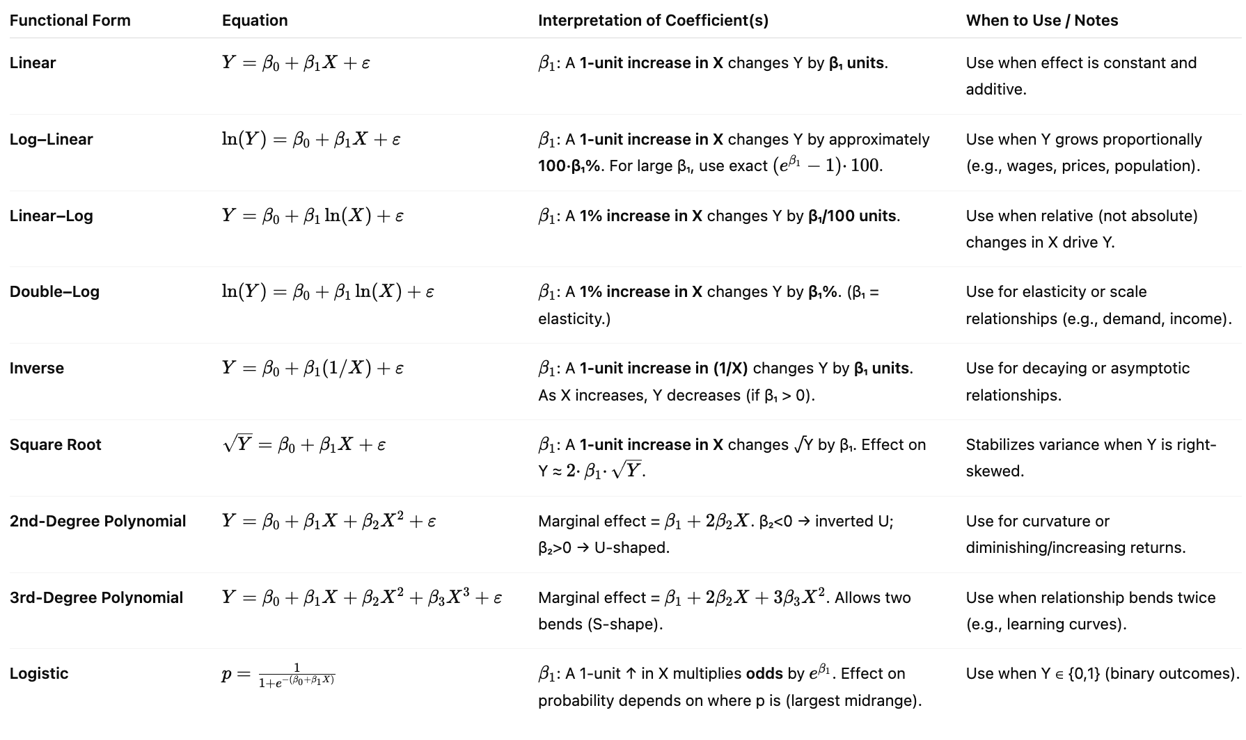
Coefficient Interpretation

Slide 38
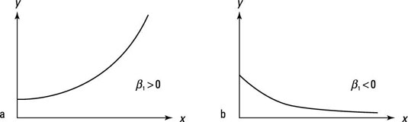
Log-Linear Model
Used to change non-linear equations into linear equations
Take the natural logarithm of the dependent variable
ln(Y) = B0 + B1*X1 + E
Coefficient interpretation: For small coefficients, a one-unit increase in X is associated with an approximate 100 x B% change in Y.
For larger coefficients, use 100((e^B) -1)%

Slide 39
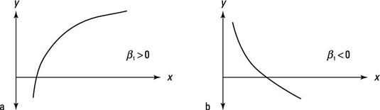
Linear-Log Model
Used to change non-linear equations into linear equations
Take the natural logarithm of the independent variables
Y = B0 + B1*ln(X1) + E
Coefficient interpretation: A one percent change in X leads to a B/100 unit change in Y

Slide 40
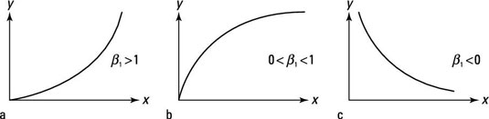
Log-Log
Used to change non-linear equations into linear equations
ln(Y) = B0 + B1*ln(X) + E
Take the natural logarithm of the dependent variable and independent variables
Coefficient interpretation: A one % change in X leads to a B percent change in Y = Elasticity

Slide 41
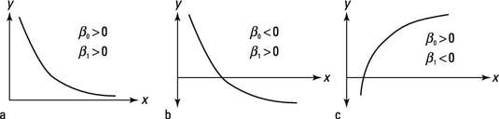
Inverse
Y = B0 + B1(1/X) + E
A one unit increase in x leads to a non-linear change in Y by B1. B1 > 0, y is decreasing as x increase

Slide 42
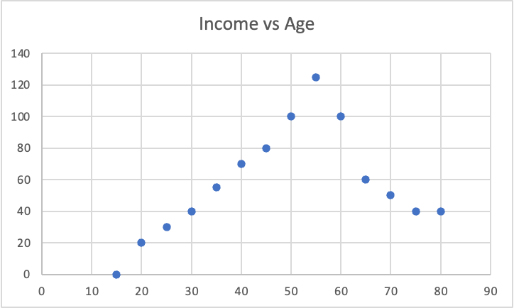
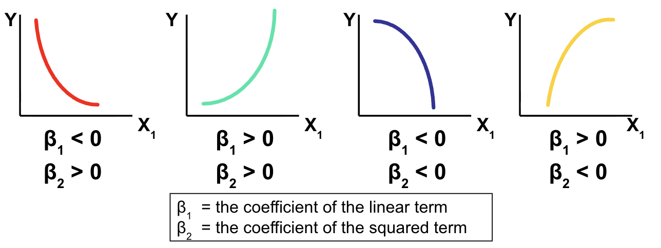
Polynomial / Quadratic Form
If a relationship between X and Y is concave or convex, a quadratic form may be needed
Y = B0 + B1(X1) + B2(X1^2) + E
Example: Income = f(Age)
As age rises (16-60) earned income rises too, but at a certain point, people retire and their earned income falls (60-100…)
A properly formed model would include an age^2 variable
Income = f(Age + Age^2)
Can be more than quadratic polynomial, depending on inflection points (X^2 = 1 inflection point, X^3 = 2 inflection points)
Interpretation is complex but can still be used for prediction
Notes:
Turning point vs inflection point

Slide 43
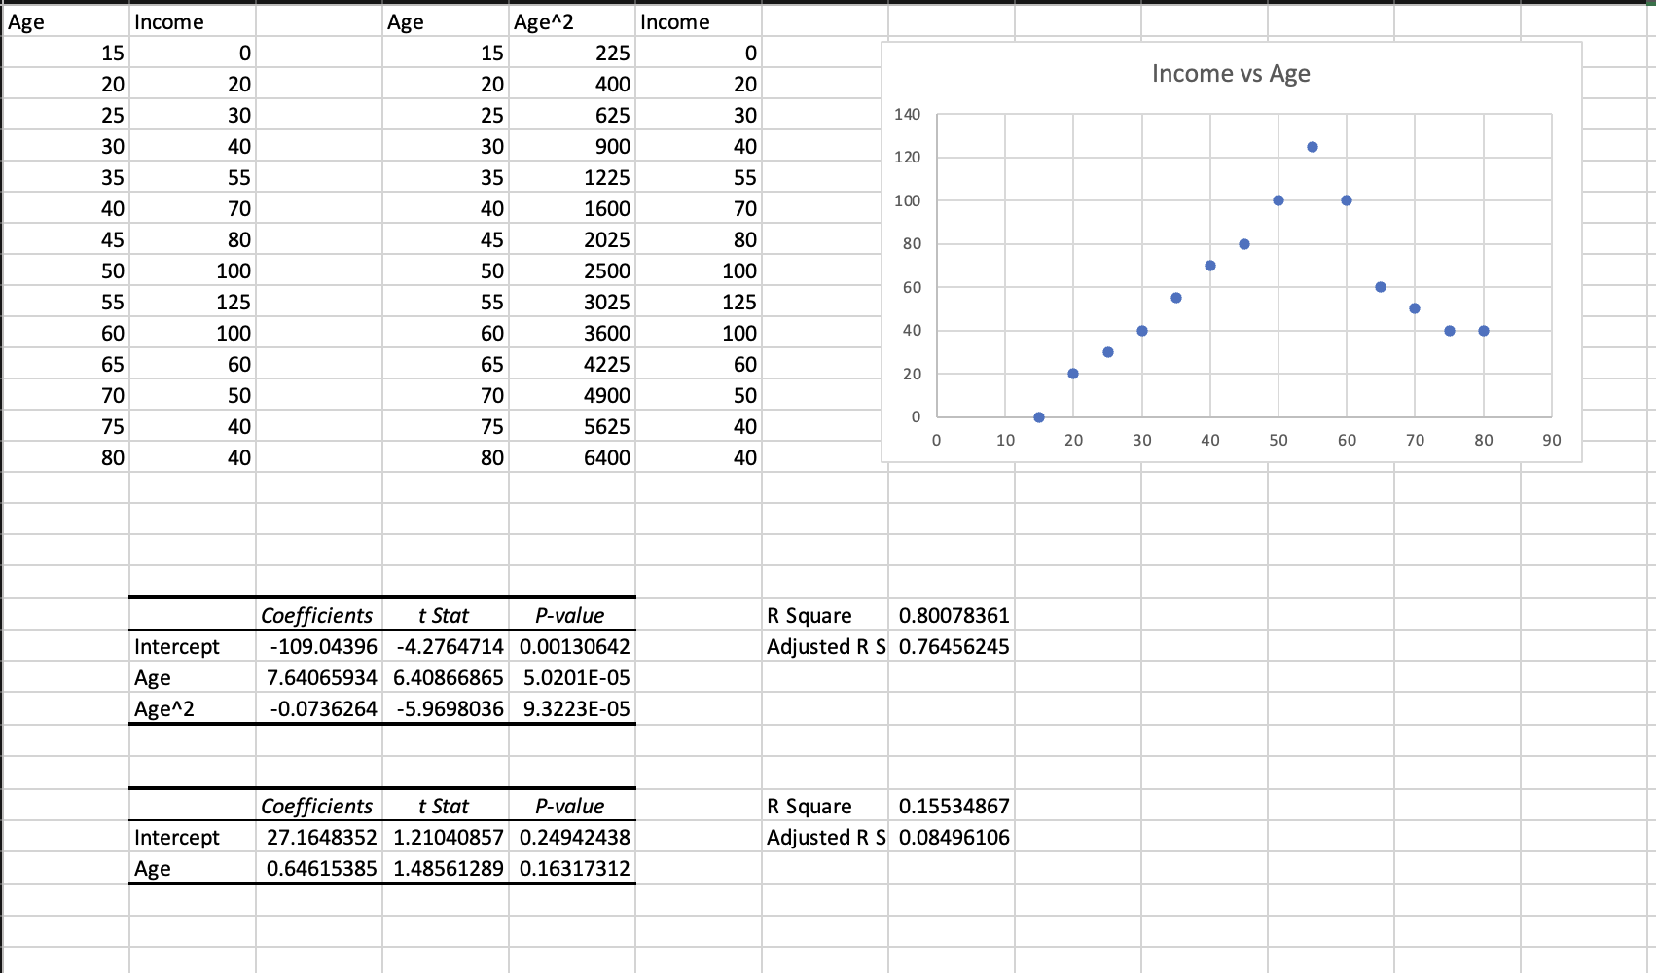
Polynomial / Quadratic Form

Slide 44
Dummy, Categorical, and Interaction Variables

Slide 45
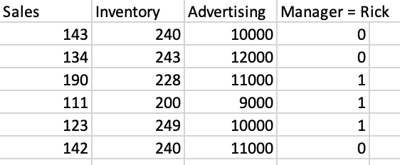
Dummy / Categorical Variables
Binary variables indicating:
Yes or No
On or off
True or false
Event or not event
Anything or not-anything
Create using 1 for whenever the condition is met and 0 for whenever it is not met

Slide 46
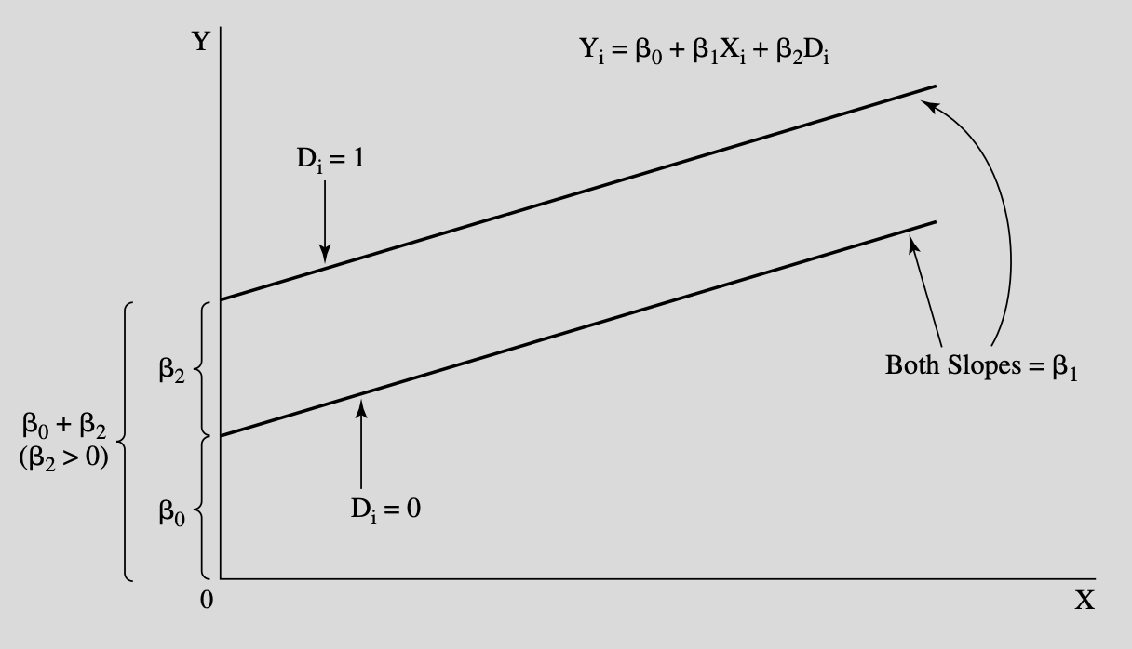

Slide 47
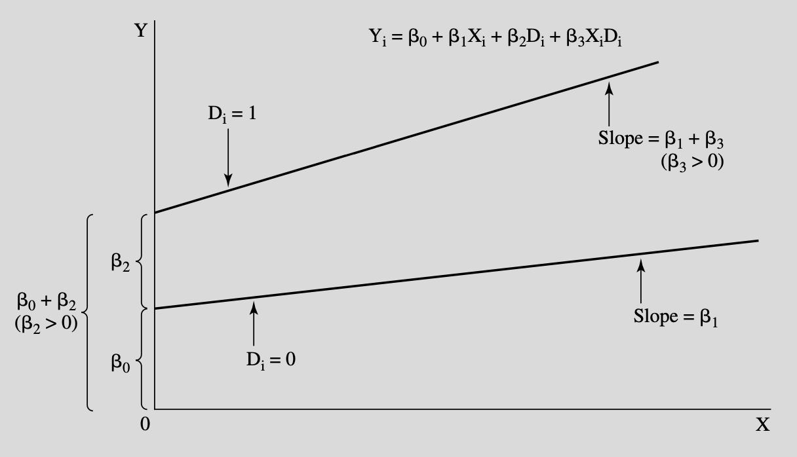
Interaction Terms
If you suspect that one variable’s effect is different under some conditions, create a new interaction variable by multiplying the two variables together and including it, alongside the original variables, in a new model
X1 = Experience (years)
X2 = Gender (1 if male, 0 if female)
B(X1*X2) = Difference in the experience slope for men and women

Slide 48
Interpreting Interactions
Continuous x Continuous
Salary = B0 + B1(Experience) + B2(Education) + B3 (Experience x Education) + E
B1 = Effect of experience when education = 0
B2 = Effect of education when experience = 0
B3 = Change in the experience slope for each additional unit of education
Continuous x Categorical
Salary = B0 + B1(Experience) + B2(MBA) + B3 (Experience x MBA) + E
B0 = Expected outcome when experience = 0 and MBA = 0
B1 = Effect of experience on salary for non-MBA workers
B2 = Difference in salary between MBA and non-MBA workers when experience = 0
B3 = Difference in the experience slope between MBA and non-MBA workers

Slide 49
Interpreting Interactions (cont)
Categorical x Categorical
Assume major = Engineering = 1, Sociology = 0
School type = Private = 1, Public = 0
Salary = B0 + B1(Major) + B2(School Type) + B3(Major x School Type) + E
B0 = Mean salary for reference group (sociology, public)
B1 = Difference in mean salary between engineering and sociology among public school students
B2 = Difference in mean salary between private and public school for sociology majors
B3 = The change in the engineering-sociology salary difference when moving from public to private schools
Main effects are conditional when interactions exist.
Meaning:
B1 is conditional on Z = 0
B2 is conditional on X = 0

Slide 50
Periodic / Seasonal Dummy Variables
Add one less variable than category
Example: Four quarters per year, so make three binary variables corresponding to any three quarters
Y = B0 + B1(Q2) + B2(Q3) + B3(Q4)
Interpretation:
Each beta coefficient is the difference between Q1 and the other quarters
B1 is the effect of being in the second quarter, relative to the first
B2 is the effect of being in the third quarter, relative to the first
B3 is the effect of being in the fourth quarter relative to the first

Slide 51
Seasonal Variables
Y | X1 | Quarter | Q2 | Q3 | Q4
1 | 2 | 1 | 0 | 0 | 0
3 | 4 | 2 | 1 | 0 | 0
5 | 6 | 3 | 0 | 1 | 0
7 | 8 | 4 | 0 | 0 | 1

Slide 52
Seasonal Variables
How would you do this with months?
11 variables…
Omitted month is baseline - If January is omitted, then all monthly indicators are the difference between that month and January.
Example: If the June coefficient is 50, then Y is estimated to be 50 units higher than January in June.

Slide 53
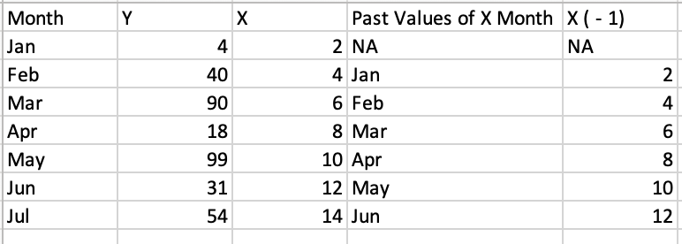
Lagging and Leading Variables
Want to know how past values relate to present/future values?
Examples: Marketing, monetary policy, etc.
Create a lagging or leading variable by shifting the variable forward or backward

Slide 54
Assessing Models
Compare models using:
Theory
F-Test of overall significance
F-Test of Nested Models
R^2 (usually rises with new variables, even if bad)
Adjusted R^2 - Like R^2, but penalized for adding variables (higher = better)
AIC and BIC tests (lower = better)
Out of sample testing / cross-validation - Leave some data out of fitting process, then see how well that data is predicted by the model
Other research / literature review

Slide 55
R^2, Adjusted R^2, AIC, & BIC
Compare multiple models with the same dependent variable only. If you transform the dependent variable, you cannot compare using the criteria below:
R^2: Higher is better (but be careful because more variables raises R^2)
Adjusted R^2: Higher is better (penalizes for irrelevant variables)
Akaike Information Criterion (AIC): Lower is better
Bayesian Information Criterion (BIC): Lower is better

Slide 56
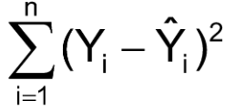
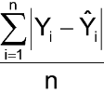
Model Prediction Evaluation / Comparison
Sum of Squared Errors
Mean Absolute Deviation

Slide 57
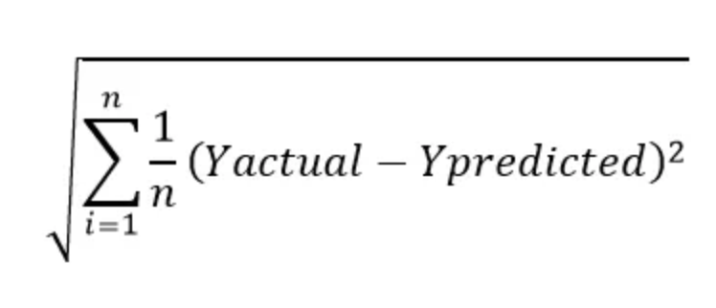
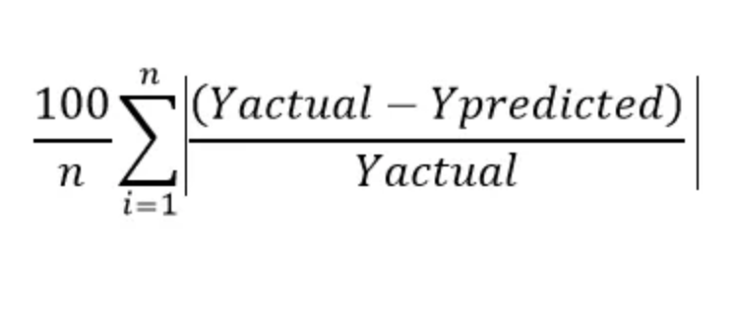
Model Evaluation / Comparison
Root Mean Squared Error
Mean Absolute Percentage Error

Slide 58
Metric | Interpretation | Strengths | Weaknesses | When to Use
SSE (Sum of Squared Errors) | Total squared error. Bigger number = worse fit. | Penalizes large errors; useful for optimization (e.g., least squares) | Not interpretable across datasets; scale-dependent; sensitive to outliers | Internal model fitting, not for reporting accuracy
MAD (Mean Absolute Deviation) | Average size of error, in original units. | Easy to interpret; robust to outliers | Doesn’t punish big errors much | General-purpose error metric; good for reporting
RMSE (Root Mean Squared Error) | Like MAD but gives more weight to big errors. | Same units as target; common in stats and ML; sensitive to variance | Sensitive to large errors and outliers; less intuitive for some audiences | When large errors are especially bad (e.g., risk-sensitive domains)
MAPE (Mean Absolute Percentage Error) | Average percent error. Unitless. | Easy to explain (“on average, X% off”); allows comparison across scales | Breaks down when actuals are near zero; undefined if actual = 0 | Business reporting, forecasting dashboards, cross-unit comparisons

Slide 59
The Bias-Variance Tradeoff
Bias: Model is systematically wrong and performs poorly on new data
Causes: Too simple of a model or incorrect functional form. Under-fitted.
Variance: Model is too sensitive to a specific sample of data.
Causes: Too complex a model. Over-fitted
We have to balance the two effects. Find the middle ground.

Slide 60
Model Validation
Train-Test-Split
Split the series into training and testing data
Training data = First 80% of observations
Testing data = Last 20% of observations
Estimate model coefficients on the training data
Predict values using the testing data
Assess accuracy and/or compare alternative models using R^2, AIC, BIC, MSE, RMSE, etc.
Cross-Validation
Split the series into k number of folds
Use all but one of the folds as the training data and the remaining fold as the testing data
Iterate through the process using each fold as the testing data and the others as the training data
Assess accuracy and/or compare alternative models using average of comparison criteria (R^2, AIC, BIC, MSE, RMSE, etc.)

Slide 61
Sensitivity Analysis & Full Reporting
Honest research likely requires publishing the results of many models
Summarize the coefficients, providing averages, ranges, or just a table of results
Create separate models to address different deficiencies and report their strengths and weaknesses.
Don’t hide methods or weaknesses.

Slide 62
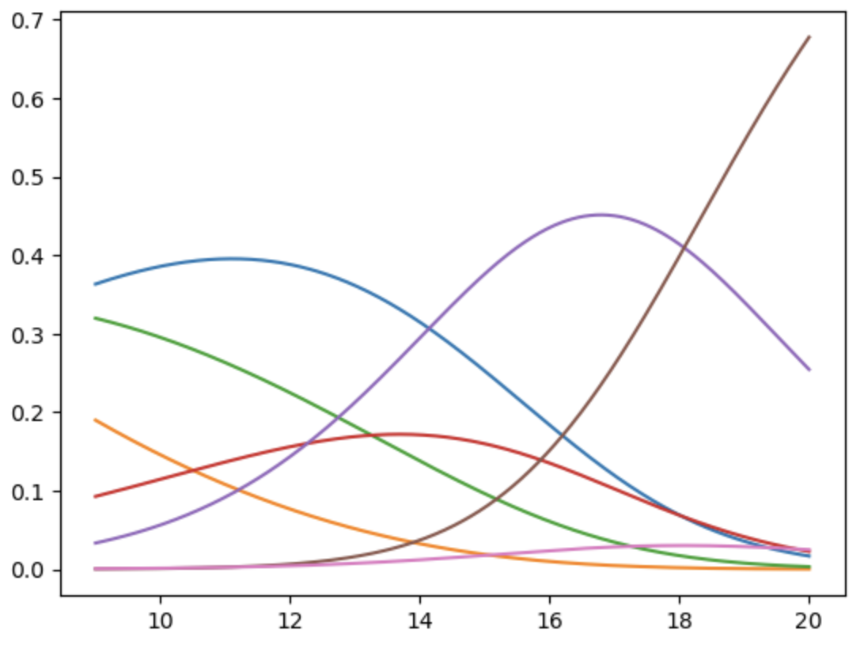
Regression Extensions
Logistic: Dependent variable is binary
Ordinal Logistic: Dependent variable is ordered
Multinomial Logistic: Dependent variable is categorical
Poisson and Negative Binomial: Dependent variable is count data
Survival Analysis: Dependent variable is time till failure
Zero Inflated: Lots of zeros in the dependent variable
Ridge, Lasso, & Elastic Net…
Quantile Regression
Generalized Least Squares
Generalized Linear Models
Time Series Methods

Slide 63
Quantile Regression
OLS gives the mean of Y, conditional upon the values of X
What if you want something other than the mean?
Use Quantile Regression!
OLS Interpretation: “a one unit increase in X changes the mean value of Y by B”,
Quantile Interpretation: “a one unit increase in X changes the T’th quantile value of Y by B”
Good when:
Effects differ at different levels of Y
When data are skewed or heavy tailed
When you care about extremes, not averages
When heteroskedasticity is present

Slide 64
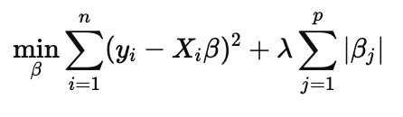
LASSO: Least Absolute Shrinkage & Selection Operator
Linear regression + L1 Penalty (sum of absolute value of coefficients)
Good to use when:
Lots of variables - Helps select most important / drops unimportant
More variables than data points (p > n)
Multicollinearity
Concerns about overfitting

Slide 65
LASSO Regression Steps and Considerations
Standardize X variables (Subtract mean and divide by standard deviation)
Use cross-validation to find lambda penalty term value
Fit model (use Scikit-Learn)
Interpret* output, get rich, live well
Considerations:
Coefficients are biased and hard to interpret.
Direction and relative magnitude matter but can’t treat like OLS coefficients
Good for prediction, bad for inference.
Can run OLS on selected for variables, for inference, but strictly speaking, this is not correct / valid

Slide 66
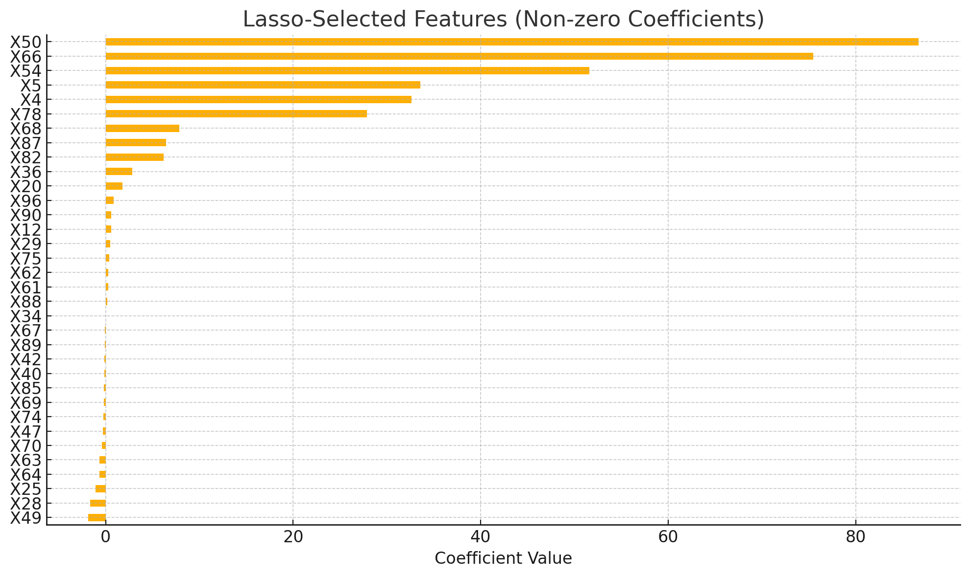
LASSO vs OLS
 | Variables | R^2 | RMSE
OLS | 100 | 67% | 74
LASSO | 34 | 99% | 11

Slide 67
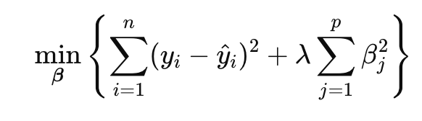
Ridge Regression
Linear regression + L2 Penalty (sum of squares of coefficients)
Good to use when:
Multicollinearity
Many predictors
You believe most variables matter (not looking to eliminate like with LASSO)

Slide 68
Ridge Regression Steps and Considerations
Standardize X variables (Subtract mean and divide by standard deviation)
Use cross-validation to find lambda penalty term value
Fit model (use Scikit-Learn)
Interpret* output, get rich, live well
Considerations:
Coefficients are biased and hard to interpret.
Direction and relative magnitude matter but can’t treat like OLS coefficients
Good for prediction, bad for inference.

Slide 69
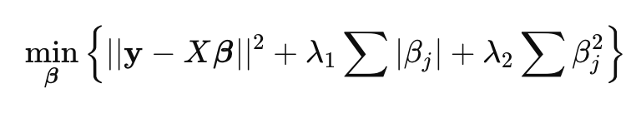
Elastic Net Regression
Combines L1 Penalty from Lasso and L2 Penalty from Ridge
Lasso is great for variable selection but not as great with multicollinearity
Ridge is great at multicollinearity but doesn’t eliminate variables
Elastic Net handles correlation and drops irrelevant variables

Slide 70
Elastic Net Regression Steps and Considerations
Steps:
Standardize predictors (not Y)
Choose a mixing parameter (alpha) using cross validation or theory (1 = LASSO, 0 = Ridge, In between = Mix)
For each alpha, use cross validation to find the best penalty (lambda)
Fit the model
Considerations:
Coefficients are biased and hard to interpret.
Direction and relative magnitude matter but can’t treat like OLS coefficients
Good for prediction, bad for inference.

Slide 71
Generalized Linear Model (GLM)
Extension of linear regression
Allows for response variables with error distributions other than normal
Components:
Random component: Distribution of the response variable (Normal, Binomial, Poisson)
Systematic component: Linear predictor
Link function: Connects linear predictor to the mean of the distribution

Slide 72
GLM Families & Link Functions
Response Type | Example | GLM Family | Link Function
Binary (0/1) | Yes/No, Pass/Fail | Binomial | Logit
Proportions | Conversion Rate, % Clicked | Binomial | Logit
Counts (integers > 0) | Number of calls, Crimes, Events | Poisson | Log
Overdispersed Counts |  | Negative Binomial | Log
Positive Continuous | Duration, Cost, Income | Gamma | Inverse or Log
Continuous (normal-ish) | Height, Weight, Test scores | Gaussian | Identity

Slide 73
HOWEVER…
Your answers will be wrong if assumptions aren’t met!

Slide 74
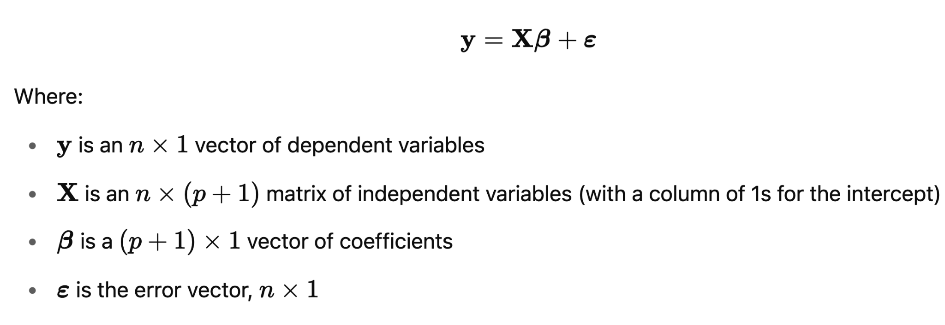
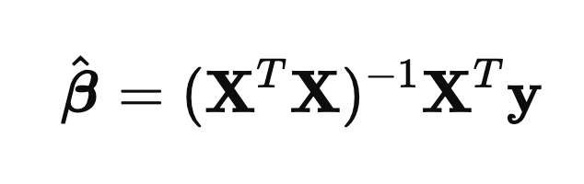
In Matrix Form

Slide 75
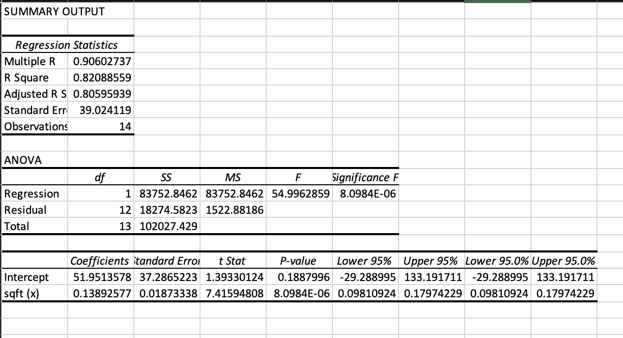
Regression With Software! - Excel

Slide 76
Regression With Software! - Python / Statsmodels

Slide 77
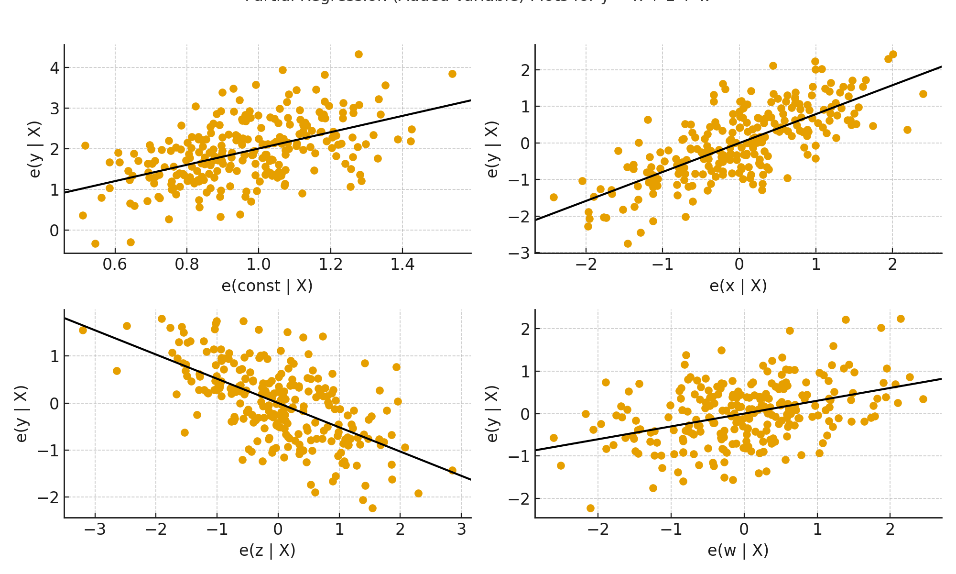
Partial Regression Plots
Plot the effect of X on Y holding constant other variables
Regress y on the other predictors
Regress x₁ on the other predictors
Plot the residuals against each other
Fit a line to the residuals

