Slide 1
Probability
Measuring uncertainty

Slide 2
Probability is the most important concept in modern science, especially as nobody has the slightest notion what it means.
—Bertrand Russell, 1929

Slide 3
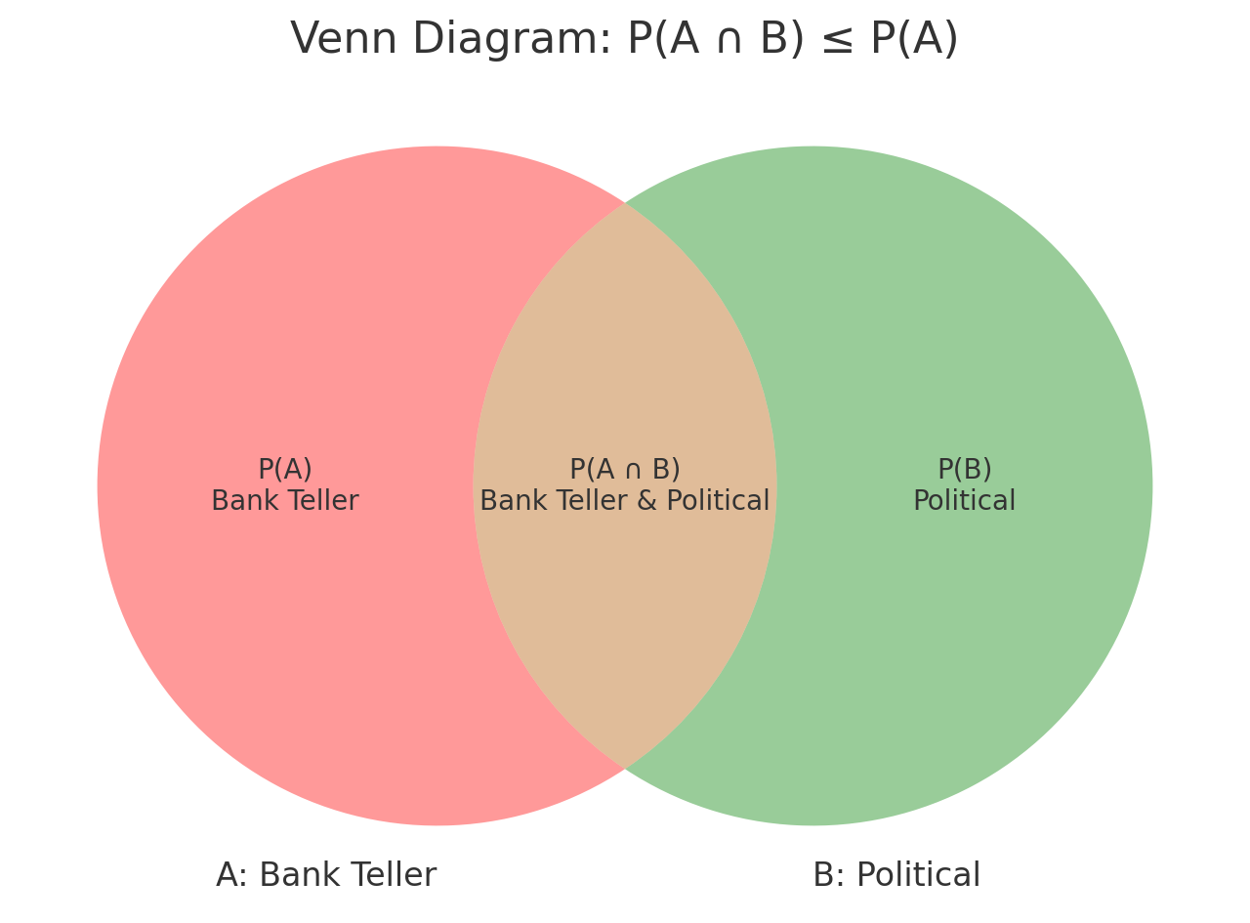
Conjunction Fallacy
Linda is a intelligent, outspoken woman.
Which is more likely?
Linda is a bank teller
Linda is a bank teller and active in politics
If you picked #2, you’re normal
AND WRONG!

Slide 4
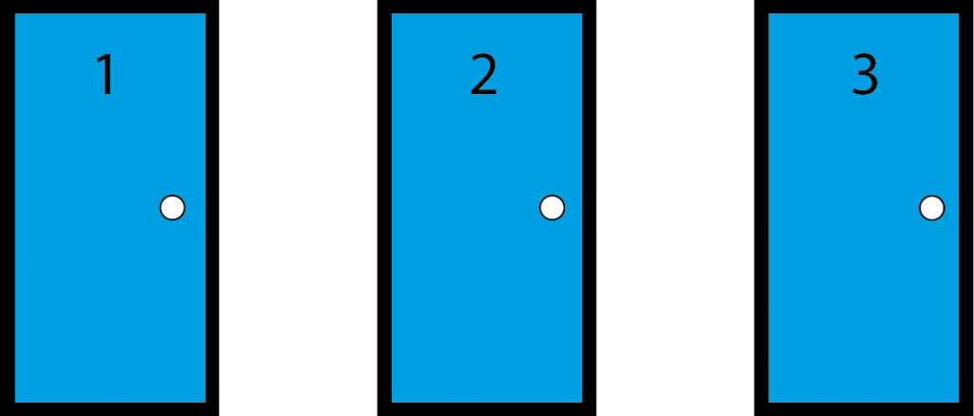
The Monty Hall Problem

Slide 5
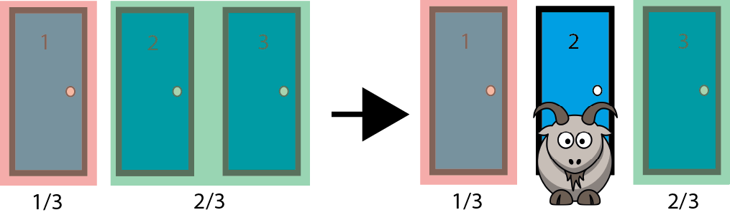
The Monty Hall Problem

Slide 6
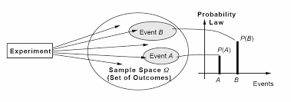
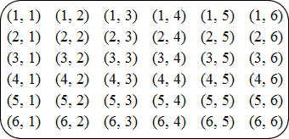
Terminology
Probability: A numerical measure of the likelihood that an event will occur
Experiment: A well-defined process that leads to a single, unpredictable result.
Example: Rolling a die
Outcome: A specific result that can happen in an experiment.
Example: Landing on 4
Event: A collection of one or more outcomes from an experiment; the group of outcomes you’re interested in
Example: Landing on an even number
Sample Space: The set of all possible outcomes of an experiment
Example: Landing on 1, 2, 3, 4, 5, or 6

Slide 7
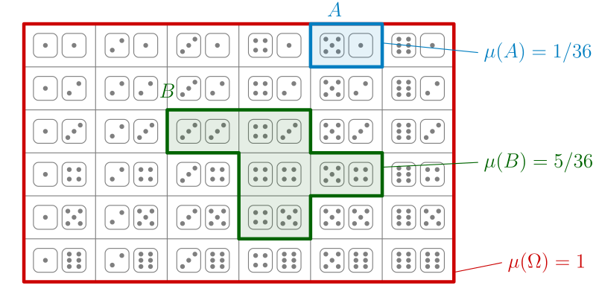
Events
Simple Events:
An event described by a single condition
Ex: A given day being in July
Joint Events:
Events described by two or more conditions
Ex: A given day being in July and a Friday

Slide 8
Sample Space and Events

Slide 9
Probability Basics
Ranges between 0 and 1
0 = 0% = Impossibility
1 = 100% = Certainty
Can be described as a decimal, percentage, or fraction.
0.33 = 33% = Happens ⅓ of the time, doesn’t happen ⅔’s of the time
0.5 = 50% = Happens ½ of the time, doesn’t happen the other ½ of the time
0.75 = 75% = Happens ¾ of the time, doesn’t happen ¼ of the time

Slide 10
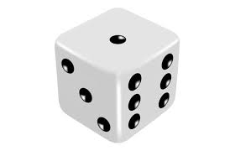
From Whence? A Priori, Theoretical, Simple and/or Uniform Probability
Probability based on the nature of the experiment / knowledge of data generating process
If all outcomes are equally likely, divide 1 by the number of possible outcomes
P(A) = 1 / # of possible outcomes
Probability of rolling a 5 (or any number) on a 6 sided die? ⅙ = 0.16666667 = 17%ish
Probability of flipping a coin and landing on heads (or tails)? ½ = 0.5 = 50%
If all outcomes are not equally likely, calculate based on the process / question
P(Randomly selecting a day of the year in July) = # of Days in July / # of Days in the Year = 31/365 = 0.0849 = 8.49%

Slide 11
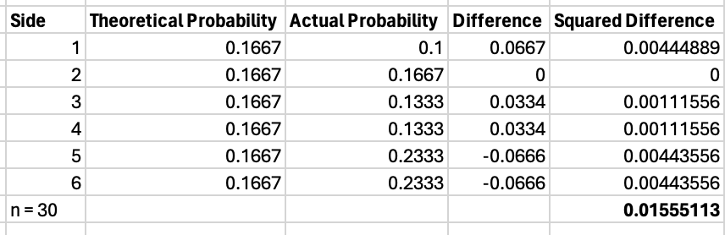
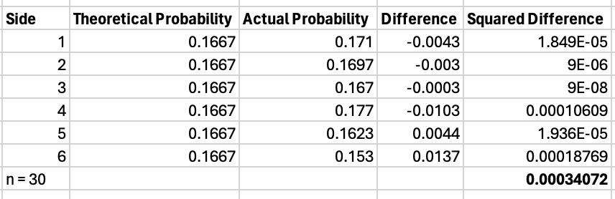
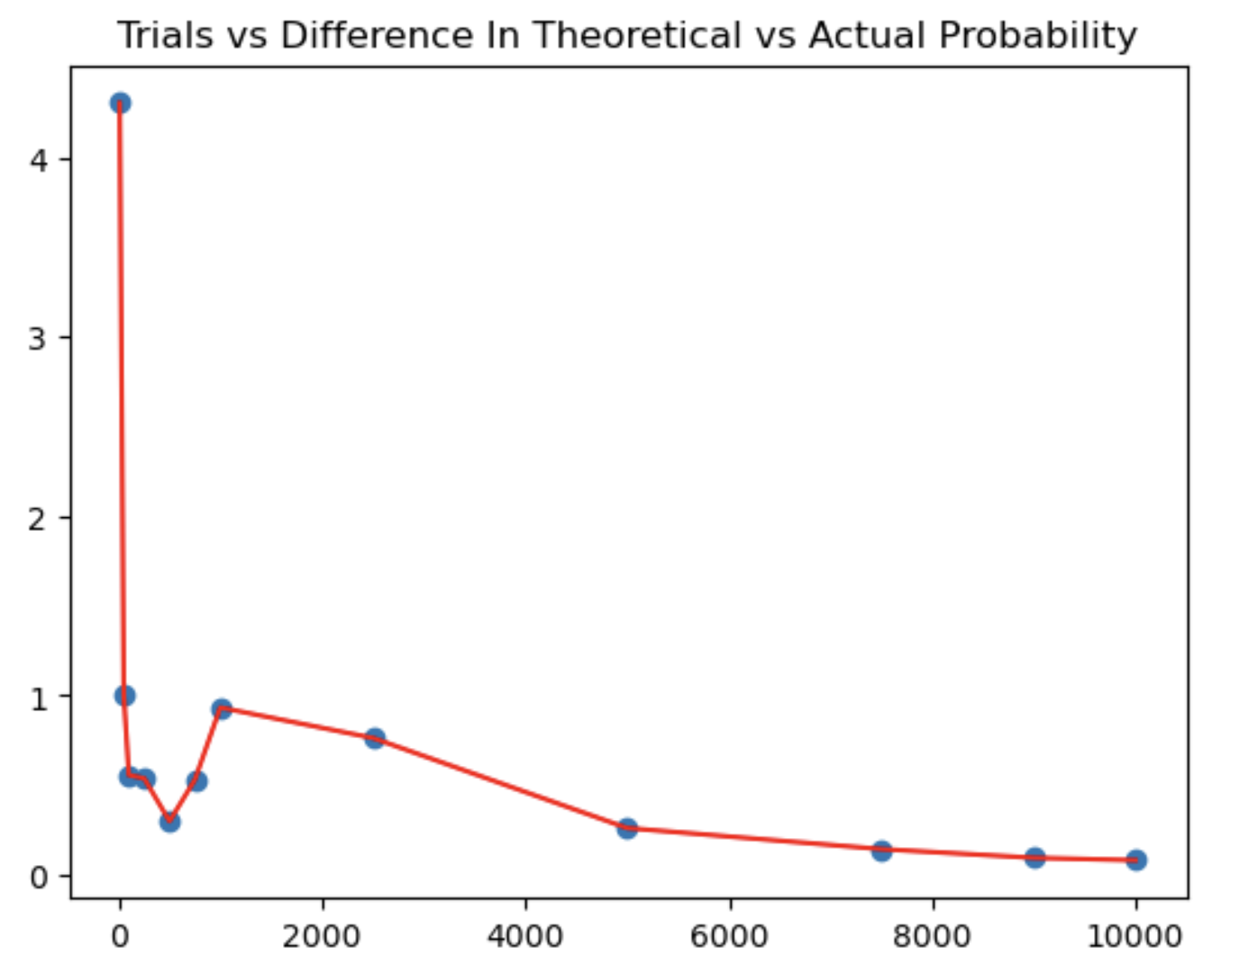
Accuracy, Asymptotics, & LLN
Probability allows us to calculate a best guess, but outcomes are still uncertain
As the number of trials tends towards infinity, the difference between the actual outcomes and the theoretical outcomes tends towards zero
This is known as the law of large numbers (LLN)
LLN: the average of the results obtained from a large number of independent random samples converges to the true value, if it exists
n=10,000, not 30

Slide 12
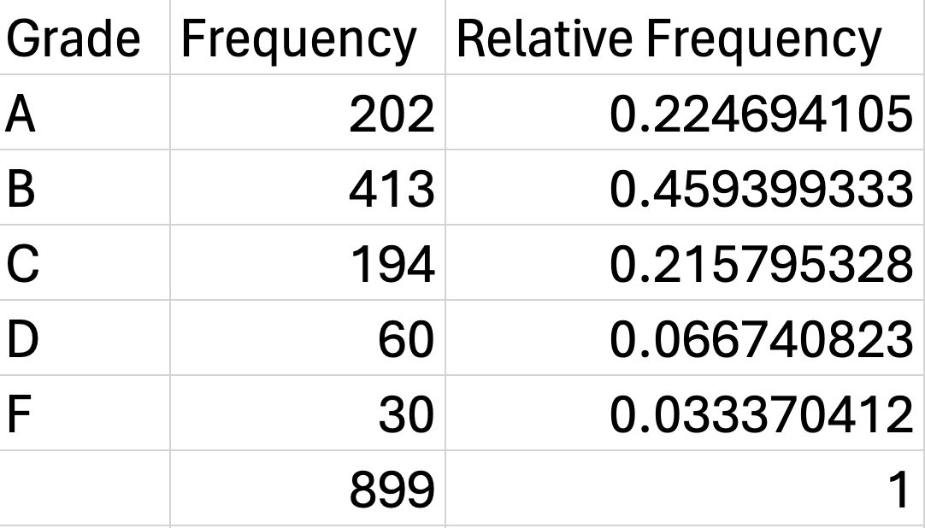
From Whence? Empirical Probability
Probability as relative frequency
Obtained from past observations
P(A) = # of times A / # of times total
The probability that a given student will get an A, based on past student grades, is 202/899 = 0.22 = 22%

Slide 13
From Whence? Subjective Probability
Individual or group judgment
Not based on calculation
Not the best / most reliable, but still useful for:
Cases where no data is available
Bayesian priors*
For a deeper dive into the nature and interpretation of probability (perhaps too deep), check out the Stanford Encyclopedia of Philosophy Entry: https://plato.stanford.edu/entries/probability-interpret/

Slide 14
Notation
P(A) is the probability that an experiment will produce outcome A
P(A’) is the probability of the complement* to A (not A)
P(A ∩ B) = P(A and B) is the joint probability that A and B will both occur
P(A ∪ B) = P(A or B) is the probability that A will occur, B will occur, or both A and B will occur
P(A|B) is the conditional probability that A will occur, given that B has occurred

Slide 15
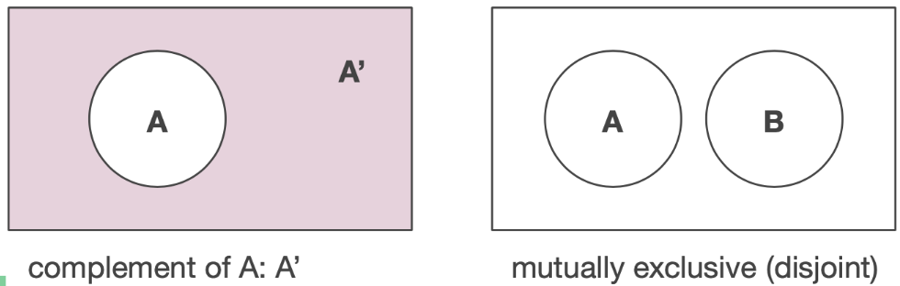
Mutually Exclusive, Collectively Exhaustive & Complementary Events
Mutually exclusive events: Events that cannot occur together
Ex: Light switch on and off
Collectively exhaustive events: All possible events with at least one of the events occurring
Ex: Dice roll lands as 1, 2, 3, 4, 5, or 6
Complementary events: Events that are mutually exclusive and collectively exhaustive: (one must happen and multiple outcomes can’t happen together)
Ex: Rain and not rain
If A and B are complements, P(A or B) = 1 and P(A and B) = 0
P(Rain OR Not-rain) = 1
P(Rain AND Not-rain) = 0
P(Not-rain) = 1 - P(Rain)
Complement Rule / Formula:
P(A’) = 1 - P(A)

Slide 16
Independent and Dependent Events
Independent events: Events that do not change the probability of one another
Example: Coin flips - Getting heads one time does not tell us anything about what will happen next time we flip the coin (assuming a fair coin)
Dependent events: The probability of an event DOES change with the occurrence or absence of another event
Example: Selecting cards from a deck (without replacement)
Probability of getting a queen = 4/52 = 7.7%
Probability of getting another queen after removing the first one: 3/51 = 5.9%
P(A third queen) = 2/50 = 4%
Note these are isolated draws / I’m not asking the probability you’ll draw two or three cards in a row and they’ll both be queens. (That would be P(Q1 and Q2)) = P(Q1) * P(Q2|Q1) = 0.077 * 0.059 = 0.0043, or 0.43%)

Slide 17
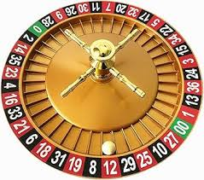
The Gambler’s Fallacy
A roulette ball lands on red 9 times in a row, so it’s likely to land on black anytime now!
True, but no more true than after the first red!!!
Each spin is INDEPENDENT of the others
18 red / 38 total =0 .4737 = 47% chance of landing on red
(0.4737)^9 = 0.00217
1 / 0.00271 = 460
In 461 9 spin sequences, you’d expect this to occur once
Assuming multiple tables and a 24 hour casino, a run of 9 reds in a row is likely to occur many times per day!

Slide 18
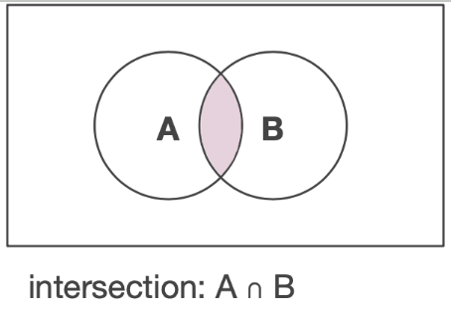
The Multiplication Rule / Formula - And Scenarios
Used for “AND” scenarios = P(X and Y)
Independent events: P(X and Y) = P(X) * P(Y)
P(Roll a six AND draw a queen) = P(6) * P(Q) = 1/6 * 4/52 = 0.16666 * 0.07692 = 0.0128, or 1.28%
Dependent events: P(X and Y) = P(Y) * P(X|Y)
P(Drawing two cards and both are hearts) = P(Heart 1) * P(Heart 2|Heart 1)
P(Heart 1) = 13/52 = 0.25 (First draw)
P(Heart 2| Heart 1) = 12/51 = 0.235 (Second draw)
P(Heart 1 and Heart 2) = 0.25 * 0.235 = .05875 = 5.87%

Slide 19
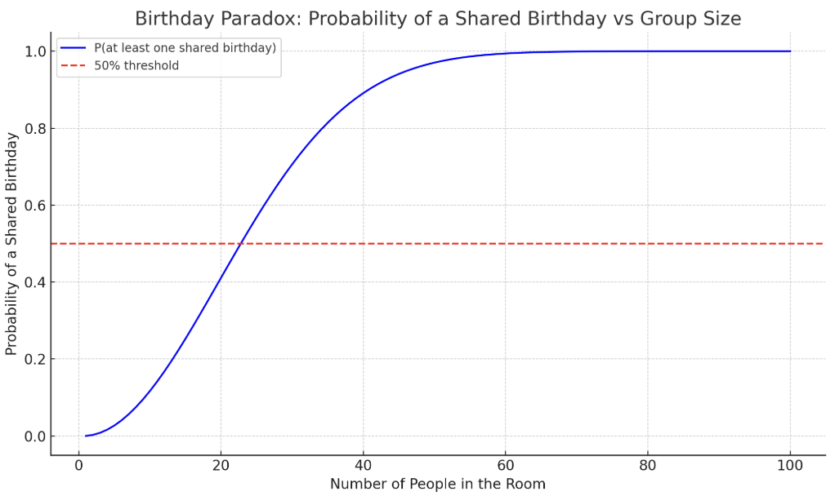
Birthday Paradox
How many people before a shared birthday?
Instead of calculating the probability of a shared birthday, calculate the probability of no shared birthday.
Person 1 can have any birthday (365/365)
Person 2 can have any birthday except person 1’s birthday (364/365)...
p(no match | n) = (365/365) * (364/365) * (363/365)...(365 - n + 1))
It only takes…
23 people in the room before there’s a greater than 50% chance
Notes:
365 - n + 1 is how many valid unclaimed birthdays remain for person N

Slide 20
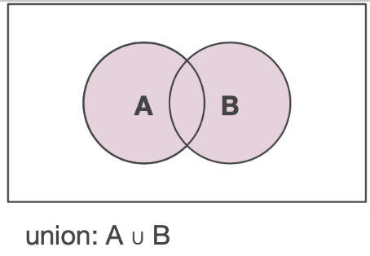
The Addition Rule / Formula - Or Scenarios
Used for “OR” scenarios = P(X, Y, or Both)
Addition rule for mutually exclusive events:
P(X or Y) = P(X) + P(Y)
Addition rule for non-mutually exclusive events:
Does one prevent the other? Cause the other?
P(X or Y) = P(X) + P(Y) - P(X AND Y)
P(“It rains” OR “it’s Tuesday”) = 105/365 + 1/7 - (105/365 * 1/7)
.287 + .143 - .041 = .389
38.9%

Slide 21
The Conditional Probability Formula
P(A|B) = The probability of A, given the occurrence of B
(We restrict the sample space to B, in the above)
P(A|B) = P(A and B) / P(B)
P(B|A) = P(A and B) / P(A)
Assume 100 people buy new cars. 40 bought warranties, 30 bought red cars, and 20 purchased both.
What is the probability that someone who purchased a warranty also bought a red car?
P(warranty)=0.4, P(red car)=0.3, P(warranty and red car) = 0.2
0.2 / 0.4 = 0.5
=50%

Slide 22

Bayes Formula
P(Unintended Fire) = 1%
P(Smoke) = 10%
P(Smoke | Unintended Fire) = 90%
What is the probability that smoke implies an unintended fire? P(Unintended Fire | Smoke)?
(1% * 90%) / 10% = 9%

Slide 23
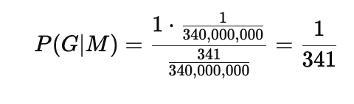
The Prosecutor’s Fallacy
P(Evidence | Innocence) vs P(Innocence | Evidence)
1 in 1 million chance of matching the DNA evidence by chance
In a country of 340 million people, 34 people would be expected to match by chance (if only this evidence is used to determine guilt)
Takeaway: Just because it’s rare for an innocent person to have certain evidence against them doesn’t mean it’s rare for someone with certain evidence against them to be innocent.
Bayes Solution:
G = Person is Guilty, ~G = Person is Not Guilty, M = DNA Match
P(M | G) = 1, P(M | ~G) = 1/1,000,000, P(G) = 1/340,000,000
P(M) = P(M|G) * P(G) + P(M|~G) * P(~G)
Plug into Bayes formula…
P(G | M) = 0.29%

Slide 24
Probability vs Odds
P(A) is the probability of outcome A
P(A) / 1 - P(A) = Odds of outcome A
Odds of rolling a 6 = 1/6 (0.17) divided by 1 - 1/6 (5/6 = 0.83)
0.17 / 0.83 = .2 or 20%

Slide 25
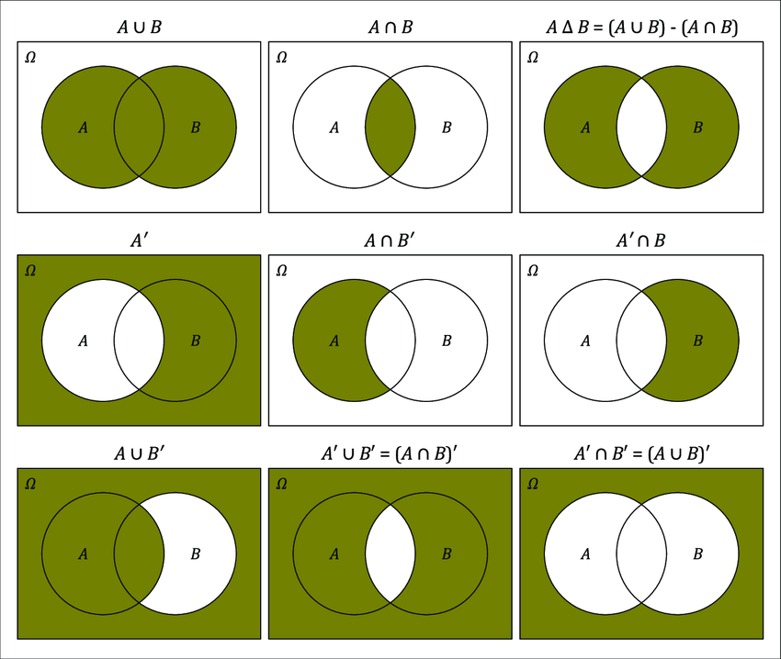
Set Theory and Probability with Venn Diagrams

Slide 26
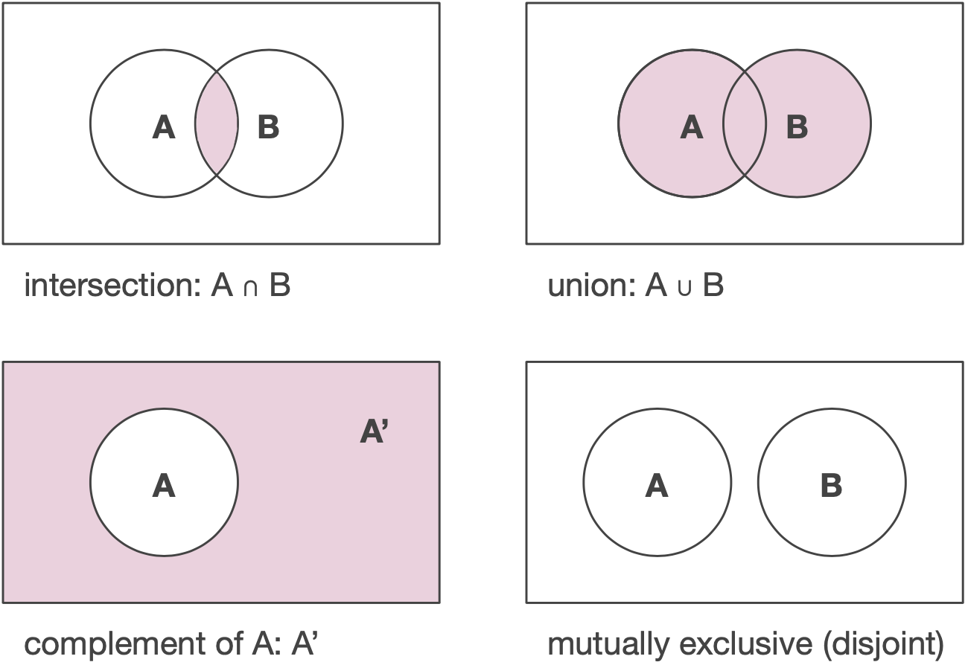

Slide 27
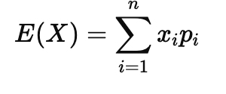
Expected Value
Steps
List each possible outcome, its magnitude, and its probability.
Multiply each outcome’s magnitude by its probability
Sum the product
Expected value: The long-term average or mean value of its outcomes, weighted by their respective probabilities
Outcome | Value | Probability | Expectation
A | $3 | 0.6 | =0.6 * 3 = $1.8
B | $10 | 0.3 | =0.3 * 10 = $3.33
C | $20 | 0.1 | =0.1 * 20 = $2
Total |  | 1 | Expected Value = $7.13

Slide 28
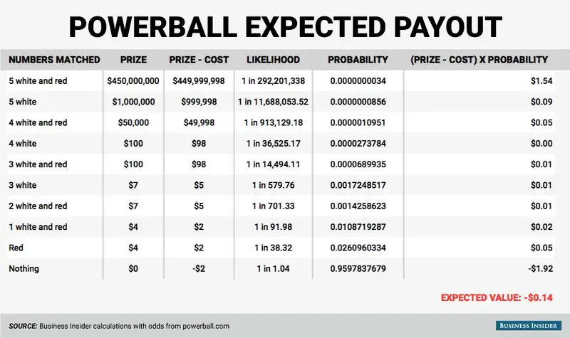

Slide 29
Probability Using Distributions

Slide 30
Random Variables
Random variables are variables that represent the outcomes of a random process or experiment
They assign a numerical value to each possible outcome of a random phenomenon, and its value depends on chance.
The probability of a variable taking a certain value / range of values is given by its “probability distribution”
Discrete random variables distribution is given by a probability mass function, while continuous random variables are specified by a probability density function

Slide 31
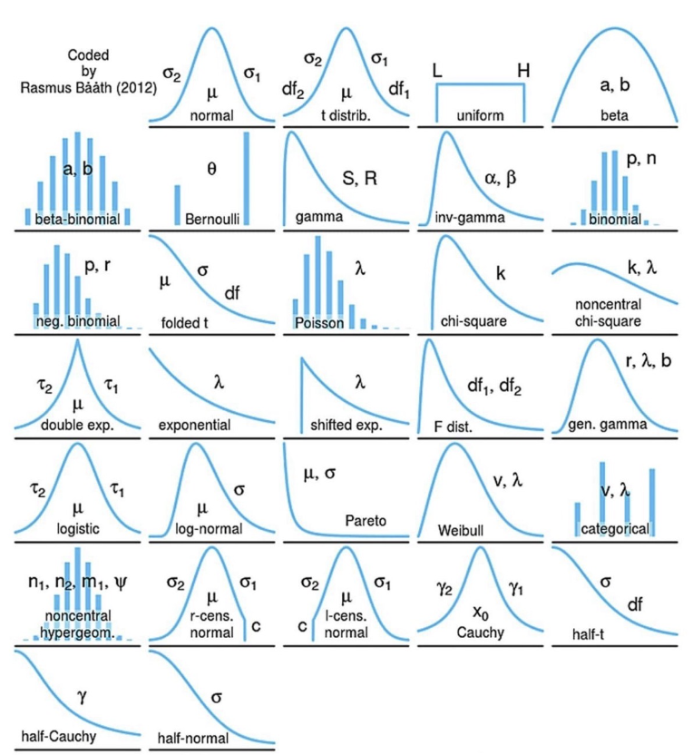
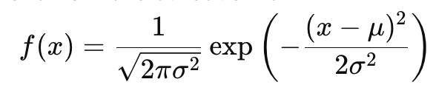
Probability Distributions
Probability distributions are mathematical formulas that specify the likelihood of a random variable taking on specific values given specific parameters.

Slide 32
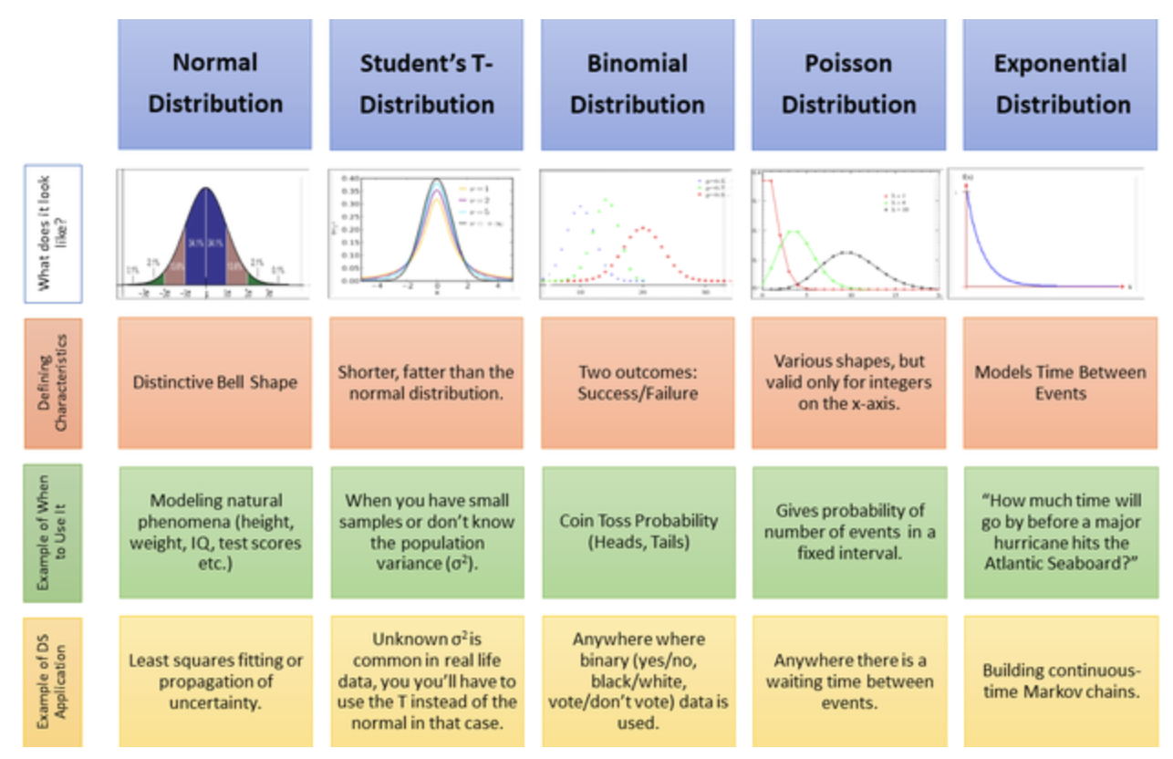

Slide 33
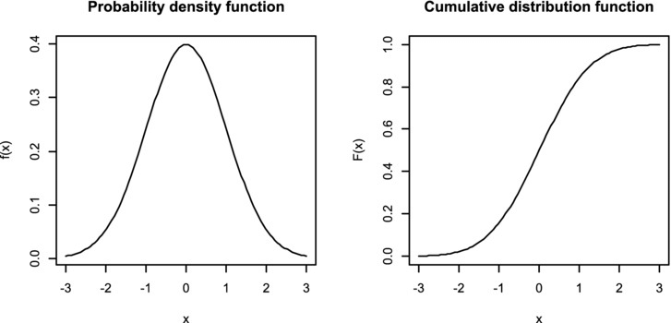
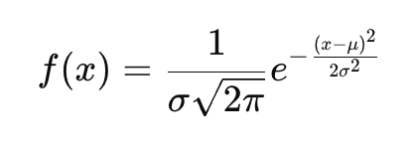
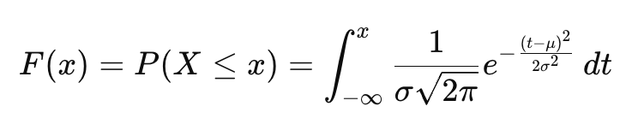
PDF vs CDF
Probability Density Function: provides the likelihood of a random variable taking a range of values. Area under curve sums to 1. Height = Density.
Cumulative Density Function: shows the probability that random variable will take a value less than or equal to a given value. Height = Probability

Slide 34
Continuous Probability Distributions
The Uniform, Normal, and Standardized Normal Distributions

Slide 35
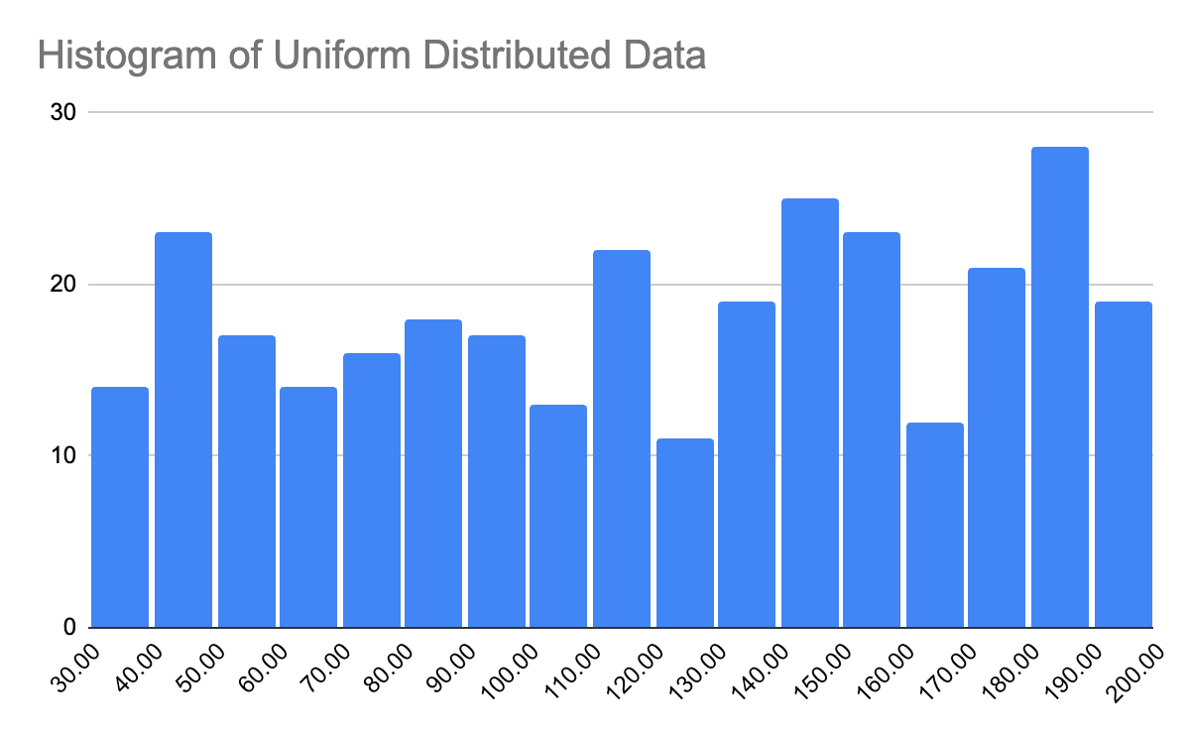
Uniform Distribution
Each value in the interval has an equal probability of occurrence
A = minimum value of distribution, B = maximum value of distribution
XL = minimum bound of interval, XH = maximum bound of interval
P(XL < x < XH) = (XH - XL) / (B - A)
Mean = (A + B) / 2
Max: 200, Min: 30…Mean = 115
P(100 < x < 150) = 50 / 170 = 29.4%
29.4%

Slide 36

Uniform Distribution Example
A video game “spawns” an enemy in a random location along a 500 meter span of map.
What is the probability that an enemy is spawned into the last 50 meters of the 500 meter map (so between meter 450 and 500)?
P(XL < x < XH) = (XH - XL) / (B - A)
XL = 450, XH = 500, A = 0, B= 500
(500 - 450) / (500 - 0) = 50 / 500 = 10%

Slide 37
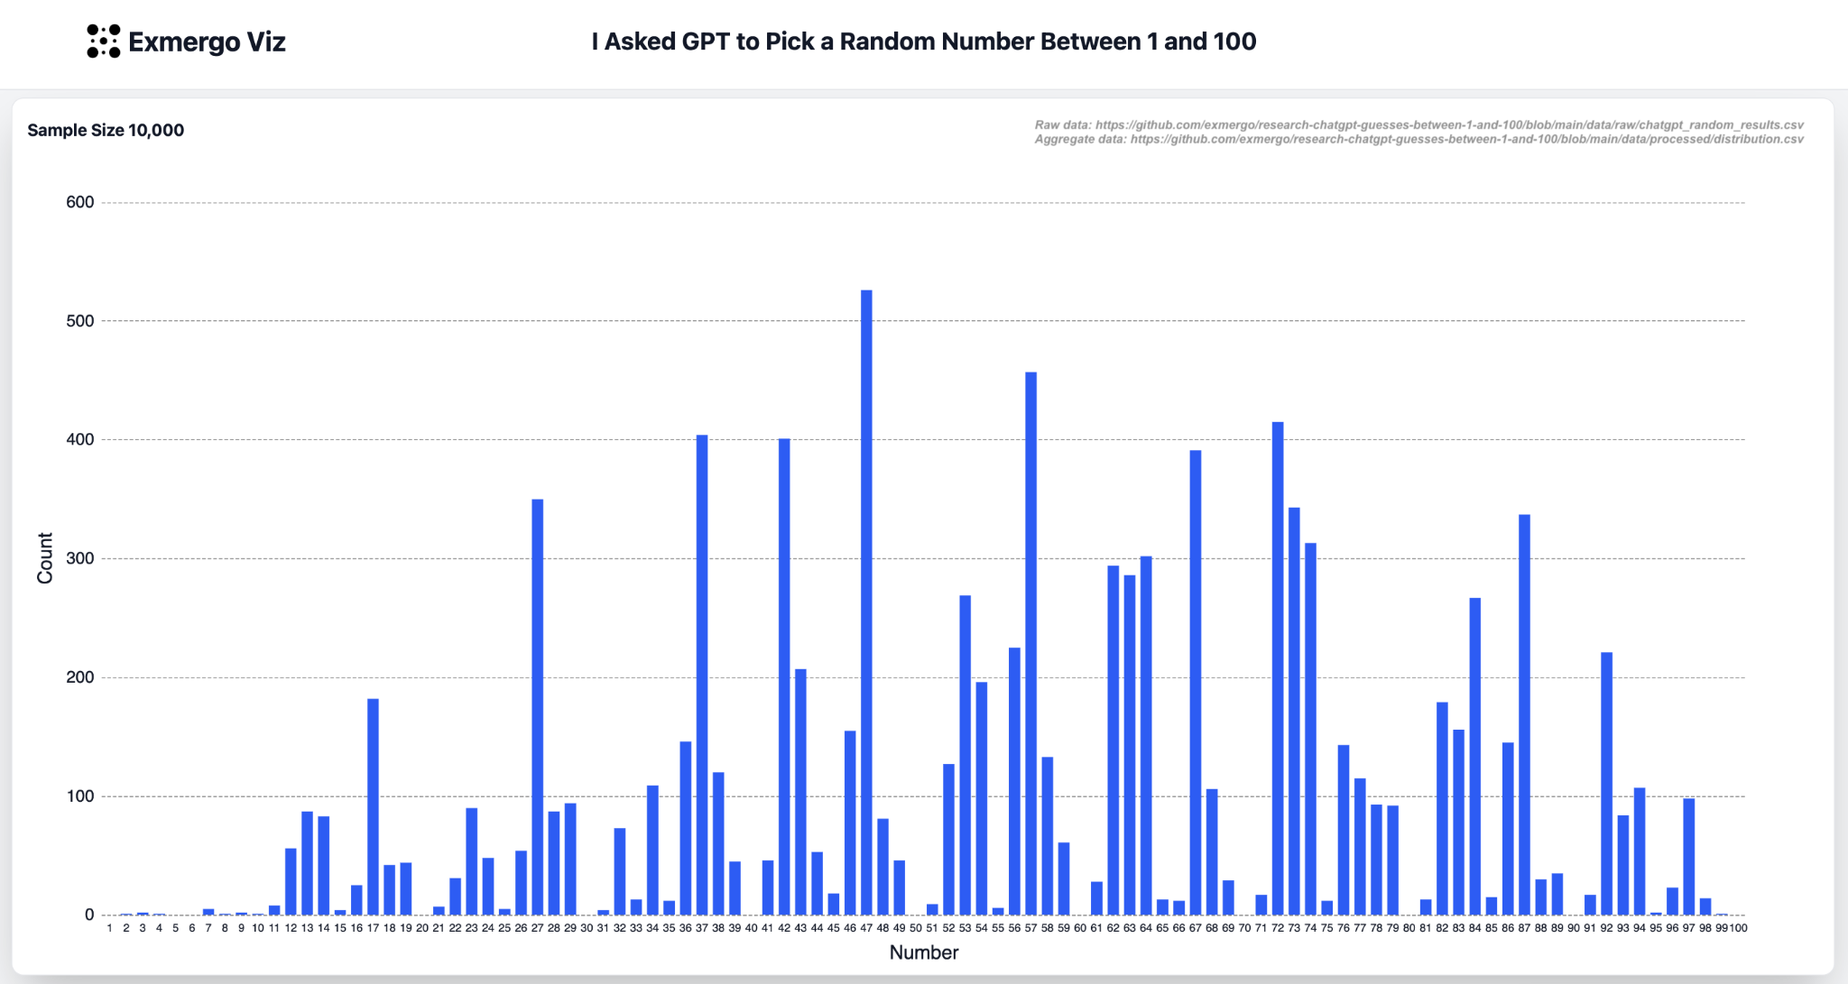
LLMs vs PRNGs
Computers typically use pseudo-random number generators
True randomness can’t be deterministically programmed, but it can be faked pretty well using complex formulas and semi-random inputs (system clock, your seed selection, even lava lamps)!
LLMs, by contrast, generate “randomness” poorly as they are using the weighted average of their training sets and people aren’t random.

Slide 38

Lava Lamps at Cloudflare HQ

Slide 39
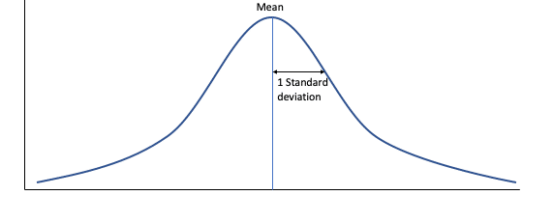
The Normal Distribution
Characteristics:
Centered on the mean value of the data
Mean = Median = Mode = Peak of Curve
Symmetrical - 50% of the data are above the mean and 50% are below the mean
Width determined by the standard deviation of the data

Slide 40
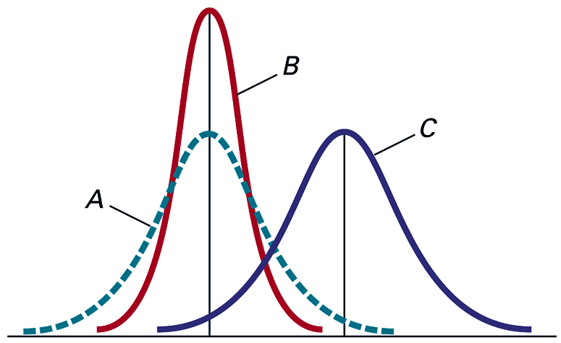
The Normal Distribution
Distributions A and B have the same mean value, but A has a larger standard deviation than B
Distributions A and C have the same standard deviation, but C has a larger mean than A

Slide 41
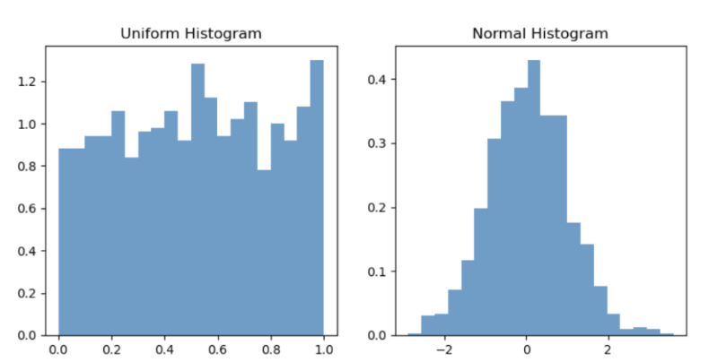
Is Your Data Normally Distributed?
For the upcoming methodology to work correctly, the data you’re analyzing must be (roughly / approximately) normally distributed?
How to tell if the data are normally distributed:
Histogram
Q-Q Plot*
Statistical test - Shapiro-Wilk*

Slide 42
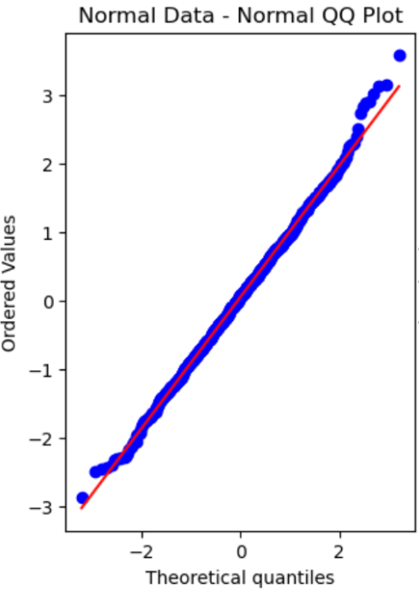
Q-Q Plots
Q-Q plots compare the distribution of your data with a theoretical distribution of your choosing.
Your data’s distribution is shown on the Y-axis and the theoretical distribution is shown on the X-axis.
A 45 degree line runs across the plot diagonally.
Points will fall on the line to the extent that the actual data matches up with the theoretical distribution

Slide 43
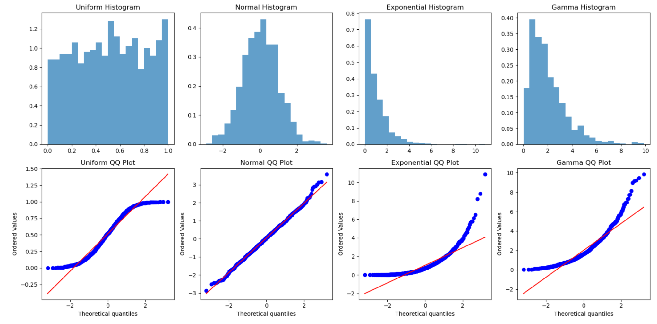

Slide 44
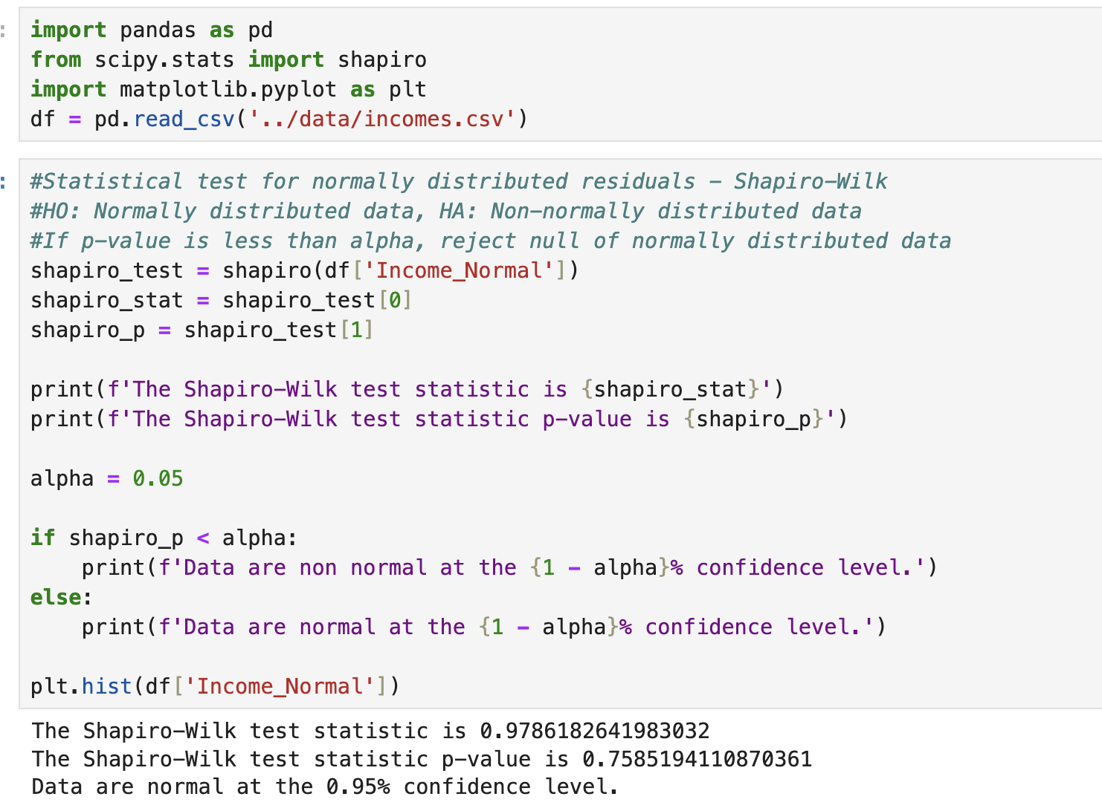
Shapiro-Wilk
H0: Normally Distributed Data
HA: Non-Normally Distributed Data
Alpha = 1 - Confidence Level
If p-value is less than alpha, reject the null hypothesis that the data are normally distributed
May or may not be a valid procedure*

Slide 45
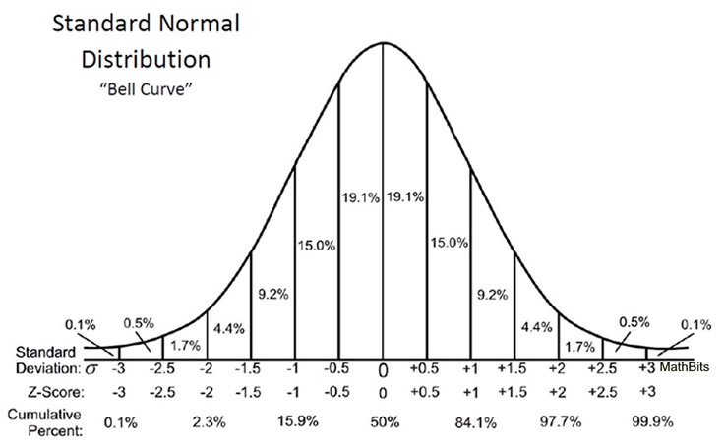
The Standardized Normal Distribution
The standardized normal distribution is a special case of the normal distribution
Mean = 0
Standard Deviation = 1
Any normally distributed data can be converted to the standardized normal distribution using the Z formula
Z = (X - Mean) / Standard Deviation
Z = # of standard deviations away from the mean
Z is negative if below the mean and positive if above

Slide 47
Z
Z = (X - Mean) / Standard Deviation
If we have a series with a mean of 50 and a standard deviation of 15, what is the Z value for the number 18
Z = (18 - 50) / 15 = -1.77
Interpretation: 18 is 1.77 standard deviations below the mean

Slide 48
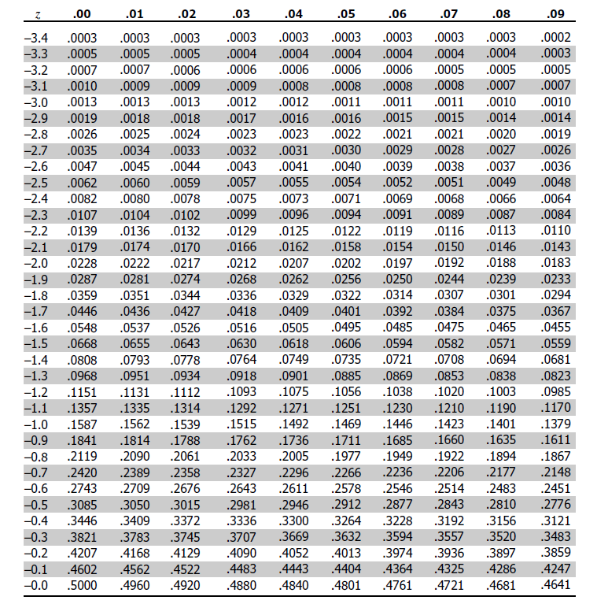
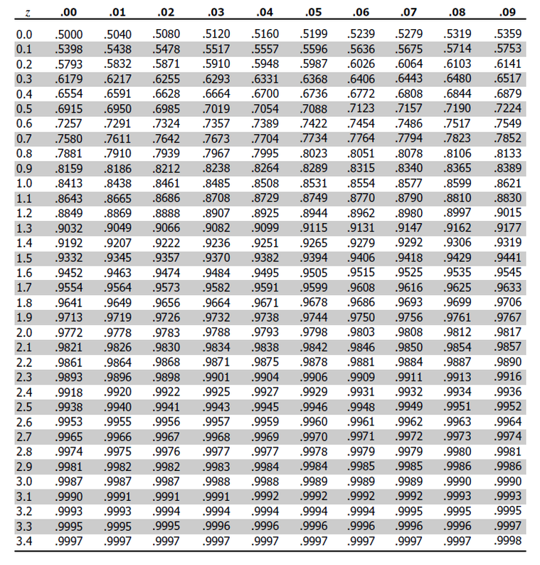
Why convert to the standardized normal distribution?
So that we can use pre-calculated probabilities (area under the curve) from a Z table / statistics software!

Slide 49
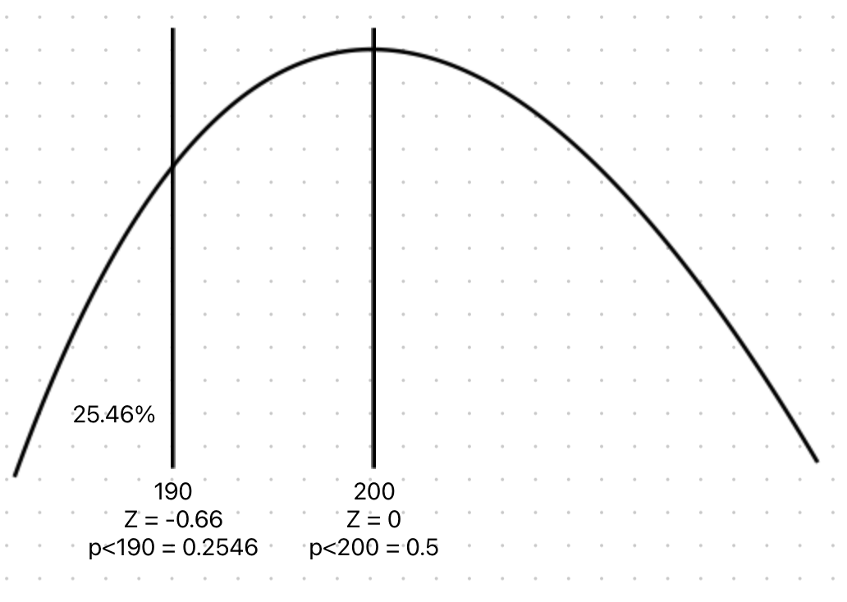
Probabilities Using Z - p(x<X)
Given normally distributed monthly sales data with a mean of 200 and a standard deviation of 15, what is the probability of selling less than 190 units on any given month?
Z = (190-200)/15 = –0.66
p(x<190) = .2546

Slide 50
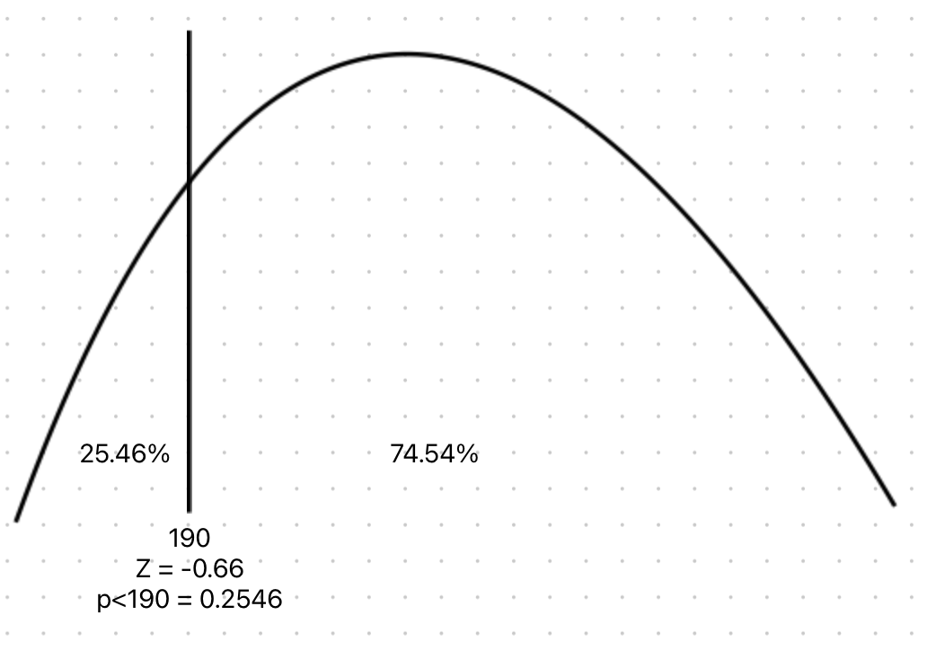
Probabilities Using Z - p(x>X)
Given normally distributed monthly sales data with a mean of 200 and a standard deviation of 15, what is the probability of selling more than 190 units on any given month?
Z = (190-200)/15 = –0.66
p(x<190) = .2546
p(x>190) = 1 - .2546 = .7454 = 74.54%

Slide 51
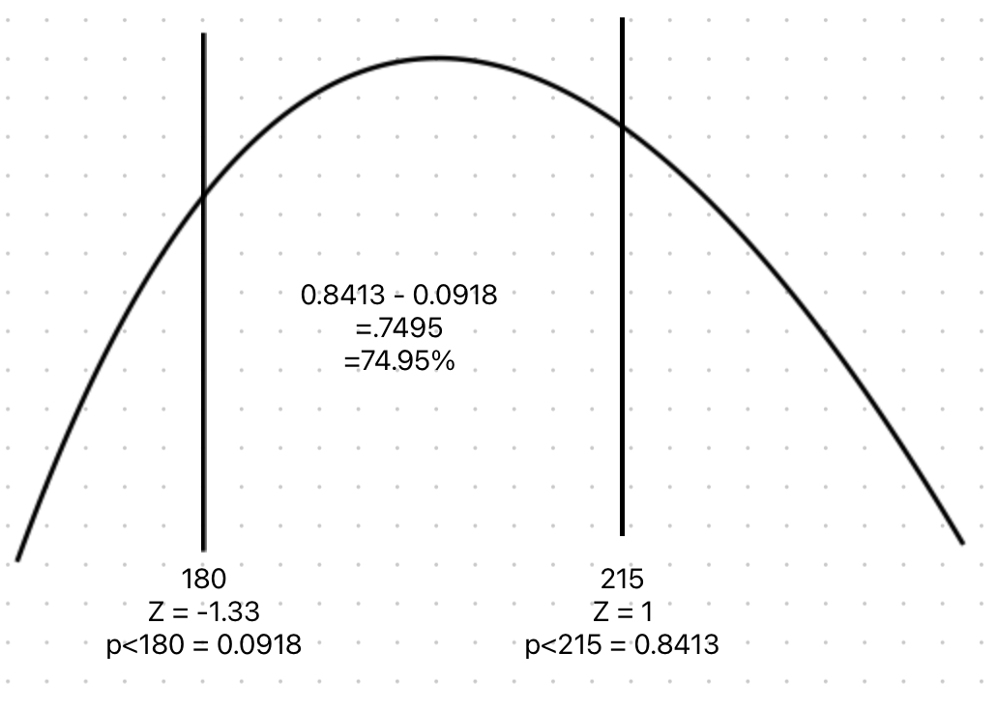
Probabilities Using Z - p(XL<x<XH)
Given normally distributed monthly sales data with a mean of 200 and a standard deviation of 15, what is the probability of selling between 180 and 215?
Z = (180-200)/15 = –1.33
p(<180) = 0.0918
Z = (215-200)/15 = 1
p(<215) = 0.8413
= 74.95%

Slide 52
Finding X, Given the Probability
Z = (X - Mean) / Stdev
With a little algebra, we can solve for X
X = Mean + Z * Stdev
Given normally distributed data with a mean of 100 and standard deviation of 15, what value of X will be greater than 40% of the data
Find 40% in the table = Z = -.25
X = 100 -.25*15
X = 100 - 3.75
X = 96.25

Slide 53
Normal Distribution in Excel
=standardize(x, mean, stdev) to find Z
=norm.dist(x, mean, stdev, TRUE) for <=
=1 - norm.dist(x, mean, stdev, TRUE) for >
=norm.dist(XH, mean, stdev, TRUE) - norm.dist(XL, mean, stdev, TRUE) for XL<x<XH
To generate random normally distributed data, =norm.inv(rand(),mean,stdev)
To generate uniformly distributed data =rand() or =randbetween(low, high)

Slide 54
Example Problems
IQ has a mean of 100 and a standard deviation of 15
What is the probability of having an IQ greater than 140?
Female height has a mean of 64.5 inches and a standard deviation of 2.5 inches
What is the probability of a woman being shorter than 60 inches?
Monthly sales have a mean of 500 and a standard deviation of 125
What is the probability of selling between 300 and 400 units next month?

Slide 55
Discrete Probability Distributions
Binomial and Poisson

Slide 56
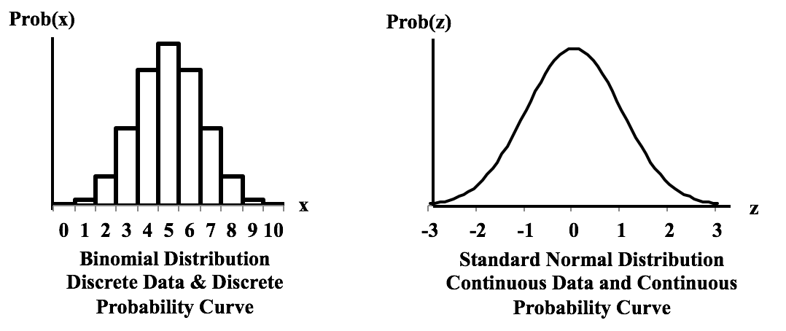
Discrete vs Continuous
Discrete only takes on whole number values and is typically a count.
Continuous takes any value within an interval and is typically a measure.

Slide 57
Factorials!
The factorial of a number is the product of that number multiplied by all of the positive integers below it
n! = n * (n-1) * (n-2)...3 * 2 * 1
5! = 5 x 4 x 3 x 2 x 1 = 120
1! = 1
0! = 1

Slide 58
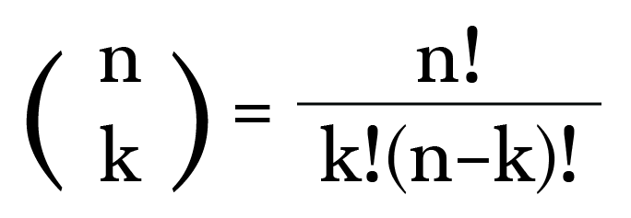
Combinations
How many groups of k size can be made from a set of n items?
How many ways can 5 cards be drawn from a deck of 52?
52! / 5!*47!...
Use a calculator / computer!
=2,598,960

Slide 59
Binomial Probability Formula
n
!
P(X=x |n,π)
=
x
n
−
x
π
(1-π)
x!
(
−
)
n
x
!
n = number of events
x = number of successes
pi = probability of success

Slide 60
Binomial Probability
Use to calculate probability of getting a fixed number of successful outcomes in a fixed number of independent trials where each trial has only two possible outcomes
Answers: “What is the probability of x successes in n trials?”
Assumes:
A fixed number of trials
Outcomes are binary
Probability of success is constant across trials
Trials are independent
Trials are identical
Could be used to estimate the probabilities of:
A certain number of customers purchasing a car
A certain number of defaults in a portfolio of loans
A certain number of defective products in a production process
A certain number of successful treatments of sick patients

Slide 61
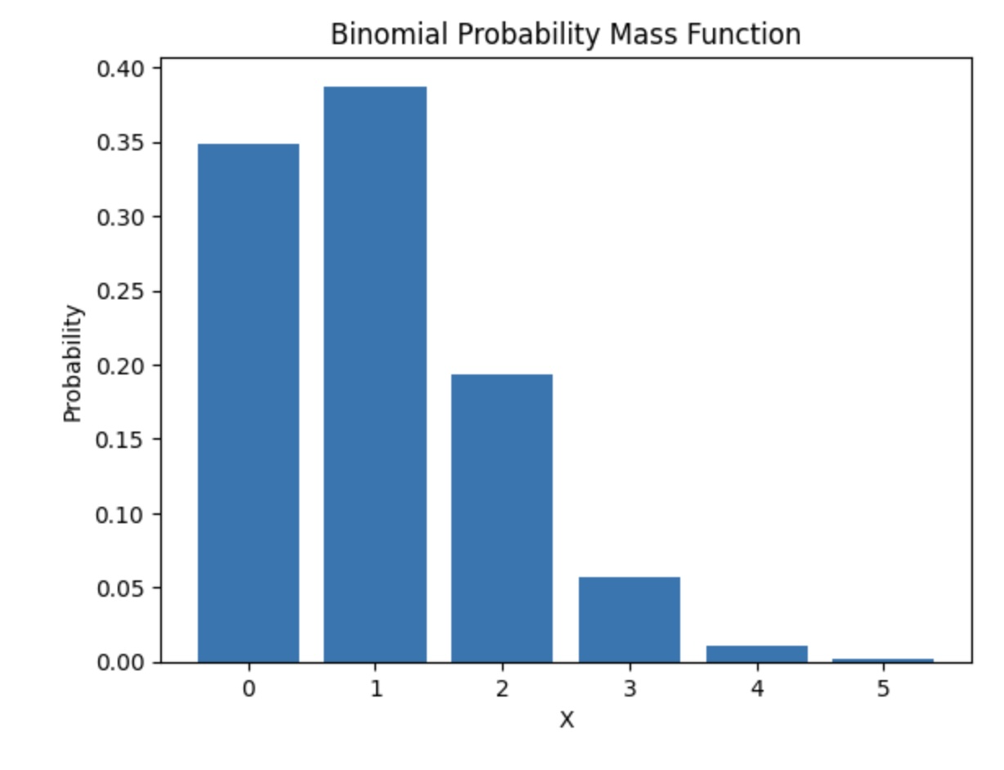

Slide 62
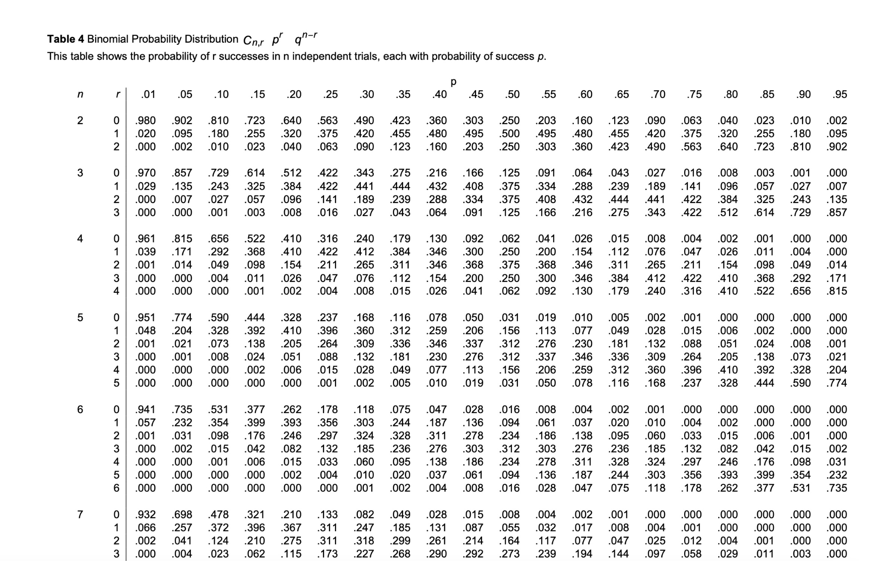

Slide 63
Binomial Probability
n
!
P(X=x |n,π)
=
x
n
−
x
π
(1-π)
x!
(
−
)
n
x
!
What is the probability of getting two heads in a series of five coin flips?
n =5, x = 2, pi = 0.5

Slide 64
Binomial in Excel
=binom.dist(x, # of trials, probability of success, False) for specific values
=binom.dist(x, # of trials, probability of success,True) for <=
=1 - binom.dist(x, # of trials, probability of success, True) for >

Slide 65
What is the probability of getting two heads in a series of 5 coin flips?
n =5, x = 2, pi = 0.5
= 0.312
p(x<2)?
p(0) + p(1)
0.031 + 0.156 = 0.187 = 18.7%
p(x>=2)?
1 - 0.187 = .813 = 81.3%

Slide 66
Binomial Probability Problems
Given a 10% chance of default and 6 loans, what is the probability of
5 defaults (=): Calculate p(5)
Less than 5 defaults (<):
Calculate p(0) + p(1) + p(2) + p(3) + p(4)
5 of less defaults (<=):
Calculate p(0) + p(1) + p(2) + p(3) + p(4) + p(5)
More than 5 defaults (>):
Calculate 1 - [p(0) + p(1) + p(2) + p(3) + p(4) + p(5)]
5 or more defaults (>=):
Calculate 1 - [p(0) + p(1) + p(2) + p(3) + p(4)]

Slide 67
Example Problems
You’re an attorney with a client facing seven charges. There is a one percent chance of conviction for each charge. What is the probability that your client will face at least one conviction?
P(1) + P(2) + P(3) + P(4) + P(5) + P(6) + P(7)
or
1 - P(0)
= 6.7%

Slide 68
Binomial Distribution Statistics
n = number of trials
p = probability of success
mean = n * p
standard deviation = sqrt(n*p*(1-p))

Slide 69
Poisson Probability
Could be used for estimating the probabilities of a certain number of:
Customers entering a store per hour
Phone calls received by a call center
Employees calling in sick
Potholes in a given length (x width = area) of road.
Use to calculate the probability of a given number of events occurring in a given interval of time or space
Answers: “What is the probability that an event happens x times in a given amount of time or space?”
Assumes:
Events are independent (no clustering)
Average rate is constant
Probability of two events occurring at the exact same time = 0
Mean = Variance*
Unlike binomial, poisson does not require a fixed number of trials.

Slide 70
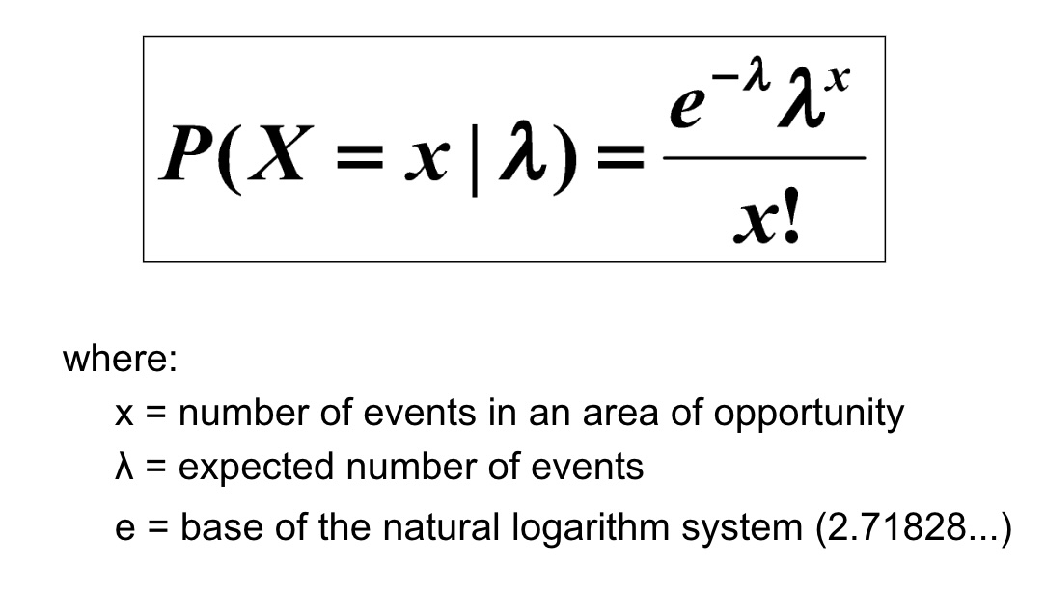
Poisson Probability Formula

Slide 71
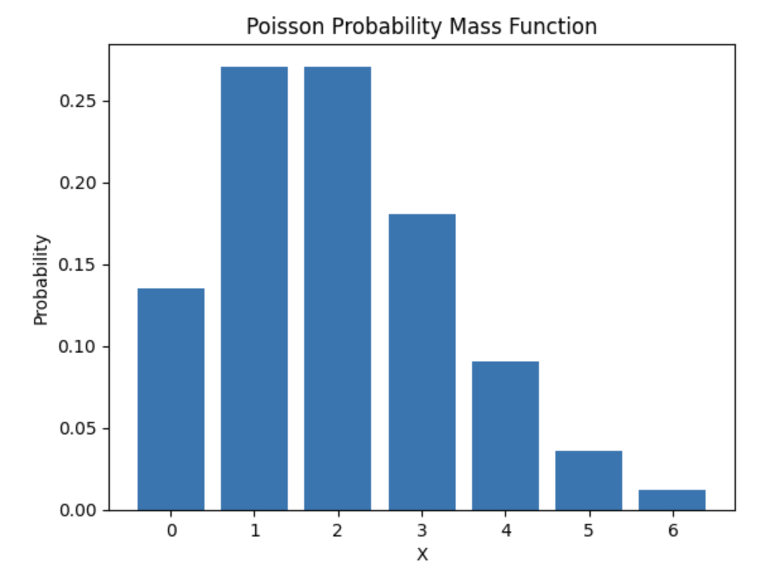

Slide 72
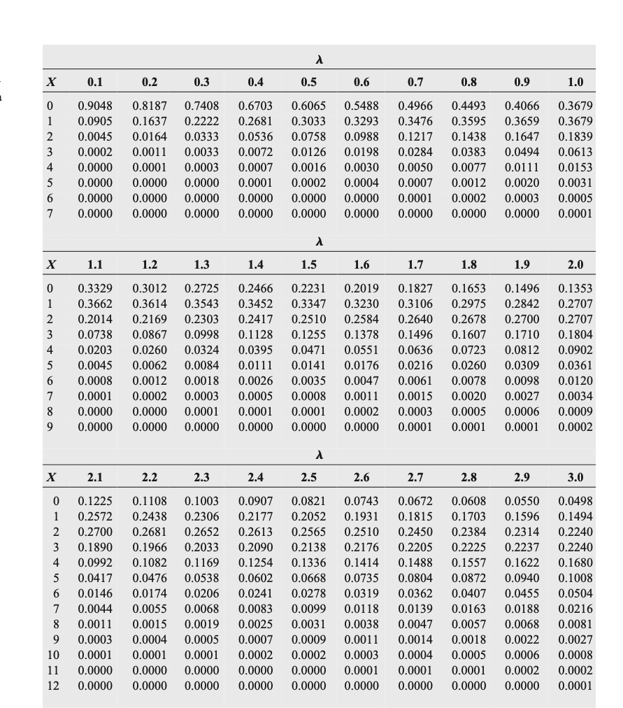
Poisson Distribution Table
Non-Cumulative
(Many pages omitted)
Example:
Average number of calls in an hour is 3
What is p(x=4)?
Find lambda = 3 and x = 4
.1680 = 16.8%
What is p(x<4)?
p(0) + p(1) + p(2) + p(3) = .0498 + .1494 + .2240 + .2240
=.6472 = 64.72%
What is p(x>=4)
= 1 - 0.6472 = .3528 or 35.28%

Slide 73
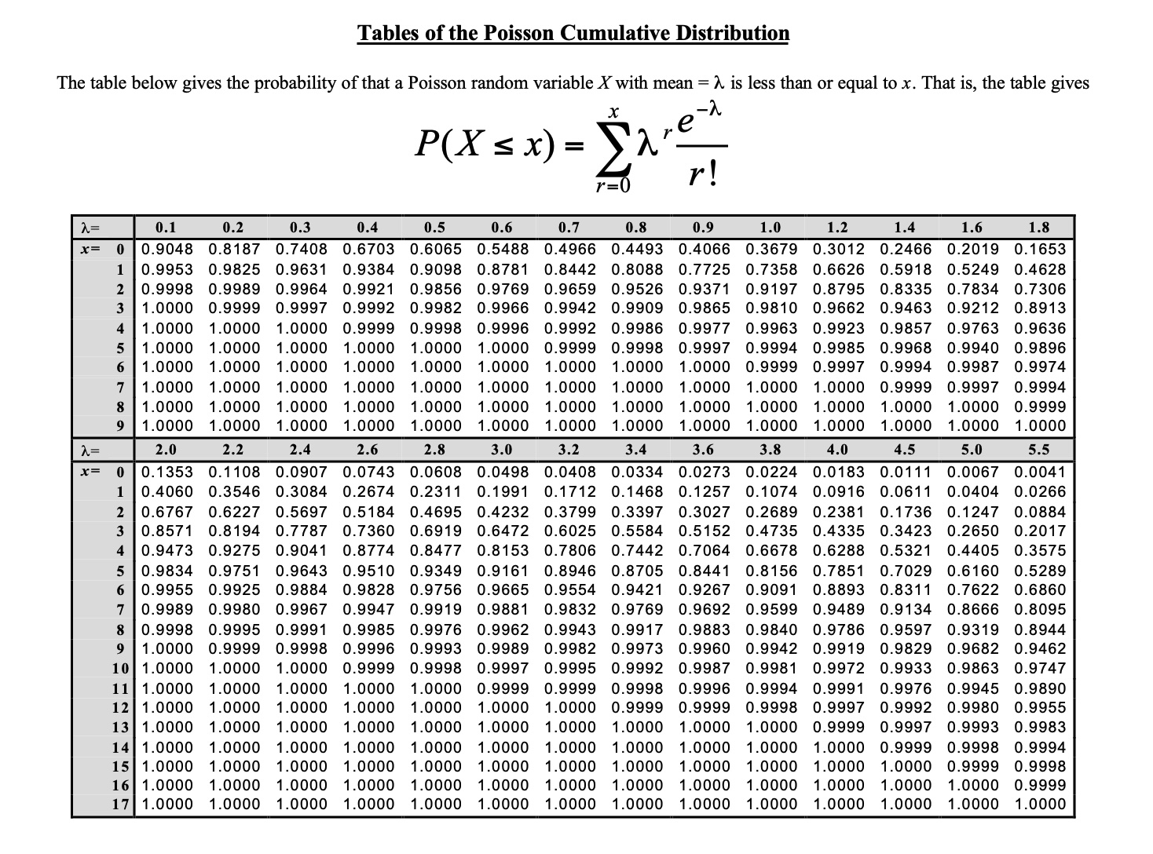
Poisson Distribution Table
Cumulative
(Many pages omitted)
Example:
Average number of calls per hour is 3
What is p(x<4)?
Find lambda = 3 and x = 3
0.6472 or 64.72%
What is p(x>4)
1-.6472 = .3528 = 35.28%

Slide 74
Poisson Probability
What is the probability of getting 10 calls in an hour if the average hourly call rate is 5?

Slide 75
Poisson Probability Problems
Given an average of 10 customers per hour, what is the probability you’ll have
5 customers (=): Calculate p(5)
Less than 5 customers (<):
Calculate p(0) + p(1) + p(2) + p(3) + p(4)
5 of less customers (<=):
Calculate p(0) + p(1) + p(2) + p(3) + p(4) + p(5)
More than 5 customers (>):
Calculate 1 - [p(0) + p(1) + p(2) + p(3) + p(4) + p(5)]
5 of more customers (>=):
Calculate 1 - [p(0) + p(1) + p(2) + p(3) + p(4)]

Slide 76
Poisson In Excel
=poisson.dist(x, mean, False) for specific values
=poisson.dist(x, mean, True) for <=
=1 - poisson.dist(x, mean, True) for >

Slide 77
What if Mean =/= Variance?!
If variance > mean = overdispersion
Use negative binomial distribution or generalized poisson distribution
If variance < mean = underdispersion
Use generalized poisson distribution

Slide 78
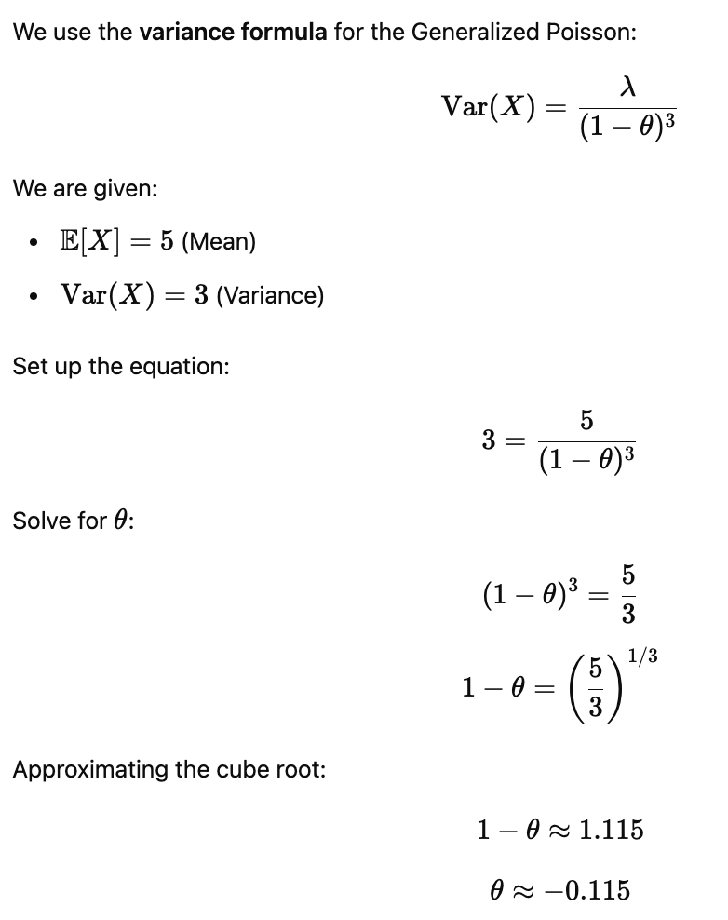

Generalized Poisson

Slide 79
Geometric Distribution
Used to calculate the probability that the first success occurs on a specific trial.
Answers: What is the probability that the first success happens on trial x?
Assumptions:
Outcomes are binary
Probability of success is constant
Trials are independent
Number of trials is not fixed in advance
The experiment continues until the first success
Can be used to estimate:
The trial on which a customer first makes a purchase
The call on which a salesperson first closes a deal
The day on which a machine first fails
The attempt on which a student first passes an exam
The flip on which a coin first lands heads

Slide 80
Geometric Probability Example
What is the probability that the first head occurs on the 4th coin flip?
p = 0.5
x = 4
P(X=4) = [(0.5)^3]*0.5 = 0.0625
Implication: Tails, Tails, Tails, Heads
Extensions:
(1-p)^x-1 = probability of no succes in the first X trials
Complement gives at least one success in first X trials
P(X < x) = 1 - (1 - p)^x-1 (no success after first x trials)
P(X <= x) = 1 - (1 - p)^x (at least one success after first x trials)
P(X > x) = (1 - p)^x (no success in trials 1 - x)
P(X >= x) = (1 - p)^x-1 (first success happens on trial x or later)

Slide 81
Summary of Geometric Distribution Problems
Question | Formula | Interpretation
( X = x ) | ( (1-p)^{x-1}p ) | First success on trial x
( X < x ) | ( 1-(1-p)^{x-1} ) | Success before x
( X = x ) | ( 1-(1-p)^x ) | Success by x
( X > x ) | ( (1-p)^x ) | Still waiting after x
( X >= x ) | ( (1-p)^{x-1} ) | x or later

Slide 82


Geometric Distribution
Used to model the number of attempts until first success
20% chance of making a sale. How many meetings are needed until first sale?
How many meetings until a sale?
E(X) = 1 / 0.2 = 5
P(sale on 3rd meeting)

Slide 83
Mean and Variance of Geometric Distributed Data
P = probability of success per trial
Mean = E[X] = 1/p
Variance = (1-p)/p^2

Slide 84
Bernoulli Distribution
Used to model a single trial with two possible outcomes
X = 1 if success
X = 0 if failure
P(X = 1) = p
P(X = 0) = 1 - p
Mean: E[X] = p
Variance = p(1-p)

Slide 85
Negative Binomial Probability
Used to calculate the probability that r-th success occurs on a specific trial.
Answers: What is the probability that it takes exactly x trials to achieve r successes?
Assumes:
Outcomes are binary
Probability of success is constant
Trials are independent
The experiment continues until the r-th success
The number of trials is not fixed in advance
Could be used to estimate the probability of:
The call on which a salesperson will close their 3rd deal
The flip on which the coin lands on heads a 4th time
The day on which a machine fails for the 10th time

Slide 86



Example
X = total number of trials
R = number of success
P = probability of success
Sales calls have a probability of success of 20%
Sales person keeps calling until they have 3 appointments.
What is the probability that the 3rd meeting is booked on the 10th call?
Interpretation: In first 9 calls, 2 appointments set, on 10th call, 3rd appointment set.
In first 9 calls, many ways 2 appointments could be set.
Call 1 and 2, Call 1 and 9, Call 2 and 5…

Slide 87
Example Continued
P = .2
R = 3
X = 10
36 * (.2)^3 * (.8)^.7 = 8.8%

Slide 88
Question | What it means in English | How to compute it
( X = x ) | The r-th success happens exactly on trial x | ( \binom{x-1}{r-1} p^r (1-p)^{x-r} )
( X < x ) | The r-th success happens before trial x | ( P(X <= x-1) )
( X <= x ) | The r-th success happens by trial x | ( 1 - P(\text{fewer than r successes in x trials}) )
( X > x ) | Still waiting for the r-th success after x trials | ( P(\text{fewer than r successes in x trials}) )
( X >= x ) | The r-th success happens on trial x or later | ( P(X > x-1) )

Slide 89


Summary Statistics For Discrete Distributions
Mean:
Variance:

