Slide 2
Sampling
Population: All of the items of interest
Examples: All of the students at Webster University, All registered voters
Sample: A subset of the population
Example: Just the students in this room (assuming we’re interested in all of the students at Webster), 100 registered voters selected at random from the voting rolls

Slide 3
Why Sample?
We collect samples instead of measuring populations because:
It’s easier
It’s faster
It’s cheaper
It’s (more) feasible

Slide 4
Types of Sample - Non Probability
Non Probability Sampling: Items are chosen non-randomly and/or without regard to their probability of occurrence
Types:
Convenience: Items are selected because they’re easy to sample
Judgment: Items are sampled based on expert / domain knowledge
These are not good ways to sample and risk sampling bias*

Slide 5
Sampling Bias
Sampling bias occurs when the sample selected for a study is not representative of the population, leading to inaccurate or misleading conclusions.
Types:
Selection Bias: Occurs when certain groups of the population are systematically more or less likely to be included in the sample. Example: Conducting a phone survey but only calling landlines, which excludes younger people who primarily use mobile phones.
Undercoverage Bias: Happens when some members of the population have no chance of being included in the sample. Example: A political poll that only surveys registered voters, ignoring eligible but unregistered voters.
Nonresponse Bias: Occurs when a significant portion of selected respondents do not participate, and those who do respond differ in a meaningful way from those who don't. Example: A survey about income levels where wealthier individuals are less likely to disclose their earnings.

Slide 6
Sampling Bias (Continued)
Types:
Voluntary Response Bias: Happens when individuals self-select into the study, meaning only those with strong opinions tend to participate. Example: An online poll about customer satisfaction where only dissatisfied customers respond.
Survivorship Bias: Occurs when only subjects that have “survived” or persisted are included in the sample, leading to misleading conclusions. Example: Studying the success of businesses by analyzing only those that still exist, ignoring failed businesses.
Convenience Sampling Bias:Happens when researchers choose a sample that is easy to access rather than one that is representative. Example: A study on college student habits that only surveys students at one university.
Healthy User Bias:Occurs when participants in a study are healthier than the general population, often affecting medical research. Example: A study on the benefits of exercise that surveys only gym-goers, who are likely to be healthier than average.
Exclusion Bias: Happens when certain groups are unintentionally left out due to study design flaws. Example: A medical trial that excludes pregnant women, leading to results that don't generalize to the entire population.

Slide 7
Types of Sample - Probability
Probability Sampling: Sampling based on known probabilities
Types:
Simple Probability
Systematic
Stratified
Cluster

Slide 8
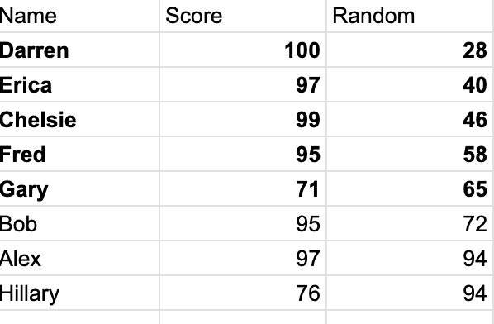
Simple Probability Sampling
Each item in the sample has an equal probability of occurrence / selection.
Sampling frame: The list of all items in the population
Steps:
Assign Each item a number randomly (using an unbiased and systematic source, like a computer, not your intuition)
The sampling frame by the column of random numbers
Select the top n number of items, where n is the number of items required to meet the significance threshold of your study

Slide 9
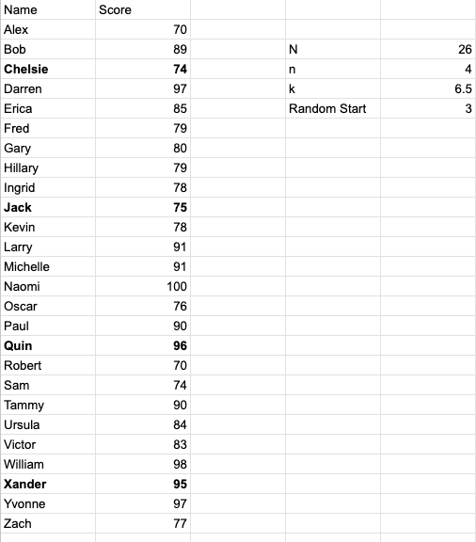
Systematic Probability Sampling
Steps:
Divide population/frame into k segments, where k = N/n
Select a starting point randomly from the first segment, then sample every k’th element

Slide 10
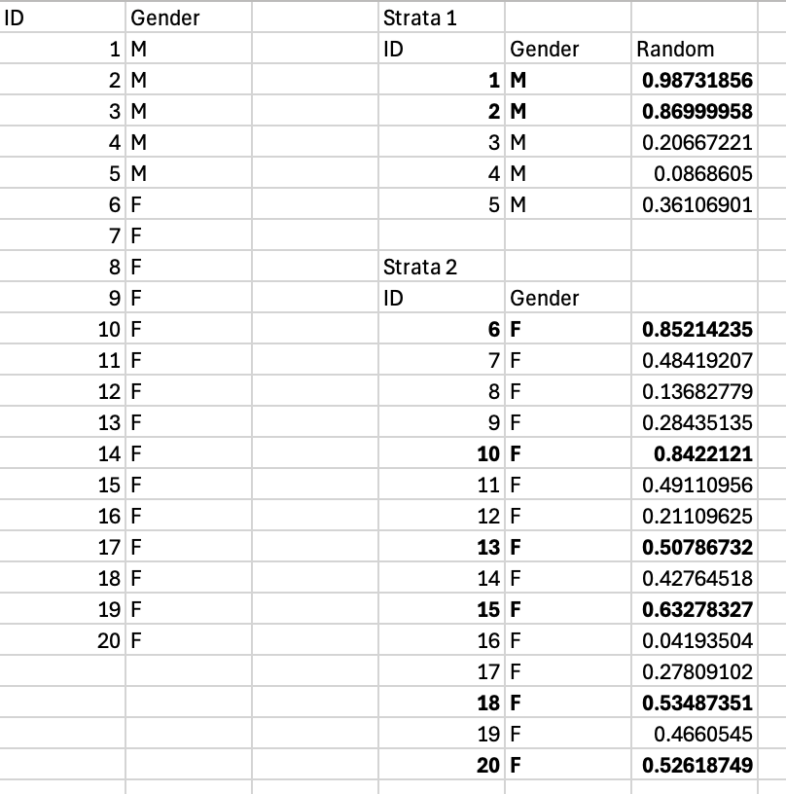
Stratified Sampling
Steps:
Divide population/frame into subgroups, called strata, based on common attributes
Randomly sample from the strata (largest random number used)
Combine the samples
Can be proportionate to the population or not - Since 3/4 of the population is female, 3/4 of the sample should come from the female strata
Can also be disproportionate and evenly sampled from each strata, but this is potentially biasing

Slide 11
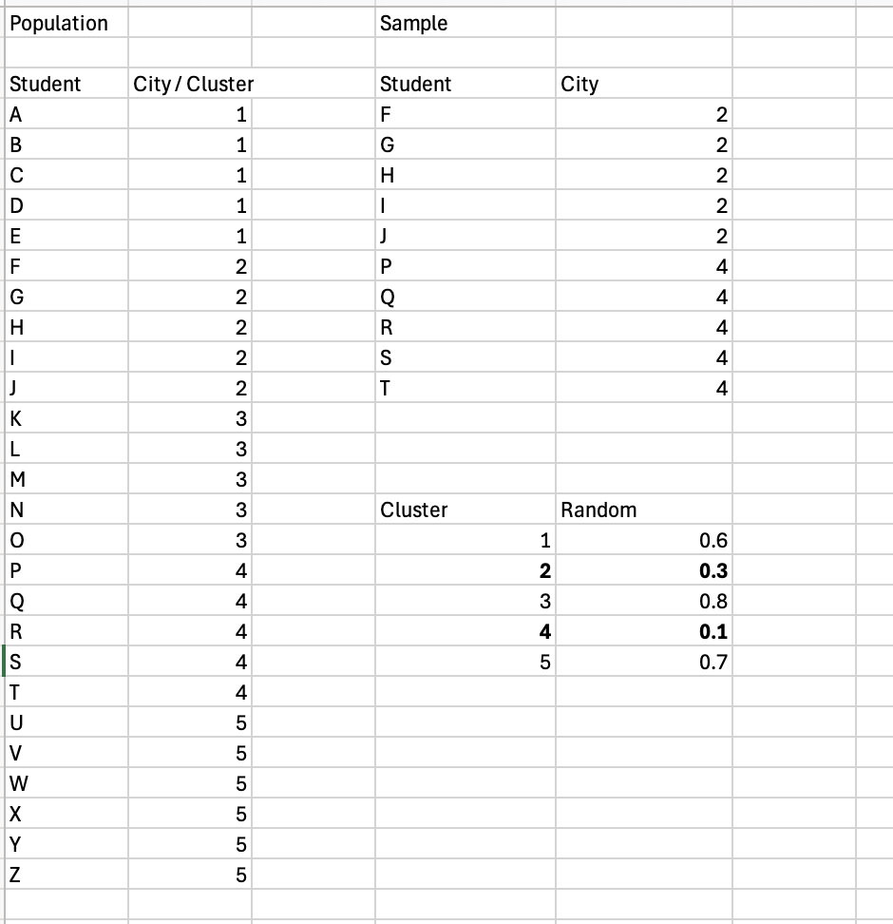
Cluster Sampling
Steps:
Divide population into clusters based on some relevant attribute
Each cluster should be representative of the whole population
Randomly select clusters (lowest random values, this time)
Use all observations from each cluster to calculate statistics

Slide 12
Sampling Methods
Method | When to Use
Simple Random | Full list, no subgroups
Stratified | Known subgroups matter
Systematic | Ordered list available
Cluster | No full list, geographically dispersed

Slide 13
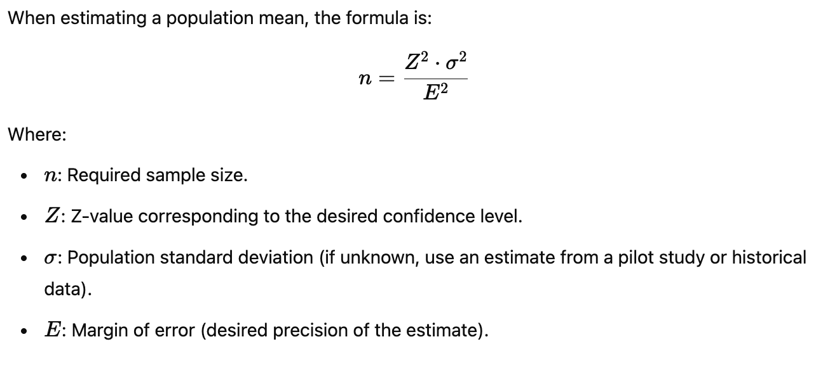
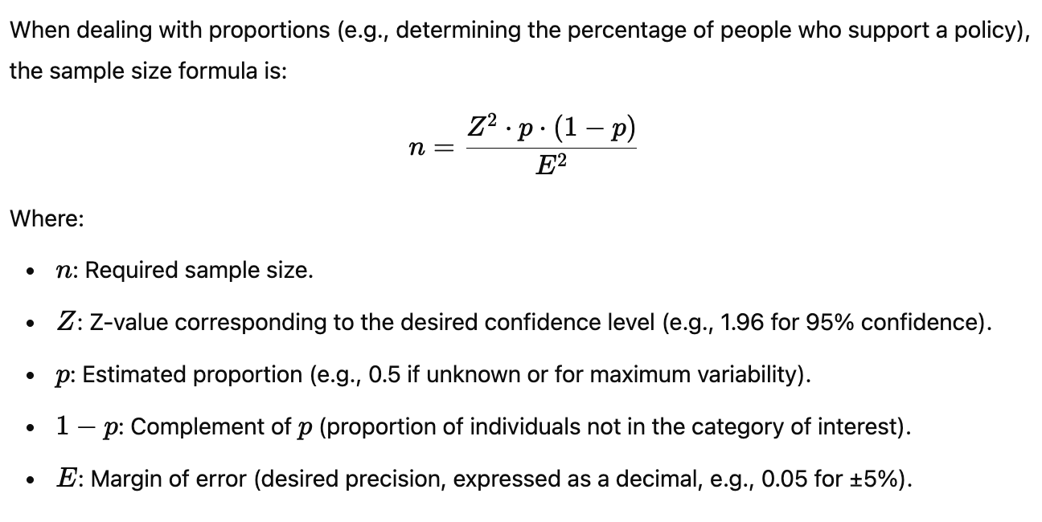
Necessary Sample Size*
*We’ll revisit this later

Slide 14
Necessary Sample Size Example - Means
Z for
90% = 1.65
95% = 1.96
99% = 2.33
E = Margin of Error = +/- Point estimate
How many apples needed to be 95% confident in your estimate of the mean, with a margin of error of +/- 0.5 oz, given a standard deviation (estimated) of 2 oz.
n = (Z^2 * stdev^2) / E^2
…Math…
n = 61.4656, which we round up to 62
Notes:
Different than for proportions

Slide 15
So, what exactly is a statistic?
When a number is used to summarize an aspect of a population, it is called a parameter.
When a number is used to summarize an aspect of a sample, it is called a statistic.

